Slide 1
Tango
Med-fi Prototype
It takes two to transit!

Slide 2
Value Proposition, Problem & Solution Overview
Value Proposition: It takes two to transit!
Problem: Our needfinding results demonstrated that college students feel uncomfortable riding alone on public transportation. But, they struggle on a regular basis to find friends taking public transportation at the same time.
Solution: Match students with other students in their area taking the same public transportation so that they have a transit buddy who can be accountable for their safety and vice versa!

Slide 3
Tasks Overview
Simple
Medium
Complex
A student commuter gets matched to ride with another student commuter on the same public train or bus.
Transit buddies can chat with each other before meeting up to coordinate meet-up details and provide specific location details.
Student commuters can engage in an interactive game with their travel buddy, creating a positive social experience for both parties and diffusing any awkwardness with meeting a new person.

Slide 4
Simple Task (Revised)
Before: A student commuter gets matched to ride with another student commuter on the same public train or bus.
Revised: A student commuter gets matched to ride with another student commuter on the same public train or bus. The student commuter can provide feedback on how safe they felt riding with each other, ensuring that the pool of potential travel buddies are safe people.

Slide 5
Medium Task (Revised)
Before: The student commuters can provide feedback on how safe they felt riding with each other, ensuring that the pool of potential travel buddies are safe people.
Revised: Transit buddies can chat with each other before meeting up to coordinate meet-up details and provide specific location details.
Rationale: We realised that the 'rating' task was a subtask of our simple task of 'matching buddies' and thus added a new task - allowing matched users to communicate with their travel buddy through a chat system
Notes:
Medium task - just rating
Revised - we realized this task was actually a subtask of the simple task. And then we came up with a new tasks for after the user gets matched they can communicate with their buddy via a chat system

Slide 6
Complex Task (No change)
Student commuters can engage in an interactive game with their travel buddy, creating a positive social experience for both parties and diffusing any awkwardness with meeting a new person.

Slide 7
Revised Interface Design

Slide 8
3 Major Design Changes
Revamping Matching Process
Revamping the In-transit Screen
Separating 'Help' and 'Emergency' functions

Slide 9
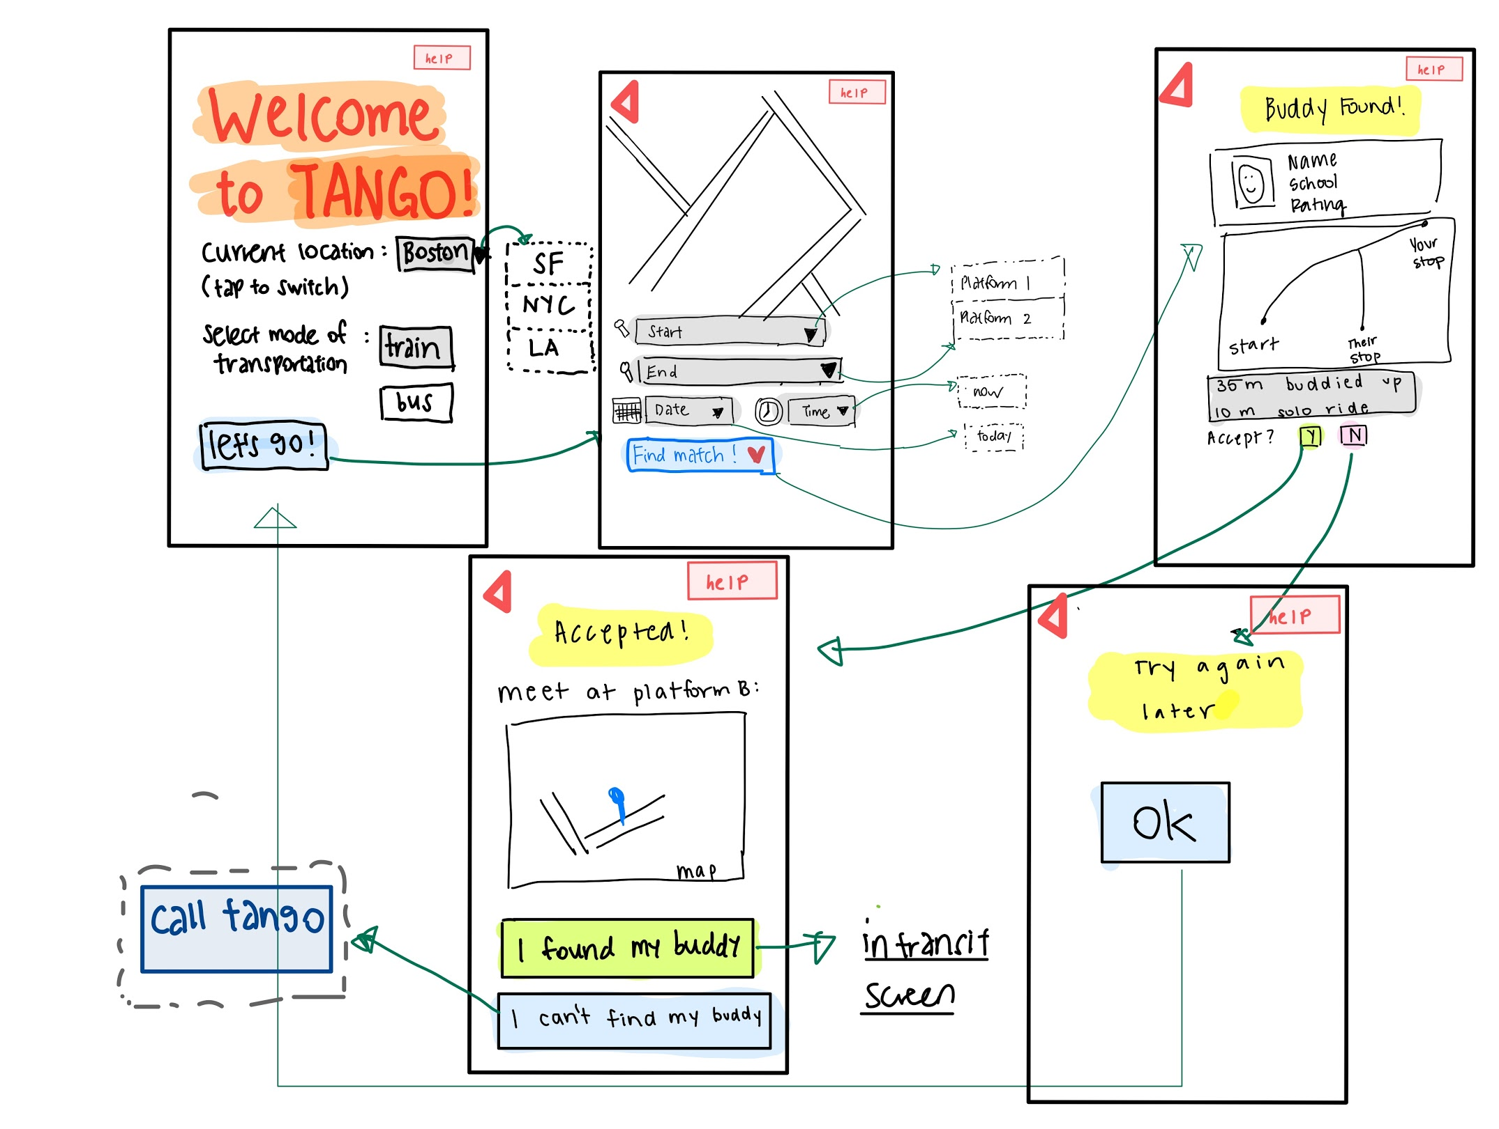
#1 Match Process Revamp - Before
Did not differentiate between finding match now and planning a trip for later (boxed in red)
Did not allow buddies to chat with each other

Slide 10
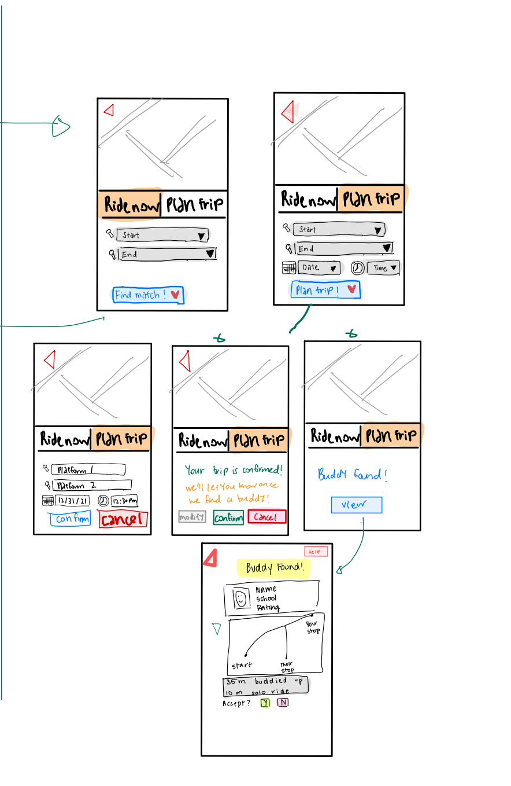
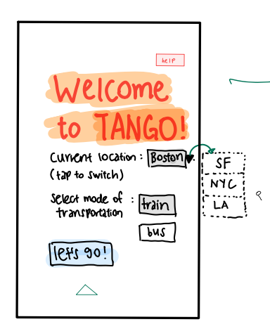
#1 Match Process Revamp - After
Added feature that allow users to find buddy immediately ("Ride Now") or later ("Plan Trip")
Rationale:
Feedback that some users would like the option to plan trips for later
In immediate trips ("Ride Now"), the date and time options are redundant and hence removed

Slide 11
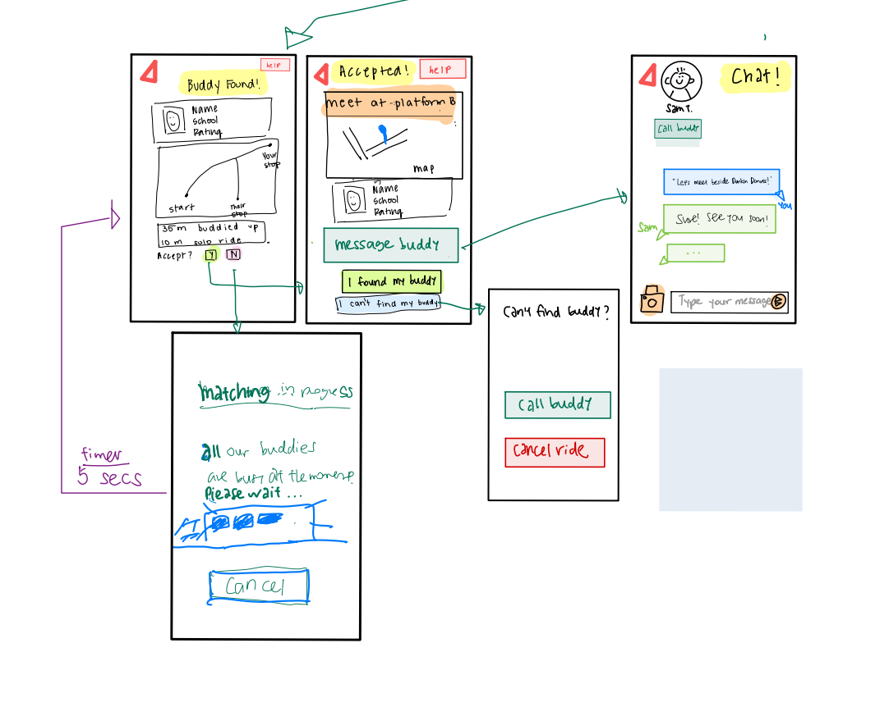
#1 Match Process Revamp - After
Including chat feature between matched transit buddies
Rationale:
Feedback from testing that this feature would be helpful for coordinating meet-up
Allow buddies to proactively provide specific location information

Slide 12
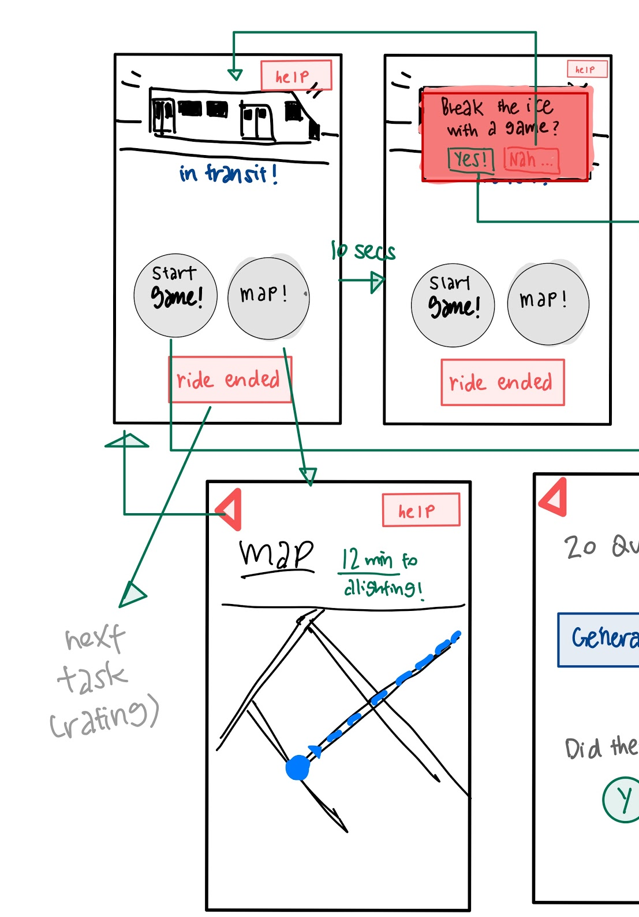
#2: In-Transit Screen Revamp - Before
Users have to click to access a separate tab showing the Map which provided details of surrounding location and remaining time on journey
Tedious and not user-friendly

Slide 13
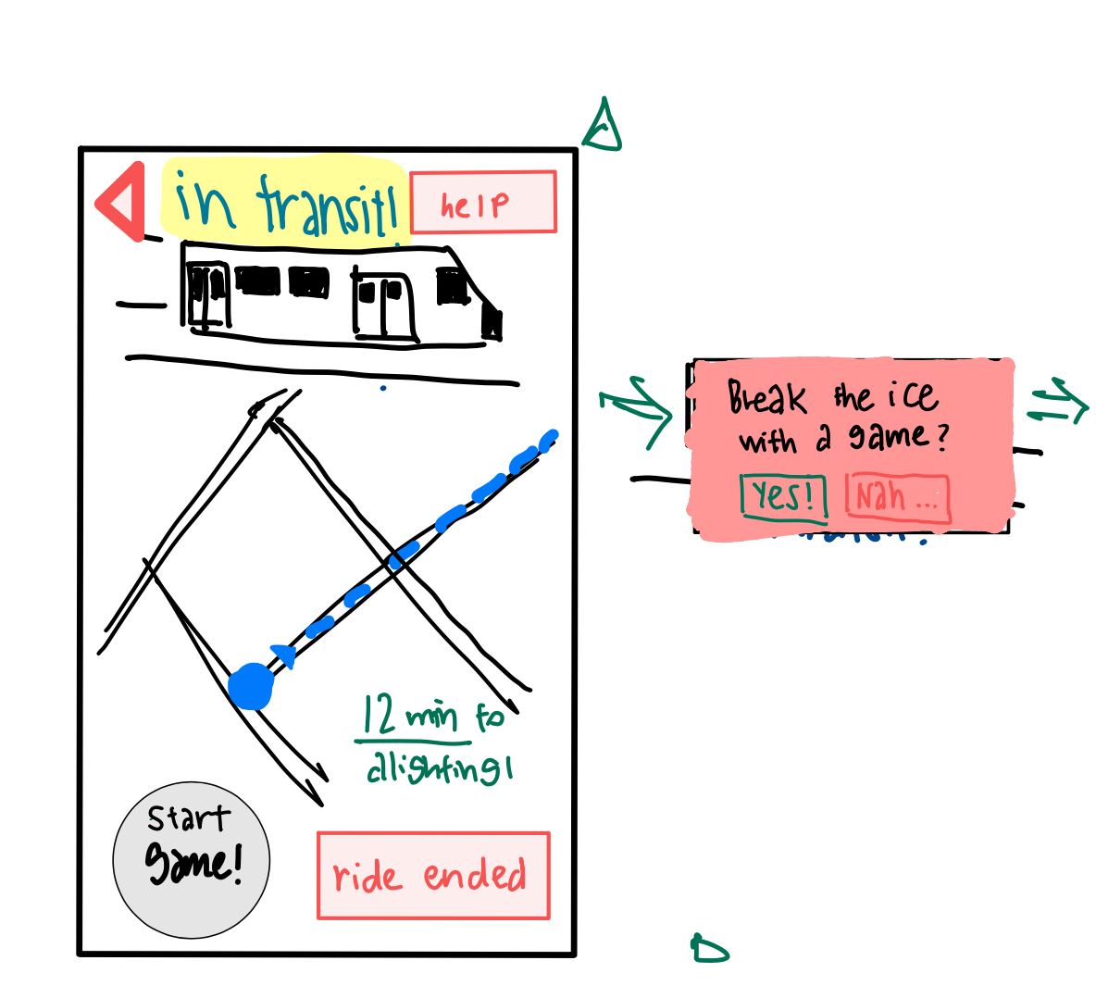
#2: In-Transit Screen Revamp - After
Included location map as main component of in-transit screen
Rationale:
Feedback that it would be useful to have the map automatically in view while users are in transit
Remaining time on journey is easily viewable

Slide 14
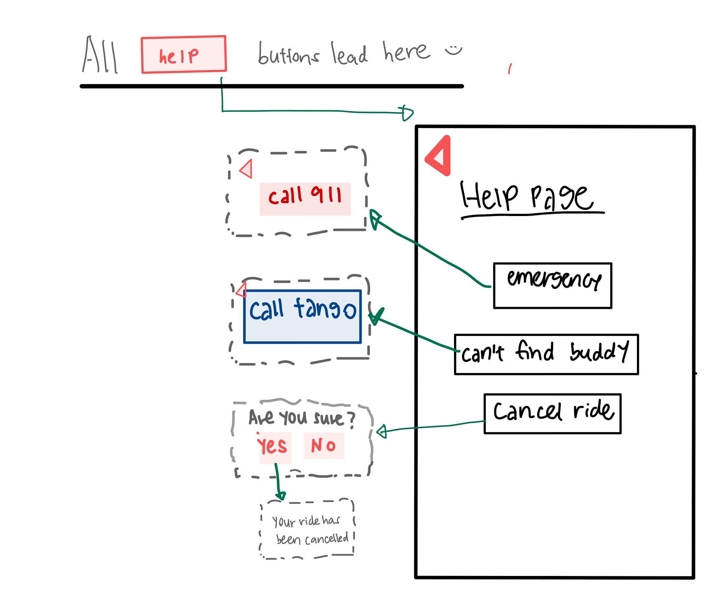
#3: Separating `Help` and `Emergency` screens
Before:
User feedback that "Help" button is ambiguous in its functionality
Unsure whether it was an FAQ, or used in emergency situations'
Some testers were even reluctant to explore the functionality

Slide 15
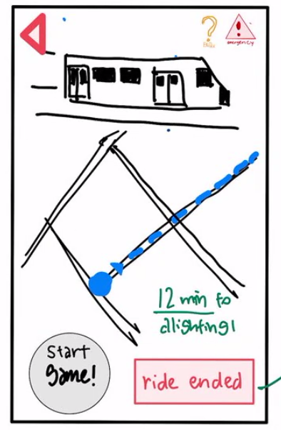
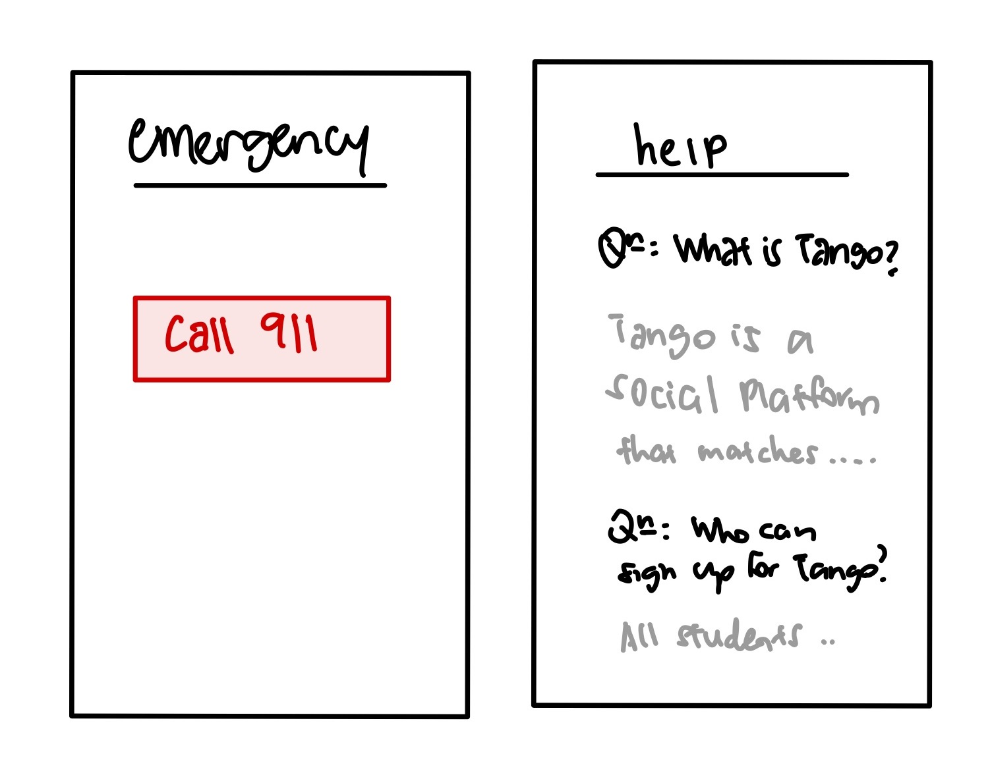
#3: Separating `Help` and `Emergency` screens
After:
Placing two additional icons ("FAQs" and "Emergency") on the top of each screen
Separating Help/FAQs and Emergency functions for better user experience

Slide 16
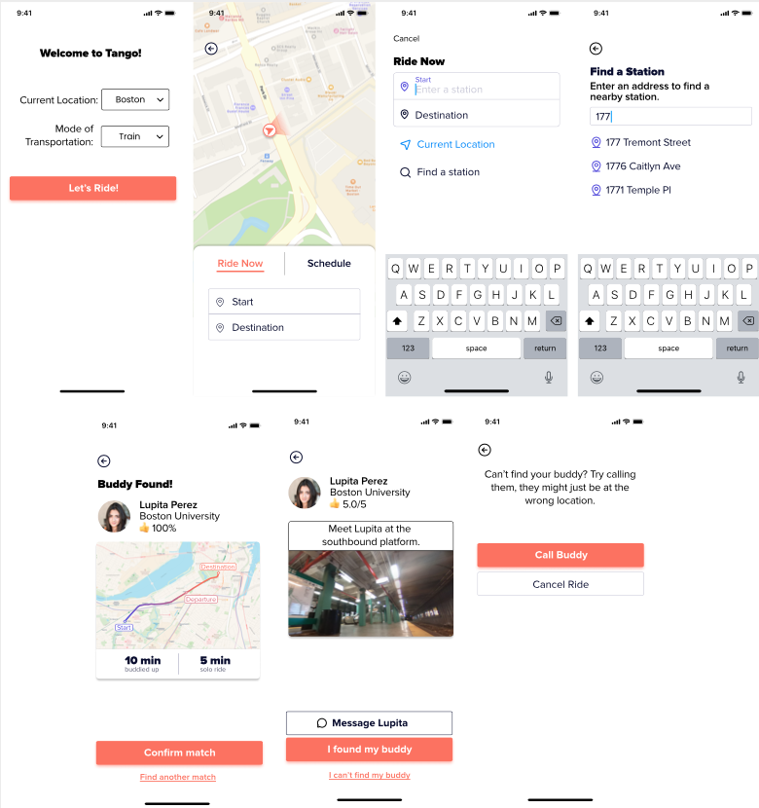
Storyboard for Task #1: Matching with a Travel Buddy

Slide 17
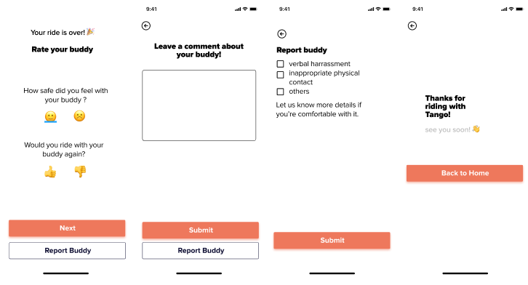
Storyboard for Task #1: Rating Travel Buddy

Slide 18
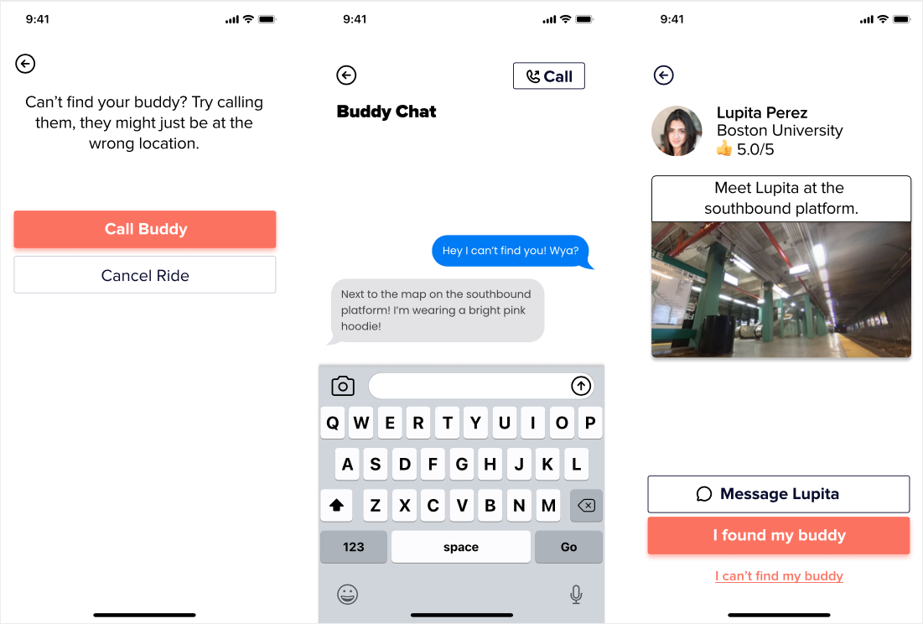
Storyboard for Task #2: Chatting with Travel Buddy

Slide 19
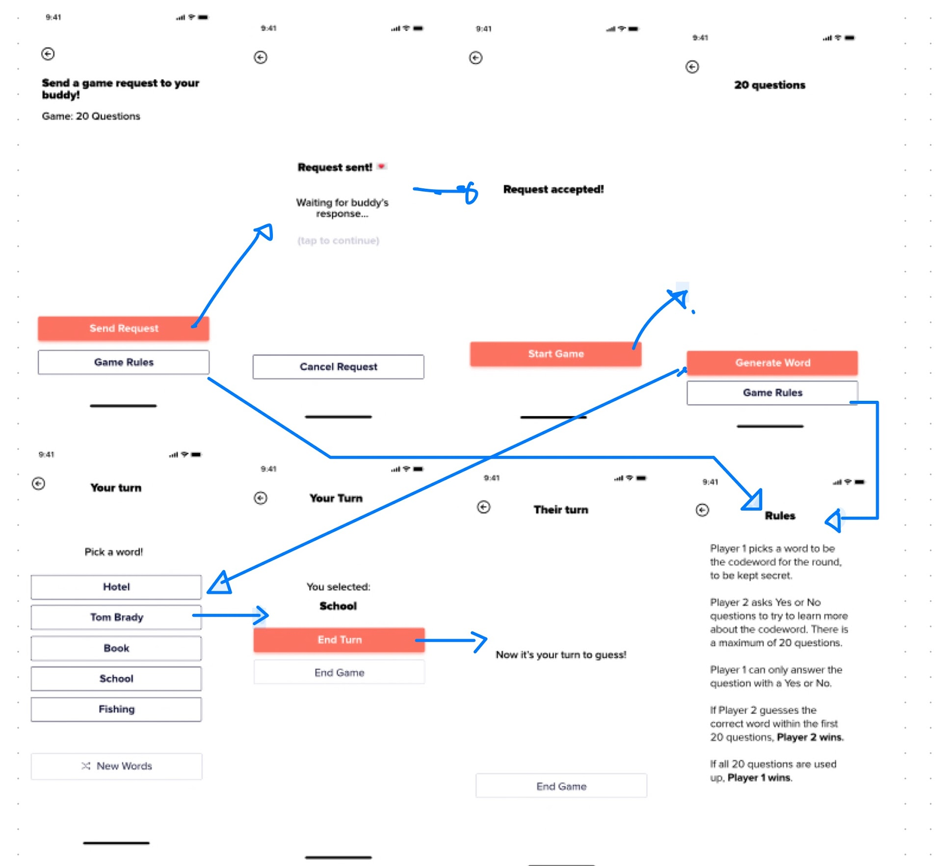
Storyboard for Task #3: Playing Game with Buddy

Slide 20
Prototype Overview

Slide 21
Design / Prototyping Tools
Design / Sketching: Goodnotes
Prototyping: Figma
Pros:
  All-in-one tool combining both design and prototyping
  Shared Canvas: allowing for collaborative editing
  User-friendly: intuitive interface with useful shortcuts
Cons:
  Limited actions available in prototyping (eg. did not allow for swiping action)
  Screen-based layout leads to many variations of the same screen with small changes in one element (eg. matching screen)
  Slower in processing speed due to Figma being a browser-based tool

Slide 22
​Limitations / Tradeoffs of Current Prototype
Limitation: Since users are unable to type, most keyboard-based input are pre-filled for them (e.g. location selection, chat features, etc.)
Limitation: Due to the lack of connection to a maps API, only a set of static maps is displayed with the preset location being in Boston
Trade-off: User experience is incomplete as the app is supposed to be a social platform with multiple users, and interaction between users is not available to users in the Figma prototype

Slide 23
Wizard of Oz Techniques Used
Instead of having a matching algorithm that pairs actual users based on factors such as location and rating, we instead provide a preset list of possible buddies that user could get matched with.
In our prototype, user will automatically get matched with a travel buddy. Realistically, this would require a matching algorithm and some time to complete.

Slide 24
Hard-Coded Features
Hard-coded features include:
Schedule Ride ▻ Date & Time: Our med-fi prototype is static, so the date and time selection is fixed to “Today, 1:05 PM”
Ride Now/Schedule Ride ▻ Start and Destination: All addresses and train stations are hard-coded, and clicking on any address/station leads to the next page, which already contains predetermined user input.
Chat responses between user and transit buddy are pre-filled
Game: 20 Questions - clicking on any option will take user to the next screen, which already contains predetermined user input

Slide 25
Hard-Coded Features
Hard-coded features include:
Game: 20 Questions - clicking on any option will take user to the next screen, which already contains predetermined user input
Both users must indicate that they want to play the in-transit game for it to begin. The prototype user indicates by sending a game request to their riding buddy. In the prototype, the request is automatically accepted. A real riding buddy has the choice to decline the game invitation, in which case the game wouldn’t begin.

