Slide 1
Spotter
Midway Milestone
Notes:
Jenn Hu, Angel Pan, AJ Rossman, Emily Yang

Slide 2
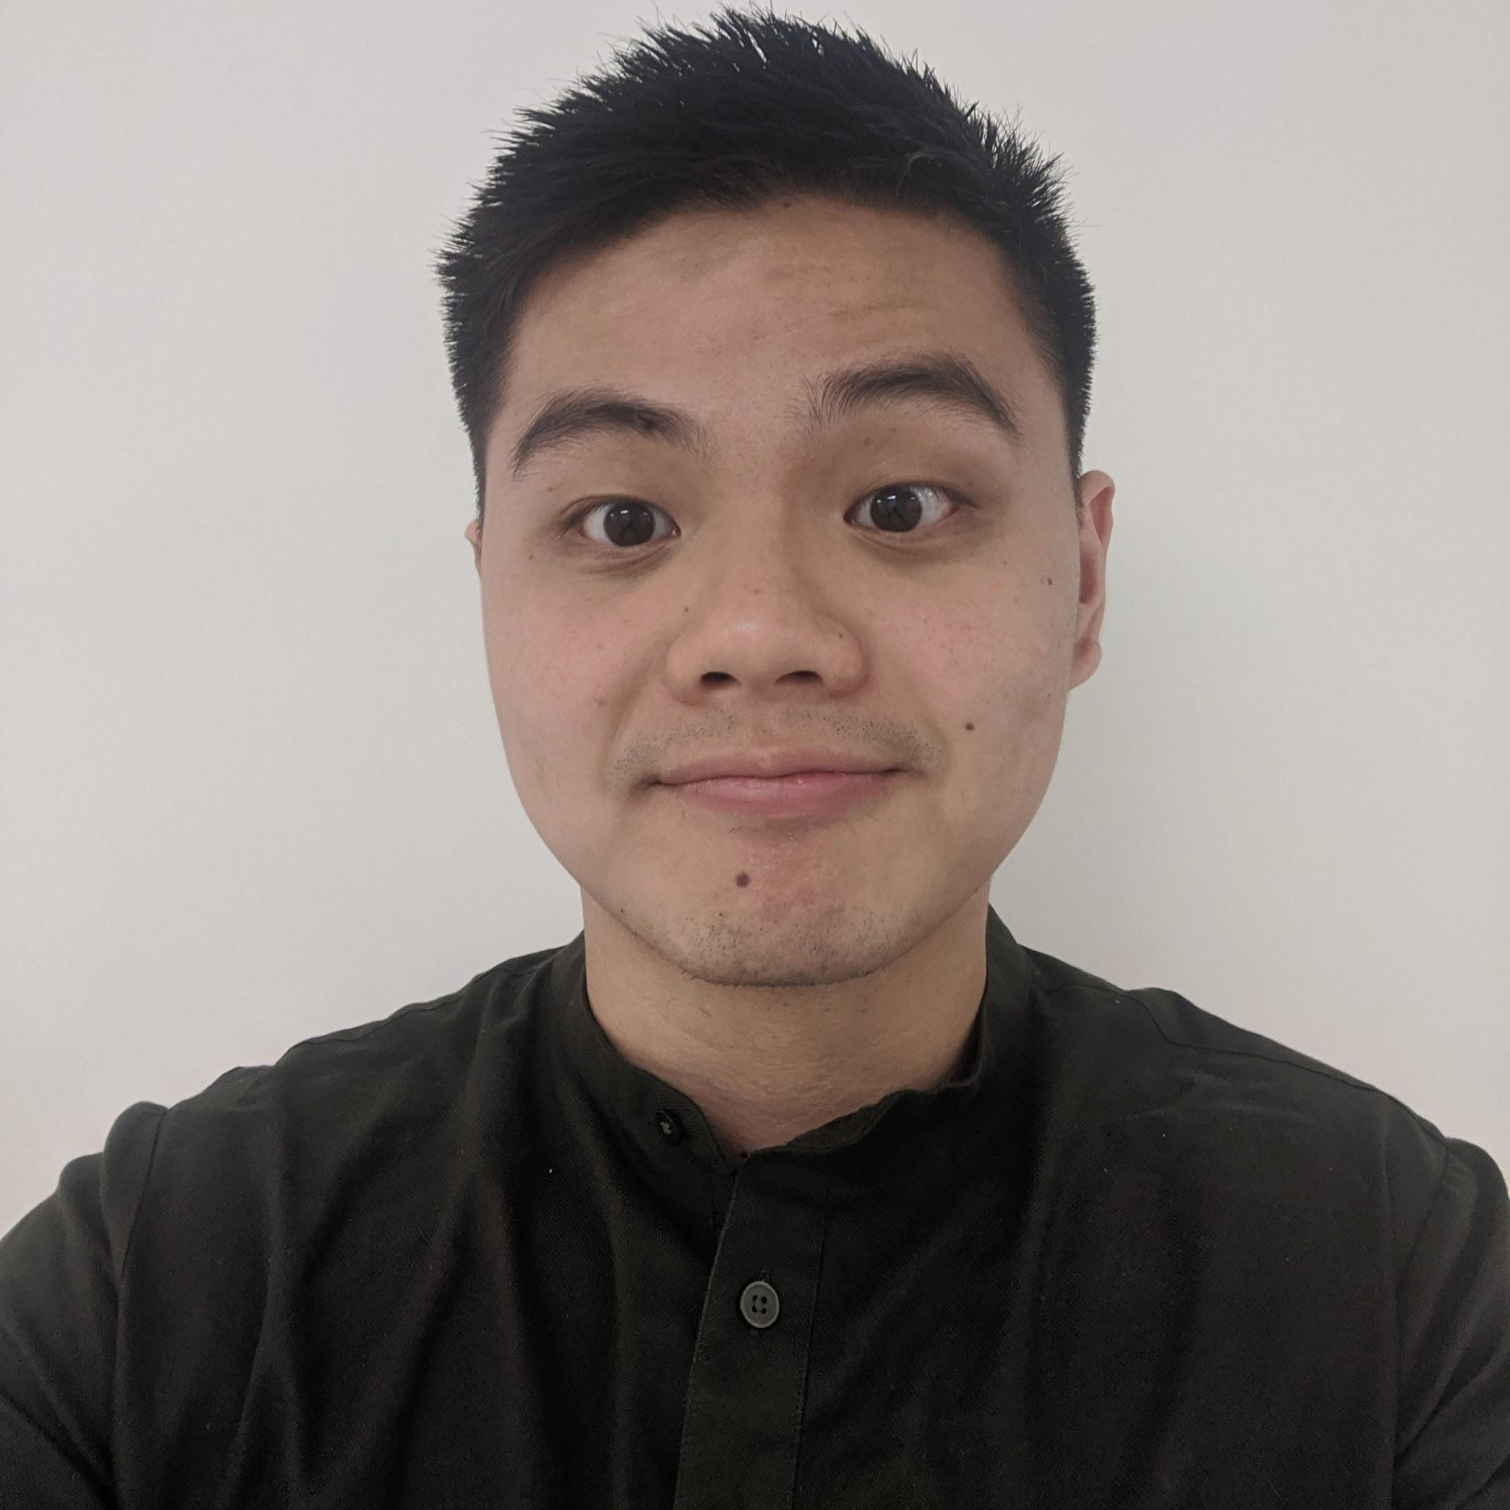
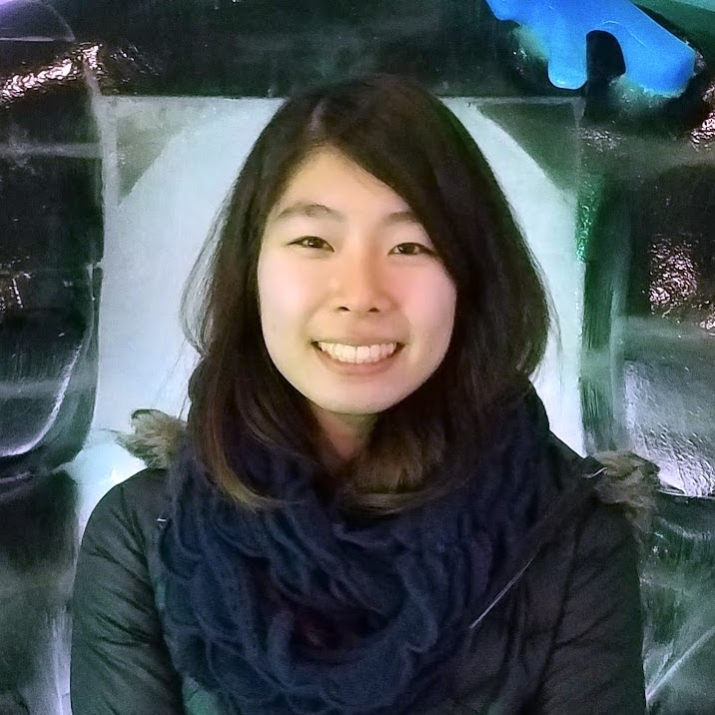
Meet the Team
Jenn Hu
Senior
IR Undergrad
Angel Pan
Senior
CS Undergrad
AJ Rossman
Junior
CS Undergrad
Emily Yang
First-year
MSCS

Slide 3
Value Proposition
The weight off your shoulders
The Problem
Beginners are often too intimidated to ask for help at the gym out of fear and guilt of wasting an experienced gym-goer’s time
The Solution
We aim to empower beginners to seek help at the gym by highlighting experienced gym-goers (“Spotters”) who are voluntarily willing to help

Slide 4
Overview
Heuristic evaluation
Results & revised designs
Prototype implementation status
Demo
Summary

Slide 5
Heuristic Evaluation
Results & Revised Designs

Slide 6
Results Overview
Severity 3-4
→ 18 violations
Severity 0-2
→ 14 violations
Most violated heuristics:
H8: Minimalist Design (8)
H4: Consistency (6)
H2: Match Sys & World (5), H3: User Control (5)

Slide 7
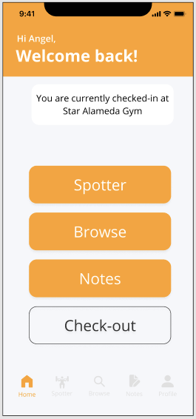
Design Revisions
Severity: 3
Type: H1 (Visibility of Status), H2 (Match Sys & World)
Problem: “Spotter” and “Browse” buttons unclear (functionality & wording)

Slide 8
Design Revisions
Fix:
New home screen
Bottom navigation bar wording

Slide 9
Design Revisions
Fix:
New home screen
Bottom navigation bar wording

Slide 10
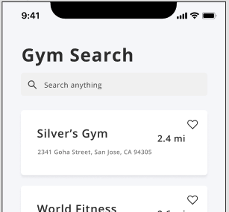
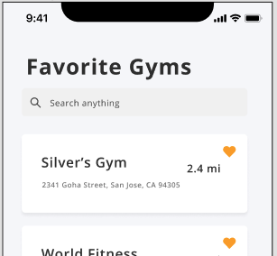
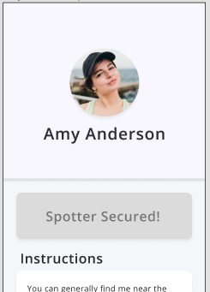
Design Revisions
Severity: 3
Type: H3 (User Control)
Problem: No back button on multiple screens

Slide 11
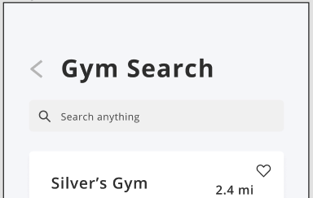
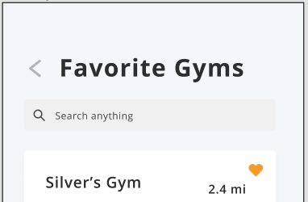
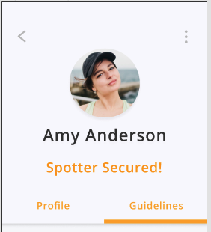
Design Revisions
Fix:
Added back buttons

Slide 12
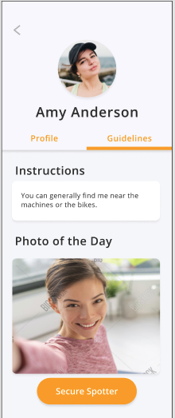
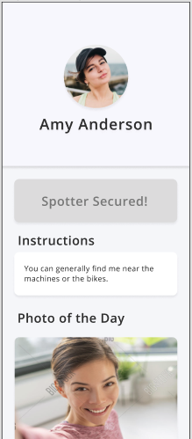
Design Revisions
Severity: 3
Type: H4 (Consistency)
Problems:
Cannot see “Profile” of Spotter bio after securing
In “Browse”, forced to view bio before “Secure Spotter”

Slide 13
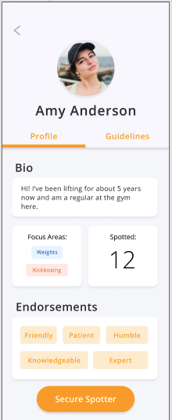
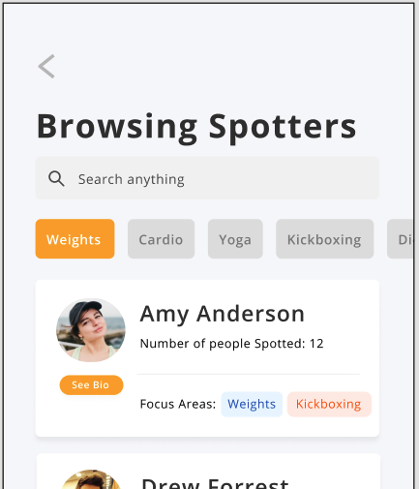
Design Revisions
Severity: 3
Type: H4 (Consistency)
Problems:
Cannot see “Profile” of Spotter bio after securing
In “Browse”, forced to view bio before “Secure Spotter”

Slide 14
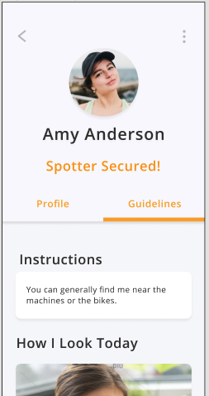
Design Revisions
Fix:
Added tabs to the “Spotter Secured” screen
Added “Secure Spotter” button to each Spotter card in “Browse” screen

Slide 15
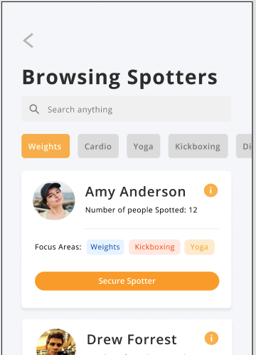
Design Revisions
Fix:
Added tabs to the “Spotter Secured” screen
Added “Secure Spotter” button to each Spotter card in “Browse” screen

Slide 16
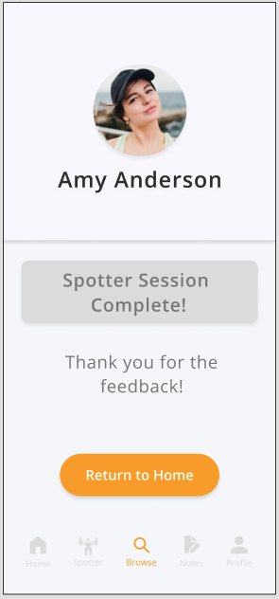
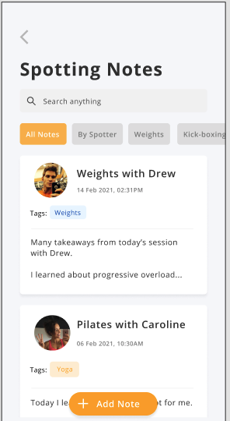
Design Revisions
Severity: 3
Type: H6 (Recognition not Recall)
Problem: Separation between Notes task and Spotter if user adds note

Slide 17
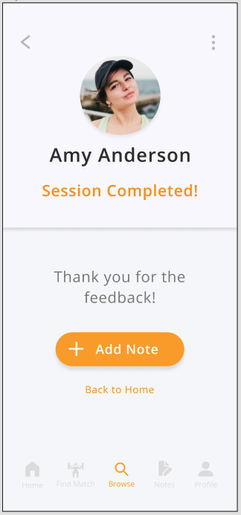
Design Revisions
Fix:
Added “Add Note” button shortcut

Slide 18
Design Revisions
Severity: 0-2
Type: H8 (Minimalist Design)
Problems:
Buttons in Home Screen redundant
Home Screen layout boring

Slide 19
Design Revisions
Fix:
Updated Home Screen

Slide 20
Hi-Fi Prototype Implementation Status

Slide 21
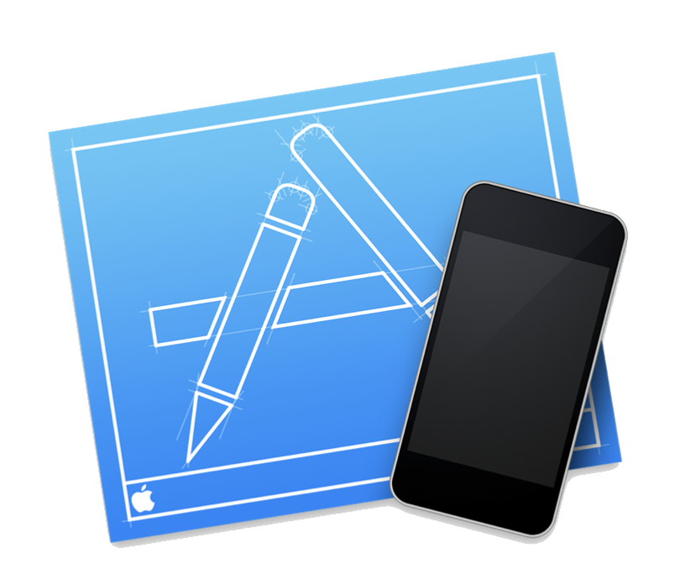
Tools Used
React Native & Expo
VSCode & Simulator

Slide 22
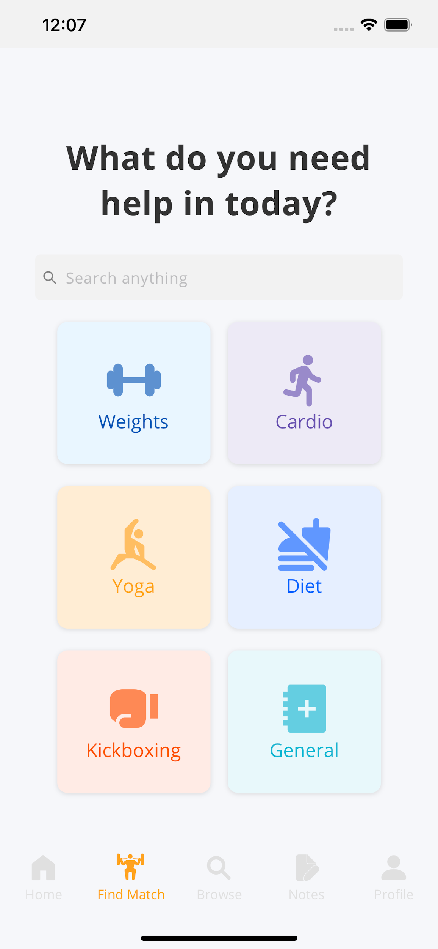
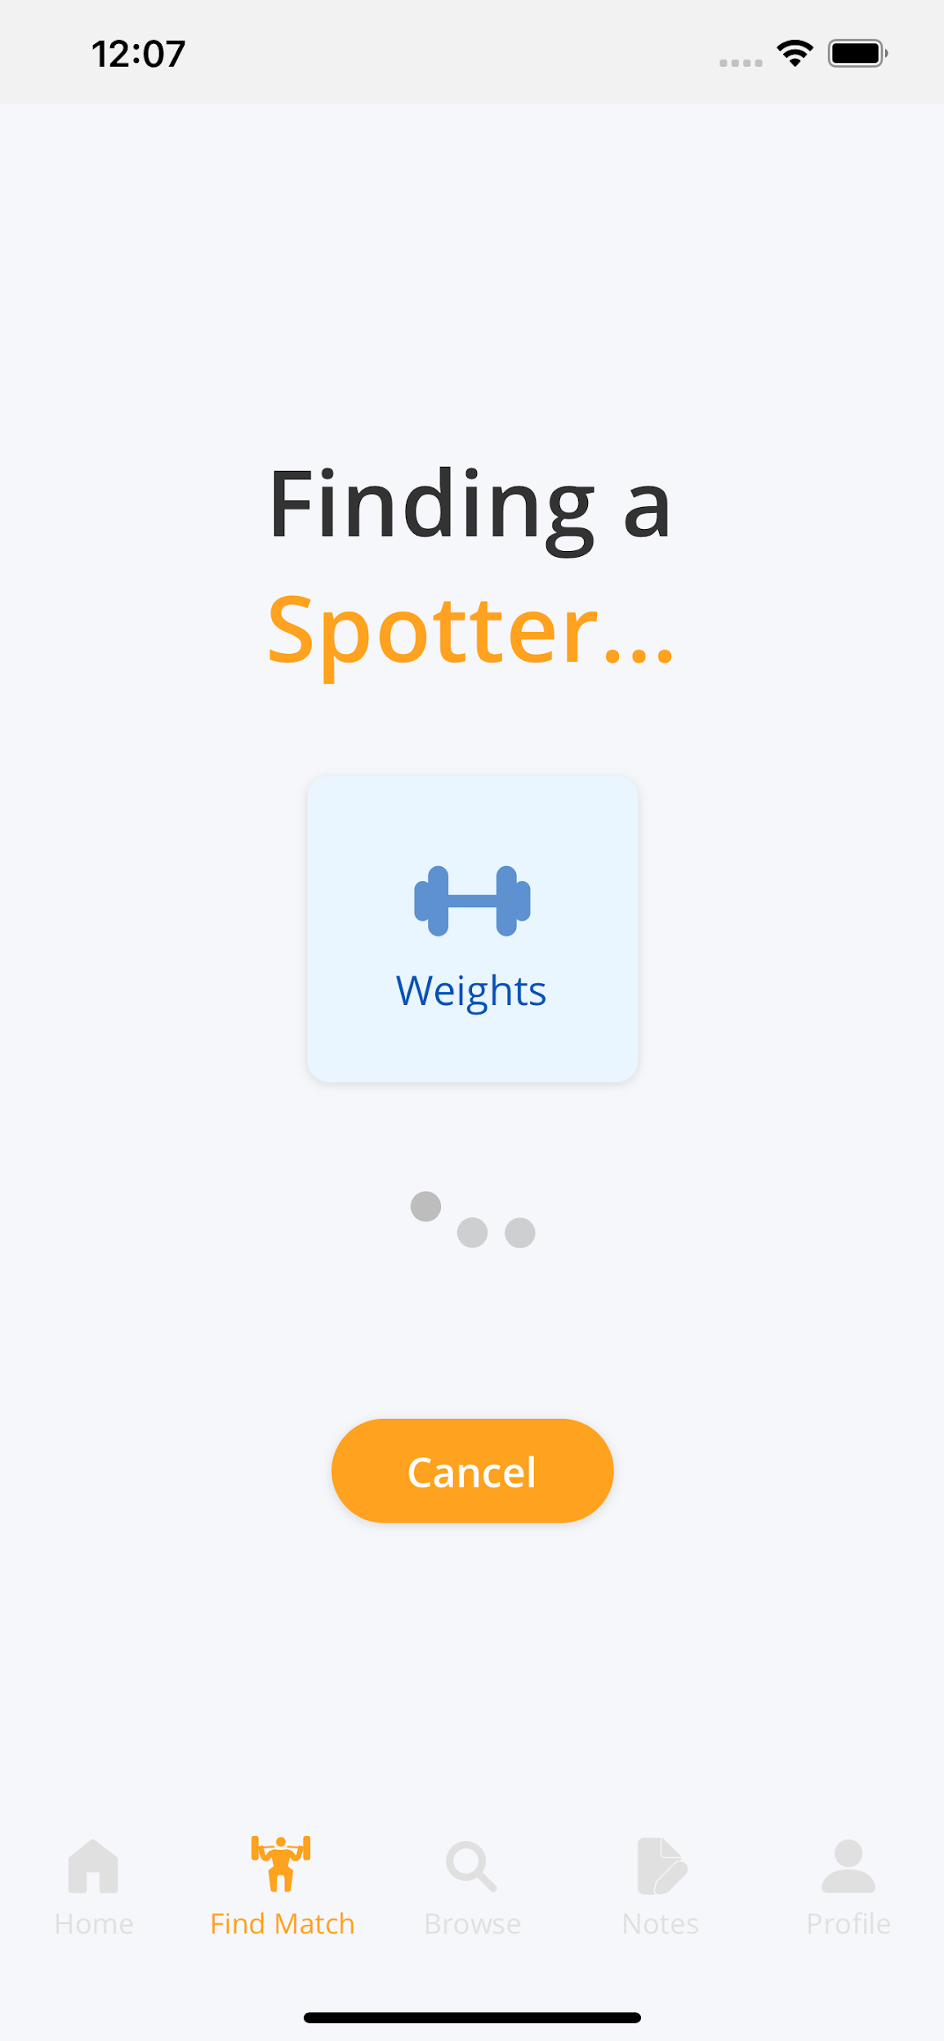
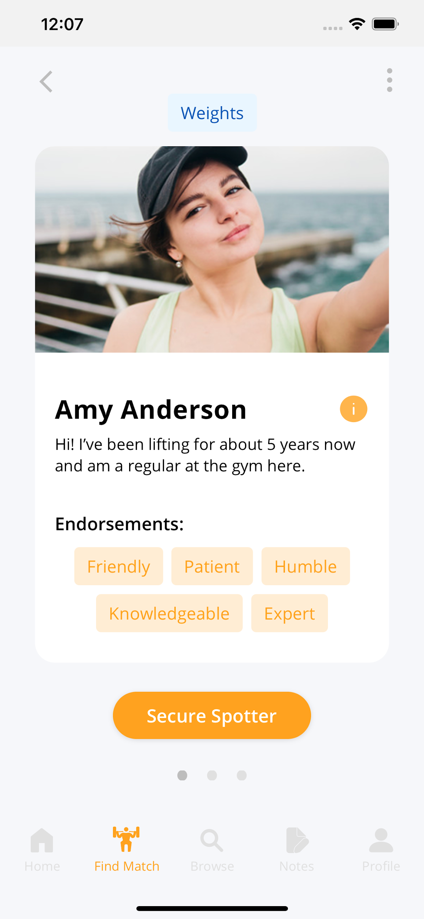
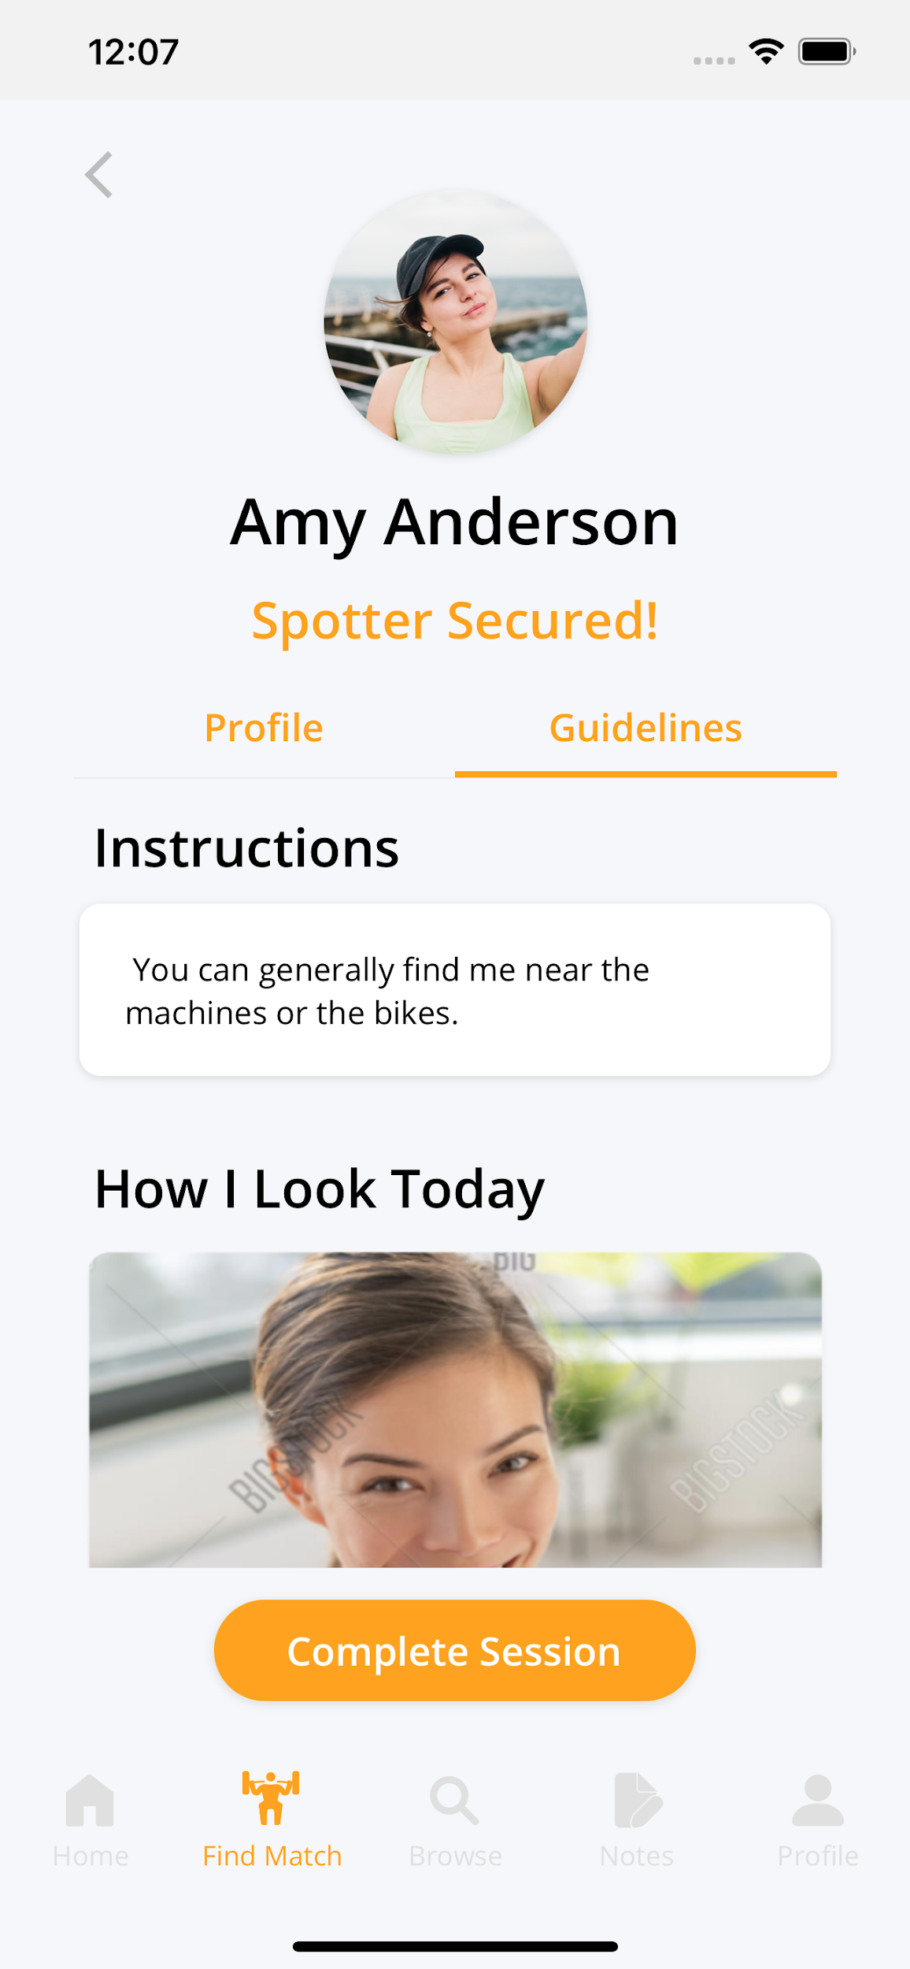
Implemented Features: Simple Task

Slide 23
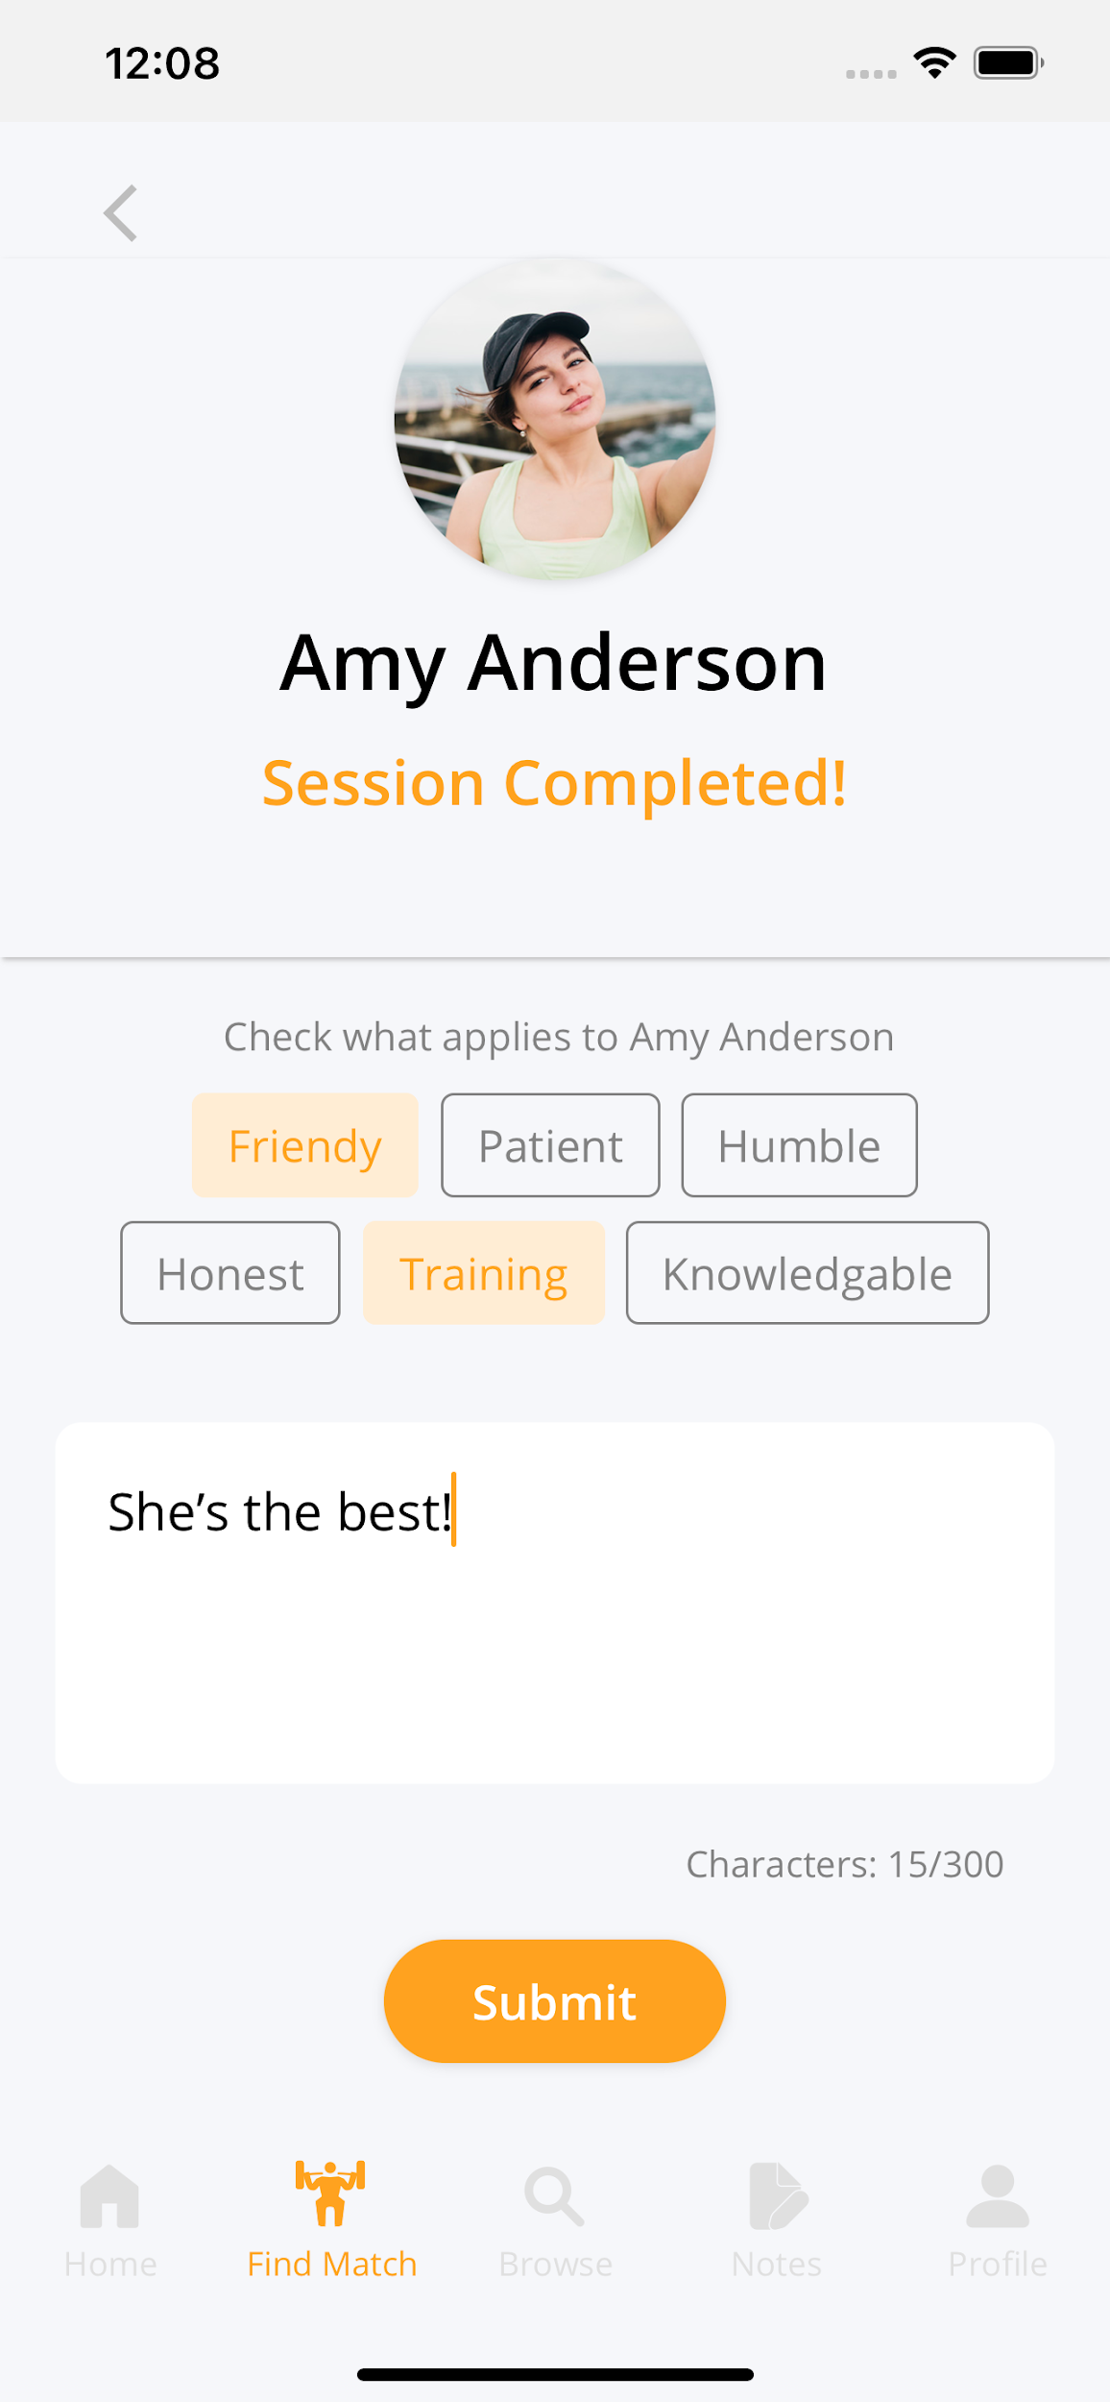
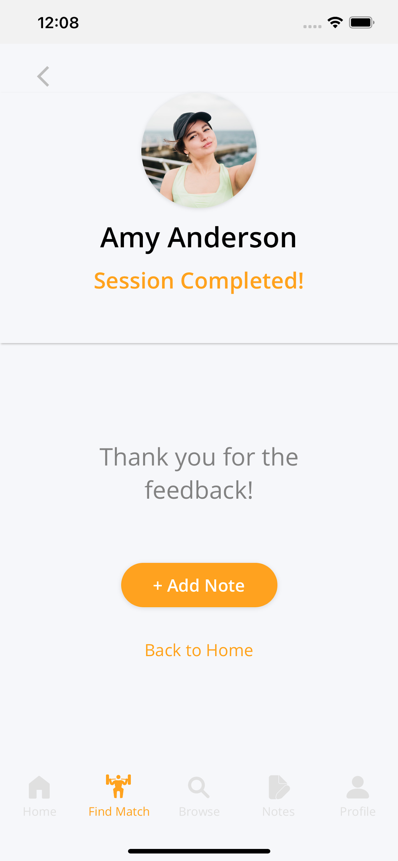
Implemented Features: Simple Task

Slide 24
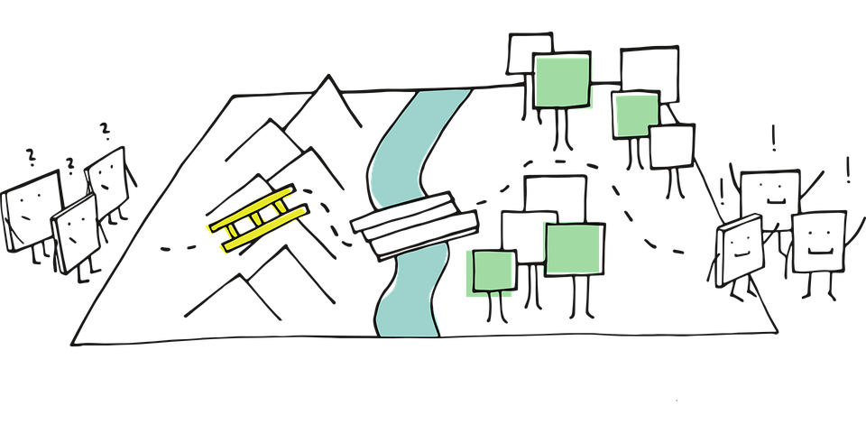
Unimplemented Features & Plan
Moderate Task: Browsing Spotters
Complex Task: Logging Notes
Checking in & Home Screen
FAQs screen

Slide 25
Wizard of Oz Techniques
Matching Spotter

Slide 26
Hard-coded Data
Spotter information
Previous notes
Gym names/locations
Notes:
Will pre-populate these data in Firebase beforehand

Slide 27
Live Demo

Slide 28
Summary
All severity 3-4 violations addressed
Progress: Simple task implemented
Next steps: Moderate & complex tasks
On track to finish by deadline!
Notes:
Some of severity 0-2 violations addressed (mainly ones that deal with Home Screen and wording issues)

Slide 29
Questions?

Slide 30
Appendix
Additional Revisions

Slide 31
Design Revisions
Severity: 3
Type: H2 (Match Sys & World)
Problems:
No emergency button
No space to leave negative feedback or report for problems

Slide 32
Design Revisions
No Fix:
Neither are relevant to our main task flows
Outside of scope

Slide 33
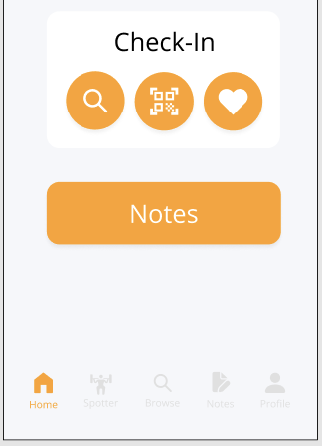
Design Revisions
Severity: 3
Type: H4 (Consistency)
Problems:
“Spotter” button greyed out during check in, not removed
“i” icon vs “See Bio” button
“Create note” screen different background color

Slide 34
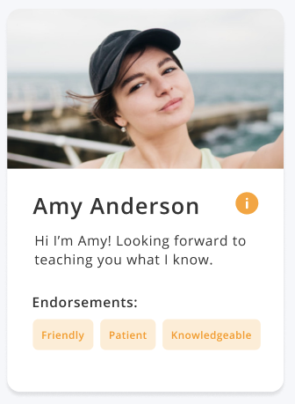
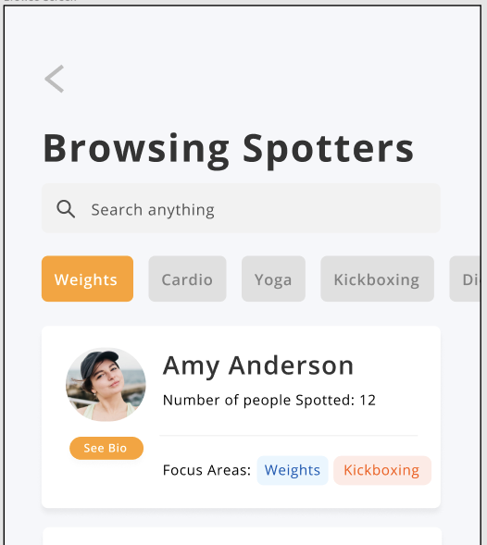
Design Revisions
Severity: 3
Type: H4 (Consistency)
Problems:
“Spotter” button greyed out during check in, not removed
“i” icon vs “See Bio” button
“Create note” screen different background color

Slide 35
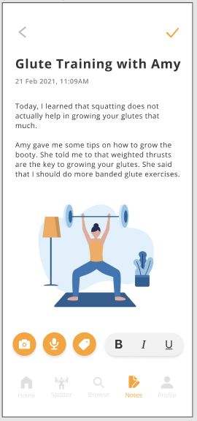
Design Revisions
Severity: 3
Type: H4 (Consistency)
Problems:
“Spotter” button greyed out during check in, not removed
“i” icon vs “See Bio” button
“Create note” screen different background color

Slide 36
Design Revisions
Fix:
“Spotter” and “Browse” icons will be removed from check-in screen in high-fi prototype
Made “i” icon consistent

Slide 37
Design Revisions
No Fix:
Intentional - Background for notes entry is consistent with text entry of endorsements screen
Signifies text can be entered

Slide 38
Design Revisions
Severity: 3-4
Type: H5 (Error Prevention)
Problems:
Small “See Bio” button
Small clickable areas (throughout app)

Slide 39
Design Revisions
Fix:
Related to med-fi limitations - will be resolved in high-fi prototype

Slide 40
Design Revisions
Severity: 3
Type: H10 (Documentation)
Problem: No FAQ page
Fix:
Adding a FAQ screen in high-fi prototype

