Slide 1
POVs and Experience Prototyping
Team 4
Health and Wellness

Slide 2
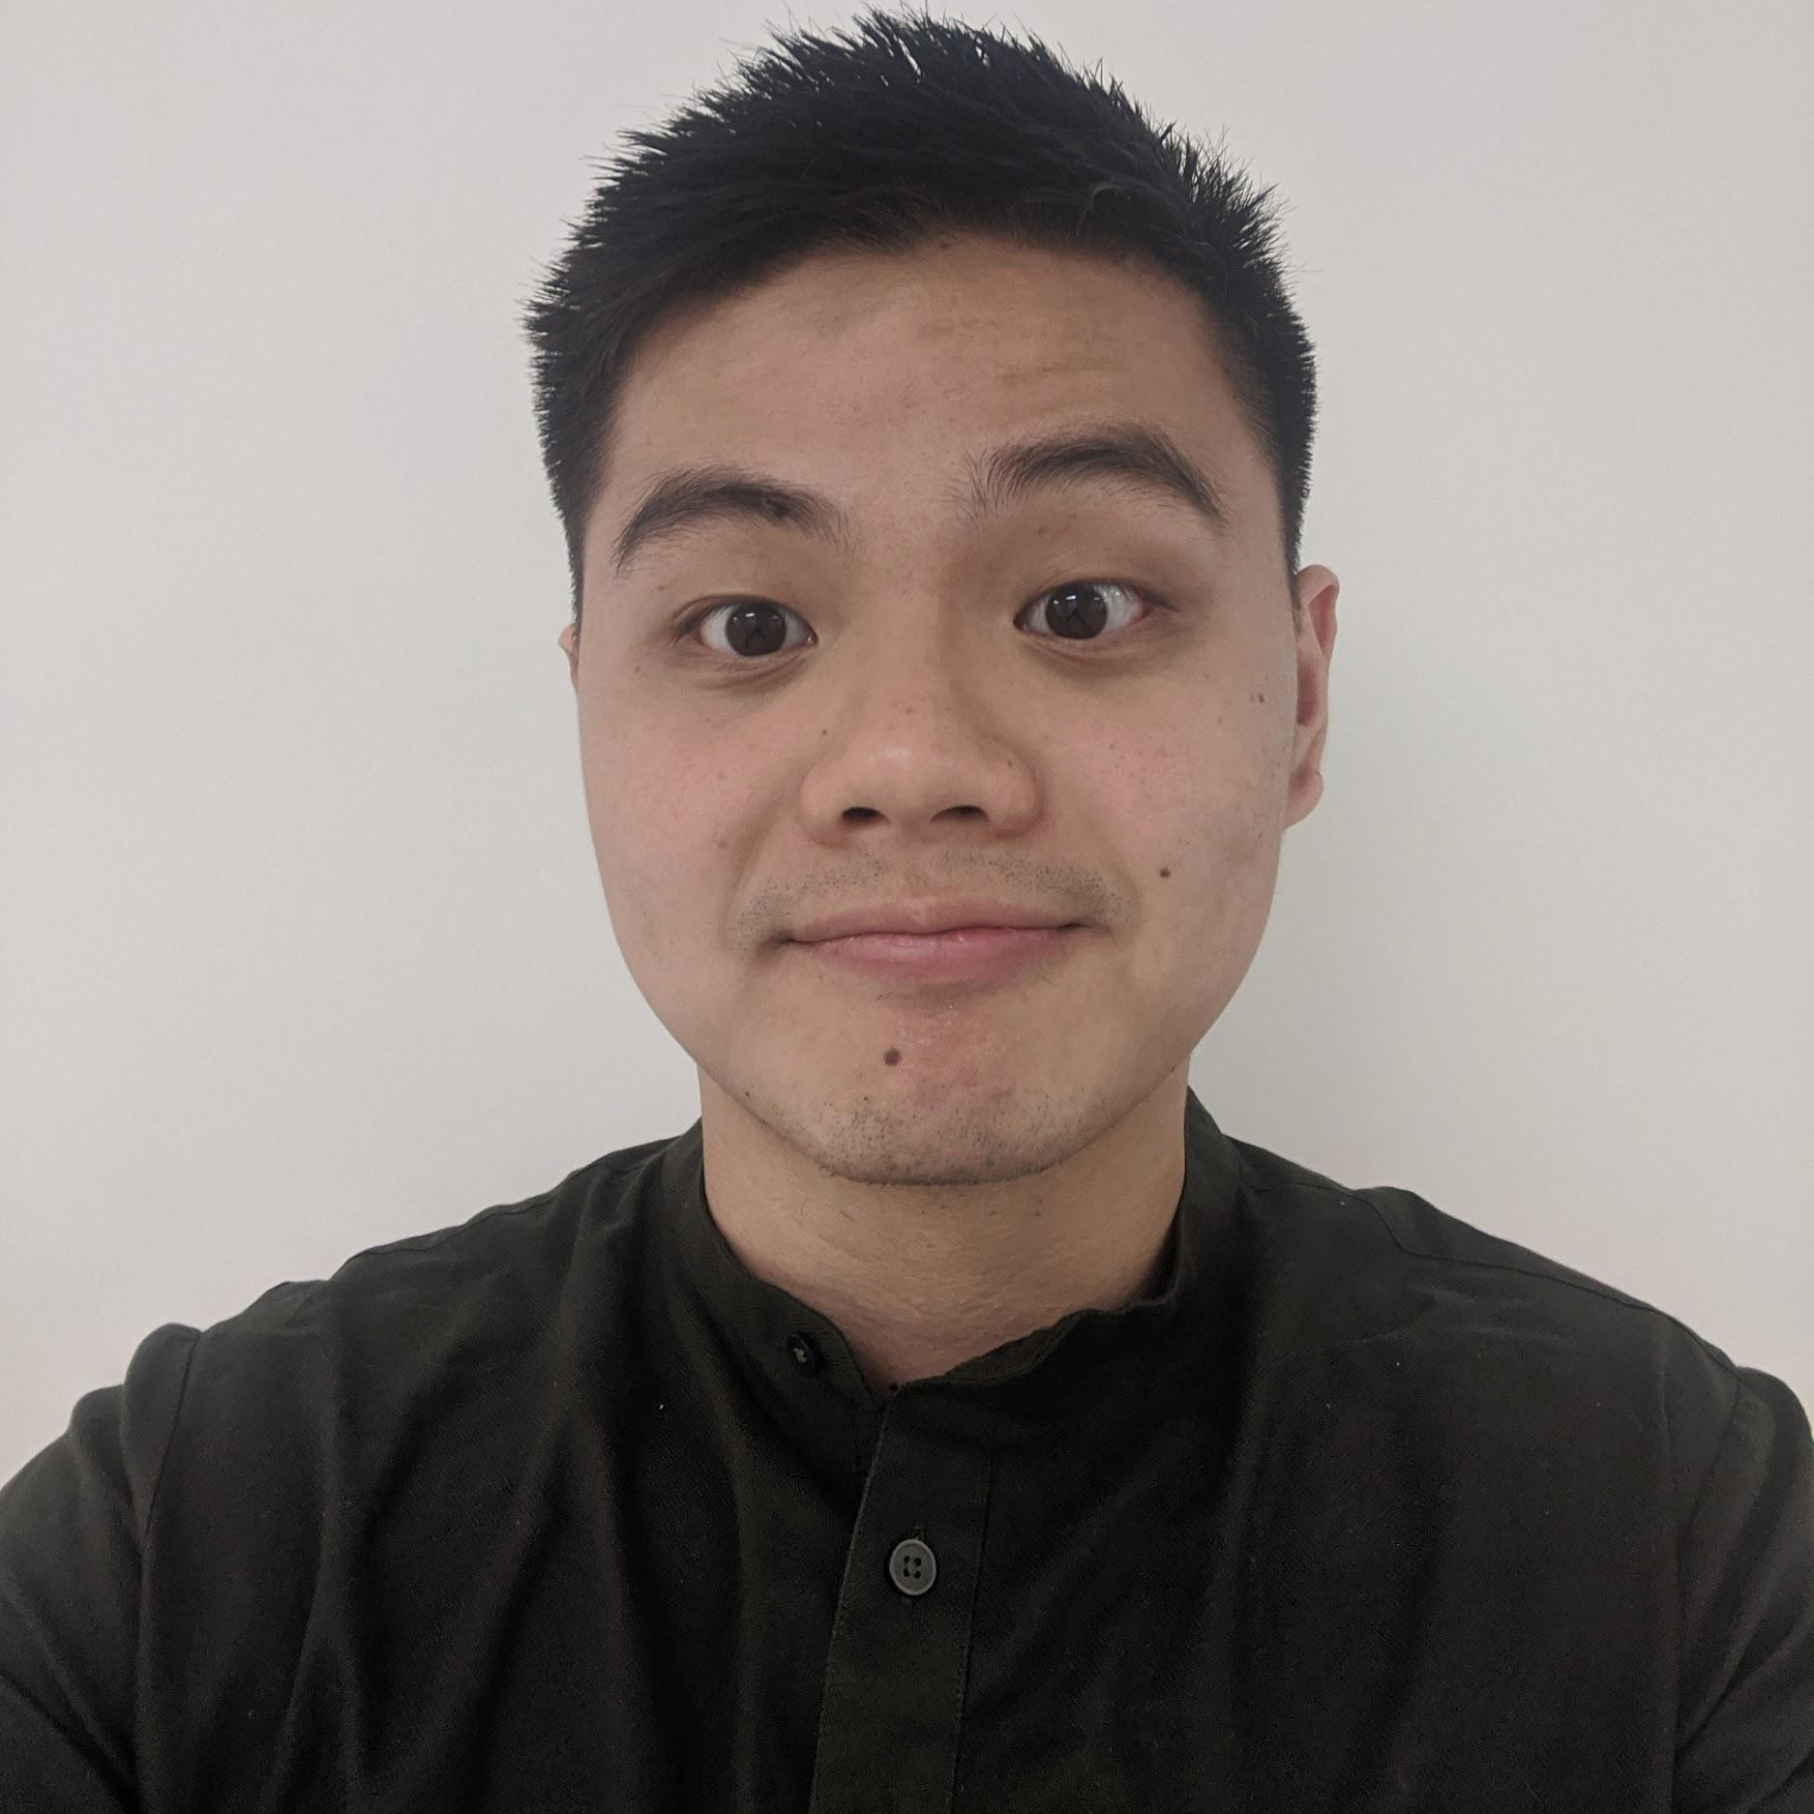
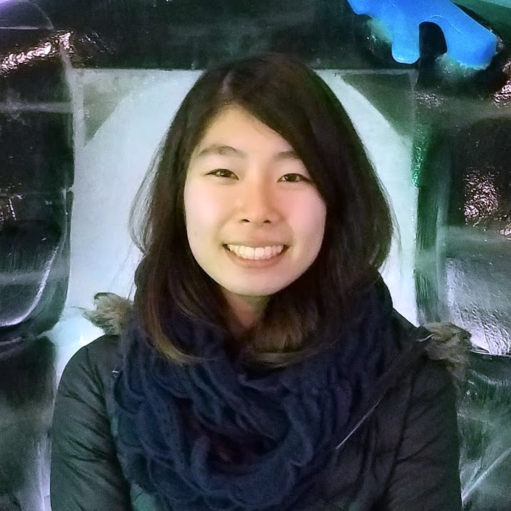
Meet the Team
Jenn Hu
Senior
IR Undergrad
Angel Pan
Senior
CS Undergrad
AJ Rossman
Junior
CS Undergrad
Emily Yang
First-year
MSCS

Slide 3
Recap
Personal Wellness
Physical
Mental
Emotional

Slide 4
Recap
How can we help beginners start a physical fitness regimen?

Slide 5
Initial POV
We met Sherry, a young professional who is active on a daily basis and is cognizant of taking care of her health
We were amazed to realize that although she was very physically involved with activities, she felt like she had to be physically qualified enough in order to ask for advice
It would be game changing if users can get help without feeling inadequate and knowing where to find help/know what to ask

Slide 6
Additional Needfinding

Slide 7
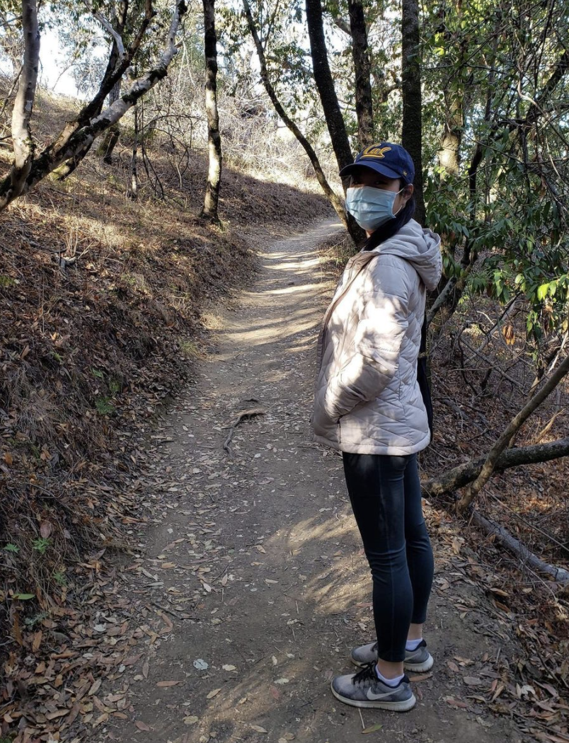
Jeanine, Consultant
Little to no physical activity
WFH and overtime on weekends
Enjoys leisurely walks and running errands

Slide 8
Insights/Contradictions
Seeing people on social media; compares herself
“Back when I went to the gym, it felt like I had to enjoy what I was doing even though it felt like punishment”
Notes:
Additional notes:
Doesn’t have time to exercise, and even if she prioritizes other aspects of her life over physical wellbeing
Feels subconscious if she goes to the gym
Feels pressure when she’s not as fit as friends, but she still enjoys the act of being able to bond with them (accountability) and that doing something is better than nothing
Wants to have a positive mood going in to the next day

Slide 9
Kevin, Regular Gym-goer
Self-led fitness journey since middle school
Has been going to the gym regularly since high school
Notes:
Elementary/Middle school
Really fat
Eat to make parents, aunts, and uncles proud
Ate everything
Really unhealthy way to look at food
Motivation to eat healthier
Cared what cute girls thought
Doing martial arts (puked on 19/20 lap)
Becoming more fit to do the things you enjoy
How did you know how to get there
Did not do too much research
Focused on eating less food
Mom came home at 10pm and would always bring chips
Would eat the chips with her and then ate dinner again with her (already ate dinner previously)
Current views
A lot more knowledge on fitness and dieting
Found these things online
Look at famous athletes
Does not make firm decision, just tries different things and then sticks with it if it is sustainable
Exercise wise has been playing basketball
Exercise usually alone but recently with friends
At Stanford exercise in the gym alone, but then when exams come, stop going
Losing weight - Accountability
Not too difficult
Just cutting out the junk and late night eating made it pretty easy
It just happened, not really a struggle
Today - accountability
More of a struggle
When I study and I am bored, I want to eat
More of a matter of do I really want to or not
If I really want to it’ll happen but if I don’t then I won’t
It happens pretty smoothly when I want it to happen
Martial arts
Kung fu panda or karate kid
Taekwondo - 2 years
Weight lifting
End of senior year of high school
Couldn’t convince to get a membership because busy in high school
Got it in the summer and worked out with friends
Did things that people did online but no clear regimen
Day-by-day was a different workout, no structure
Did whatever they felt was nice
Bart kwon online
Thought about the cost of gyms per month, went to ymca because it was cheap and close
When wanted to workout went with friends
Worked out with other people, would go almost every day but just message each other
Now that gyms are closed plays basketball instead or go for a walk if you can’t
Ideally workout strength and also some sport or some activity
Used to do indoor workout back in march and April (no people to play basketball with)
Used a single dumbbell and some resistance bands
Did a 10k pushups a month challenge
Had to quit because joints couldn’t handle it, shoulders got marks
Got a pullup bar
Motivated by avatar the last Airbender (uncle iron prison)
Why don’t you do home workouts now
Probably laziness
Want to play basketball to get better
Prefers cardio over home workout because hard to simulate workout in gym with home workout
Workout consistently buy did not see results in the beginning
Was not sure if things were working or not
If you have a coach they give you motivation and you know you are on the right path
Knew exercise was good but not sure how it worked
Would asked more experienced lifters for advice but not in person to help
Biggest difference between remote stuff and in person is because it is similar to things you see online
A lot of the same advice, do not fully absorb it
A coach their physically has more say
For the most part was confident that I knew what I was doing
Not sure if what I’m doing is the best thing but I know its doing something so I continue to do it
Hard to tell what is achievable without drugs and what to expect
One of my friends started coaching as a business
Tried coaching for a bit
Inexpensive since coach target demographic was lower income folks
Learned to do some Olympic weight lifting
Biggest thing I learned is that I never criticized my form
Learned more about how to do exercises in terms of form to target certain muscles and avoid injury
Its not like he’s giving a bunch of information but can point out a few things here are there, how to do things better
It’s also more fun; it’s dull with yourself
People can keep you accountable
They can spot you also, can push yourself more
Even though I worked out for a while, did not have a workout plan
Coach helped to have a workout plan
A lot more organization that he introduced and some I kept
Eye-opening to see how things are done differently
Easier to figure out what you need to fix
Fix and tinker things as needed
Do not fully buy into or trust things online
Saw workout plans online but usually do not follow fully
Does not trust reputation of online things because not personalized and information overload
Coach is giving one and making it personalized so more trustworthy
Because too much information, often conflicting best way is to just do it and see if it works instead of doing too much research
Good way to make you feel like you’re making progress when you aren’t actually making progress
Overall feel good about where I am about physical fitness
If I had to criticize, would say I often eat more than I need to
Would like to be more athletic and lose some body fat

Slide 10
Insights/Conclusions
Distrusts online information because it lacked personalization and was often contradictory.
“There are so many online workouts out there but a coach just gives you one and it’s just for me, so I can trust it. ”

Slide 11
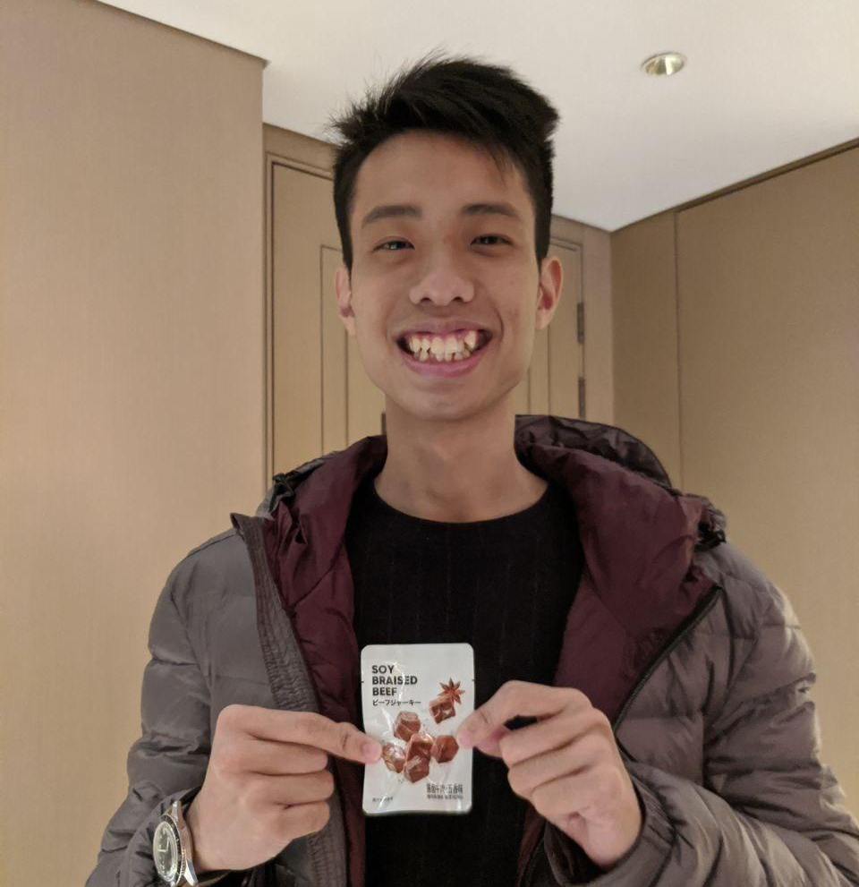
Yihui, Muscle Aspirer
Starting to develop his own fitness and diet regimen
Goes to the gym 3 times a week

Slide 12
Insights/Conclusions
Tries to strike a balance between structure and flexibility
“I don’t want to pose too many restrictions because it can become unenjoyable and that can break the habit.”

Slide 13
SUmmary of Insights
We heard…
There is a pressure to have fun and “know what you’re doing” when at the gym.
Our insight…
Users are intimidated to ask for help and don’t want to waste someone else’s time with their ignorance.

Slide 14
SUmmary of Insights
We heard…
Overly restrictive and structured regimens can cause people to give up and break the habit.
Our insight…
Users want to avoid feeling like they failed in a commitment.

Slide 15
SUmmary of Insights
We heard…
The lack of personalization and contradiction in online sources can make the journey even more challenging.
Our insight…
Users have to spend too much extra time to cross-reference and verify information to suit their needs.

Slide 16
Revised POVs

Slide 17
POV 1
We met Sherry, a young professional who enjoys being active daily and the feeling of getting stronger.
We were amazed to realize she did not feel she met a certain threshold in physicality and knowledge to ask for advice at the gym even though she played multiple sports.
It would be game changing if there’s a sense of security in asking for fitness help without feeling shame or guilt on other people's time and space
Notes:
Sample of 10 HMWs for POV 1:
HMW: change stigmas on asking for help?
HMW: make asking for advice feel more enjoyable?
HMW: encourage newcomers to fitness to feel included/wanted?
HMW: build anonymity in asking Qs to minimize pressure?
HMW: entirely remove the need to ask for help in the first place?
HMW: find people who want to help beginners/be mentors?
HMW: encourage others to be willing to offer advice?
HMW: provide useful information to people who don't know they need it?
HMW: leverage other's experiences to help newcomers?
HMW: connect people of similar level/goals?

Slide 18
POV 2
We met Jenny, a sedentary university student who used to be an avid tennis player in high school.
We were amazed to realize the feeling of hatred she has towards routines because of the pressure it gives her.
It would be game changing if people can adopt flexible, failure-free routines but still move towards their goals
Notes:
Sample of 10 HMWs for POV 2:
HMW: instill consistency while allowing for flexibility?
HMW: give imperfect routines feeling of success?
HMW: define overall goals to allow for flexibility on a day-to-day basis?
HMW: "gamify" working out?
HMW: make routines feel more fun?
HMW: measure a person's fitness goals/journey?
HMW: make the routine feel like a story/journey/adventure?
HMW: allow people to feel satisfied about working out without having to take lots of time out of their day?
HMW: get people to make time to stick to routine?
HMW: make routine easily integrated into people's busy schedules?

Slide 19
POV 3
We met Kevin, an avid gym-goer who was once inactive.
We were amazed to realize that because he finds online information lacking personalization and often contradictory, he is wary of online guides and information.
It would be game changing if people could save time in absorbing online information and tailor it into something personalized and meaningful
Notes:
Sample of 10 HMWs for POV 3:
HMW: present information in accessible, easy ways?
HMW: make complicated workout jargon easy to read/digest?
HMW: make scientific studies on fitness accessible to a beginner?
HMW: present the info less intimidating to layman?
HMW: reconcile contradictory information on the web?
HMW: we debunk and discourage proliferation of incorrect information online?
HMW: build people's trust in online info?
HMW: cater a selection of reputable sources?
HMW: provide personalized information in a virtual medium?
HMW: make finding info like a scavenger hunt?

Slide 20
Top 3 HMWs

Slide 21
POV 1
We met Sherry, a young professional who enjoys being active daily and the feeling of getting stronger.
We were amazed to realize she did not feel she met a certain threshold in physicality and knowledge to ask for advice at the gym even though she played multiple sports.
It would be game changing if there’s a sense of security in asking for fitness help without feeling shame or guilt on other people's time and space
HMW: Make amateurs excited to ask for help?

Slide 22
POV 2
We met Jenny, a sedentary university student who used to be an avid tennis player in high school.
We were amazed to realize the feeling of hatred she has towards routines because of the pressure it gives her.
It would be game changing if people can adopt flexible, failure-free routines but still move towards their goals
HMW: Celebrate small fitness wins and forgive ourselves for small failures?

Slide 23
POV 3
We met Kevin, an avid gym-goer who was once inactive.
We were amazed to realize that because he finds online information lacking personalization and often contradictory, he is wary of online guides and information.
It would be game changing if people could save time in absorbing online information and tailor it into something personalized and meaningful
HMW: Correct false preconceptions about fitness/physical wellness?

Slide 24
Best Solutions & Assumptions

Slide 25
SOLUTION 1: App you use at a gym to find those who are experienced and willing to help
ASSUMPTIONS:
Experienced gym-goers want to help the less experienced
Those who want to help are willing to be identified from the app
People seeking help will have the courage to ask people for help when they know who to ask

Slide 26
SOLUTION 2: Cute virtual mascot that that encourages the user to perform small fitness goals, evolving as goals are met
ASSUMPTIONS:
People care about these mascots enough to be motivated to stay on a fitness routine
People will be more inclined to return to a routine if the feeling of “failure” isn’t actually failing
People want to be able to visually quantify their progress

Slide 27
SOLUTION 3: Verified channel of fitness tips with links to scientific articles (Khan Academy-like)
ASSUMPTIONS:
People will trust information on the app even if it contradicts their earlier assumptions
People are interested in the science behind fitness tips
People are willing to spend time to increase their fitness knowledge

Slide 28
Experience Prototypes

Slide 29
SOLUTION 1: App you use at a gym to find those who are experienced and willing to help
Prototype 1a: Simulated Gym
Designed mock gym scenario that was done over zoom. Wanted to see how potential helper would react
Testing assumption: experienced gym-goers are willing to help those who ask for it

Slide 30
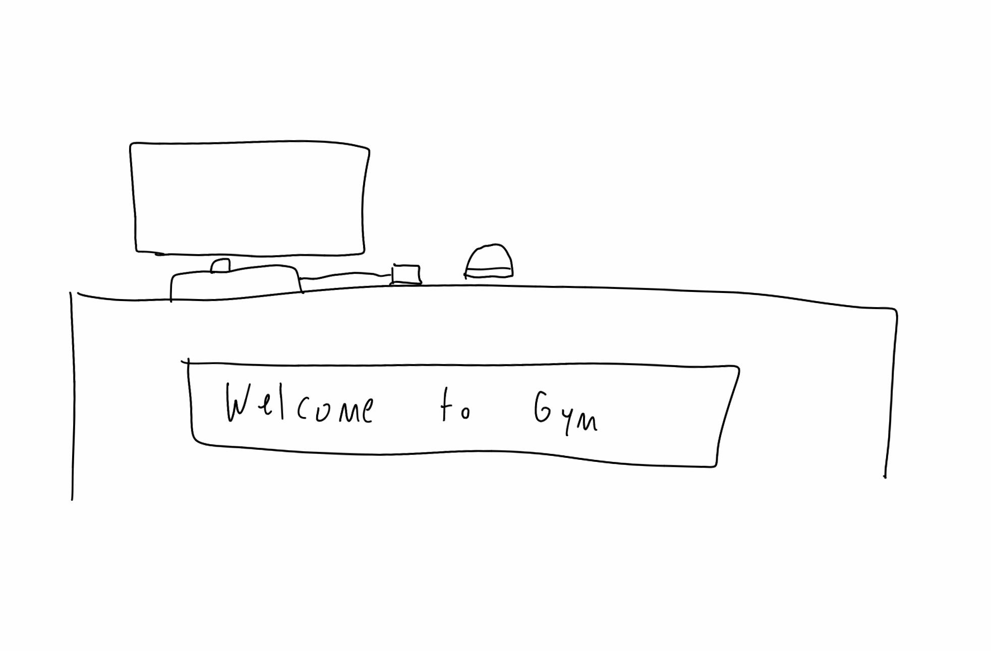
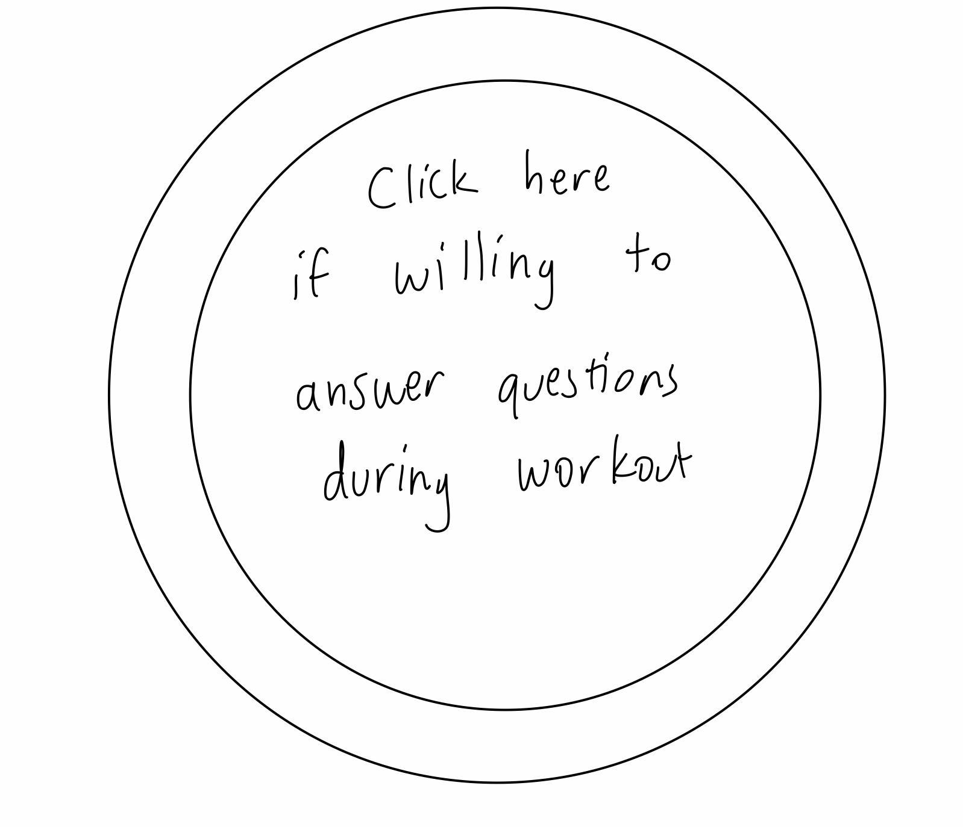
Interviewee: Zack
Former college athlete, experienced gym-goer
Zack “walks up” to sign into gym
Presses button to let people know he will answer questions
Ask questions, judge reaction

Slide 31
Prototype 1a Results
Things that worked
Seemed excited and pleased at idea of helping people at gym
Didn’t mind taking 5 min out of his workout (as long as it’s at appropriate time)
Things that didn’t worked
“What if I don’t like him?”
Surprises
He’s never had anyone ask him questions at gym before
New learnings
Can we give helper some choice in who he helps, such as mentor/big brother model?

Slide 32
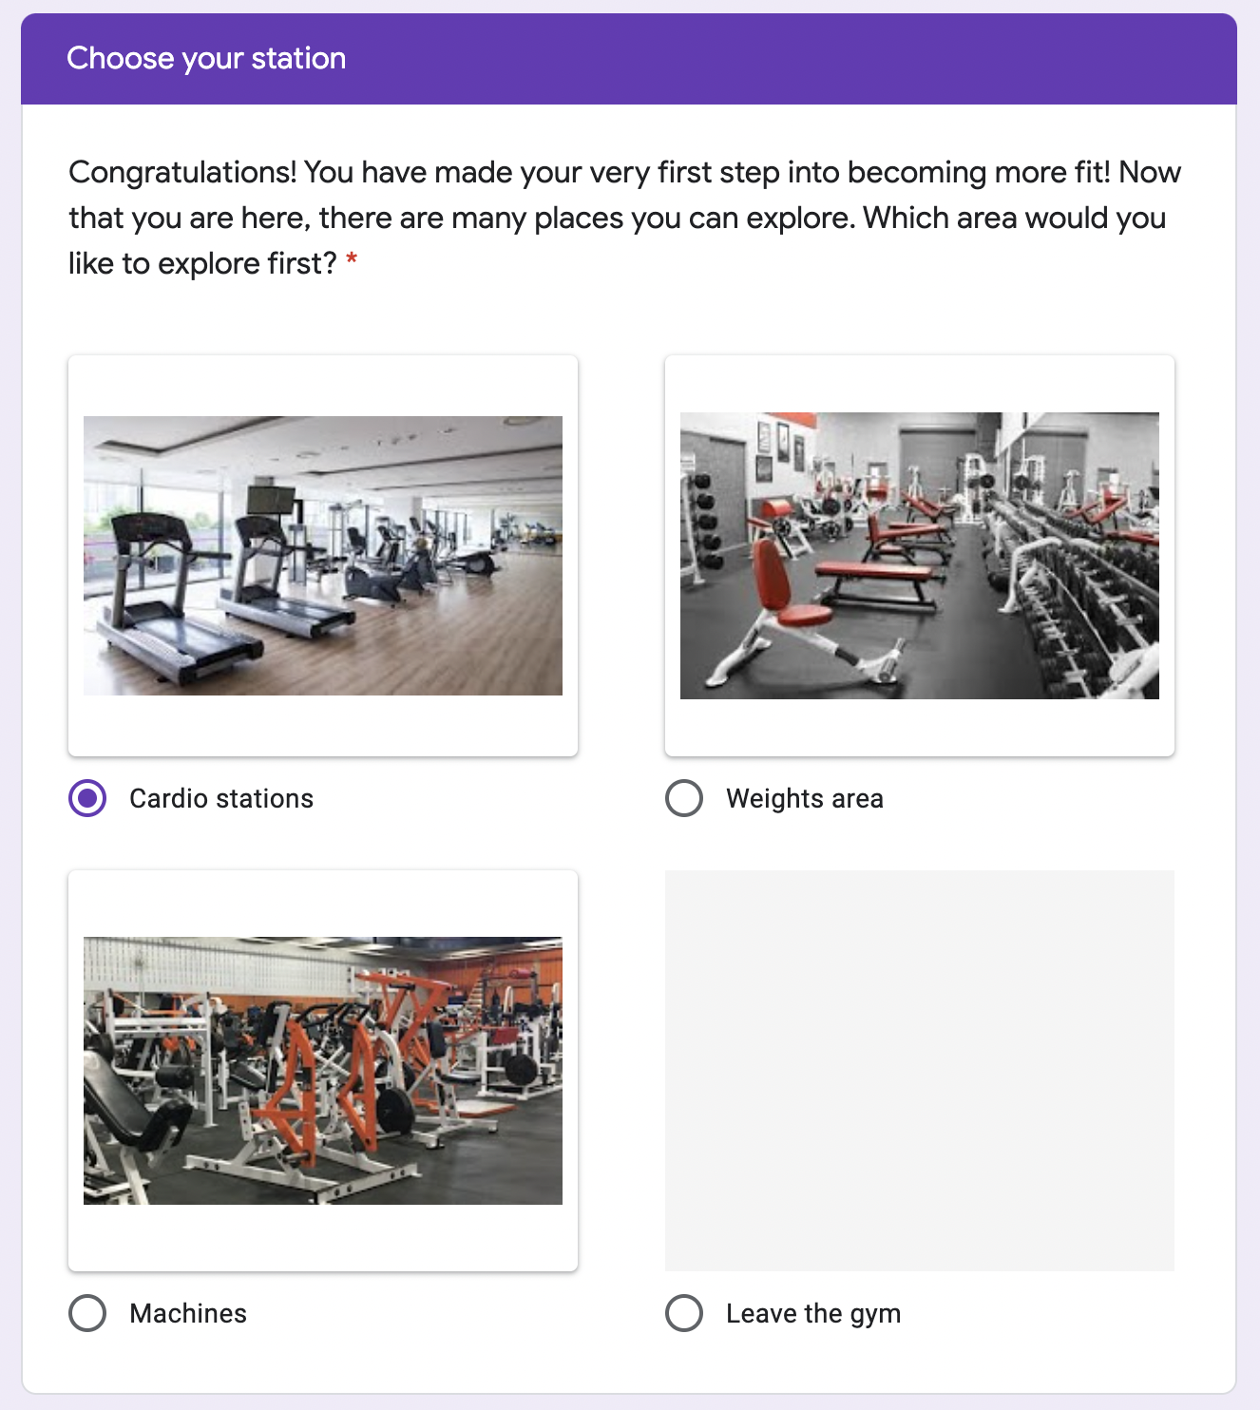
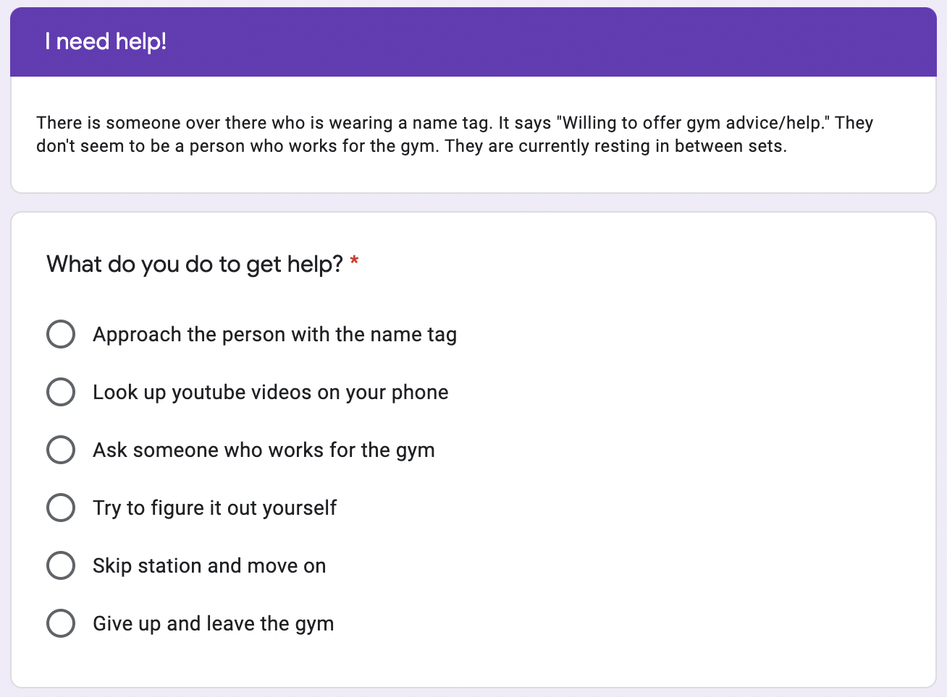

Slide 33
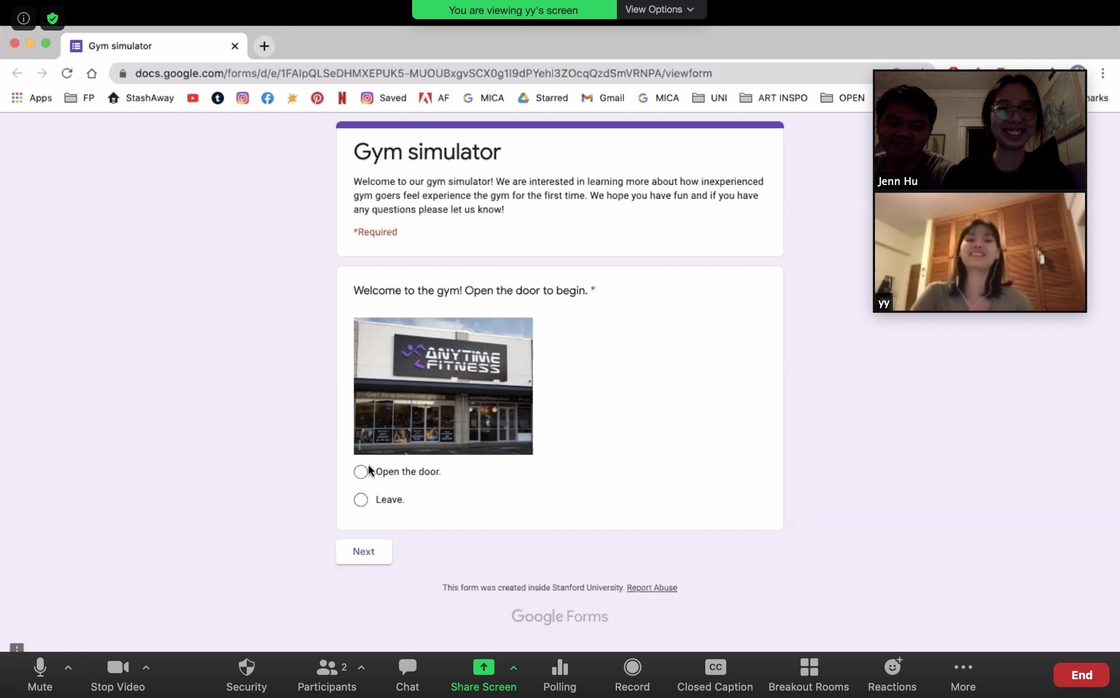
Prototype 1b: Gym simulator, for new gym-goers
Interviewee: YY
New gym-goer
Testing assumption: New gym-goers are willing to ask volunteers for help

Slide 34
Prototype 1b Results
Things that worked
“A volunteer feels closer to my experience level so there is a sense of familiarity in that”
“If I can’t figure it out myself I will ask for help since I am at the gym already”
Things that didn’t work
“If I am being completely honest, I would not go to the gym alone as a beginner.”
“I would research how to do things before I get there.”
Surprises
The fear of failure exceeded user’s fear of social interaction
Sense of familiarity > quality of help
New learnings
Gym volunteers are not made obsolete by gym workers
Still prefer to do things alone if possible

Slide 35
SOLUTION 2: Cute virtual mascot that that encourages the user to perform small fitness goals, evolving as goals are met
Prototype 2: Fitness Mascot
Google Form showing a cute creature that’s requesting the user to help it perform a certain exercise
Creature will “grow up” if user completes task

Slide 36
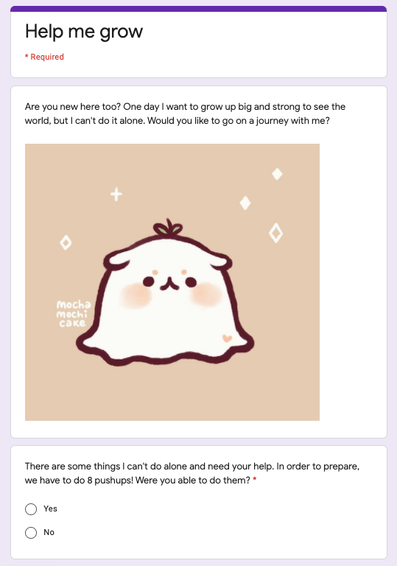
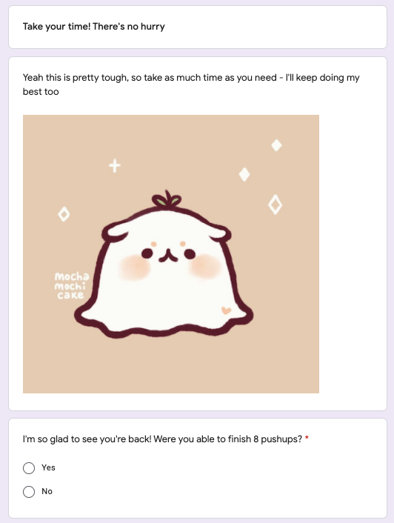
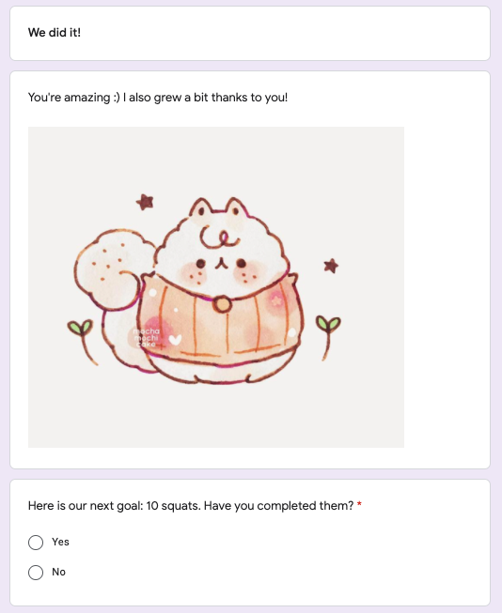
Yes
No
Yes

Slide 37
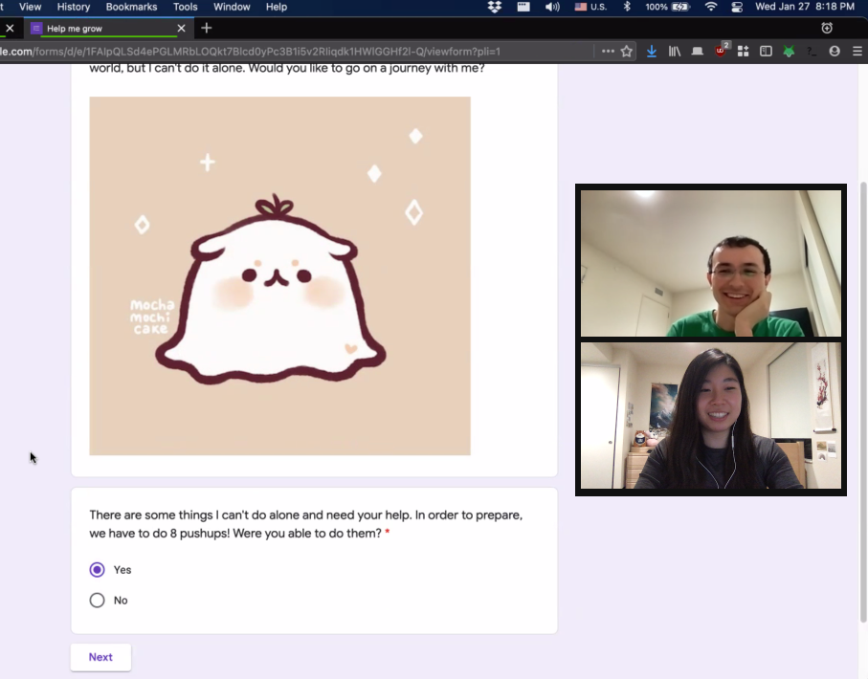
PROTOTYPE 2: Google Form showing a cute creature that’s requesting the user to help it perform a certain exercise
Interviewee: Andrew
Software Engineer, not very active
Testing assumption: People care about these mascots enough to be motivated to stay on a fitness routine

Slide 38
Prototype 2 Results
Things that worked
“The mascot made it more motivational than if it wasn’t there”
“I was hoping to see it grow more”
Things that didn’t work
“What if I couldn’t physically do the amount it said?”
Not enough exposure ↳ no deep personal connection
Surprises
Enjoyed seeing the progression but “didn’t feel like I earned it”
New learnings
Since he had full control over the process, it didn’t feel as rewarding or satisfying to click each time to see the reward
Notes:
Something else that worked: Curious in seeing the mascot change if he fulfilled exercises
Something else that didn’t work: He could skip through it if he wanted to

Slide 39
SOLUTION 3: Verified channel of fitness tips with links to scientific articles (Khan Academy-like)
Prototype 3: Fitness Tips Sheet
List of fitness tips, cited with sources ranging from pseudoscience to science backed. Test interviewee’s sensitivity towards sources.
Testing assumption: beginners would favor science-backed fitness tips over those that are not.

Slide 40
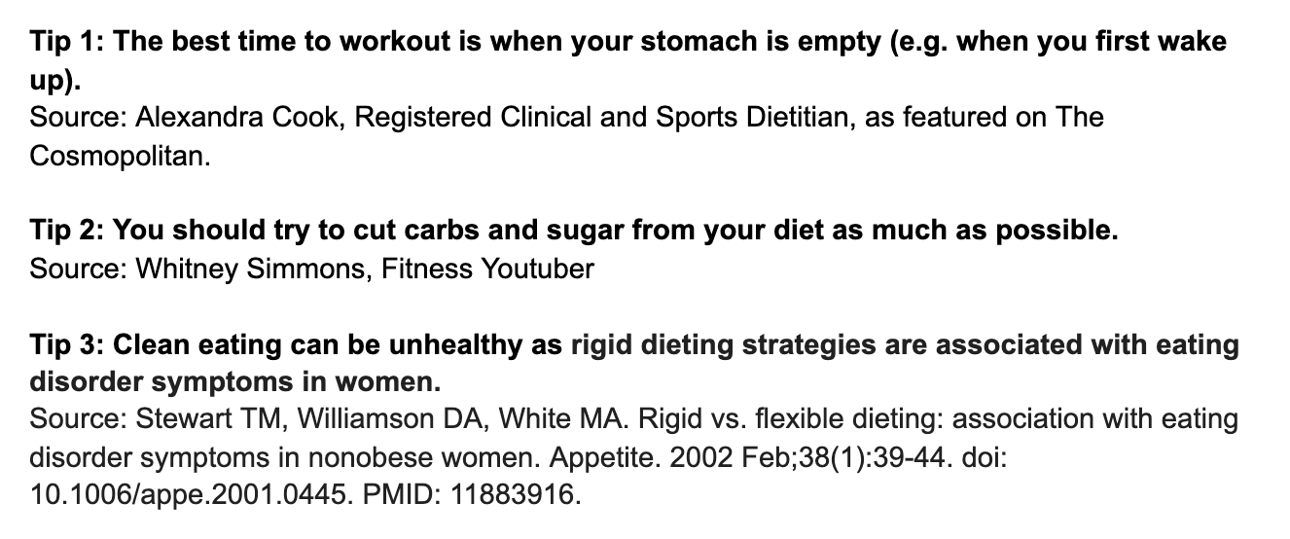
PROTOTYPE 3: Fitness Tips Sheet

Slide 41
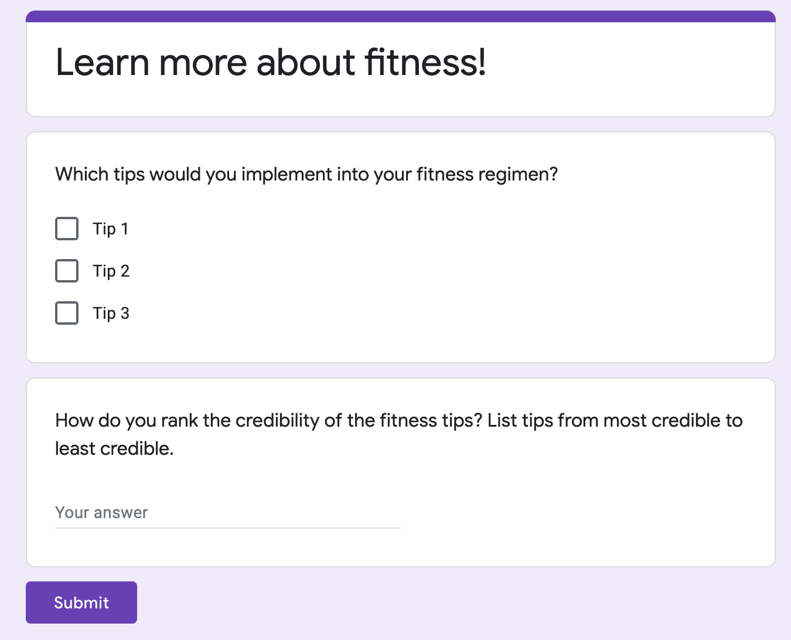
PROTOTYPE 3: Fitness Tips Sheet

Slide 42
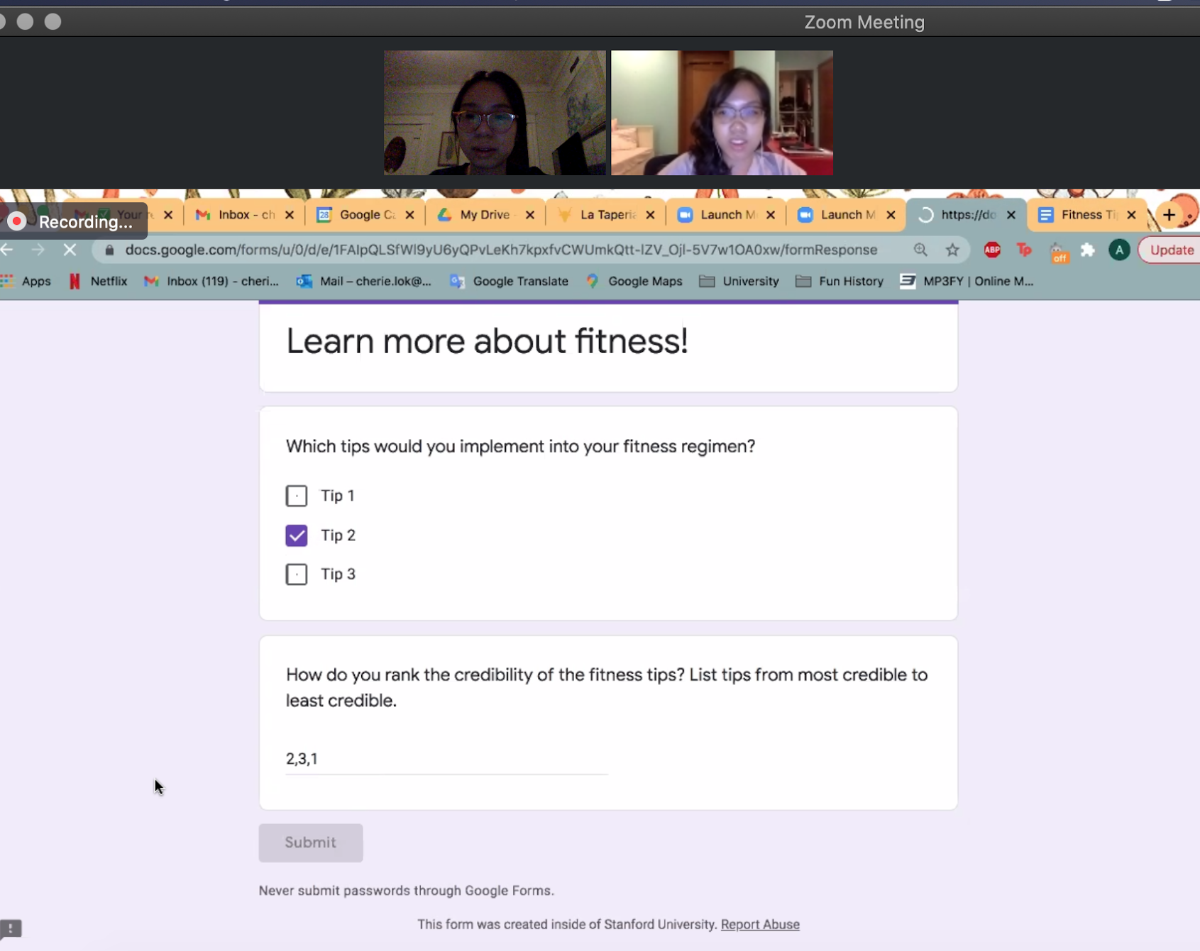
PROTOTYPE 3: Fitness Tips Sheet
Interviewee: Cherie
Beginner trying to implement a more informed regime.
Testing assumption: Beginners would favor science-backed fitness tips over those that are not.

Slide 43
Prototype 3 Results
Things that worked
“Good to know the sources behind each tip.”
Wanted to learn the scientific explanation behind each tip
Things that didn’t work
Didn’t understand the difference in credibility behind each source
She didn’t have a strong science background
Surprises
Chose to implement tip that was backed by the least credible source
“I heard it before everywhere; it’s common knowledge.”
New learnings:
Need to explain science behind tip in an accessible manner
Next question: Would people read the explanation if it were there?

Slide 44
Validity of Assumptions
Gym Simulator for Helper:
Validated - as long as there’s connection between helper and asker
Gym Simulator for Asker:
Validated - as long as the beginner makes it to the gym
Fitness Mascot:
Partially validated - but overall not very effective long-term
Fitness Tips Sheet:
Not valid - difficult to change preconceived opinions

Slide 45
Which direction is the most promising?
Given validity of assumptions, matching gym volunteers with gym beginners appears to be the most promising.
Notes:
Matching those who are experienced and willing to help with gym beginners helps beginners find the help they need in a non-intimidating manner. The cute virtual mascot helps user build a routine without the pressure of commitment. However, given the results of our experience prototype testing, matching gym volunteers with gym beginners appear to the be the most promising. Not only is it the most novel, but the assumptions underlying it have been proven to be valid.

Slide 46
Conclusion

Slide 47
Key Learnings
Beginners harbor irrational fear of judgment at the gym.
Beginners are more willing to ask a more experienced gym-goer for help.
Experienced gym-goers are willing to help, as long as they are appropriately matched to beginner.
Notes:
1. Beginners harbor irrational fear of judgment at the gym and don’t want to bother others with their lack of knowledge
2. Beginners are more willing to ask a more experienced gym-goer for help, rather than someone who officially works at the gym.
3. Experienced gym-goers are willing to help, as long as they are appropriately matched to beginner.

Slide 48
Next Step
How should we match those who need help with those who are willing to give it?

Slide 49
Questions?

Slide 50
Appendix

Slide 51
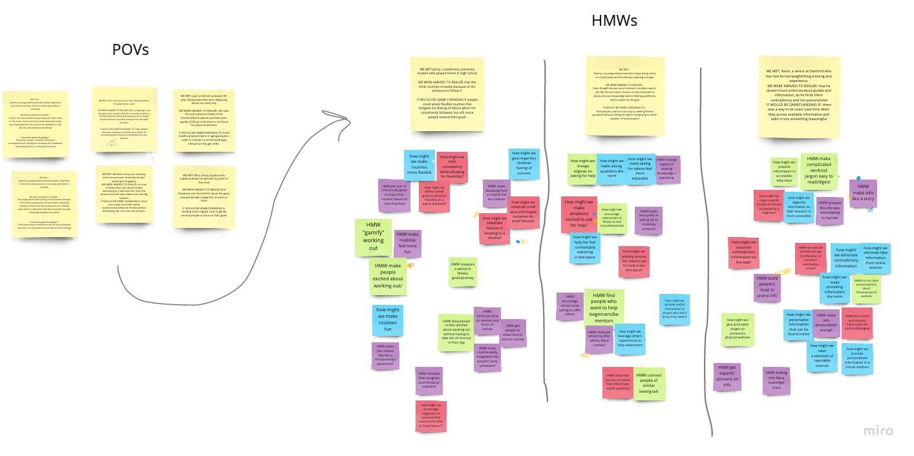
Top 3 POVs and HMW Brainstorming

Slide 52
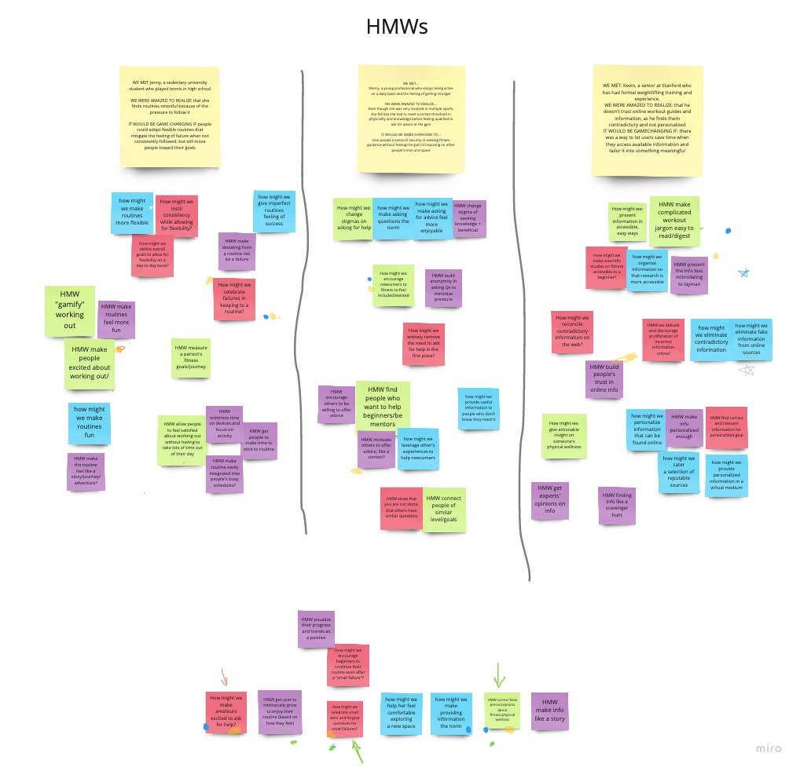
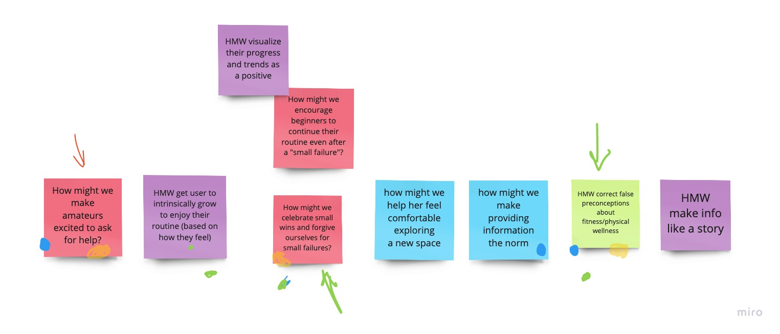
HMW Selection Process

Slide 53
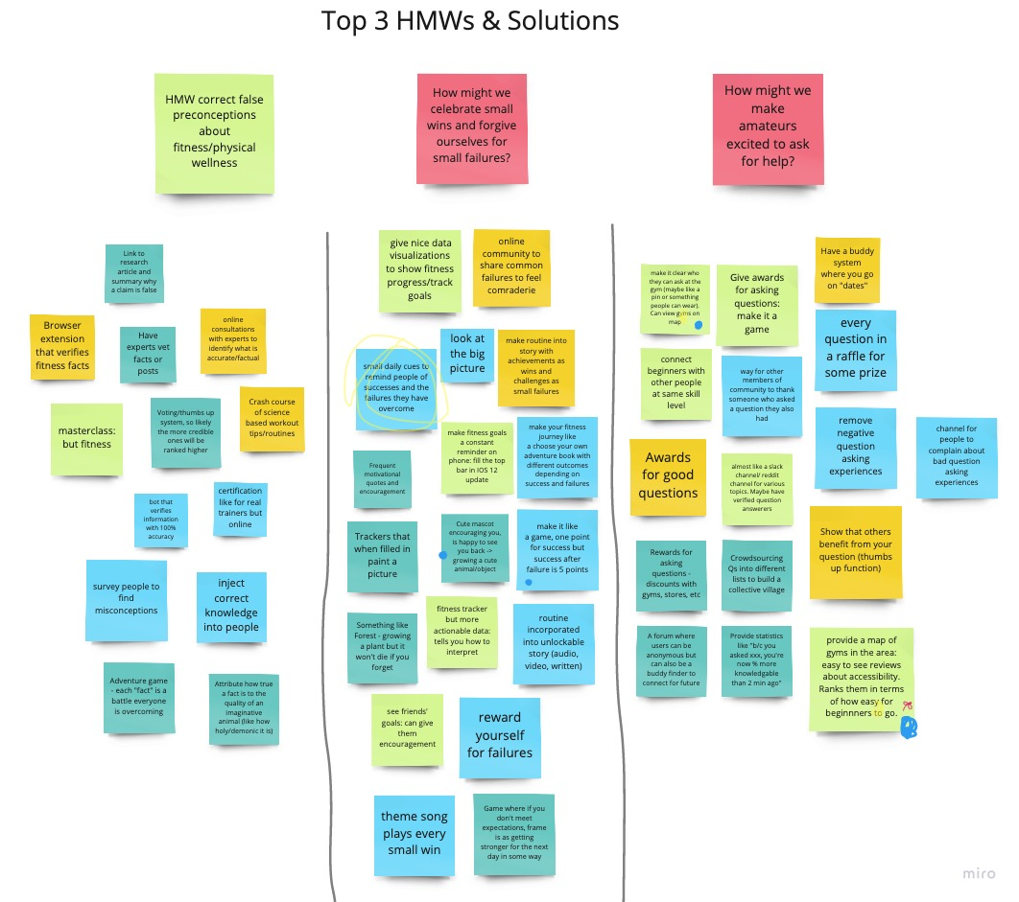
Top 3 HMWs & Solutions Brainstorming

Slide 54
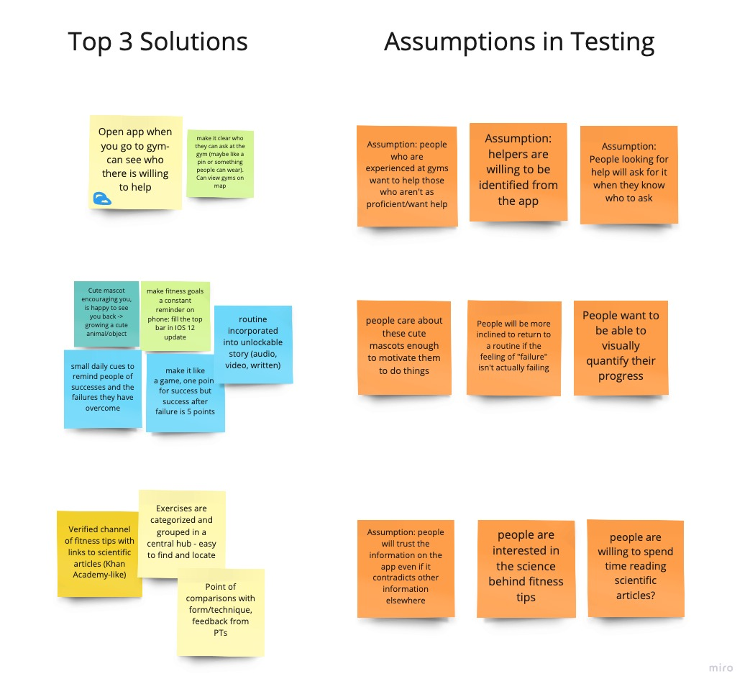
Top 3 Solutions & Assumptions

