Slide 1
Health & Wellness
Personalized Health Tracking
Caroline, Nick, Dylan, Cameron

Slide 2
Need Finding
Let's dive into our participants...

Slide 3
Balance: Average users, Extreme users, industry insiders and healthcare professionals
1
Choosing Participants
Types of Circles: We intentionally reached out beyond our own circles. 5 different time zones, 4 different countries.
2

Slide 4
Can you tell me about the most recent health goal you’ve had? [Users]
How has COVID impacted the health tracking industry? [Industry insider]
Over the last year, can you tell what action you took that was the most productive for your health and wellness? [Users]
What do you recommend to patients regarding taking care of their health on their own? Why so? [Doctor]
Questions
Have you recommended friends and family to track their health? Why? [Everyone]
Tell me what aspects of your own health you track? Why? [Users]
Walk me through your day today, what have you done that would improve your health? [Users]
From waking up to going to bed, can you tell me about the activities that trigger you to think about health? [Users]

Slide 5
Interview Insights
Let's dive into some of our interviews...

Slide 6
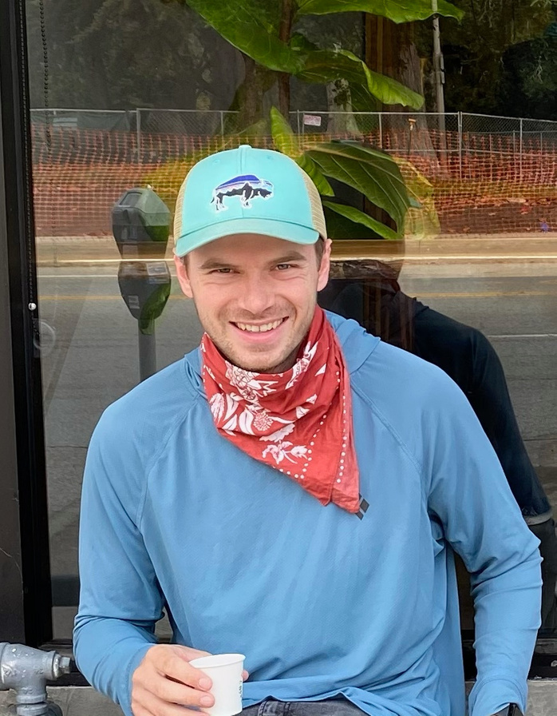
"[Garmin] gives you a rough amount of recovery you need after every activity. I rarely listen, but it is nice if you do a nine-hour day and you look at it and it tells you to take 56 hours off. You don't go and do a huge day the next day."
Andrew
Biohacker

Slide 7
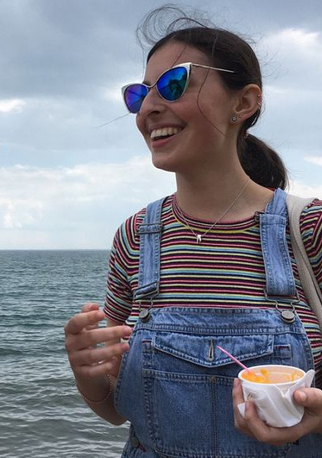
"I've reconfigured the meaning of what health means to me"
Hannah
Freelance Journalist, Toronto
(Average user)

Slide 8
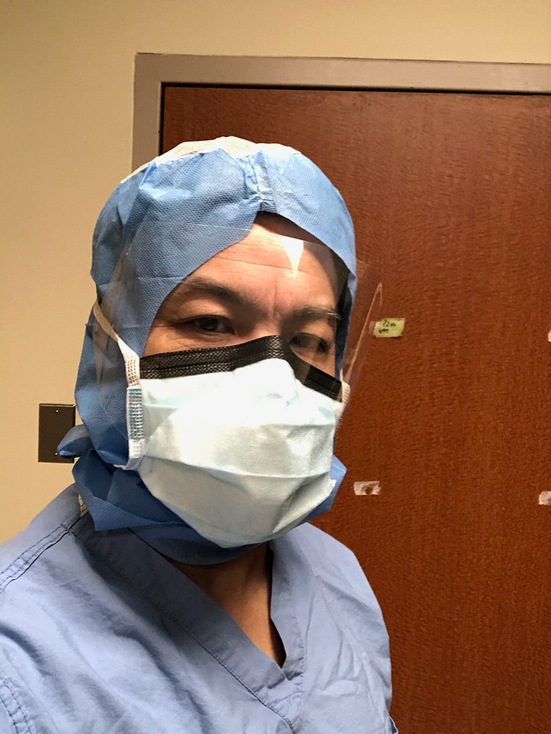
"carving out time in my schedule is the biggest obstacle - there's so much to be concerned about, I don't make an effort to track my health"
Dr. H
Doctor in Toronto, Canada
(Health care professional and user)

Slide 9
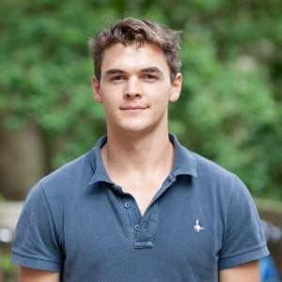
"WFH means work is always there 24/7"
Toby
(Young Professional in London, who is a biker and rower)

Slide 10
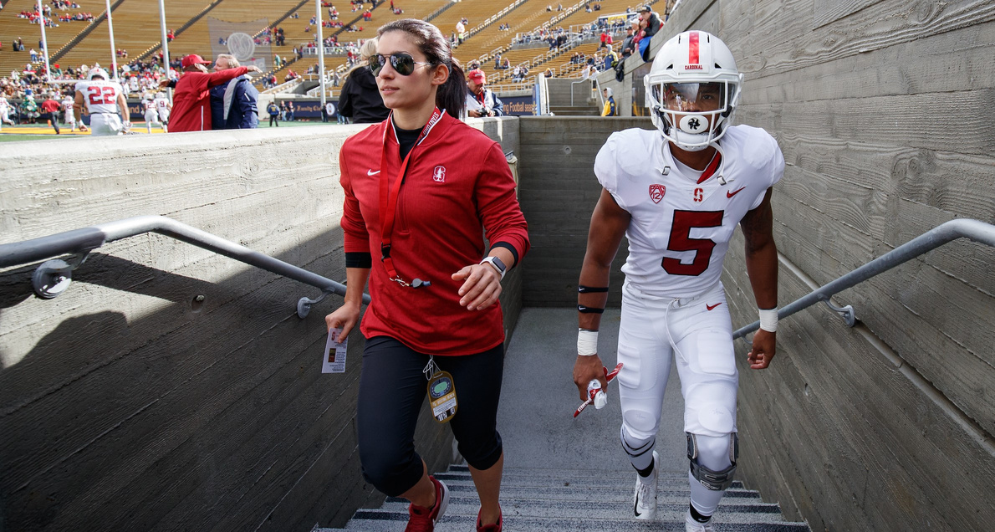
"Whoop is so nice to use that I will check the app [even though] I like the Garmin data better."
Coach C
Collegiate Strength Coach and Ex-Athlete
(Extreme User)

Slide 11

"When you wake up in the morning and you're tired, you know what you've done before you go to bed. But there's something else that clicks. When you see the actual data behind it and you see yeah, I'm feeling tired today."
Jackson
Employee at Oura Ring, Healthcare Industry insider

Slide 12
Jackson Empathy Map
Aspects of our interview that were most intriguing. From tensions to contradictions - here are the highlights.

Slide 13
Say
You should definitely consult doctors to understand your data
Has realized taking more time for personal health has made him work better
You have no idea how hard you were working when you were asleep
Associations in the small things in life can make a big difference
Seeing the data associated with how you feel makes it click.
Biohackers are dedicated to getting everything out of themselves. They are passionate and growing.
Data visualization can trigger real action
I just need to carve out time from my schedule
[Data tracking] Helps regular people with marginal improvements to improve the day
Its one thing to have data and another thing to do something with it
It's gotten very easy to be stagnant [during WFH], but we also have more freedom with time

Slide 14
Do
Wore an Oura ring only because he works there
Checks his sleep data only when he feels very tired
Trying to take a health/fitness break in the middle of his work day
Mentally tracks his sleep and its impact
He has gotten a few other friends to wear Oura rings
Doesn't check his Oura ring daily
Tries to at least take a walk or workout most days
Has started to be more conscious of his mental health and wellness
Often sits at his desk all day without any activity
Tries to change his sleep habits

Slide 15
Think
He thinks people feel safer if they have data
He seems to think that only athletes are truly justified in health data tracking.
Everyday people don't benefit much unless they know what to do with the data
He has a very humble outlook on his health
Wishes to place more value in exercise
Data tracking is becoming increasingly popular and desired
Thinks he is 7/10 healthy, but not overly concerned with health
Thinks trackers are only feasible for privileged people
Health is often individually motivated
Thinks Covid has made temperature tracking more important
People change their habits better if they have visual data
It's important for people to understand their own data

Slide 16
Feel
Feels less justified using tracker as a non-athlete/biohacker
He feels confident and knowledgeable about health
He feels guilty that understanding health data is difficult
Fatigue from work and daily tasks detracts from thinking about wellness
Awareness of day-to-day health prompts feelings of security
He enjoys seeing the cause-and-effect of his decisions
Embarrassed at the lack of exercise
Overwhelmed with many goals and areas of focus in life
Feels lazy and unmotivated in thinking about tracking

Slide 17
Insight and Need Analysis

Slide 18
Insight
An average user can't apply their health data without assistance
"People should consult doctors to talk about their health data"
Need
Health data needs to be easily understandable with recommended actions

Slide 19
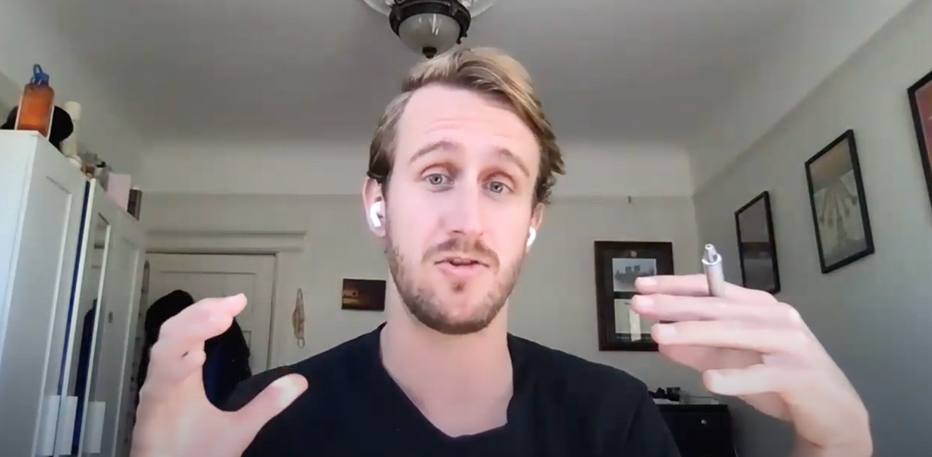
Insight
Although people care about their long-term health, most people only check in with their health when they feel tired or sick
Need
It would be game-changing to incentivize people to become more proactive with their health

Slide 20
Insight
Health data is more available than ever before but people still prioritise how they feel qualitatively
Need
People need to be able to personalize health data with qualitative information for better insights.

Slide 21
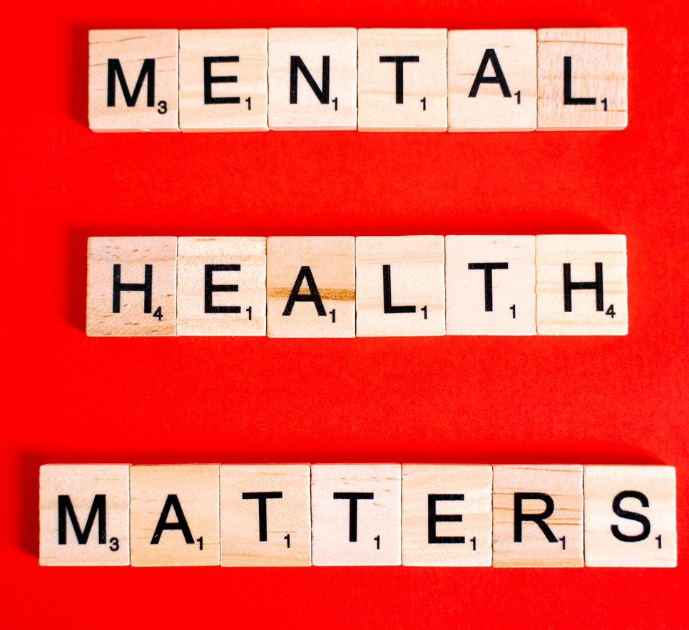
Insight
Health data focuses on physical performance. However, people care equally as much about their mental performance and health
Need
It would be transformative to track information related to mental performance and health in addition to physical performance and health

Slide 22
Insight
COVID has permanently disrupted people's environment and structure which are pivotal to maintaining their health and wellness
"My work desk and bed are 1 metre apart"
Need
People need structure and environment to balance their work and life and to improve their health and wellbeing

Slide 23
1
COVID
Summary
COVID has fundamentally changed people's environments and structure strongly affecting their health and wellbeing
What did our need finding show us?
2
PERSONALIZED
Health and wellbeing changes are deeply personal and generic advice is insufficient to change habits
3
APPEALING AND ENJOYABLE
Health and wellbeing products are time-intensive, to get users on board there is a premium on positive engagement and design

Slide 24
Questions?

