Slide 1
Personal Health Tracking

Slide 2


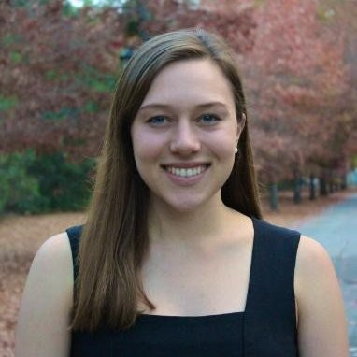
Hello!
Nick M.
Dylan P.
Caroline F.

Slide 3
WEEK 1 POV

Slide 4

We met Jackson, a scientific 20-something man and employee at a health-tracking wearable company, who feels guilty and sheepish that quantitative health data is generally uninterpretable and inactionable.
We were amazed to realize that although his health data was more available to him than ever before, he still prioritized how he felt qualitatively. It would be game changing to provide Jackson a way to personalize health data with qualitative information for better insights.

Slide 5
Additional Needfinding

Slide 6
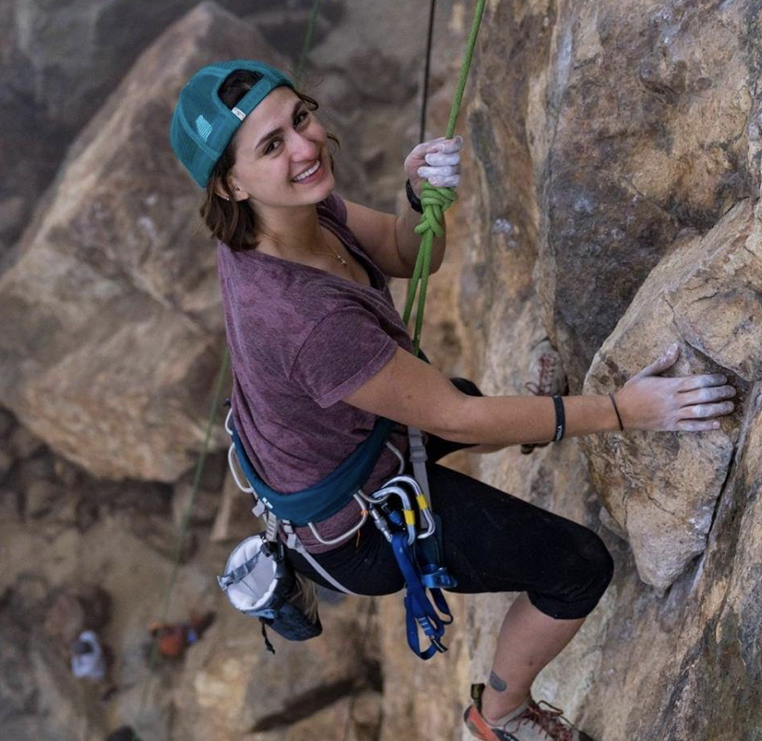

Focus on Interview Diversity
Bree
Budget-conscious vegan
Liz
60-something woman

Slide 7
Bree
> Adventurous
> Budget-conscious
> Vegan
Frightened that she may revert to obsessively focusing on body image
Finds comfort in the community of Crossfit culture.
Feels powerful during unstructured, outdoor exercise

Slide 8
Liz
> Humble & honest
> Irish
> Middle-aged mom
Wants to continue to fit into her non-stretch all-cotton jeans
Feels disappointed that gyms do not cater to her demographic
Is decidedly not motivated by numbers

Slide 9
Liz
“
Running a 5k in x amount of time means nothing to me.

Slide 10
Revised POVs

Slide 11
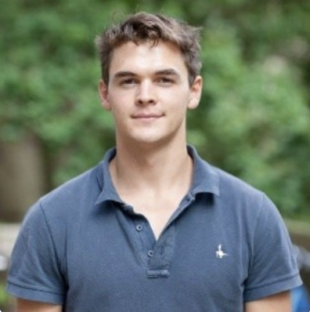
We met Toby, a 24 year old in finance who has been working from home for nearly a year.
We were amazed to realize he missed the structure that office life and a gym provided and work now seeped into every aspect of his life.
It would be game changing if Toby did not need the structure or environment from a physical space to improve his health and wellness.
Notes:
Selected HMWs for Notes:
HMW help employees advocate for their own personal health without appearing to shirk work responsibilities?
HMW separate work space and home space with WFH?
HMW help people to build an environment around them that prioritizes their health and wellness?

Slide 12
Sample of HMWs
HMW help employees advocate for their own personal health without appearing to shirk work responsibilities?
HMW separate work space and home space with WFH?
HMW help people to build an environment around them that prioritizes their health and wellness?

Slide 13
We met Liz, a humble mom who wants to continue to fit in her non-stretch all-cotton jeans.
We were amazed that although Liz scoffs at creating numeric fitness goals, she still seeks motivation to feel good and wants to make sure she is staying on track.
It would be game changing to motivate people like Liz without numbers and track their progress qualitatively.

Slide 14
Sample of HMWs
HMW illustrate how the data relates to subjective feelings?
HMW make health data feel like it's not just for biohackers?
HMW provide and highlight the data that truly matters?
Notes:
Selected HMWs for Notes:

Slide 15
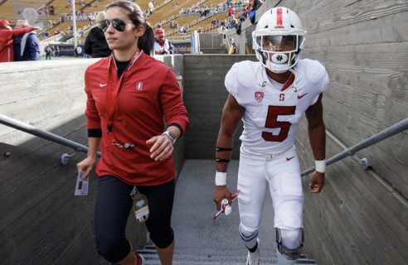
We met Coach C, a Millenial strength coach and ex-athlete who is an extreme user of wearable tracking tech.
We were amazed to realize even though she has deep knowledge about the data, she gravitated toward the tech with the sleekest design and most enjoyable user experience.
It would be game changing to combine Coach C’s most important data with enjoyable, inspiring design.

Slide 16
Sample of HMWs
HMW create an interface that people will use for sheer enjoyment?
HMW give nonathletes a goal-oriented, health-focused community that encourages wellness?
HMW make complex health data applicable for everyone?
Notes:
Selected HMWs for Notes:

Slide 17
HMWs

Slide 18
POV 1
We met Toby, a 24 year old in finance who has been working from home for nearly a year. We were amazed to realize he missed the structure that office life and a gym provided and work now seeped into every aspect of his life. It would be game changing if Toby did not need the structure or environment from a physical space to improve his health and wellness.
HMW help people to
create an environment and community
around them
that prioritizes health and wellness?

Slide 19
POV 2
We met Liz, a humble mom who wants to continue to fit in her non-stretch all-cotton jeans. We were amazed that although Liz scoffs at creating numeric fitness goals, she still seeks motivation to feel good and wants to make sure she is staying on track. It would be game changing to motivate people like Liz without numbers and track their progress qualitatively.
HMW make personal health data approachable and actionable for non-athletes?

Slide 20
POV 3
We met Coach C, a Millenial strength coach and ex-athlete who is an extreme user of wearable tracking tech. We were amazed to realize even though she has deep knowledge about the data, she gravitated toward the tech with the sleekest design and most enjoyable user experience.It would be game changing to combine data with enjoyable, inspiring design.
HMW redesign personal health data to be enjoyable and inspiring?

Slide 21
Solutions &
Experience Prototypes

Slide 22
HMW help people to
create an environment and community
around them
that prioritizes health and wellness?

Slide 23
Solution
Assumption
Create a personal health tracking system which businesses can provide to employees that aims for long-term wellness and productivity.
Businesses are willing to pay for personal health tracking app that might sometimes suggest long-term health outcomes at the expense of short-term work deadlines.

Slide 24
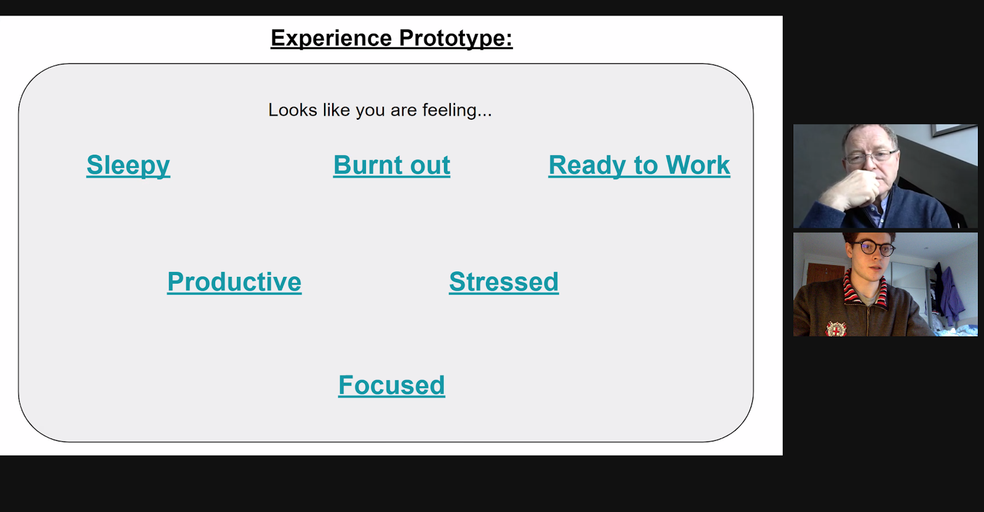
Experience Prototype 1
We created an interactive slide deck where the user could click between slides to understand how they may solve their health problem, and we pitched it to a business owner.

Slide 25
Results
What worked
The interface prompted more grounded conversation, especially for someone less experienced with technology.
What didn’t
The linked-slides interface was confusing for the user.
Surprises
The Employer would see value in anonymised overview of employee health!
We would need to provide not just data but how to use data (self-help systems etc..).

Slide 26
Learnings
Validity
New Assumptions
Employees don’t mind being tracked by employer
Even within best businesses, some middle managers won’t be responsive to employees
Businesses are willing to pay for an employee using a health tracking app
Employees desire personal health tracking app from their employer
A self-help system is useful for smaller companies

Slide 27
Learnings
Validity
New Assumptions
Employees don’t mind being tracked by employer
Even within best businesses, some middle managers won’t be responsive to employees
Businesses are willing to pay for an employee using a health tracking app
Employees desire personal health tracking app from their employer
VALID...ish
A self-help system is useful for smaller companies

Slide 29
HMW make personal health data approachable and actionable for non-athletes?

Slide 30
Solution
Assumption
Gamify tracking health and wellness for yourself and your personal community
People won’t consider their mobile gaming time as onerous health-tracking

Slide 31
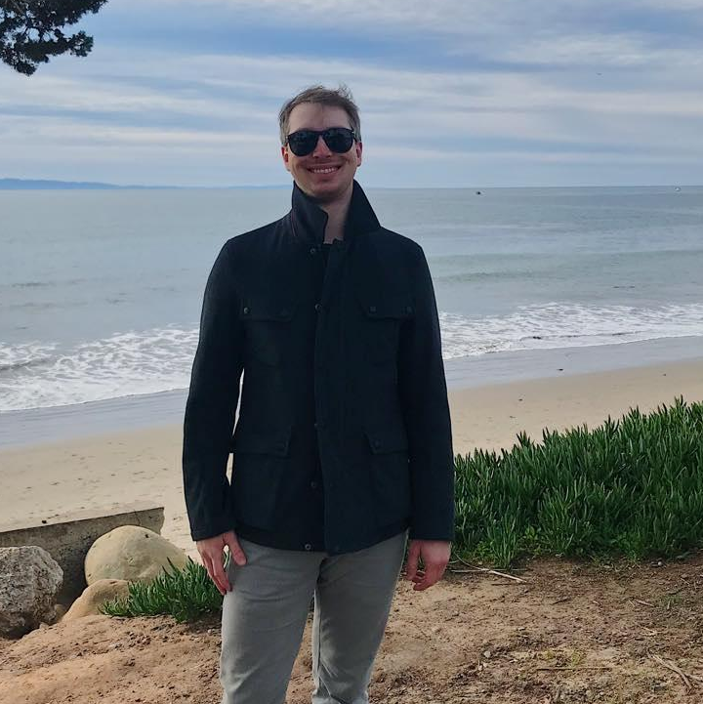

Experience Prototype 2
We played a role-playing game via phone with our interviewee by telling him to imagine he was part of a story in which he had decided to trying to run more and eat more vegetables.

Slide 32
Results
What worked
A treasure chest was novel enough to get an unmotivated person out of bed and tracking a workout!
The social and teams component made it feel more compelling.
What didn’t
Our interviewee was not interested in inputting anything related to his diet, at least how we structured it. It still felt like work.
He didn’t like the idea of competing with people fitter than him.
Surprises
The possibility of meeting new, random people similar to you is fun and interesting and a reward in itself.
The interviewee did not consider the running game to be a health tracking application at all.

Slide 33
Learnings
Validity
New Assumptions
People won’t consider their mobile gaming time as onerous health-tracking
People want to compete when there’s a chance they can win
We successfully gamified exercise, but not with diet
People can be motivated to track their exercise with gamification.
He wanted to exercise with people like him

Slide 34
Learnings
Validity
New Assumptions
People won’t consider their mobile gaming time as onerous health-tracking
People want to compete when there’s a chance they can win
We successfully gamified exercise, but not with diet
VALID...ish
People can be motivated to track their exercise with gamification.
He wanted to exercise with people like him

Slide 36
HMW redesign personal health data to be enjoyable and inspiring?

Slide 37
Solution
Assumption
Create a personal health app for non-biohackers to improve wellness and functional ability over the long term. Include specific benchmarks for all user ages and abilities with the goal of improving quality of life as they age.
People who aren't biohackers would be more dedicated to their wellness if they had individualized benchmarks and long-term goals to pursue, with guidance on how to get there.

Slide 38
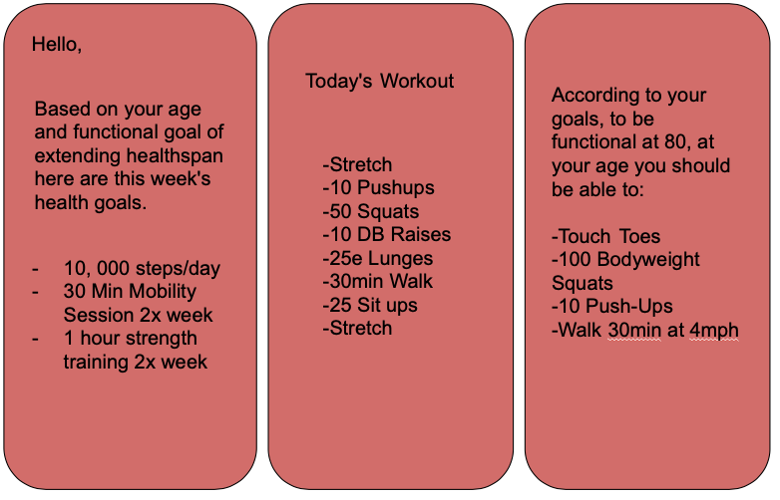
Experience Prototype 3
We created a set of "screenshots" that provide the user with customized wellness goals and plans for how to get there.

Slide 39
Results
What worked
They liked having an individualized plan to follow that they didn't have to think about.
What didn’t
They wanted to be sure the specifics of their age and ability would be reflected. They also wanted markers for short term progress shared.
Surprises
Most people in the non-athlete demographic aren't actively seeking fitness apps, and often think they're fit enough for their current life.

Slide 40
Learnings
Validity
New Assumptions
People who aren't biohackers would be more dedicated to their wellness if they had individualized benchmarks and long-term goals to pursue, with guidance on how to get there.
People aren’t aware they need a health tracking app
This solution is valid, but it must marketed very well to create interest in the non-biohacker demographic.
People will only be satisfied with very personalized recommendations

Slide 41
Learnings
Validity
New Assumptions
People who aren't biohackers would be more dedicated to their wellness if they had individualized benchmarks and long-term goals to pursue, with guidance on how to get there.
People aren’t aware they need a health tracking app
This solution is valid, but it must marketed very well to create interest in the non-biohacker demographic.
People will only be satisfied with very personalized recommendations
VALID

Slide 42
Solution

Slide 43
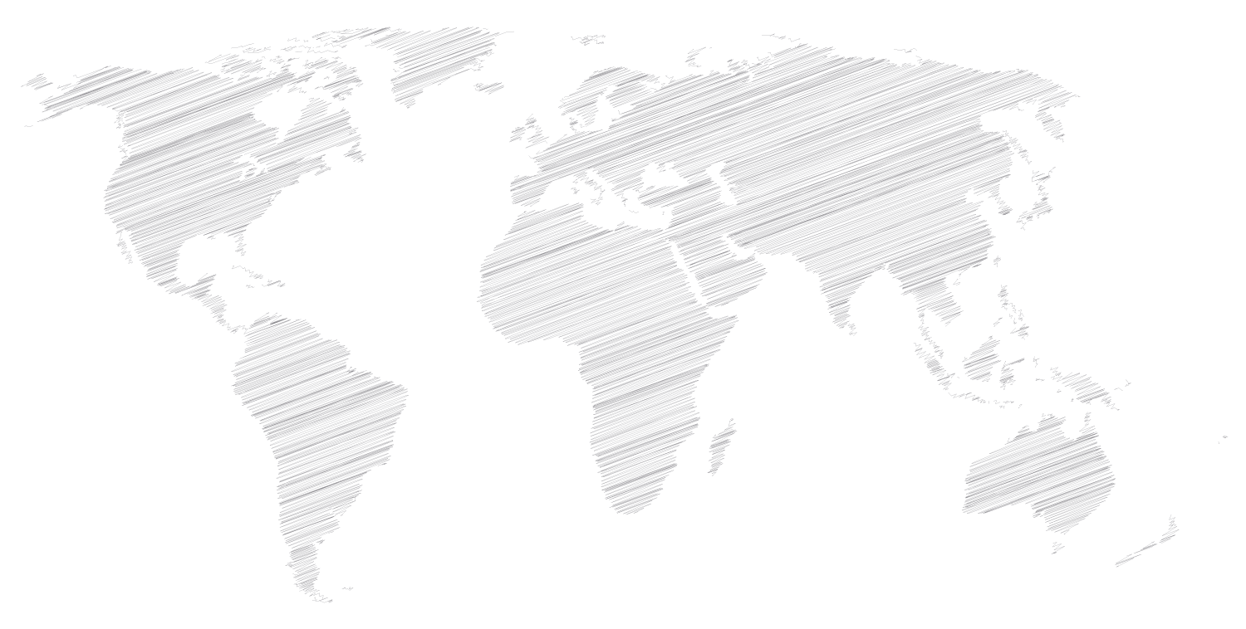
Solution
We want to create an inspiring system to improve the health and wellness of those who aren't in targeted populations, like athletes or biohackers.
We want to build a game that includes community and lifestyle-based goals to motivate action for real people, improving real lives.
Notes:
Creating a social game to promote health and wellness tracking for yourself and your community
Gamification increases motivation to do exercise --- allows people to explore local areas, interesting APIs if we go down this route
Well-regulated health social communities for exercise are hard to discover for nonathletes, 40+ years olds - tend to be very competitive and intimidating

Slide 44
SUMMARY

Slide 45
Summary
Key learnings
> Gamifying a difficult task can make it feel more like fun and less like work.
> Non-athletes aren't motivated by the same things as usual users of wearable tech. The tech must be enjoyable, inspiring and inclusive. They also have different goals.
> The feeling of belonging to a community is motivating, especially in health and wellness.
Next steps
Research on other apps around the gamification of exercise
Brainstorming more innovative ways to reward movement
Motivation
The possibility of making people healthier through exercise is an incredibly worthy goal.
We want to focus on how to help people move more without having to obsess over numbers.
Gamification for the sake of gamification won’t work: we need truly innovative and inspiring ways to make exercise not feel like exercise.

Slide 46
Thanks!
Any questions?

Slide 47
Credits
Our great and very patient interviewees who really emotionally opened up about a very sensitive topic: personal health.
Slide Carnival for the starter formatting for the deck,, used under the Creative Commons Attribution license

