Slide 1
Fitcoin
Medium-Fi Prototype

Slide 2



People
Nick M.
Dylan P.
Caroline F.

Slide 3
Value Proposition:
Fun Fitness for All!
Problem:
People can’t sustain their healthy exercise habits. Unmotivated by arbitrary health goals, people find exercise monotonous and chore-like.
Solution:
Our solution is to gamify fitness so it’s accessible and sustainable for all people by providing communities and fun activities.

Slide 4
Tasks
Simple Task: Find a Fitcoin
Medium Task: Connect with your Community
Complex Task: Spend Coins on a Reward

Slide 5
Design Changes

Slide 6
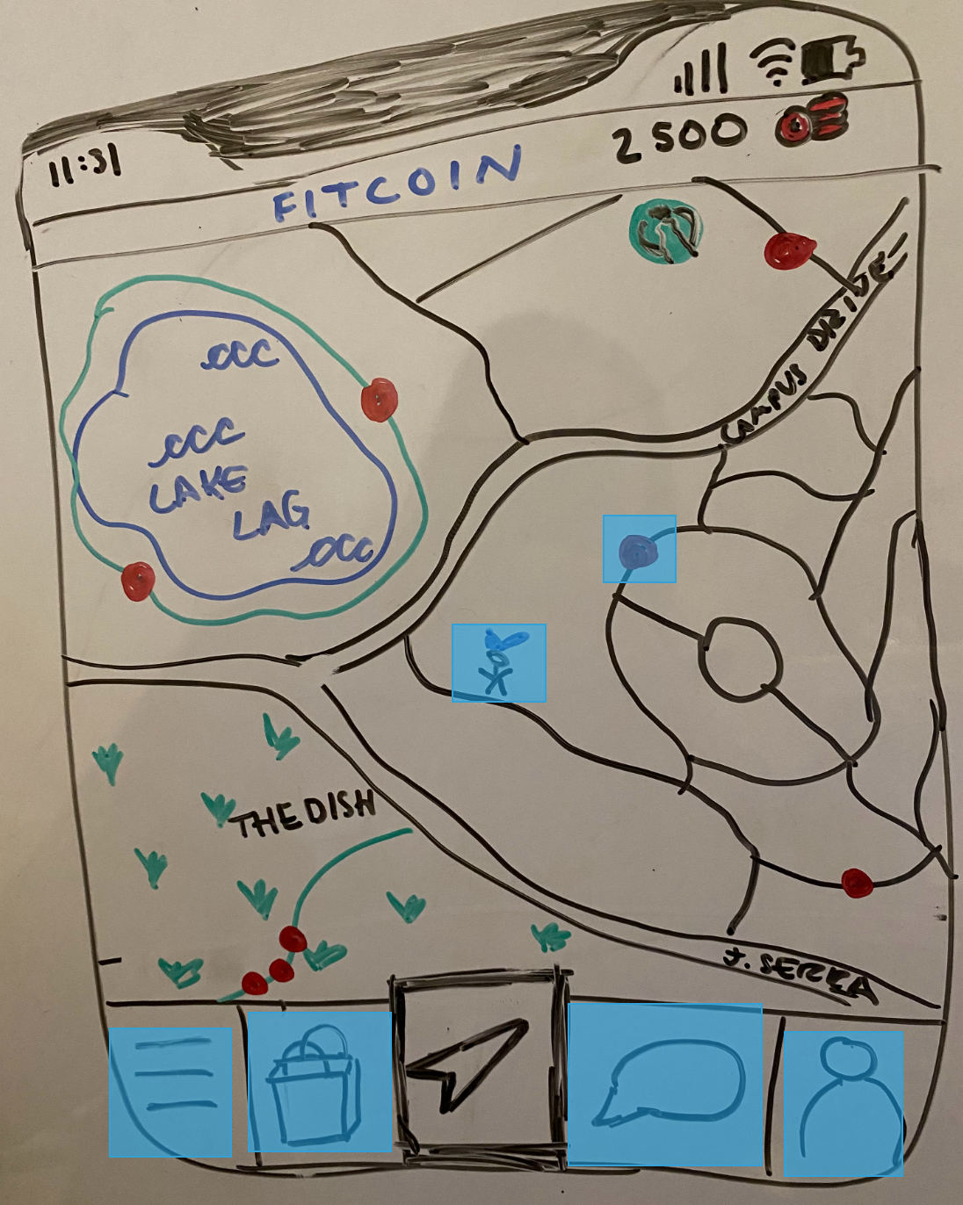
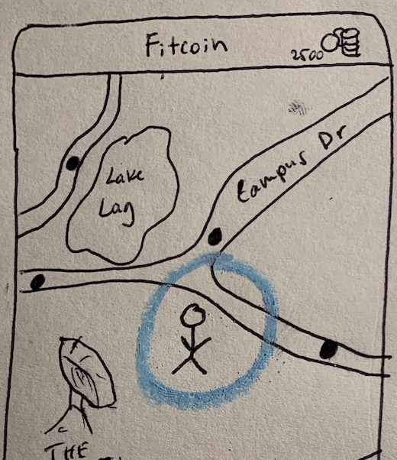
Centering the User on the Map
In the past, the characters on the map were only other people, and the user itself wasn't shown on the map. Now the user is centered on the map.
Rationale: We wanted to emphasize the importance of the user's location on the map and make clear who is the user and who are other characters.
OLD (Random Person Circled)
New (User Circled)

Slide 7
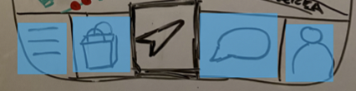
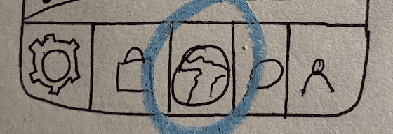
Home/Map Icon
The center icon that navigates to the home map was changed from a location arrow to a world icon.
Rationale: Previous users had assumed the icon was for directions, leading to confusion over the purpose of the page. The world represents the map without the implied direction function.

Slide 8
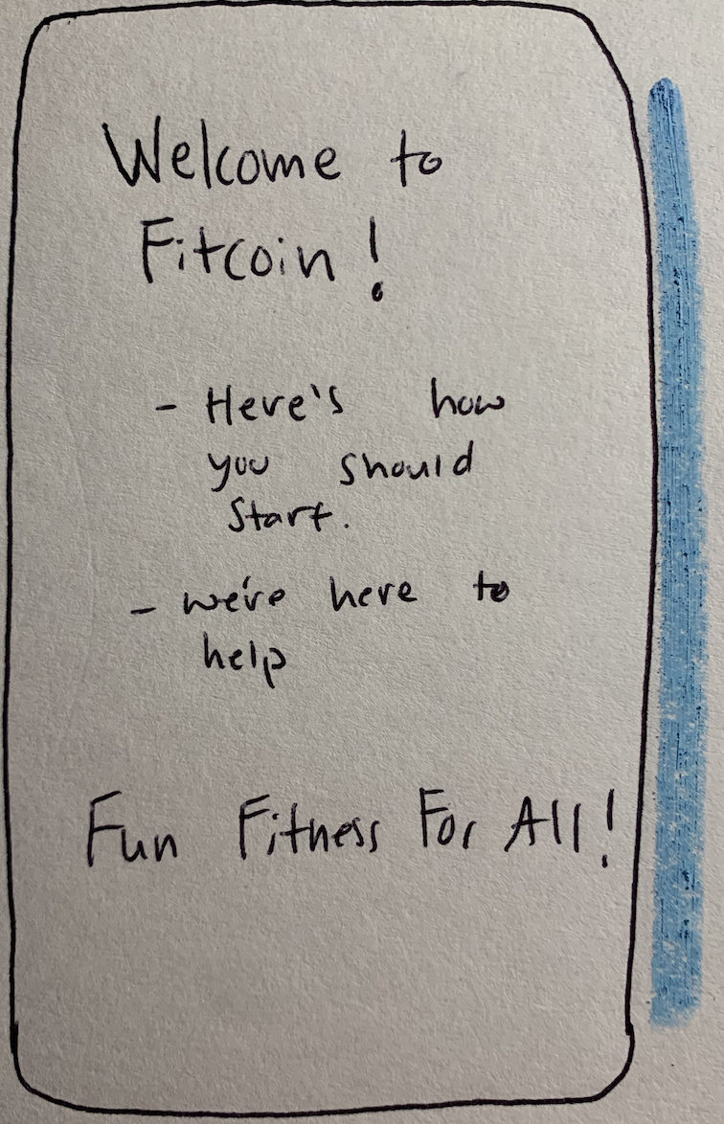
Onboarding
We added a completely new onboarding screen when the user first downloads the app to explain the functionality and some of the complex parts of the app, like augmented reality and rewards.
We didn't have an old interface to compare - we just would've opened to the map in the past.
Rationale: The conceptual basis of our app was confusing to some users, so by walking through onboarding we remove this barrier to entry.

Slide 9
Medium-Fi Task Flows

Slide 10
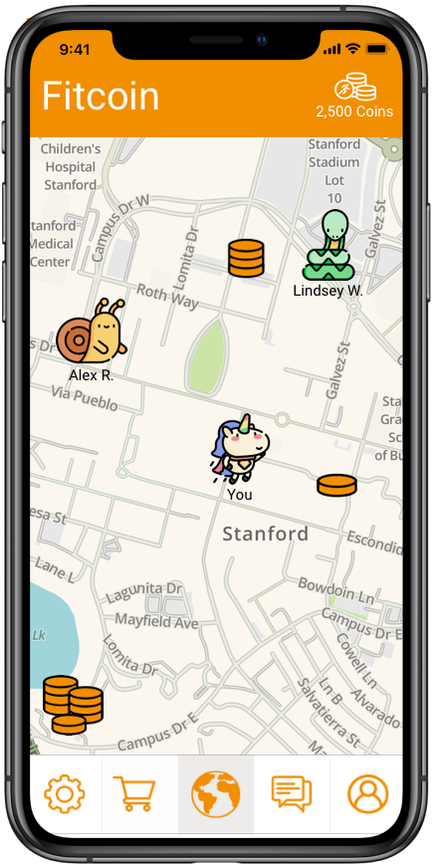
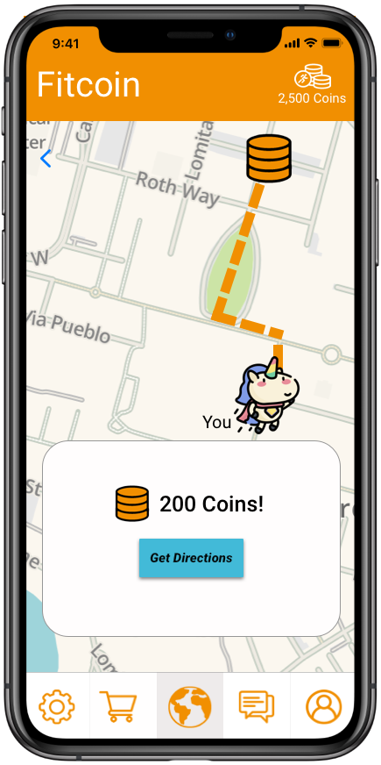
Simple Task: Find a Fitcoin
Notes:
-All Coins on the map are similarly interactive. Different sized stacks of coins contain different numbers of coins. The basic coins are populated individually for each user based on location.

Slide 11
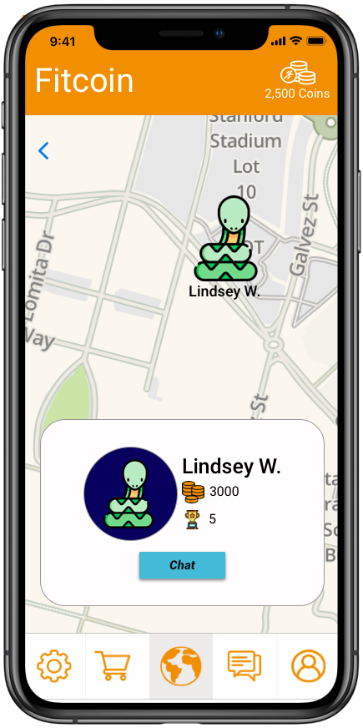
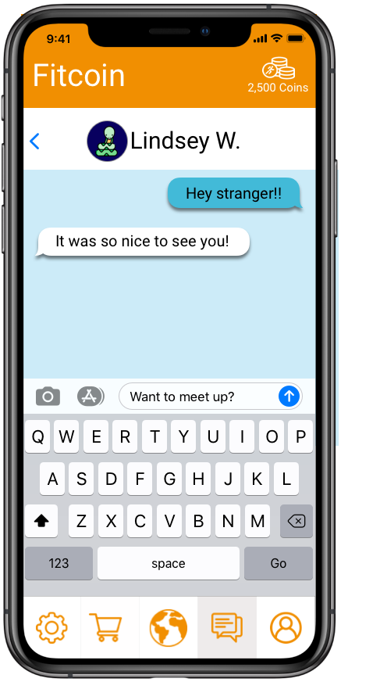
Moderate Task: Connect With Community
Notes:
-To be able to converse with a stranger and see their name/location you would have to be accepted as a friend by the other user.

Slide 12
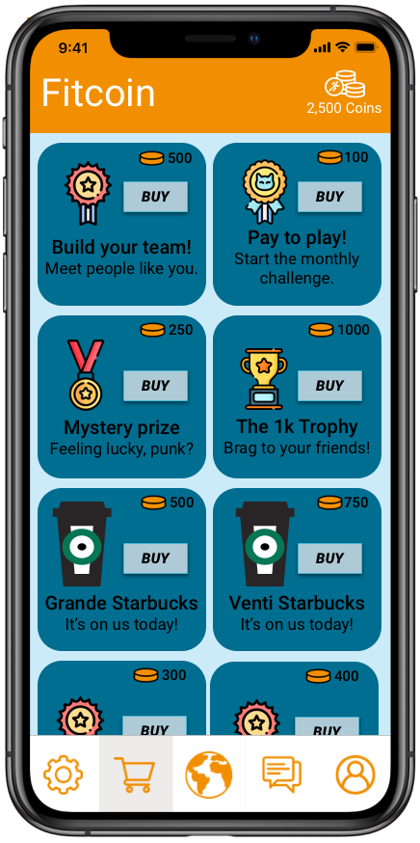
Complex Task: Spend Coins on a Reward

Slide 13
Prototype Overview

Slide 14
Tools
Sketch to iterate on designs of symbols, icons and pages
Figma to present the linked prototype
Slack to share and critique designs
Pros
Sketch was easily to download and install
Sketch responds quickly to moving around large pieces of media
Sketch is relatively intuitive
Previously used Sketch
Figma was intuitive and more flexible than Invision
Cons
Sketch is difficult to share and get feedback on different designs since it is desktop based
If previously tested Sketch, difficult to test it out again due to 30 day policy
Invision’s presentation was more impressive-looking than Figma’s

Slide 15
Limitations & Tradeoffs
We don’t know where our tester is, so we had to hardcode the map and location. We believe this could be a potential place for confusion, since we rely heavily on the user understanding it is an augmented reality game. We pretend the user knows to walk to the coins, without our map depicting that they are walking to the coins.
Hitting the back button doesn’t always go back to the page the user was previously on, since we don’t really know where the user is coming from. For example, using the back button in a chat with an individual will always bring you back to the Messages screen.
Some parts of the application, like the Rewards or Messages, may look scrollable; although we didn’t implement scrolling, we think the tester can imagine the continuation of the list on the page.

Slide 16
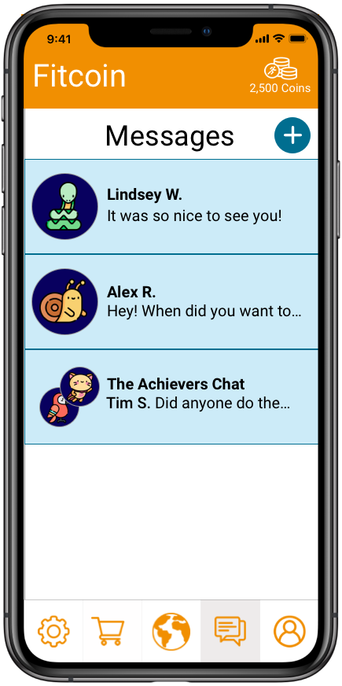
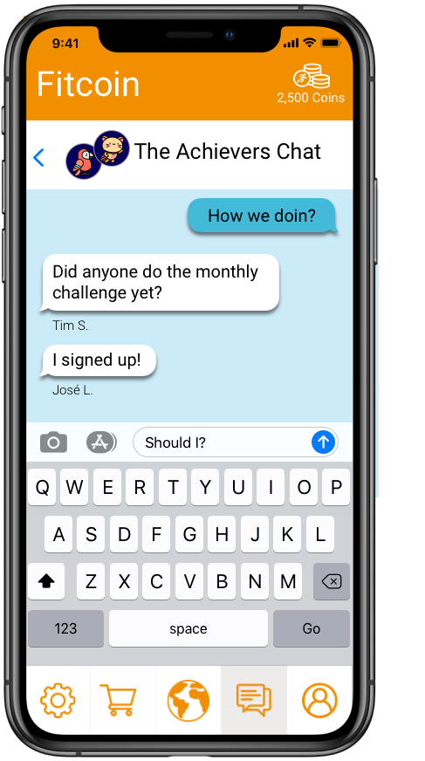
Wizard of Oz Techniques & Hardcoding
The only Wizard of Oz techniques we used involved hardcoding the Map/Location features and Messages.
Hardcoding: The user location and map were hardcoded to replicate our tracking functionality. Messages were hardcoded in to show design and function.

Slide 17
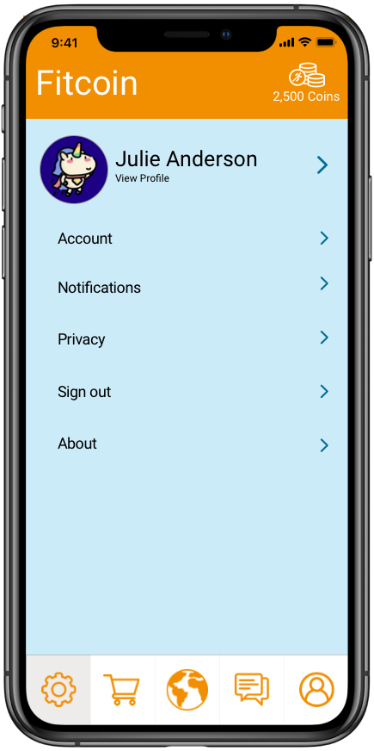
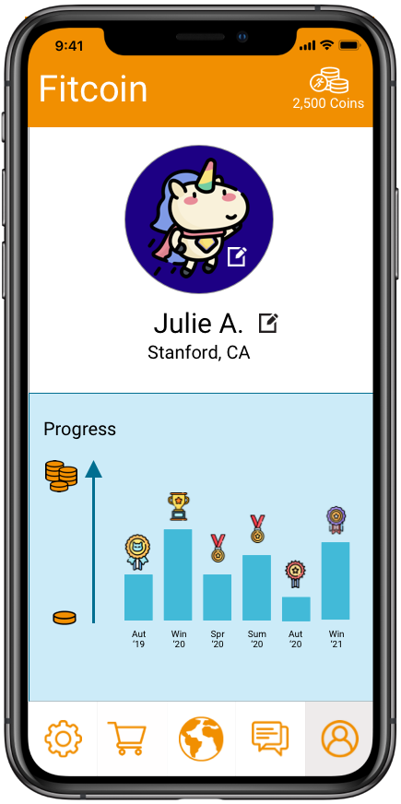
Appendix: Other Prototype Screenshots
Settings
Messages
Group Chat
Profile & Progress

Slide 18
Appendix
Medium-fi prototype link
Figma in application presentation mode: https://www.figma.com/proto/3clRPZwJQ9btxqjFdXxltL/Fitcoin%3A-Medium-Fi-Prototype?node-id=1%3A9&scaling=min-zoom
Figma in map mode: https://www.figma.com/file/3clRPZwJQ9btxqjFdXxltL/Fitcoin-Medium-Fi-Prototype?node-id=0%3A1

