Slide 1
InvestEd – Prototype Midway Milestone
Leonardo Jimenez, Eric Zhou, Jestin Ma, Godsfavour Simon

Slide 2
InvestEd Overview
Problem and Solution: Making your first investment is extremely daunting. There are many barriers to entry including social, economic, emotional, and mental. InvestEd helps like minded individuals come together and overcome these barriers by learning from investors that they can personally relate to.
Value Proposition: InvestEd creates a social ecosystem related to investing and finance, which allows people to learn about financial topics from each other. In addition to learning, people can become more excited about investing by sharing their investments with their friends.

Slide 3
Heuristic Evaluation and Design Revisions

Slide 4
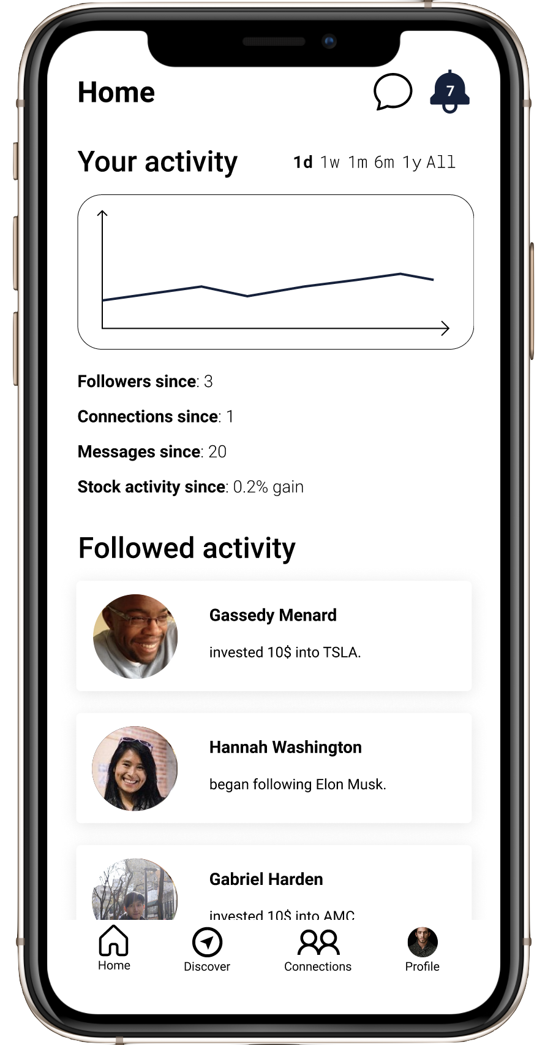
Problem: Number of notifications is not the same on the notifications screen
Solution: Fix the inconsistency
Problem: The headings are unclear and repetitive
Solution: Modify headings (“Since you have been gone”, “Updates”)
Problem: The chat button is only present at the top of the home page.
Solution: Add it to the bottom navigation bar.

Slide 5
Problem: No help/documentation available
Solution: Add a help page, accessible from the home page
Problem: Profiles in home page feed are not clickable
Solution: Make activity in the feed link to other profiles
Problem: Users want to know if activity they are seeing is from connections or people they follow
Solution: Add a tag identifying other users in the feed
Problem: People may not want to share the exact amounts they’re investing
Solution: Add privacy settings so users can modify this

Slide 6
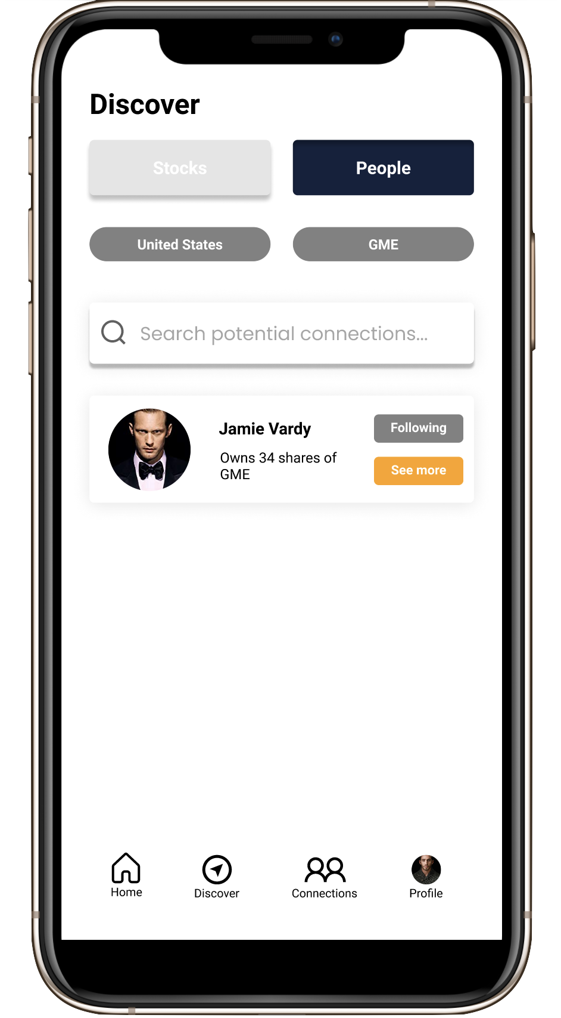
Problem: Initially, unclear that you must pick filters before being shown other users
Solution: Add a message indicating this
Problem: The following button goes from navy to gray when clicked, which is different from other buttons
Solution: Make all button colors consistent
Problem: Initially, presence of search bar is confusing
Solution: Hide search bar until users have chosen filters
Problem: Users can’t unfollow others easily if they accidentally follow them
Solution: Add an unfollow button

Slide 7
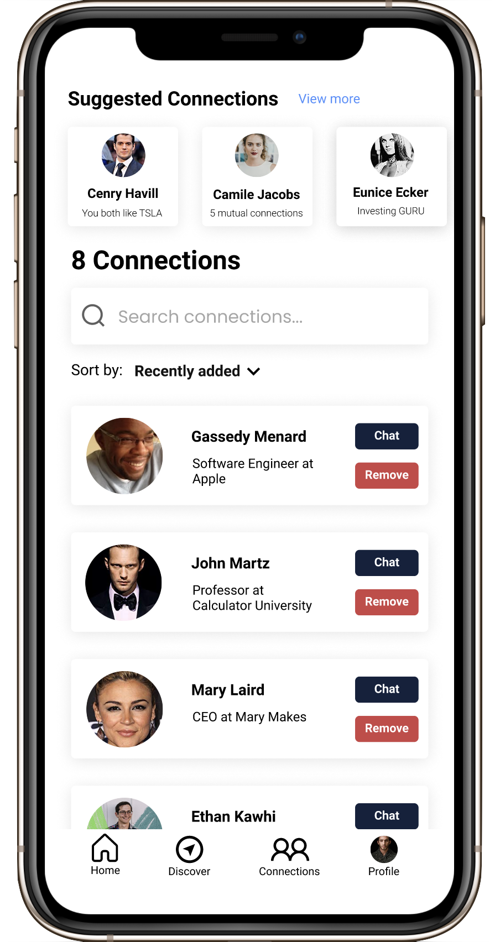
Problem: The distinction between “following” and “connections” is unclear
Solution: Offer documentation explaining the difference
Problem: After attempting to remove a connection, it is unclear if this was done
Solution: Add a message that a connection was successfully removed

Slide 8
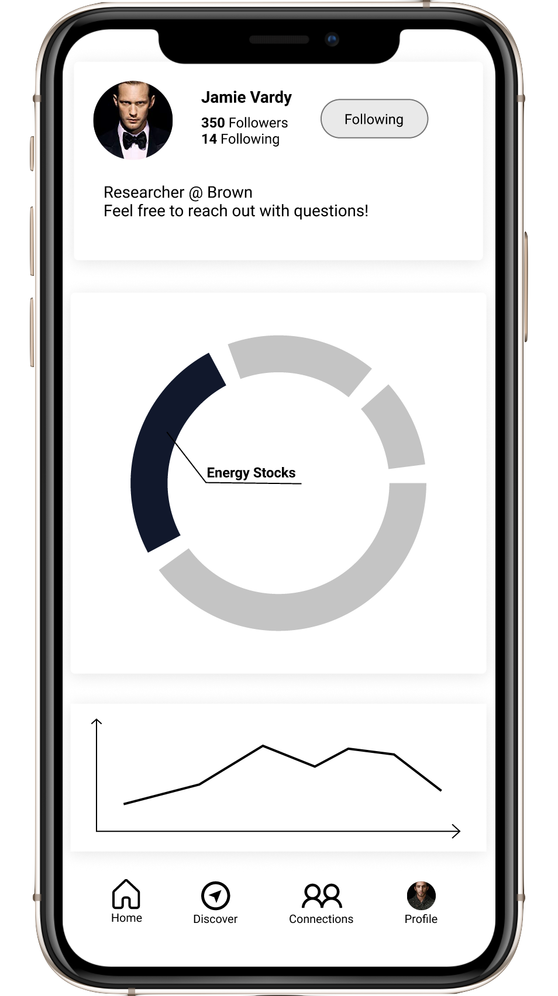
Problem: Users cannot return to the discover page after viewing someone’s profile
Solution: Add a back button
Problem: The pie chart representing someone’s portfolio is unclear
Solution: Add labels, colors, and percentages to make the portfolio breakdown clear

Slide 9
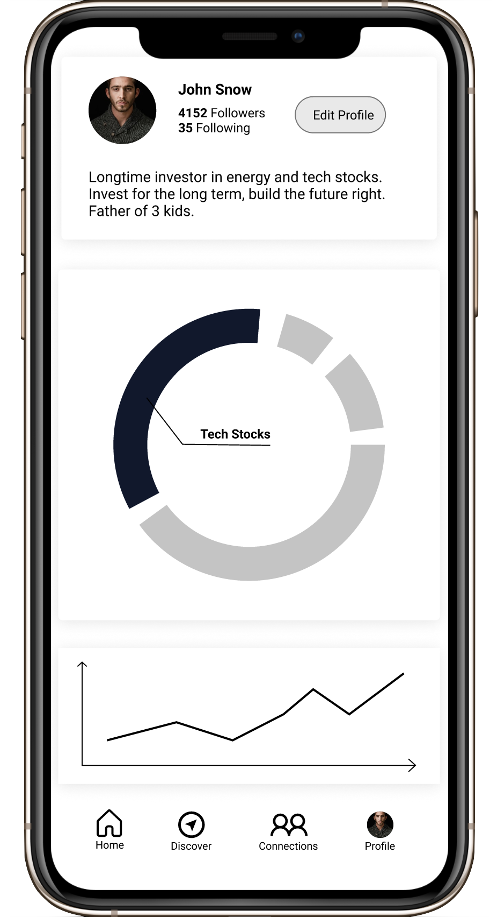
Problem: Users can’t see who they are following
Solution: Make the “following” information on one’s profile clickable, leading to a page where users can see who they follow
Problem: Users can’t unfollow other users
Solution: Add an unfollow button on the screen where users can see who they follow
Problem: Users don’t know which tab they are on
Solution: On the bottom navigation bar, indicate which tab is currently being viewed with colors or shading

Slide 10
Prototype Implementation

Slide 11
Prototype Overview
Tools we are using:
  Set up a React Native repository on Github
  Using Expo v40
  Navigation set up using React Navigation 5
Work division:
  According to expertise
  By tasks
Limitations:
  Hard-coded mock users using json objects
  Data isn’t stored between sessions

Slide 12
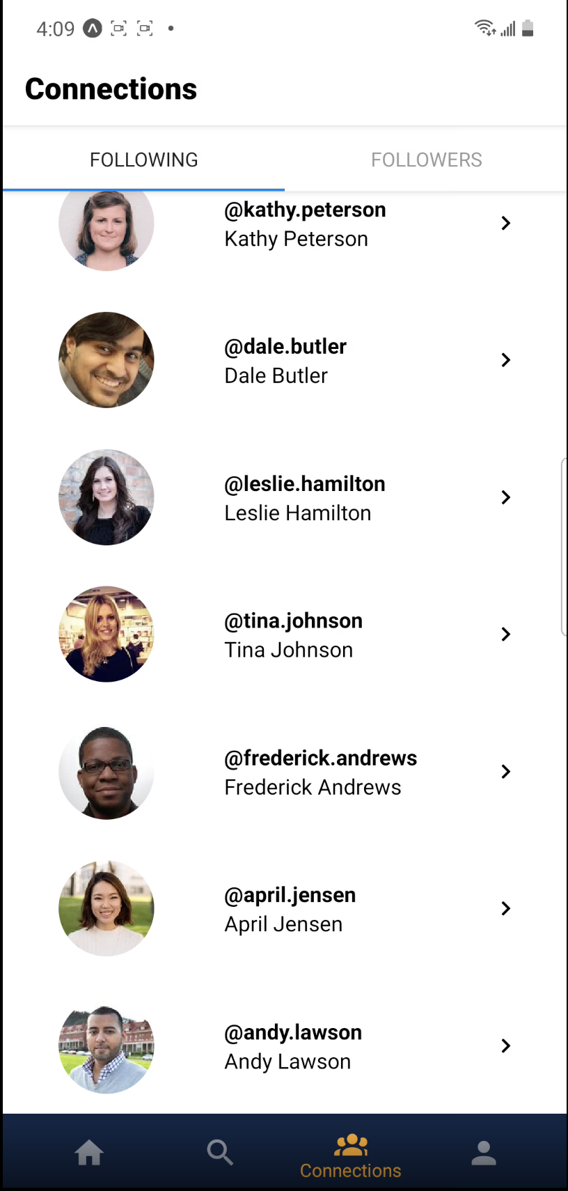
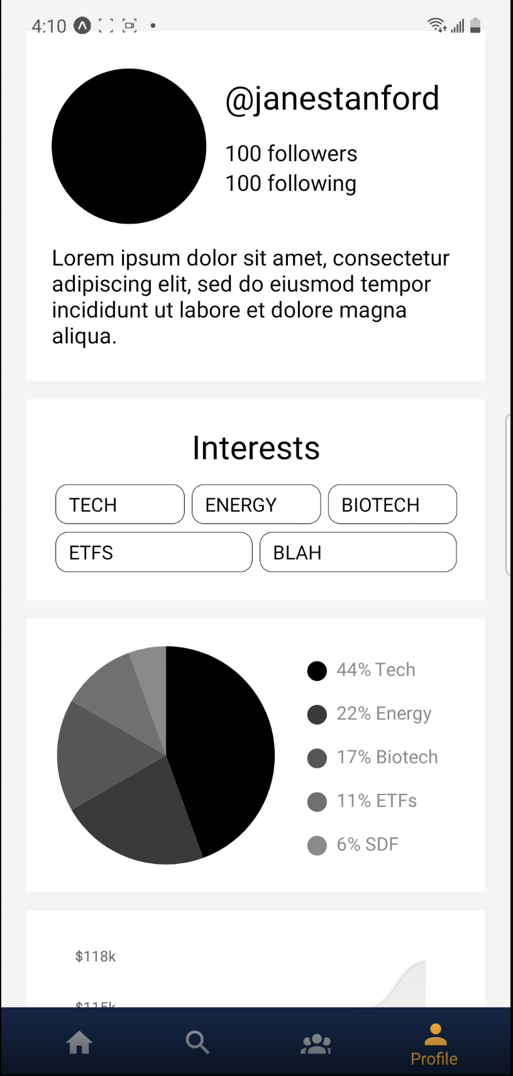
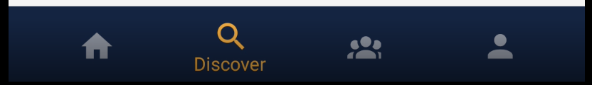
What is Done So Far

Slide 13
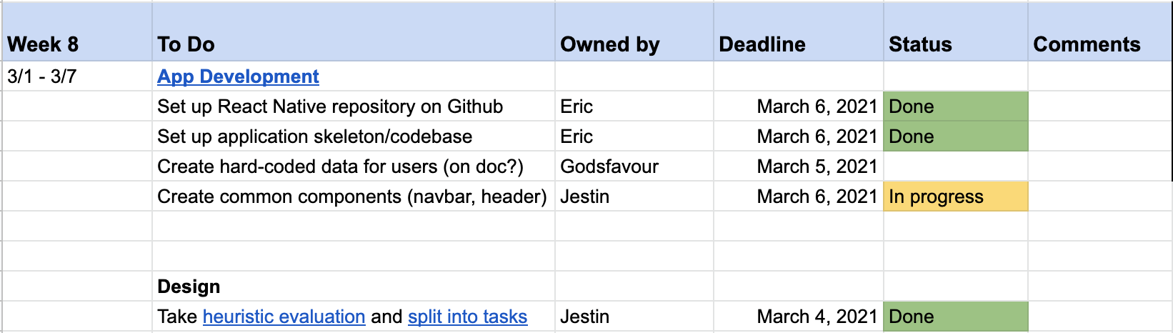
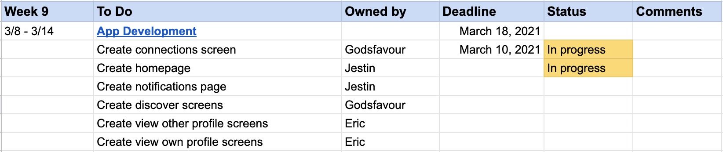
Implementation Plan

Slide 14
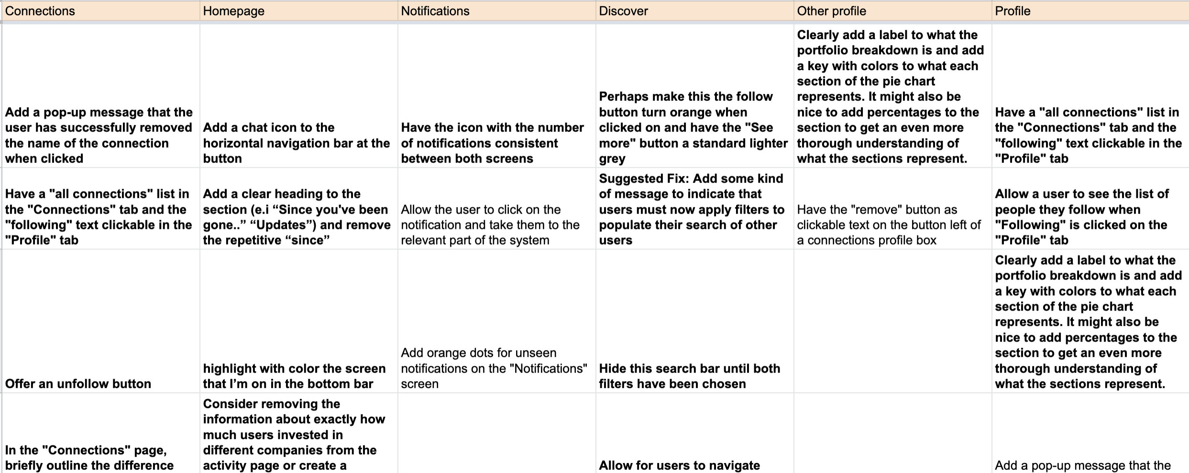
Implementation Plan

Slide 15
Prototype Demonstration
Task 2: View someone else’s investment habits and portfolio

Slide 16


Slide 17
Summary
Based on the heuristic evaluation of our medium fidelity prototype, we identified several areas where we could change or improve our design.
The most severe issues were largely related to ease of use and lack of explanation/help for users.
We revised our designs with solutions to the problems we identified that should improve the InvestEd user experience.
We have set up, planned, and divided our high fidelity prototype implementation effectively for a smooth development process.
We have successfully implemented one of our three tasks for our prototype and are on track to complete the rest of them soon.

