Slide 1
InvestEd
Investing and connecting in your daily life.
Problem: Getting started in investing often requires overcoming barriers, such as social, economic, emotional, and mental. These barriers can be difficult to get past alone just with a brokerage firm’s app.
Solution: We propose (a) bringing investing to people’s everyday lives such as at the supermarket, and (b) having people learn from others’ experiences.

Slide 2
Tasks
Simple
Purchase a stock physically during their daily routine
Moderate
Learn about stocks and investing
Complex
Talk to people who have bought the same stock as you / learn about the stock and similar investments from people you find

Slide 3
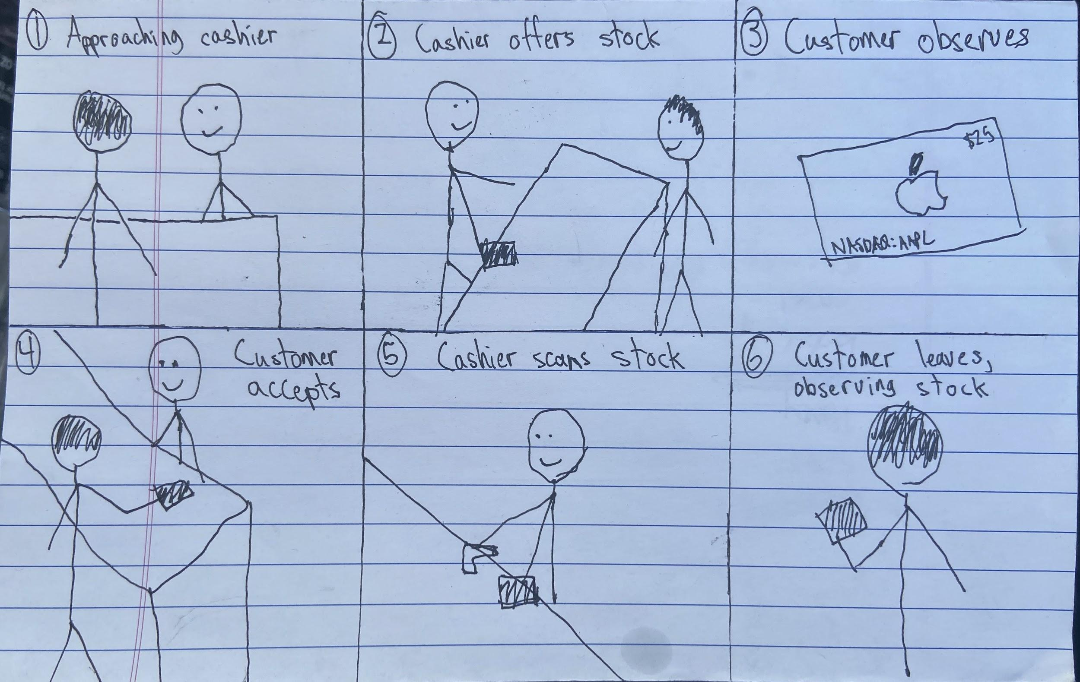
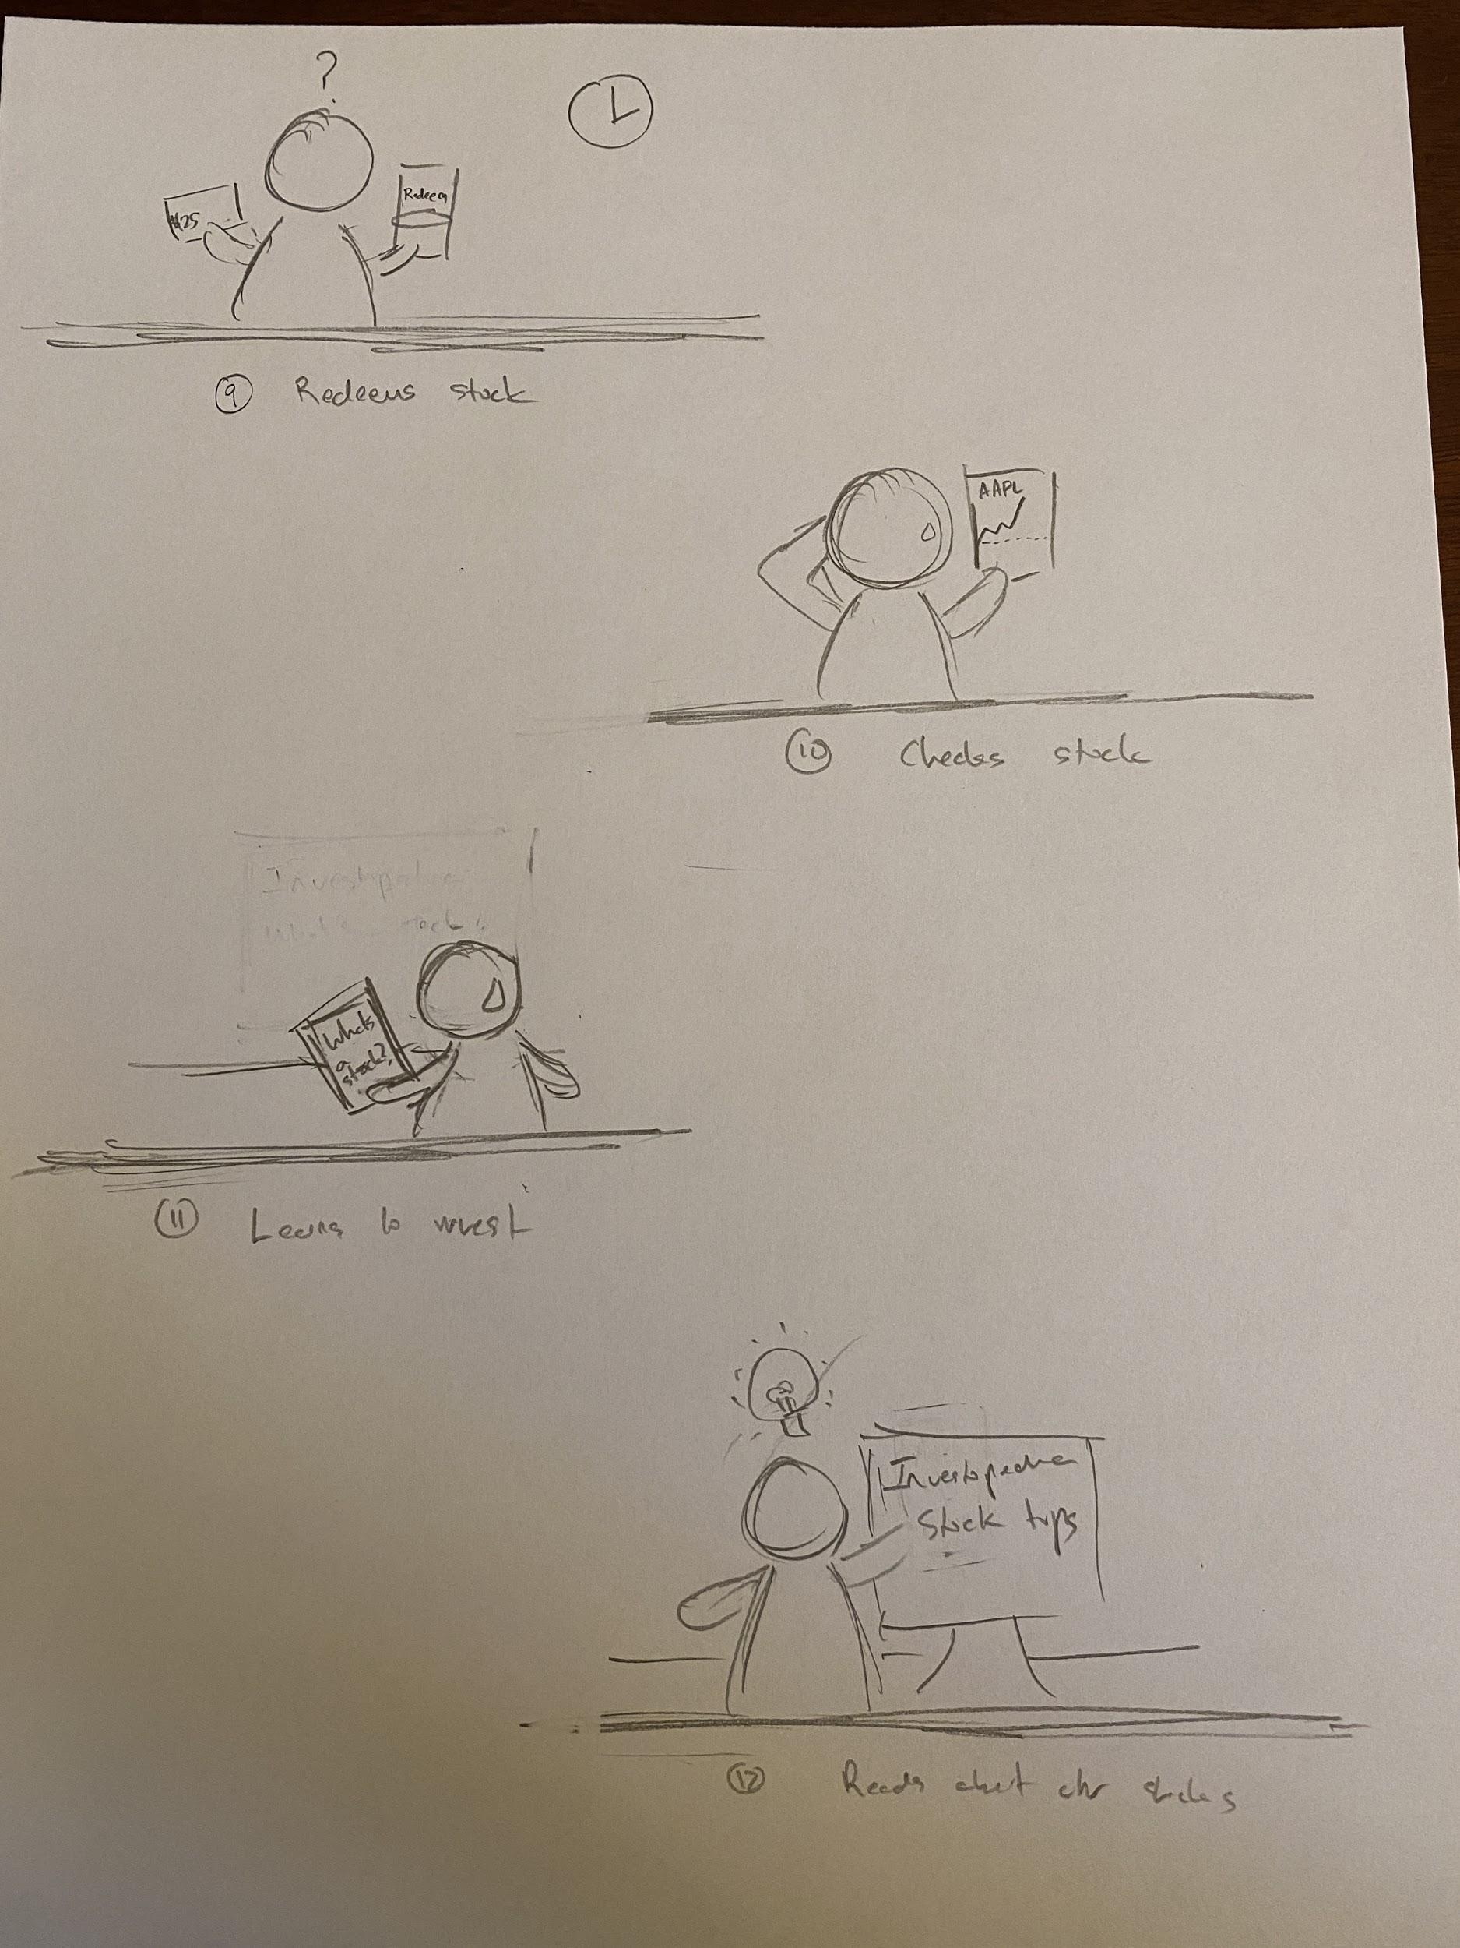
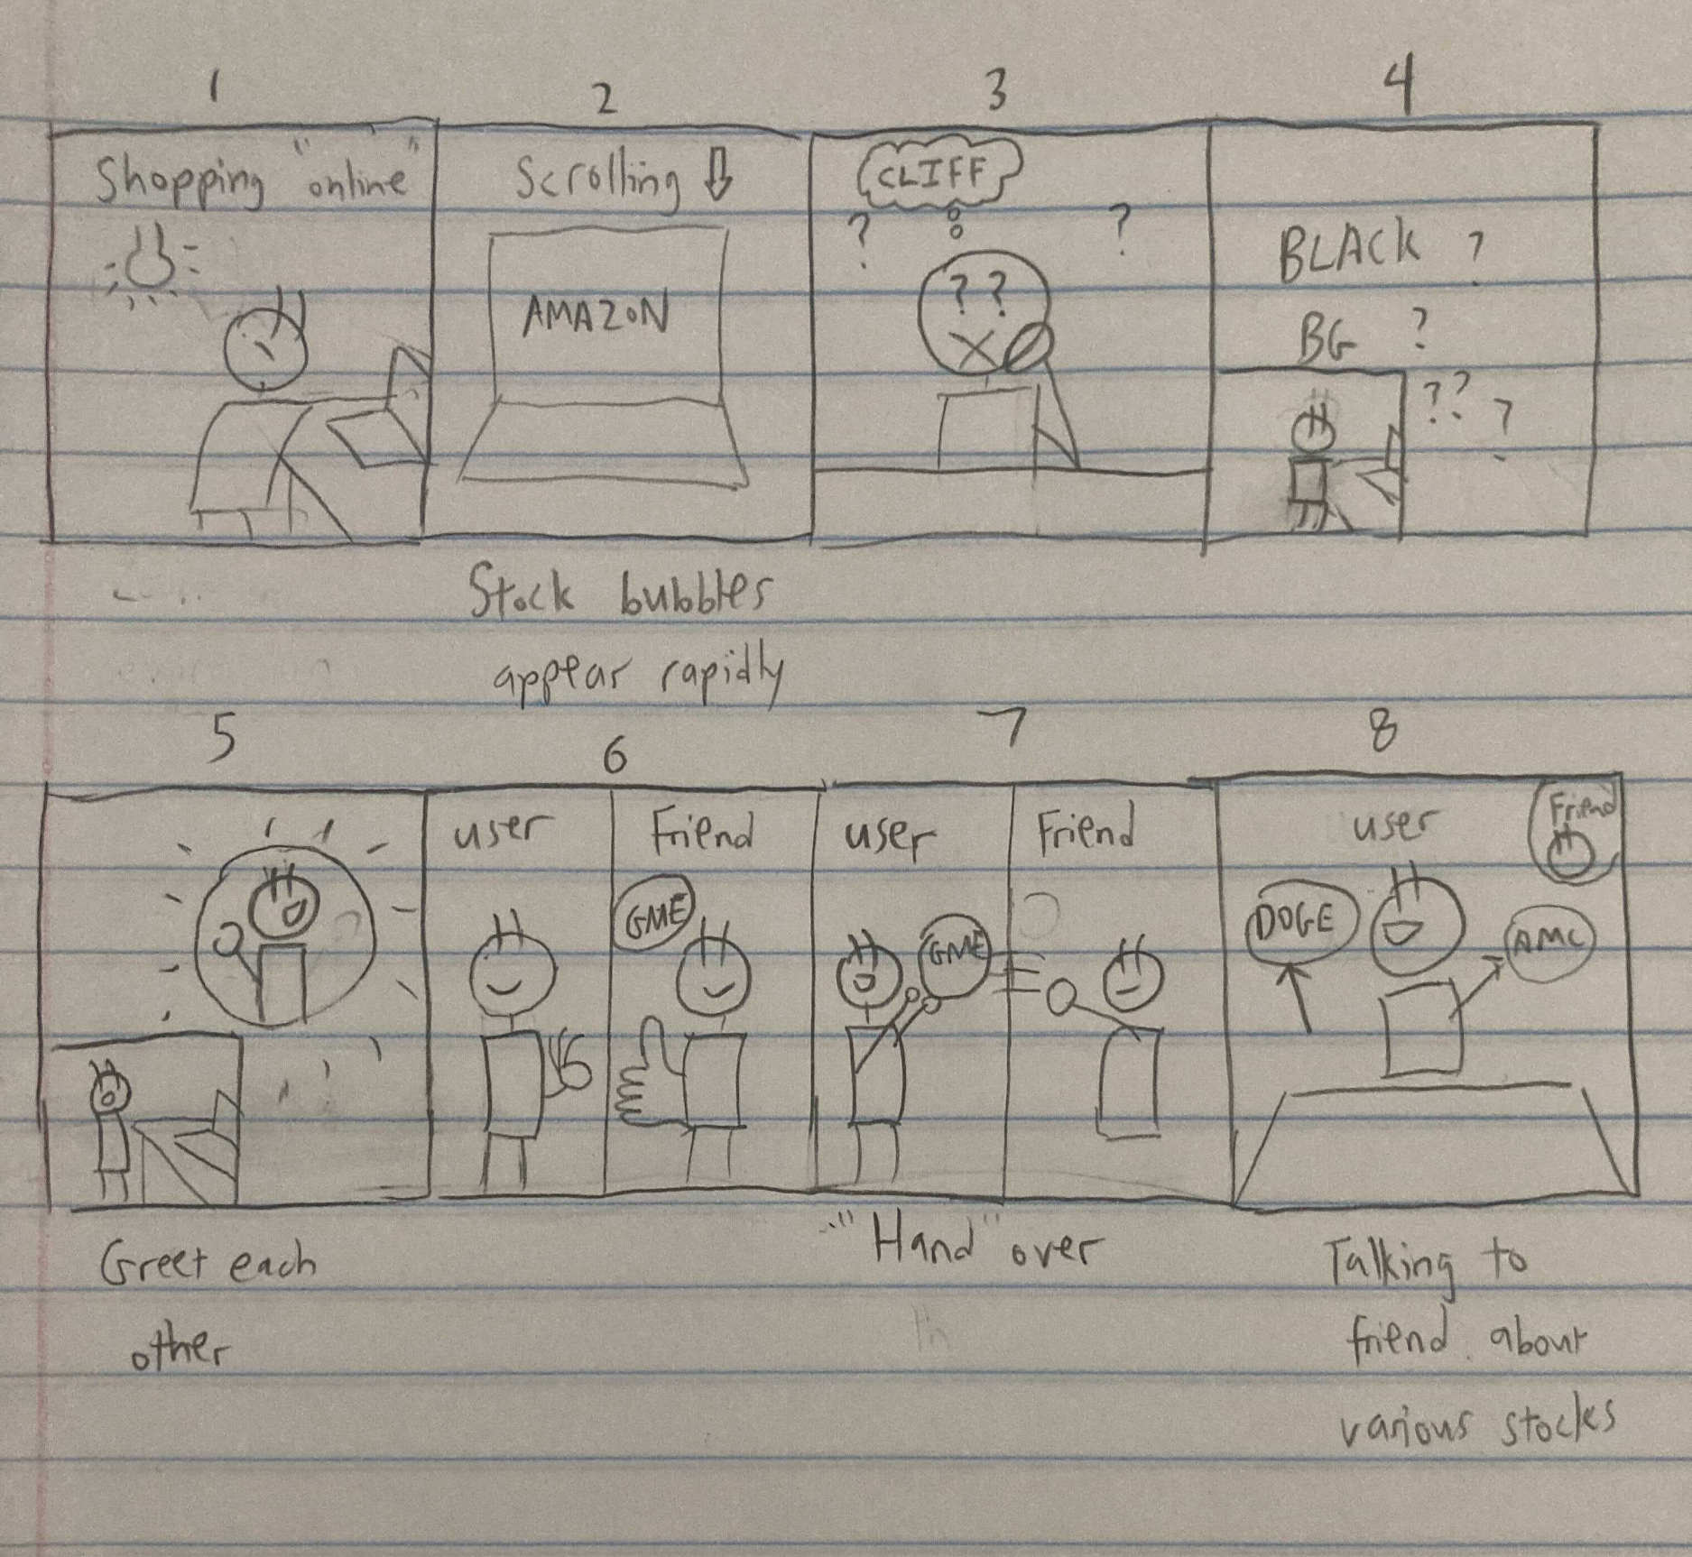
Storyboards
Task 1
Task 2
Task 3

