Slide 1

“Empowering
the Underdog:”
A Deep Delve into Financial Literacy, Resilience, & Health
Blake Brandon, Danya Adib,
Nathan Traxler, Sai Ma

Slide 2
PART
ONE
Initial POV

Slide 3
Initial Insight and Need
Insight:
Although financial education is important, there is some doubt about the efficacy of proactive learning
Need:
A way to incentivize learning before it is too late

Slide 4
PART
TWO
Additional Needfinding

Slide 5
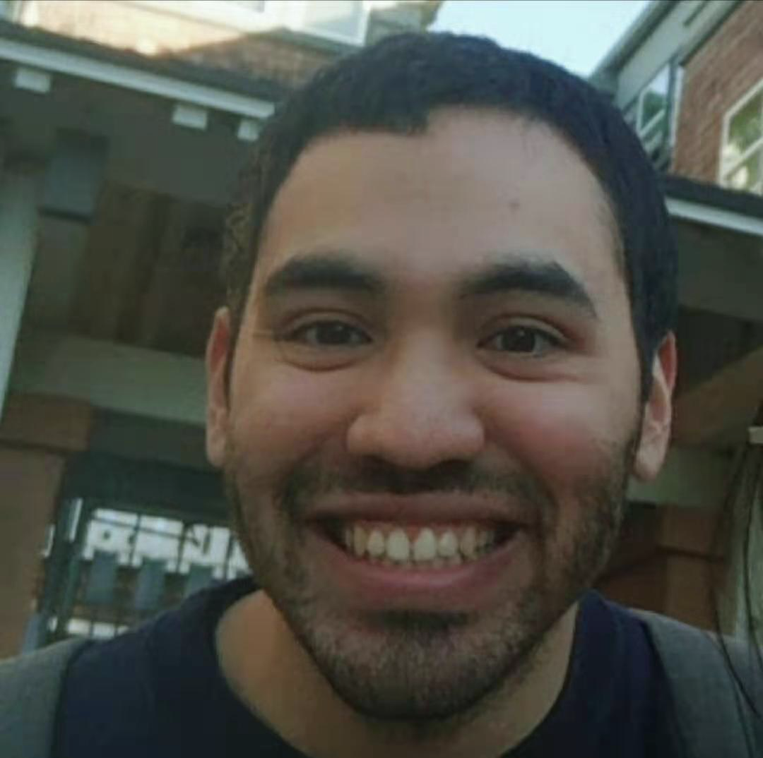


Additional 3 Needfinding
Edgar
Carter
Ish

Slide 6

1
“There is no specific resources for me to prepare for scholarship interviews.”
Need:
Empower people's confidence and preparation for scholarship interviews
Edgar, graduated from Berkeley and is preparing for scholarship interviews to study in China

Slide 7
2
“They make the terminologies incredibly complex and intimidating so that you don’t do it and you give your money to a financial advisor.”
Need:
Give people the knowledge to take control of their own finances.
Make financial language easier for people to understand
Carter, co-founder and CEO of Champions Round startup.

Slide 8
3
“The only thing that helped me gain control of my finances was not being able to see the money come in.. Later, gamifying my life helped me hack my habits”
Need:
A way to empower clear-headed financial decision making
Ish Verduzco, entrepreneur & social media strategist at CRAVEIT
Notes:
“Ish’s family had little disposable income growing up, where McDonald’s was a rare treat, so after he hustled and got a 6 figure job, he still had to confront “hood habits” that were hard to shake, such as spending on bottle service rather than 401k”

Slide 9
WE MET…
Ish, 26 year old entrepreneur and social media strategist
WE WERE AMAZED TO REALIZE…
that in "the hood," people will often freeze a debit card in water so that they must wait a few hours for it to thaw & make a financial decision
IT WOULD BE GAME-CHANGING TO…
to find a way to circumvent impulse buying and empower people to make financial decisions with a clear head

Slide 10
PART
THREE
Revised POVS & HMW

Slide 11
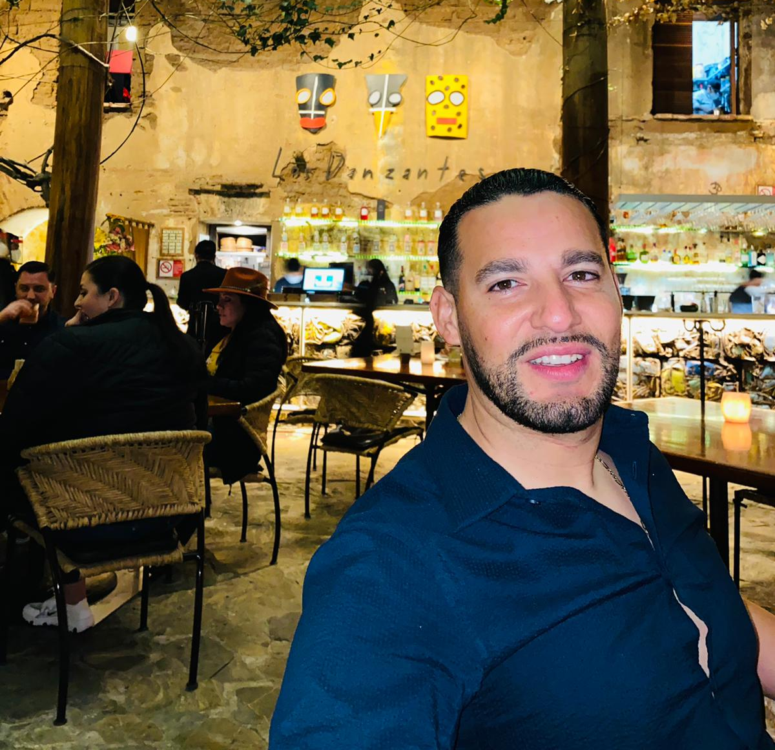
WE MET…
Rafa, a 35 year old garbage truck driver & property investor
WE WERE AMAZED TO REALIZE…
The many hoops he had to jump through without having a clear source of trust to turn to
IT WOULD BE GAME-CHANGING TO…
Mitigate uncertainty and fear that people have surrounding financial systems
Notes:
HMW.. we make learning personal finance rewarding instead of scary?
HMW.. make learning about personal finance easily accessible to everyone?
HMW.. improve trust in financial systems?
HMW.. redesign the education resources available to "the underdog?" 👌🏻
HMW.. show people how far they've come on their financial journey? 👍
HMW.. become a trustworthy source of financial knowledge?
HMW.. make learning about finance proactively fun?
HMW.. humanize financial systems / ways of learning?
HMW.. break taboos about talking with other people about finance?
HMW.. make the experience of engaging with financial systems more whimsical? 😄🌹 👍👌🏻
HMW.. turn the fear and uncertainty of financial systems into excitement?
HMW.. make the financial systems themselves more transparent?
HMW.. entirely remove the need for learning financial systems?
HMW.. leverage the experience of other people in their network to break through uncertainty? 🌹👌🏻🎉
HMW...teach people to ask the right questions?
HMW... connect the public to financial experts?

Slide 12
WE MET…
Carter, co-founder and CEO of Champions Round startup.
WE WERE AMAZED TO REALIZE…
He is upset with his inadequate knowledge about finance and having to hand over the control of her finance to experts
IT WOULD BE GAME-CHANGING TO…
Make financial language easier for people to understand and ultimately empower people to take control of their own finances.
Notes:
HMW.. we make learning personal finance rewarding instead of scary?
HMW.. make learning about personal finance easily accessible to everyone?
HMW.. improve trust in financial systems?
HMW.. redesign the education resources available to "the underdog?" 👌🏻
HMW.. show people how far they've come on their financial journey? 👍
HMW.. become a trustworthy source of financial knowledge?
HMW.. make learning about finance proactively fun?
HMW.. humanize financial systems / ways of learning?
HMW.. break taboos about talking with other people about finance?
HMW.. make the experience of engaging with financial systems more whimsical? 😄🌹 👍👌🏻
HMW.. turn the fear and uncertainty of financial systems into excitement?
HMW.. make the financial systems themselves more transparent?
HMW.. entirely remove the need for learning financial systems?
HMW.. leverage the experience of other people in their network to break through uncertainty and ultimately enable them to take control of their own finances? 🌹👌🏻🎉
HMW...teach people to ask the right questions?
HMW... connect the public to financial experts and make people feel safe and happy to solicit suggestions from experts?

Slide 13
WE MET…
Edgar, a Berkeley grad in the process of applying for scholarships to study in China
WE WERE AMAZED TO REALIZE…
There are no specific resources for him to prepare for scholarship interviews
IT WOULD BE GAME-CHANGING TO
Empower people's confidence and preparation for scholarship interviews
Notes:
HMW.. educate people on preparation for scholarship interviews?
HMW.. remove the need for users to interview for scholarships?
HMW.. plan out an individual's interview schedule?
HMW.. streamline the process of finding scholarships and applying/interviewing for them? 👌🏻 👍🌿
HMW.. extend job interview resources to cover scholarship interviews?
HMW.. simulate the interview experience virtually / solo? 👌🏻
HMW.. connect interviewees with people that have already gone through the process? ☀️🌹
HMW.. motivate scholarship interview committees to involve in helping candidates prepare for interviews?
HMW.. provide resources to help those preparing for scholarship interviews?
HMW.. make the preparation process more enjoyable and exciting for candidates?
HMW.. facilitate communication between scholarship committees and applicants?🌟
HMW.. help people claim ownership of their story?
HMW..create a positive feedback loop throughout the scholarship preparation process?
HMW.. pair up people applying for interviews so that they can help each other?
HMW..make categorized interview resources that suit candidates' needs?

Slide 14
HMW.. make the experience of engaging with financial systems more whimsical?
Notes:
A gamified app that teaches beginners about financial systems
Crowd sourcing suggestions (sort of like a reddit) for what to do in financial situations
create an app that has multi-stages of learning and people collect points for every lesson they complete 👍🎉
maybe like point 3, when people collect points they can apply these fake points towards a particular investment strategy and see it grow
Piggybacking of off 3 and 4 there could be a leaderboard so people can see how there scores compare to friends and others
Quest-Style video game where people complete a financial journey and can see / test their progress
Create an app where people can compete with others in a trivia type game on financial systems
An app that allows users to engage in the stock market with fake money to see how their investments would grow without any risk. 👌🏻 👍🔹🎉
An app that allows people to customize the topics that they're interested in and gives short video lessons
An app somewhat like duolingo that can teach people the dos and don'ts of credit score. 👌🏻

Slide 15
HMW.. leverage the experience of other people in their network to break through financial uncertainty and ultimately enable people to take control of their finances?
Notes:
Create a platform where people that have expertise can connect and offer advice
Crowd sourced forum where experts have incentive to give advice to beginners who have questions 👍 🌿🎉
Video-streams from people in their community
Reddit-style upvoting on the top recommended resources
Post anonymous financial situations people in their network can respond to and give feedback.
Create a platform to pair college students in finance-related fields with people who need to learn financial literacy.
Allow users in community to post their own financial story anonymously to give more information to users who want to learn from mistakes of people in similar situations.
App where users can pay for one on one interviews with experts to learn finance basics.
App that keeps track of a users financial investments cleanly in one place. Share functionality would allow users to easily share their investment profiles with their friends.
App where you can see what stocks people in your community is investing in App where you can post poll questions about certain stocks whether they're buy/sell/hold.

Slide 16
HMW.. streamline the process of finding scholarships and applying/interviewing for them?
Notes:
A forum that shows scholarship information submitted and edited by individuals
Consolidating scholarship search, application, and interview preparation into a single platform. 👌🏻 ⭐
Create video prompts that allow people to practice answering interview questions, where they can go back and see their answers & evaluate 👌🏻 ⭐
An app that enable users to schedule one-on-one consultation with others who have gone through the scholarhsip interview process
Create an app (similar to Glassdoor for job interviews) that allows people to write and view reviews from people who have completed scholarship interviews
Interview practice platform that connects individuals with people who have interviewing experience + gives feedback. ⭐
Allow users to set a budget for cost of school. Narrow down search for scholarships/institutions that meet that budget. Streamline applications to those scholarships.
App where people can collaborate to build study guides for scholarship interviews
App that lists requirements and specifications for financial aid applications filtered by school
App that easily allows you to compare the different financial aid packages that schools offer

Slide 17
PART
FOUR
Three Best Solutions

Slide 18

HMW.. make the experience of engaging with financial systems more whimsical?
Create an app that has multi-stages of learning and people earn money for every lesson they complete
Create an app where people can compete with others in a trivia-style game on finance
SOLUTIONS
‹#›
Notes:
We chose two solutions from the same HMW1 because we thought the solution is more likely to accomplish than the one we pre-selected for the HMW 2 (HMW.. leverage the experience of other people in their network to break through financial uncertainty and ultimately enable people to take control of their finances? )
)

Slide 19
HMW.. streamline the process of finding scholarships and applying/interviewing for them?
Create video prompts that allow people to practice answering interview questions, where they can go back and see their answers & evaluate
SOLUTIONS
‹#›

Slide 20
PART
FIVE
Three Experience Prototypes

Slide 21
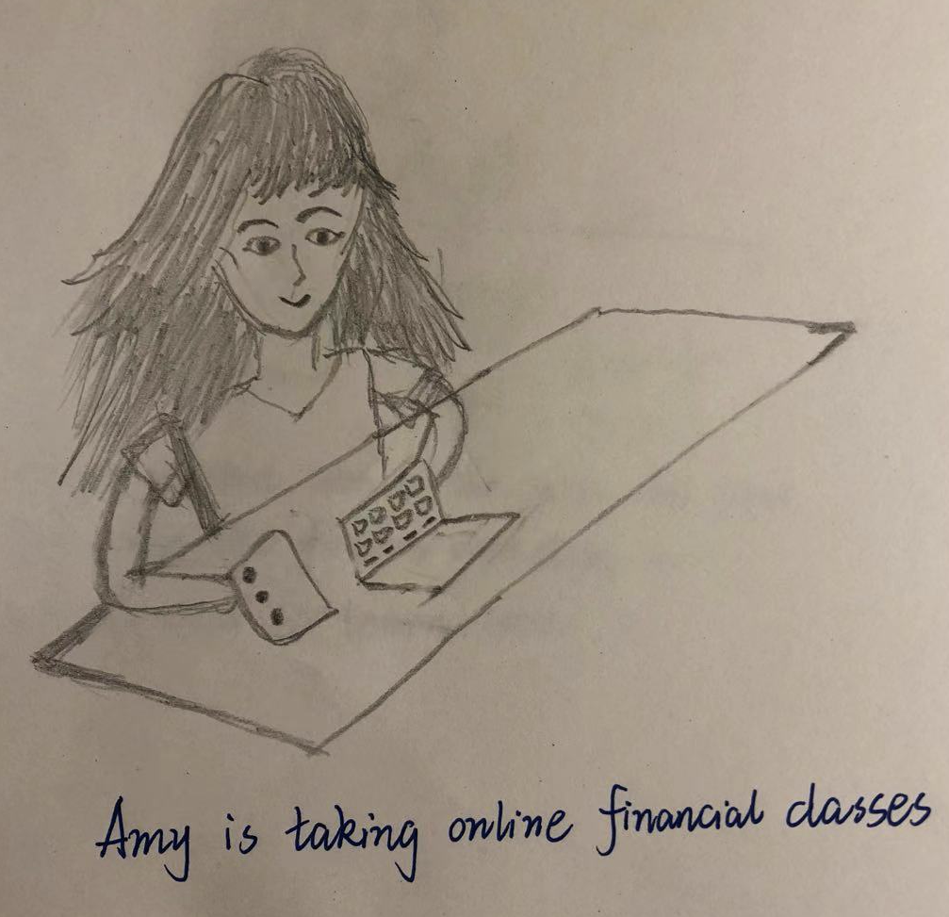
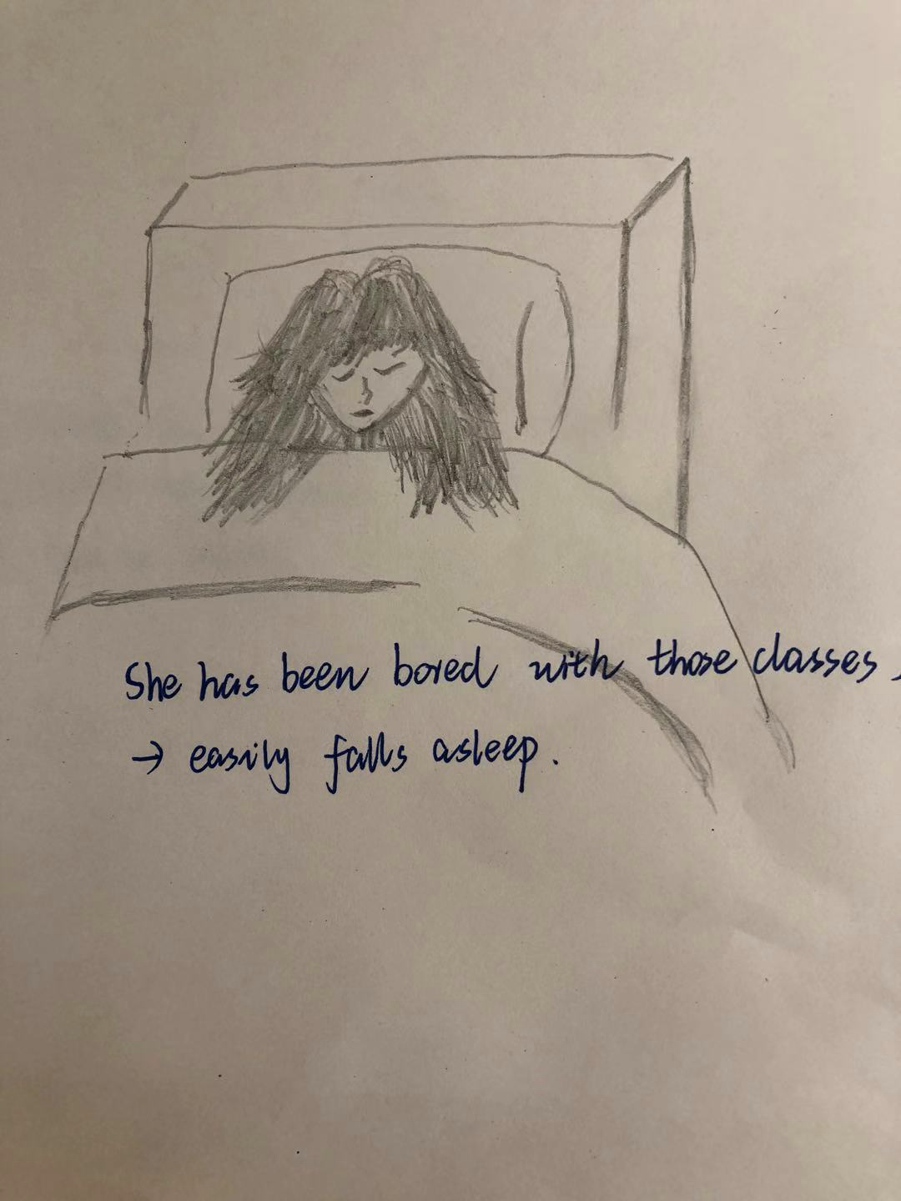
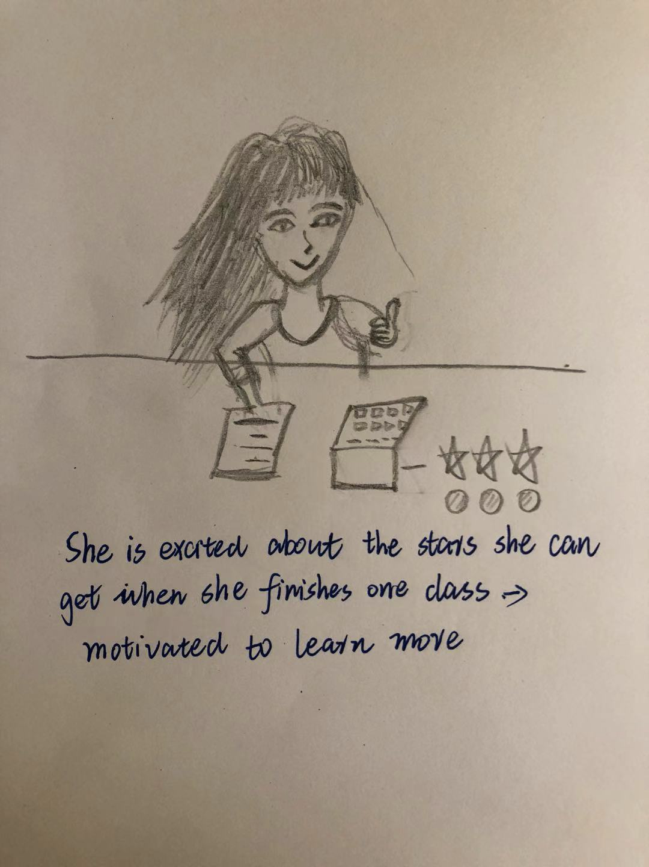
No.1
Experience Prototype 1: Learn with Rewards
Create an app that has multi-stages of learning and people earn money for every lesson they complete
Assumption: People will feel motivated to complete lessons if there is some reward associated with it (positive feedback loop)

Slide 22

No.1
Experience Prototype 1: Learn with Rewards
Tina (Pinyi) Liu, Sr. Consultant at EY Consulting (US) / Graduated from University of Rochester - Simon Business School with a focus on Business Analytics / undergraduate major in Finance
Notes:
Testing Method:
Asked Tina to watch 15-minute video about Intro to Personal Finance. During the process, asked her to rate her interest level of taking and completing the class (From 1 - 10)
Appropriateness of participants:
Tina has background in Finance and we wanted to test if such individuals with stronger financial background would be willing to and feel inspired to take classes to learn more when there is monetary reward. (Tina can be accounted as extreme user. )

Slide 23
No.2
Experience Prototype 1: Learn with Rewards
Create an app that has multi-stages of learning and people earn money for every lesson they complete
What worked:
Tina rated a higher interest level (8 point) of taking financial classes after learning that completing each class and assignment will earn her extra money
Surprises/ new assumptions:
Financial reward is one way to motivate people to take classes, but other dimensions also matter (class length, in this case) and would possibly compromise the efficacy of rewards.
What did not work:
Tina rated a lower interest level (4 point) of taking financial class if the class is more than 10 minutes, even though she is aware of potential rewards > she prefers to efficiently use her fragmented time to learn.

Slide 24
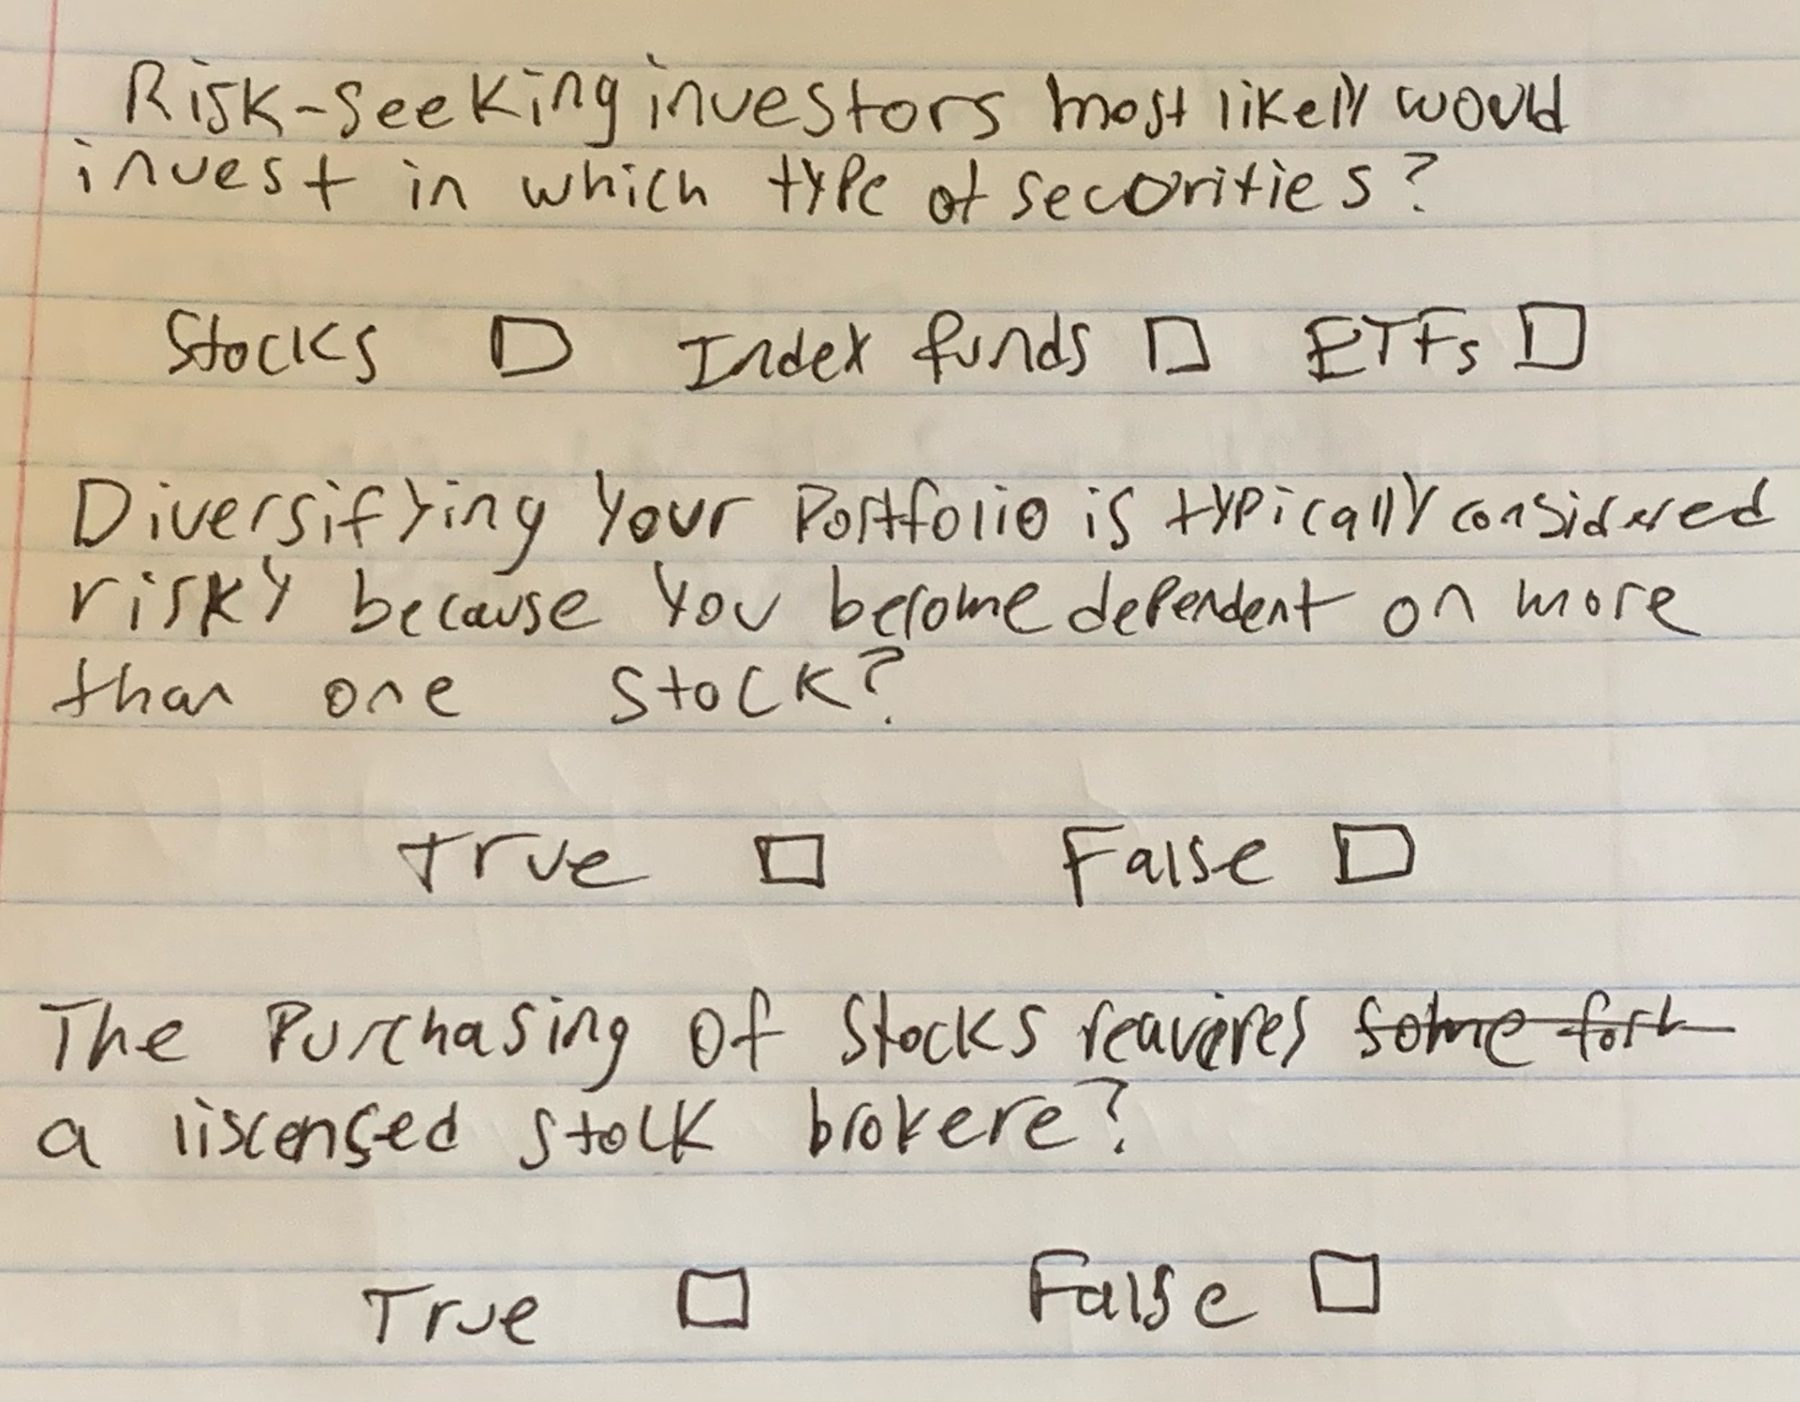
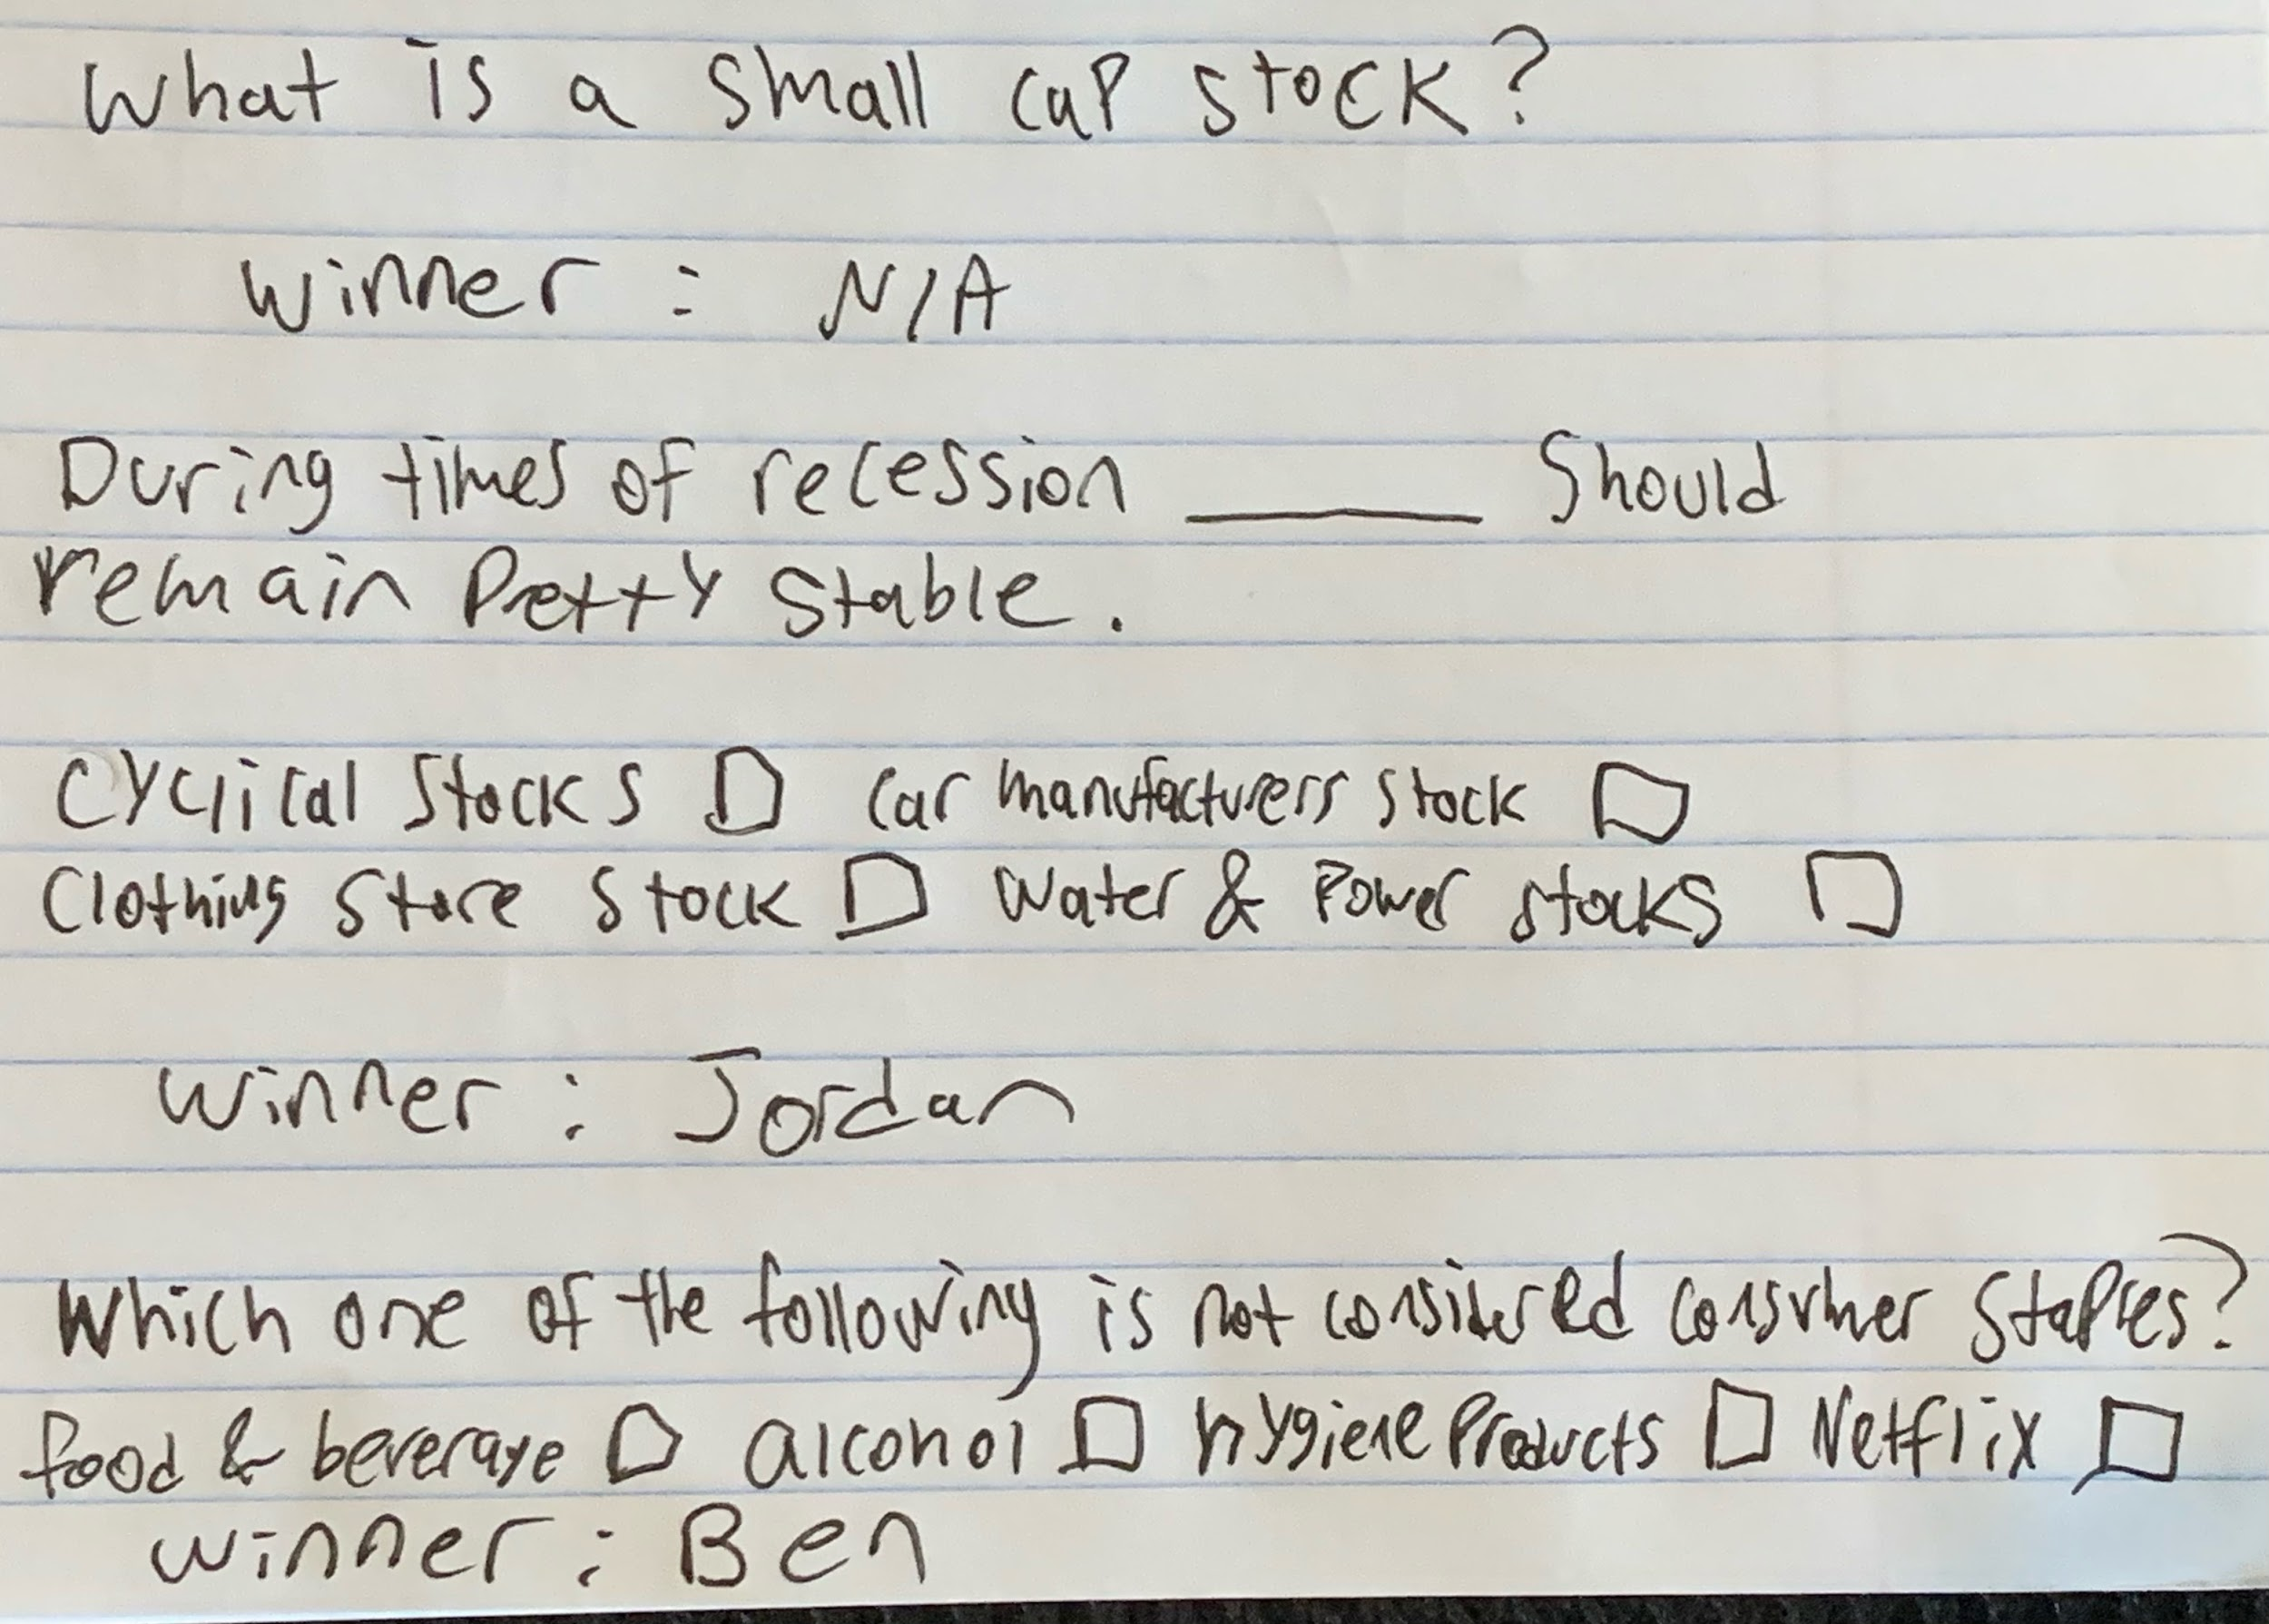
No.2
Experience Prototype 2: Competition
Create an app where people can compete with others in a trivia type game on financial systems.
Assumption: People will be interested to learn if there is competition
Notes:
Testing Method:
Asked participants to answer finance questions on their own. Then asked them to answer a questions but the first to answer would be rewarded one point.

Slide 25

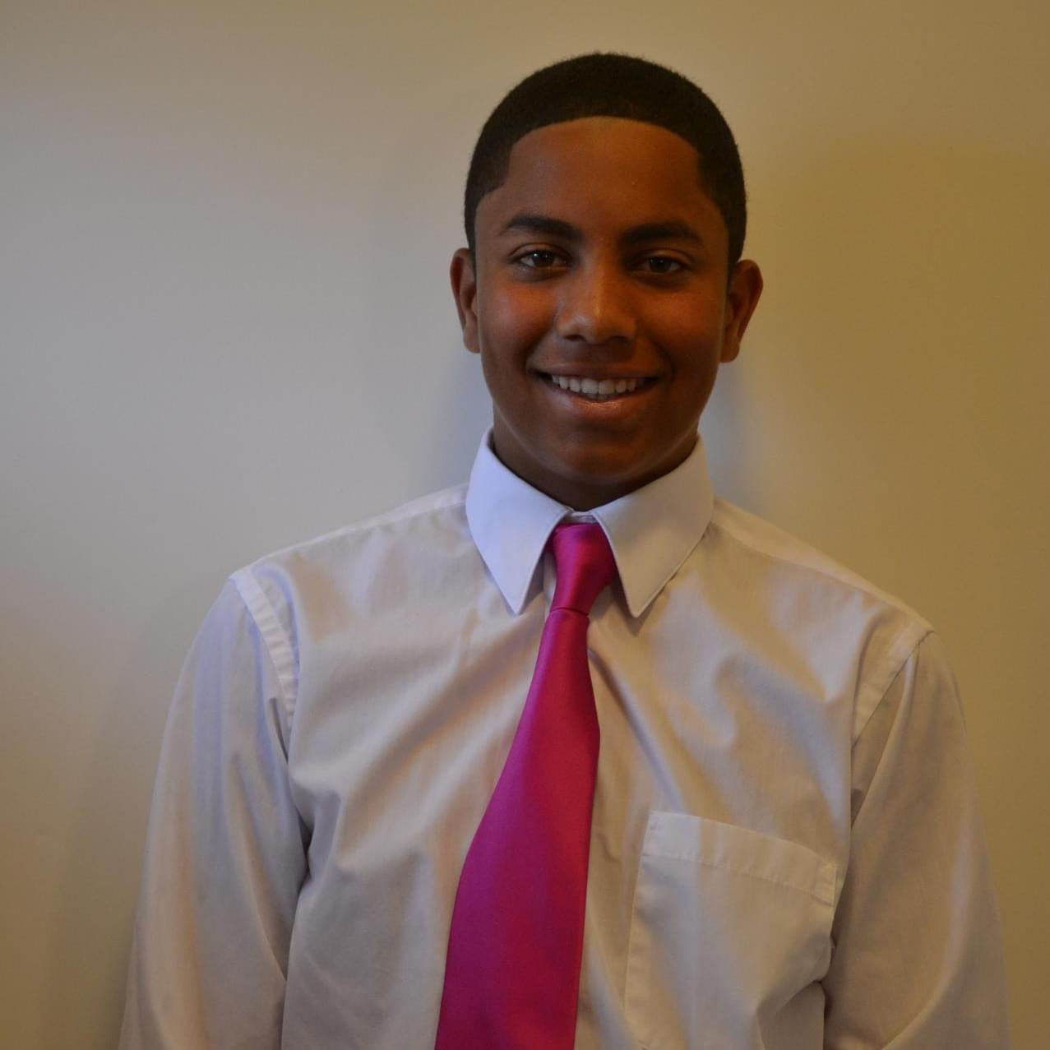
No.2
Experience Prototype 2: Competition
Ben Coombs-Perez. Student at Boston University with a limited amount experience in finance.
Jordan Caines. Recent grad from the University of Oregon with little financial experience.
Notes:
Appropriateness of participants:
Interviewed two people who are new to finance in order to create a fair competition

Slide 26
No.2
Experience Prototype 2: Competition
Create an app where people can compete with others in a trivia type game on financial systems.
What worked:
Motivation to answer questions correctly was increased when competition was introduced.
Surprises/ new assumptions: Participants were still pretty motivated to learn about finance even when competition wasn’t involved
What did not work:
Participants felt more pressured, and wanted to throw out their first thought in order to get the correct answer first.

Slide 27
No.3
Experience Prototype 3: Practice & Evaluate Interviews
Create video prompts that allow people to practice answering interview questions, where they can go back and see their answers & evaluate
Grading criteria --> “Tell me about your greatest strength” | Score 0-10
1) How succinct was your answer?
2) How well supported by examples was your answer?
3) How well did you demonstrate your personality & interests?
4) How clearly did you speak?
5) How would you rate your confidence in this interview?
Assumption: People benefit from self-evaluation when they are allowed to watch themselves & reiterate
Notes:
Testing Method:
Asked participants to answer an interview question (“tell me about your greatest strength”) in 60 seconds while recording & evaluating them based off of this rubric. We then we asked them to watch the video & self evaluate. After, they were given another opportunity to re-record their answer and self-evaluate

Slide 28

No.3
Experience Prototype 3: Practice and Evaluate Interviews
Bud
Senior studying sustainability
Carmen
Architect & business owner
Notes:
Appropriateness of participants:
Interviewed a student with less interview experience and a business owner with more interview experience to account for the cofounding factor of experience

Slide 29
No.2
Experience Prototype 3: Practice & Evaluate Interviews
Create video prompts that allow people to practice answering interview questions, where they can go back and see their answers & evaluate
What worked:
Participants were (initially) excited to share about themselves & open to objective rater’s feedback
Surprises/ new assumptions:
“wasn't able to feel the normal pressure or adrenaline”
“the more people think about their answers, the more critical they become, moving from ease to disease"
What did not work:
Interviewees felt more critical and performed worse in the second iteration (by objective & self-evaluation)

Slide 30
PART
SIX
Solutions & Summary

Slide 31
Summary
Prototype 1 (Learn with Rewards) implies financial reward does work to motivate people to learn, but it is not a decisive factor > needs further testing on what other dimensions would impact learners’ mindset and behavior
Prototype 2 (Competition) reveals that human interactions/connections are important during the learning process; but we should create a less speed-oriented environment.
Prototype 3 (Practice & Evaluate Interviews) demonstrates that self-evaluation, while in-line with objective evaluation, weakens subsequent performance
A sense of control over one’s finances is the ultimate goal of learning financial literacy
Next Step: Tap deeper into what motivates and maintains people’s interest to learn financial literacy; how to improve one’s interview performance after their self-evaluation

Slide 32
Summary
Prototype 1 (Learn with Rewards) implies financial reward does work to motivate people to learn, but it is not a decisive factor > needs further testing on what other dimensions would impact learners’ mindset and behavior
Prototype 2 (Competition) reveals that human interactions/connections are important during the learning process; but we should create a less speed-oriented environment.
Prototype 3 (Practice & Evaluate Interviews) demonstrates that self-evaluation, while in-line with objective evaluation, weakens subsequent performance
A sense of control over one’s finances is the ultimate goal of learning financial literacy
Next Step: Tap deeper into what motivates and maintains people’s interest to learn financial literacy; how to improve one’s interview performance after their self-evaluation

Slide 33
Thank you!

