Slide 1
BUDGET BUDDIES
Gaby Goldberg, Glynnis Millhouse, and Pierce Lowary

Slide 2
OVERVIEW
Mission and Interface
Prototypes and Tasks
Testing and Results

Slide 3
There is unease about finances, particularly among millenials. People feel anxious about money, whether due to a big move, a new baby, or just wanting to feel secure.
People have a vision of their ideal financial future, but have trouble mapping their way there. They can’t see how the tectonic plates of home, family, and career fit together into a financially sound life.
Budget Buddies helps you feel great about your financial decisions and enables you to achieve what matters most.

Slide 4
Mission Statement
Spend with confidence.

Slide 5
SKETCHES

Slide 6
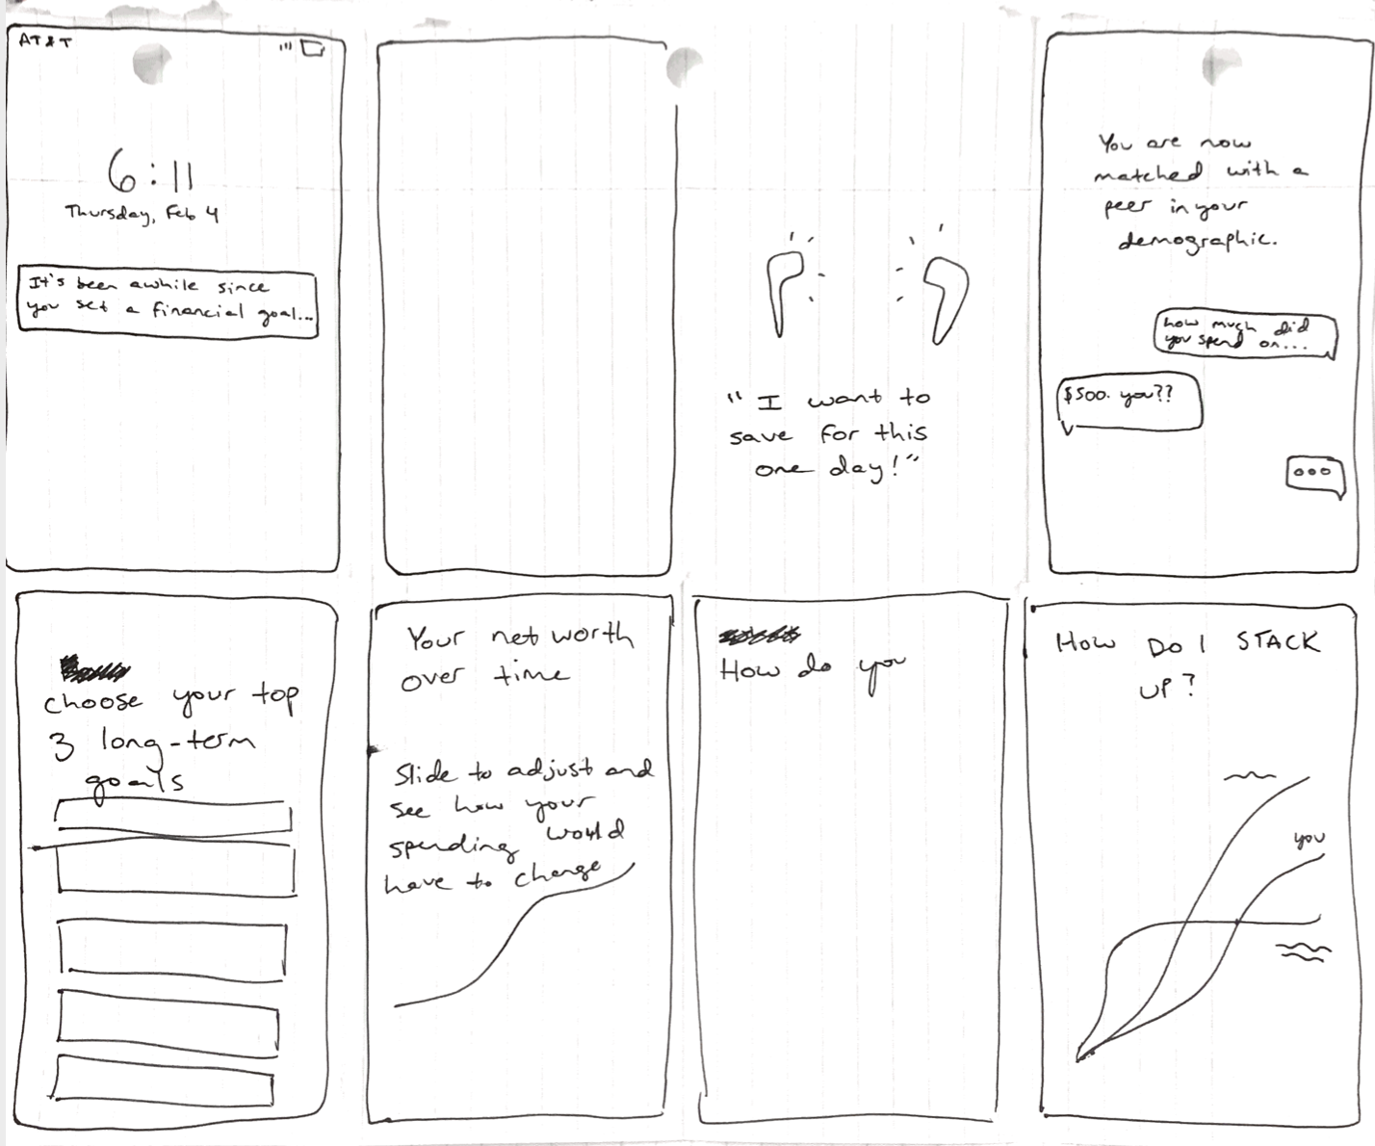
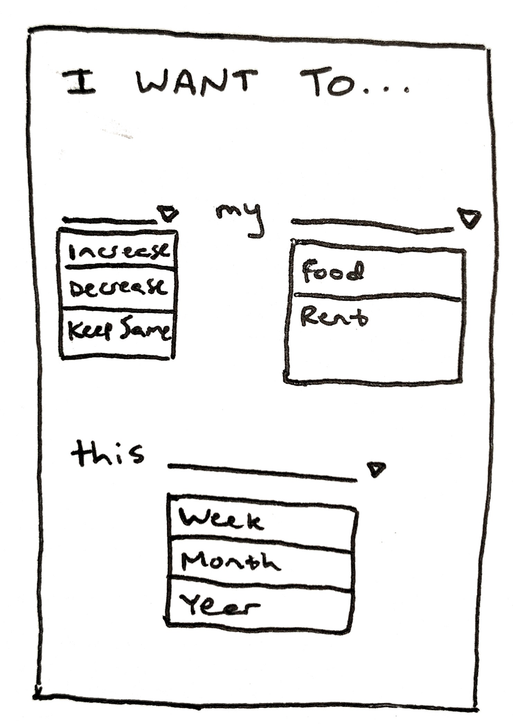

Slide 7
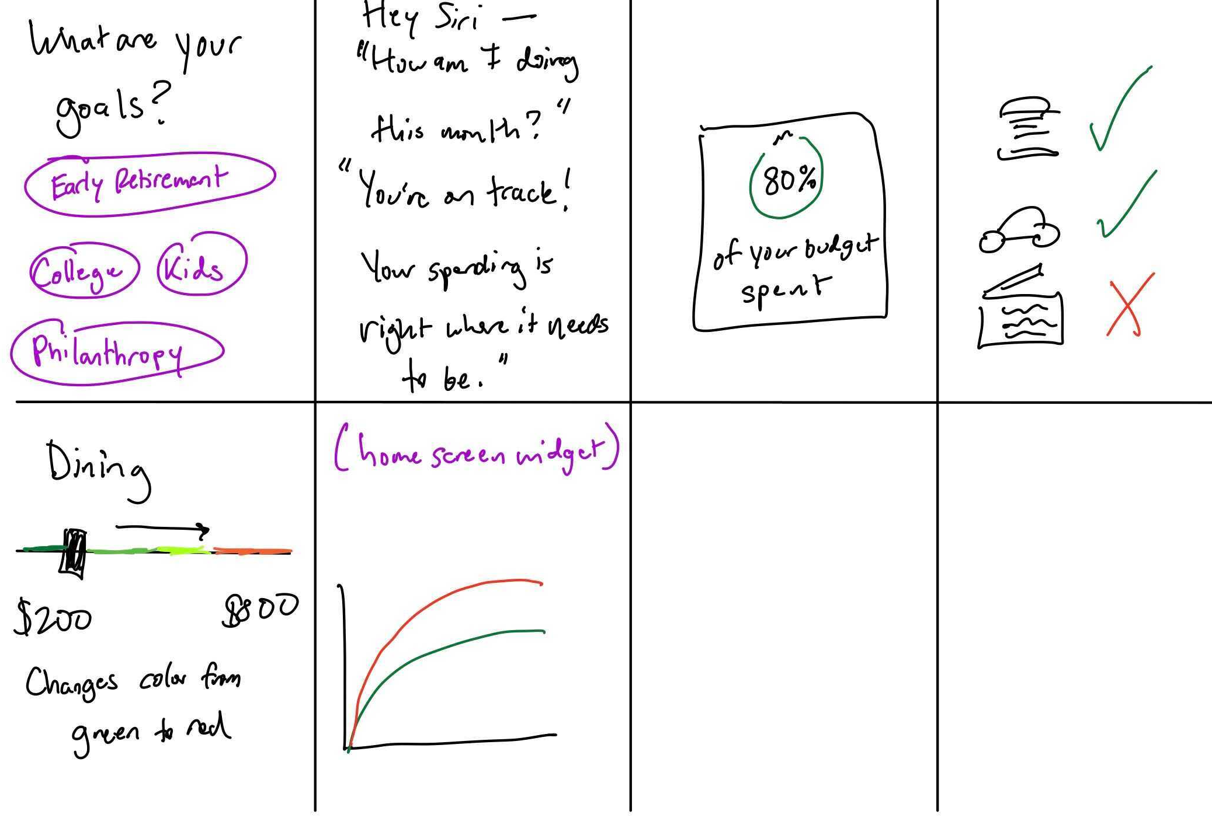

Slide 8
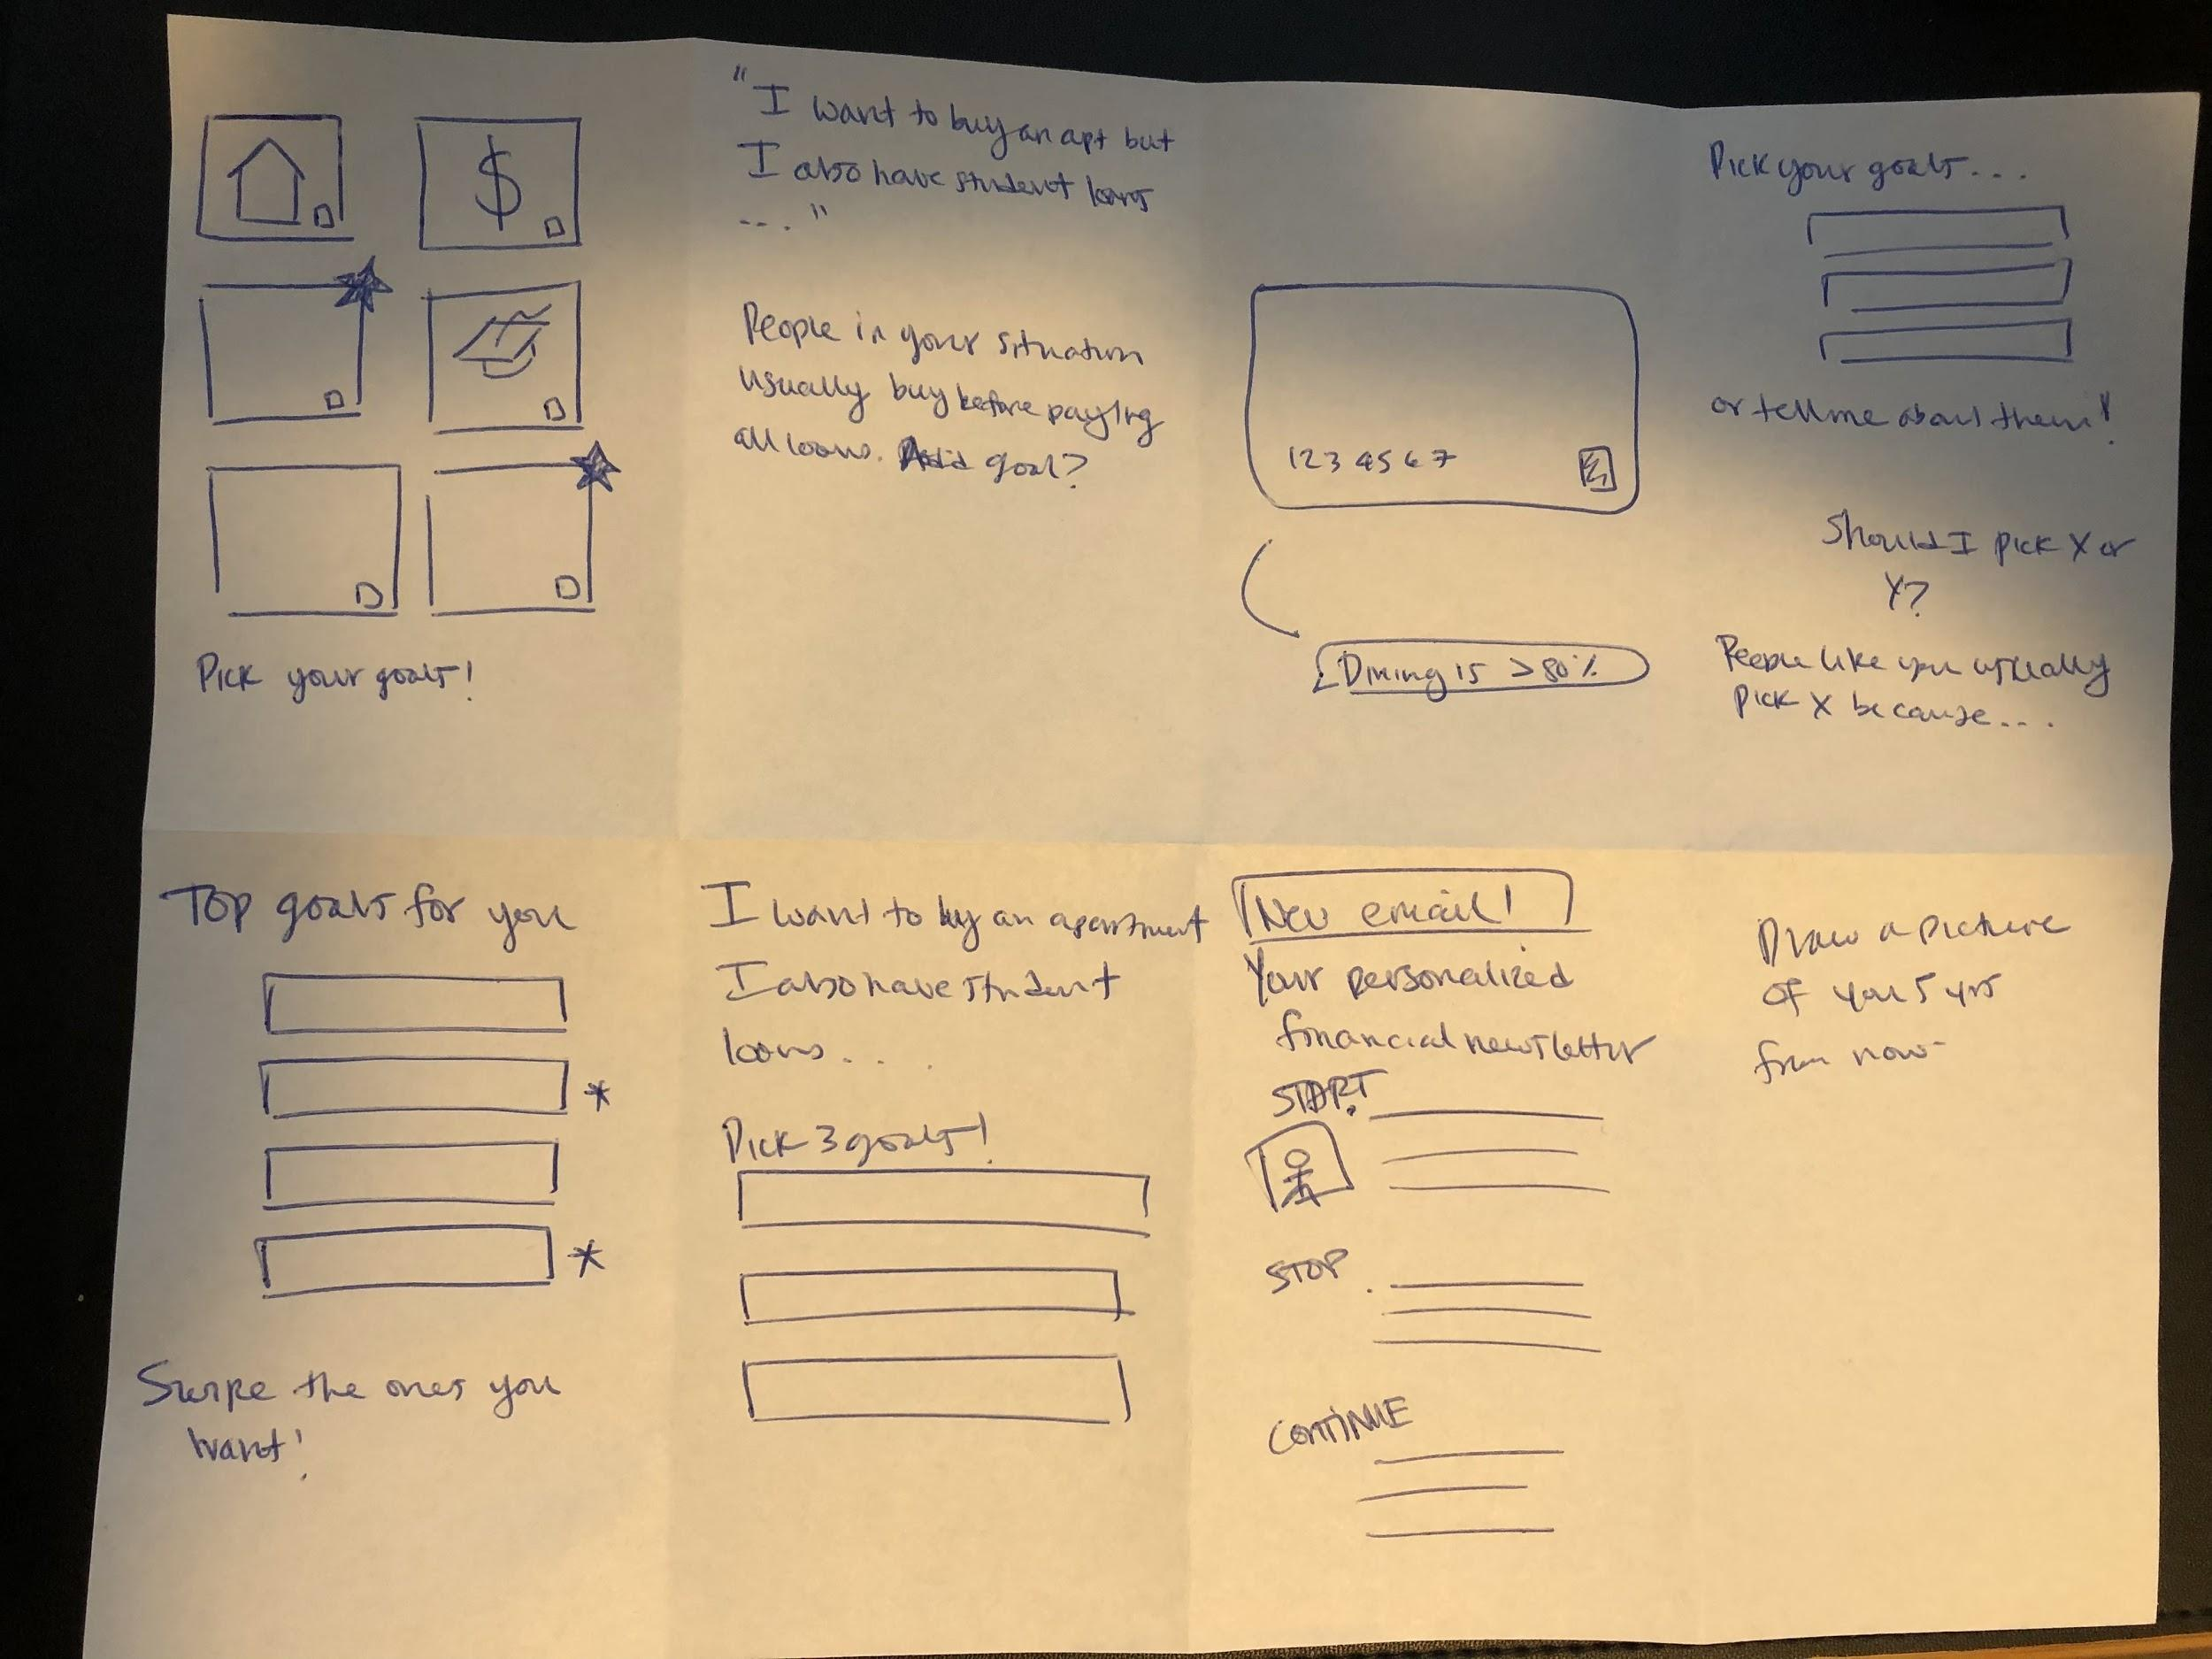
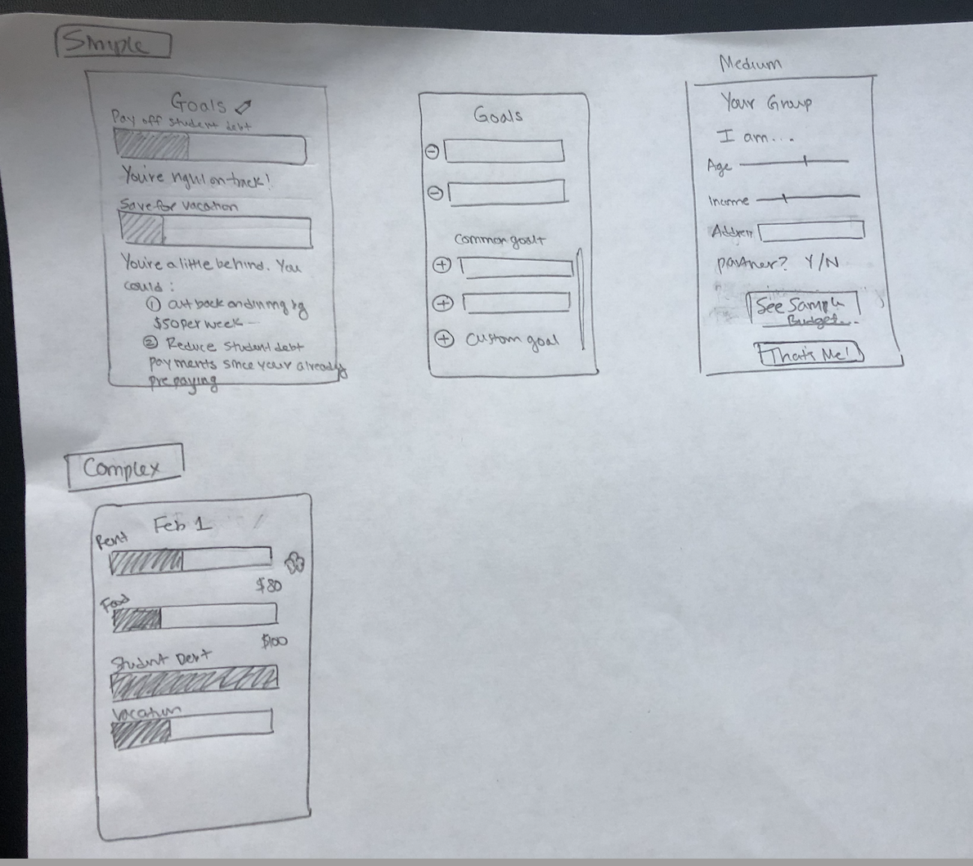

Slide 9
TWO SKETCHES

Slide 10
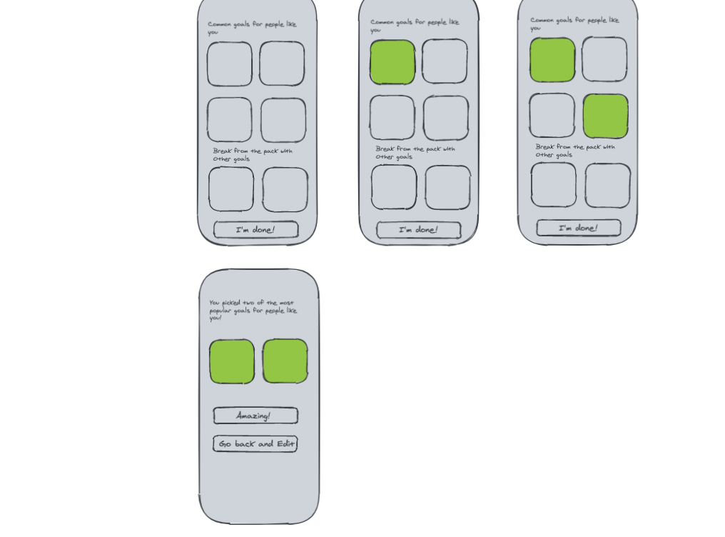
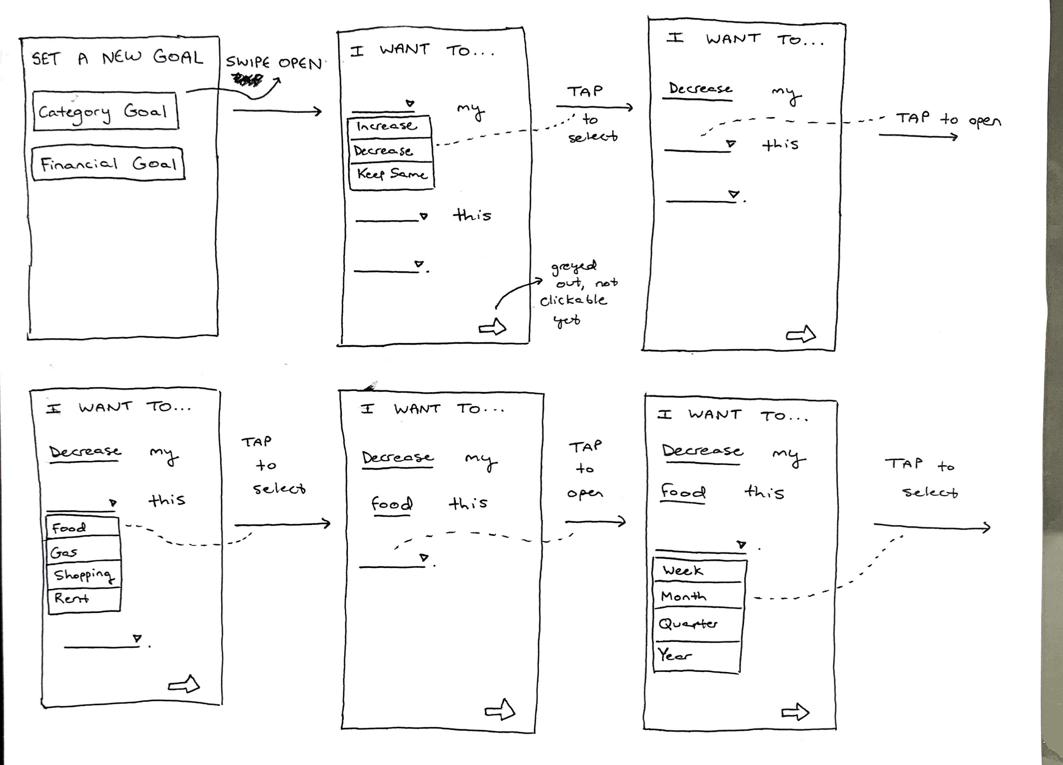
Click the preset goals, which light up when selected
Click I’m done at any time to look at your goals
Contextual info comes up at the end to help you feel confident about your goals

Slide 11
SELECTED INTERFACE

Slide 13
THREE TASKS &
TASK FLOWS

Slide 14
Task 1:
Set long-term
budgeting plan

Slide 15
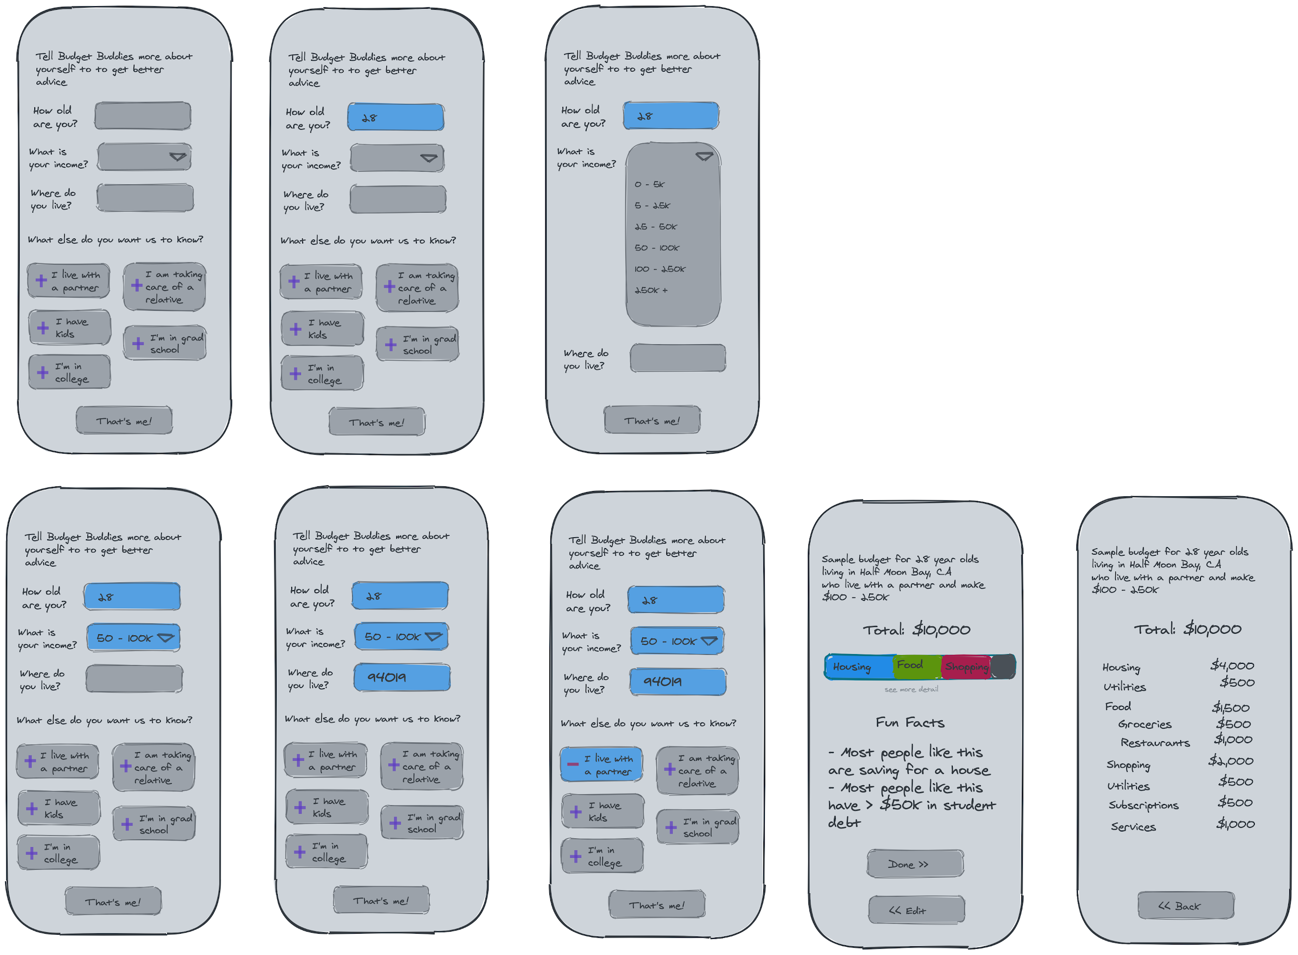
Task 2:
Compare spending
with others

Slide 16
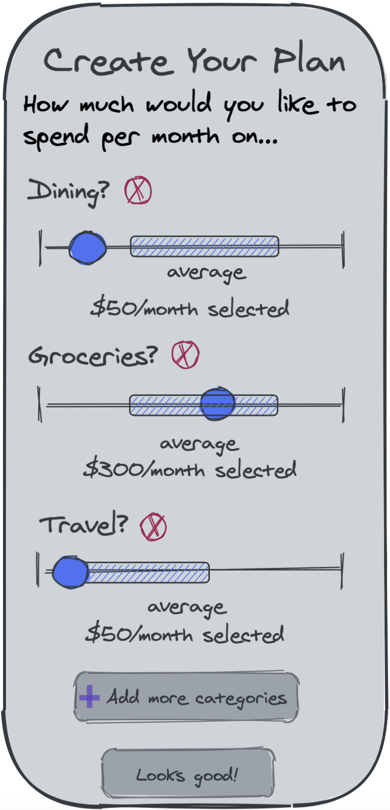
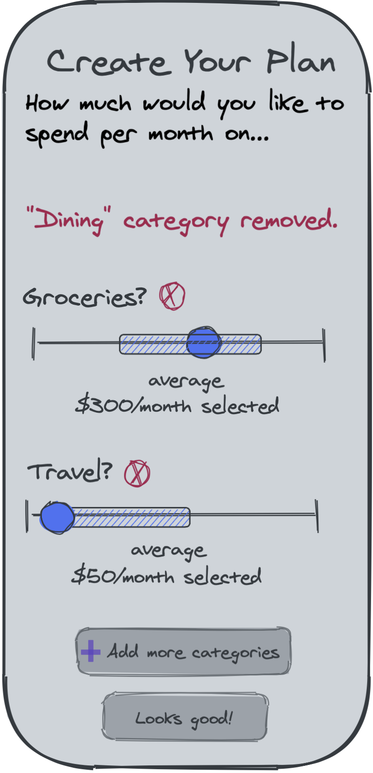
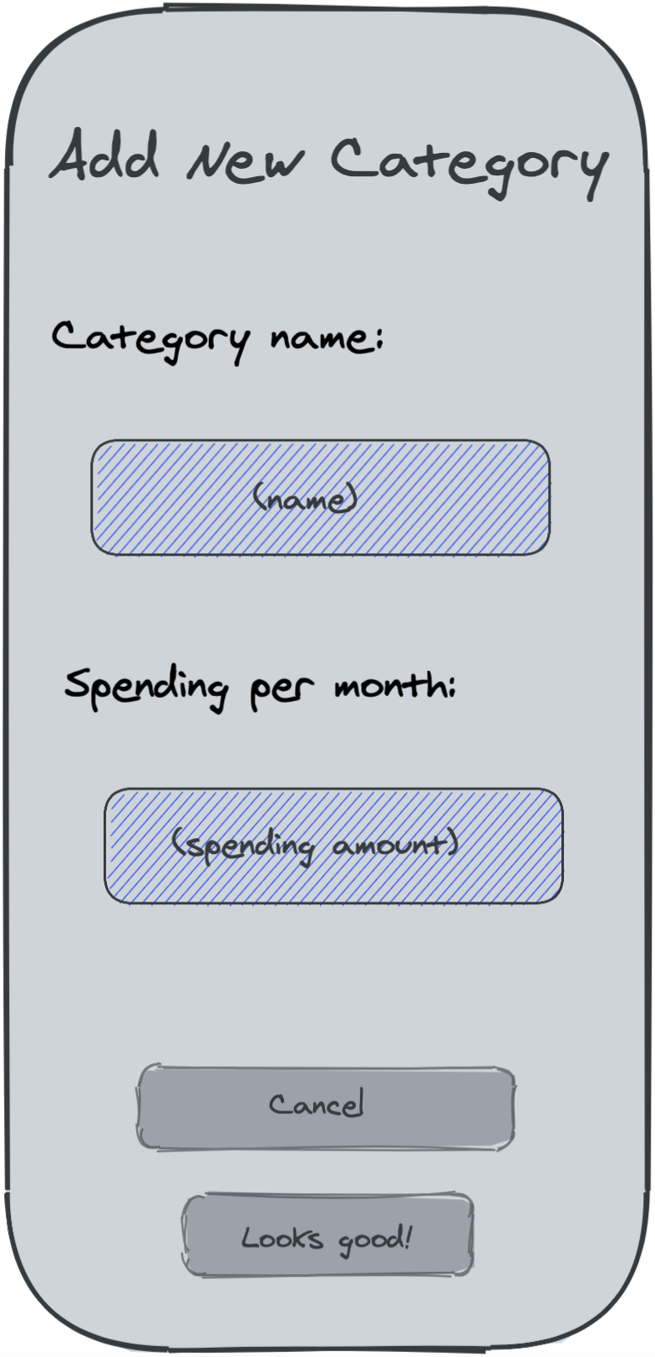
Task 3:
Make a plan
to achieve the
future you want

Slide 17
PAPER PROTOTYPE

Slide 18
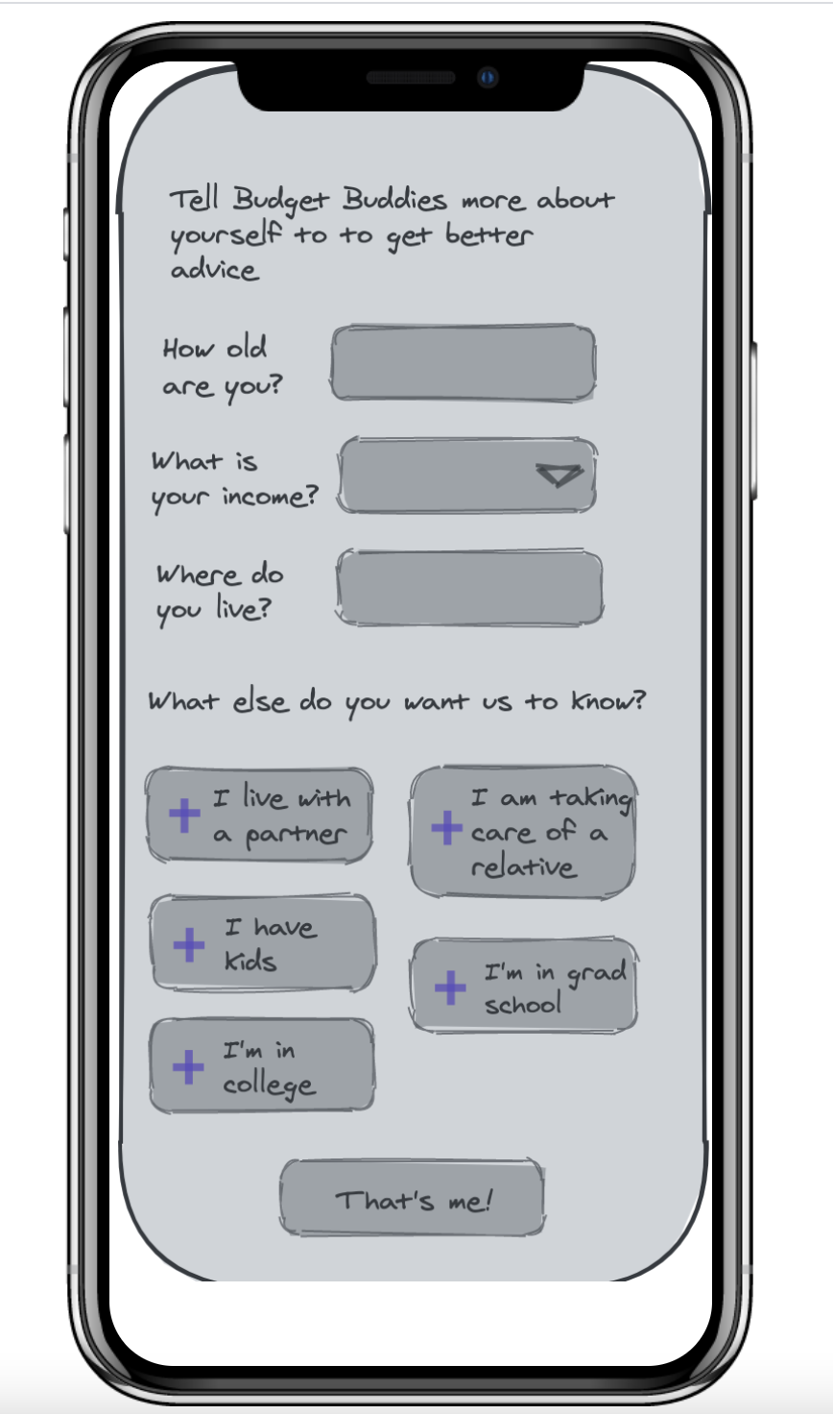
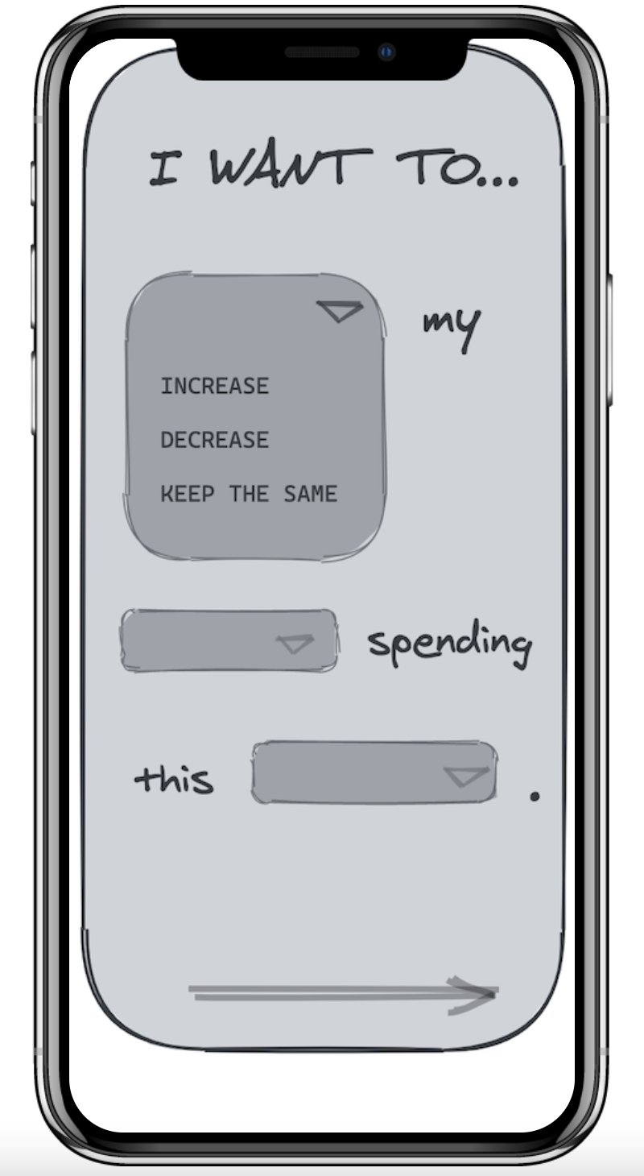
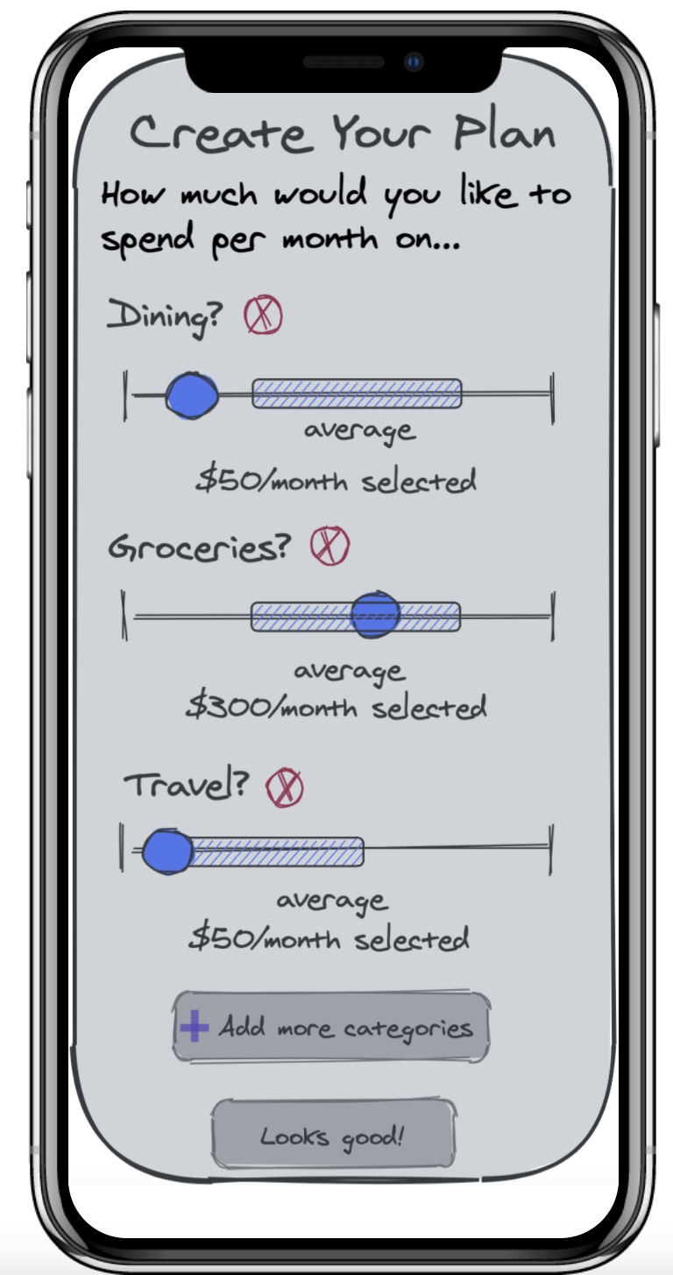
https://marvelapp.com/prototype/6hca27j/screen/76731325

Slide 19
TESTING
Chris
Chris
Jennifer
Jason

Slide 20
KEY
TAKEAWAYS

Slide 21
KEY TAKEAWAYS
Delight around the ability to “fiddle” with your budget
Confusion about setting goals using the “madlibs” approach because some of the combos don’t make sense (e.g. “why would I want to increase my food spending?”)
Interest in a more prominent “Why” e.g. why does my budget matter?
High-level categories were not relevant enough when seeing the sample budget from peer group

Slide 22
SUGGESTED
CHANGES
Make goal-setting more structured around common goals that are higher stakes and centered around a strong why (e.g. instead of decrease food budget, save for a vacation)
Get rid of high-level sample budget and instead focus on immediately offering a more granular and relevant view

Slide 23
QUESTIONS?

