Slide 1
Budget Buddies
Spend with confidence
People feel anxious about money, whether due to a big move, a new baby, or just wanting to feel secure. Budget Buddies helps you feel great about your financial decisions and helps you achieve what matters most.

Slide 2
THREE TASKS
Simple: Set long term budgeting plan
Medium: Compare spending with others
Complex: Make a plan to achieve the future you want

Slide 3
VIDEO STORYBOARDS

Slide 4
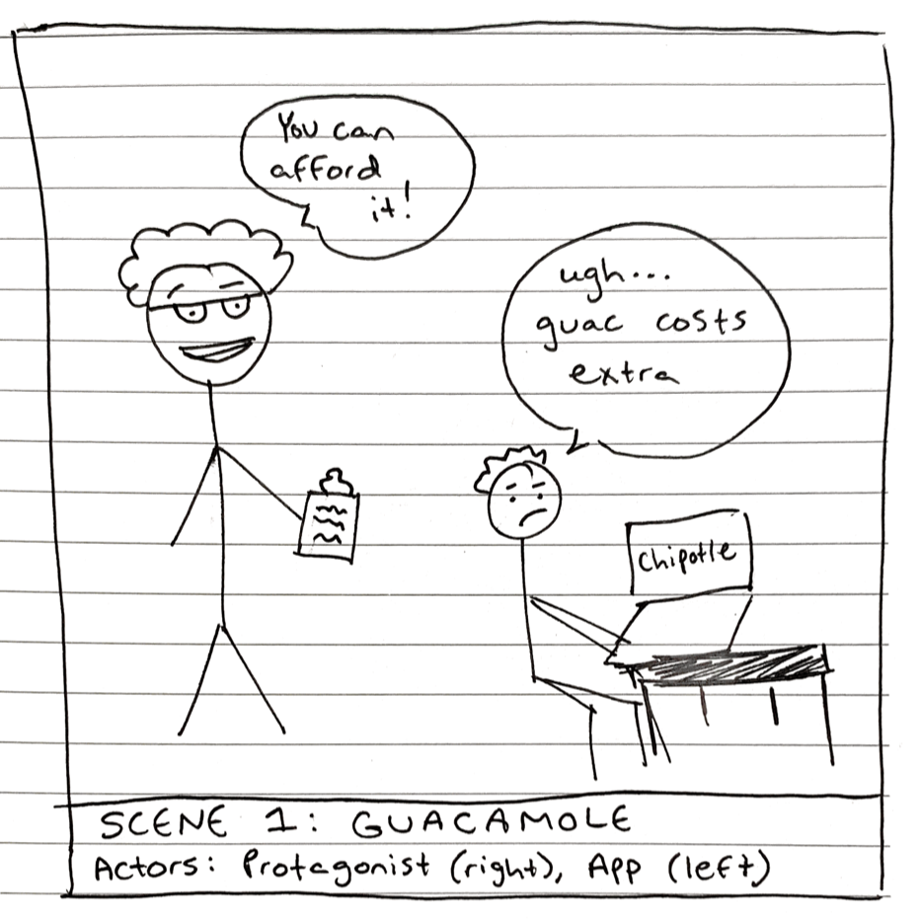
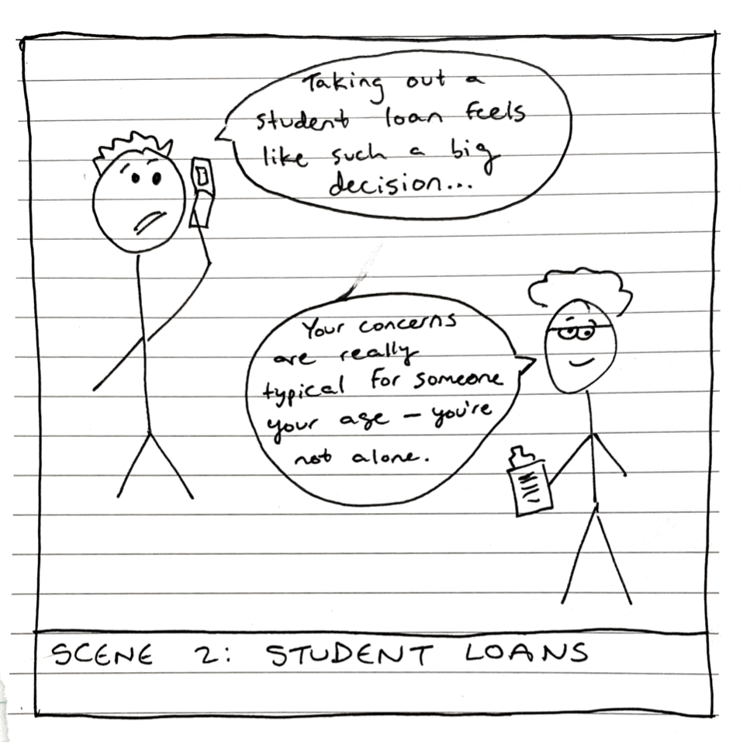
Don’t worry! Other people your age spend just as much money on food as you
I really want guac but it’s so expensive...

Slide 5
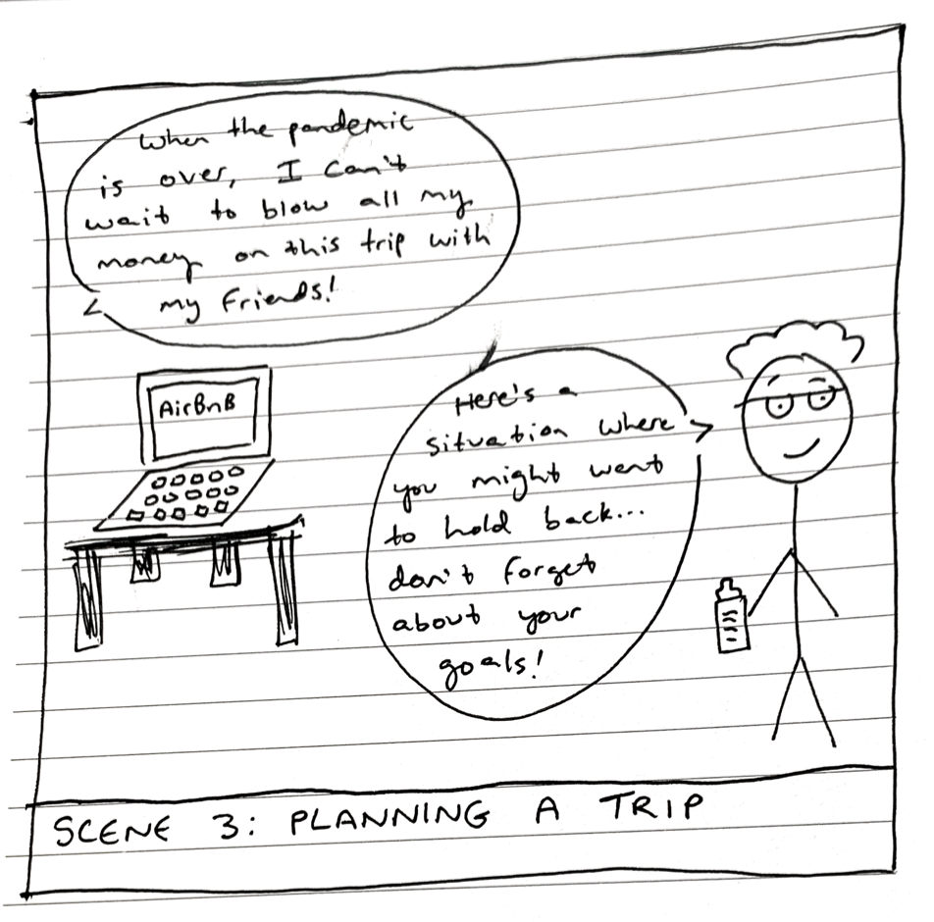
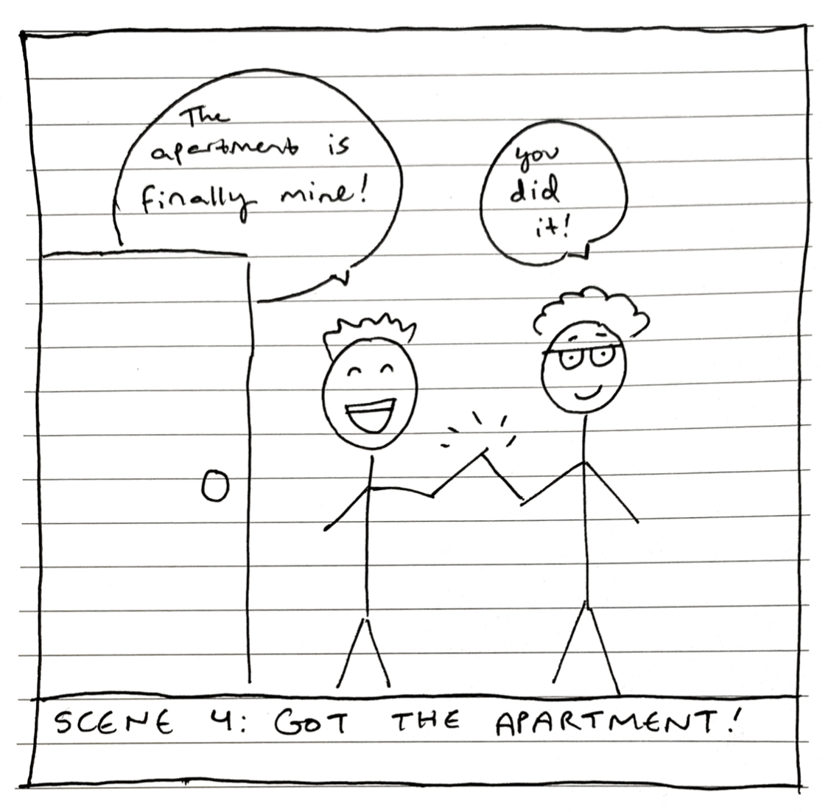

Slide 6
Budget Buddies

