Slide 1
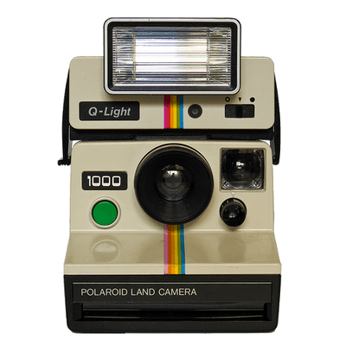
Flashback
Priyanka S.
Jo T.
Zak S.
Notes:
Problem domain - Storing Memories
Memories (Physical, location based, people)
Digital Preservation (Memorials, reviews, commemoration, re-live the glory days)

Slide 2
Overview
Who we are
Why our prototype
Task Flows
Feedback and suggestions

Slide 3
Flashback is an engaging way to store and review memories that matter.
Problem
In retrospect, people want more memories but don’t remember to capture them in the moment.
Solution
Digital journal with timeboxed prompts to encourage authentic memory creation and sharing.

Slide 4
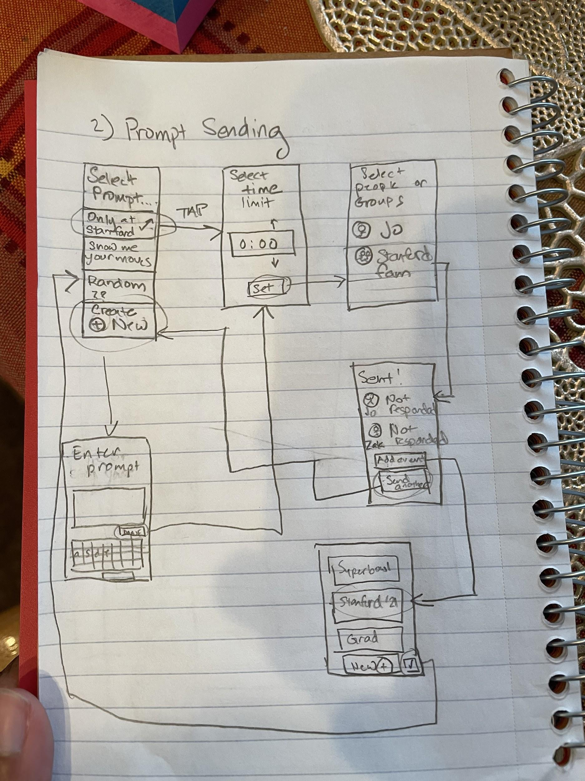
Selected Interface & Rationale
Chose a mobile device
Easiest way to record memory
Most common, most people are likely to have it in our demographic of interest
Most likely to be the device available during spontaneous events/moments of interest

Slide 5
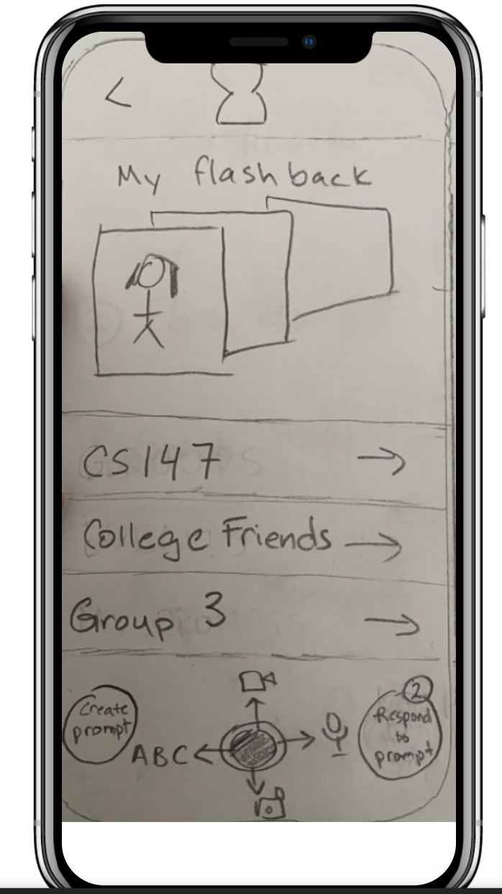
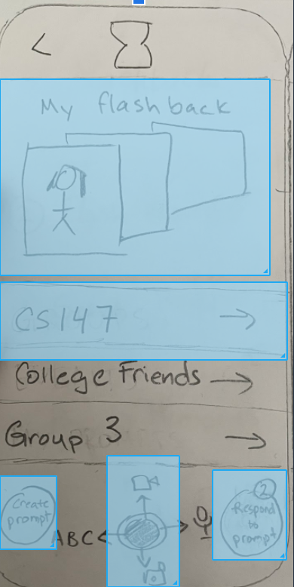
Low-fi prototype structure
https://marvelapp.com/prototype/606cad0/screen/76725157

Slide 6
Task Flows

Slide 7
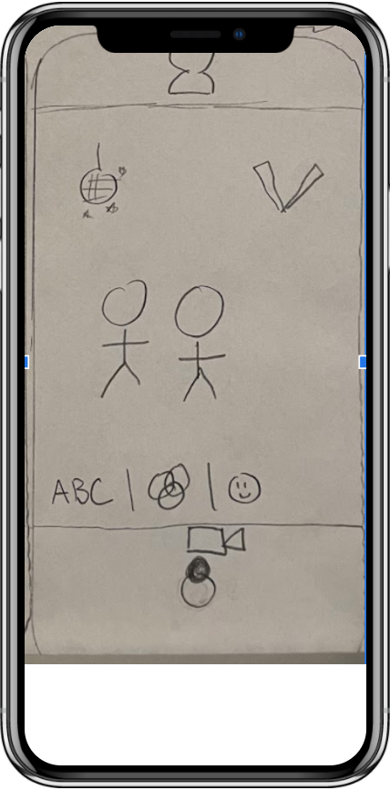
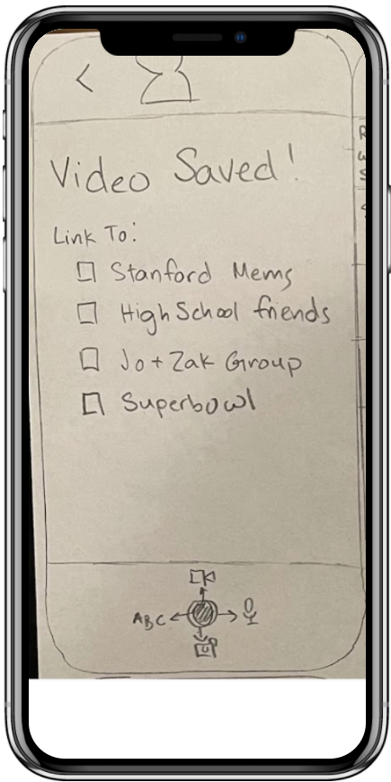
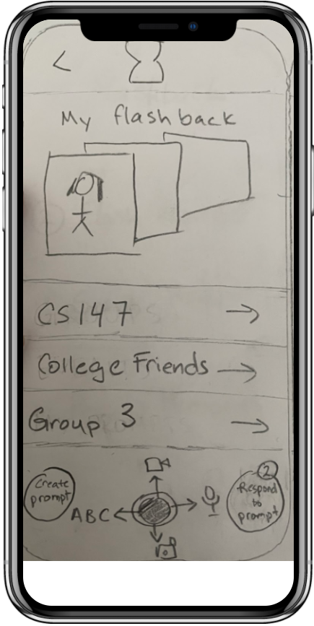
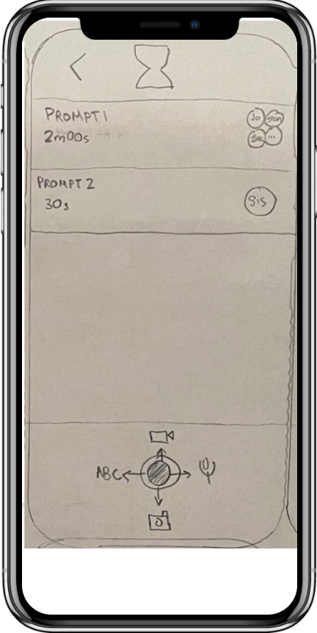
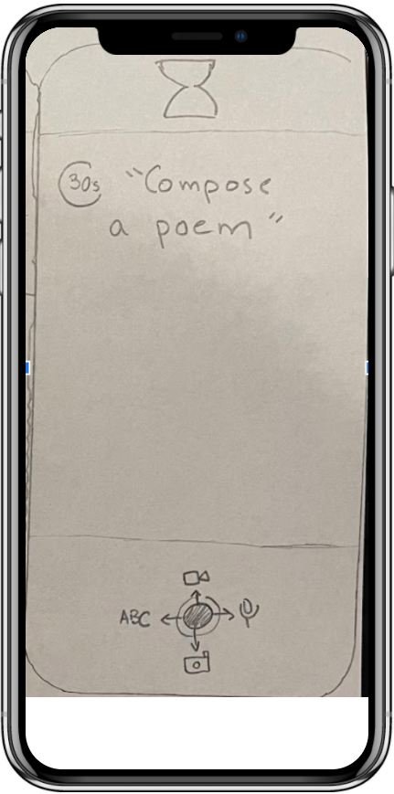
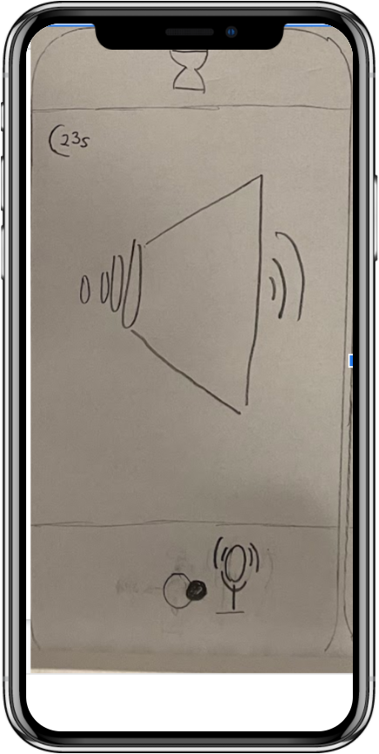
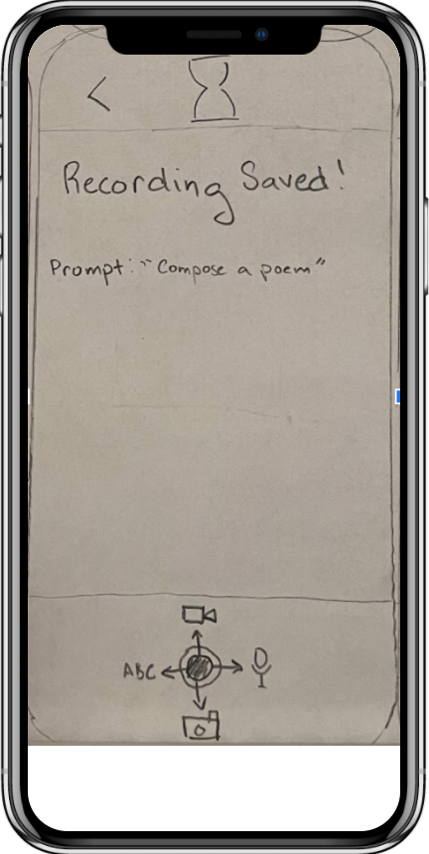
Task 1- Record an authentic memory

Slide 8
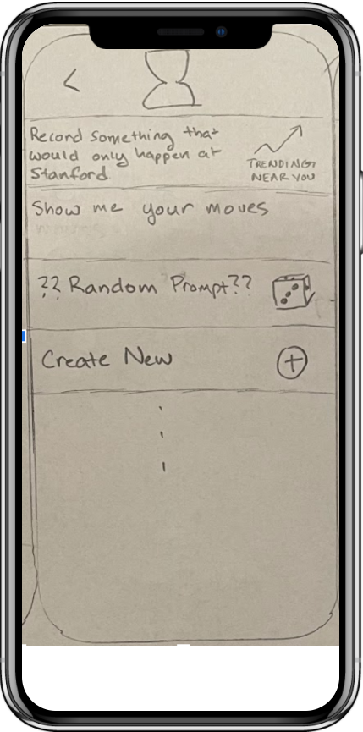
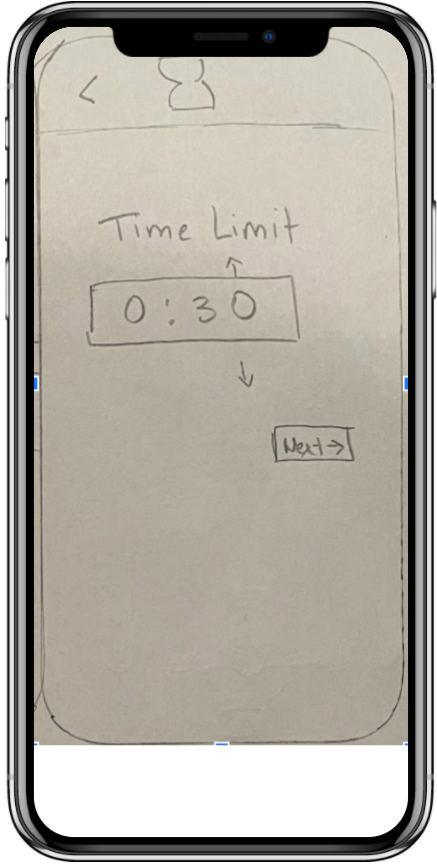
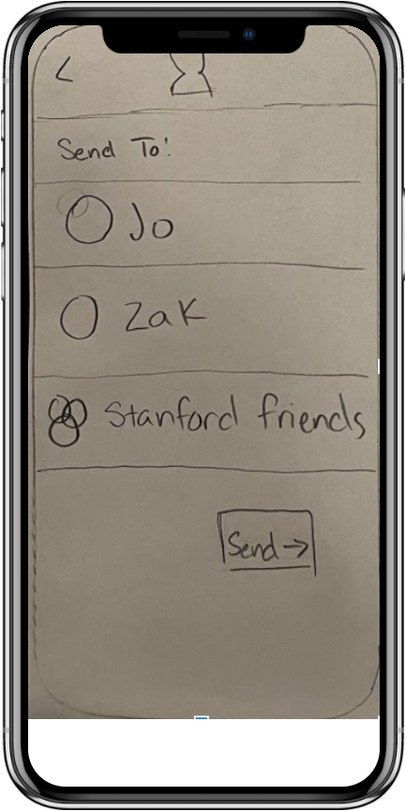
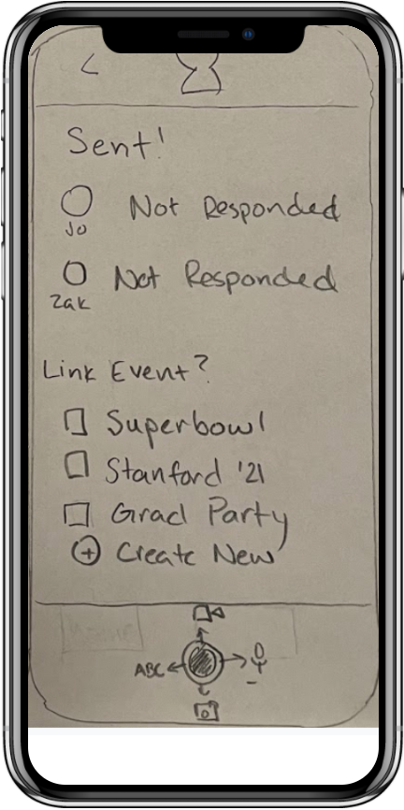
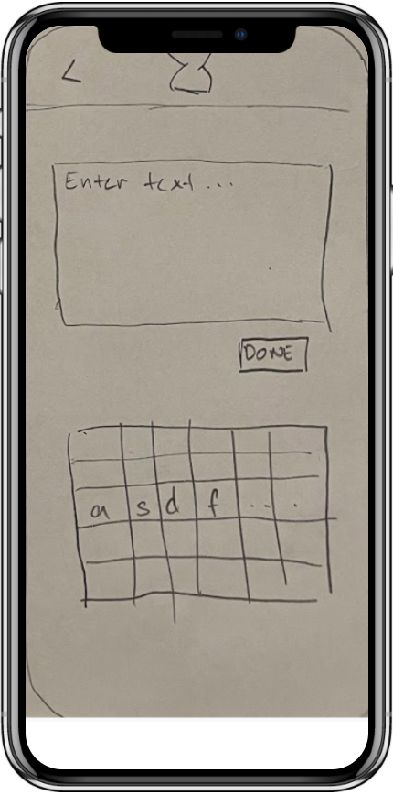
Task 2 - Encourage others to record memories that matter to you

Slide 9
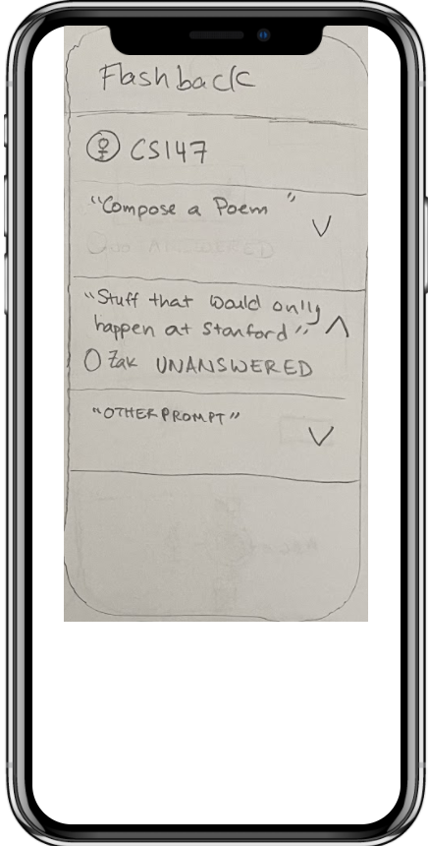
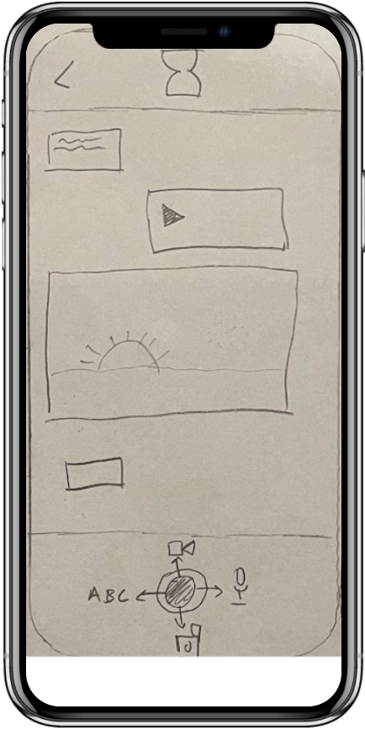
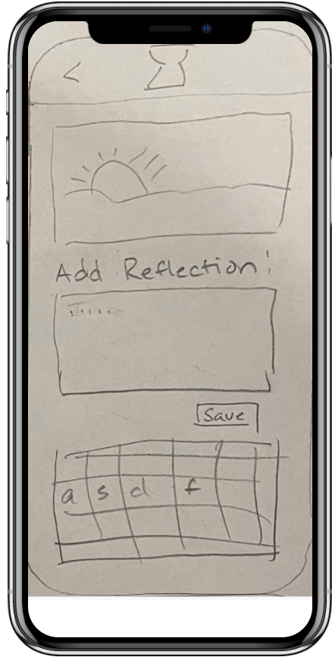
Task 3 - Engage with your flashbacks

Slide 10
Experimental method (participants)
a. Participants: demographics how they were recruited
Early to mid-20s
Recruited through friends
b. Environment
In their homes, remote/zoom, in person
c. Tasks
Record memory, encourage friend to record memory, review memories
d. Procedure
Take notes of any strong reactions
Take notes of any confusion
Do not tell them what any buttons do - if they appear confused ask what they expect certain buttons to do
e. Test Measures
Mainly qualitative
f. Team Member Roles
Rotating roles in each interview

Slide 11
Experimental Results

Slide 12
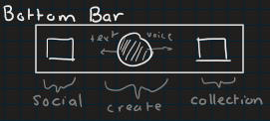
Experimental results
Finding out how to record a memory was quick and easy for 2 testers
One user found both methods saving memories extremely quick
Record button at bottom and responding to prompt

Slide 13
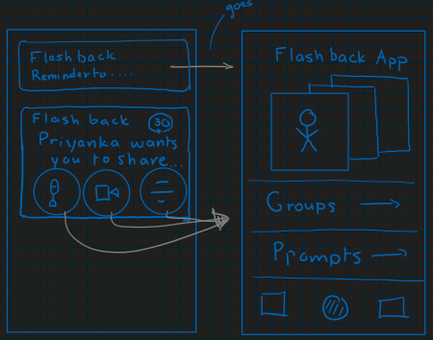
Experimental results
2 testers requested notifications
1 tester was confused by the need for a “time limit”

Slide 14
Experimental results
1 tester was confused by the concept of a “prompt” thought it was a reminder for herself
1 tester never made it to the “respond to prompts” screen
1 tester was very confused by the app flow. “This is the Oregon Trail but for apps.”
6 screens to send prompt

Slide 16
Suggested UI changes
Group threads
wasn’t a way to respond directly to the prompts from the “timeline”
Like/comment functionality for responses
Prompt Generation
“Time Limit” -> “Time to Respond”
Importance of Notifications

Slide 17
Summary
Easy to record memories
Further clarification for prompts needed
Simplify UI
Enjoy review process, but could include more interactivity

Slide 18
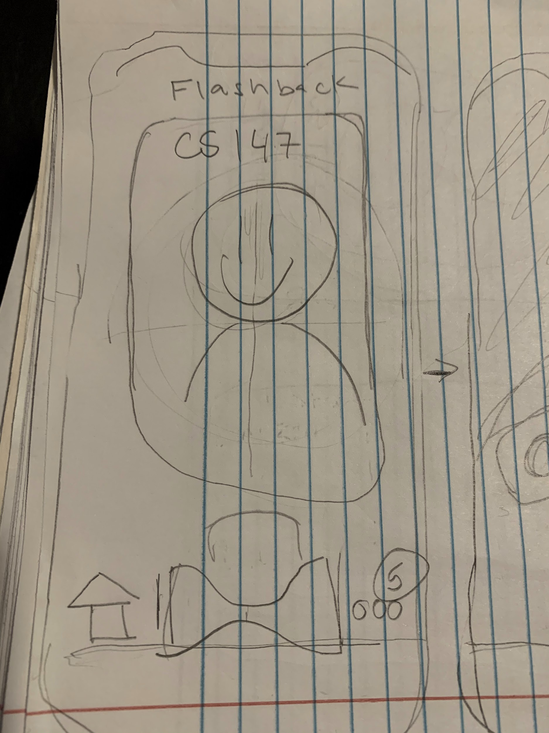
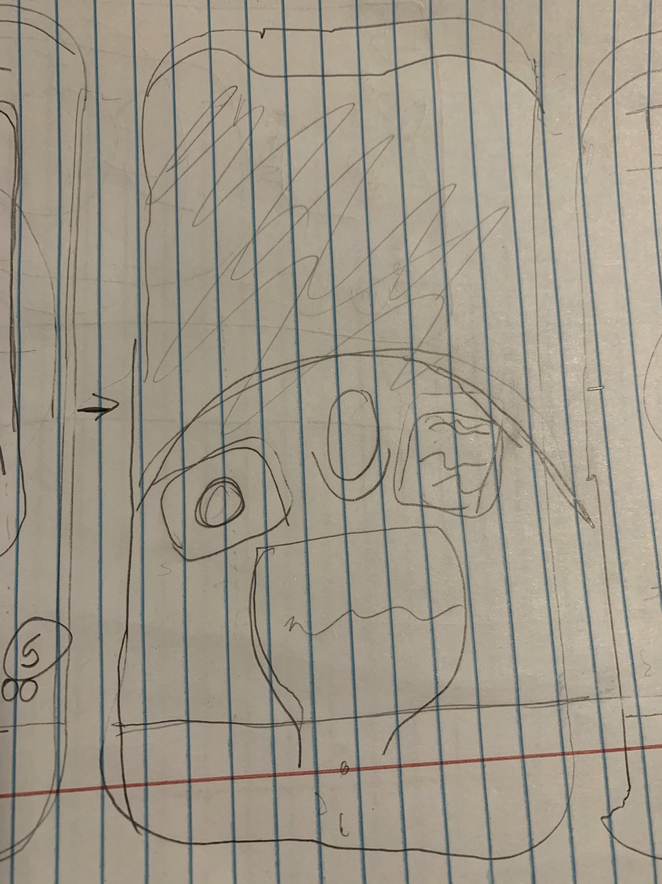
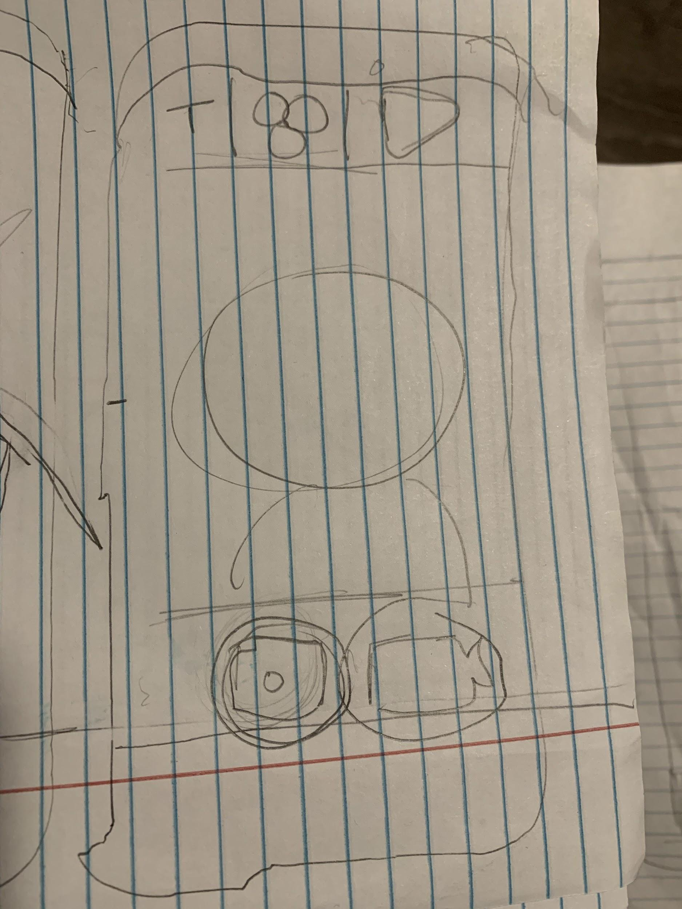
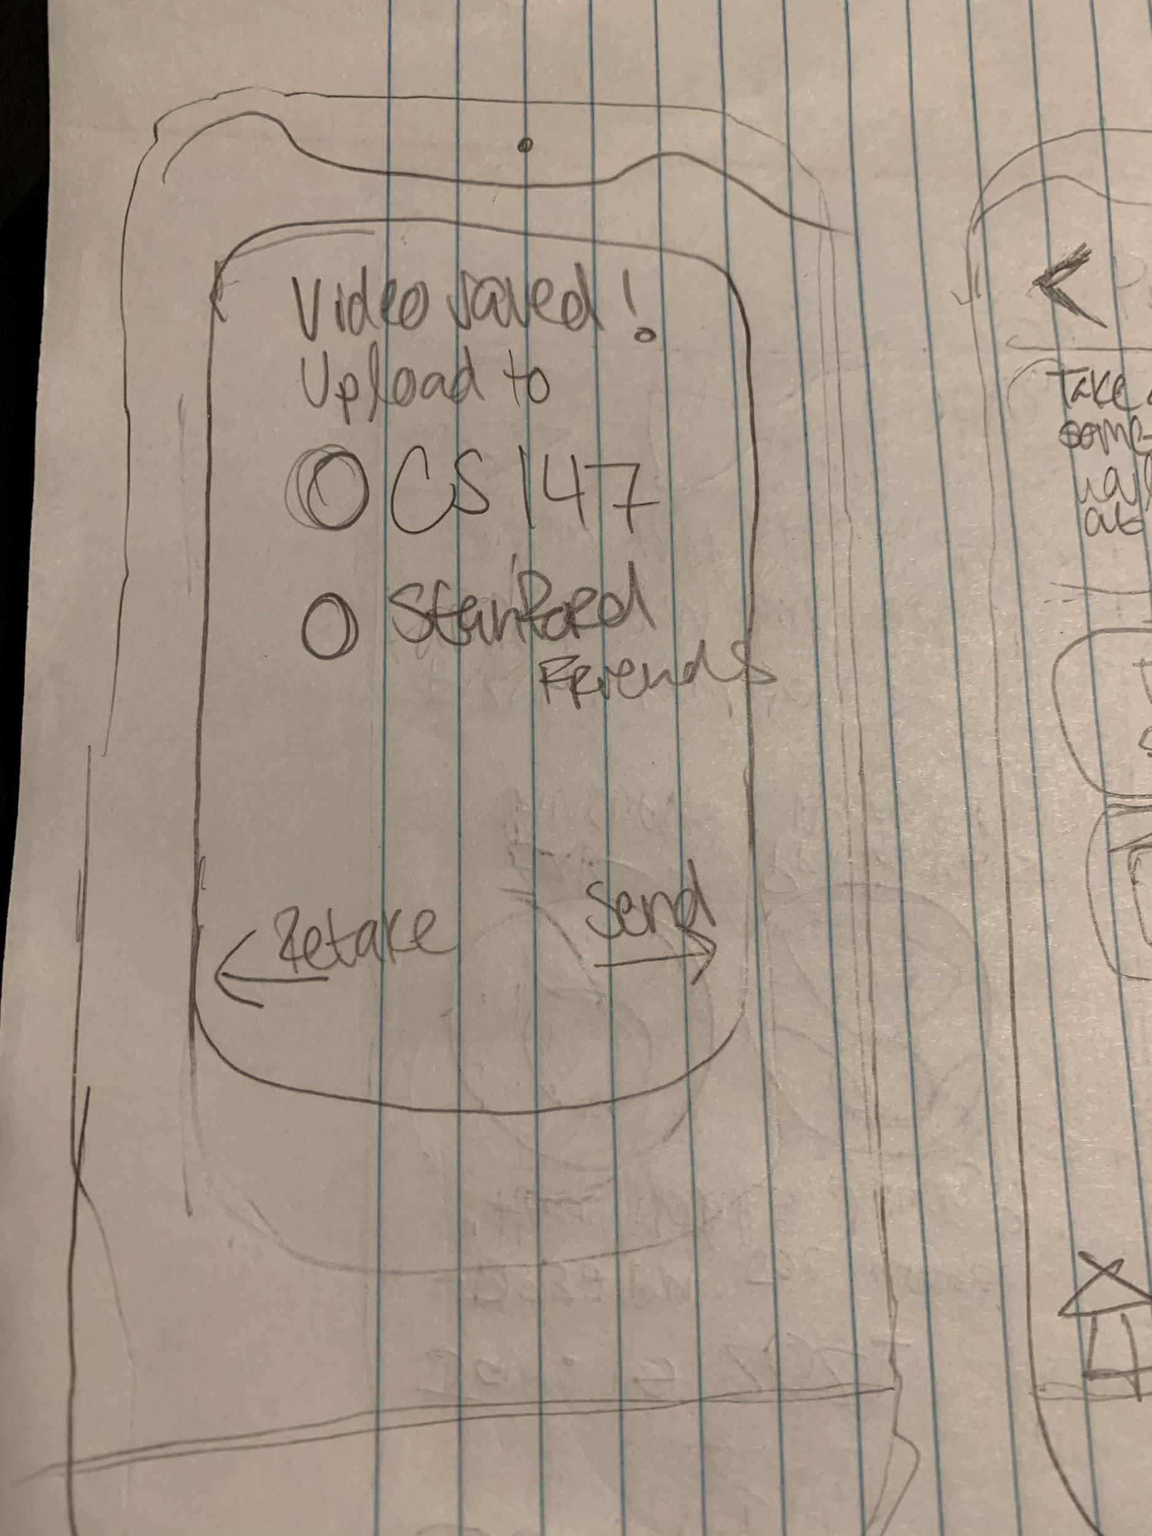
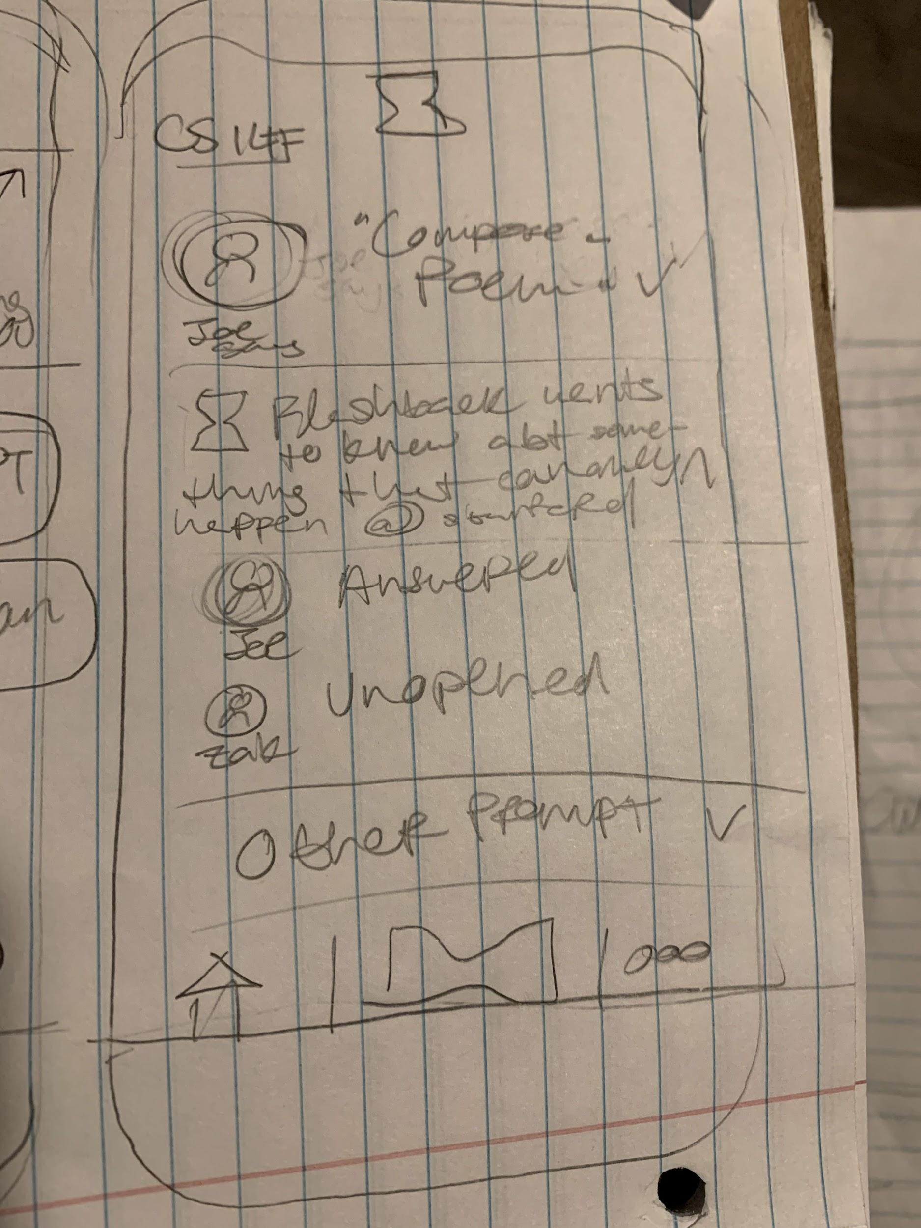
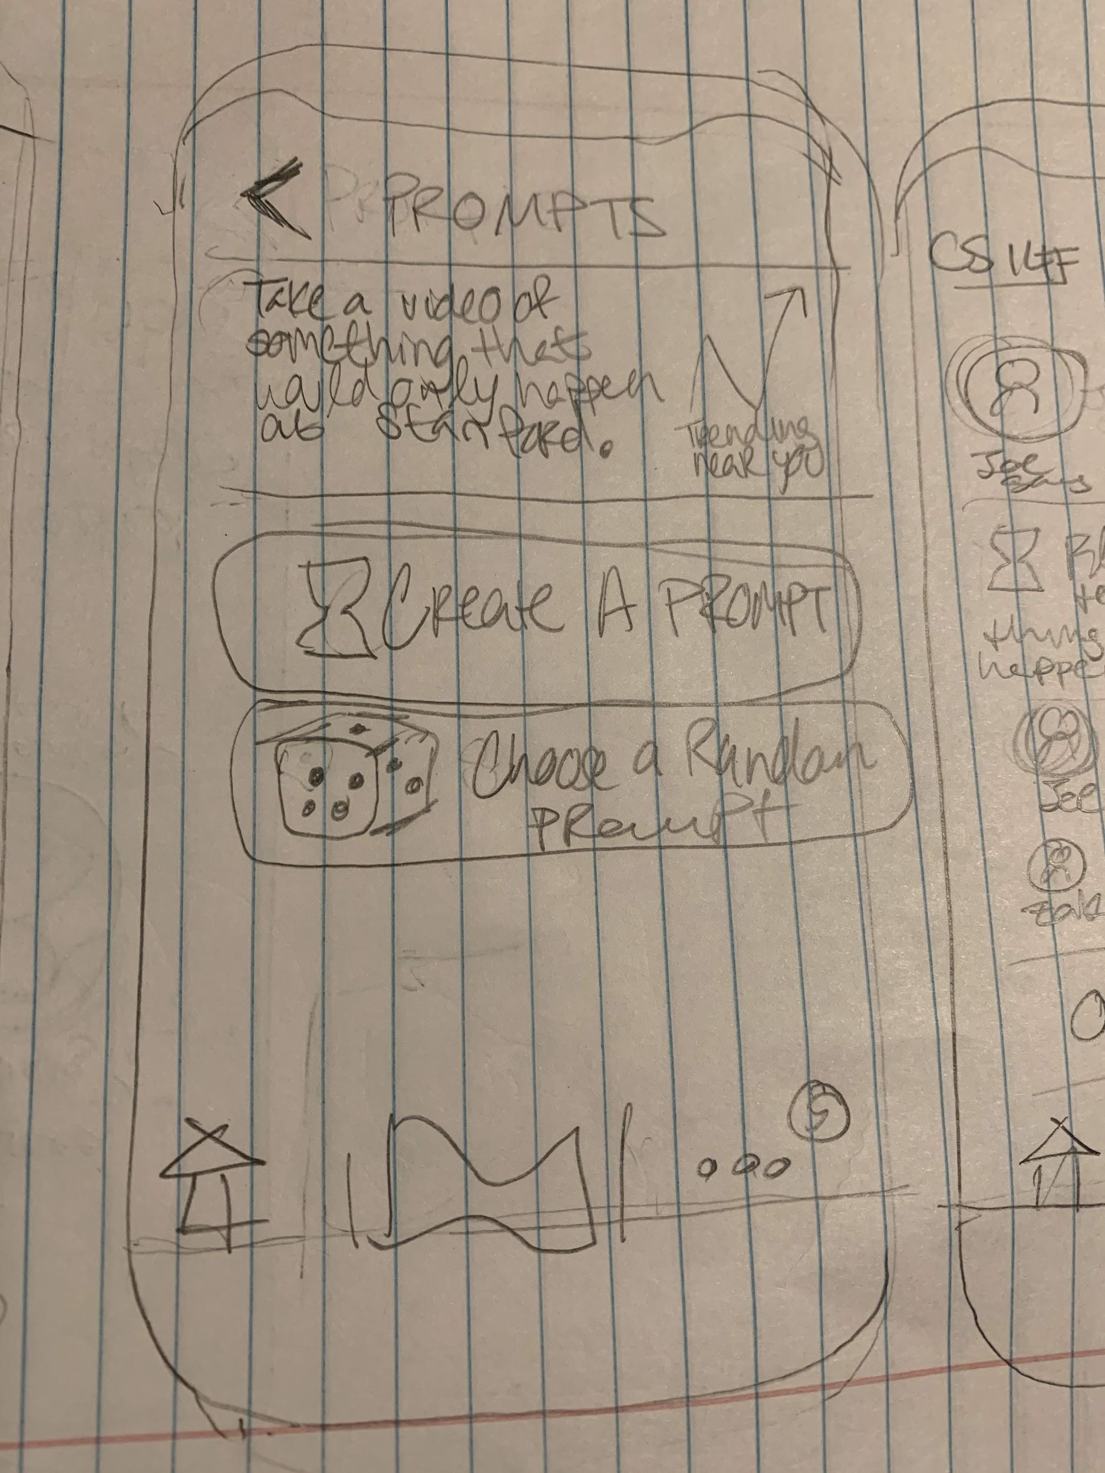
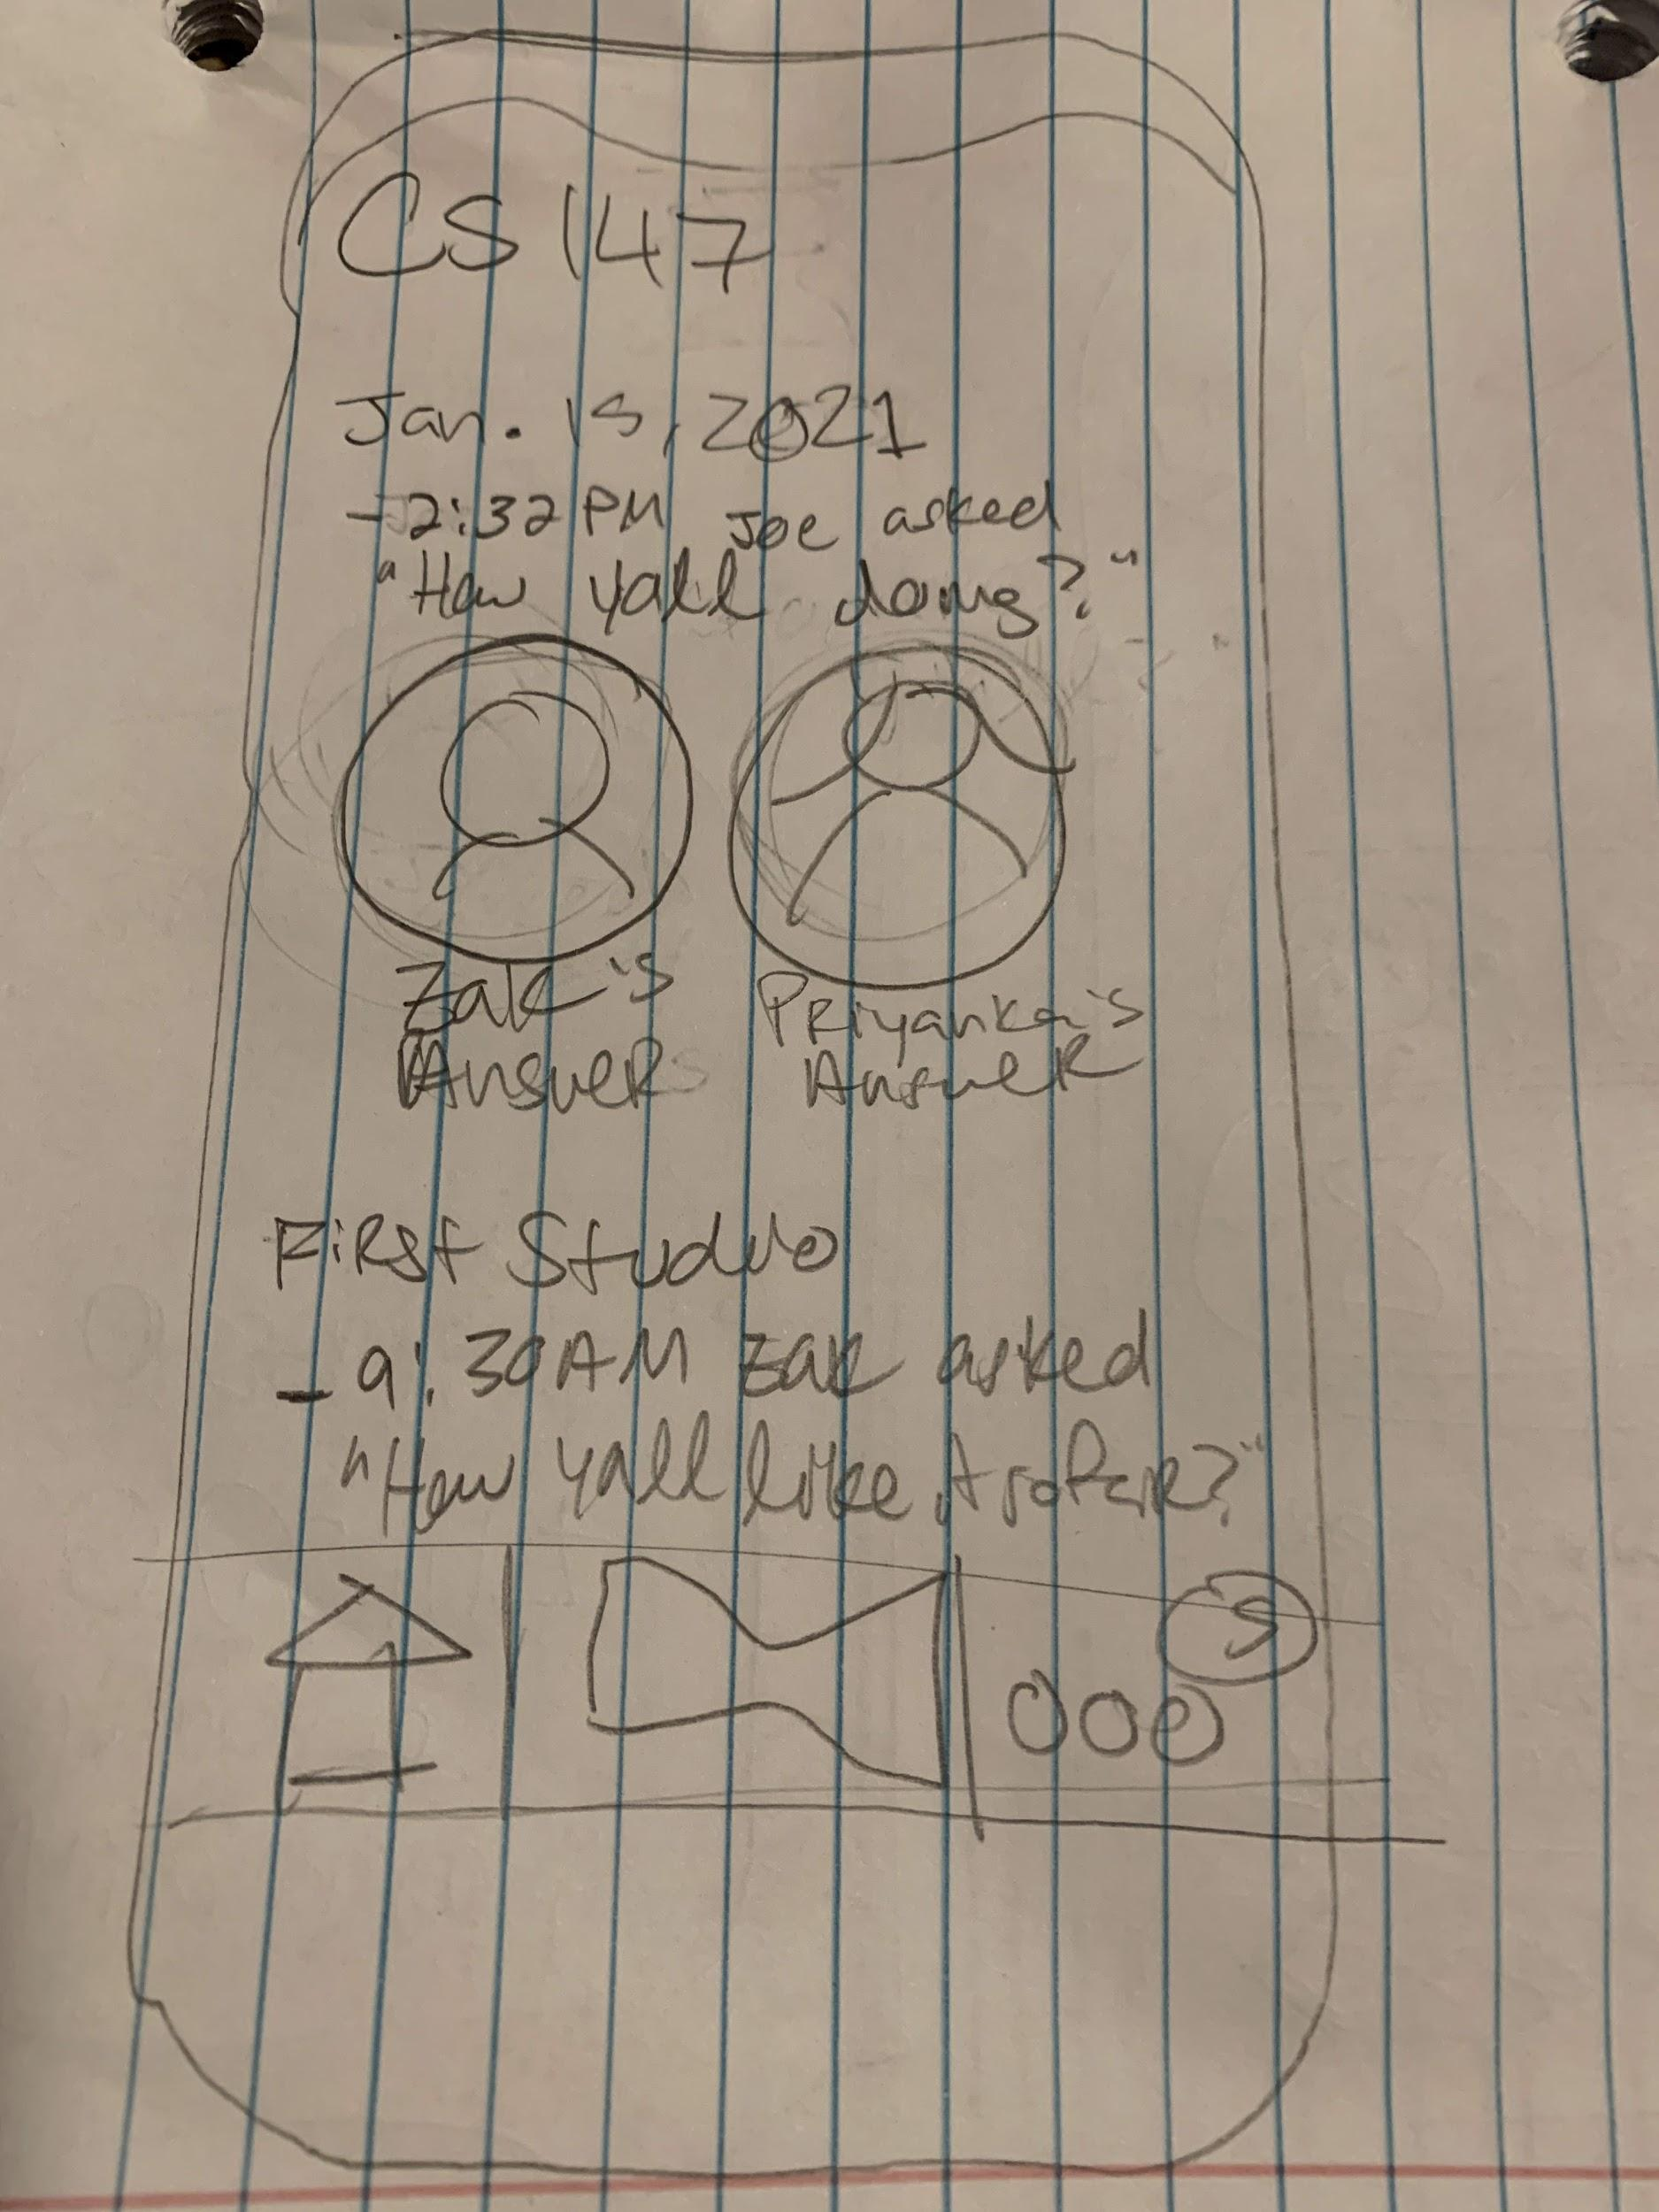
Appendix — Storyboard 1

Slide 19
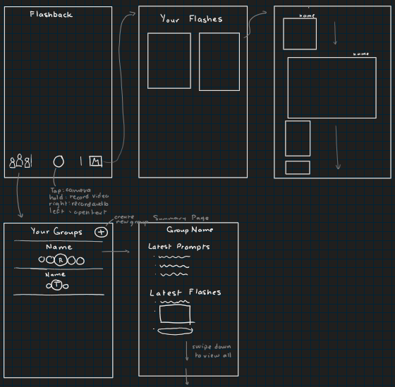
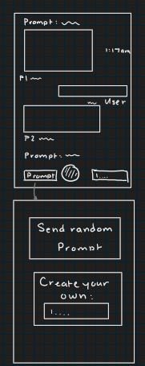
Appendix - Storyboard 2

