Slide 1
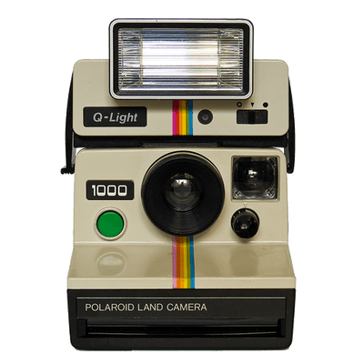
NOSTALGIA & MEMORY
Priyanka S.
Jo T.
Zak S.
Notes:
Problem domain - Storing Memories
Memories (Physical, location based, people)
Digital Preservation (Memorials, reviews, commemoration, re-live the glory days)

Slide 2
Flashback
Problem: In retrospect, people want more recorded memories but don’t remember to capture candids in the moment.
Solution: Digital journal with timeboxed prompts to encourage authentic memory creation and sharing.
An engaging way to store and review memories that matter

Slide 3
Tasks
Simple
Medium
Complex
Record an authentic memory
Encourage others to record memories that matter to you
Create and engage with your flashbacks

Slide 4
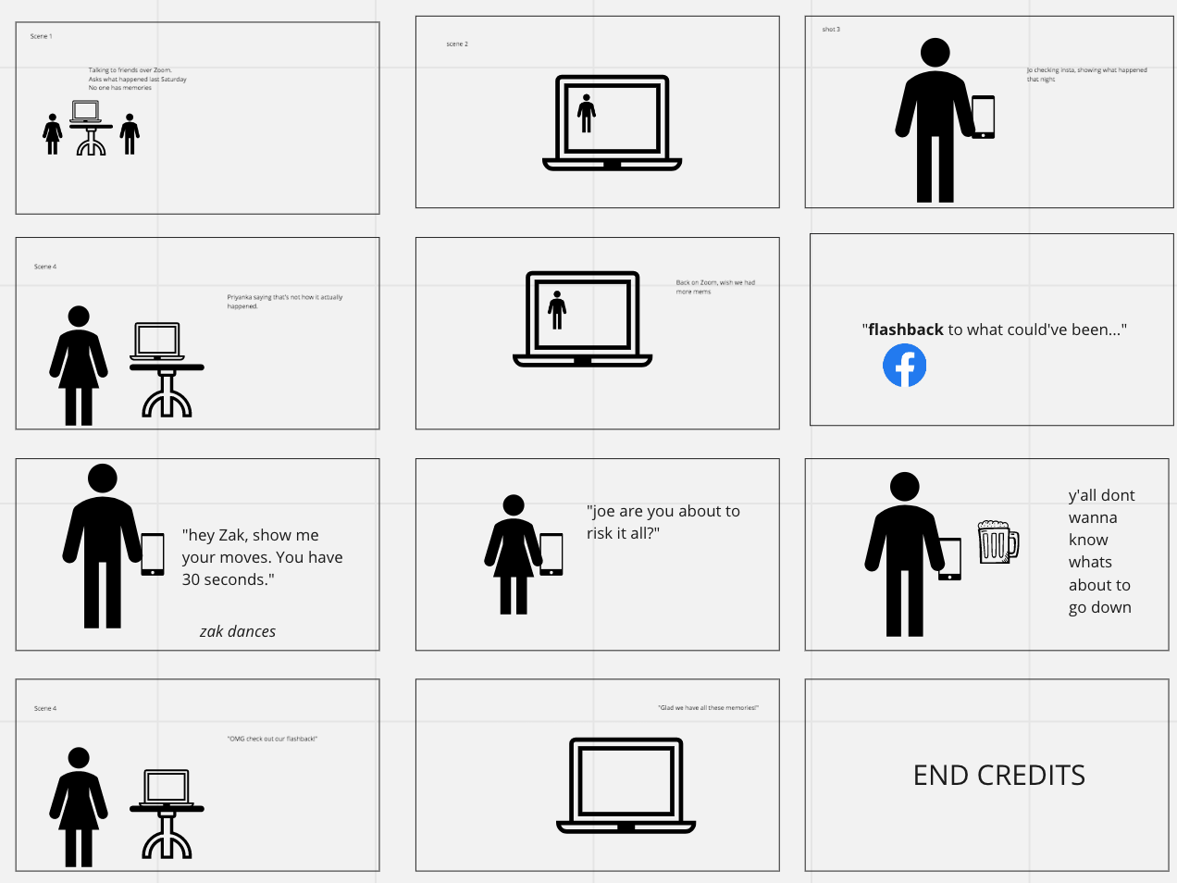
Storyboard: https://miro.com/app/board/o9J_lWYhPZ8=/

