Slide 1
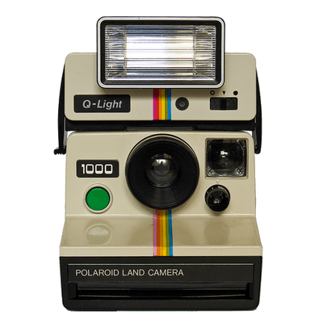
NOSTALGIA & MEMORY
Notes:
Problem domain - Storing Memories
Memories (Physical, location based, people)
Digital Preservation (Memorials, reviews, commemoration, re-live the glory days)

Slide 2
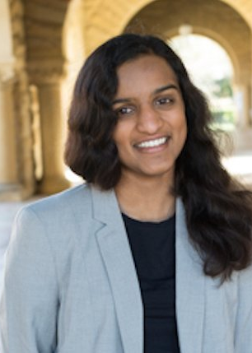
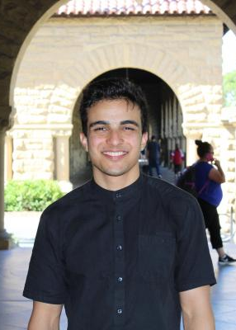
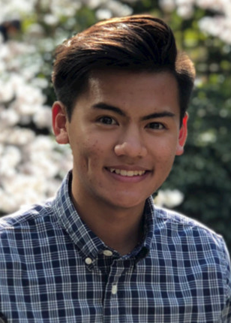
TEAM
PRIYANKA
ZAKARIA
JO
Major: CS (AI)
Major: Political Science
Major: CS (Biocomp)
Notes:
Problem domain - Storing Memories
Memories (Physical, location based, people)
Digital Preservation (Memorials, reviews, commemoration, re-live the glory days)

Slide 3
WHAT WE ASKED
01
CHATTING
Question: Where did you grow up?
Question: Favorite memory from when you were a kid?
02
PRIMING
Question: Tell me about a loved one or experience you hope to remember or wish you remembered better.
03
Question: What are the things you remember about that person (or experience)?
STORIES
04
Question: What’s your favorite way to relive memories of that person or experience?
SUGGEST

Slide 4
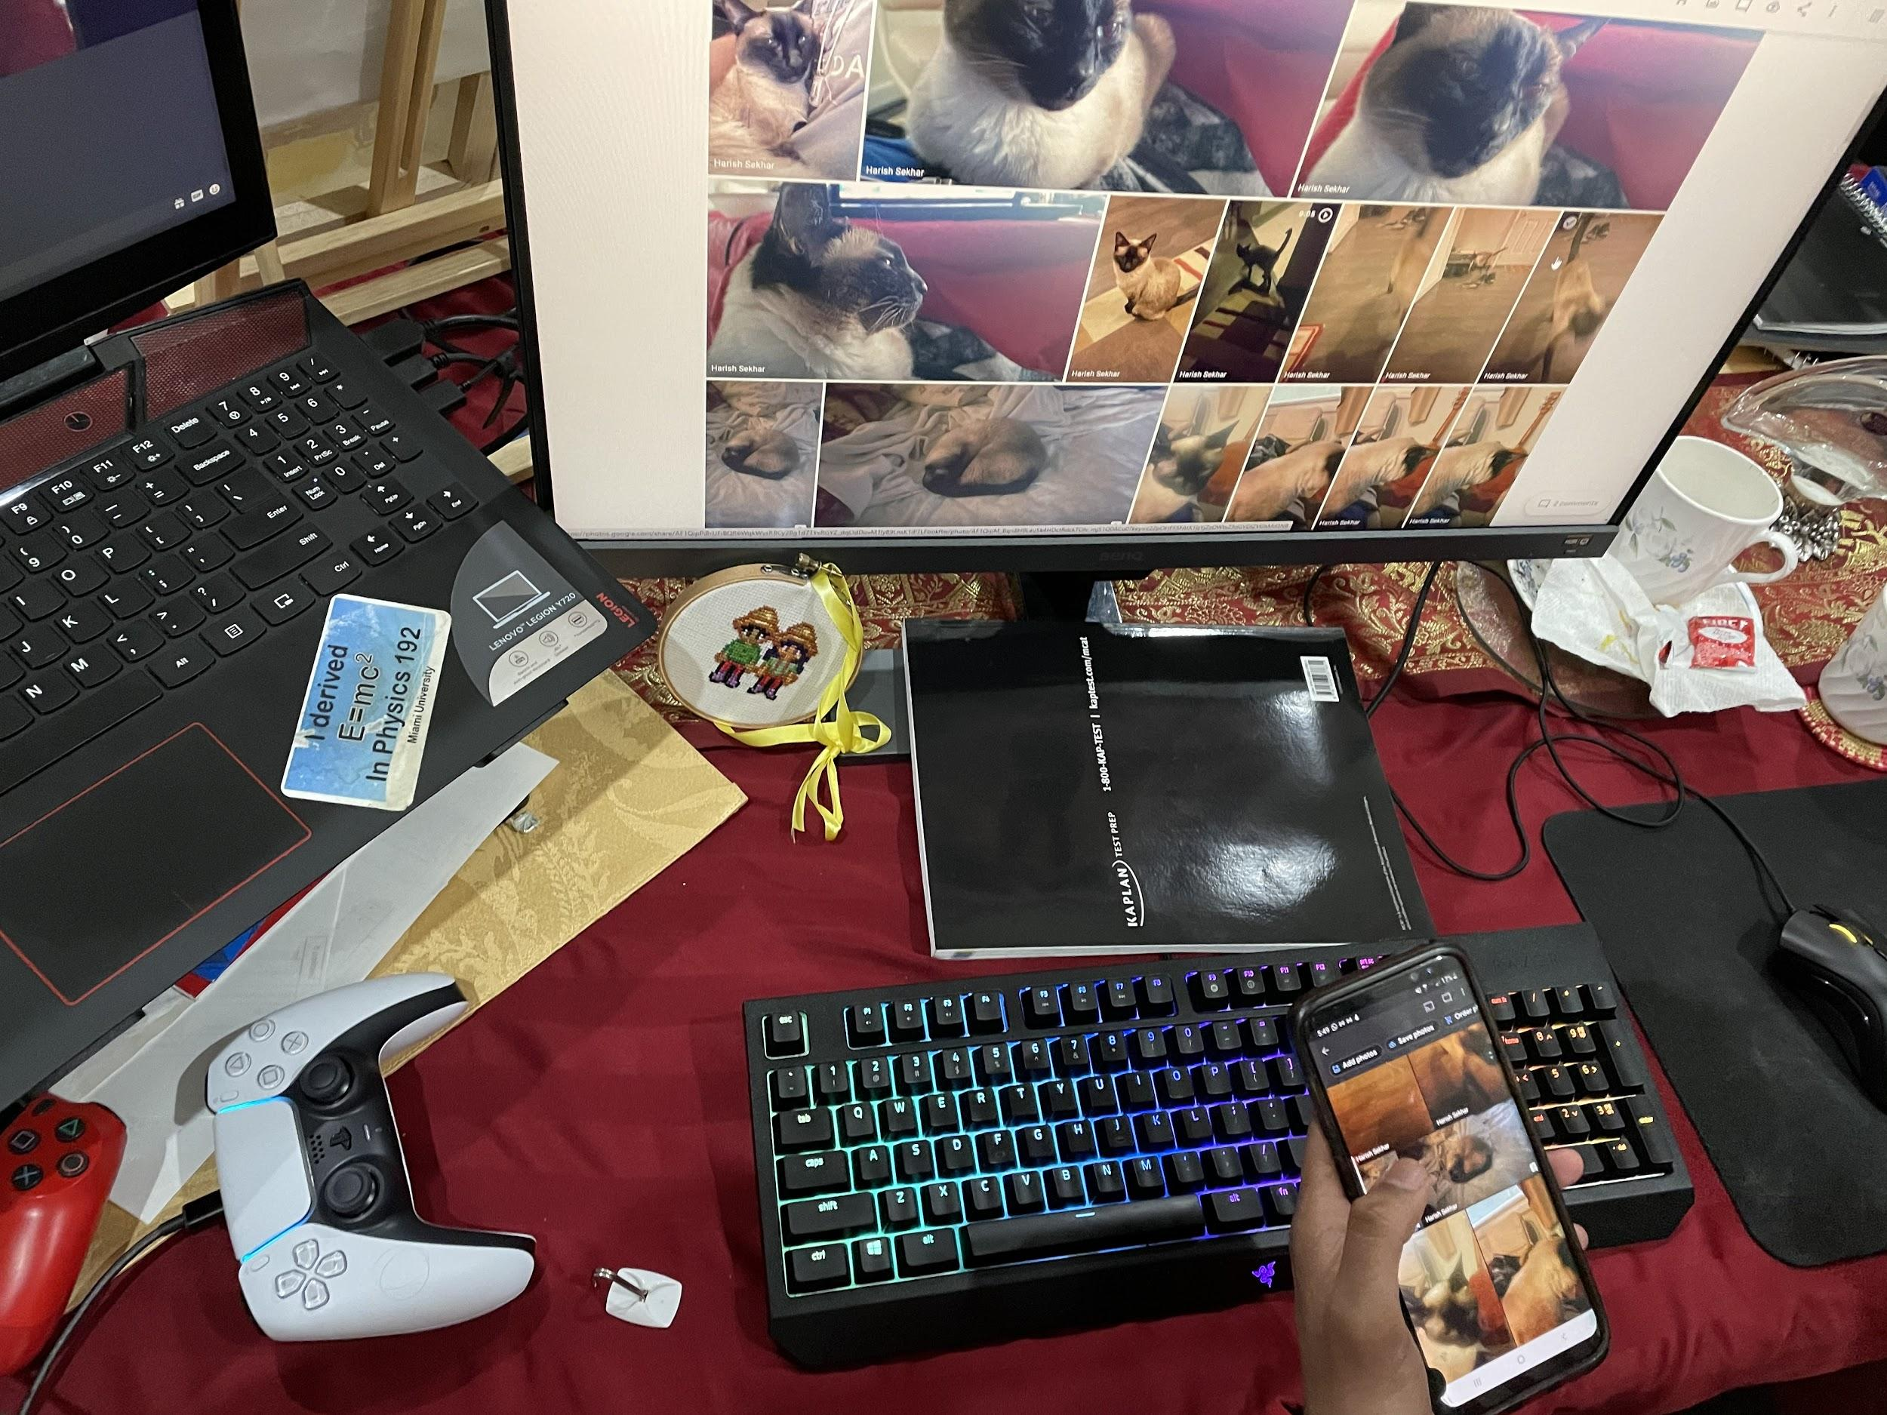
NEED-FINDING INTERVIEWS
Harish
Who: Miami U Student, 23
Why: Tech Savvy
Where: Ohio
How Comp: N/A
“[My girlfriend] might have taken a screenshot since she screenshots everything - thank god”
Notes:
Wanted to commemorate the cat
Doesn’t spend a lot of time taking pictures in regular life
Prefers videos as a way of storing memory
Was missing a specific photo he knew existed
Is collaborating on building out a Google Photo folder of pictures and videos

Slide 5
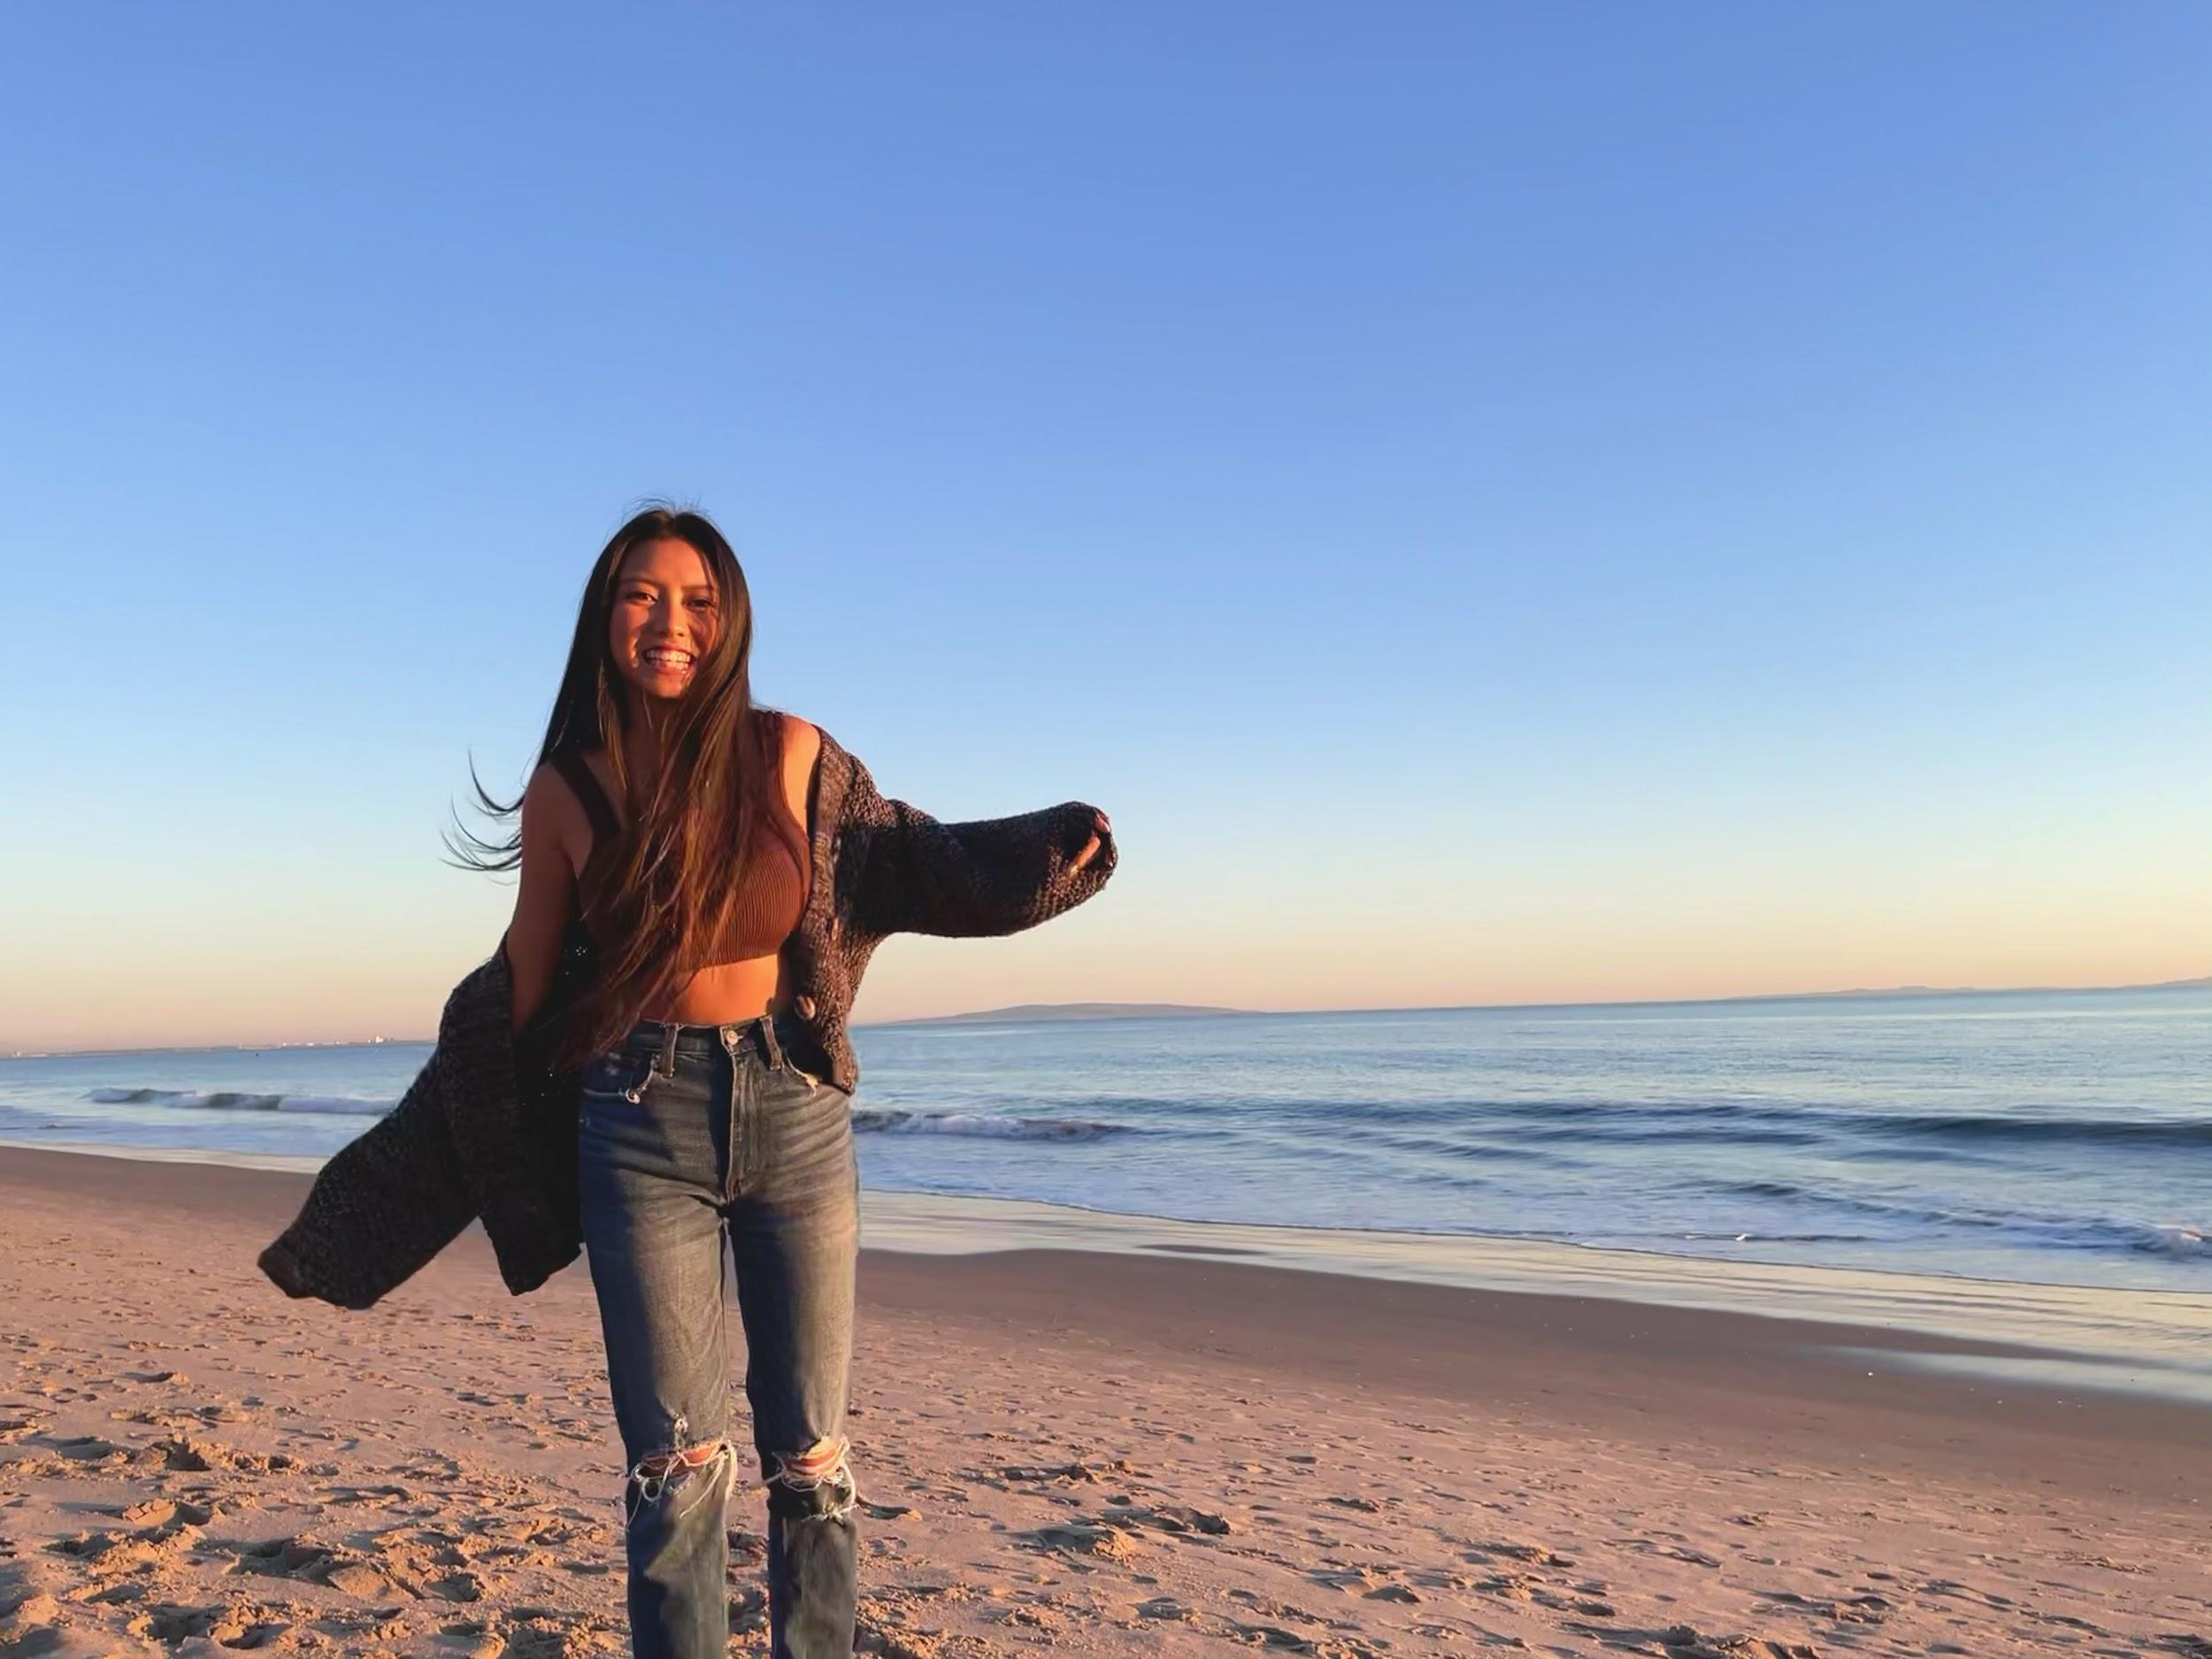
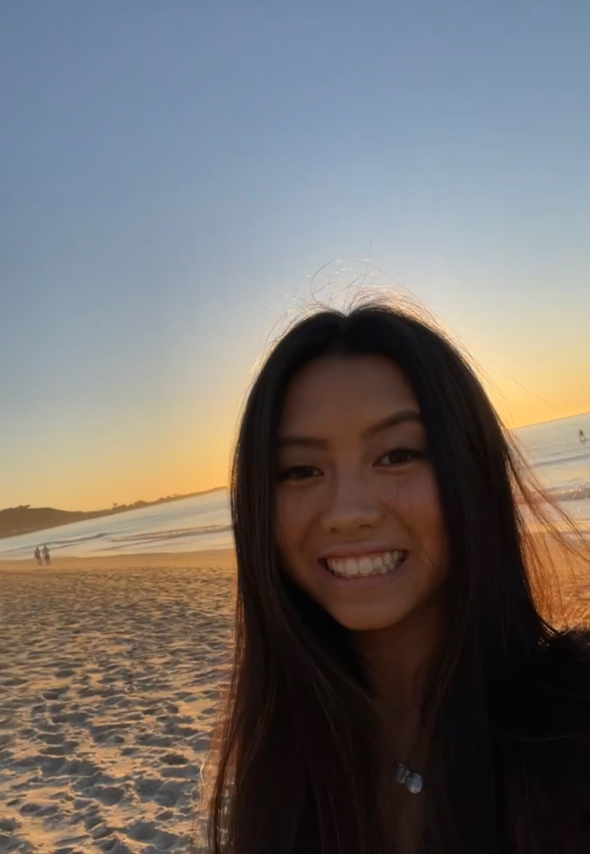
NEED-FINDING INTERVIEWS
Noel Tran
“Someone had a video of me recording video of my friend who was recording a video of herself doing...”
Who: UCLA, 20
Why: Pre-med gang
Where: Las Vegas
How Comp: N/A
Notes:
Records snapchat but doesn’t sent them out to people
Piece together events with friends (lots of different perspectives) - there’s an interactive element here
Snapchat = casual and candid enough; insta and pictures are staged
Never regrets taking too many videos - depends on who shes with (social aspect: with people who take more photos -> she’ll take more photos)

Slide 6
NEED-FINDING INTERVIEWS
Cindy
“I wish he could’ve left me a voicemail… so I could feel him again.”
Who: 50 year old mother of two
Why: Older demo, different relationship to memory
Where: Ohio
How Comp: N/A
Notes:
Spoke about her stepfather
Mentioned specific phrases and things he’d said to her
Wasn’t a big picture taker, but worried about remembering more things
Connected with audio — “I wish he could’ve left me a voicemail… so I could feel him again.”

Slide 7
Say
“When I see [photos of my stepdad] there’s sadness because I miss him, grat[itude] for having
had him in my life, laughter when I think of a funny memory, and joy.”
“Remembering him is extremely important to me.”
“I wish I remembered my stepfather better. He was the most influential person in my teenage years and inspired me to be a better person. He told me that ‘of all my children, I know that you’ll be the one to make a difference.’”
“I should’ve taken more photos of videos”
Think
“My stepdad taught me more lessons than I’d thought”
“I wish I remembered more”
“I’m scared of forgetting the memories I have”
“Pictures take me back and I hear his voice in my head.”
“His legacy was his sense of family. If you needed him to be there, he was there.
He was love.”
“I wish I could’ve known my stepdad better”
“There are all sorts of triggers. [My husband] will be watching golf and say ‘I used to do this with your dad.’”
“I’m so lucky to have had my stepdad in my life”
“I miss doing things with my stepdad”
“I don’t go looking for memories in pictures. They just come about.”
“The thing I remember about [my stepfather] was his laugh. His smile when anyone walked into the room. His joy and the way he would talk to my kids.”
“I wish my stepdad could see who I am now”
“I wish he could’ve left me a voicemail… so I could feel him again.”
“I wish I could still talk to him”
“There was more I had to learn from him”
“I wish my stepdad could say he’s proud of me”
Looking up when remembering her stepfather
Tearing up at moments
Imitating the vocal patterns of her father when quoting
Grateful
Regretful
Relaxing shoulders midway through the interview
Joyous
Nervous
Fulfilled
Nostalgic
Wistful
Closing eyes when talking about specific stories
Laughing when recalling specific quotes
Sighing when talking about her memory patterns
Longing
Warm
Distant
Pensive
Frustrated
Do
Feel
Notes:
Zak

Slide 8
QUOTES FROM THE FIELD
“I’m scared of forgetting the memories I have”
“I wish I was reminded of these memories more frequently than a year”
“The shared folder is so hard to find”
“My groupchat always has a different POV of the things that happened”
“Sometimes pictures feel too posed.”

Slide 9
SURPRISES/TENSION
Audio
Take it in or take it home
Happy Stuff Only
Photo/Video isn’t the only component of memory
Some wish they had audio recordings of their loved ones instead
People say they want to remember everything… but they tend to only store and curate the good stuff
Tension: Some pictures bring great and sad memories
“I wish I had more pictures from her younger days”
vs
“I don’t like stopping to take pictures while doing an enjoyable activity”
Notes:
Leap - for some users, collecting memory distracts from enjoying the moment, thus making the memory less engaging and thus less meaningful/important to preserve

Slide 10
FINDINGS
Candid
Interaction
Crowdsourcing
Most powerful stored memories capture the emotion of the moment, whether mundane or exciting.
The act of piecing together a memory can be an engaging experience independently of the finished product.
Memories are communal, and the entirety of an event is often pieced together using media from multiple people.

Slide 11
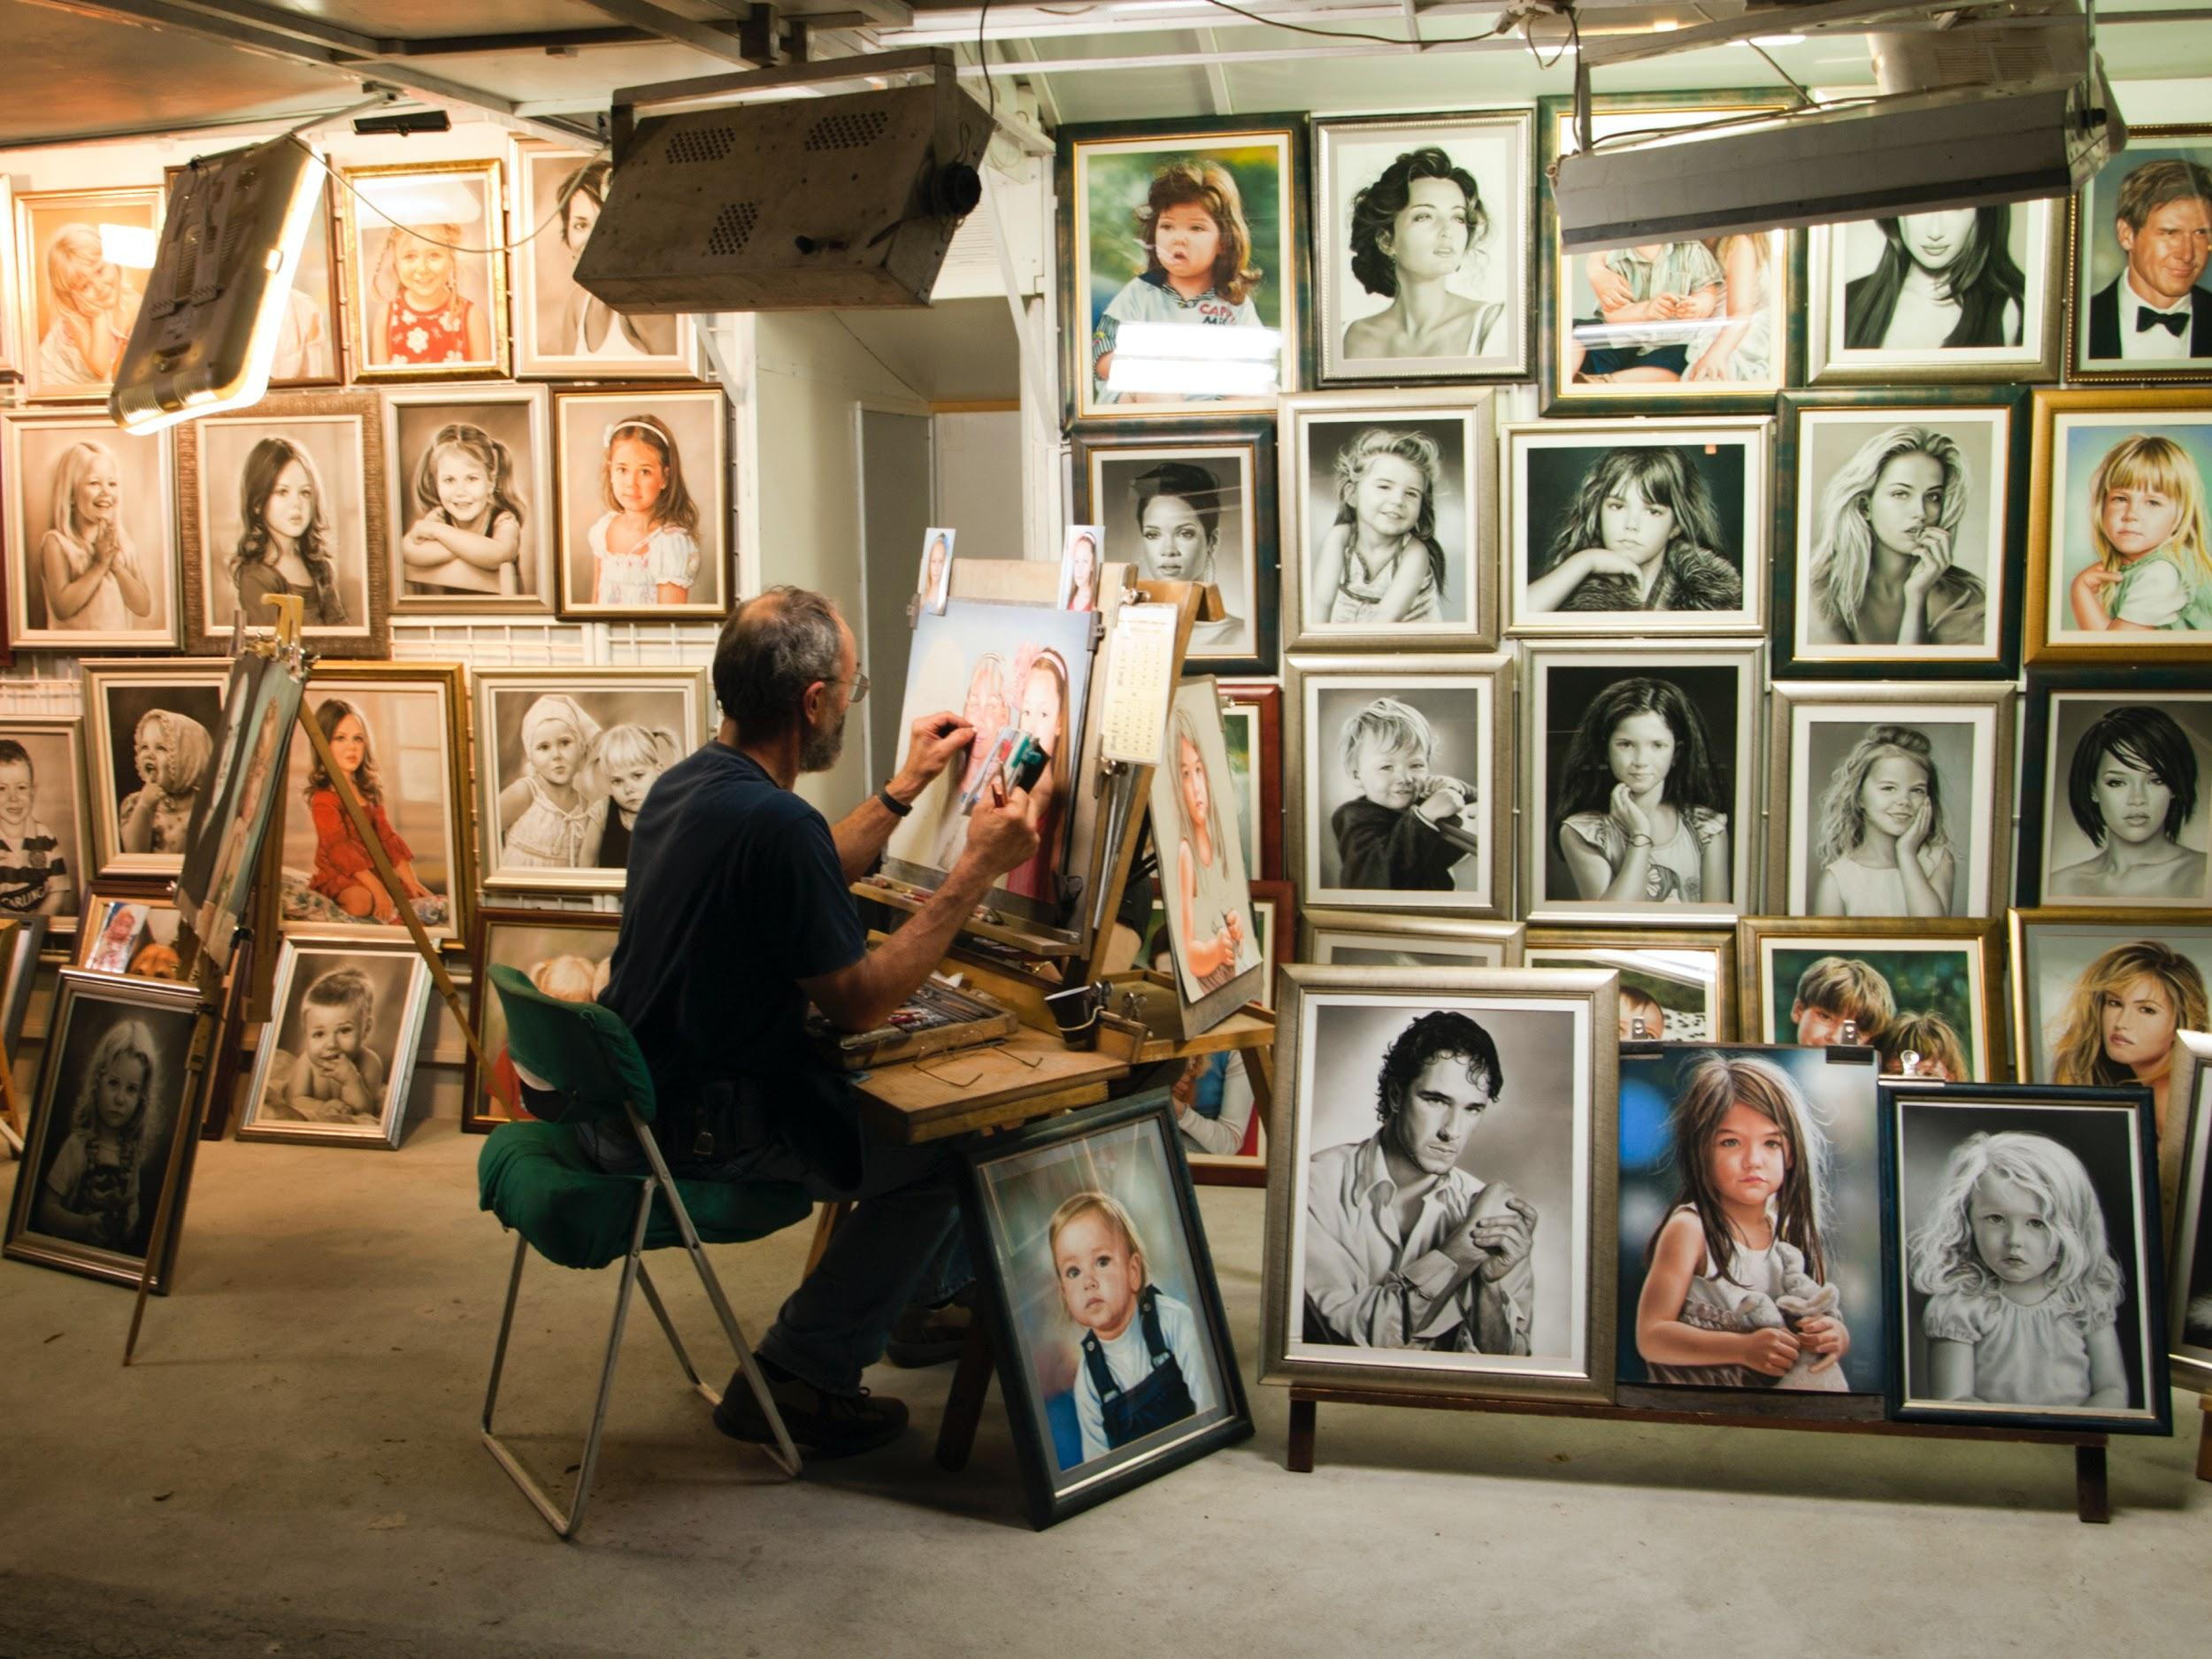
MEMORY & FAMILY
INTERVIEWS
INSIGHT
MOVING FORWARD
We met participants of varied age and lifestyle who believe memories are important.
We were amazed to realize people enjoyed keeping their memories alive and valued authenticity over quality.
It would be game changing to make candid memory collection more engaging and interactive.
Notes:
Collect memories without distracting from the physical moment in which they are happening

Slide 12
Questions?

Slide 13
...and our sets of editable icons
You can resize these icons, keeping the quality.
You can change the stroke and fill color; just select the icon and click on the paint bucket/pen.
In Google Slides, you can also use Flaticon’s extension, allowing you to customize and add even more icons.

Slide 14
Educational Icons
Medical Icons

Slide 15
Business Icons
Teamwork Icons

Slide 16
Help & Support Icons
Avatar Icons

Slide 17
Creative Process Icons
Performing Arts Icons

Slide 18
Nature Icons

Slide 19
SEO & Marketing Icons

