Slide 1

BudgBuds
d
Notes:
Welcome to budgbuds, where you don’t have to budget alone

Slide 2
“where you don’t have to budget alone”
value proposition
Problem
People who regularly spend in social groups are often unable to regulate their expenses and give in to social pressure.
Solution
An app supplemented by social accountability, for groups to collectively budget for activities that require communal spending, while factoring in individual financial means.
Notes:
BudgBuds stemmed from the insight that many of us struggle to stick to our budget, especially when spending in a group setting, largely due to social pressures. And since our budgets are often personal, we don’t feel comfortable letting our groups know when we go over-budget.
Our solution is an app that allows you to take advantage of social interactions and accountability to create and maintain budgets, even while in a group setting (through group budgets).

Slide 3

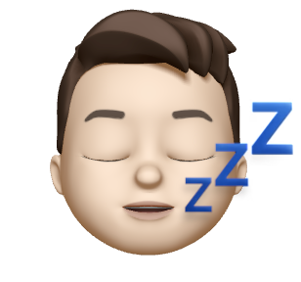


RAAGAVI
Junior - CS
Has had hair catch on fire twice
JACOB
Junior - CS
Is a knight of Sealand
HABEEB
Junior - BMC
Never been in the ocean
MELVIN
Masters - MS&E
Just tired

Slide 4
HEURISTICS
Notes:
To move into how our app has developed since receiving feedback, we’ll first look into the results of the heuristic evaluation...

Slide 5
Results
Severity 3 violations:
15 total → 11 changes
Severity 1-2 violations:
34 total → 15 changes
Most violated heuristics overall:
H3 - user control (6)
H4 - consistency (7)
H7 - efficiency (8)
Notes:
We had 15 total severity 3 violations and were able to make 11 modifications to our app
The severity 1-2 violations were more prominent and we were able to include some of these in our UI changes as well
And we had no severity 4 violations.
In terms of of our most frequently violated heuristics overall
consistency, that dealt more with our language and the terminology we used in our app (so we had to work to make that more uniform throughout the app)
with user control and efficiency, alot of the problems that were mentioned dealt with giving users more flexibility and power with the groups that are created and the friends within a group
Even though from these categories we only had 1 or 2 severity 3 violations, we decided to mention them here because (as you’ll see when we describe the UI changes we made) these 3 constituted the most significant and widespread problem within our app

Slide 6
Severity 3
NOTIFICATION
Alert icon not on home page
EDITING
Cannot unfriend people
No way to remove group
Users cannot edit group names/members
CLARITY
No names on leaderboard top 3 or sub-budget menu
Leaderboard points lacks clarity
No FAQ page
Notes:
For the severity 3 violations we had, we were able to group some of them into general categories
So one of them was issues with notifications - just letting the users know when something needed to be done. The problem was when we first implemented this notification system it was only to address specific issues or pages within our app (such as letting friends know that a new budget group was added). But it wasn’t visible throughout the entire app, so it took some searching to find the problem that needed attention. So we had to restructure that
In terms of editing, as I said earlier, his had a lot to do with the allowing the users more control with...
Our leaderboard faced a lot of structural issues. Since social interactions is a major factor within our app and part of our value proposition, we had to make sure the leaderboard made sense if we wanted to succeed in the goal of fostering social accountability within a group

Slide 7
UI CHANGES
Notes:
Now to go into a little more detail with the fixes we made

Slide 8
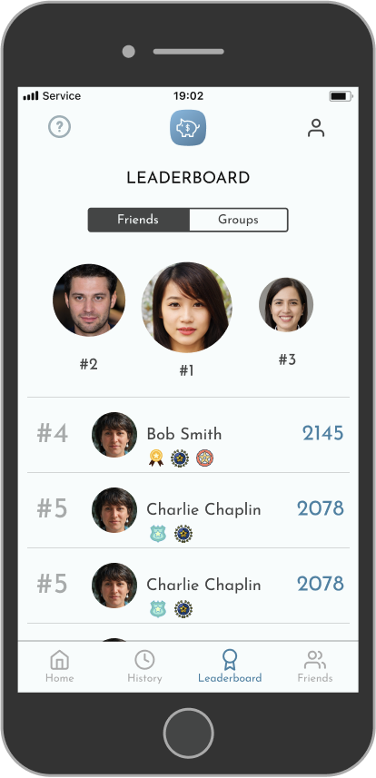
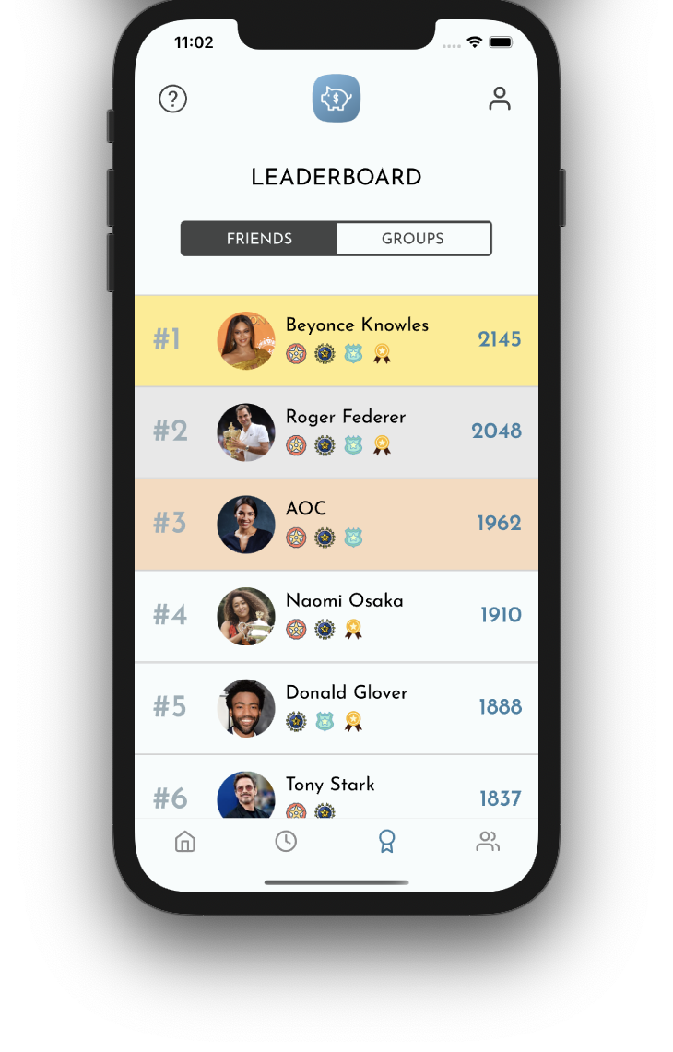
MAJOR DESIGN CHANGES
MAJOR DESIGN CHANGES
1.
BEFORE
AFTER
CLARITY
Restructured leaderboard to make it clear who is winning
Notes:
OLD
Leaderboard had a pedestal orientation for top 3 without names or points for them.
Result: Users did not know what qualified the top 3 or who they were.
NEW
Top 3 still in list format with others, showing names and points.
Reasoning: Leaderboard as a function makes little sense if people can’t tell who is winning.

Slide 9
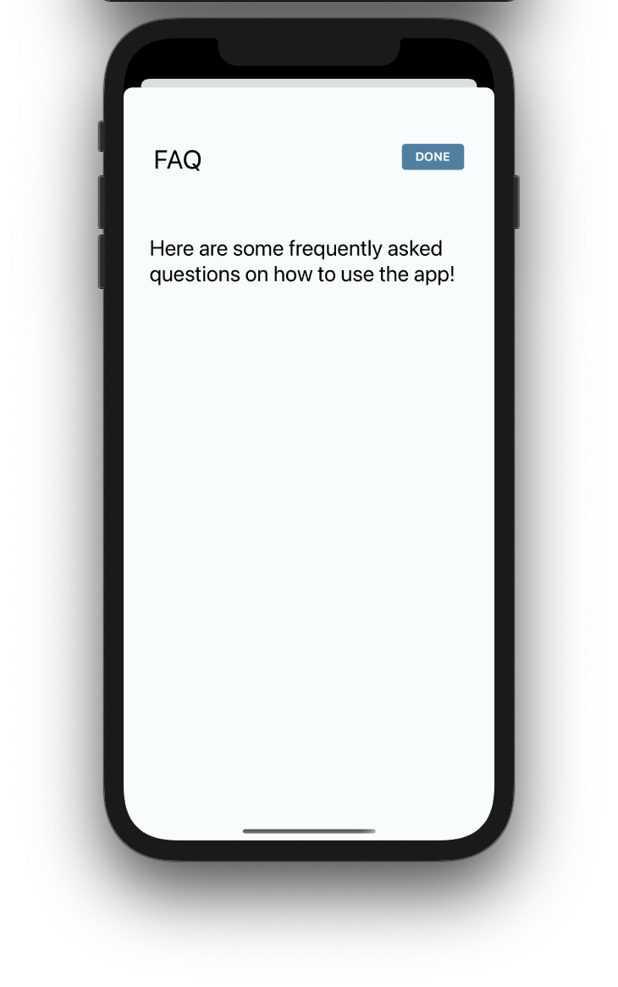
MAJOR DESIGN CHANGES
2.
FAQ
FAQ page with information regarding the entire app.
How do I add a budget?
Press the add budget button and fill in the corresponding text fields.
How do I delete a group?
Press the trash can icon next to the group name on the Home Screen.
Notes:
OLD
We had a lot of new pages when the user was adding either budgets or expenses.
Result: Users felt like it was of overwhelming to have new pages for all of these activities without a clear ending.
NEW
We made Modals for adding new budgets and expenses.
Reasoning: The popup form of the pages puts a lot less pressure on the user to remember where they are

Slide 10
MAJOR DESIGN CHANGES
OLD We had a lot of new pages when the user was adding either budgets or expenses. Result: Users felt like it was kind of overwhelming to have new pages for all of these activities without a clear ending.
3.
NEW
We made Modals for adding new budgets and expenses.
Reasoning: The popup form of the pages makes them seem like less pressure on the user.
Notes:
OLD
We had a lot of new pages when the user was adding either budgets or expenses.
Result: Users felt like it was kind of overwhelming to have new pages for all of these activities without a clear ending.
NEW
We made Modals for adding new budgets and expenses.
Reasoning: The popup form of the pages makes them seem like less pressure on the user.

Slide 11
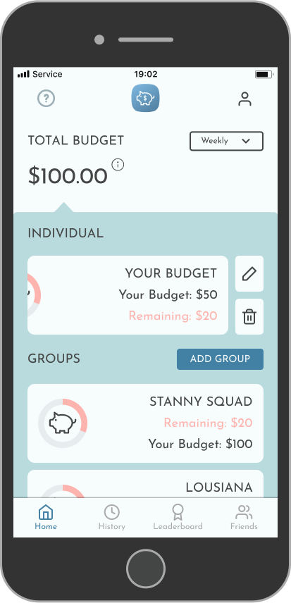
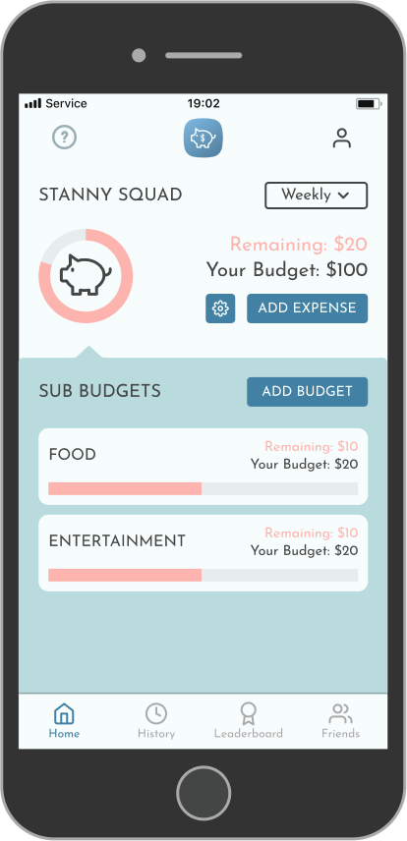
MAJOR DESIGN CHANGES
3.
EDITING
Allow for different modes of editing of groups and group members
Notes:
swipe feature
settings button -
This was to address the fact that there wasn’t much freedom in editing the various components within a certain group or in your individual budget. All the information about the particular group (friends [editing & deleting], leaving the group)

Slide 12
Severity 1 & 2
Clarifying language (budget/remaining)
Added done button to exit popups
Having more than the weekly option
More consistent formatting

Slide 13
PROTOTYPE
Notes:
So to get into the prototype we’ve coded so far

Slide 14
PROTOTYPING TOOLS:
React Native & XCode
PROS | CONS
Cross Platform Similar to base React Easy to import libraries Easy to create and re-use components Easy to test through expo | No design layout like Android Studio Styling can be difficult Error messages are not always clear React Native changes frequently and is not backwards compatible
Notes:
similar to base react - made transition easier to react native
changing quickly - alot of the development pages are now deprecated
other tools we’re using is expo as well as expo snack (to test different components) as well as github to collaborate on the code

Slide 15
FEATURES
Implemented
Unimplemented
Home Screen
Individual Budget
Add Sub-Budget to Individual
FAQ Page
Add Expense
Profile
History tab
Friends tab
Group budgets
Firebase
Notification
Notes:
PLANS TO FINISH
other two task flows - which includes
Firebase

Slide 16
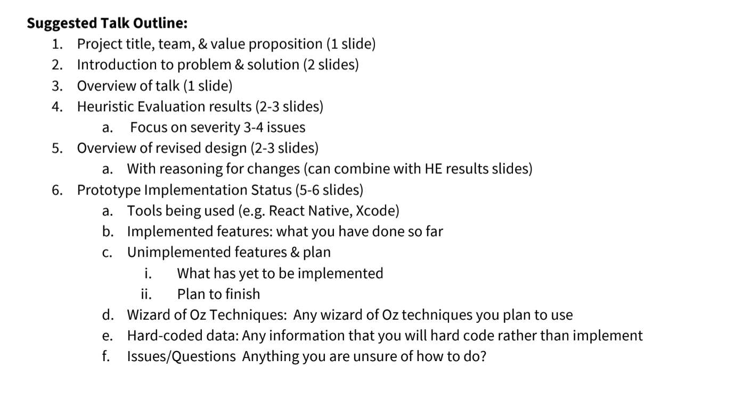

Slide 17
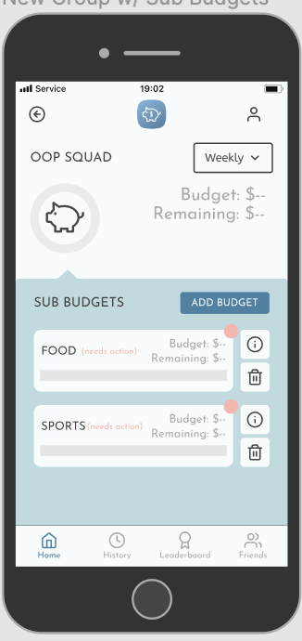
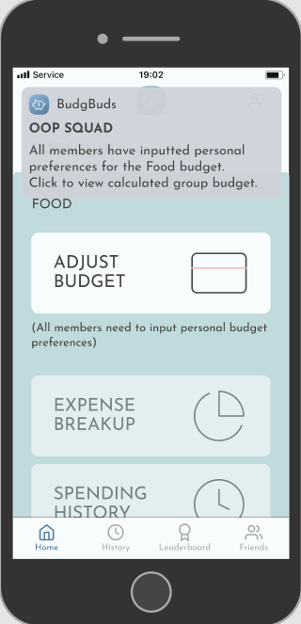
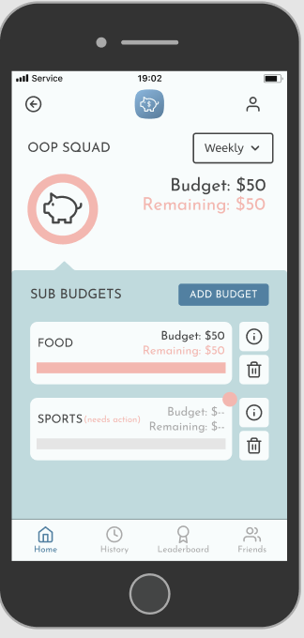
WIZARD OF OZ COMPONENTS
Since sub budgets need to be approved by all group members before a budget is set, we just manufactured this process so that no other users were necessary.
Notes:
… was within adding a group
We skipped a lot of steps with this process, particularly those related to other users, and we mostly just filled in that information or assumed that the user’s friends did what they needed to do.

Slide 18
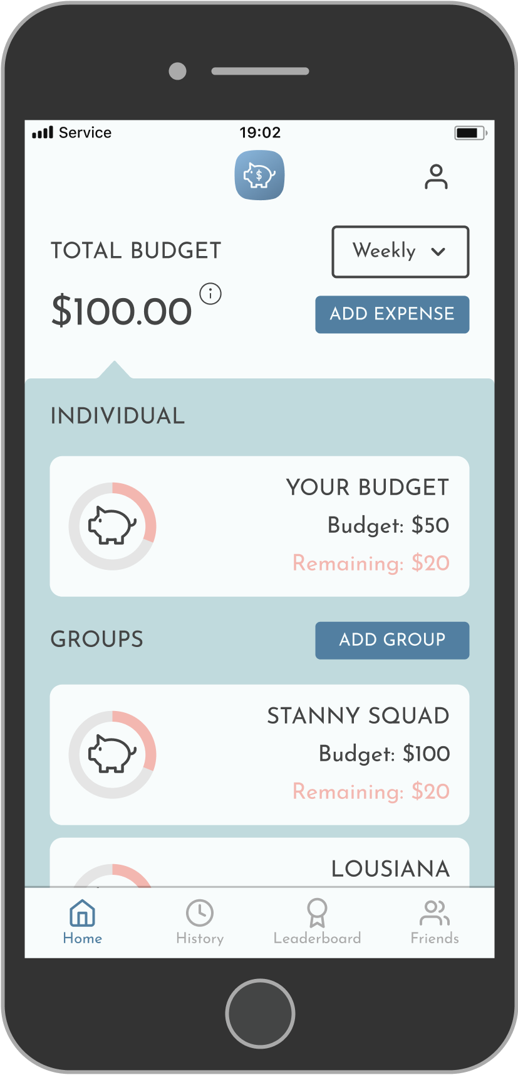
HARD-CODED COMPONENTS
Group budgets: to provide immediate examples. We also have pre-populated friends for these groups.
Notes:
We hard-coded group budgets to provide immediate examples of what the home screen will look like and what actions users can take from the home screen.
Lastly, we hard-coded a list of friends and their budget-related activities to show the types of social interactions enabled by the platform. Building on the friends list, we hard-coded a leaderboard consisting of friends and groups, with both a badge and point system to integrate elements of gamification.

Slide 19
DEMO

Slide 20

Prototype Demo
Video here

