Slide 1

BudgBuds

Slide 2
“where you don’t have to budget alone”
value proposition
Problem
People who regularly spend in social groups are often unable to regulate their expenses and give in to social pressure.
Solution
An app supplemented by social accountability, for groups to collectively budget for activities that require communal spending, while factoring in individual financial means.
Notes:
BudgBuds stemmed from the insight that many of us struggle to stick to our budget when spending in a group setting, largely due to social pressures. Furthermore, as our budgets are often personal, we don’t feel comfortable letting our groups know when we go over-budget. Related to this, many people can’t leverage the benefits of social interactions and accountability to uphold their budgets.
Our solution is an app that allows you to take advantage of social interactions and accountability to create and maintain budgets, even in group settings (through group budgets). A key component of the solution, is for BudgBuds to consider each member’s financial means (privately) and factor that in when creating group budgets.

Slide 3
TASKS
Can you...
SIMPLE
MODERATE
COMPLEX
...create an individual budget.
...create and edit a group budget.
...find who spent the most on food.
...give your close friend, Whitney, encouragement.
Notes:
Our simple task is to create an individual budget. This is a relatively common task that people can do with or without a budgeting app, but is a crucial step as BudgBuds should strive to be an “one-stop-shop” for budgeting needs.
Our moderate tasks include 1) creating and editing a group budget, and 2) finding who spent the most on food. Starting with 1), this task could be done without an app, however as mentioned earlier, the ability to privately disclose individual constraints when creating a group budget is a key feature. Next 2), this task has elements of general group budgeting as well as social accountability as everyone in a group should be held accountable for overspending in a group setting.
Our complex task delves deeper into elements of social accountability: to give your close friend Whitney, some encouragement. Accomplishing this task in a way that leverages social accountability is a balancing act as the action should not seem forced (there is a need for intrinsic motivation to give encouragement) but should be guided (so an opportunity to give encouragement to close friends is always known)

Slide 4
UI CHANGES
Notes:
We took note and made necessary UI changes from the feedback we received last week after low-fi prototyping and testing.

Slide 5
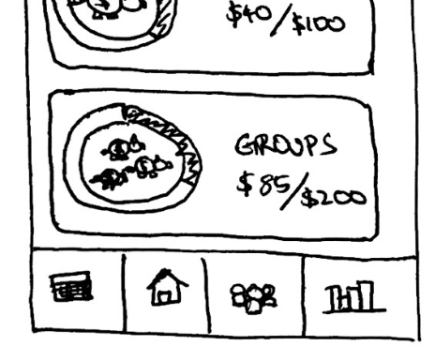
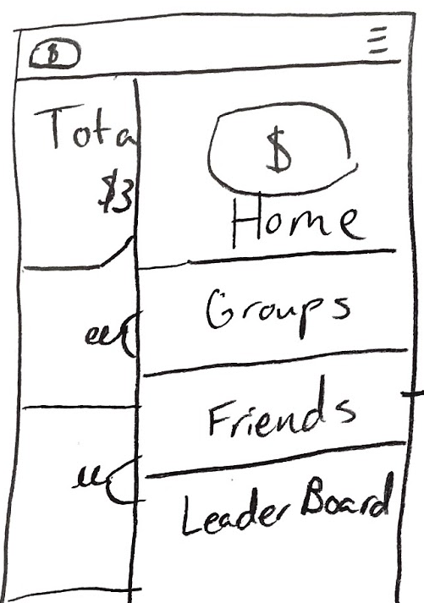
MAJOR DESIGN CHANGES
1.
OLD
Hamburger menu with general overlapping tabs.
Result: Users did not know the contents of the menu bar and did not think to click on it immediately.
NEW
Universally accessible navigation bar with individual tabs for distinct features.
Reasoning: The navbar is more visible, intuitive and involves a single click to access several features
Notes:
The first major design change revolved around our use of a hamburger menu. As the hamburger menu hides the contents of the menu bar, they often overlooked it and instead focused on what was immediately available to them. Hence, we decided to replace the hamburger menu with a universally accessible navigation bar to make key options visible at all times.

Slide 6
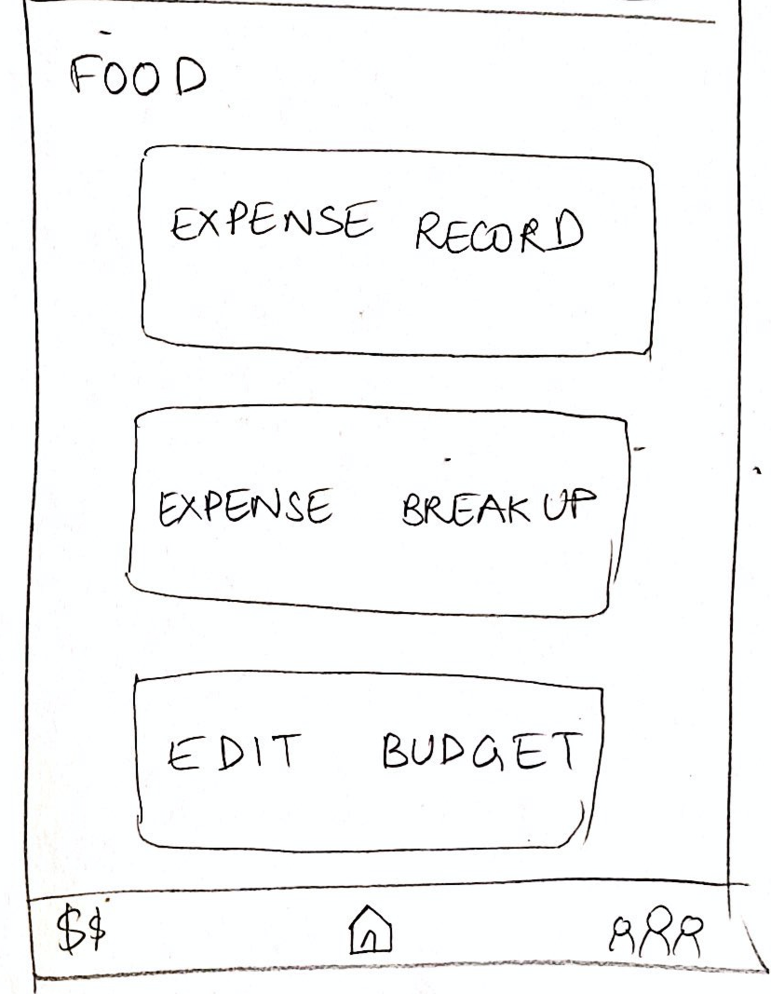
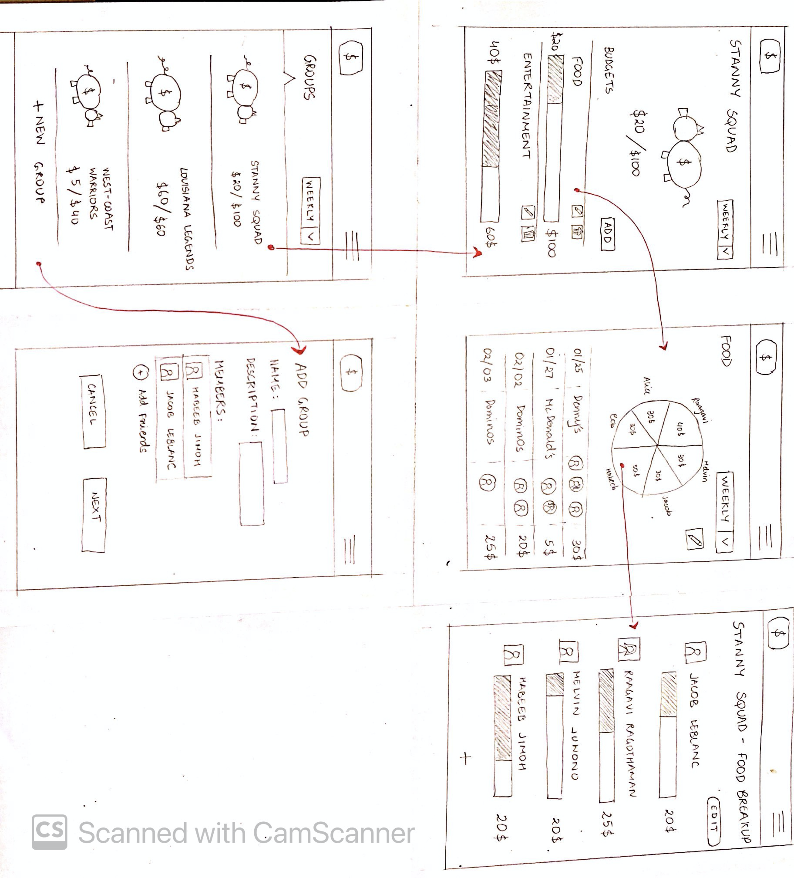
MAJOR DESIGN CHANGES
2.
OLD
Click on spending history pie-chart to access expense breakup.
Result: users struggled to locate the expense breakup page. Pie-chart didn’t seem clickable.
NEW
Expense breakup and spending history on separate pages, accessible through separate, explicit tabs.
Notes:
The next major design change we implemented had to do with our use of a clickable pie-chart. The pie-chart had two purposes, one to give a quick overview of a group budget breakdown, and the next as a button to lead to a more detailed group budget breakdown. After recognizing the slight redundancy, and also noticing some confusion around the expense record (shown below the pie-chart), we decided to use an intermediate page with explicit tabs that will hopefully reduce confusion for the user.

Slide 7
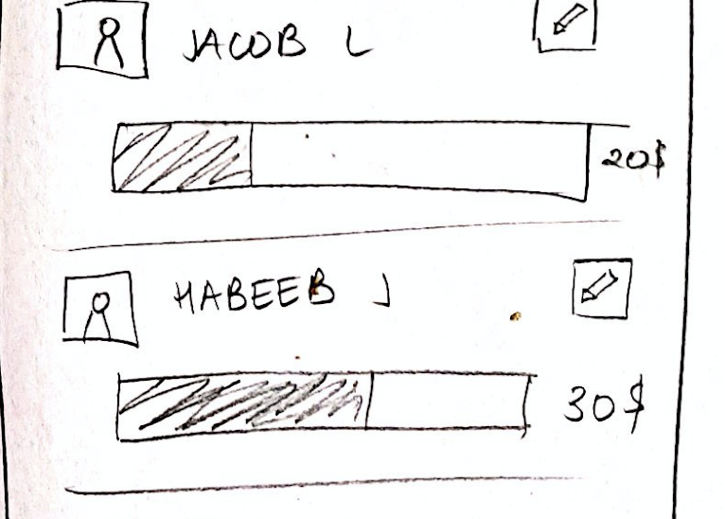
MAJOR DESIGN CHANGES
OLD
Pie-charts to show total spending and cost distribution.
Result: Users did not think it was helpful since it involves too much data that requires time and interpretation
3.
NEW
Budget-specific progress bars that lead to user specific progress bars to represent cost distribution.
Reasoning: Progress bars are more readable, visual and make user-specific data more accessible as opposed to a collective pie-chart.
Notes:
Related to the previous design change, we noticed that use of the pie-chart to show total spending and cost distribution was not as effective as we hoped. We decided to replace it with budget-specific progress bars instead as they were more readable and potentially more visually appealing.

Slide 8
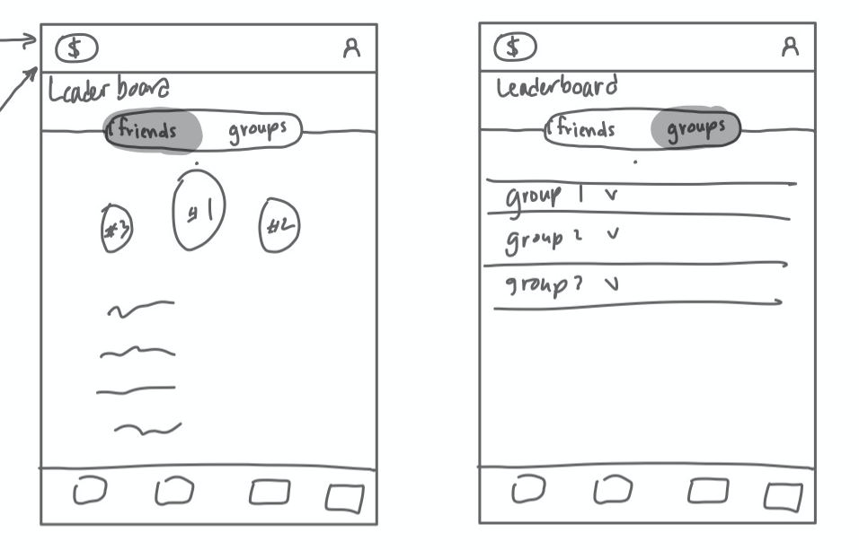
MAJOR DESIGN CHANGES
NEW ADDITIONS
4.
Leaderboards
Group-specific leaderboards driven by an automated point system to encourage social accountability through gamification and social media aspects such as commenting and reacting.
Notes:
Our final major design change had to do with our complex task. Specifically we became aware that users may need more intrinsic motivation to get them to encourage their close friends on their budgeting progress. We decided to implement several initiatives. The largest of which is a leaderboard to integrate elements of gamification. A point system is assigned whereby the more you save (relative to your set budget), the more points you get. Friends can compete on point systems and encourage others when they’re struggling to get points or when they’re particularly on a roll.
Furthermore, the leaderboard system will assign badges to users depending on some budgeting-related accomplishments.
Lastly, to nudge users to provide support for their friends, we included notifications for whenever a close friend has reached a milestone or some form of accomplishment.

Slide 9
TASKFLOWS
Notes:
Based on our changes, we built out our taskflows on figma to better represent components and transitions.

Slide 10
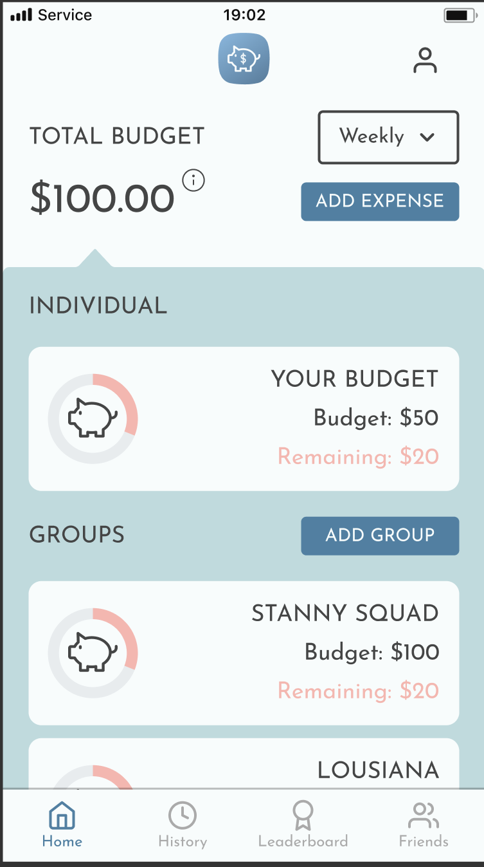
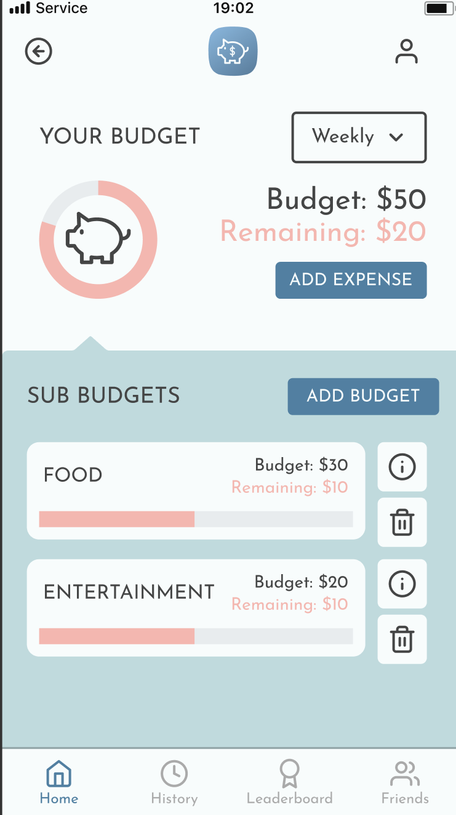
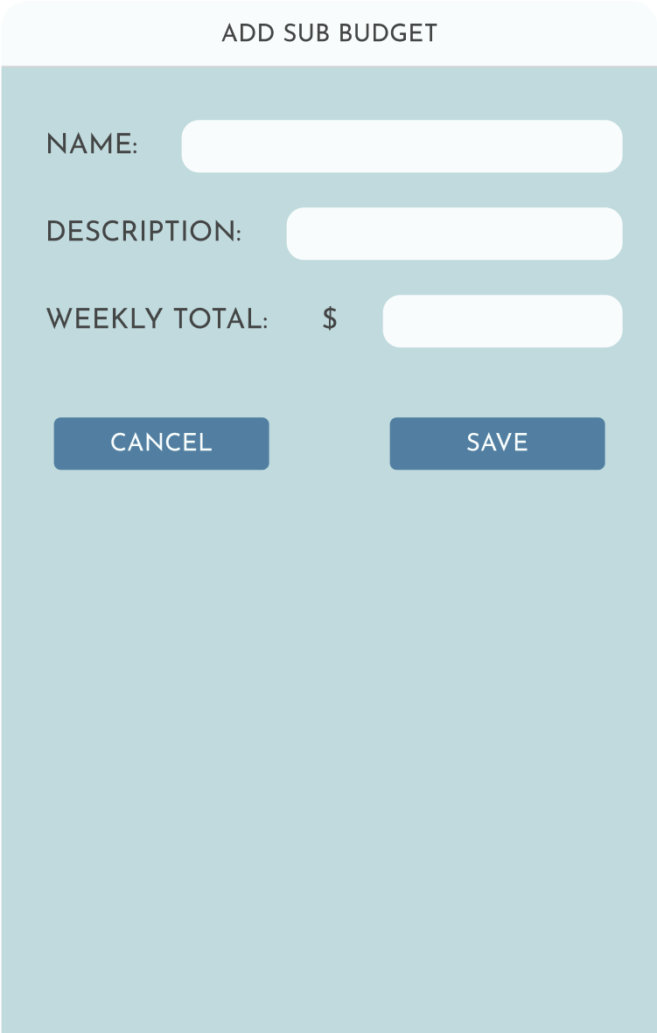
...create an individual budget.
TASKFLOW
1.
Notes:
The first taskflow, creating an individual budget: users simply need to click on the individual budget tab on the home screen, then click add budget to fill in details and save.

Slide 11
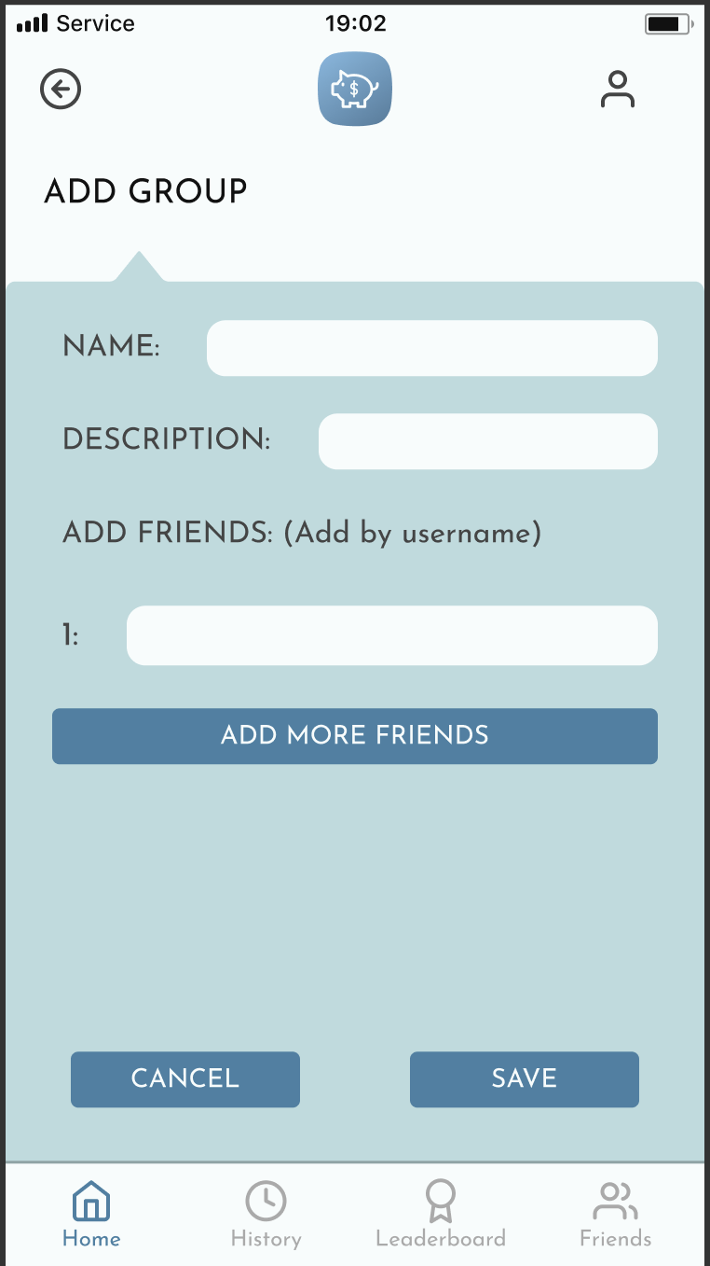
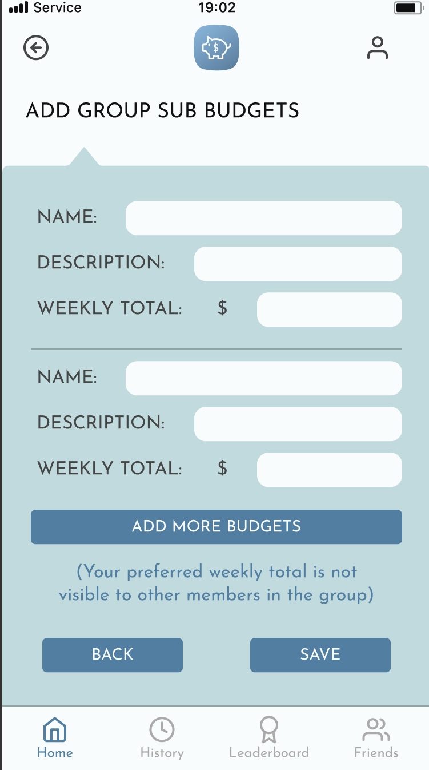
...create and edit a group budget.
TASKFLOW
2.
OOP Squad
Food
Entertainment
Notes:
The next taskflow, creating and editing a group budget:
Users should click add-group on the home screen
Then fill in details about the group and group members, click save
The user can then add group sub-budgets along with their personal weekly total preference / constraint
There is a note telling them that the preferred weekly total they include here will not be shared (just used as part of BudgBuds calculation of the group budget)
Click save when done

Slide 12
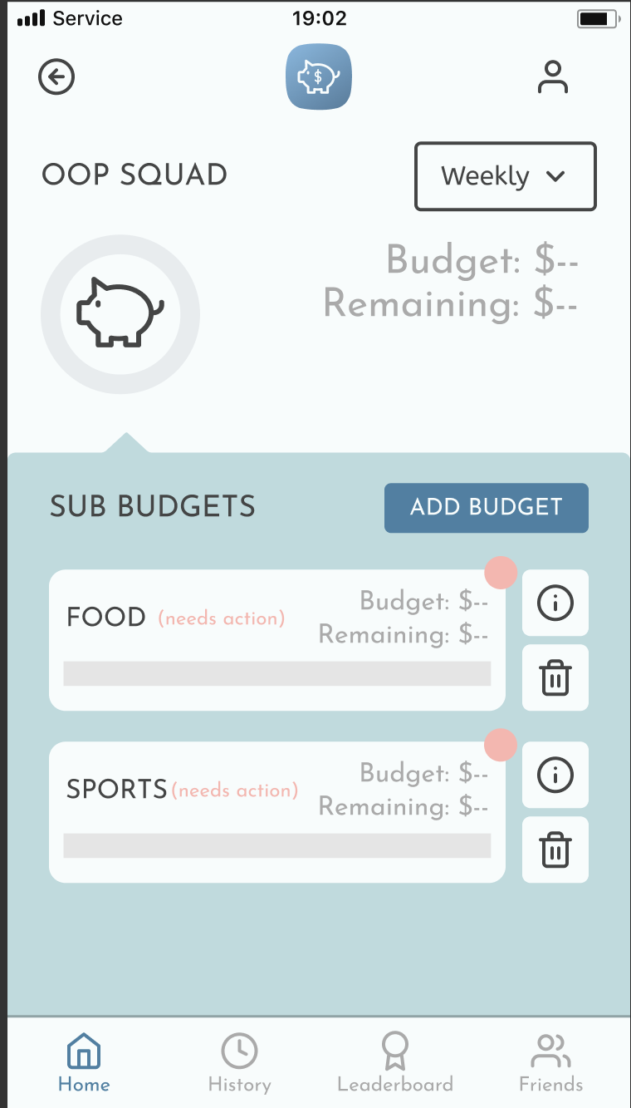
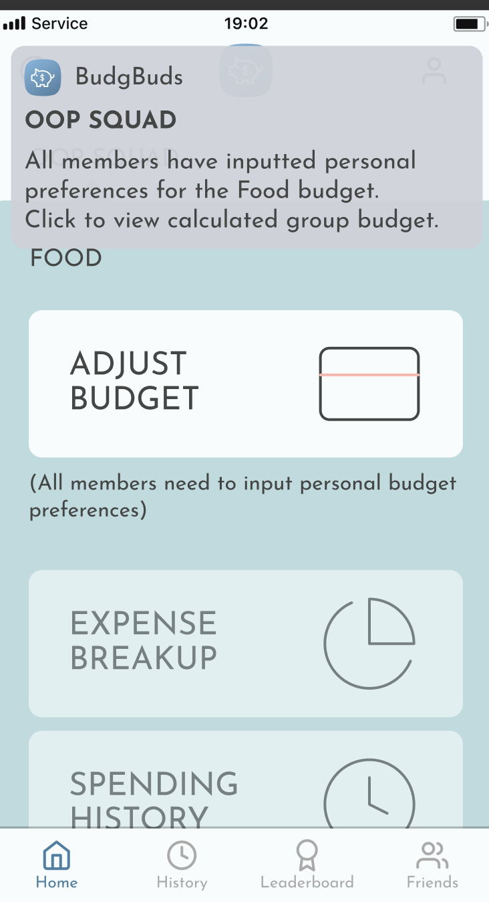
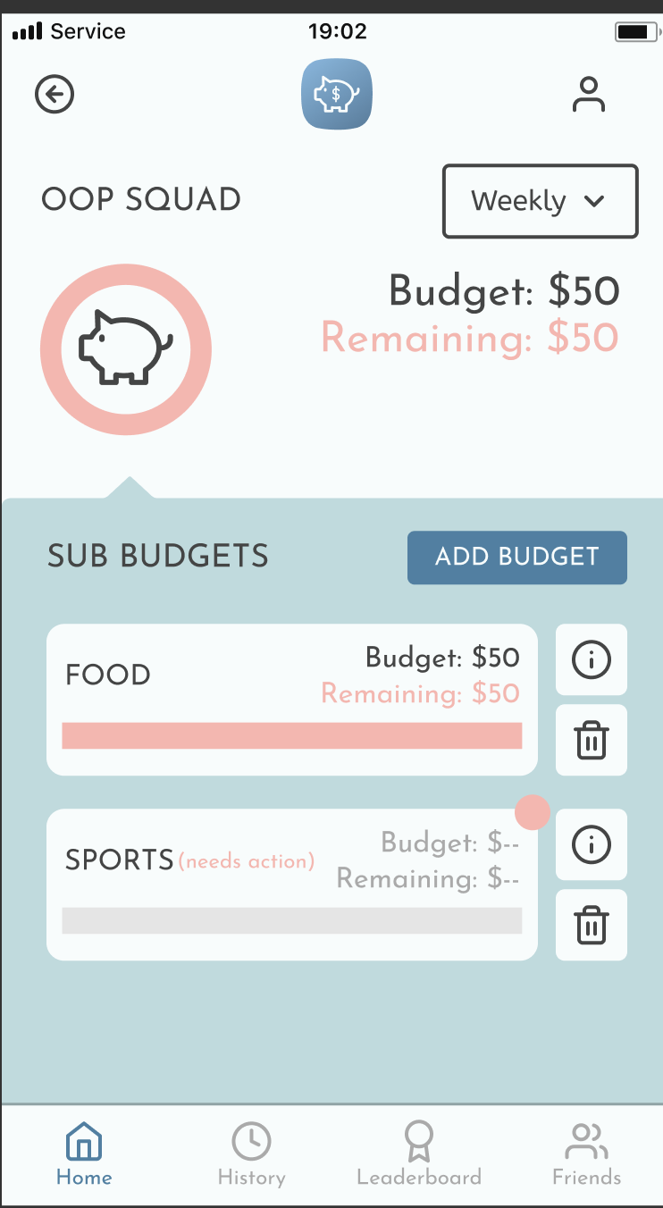
...create and edit a group budget.
TASKFLOW
2.
Notes:
This should result in a group being created with sub budgets that require action.
From here, you can either click on the information icon (i) or the Food tab to take you to a page with the expense breakup, spending history, and an option to adjust / edit budget.
Once all group members have inputted personal preferences for the a group budget, the group budget is calculated and each user is notified.
The last screen displays a completed food sub-budget

Slide 13
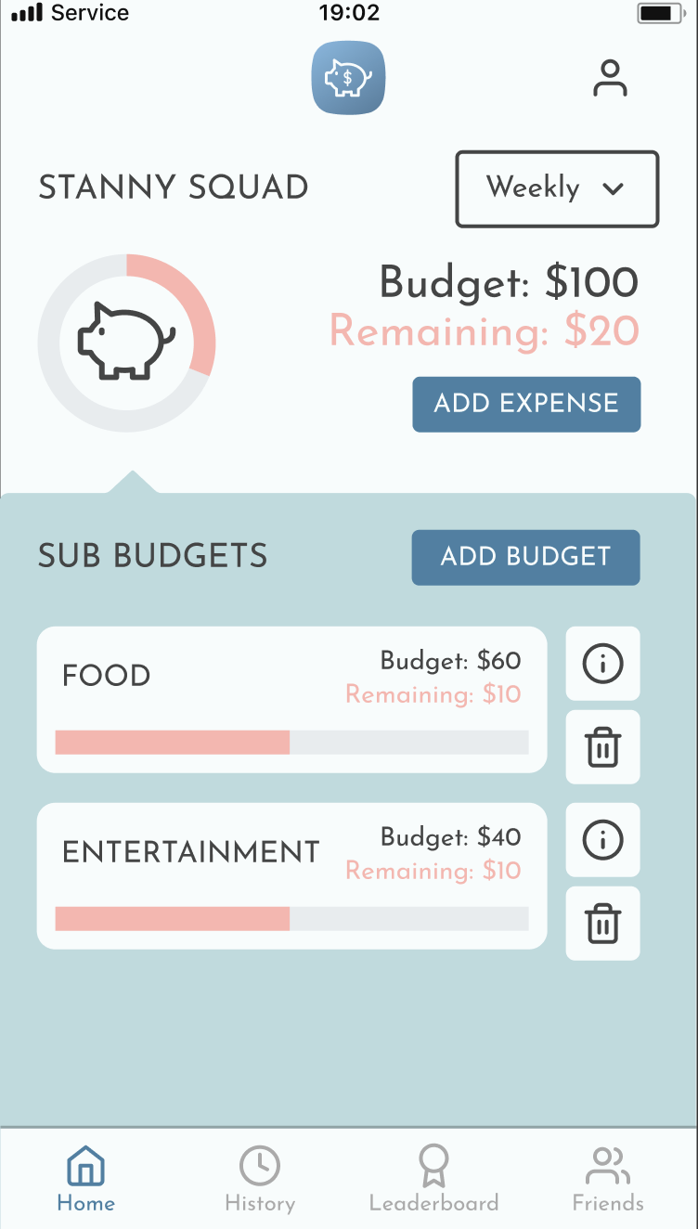
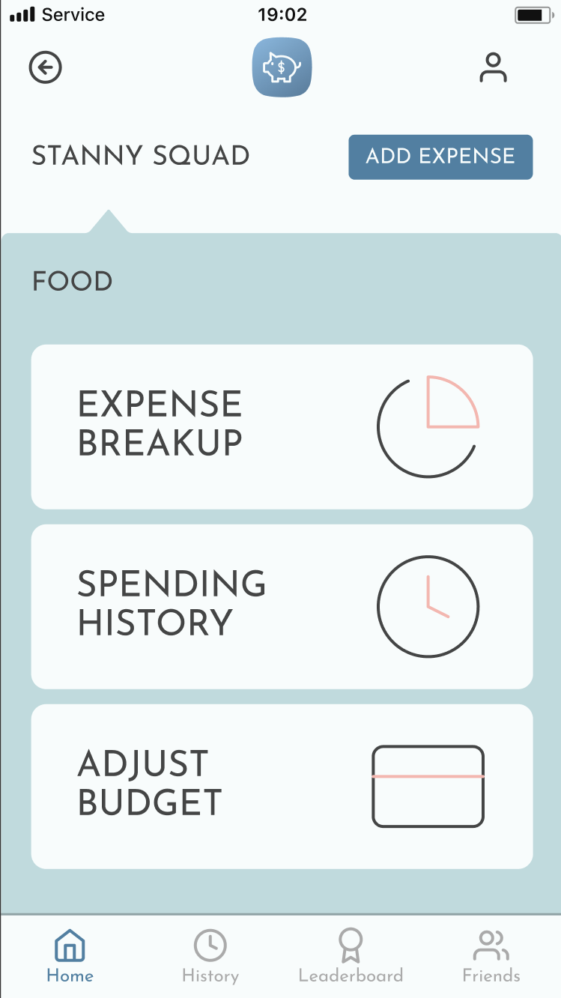
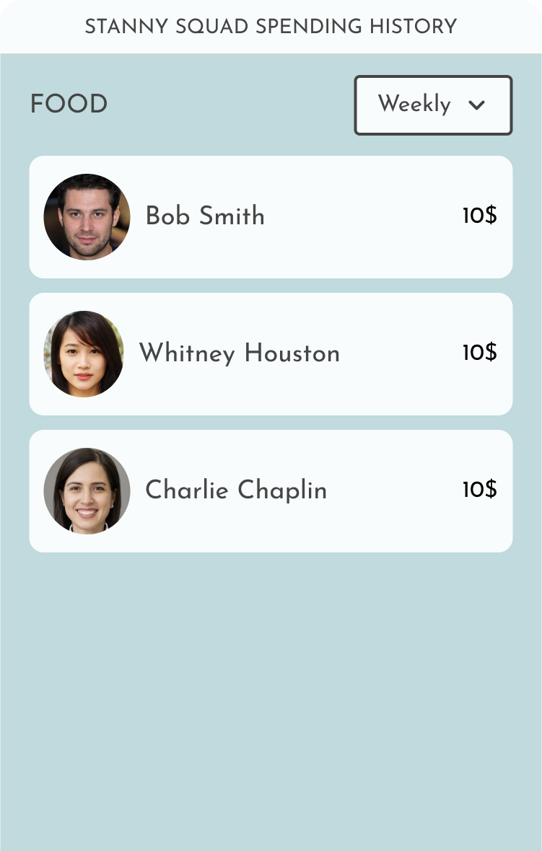
...find who spent the most on food.
TASKFLOW
3.
Notes:
For taskflow 3, find who spent the most on food: click on a group from the home screen. Then proceed to click on either the information icon or the food tab to take you to a list of options. Then select expense breakup to view each member’s spending

Slide 14
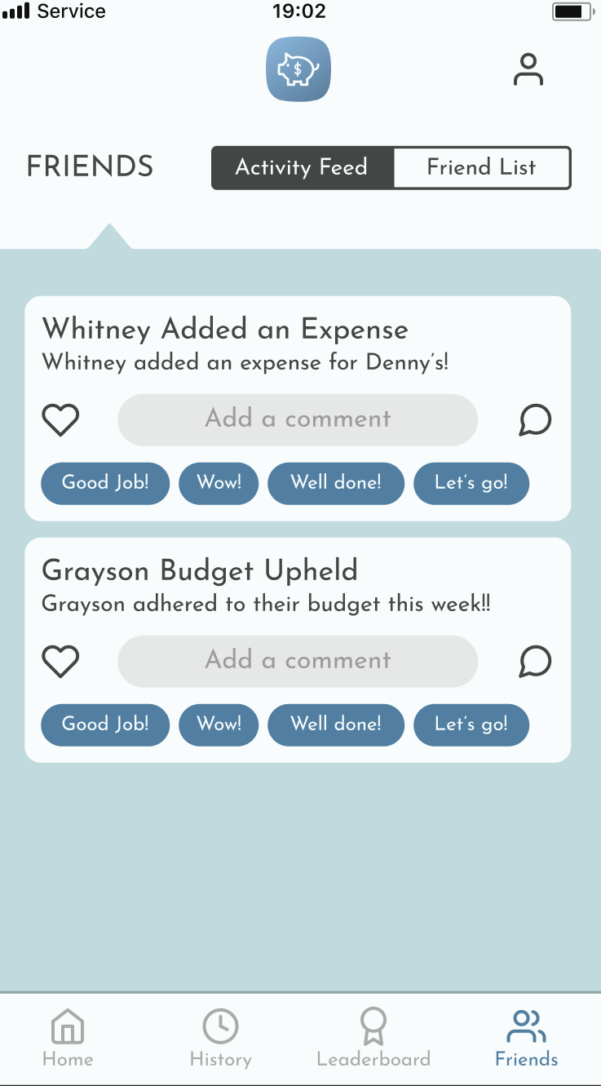
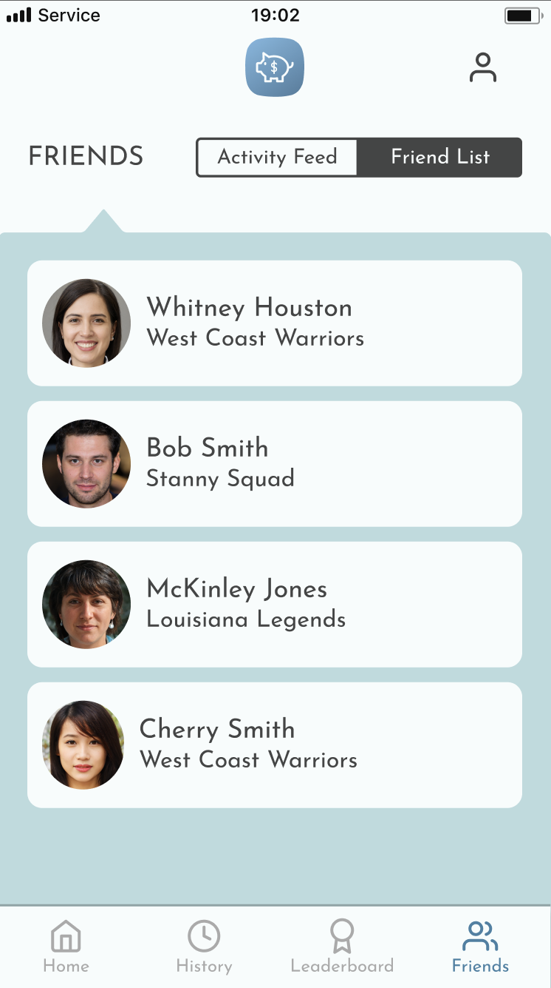
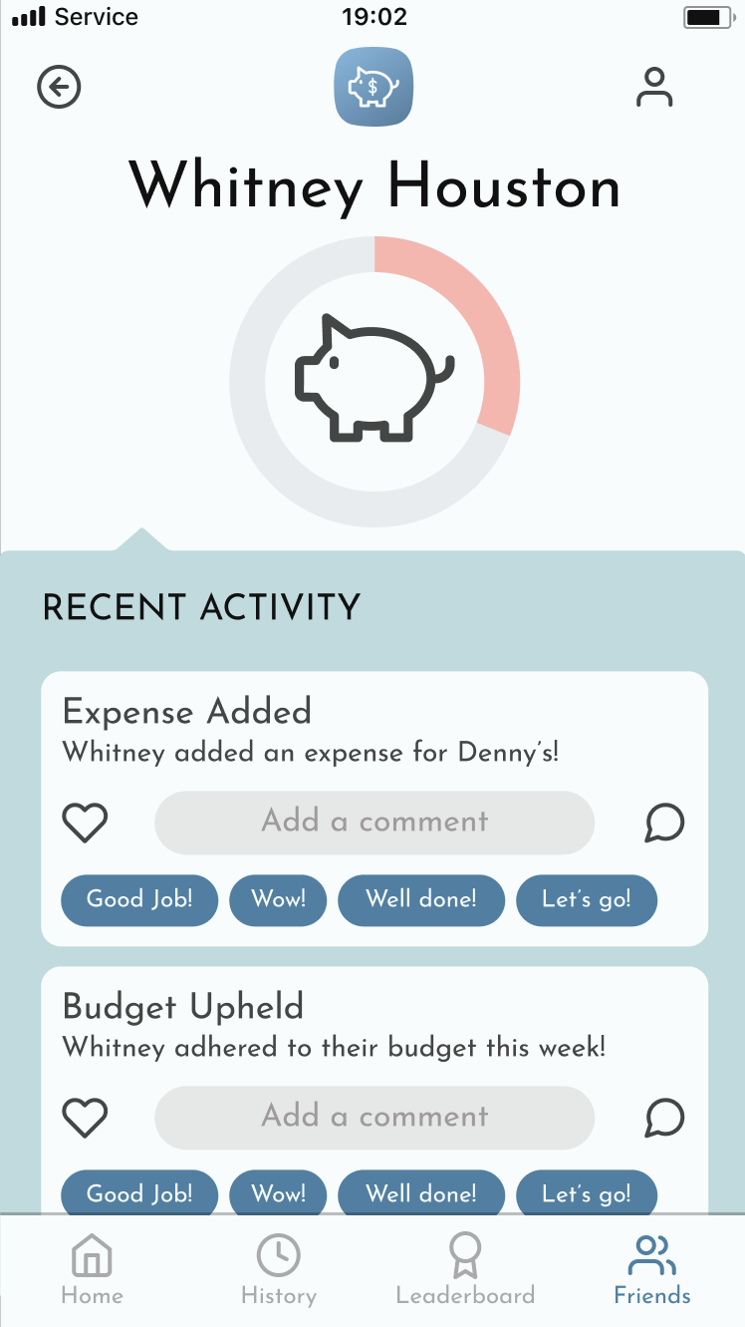
...give a close friend encouragement.
TASKFLOW
4.
Notes:
For our last taskflow, give a close friend encouragement: use the nav bar to take you to the friends page. To select a specific friend, navigate to the friends list, select the friend and add a comment. Note that this task works in tandem with other pages on our figma. Specifically we are hoping the gamification element from the leaderboard and the guidance provided by notifications should help users complete this complex task.

Slide 15
PROTOTYPING TOOLS:
Figma
PROS | CONS
Components allow quick editing for universal changes. Ability to create clickable and realistic UI elements. Easy to test realistic flow of the app. Collaborative platform - allowed the team to make changes asynchronously. | Hard to keep track of element after a large number have been added. Challenging to create animations.
Notes:
We used figma in order to create our prototype. Figma allowed us to create the shapes necessary for the phone screens as well as connect them all into a clickable prototype. We found it relatively easy to use because its component system allowed us to universally change things like buttons very easily. Additionally, we found it easy to actually test the prototype as well as work collaboratively on this project because of the tools Figma offers. However, it did get a little overwhelming at the end due to the large number of elements we had created, and it was very difficult to actually create animations to show flow like a real app would.

Slide 16
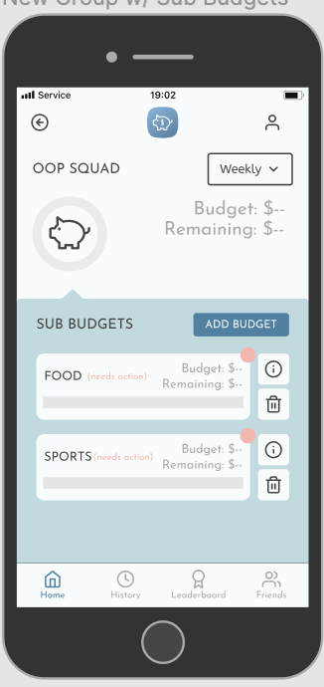
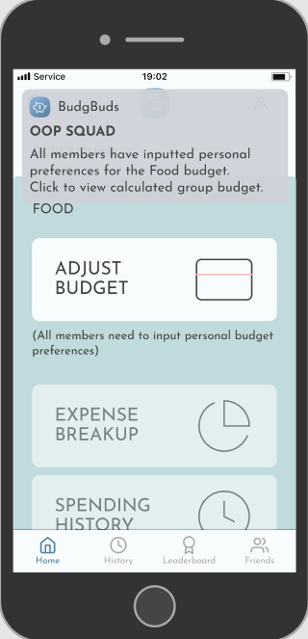
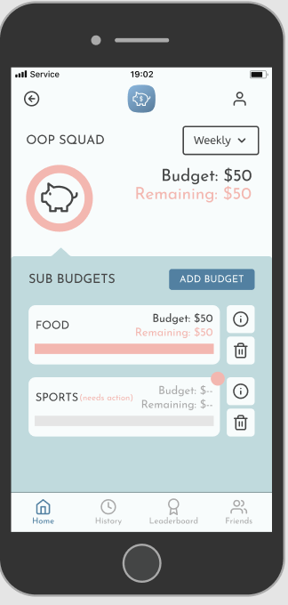
WIZARD OF OZ COMPONENTS
Since sub budgets need to be approved by all group members before a budget is set, we just manufactured this process so that no other users were necessary.
Notes:
We skipped a lot of steps with this process, particularly those related to other users, and we mostly just filled in that information or assumed that the user’s friends did what they needed to do.

Slide 17


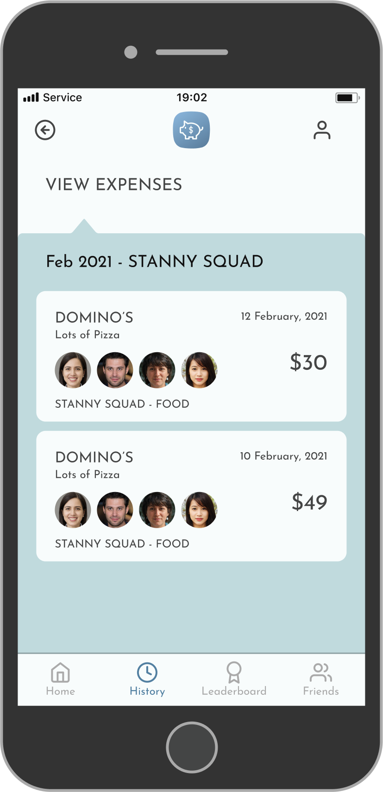
HARD-CODED COMPONENTS
Budget amounts and amount remaining: to avoid calculations with dependent variables
Individual and group budgets: to provide immediate examples.
Sub-budgets: to give common examples showcasing budget breakdown
Progress bars: to skip calculations with dependent variables
Expenses: to provide quick examples
Friends: to provide examples without requiring multiple friends testing together
Notes:
We hard-coded individual and group budgets to provide immediate examples of what the home screen will look like and what actions users can take from the home screen.
All budget amounts, amount remaining, and any values that require a sum of two or more budget amounts were also hard-coded to enable us to show them visually whilst skipping calculations. Moreover, we added hard-coded progress bars to help with visualization.
Expenses and expense history were hard-coded as these are unique to users but were important to show as they give further context of how the relationship between budgets and your spending is shown via the app.
Lastly, we hard-coded a list of friends and their budget-related activities to show the types of social interactions enabled by the platform. Building on the friends list, we hard-coded a leaderboard consisting of friends and groups, with both a badge and point system to integrate elements of gamification.

Slide 18
Additional Photos and Links

Slide 19
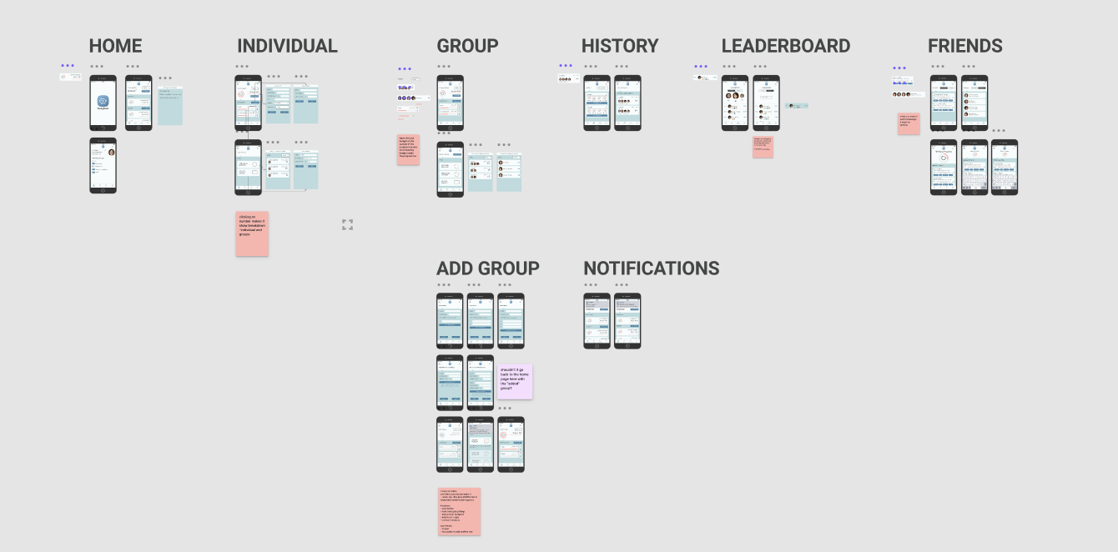

Slide 20
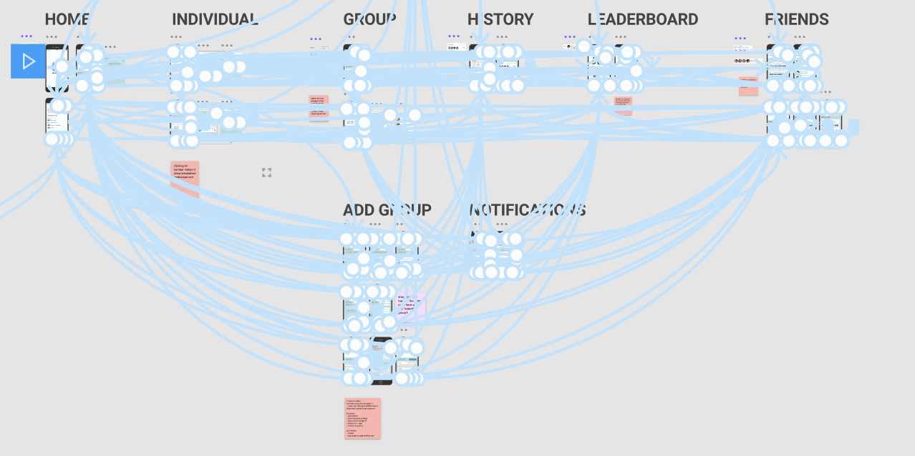

Slide 21
Prototype Link
https://www.figma.com/proto/KtYNE4zXlIGKk0S9MdsAzR/BudgBuds?node-id=163%3A1861&viewport=-471%2C-196%2C0.4470804035663605&scaling=scale-down

