Slide 1

BudgBuds
Low-fi Prototyping & Pilot Usability Testing
Habeeb J | Jacob L | Melvin J | Raagavi R

Slide 2
Mission Statement
Selected Interface
Lo-Fi Prototype
Experiment
UI Changes

Slide 3
Mission Statement
Selected Interface
Lo-Fi Prototype
Experiment
UI Changes

Slide 4
VALUE PROPOSITION
“where you don’t have to budget alone”
Notes:
We recognize that people can budget alone and people like to share positive events in their life - make budgeting a positive experience combining these two things

Slide 5
PROBLEM/SOLUTION
Problem
People who regularly spend in social groups are often unable to regulate their expenses and give in to social pressure.
Solution
An app supplemented by social accountability, for these groups to collectively budget for activities that require communal spending, while factoring in individual financial means.
Notes:
With several interviews, we heard that people who lived in groups, esp during the pandemic, had a tendency to get sucked into spending more beciase other people in the group wanted to do so and they didn’t want to be the buzzkill

Slide 6
Mission Statement
Selected Interface
Lo-Fi Prototype
Experiment
UI Changes

Slide 7
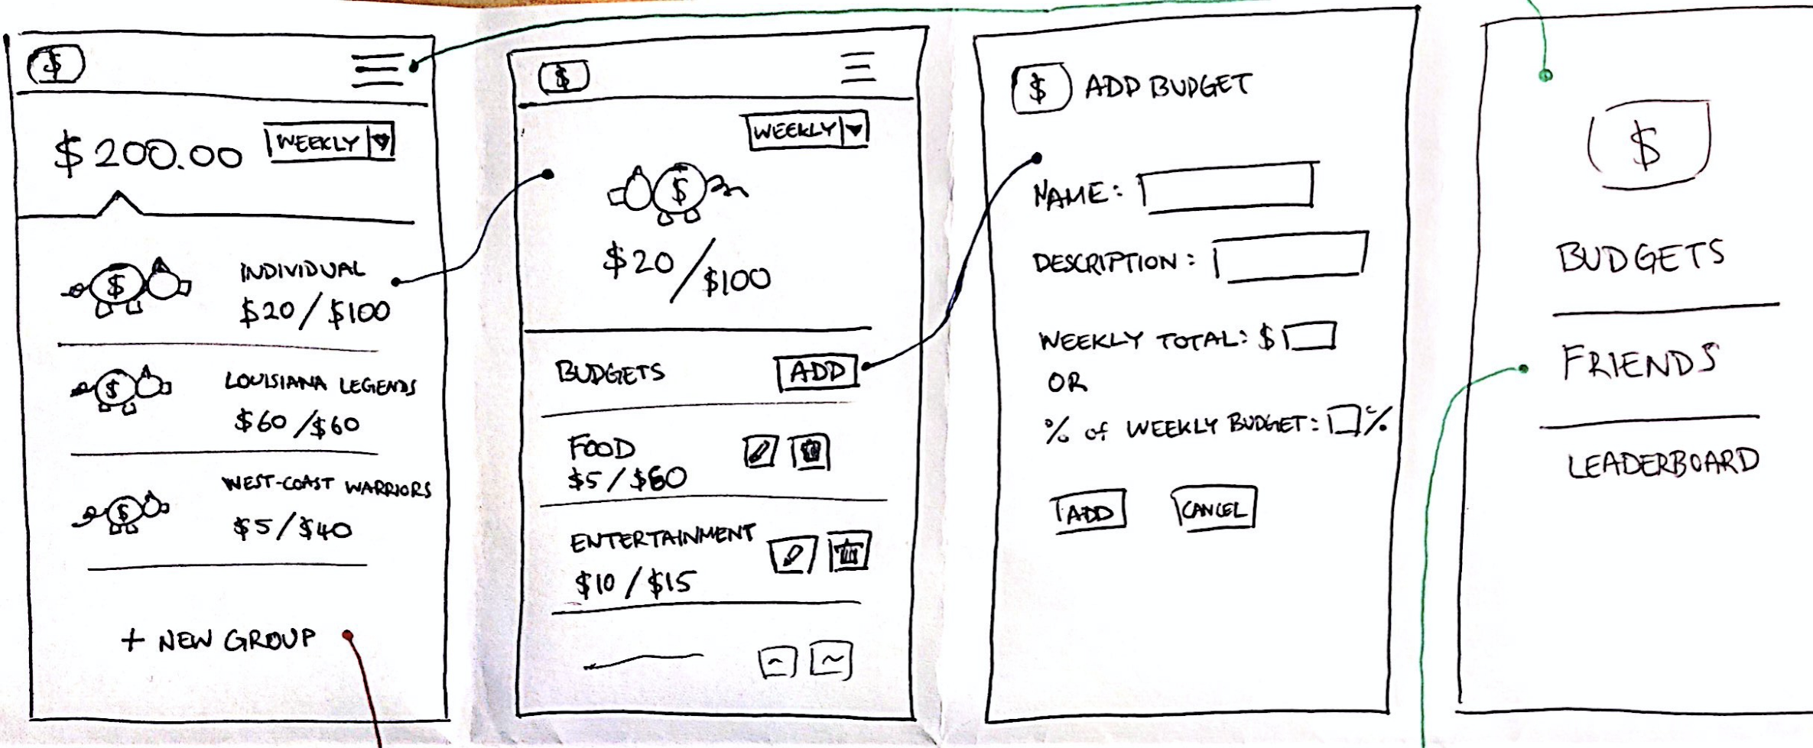
Notes:
Rationale: very visual and interactive,
this option was user friendly, more readable,not as crowded
We wanted onboarding time to be as low as possible and this design did that

Slide 8
Notes:
The design we selected

Slide 9
Mission Statement
Selected Interface
Lo-Fi Prototype
Experiment
UI Changes

Slide 10
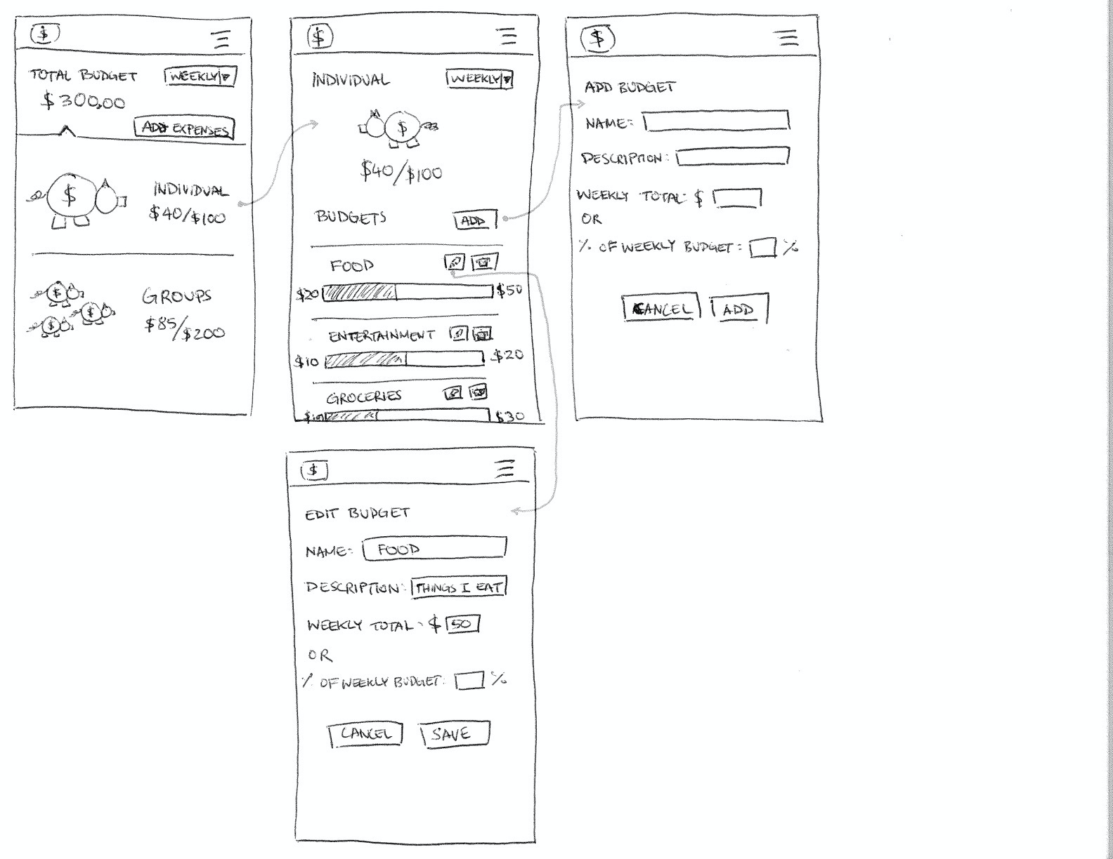
Can you...
...create an individual budget.

Slide 11
Can you...
...create an individual budget.

Slide 12
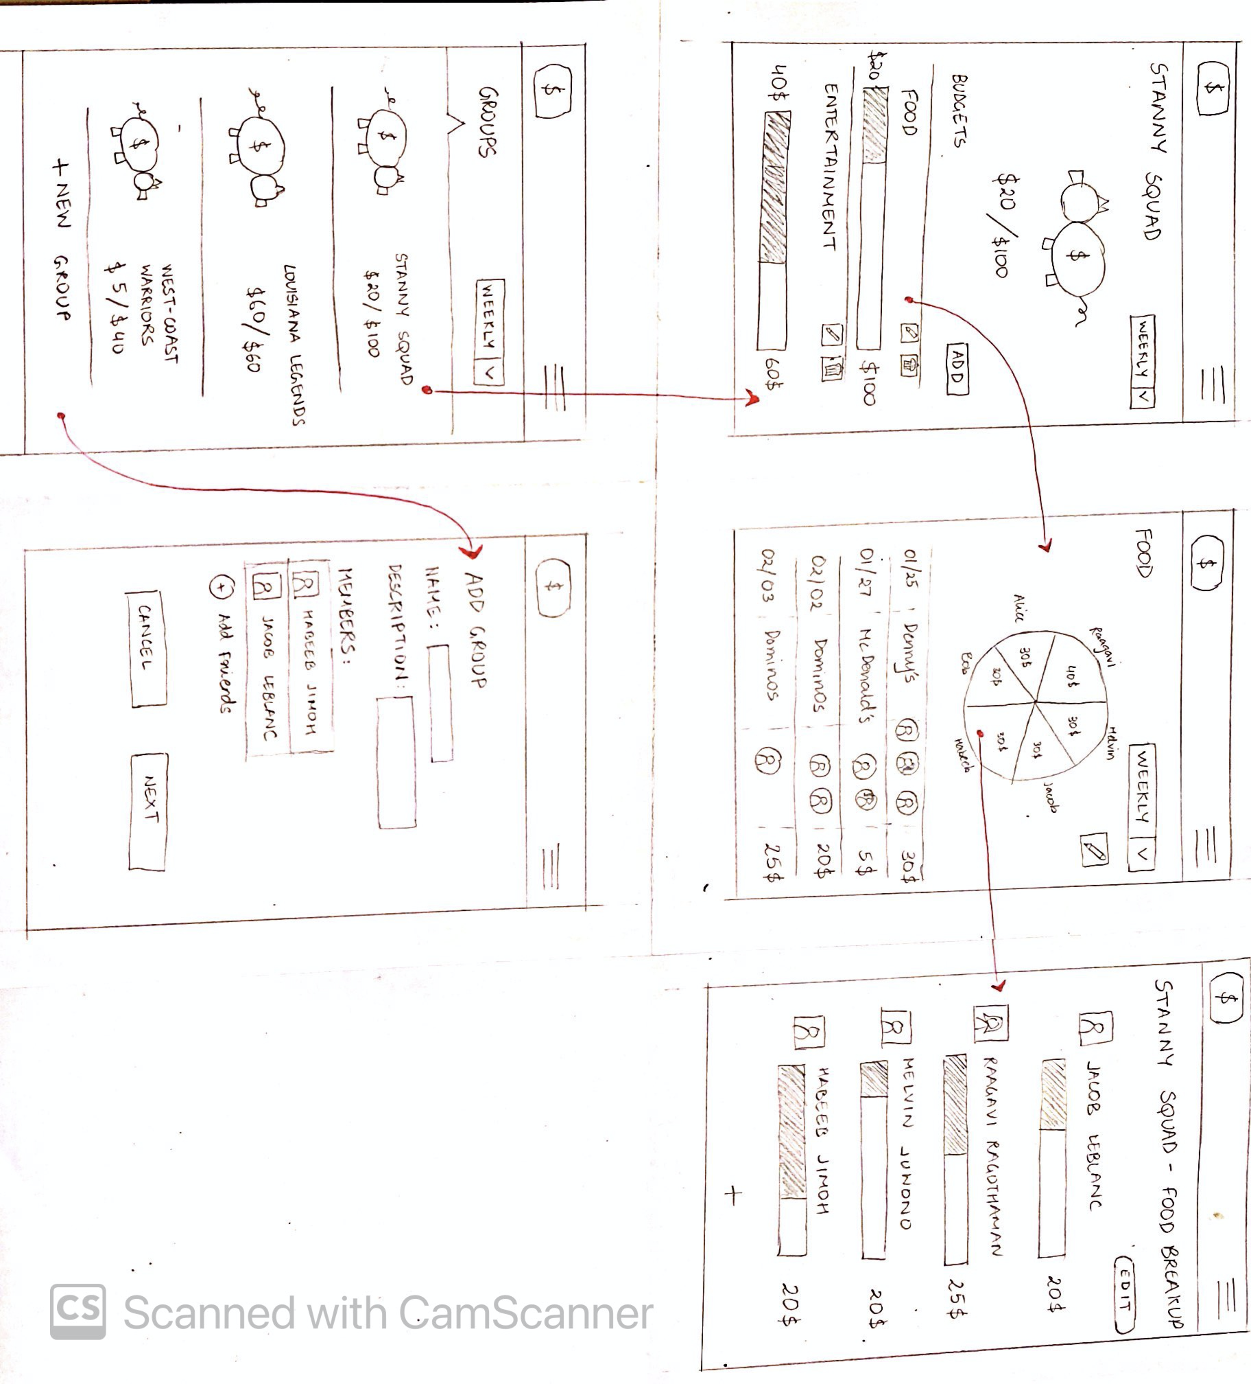
Can you...
...create and edit a group budget.
...find who spent the most on food.

Slide 13
Can you...
...create and edit a group budget.
...find who spent the most on food.

Slide 14
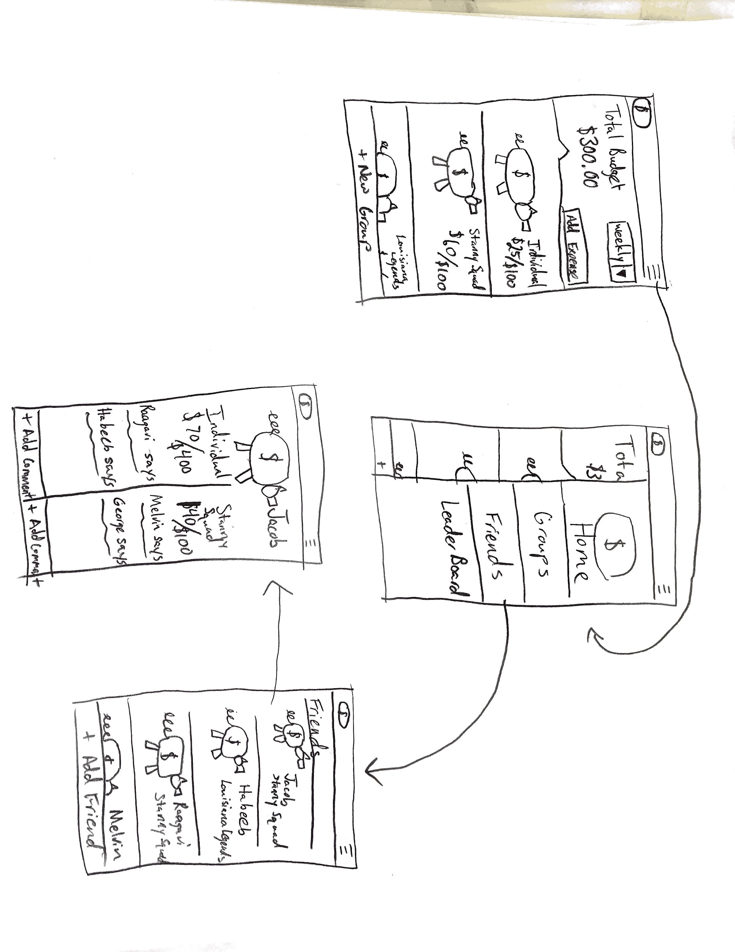
Can you...
...give your close friend encouragement.

Slide 15
Can you...
...give your close friend encouragement.

Slide 16
Mission Statement
Selected Interface
Lo-Fi Prototype
Experiment
UI Changes

Slide 17
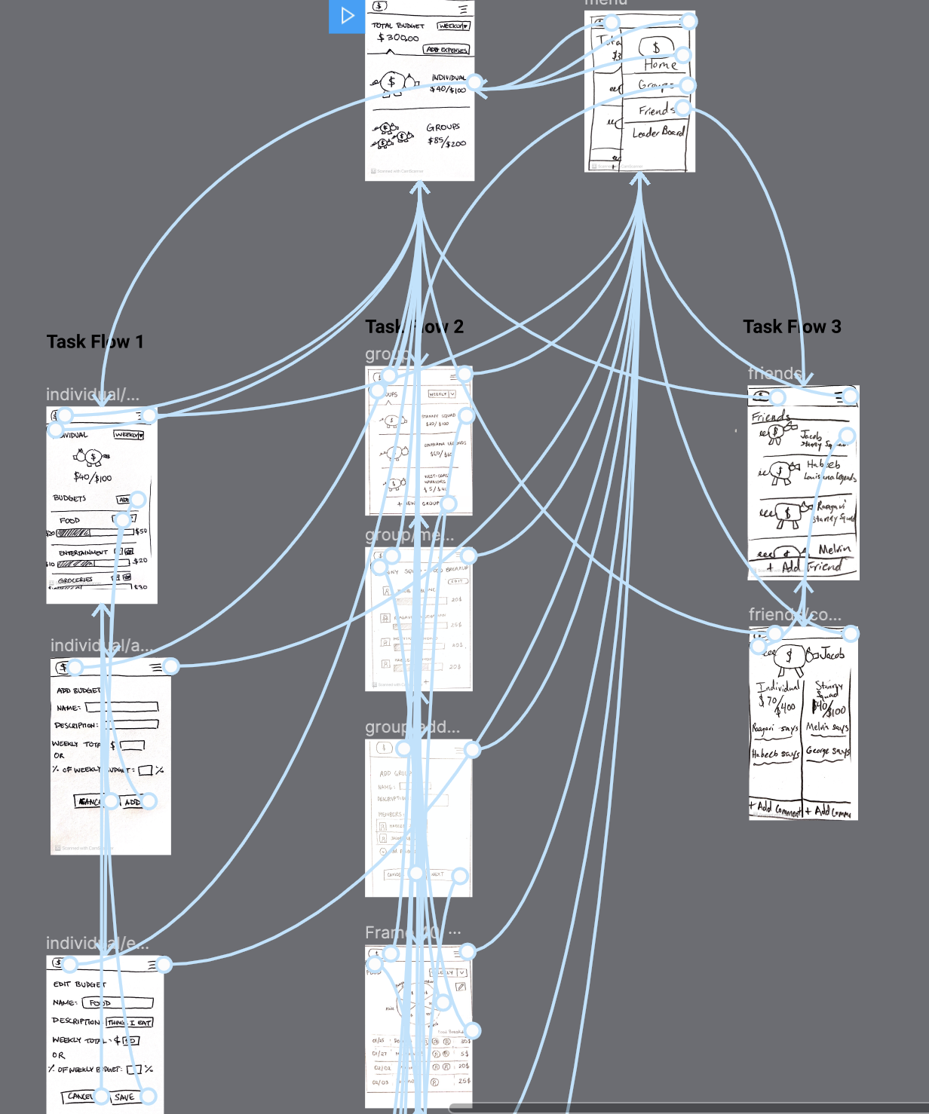
SETUP
4 tasks.
Figma clickable image flow.
Interactive Zoom screen.
Noted unintuitive vs intuitive features.
Recorded users’ preferences.

Slide 18



PARTICIPANTS
PhD student at Stanford University in the Chemical Engineering program
Junior at Santa Clara University studying accounting
Software Engineer at NCR Corporation

Slide 19

Notes:
Gave a brief high-level description
We recorded the user-testing
along with the 3 main tasks we asked additional tasks
Meanwhile kept note of comments, difficulties, and successes of the participants
received feedback

Slide 20


Results
 | Participant 1 | Participant 2 | Participant 3
Create an individual budget
Create and edit a group budget.
Find who spent the most on food.
Give your close friend encouragement
?
?
?
?
?
Notes:
Check - able to do smoothly without issues
? - able to do it but had some initial confusion or reservations about the feature
X - unable to complete the task
Task 1 was relatively straightforward. Participant 3 was able to complete the task after spending a bit of time familiarizing himself with the interface.
Task 2 was straightforward - no issues.
Task 3 was troublesome as the page showing details of a group’s food budget had elements that were ambiguous.
Task 4 was confusing as participants thought giving encouragement to friends were linked to the groups (we had them as two separate UI flows)

Slide 21
Mission Statement
Selected Interface
Lo-Fi Prototype
Experiment
UI Changes

Slide 22
UI CHANGES
Limit click depth to 3
Let visual elements be purely visual, not clickable
Notes:
We don’t want users to have to get past 3 other pages to get to a single feature, so we want to limit the highest number to 3
The initial design also featuresw a clickable pie chart that then displayed a more detailed expense breakdown and this was not intuitive for most of our participants

Slide 23
UI CHANGES
?
Include a ‘back’ button
Replace hamburger menu with a bottom nav bar
Notes:
Create a navigation bar at the bottom that helped users know exactly what the larger themes of the app are and not have them go looking for each feature

Slide 24
UI CHANGES
?
Go to encouragement profiles upon viewing spending habits
Notes:
Like many other social media apps,we also want to add support for users profiles to be accessible from any other page they’re visible on, without expecting users to navigate to a certain group or contactss page to look at their friends’ profiles

Slide 25
SUMMARY
Users found the design generally intuitive and liked the overall concept.
Some flows went too far into the app and lead users astray.
We need to make the role of some clickable features a lot more obvious.

