Slide 1

BudgBuds
Where you don’t have to budget alone
Problem: People who regularly spend in social groups are often unable to regulate their expenses and give in to social pressure.
Solution: An app supplemented by social accountability, for these groups to collectively budget for activities that require communal spending, while factoring in individual financial means.

Slide 2
tasks
Alice, Bob and Charlie need to create a communal budget but Alice isn’t making as much as the other two and needs help with individual expenses
Charlie is motivated to spend less when people praise him for sticking to his goals, but he finds it tiresome to actively let people know.
Set up separate budgets for individual expenses and group expenses

Slide 3
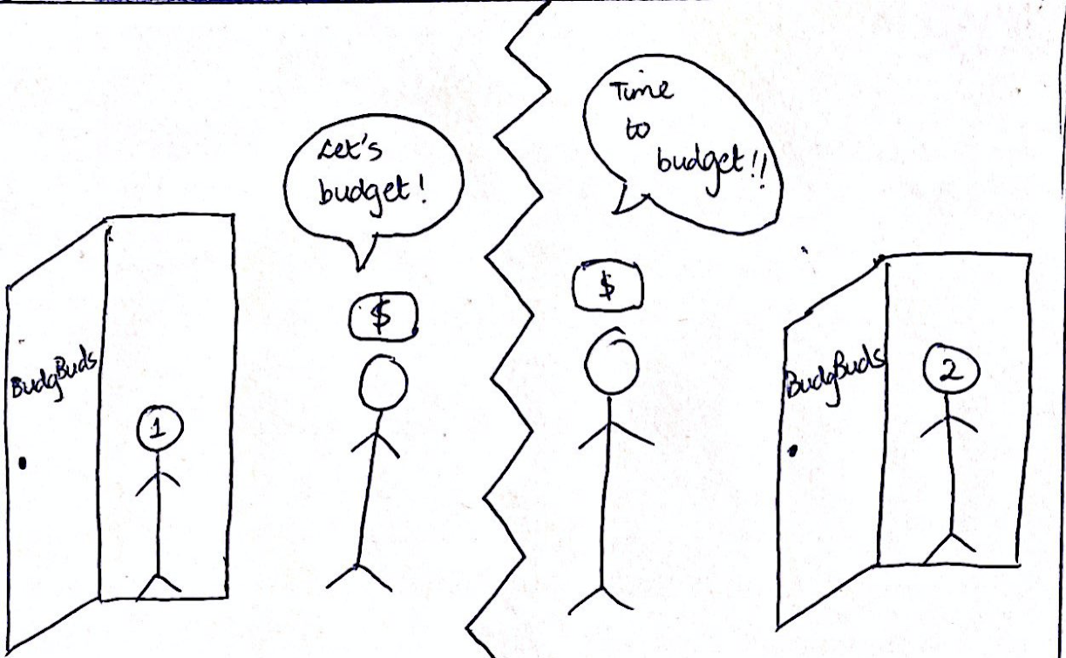
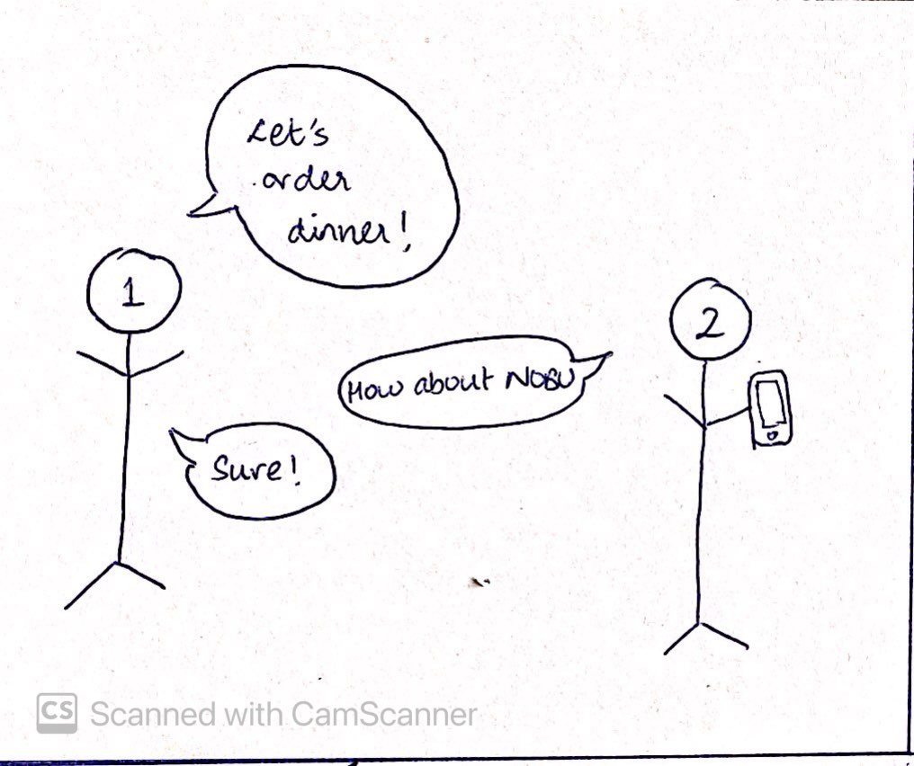
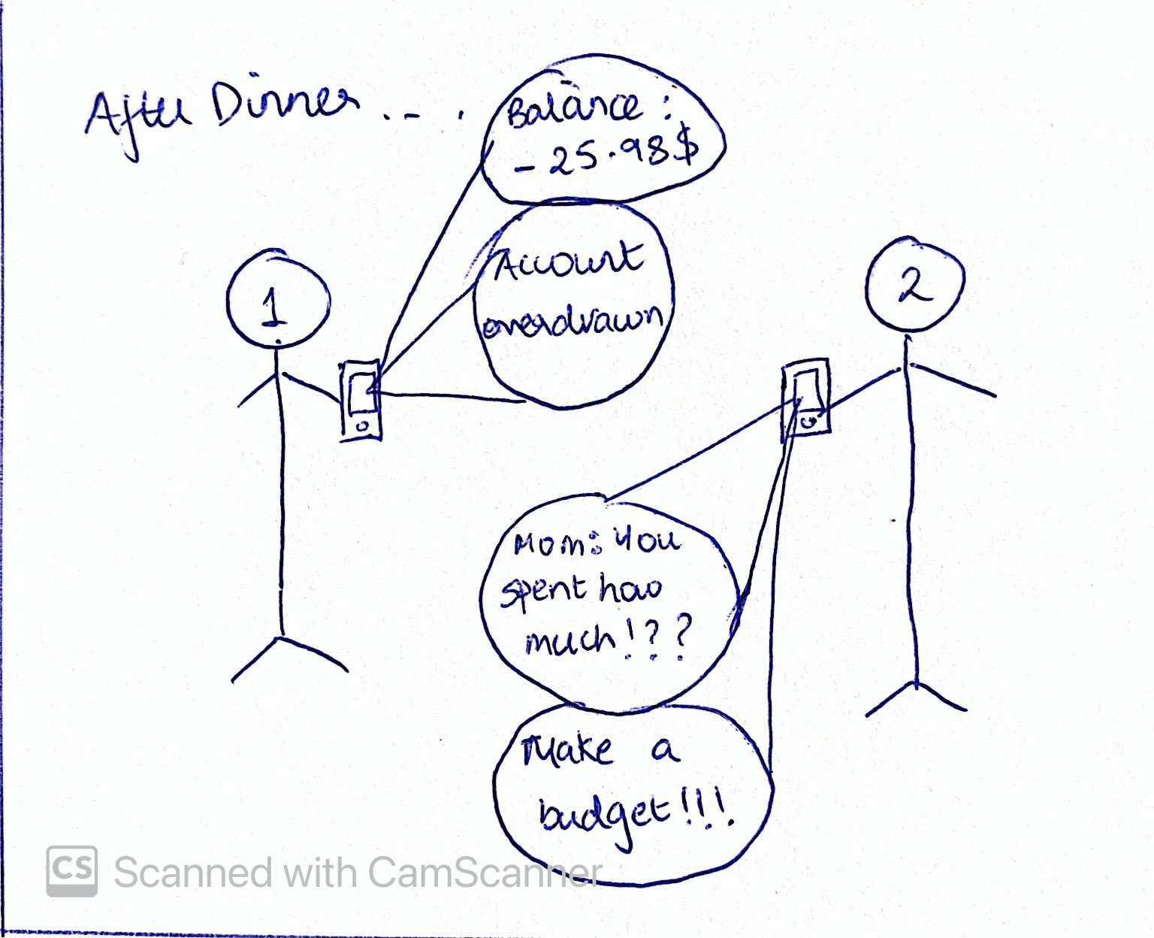
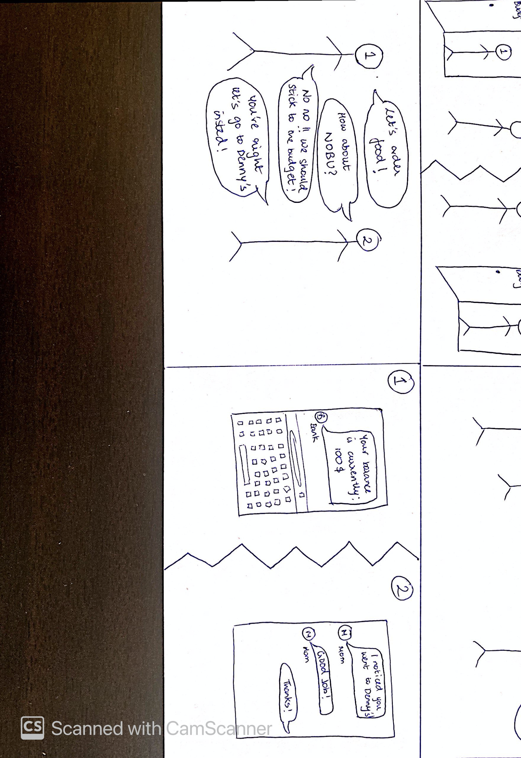
storyboard

