Slide 1
LIFE
AFTER LOCKDOWN

Slide 2

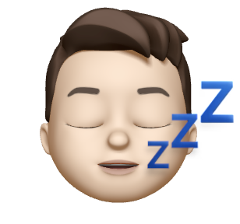


THE TEAM
RAAGAVI
Junior - CS
Has had hair catch on fire twice
JACOB
Junior - CS
Is a knight of Sealand
HABEEB
Junior - BMC
Never been in the ocean
MELVIN
Masters - MS&E
Just tired

Slide 3
LAST FRIDAY...
Social Interactions
Financial Habits
Motivation to Work
Work-Life Balance

Slide 4
CURRENT SUBTHEMES
Social Interactions
Financial Habits
Motivation to Work
Work-Life Balance

Slide 5
POV’s

Slide 6
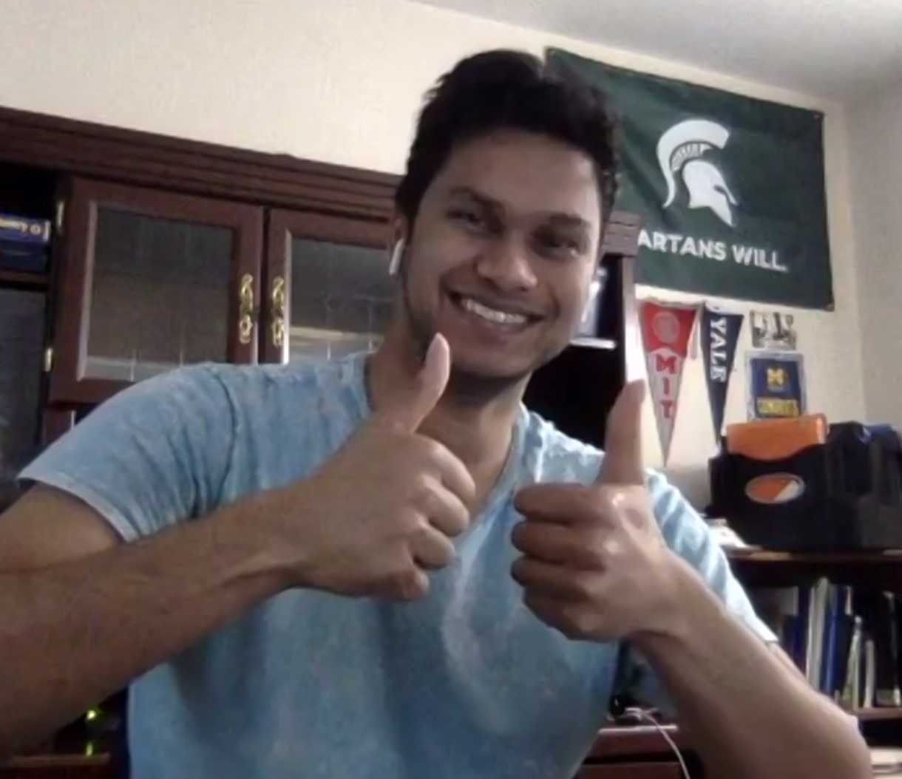
We interviewed...
We were surprised by….
It would be game-changing to...
...how much a person we considered to be motivated was struggling with motivating himself to work.
...to give students and employees a sustainable and easy way to boost self-motivation in professional and academic settings.
...Dhruv, a recent graduate working in Finance in New York City.

Slide 7
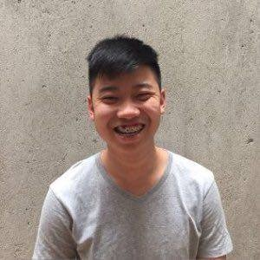
We interviewed...
We were surprised by….
It would be game-changing to...
...to keep track of how both frequent and occasional purchases affect disposable income for people who aren’t financially conscious.
...the fact that he doesn't think of one-off purchases as disposable income when budgeting.
...a small business owner of a SaaS platform.

Slide 8
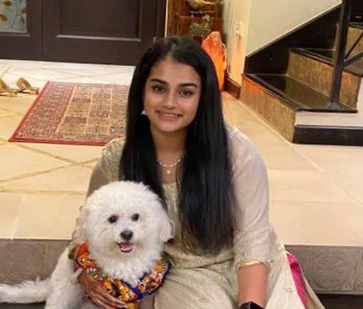
We interviewed...
We were surprised that….
It would be game-changing to...
...she tried to budget but didn't find herself being held accountable for her spending habits.
...help college students be responsible with their finances by holding them accountable to any financial limits they set for themselves.
...Shreya, a Junior at UC Berkeley living off-campus with friends.

Slide 9
HOW MIGHT WE...

Slide 10
..sustainable, easy way to boost self-motivation in professional settings
The game changer:
HOW MIGHT WE….
...encourage people to tackle small wins first to feel productive and then build momentum to kickstart productivity in their daily professional/academic lives.

Slide 11
...track how various purchases affect disposable income for people who aren’t financially conscious.
HOW MIGHT WE….
...clearly demonstrate the positive and negative effects every purchase can have on a user’s financial standing, especially in the long-term.
The game changer:

Slide 12
...help students be responsible by holding them accountable to their financial limits.
The game changer:
HOW MIGHT WE….
... leverage social interaction to teach college students how to budget without overwhelming them.

Slide 13
OUR SOLUTIONS

Slide 14
1.
An app that helps people prioritize doing smaller tasks earlier in the day by ranking priority of goals for the day and using that momentum to encourage them to want to be productive with their remaining work.

Slide 15
2.
Find consistencies in users’ spending habits that can be improved upon and suggest steps to do so by providing customized tips and prompts to match the user’s daily habits, financial status, location and other factors.
Notes:
(Ex: someone buys starbucks every day, maybe suggest other options, like a “what would happen if you bought a coffee that’s $1 less every day… you’d save $300 a year --- this $300 can go towards that new laptop you wanna buy”)

Slide 16
3.
An app for social groups to collectively budget for periods that involve social activities that require communal spending.

Slide 17
PROTOTYPING

Slide 18



1.
Assumption: People feel more motivated after completing several small tasks.
Result:
“...as the day progressed I felt relatively motivated, achieving what I had initially planned to complete.”
Participant as potential user
Researchers as the app.
“...due to the unpredictability of the type of work, each day is a surprise of its own with mixed emotions.”
Roles
Scene
Workplace of her 9am - 11pm job
Props
Two Google Forms

Slide 19
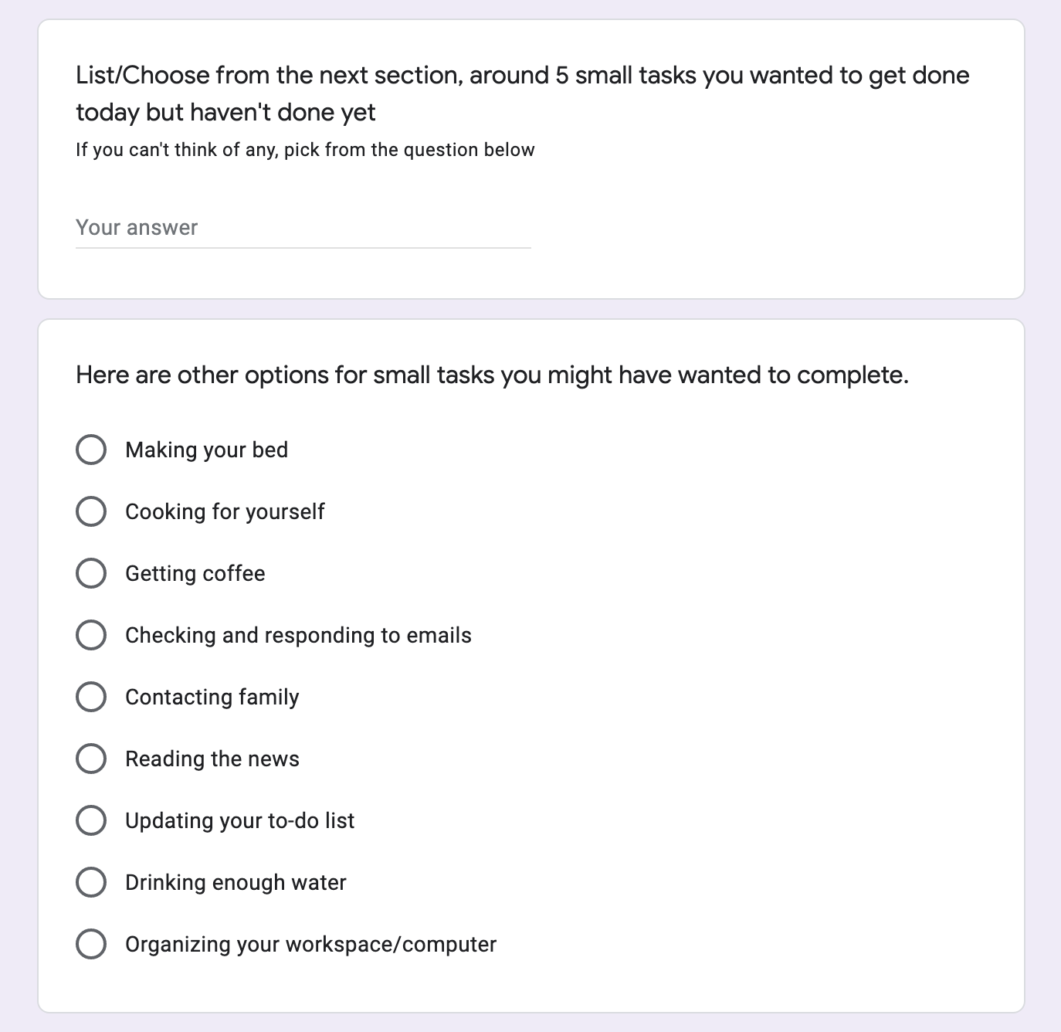

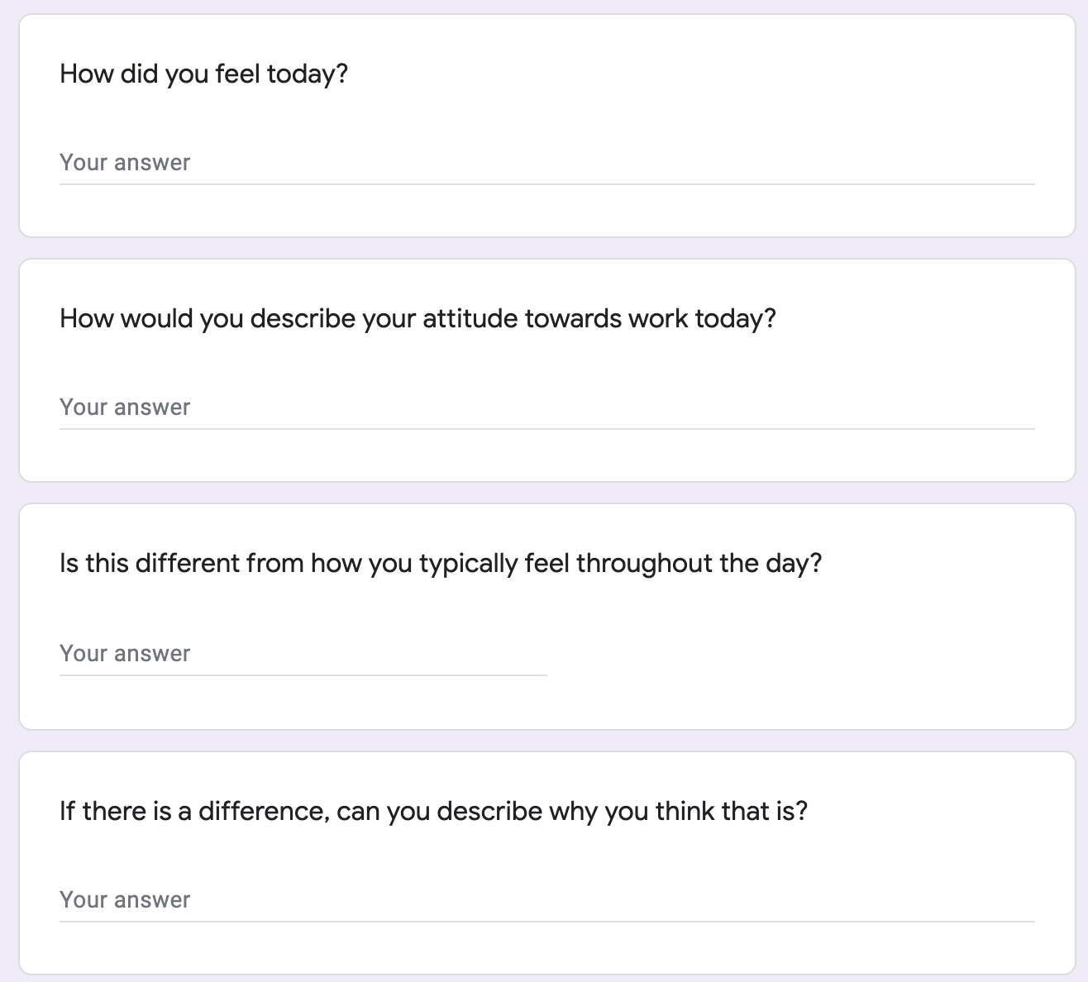
1.
...Manasvini, a short-term employee at Pricewaterhouse Coopers, U.K.

Slide 20
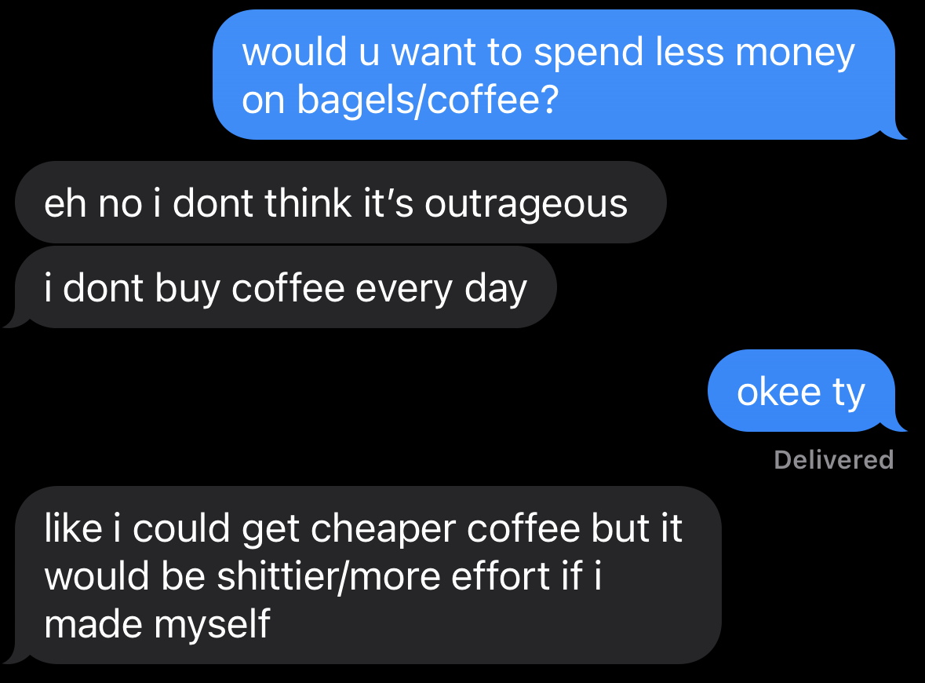
2.
Assumption: People are not aware of how much they spend daily and the effects it has.
Result:
Participant as potential user
Researchers as “guides”
Roles
Scene
Avg. day studying / working
Props
Text Messages

Slide 21
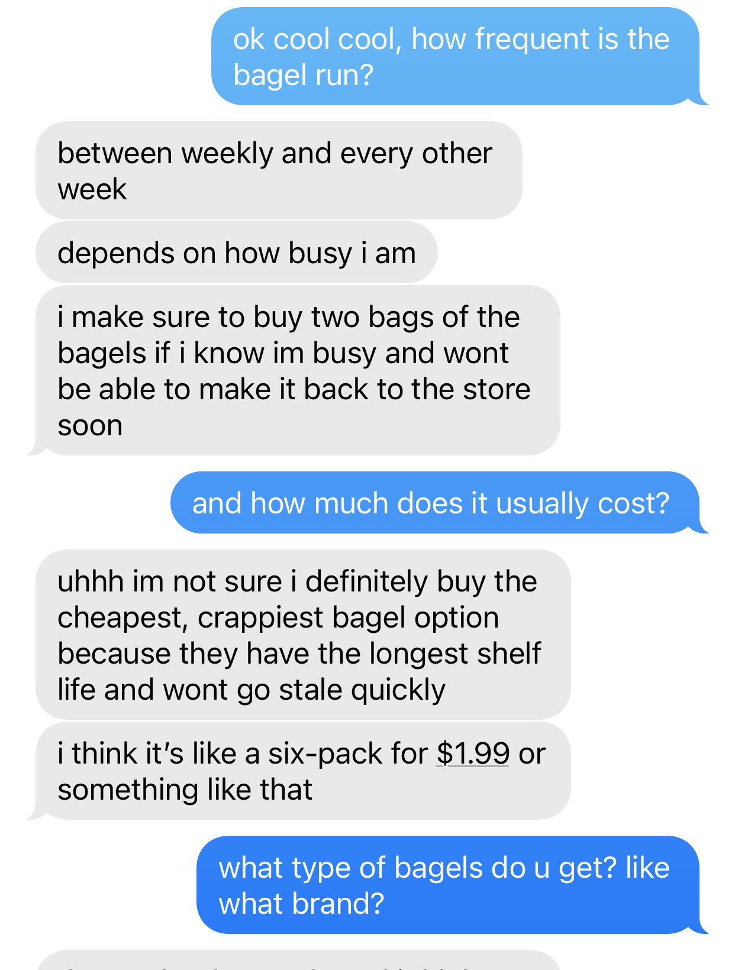
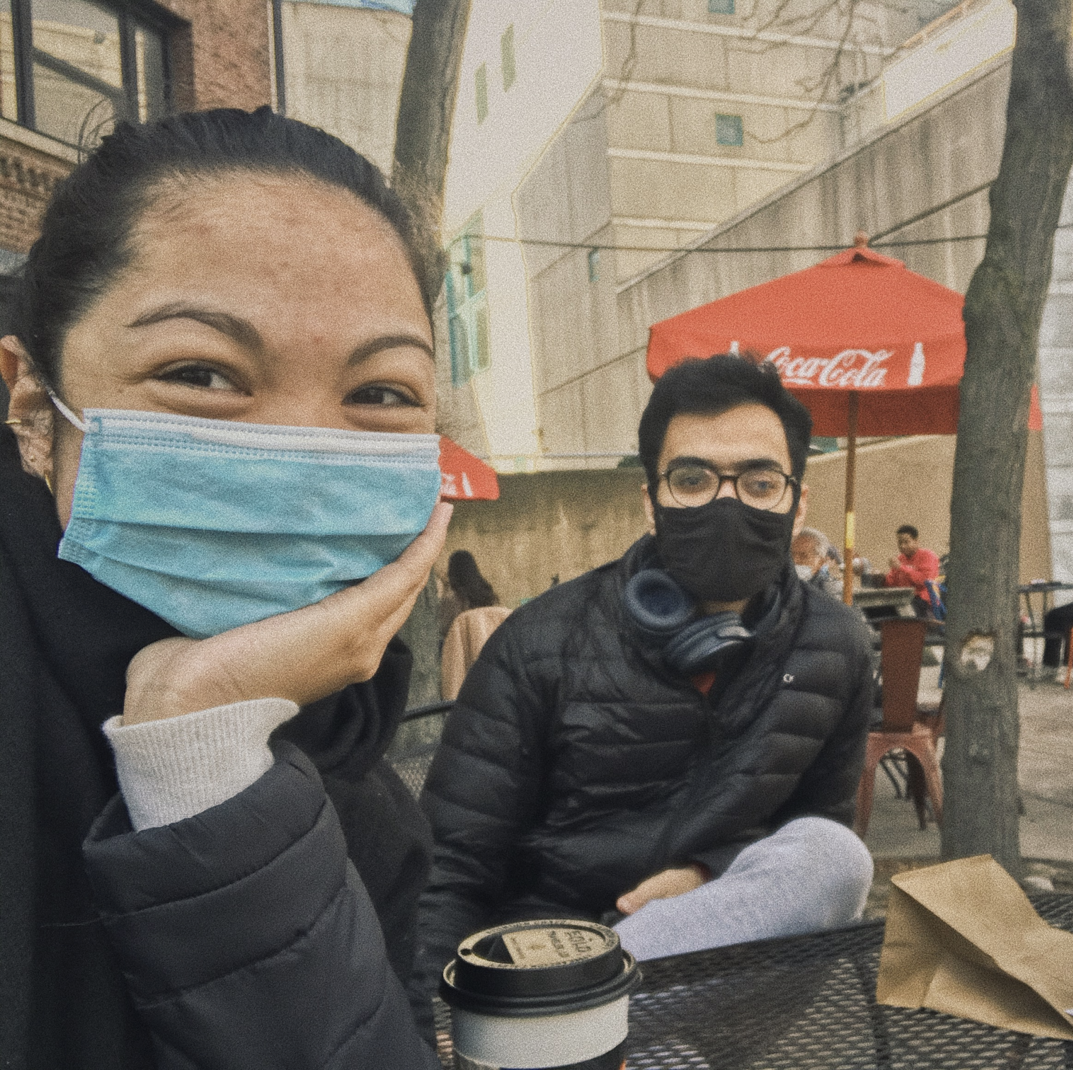
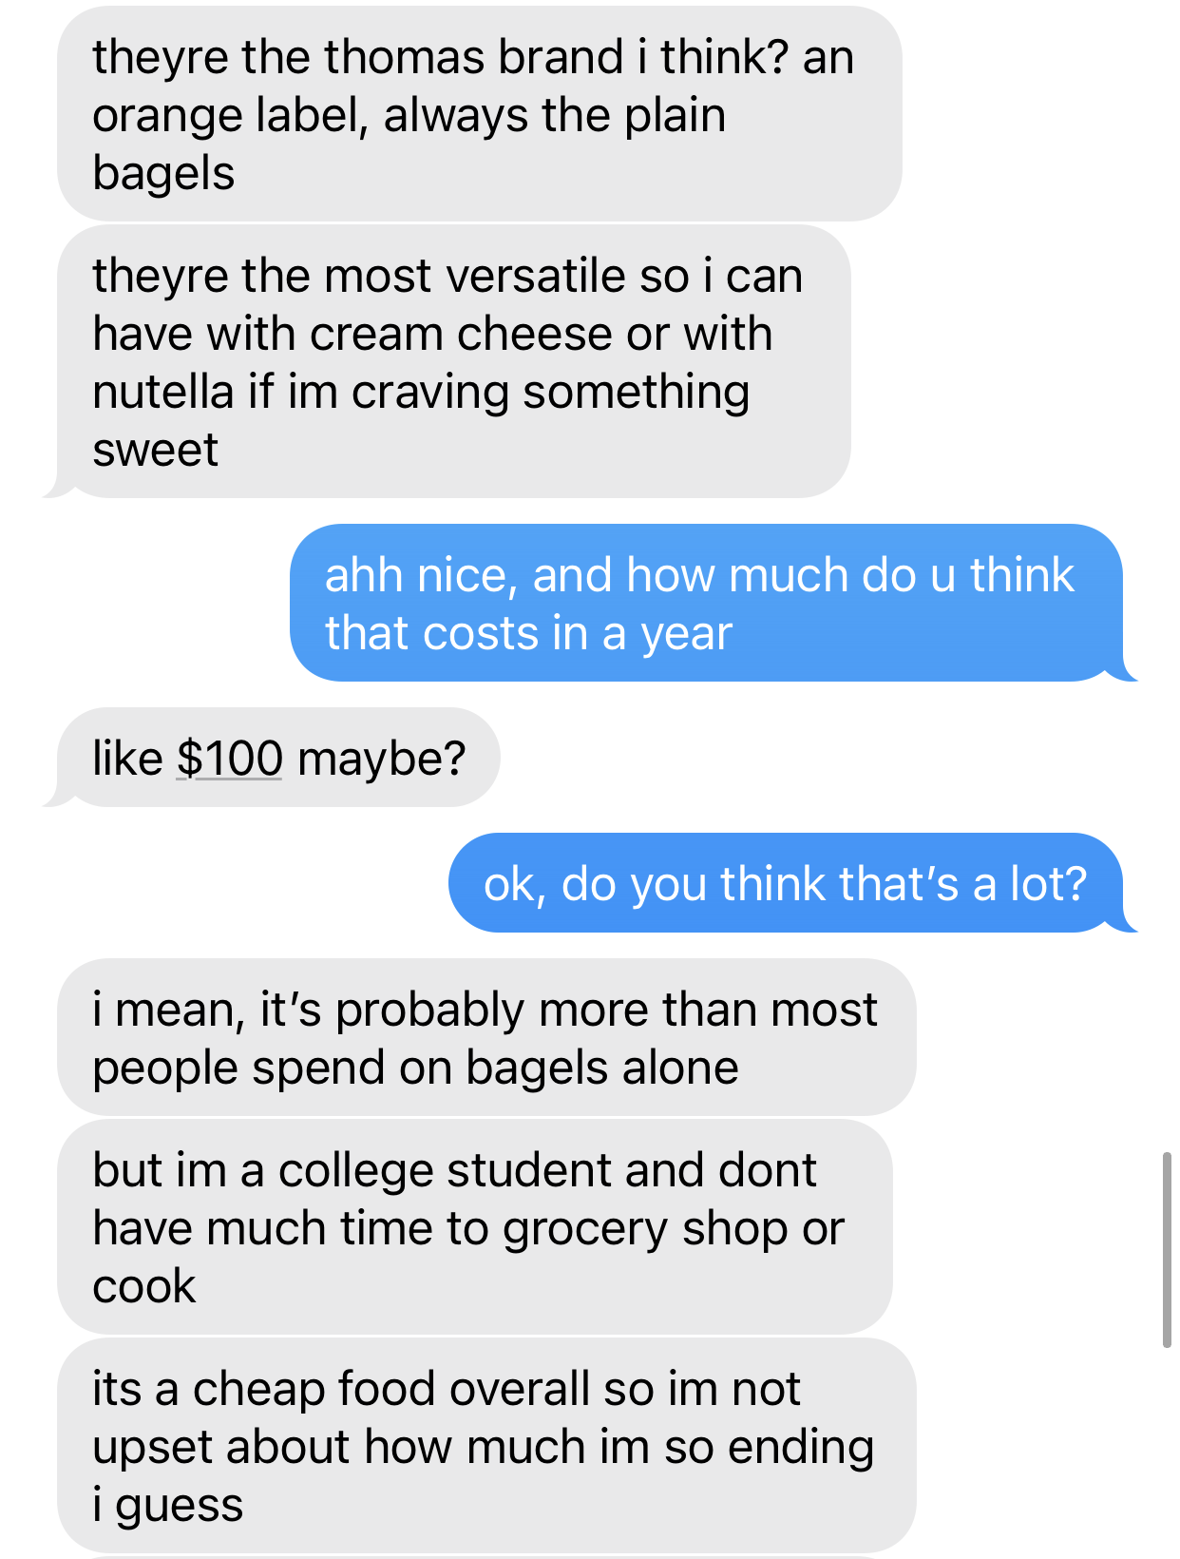
2.
...Kathryn, a college student at Cornell

Slide 22
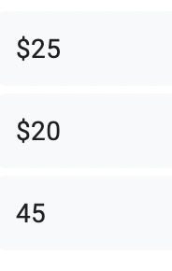
3.
Assumption: People want to budget in groups.
Result:
“I enjoy the group accountability and simplicity. “
“I like it because we can keep closer track of our spending.”
Participants as potential group of users
Researchers as “guides”
Roles
Scene
The house of 4 students
Two Google Forms
Text Message
Props

Slide 23
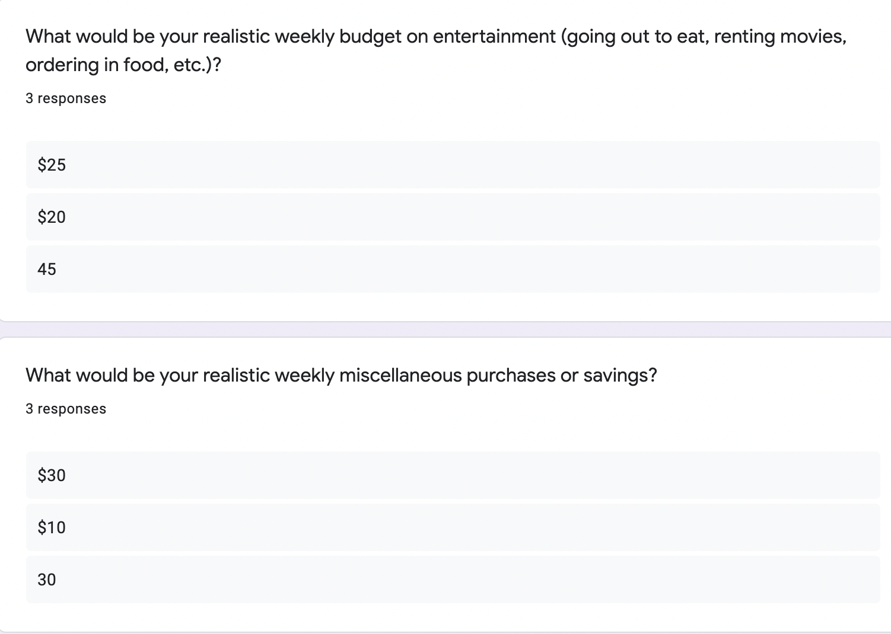
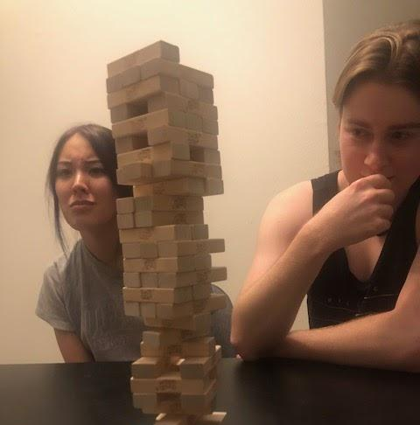
3.
...a house of Stanford students

Slide 24
2.
3.
SOLUTION
An app for social groups to collectively budget for activities that require communal spending, while simultaneously factoring in individual financial means. This means that we can actively suggest ways for an entire group of people to save by helping individuals improve upon their spending habits.

Slide 25
SUMMARY
Key Learnings:
A sizeable portion of people’s money is spent in groups
It is appealing to form / stick to a group budget
Next Steps:
Concept Video
Get more feedback
Financial Habits
As we notice a growing number of college students / fresh graduates moving in with friends, the need to budget as a group and account for each individual’s constraints should be a point of consideration.

Slide 26
Appendix

Slide 27
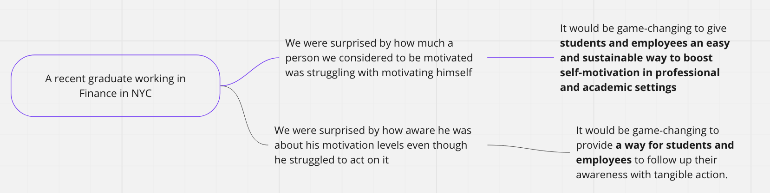
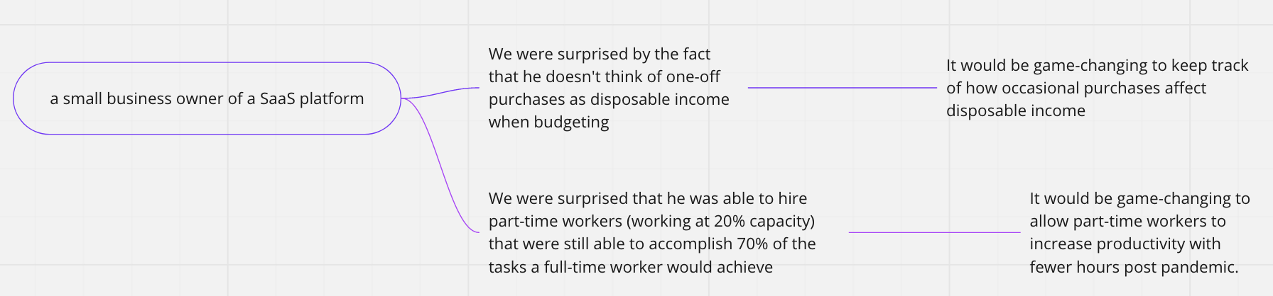
POVs
(Samples)

Slide 28
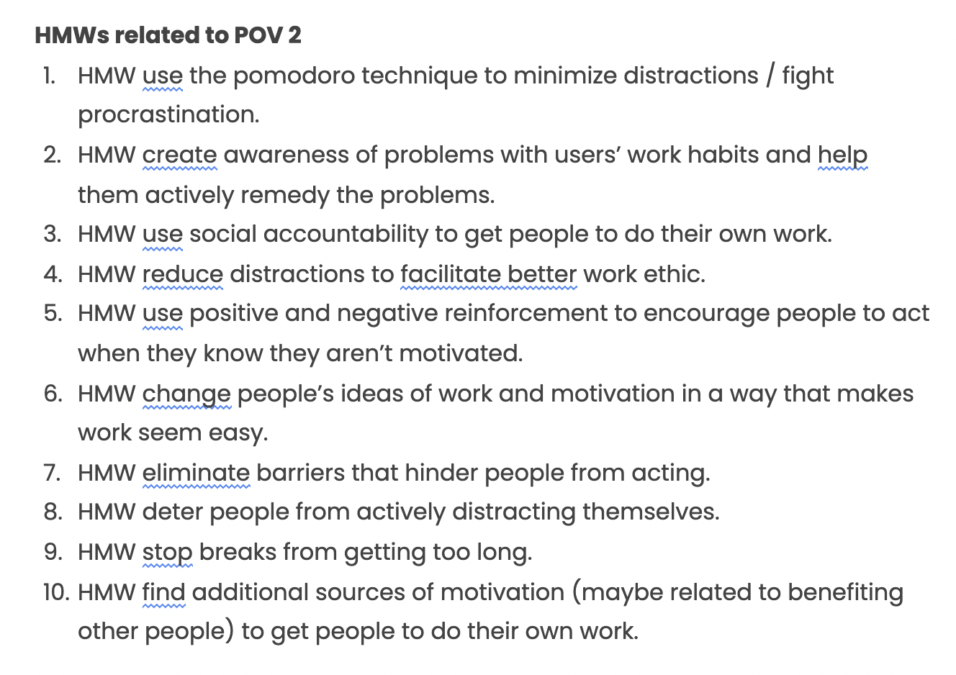
How Might We’s…
(Samples)

Slide 29
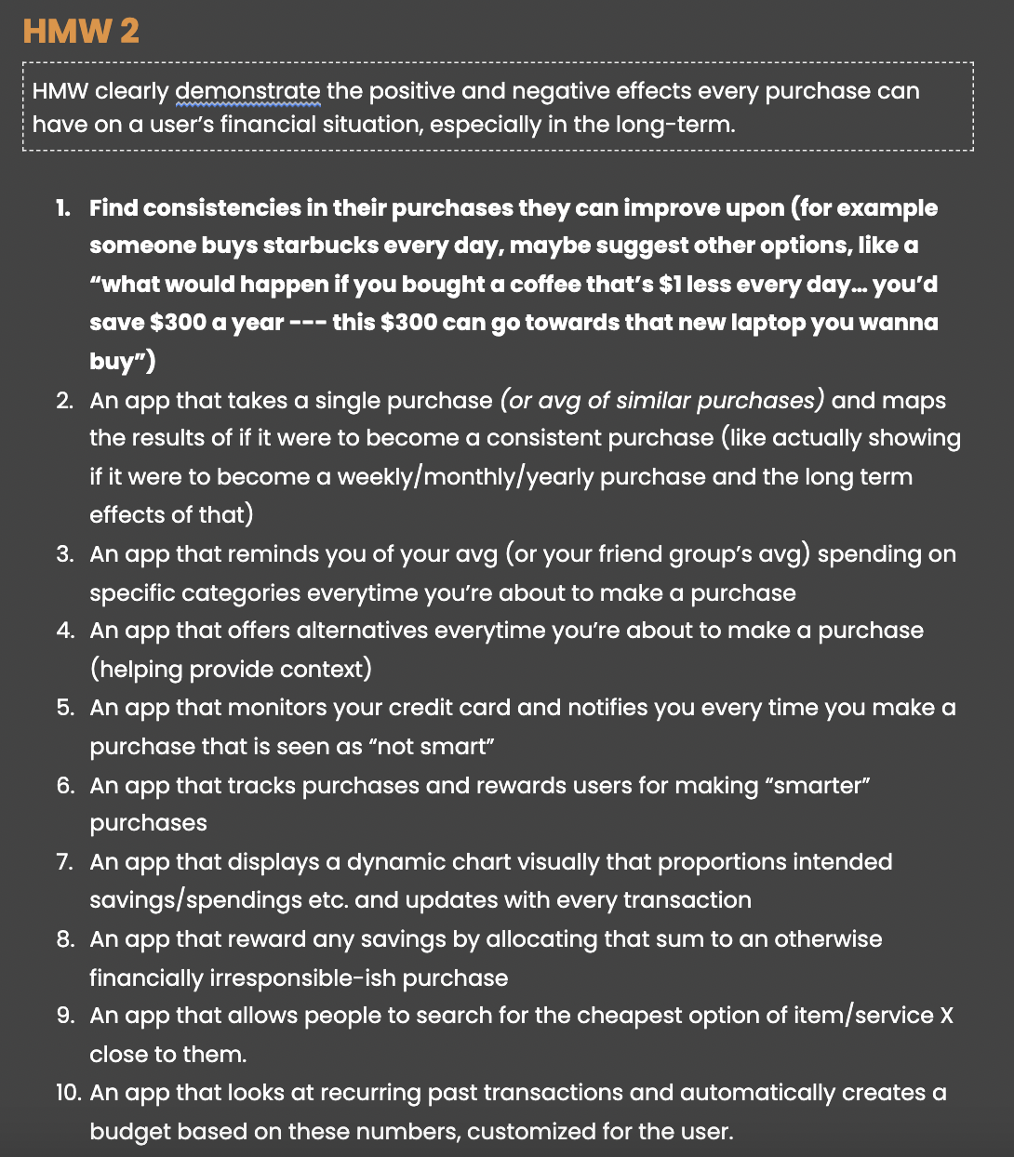
Solutions
(Samples)

