Slide 1
LIFE
AFTER LOCKDOWN
Hebeeb | Jacob | Melvin | Raagavi
Notes:
raagavi

Slide 2
NEEDFINDING METHODOLOGY
Notes:
subthemes
work related
motivation (forced into situations)
financial (brought to light some of the issues)
social aspect (needing to interact more )

Slide 3
Has the move to being online changed your lifestyle within the past year
Do you think your social behavior will change post pandemic?
Walk me through a day in your life.
?
How do you try to motivate yourself?
How do you organize and schedule?
How have your financial habits changed post-pandemic?
What is your relationship with social media?
Why did the pandemic affect your work habits?
How has your everyday experience changed since moving to a bigger online presence?
How do you budget?
Notes:
Questions we asked

Slide 4
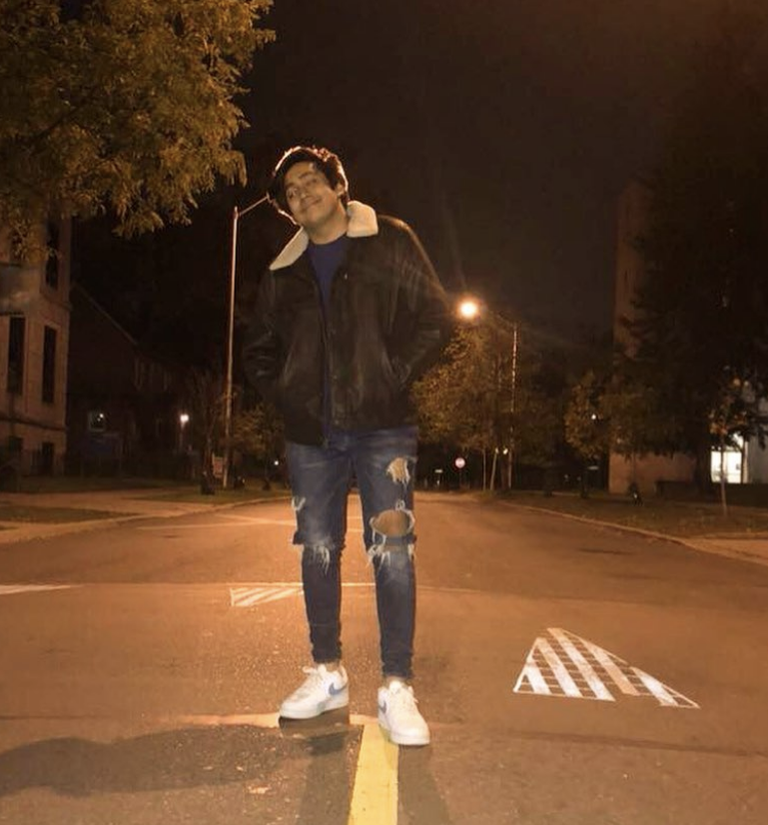
“Everyone else is a blur, when you’re forced to spend so much time with yourself”
Over Zoom College Student
Notes:
we found these people through social media and other personal outlets

Slide 5
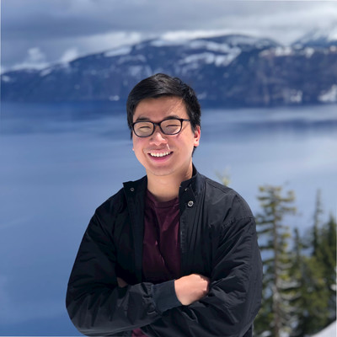
“I was able to grow operations, and start fulfilling orders on a daily basis” Over Zoom Home-based Micro
Business Owner
Notes:
the taco guy

Slide 6
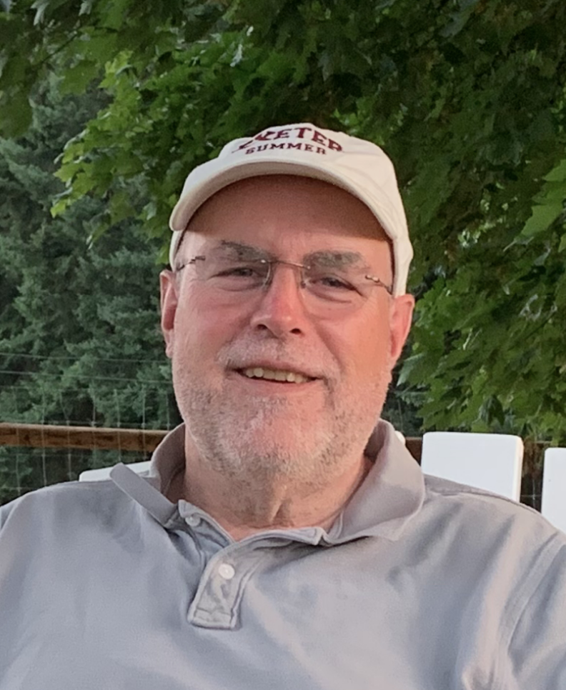
“Having a clear list of things I'm going to do today rather than a long list to choose from...helps me stay focused”
Over Zoom
Director of Architectural Design and Resident Fellow

Slide 7

“Being online has made class easier to skip. There’s less structure, so there’s less motivation to be there”
Over Zoom
College Student
Notes:
extreme users

Slide 8
EMPATHY
MAP

Slide 9
“I like being busy, but i like when i can turn the switch off”
“The pandemic allowed me [my small business] to hire people; experienced people at lower rates”
“Everything is more integrated”
“A lot of professors are just reusing old recordings, it’s hard to feel motivated with that.”
“The pandemic also allowed me to spend less by eating out less”
SAY
“I wouldn’t know where to start with budgeting”
“Time management became a blur this semester”
“I’ve struggled to maintain social connections and keep in touch”
“I already procrastinated pretty heavily, so being online only made that worse.”
“It was always my intention to spend less, so I can use more of my income to invest in new ventures”
“I want to continue being intentional about my down time”
“I would really like to find a way to make university- wide changes to affect motivation”

Slide 10
Hired three people with relevant industry experience to help run his small business
As a self-described extrovert, he tries to put himself in social settings to gain motivation.
Chose to take our interview in a crowded area with lots of people.
Shared a color coded calendar packed with interviews, meetings and classes
DO
Started eating out less, and used the income saved to invest in projects that compliment his small business
Reorganizes her day so she has a larger block of free time but doesn’t make the best of that time
Nodded to the people that he knew that walked by.
Shook his head as he spoke about his lack of motivation to do any college work

Slide 11
Happy and proud of his hires as they improved operations
I feel more guilty cause I don’t even walk anymore.
Frustrated with his social situation and not being able to see people as much as he would like.
Feel busier than usual despite the same workload
FEEL
Feels indifferent about changes in work days as he still works from home
Some of the same things she used to do, now feel more rewarding
Discouraged by his lack of motivation and frustrated that he can’t find a way to fix it
Boredom makes me spend money to pass time
I feel overwhelmed by notifications and messages from college
Glad and excited about being able to spend less and invest more
Feels more tethered to email
Feels off balance with his world flipping from in person to online.

Slide 12
Thinks positive opportunities arose as a result of the pandemic
He values the small interactions he used to have
He thinks that professors also feel unmotivated.
I think I tend to spend way too much money on food
Thinks it was always her goal to save more despite being forced amidst the pandemic
The flow of conversation is more natural when you can go out
Thinks that the pandemic has negatively affected his social relationships
I need to find better ways to be more motivated
THINK
I think part of the reason I used to eat out so often was the social aspect of it.
Not sure where to draw the line between fun and work
He appreciates the social interactions that he does get.
Having one place to keep track of everything I need to do helps

Slide 13
NEEDS AND INSIGHTS

Slide 14
Insight: There is an increasing gap between what someone wants to do and what they actually do.
“I spend more time planning my day, trying to hold myself accountable”
Need: A way to bridge the gap and synchronize their thoughts with their actions.
Notes:
TENSIONS: forced to be in this situation, interesting to see how people handle the things in life they don’t want to do
people have been forced into this environment

Slide 15
Insight: People want to maintain social interaction.
“I do whatever I can to interact with other people when possible”
Need: A way to interact across distance in a way that doesn’t seem forced (spur of the moment interactions)

Slide 16
Insight: People are happier to spend less but they struggle with self control when not guided in the right direction.
“It would help to know about alternative [cheaper] ways to spend my money”
Need: Techniques to actively modify financial habits and assist in budgeting, not just by tracking expense history but also by intercepting impulsive spending.
Notes:
people are happier to spend less but they struggle with self control when not guided in the right direction
context: the pandemic forced them into a certain situation where they struggled with self control

Slide 17
Insight: Communication has become a larger goal and has made it harder for people to enforce a strict work-life separation.
“Everything is more integrated… I like being busy, but I like when i can turn the switch off”
Need: Having a way to provide that definition between work and not work, and still being able to communicate with colleagues and loved ones more.
Notes:
mix of communication and motivation

Slide 18
Insight: Small businesses hiring people recently laid off due to the pandemic, can benefit both parties and support economic growth.
“The benefit from hiring a few [experienced] employees to run operations is that I can spend more time figuring out how to optimize things”
Need: A way to easily and cheaply expose small businesses to potential hires, and vice versa.
Notes:
Quote from the interviewee

Slide 19
SUMMARY
analyzing effects of the pandemic on everyday habits
motivation
social interaction
financial habits
work-life balance
NEXT STEPS:
narrow down our subthemes
additional interviews

