Slide 1
impart
Problem:
Collaborating with other artists feels more like work than play. It takes effort to establish a network of artists to bounce ideas off of, and it takes time to get exciting feedback.
Solution:
What if collaboration was less talking and more making? impart connects artists to share works in progress together. Artists take inspiration from a work in progress to remix into their own new and original art—which also provides a new perspective to the source artist.
Give and take inspiration
Notes:
Concept video link: https://youtu.be/2Gi1RN99Qdg

Slide 2
Three Tasks
Post a new creation
Remix someone else’s creation
Make a private remix group
Simple
Moderate
Complex

Slide 3
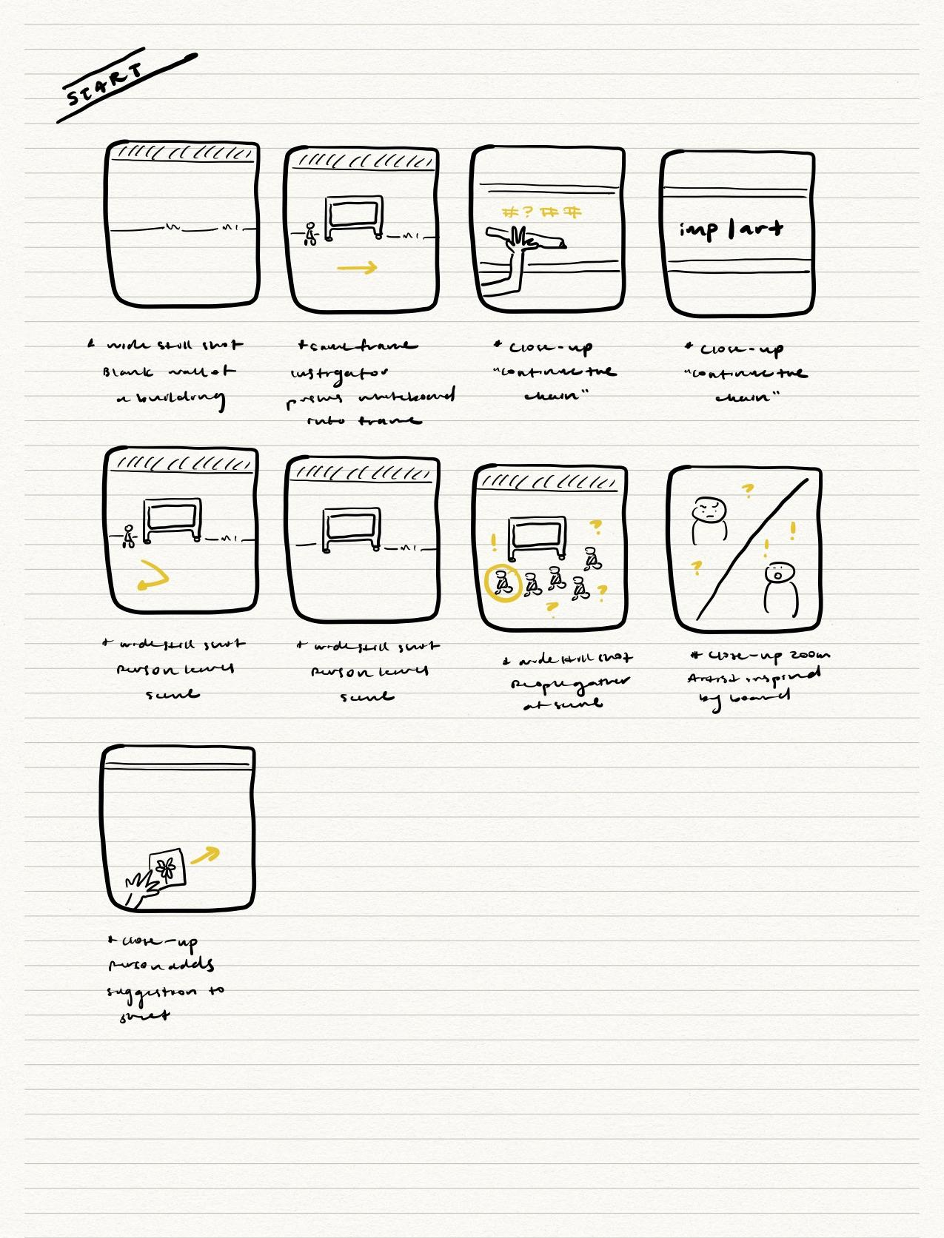
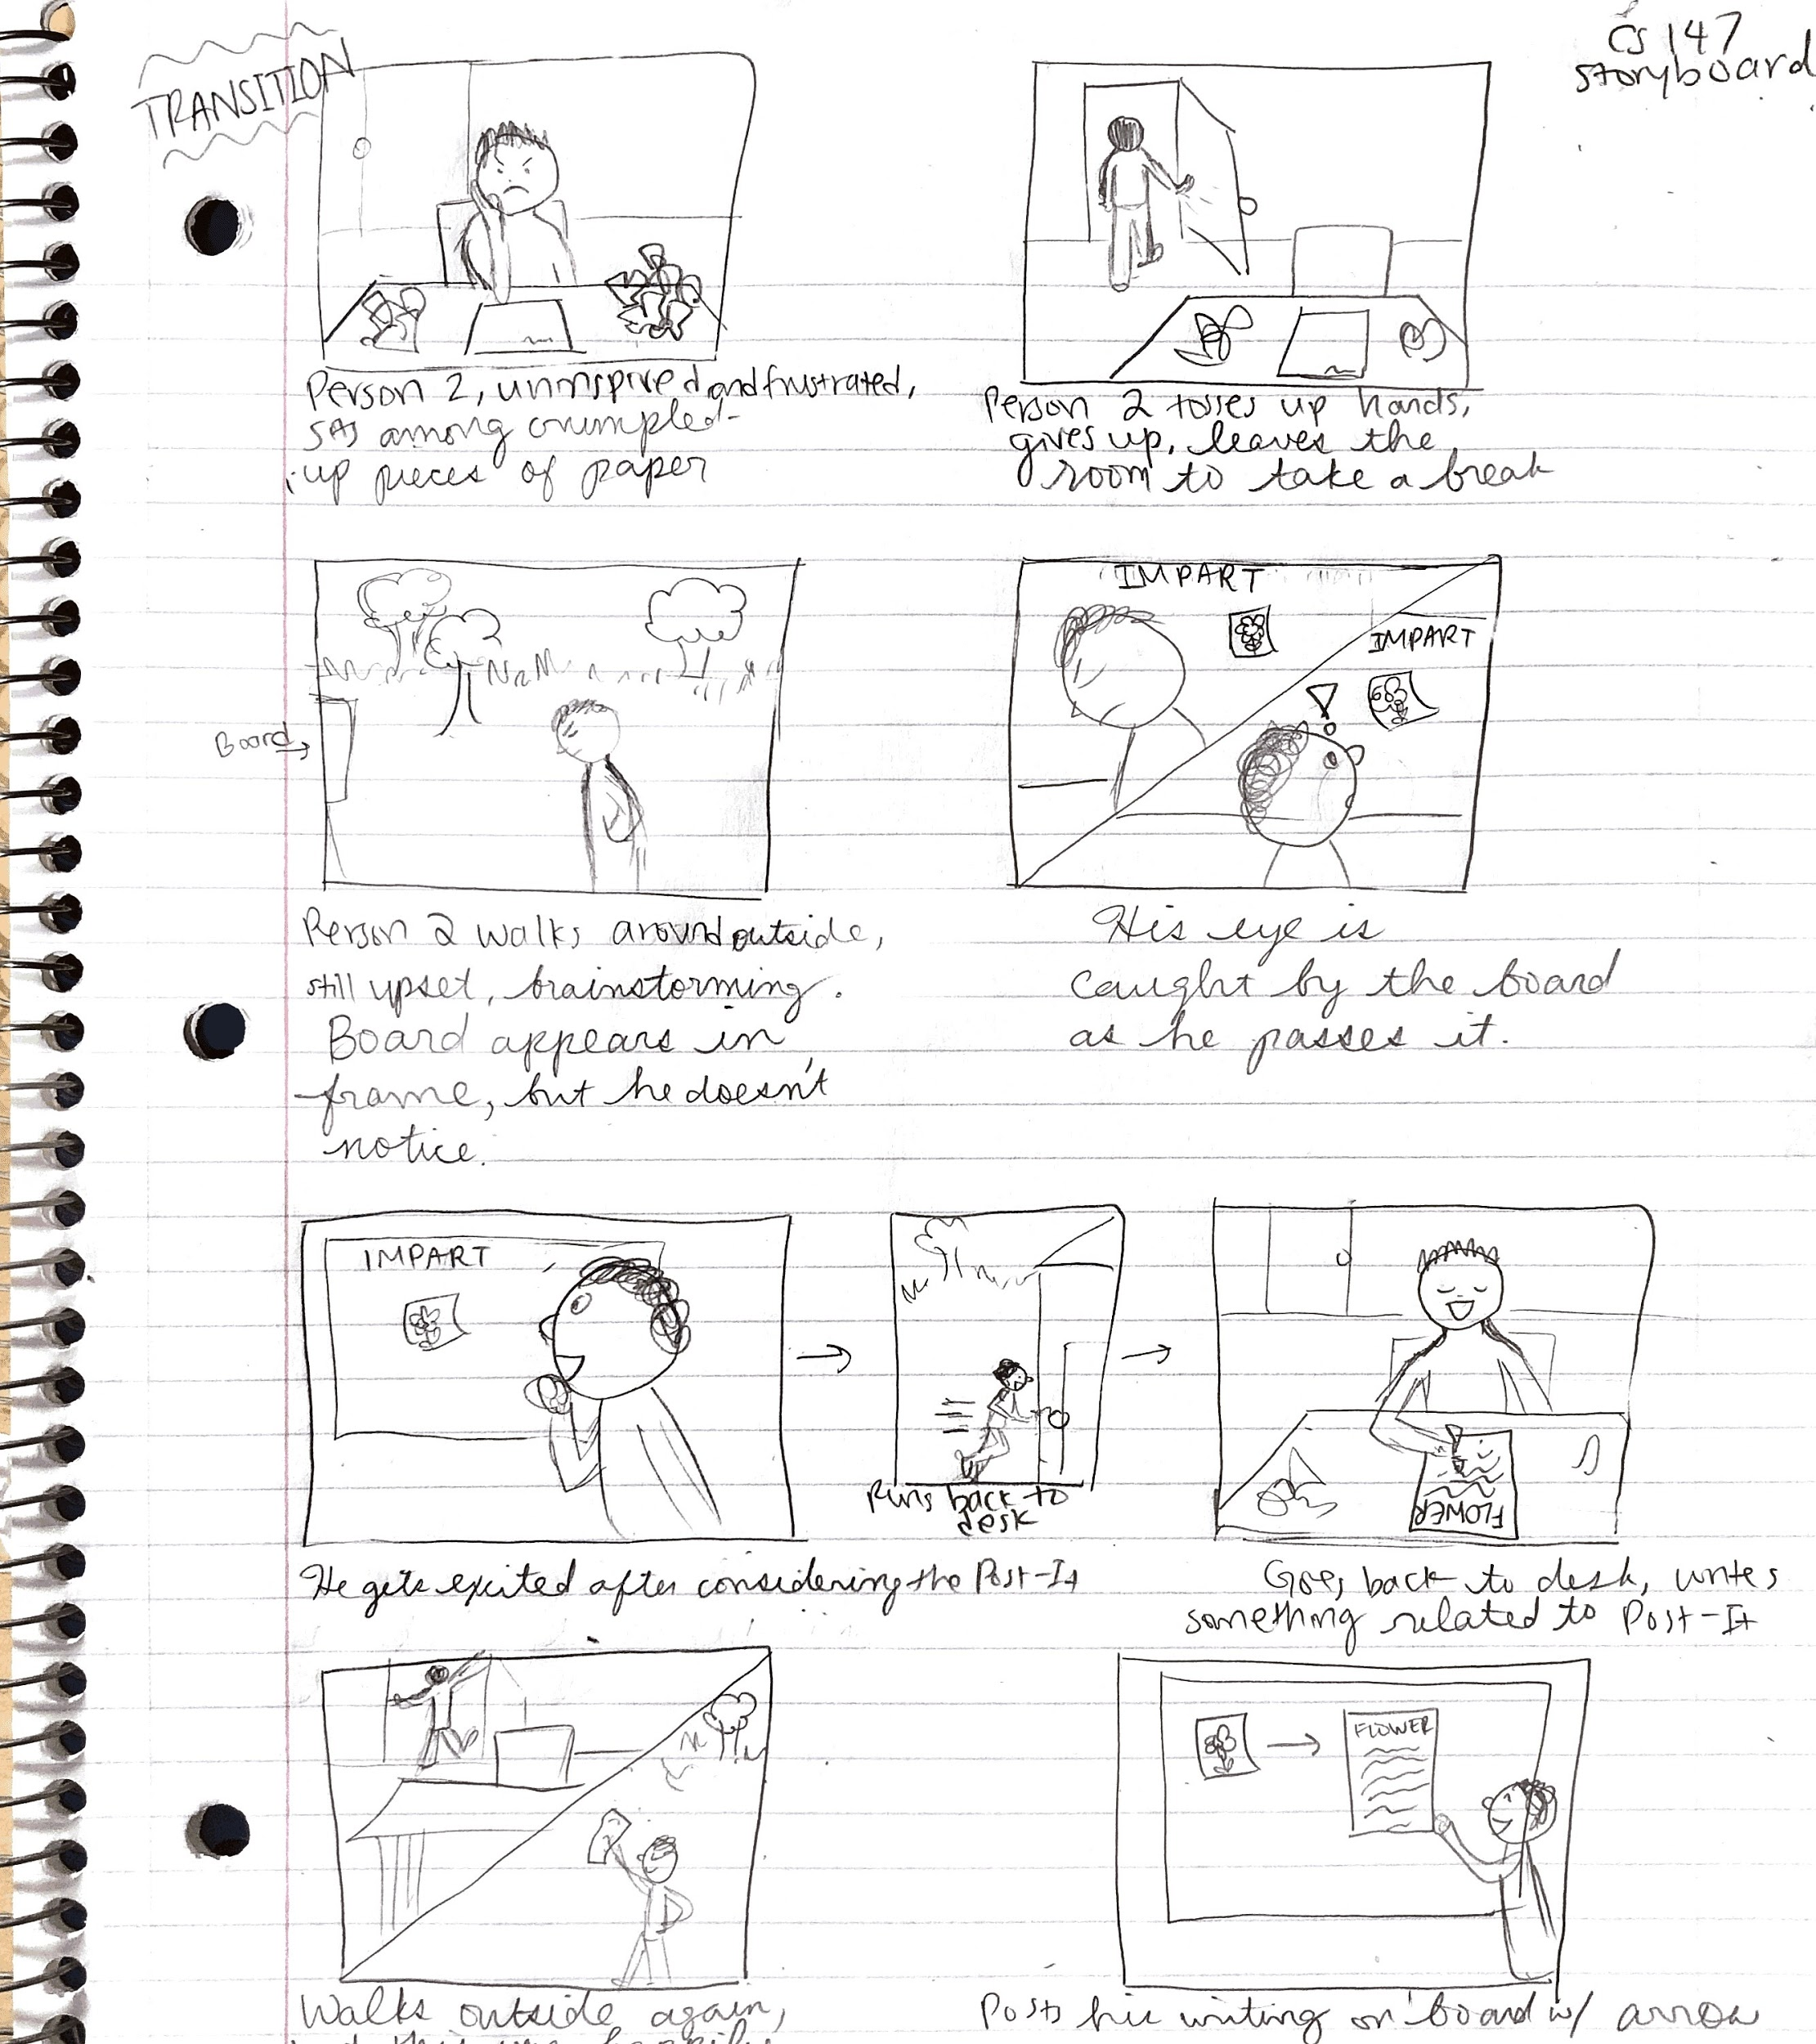
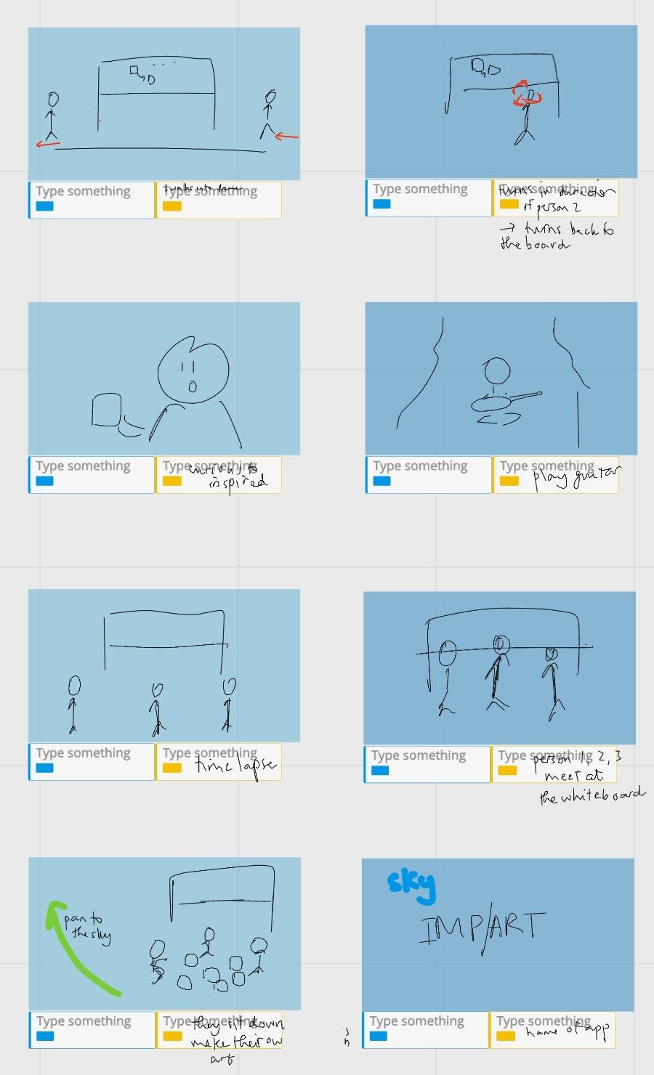
Three Storyboards

