Slide 1
Assignment #1: Needfinding
Team Gingham

Slide 2
Introductions and Domain
3 Interviewees
Veronica’s Empathy Map
Analysis and Closing

Slide 3
Introductions and Domain
3 Interviewees
Veronica’s Empathy Map
Analysis and Closing

Slide 4
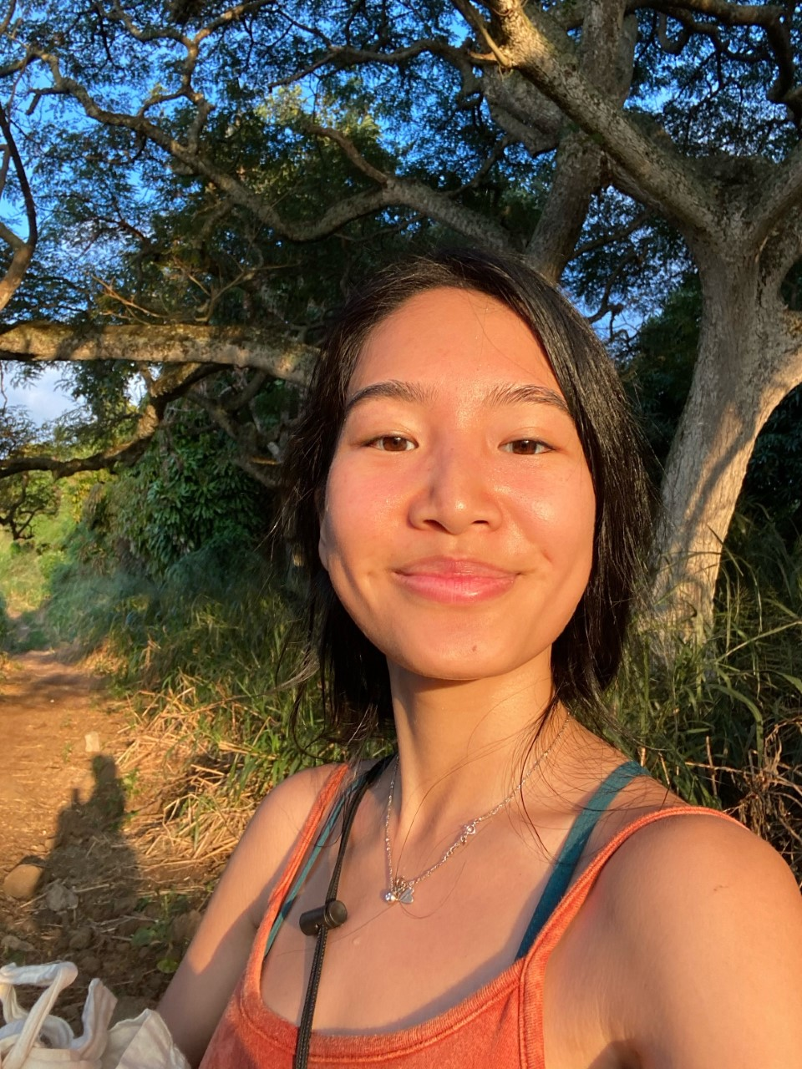
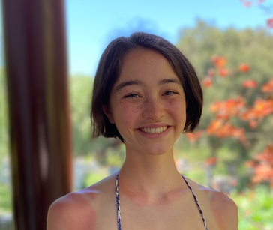
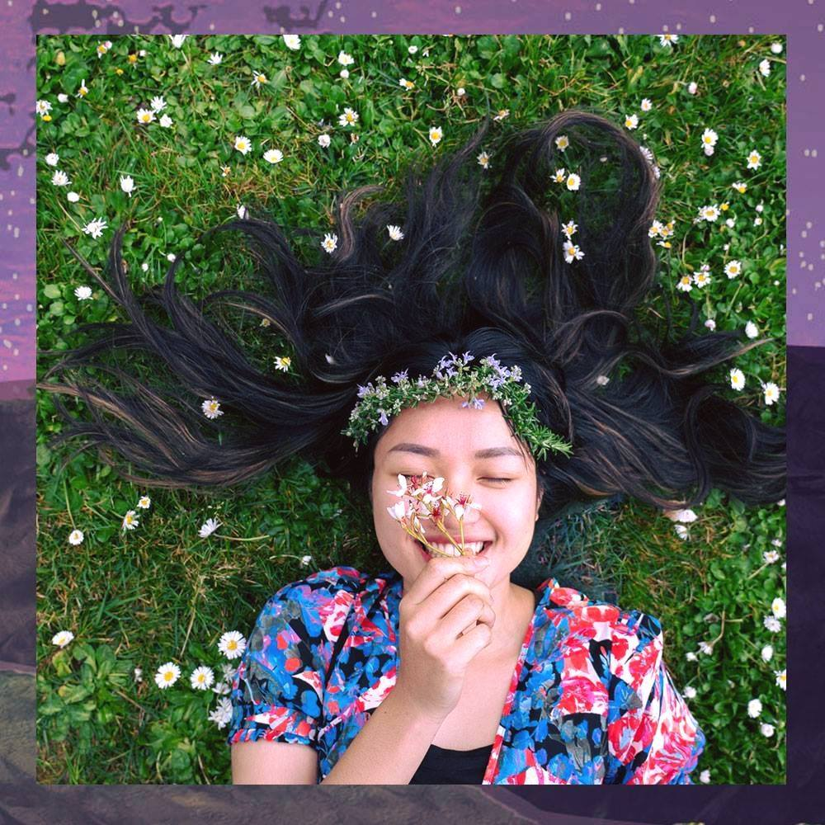
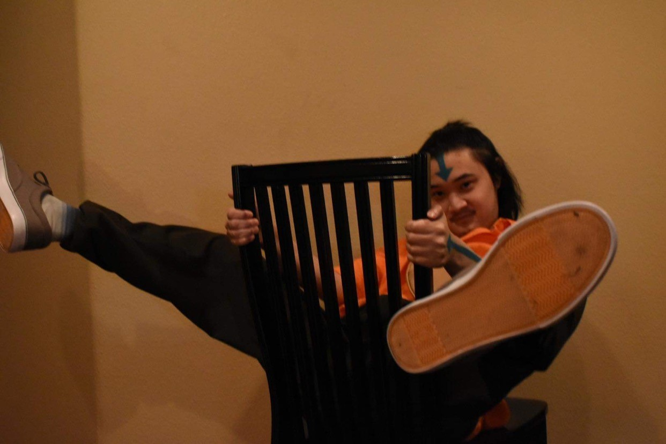
Jen (she/her)
Team Gingham
Julia (she/her)
Khuyen (she/her)
Ryan (he/him)

Slide 5
Arts and Culture
Creative Freedom in Arts Careers

Slide 6
Introductions and Domain
3 Interviewees
Veronica’s Empathy Map
Analysis and Closing

Slide 7
Introductions and Domain
3 Interviewees
Veronica’s Empathy Map
Analysis and Closing

Slide 8
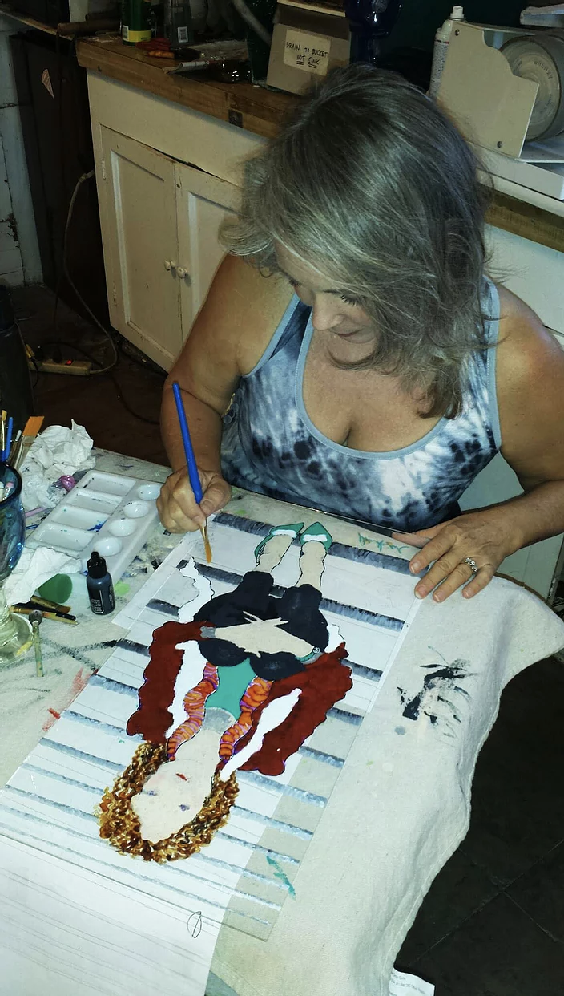
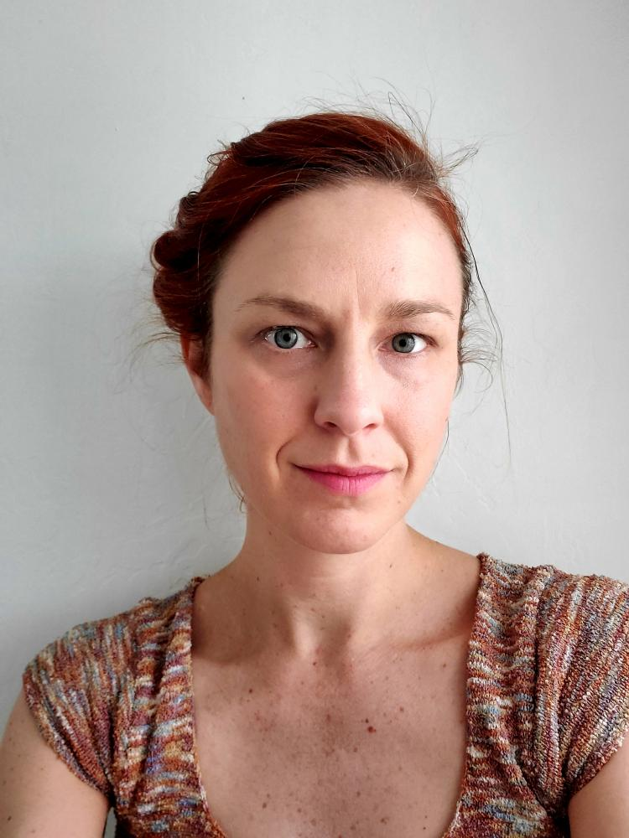
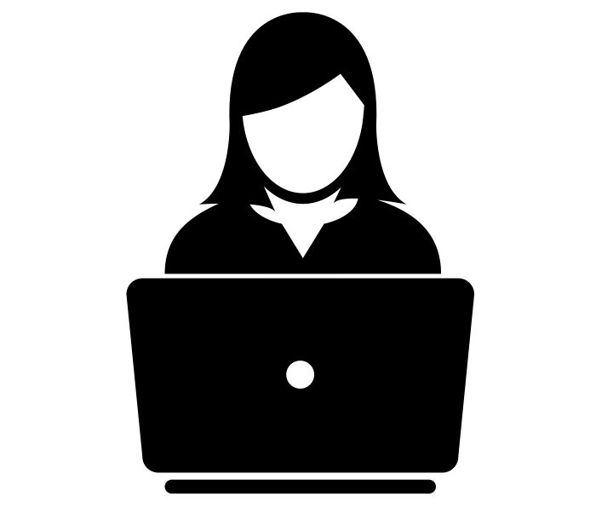
Makena
Daphne
Veronica
Art major (UCSB)
digital artist, doodler,
fandom participant
Artist, Art Collective Exec
painter, media experimenter,
young artist mentor
Artist, Teacher
printmaker, video game designer, art collaborator
Notes:
who​ your participants were, ​why​ chosen, ​how​ they were recruited/compensated, and ​where​ they were interviewed (​include images​)
Art creators of various levels of art as their career
Makena:
Makena is an Art major at UC Santa Barbara.
She specializes in digital art.
We thought she would provide a unique perspective to the project because in contrast to our other interviewees, Makena is “non-user” an emerging artist who has not yet established a career in art.
Also, Makena often talks with other digital artists through social media, so we thought that she would provide insight into the ways in which artists build and engage with online communities.
One of our team members knew her, so we recruited her through text.
She was interviewed on Zoom.
Daphne:
- artist based in San Diego.
- studio in an open-door artist collective, where she paints and teaches painting classes.
- reason for interview: she works with physical materials (extreme) her art classes are in person → how is she dealing with the pandemic?
- recruit: through email (a team member knows her)
- interviewed on Zoom
Veronica:
artist based in NorCal
book-printing and video game art.
Reason for interview: (model subject, art as career along with other career) works on a lot of collaborative projects → how do these artistic collabs work during the pandemic?
Reason for interview: through email (taught at Stanford)
She was interviewed on Zoom.

Slide 9
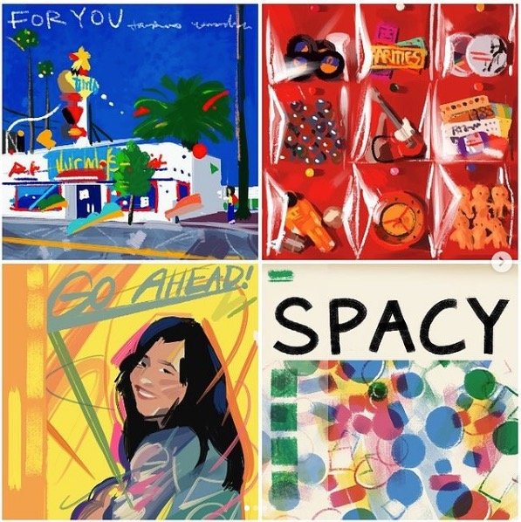
“An anonymous username is a blank slate. And when I’m a blank slate, people can see my art more genuinely.”
Makena
Art major (UCSB)
digital artist, doodler,
fandom participant
Notes:
Insta art
Something strange and/or surprising about how you have been making and/or consuming digital art during the pandemic? - stolen work on Instagram
How do you meet other artists online? - Art classes are inspiring, but infringe on personal art. Instagram puts limitations on users (aspect ratio, copyright)
What do online communities around art look like? - anonymity
Tension: Personal online community AND anonymity [NEXT SLIDE]

Slide 10
“An anonymous username is a blank slate. And when I’m a blank slate, people can see my art more genuinely.”
Makena
Art major (UCSB)
digital artist, doodler,
fandom participant
Notes:
Tension: Personal online community AND anonymity [NEXT SLIDE]
Is that even possible?

Slide 11
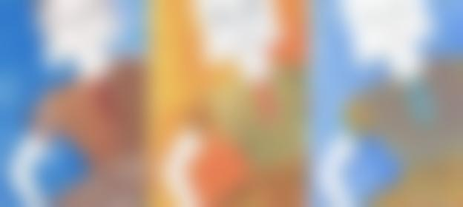
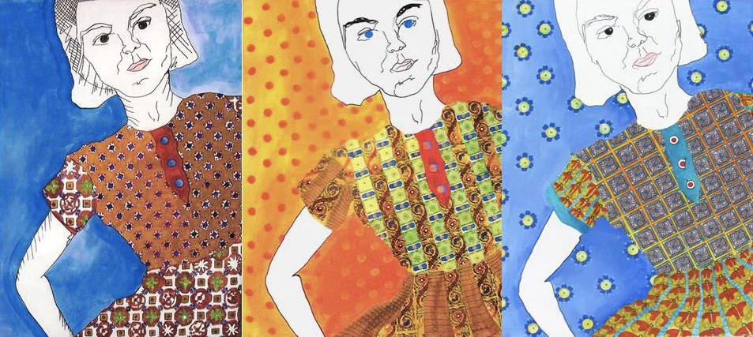
“I don’t enjoy commissions. [Clients] always have a strong vision.”
Daphne
Artist, Art Collective Exec
painter, media experimenter,
young artist mentor
Notes:
Children’s books
Who will you give your children’s book to for feedback?
Have you ever made a lasting friendships with another artist through social media?
How do you feel when you interact with younger artists that you are mentoring?
Our tension: large audience vs. separating art & personal spaces (anonymity!!!), enjoys mentoring and learning, Big structured opportunities vs. freedom;

Slide 12
“I don’t enjoy commissions. [Clients] always have a strong vision.”
Daphne
Artist, Art Collective Exec
painter, media experimenter,
young artist mentor
Notes:
Big structured opportunities vs. creative expression
Surprise: can commissions exist alongside creative expression?
Daphne LOVES Instagram!

Slide 13
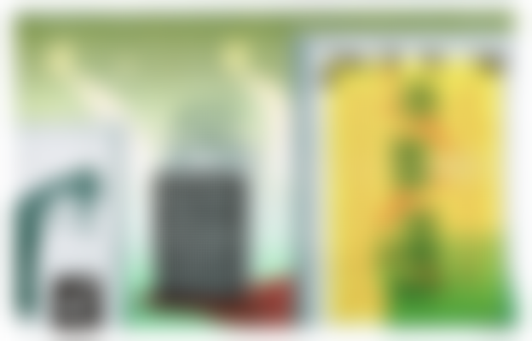

“Seeing somebody do something with the same means I have is powerful. If they can do it, I can do it.”
Veronica
Artist, Teacher
printmaker, video game designer, art collaborator
Notes:
Book cover
What does one day look like? - printmaking process PHOTOSHOP
How do you prefer to keep in contact with your collaborators? / artist friends?
What has your newfound freedom revealed about your art practice?
Empathy map -

Slide 14
Introductions and Domain
3 Interviewees
Veronica’s Empathy Map
Analysis and Closing

Slide 15
Introductions and Domain
3 Interviewees
Veronica’s Empathy Map
Analysis and Closing

Slide 16
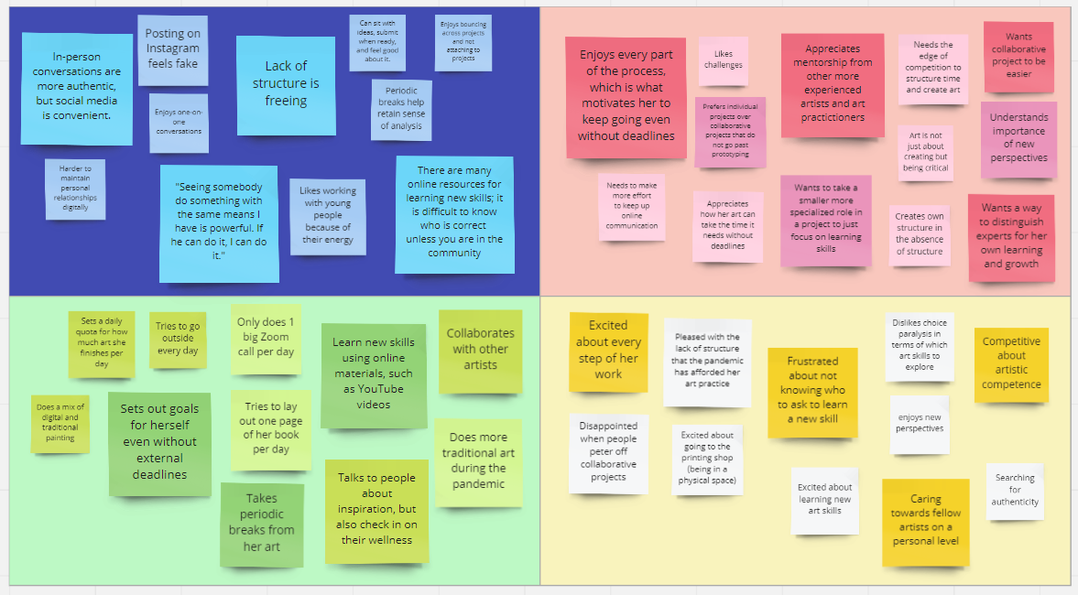

Slide 17
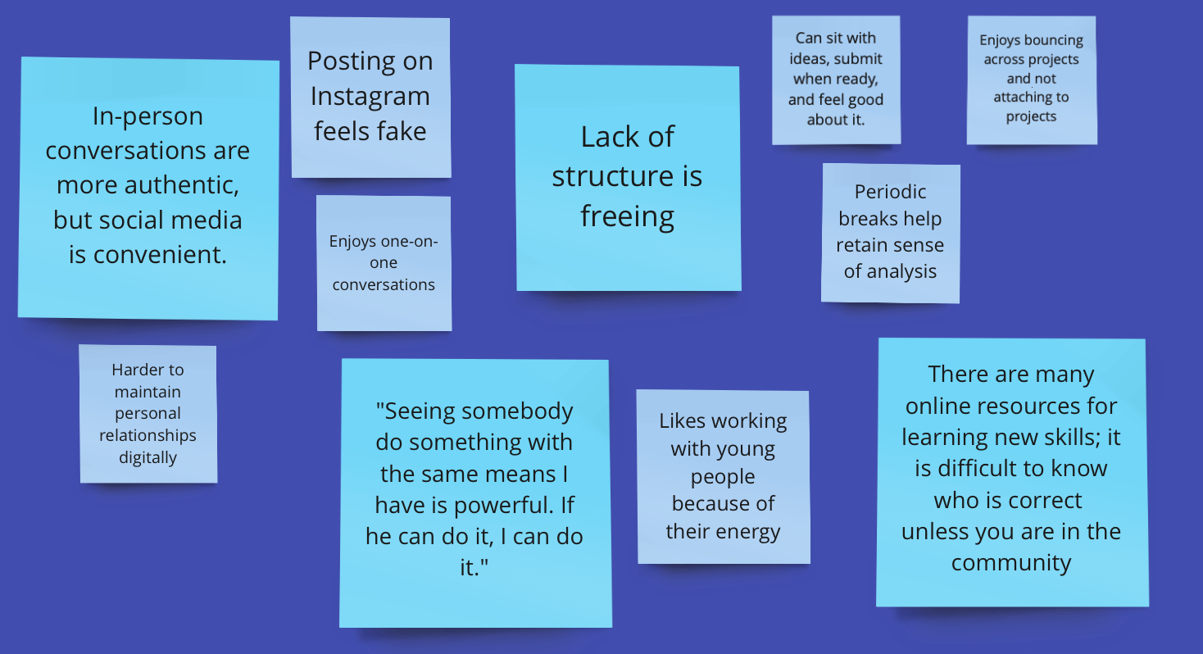
Say
Notes:
Neon blue = most important
Tensions/Contradictions: In-person vs. social media
Surprises: Lack of structure is freeing; Power of learning from other artists

Slide 18
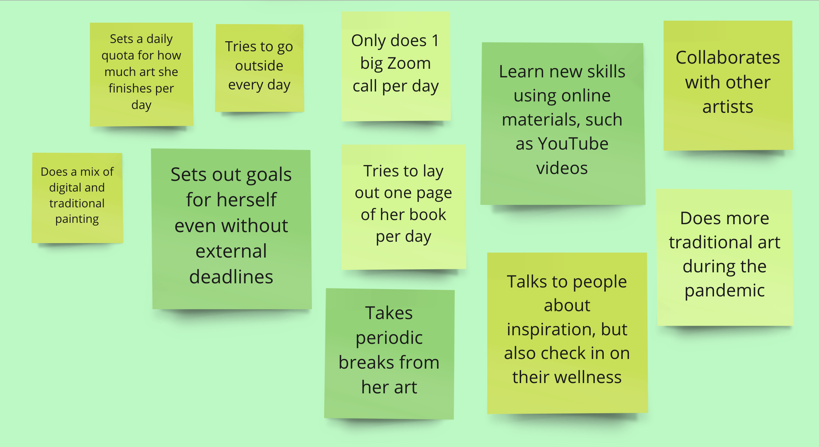
Do
Notes:
Dark green = most important
Medium green = medium important
Tensions, Contradictions: Limits use of digital media and tries to go outside
Surprises: Part of art is taking these breaks: staring at screen and colors look wrong

Slide 19
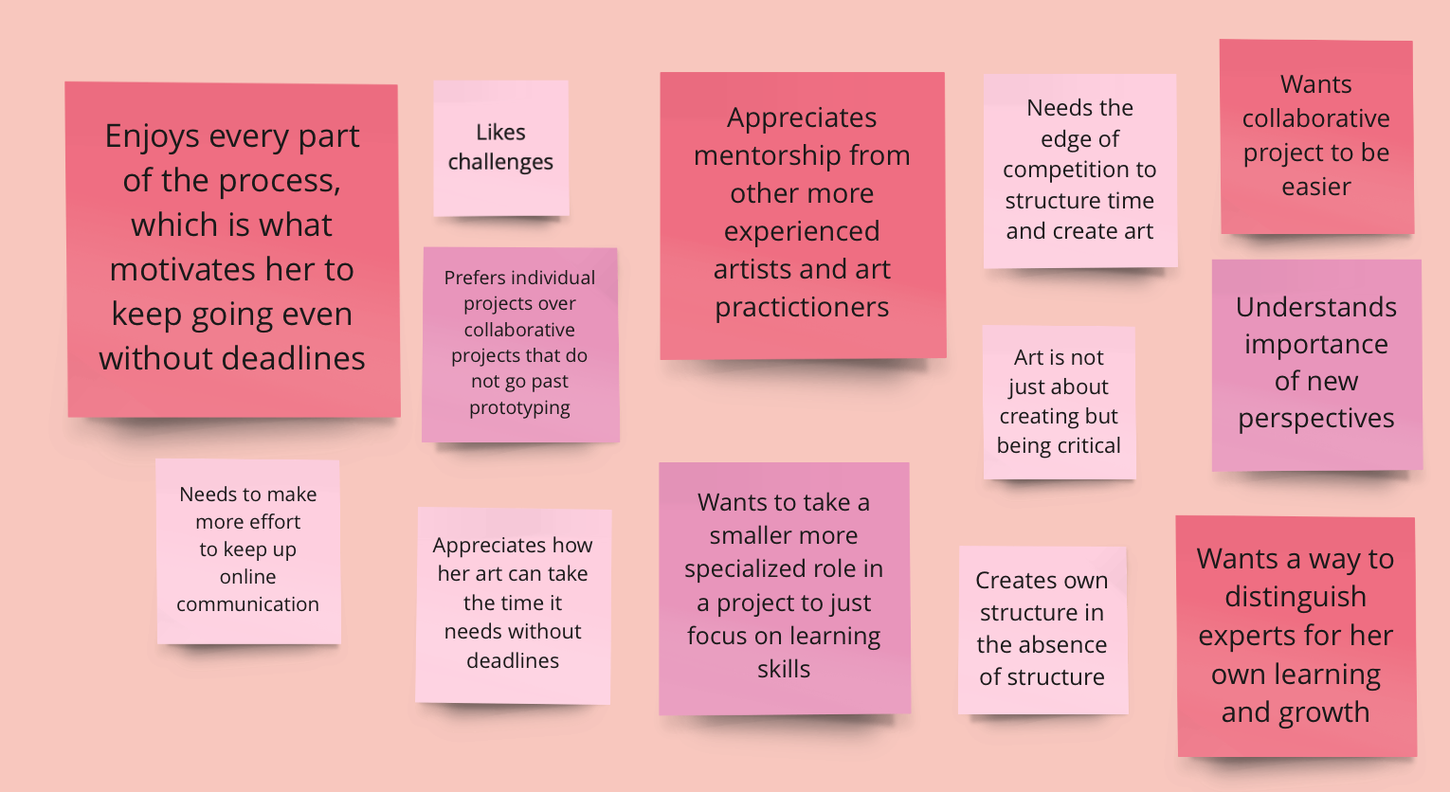
Think
Notes:
INFER
Darkest pink = most important
Medium pink = medium important
Tensions, Contradictions: Always ready to create, but needs a push from collaborators and mentors
Surprises: With less deadlines in pandemic, that means art can be finished before submitting

Slide 20
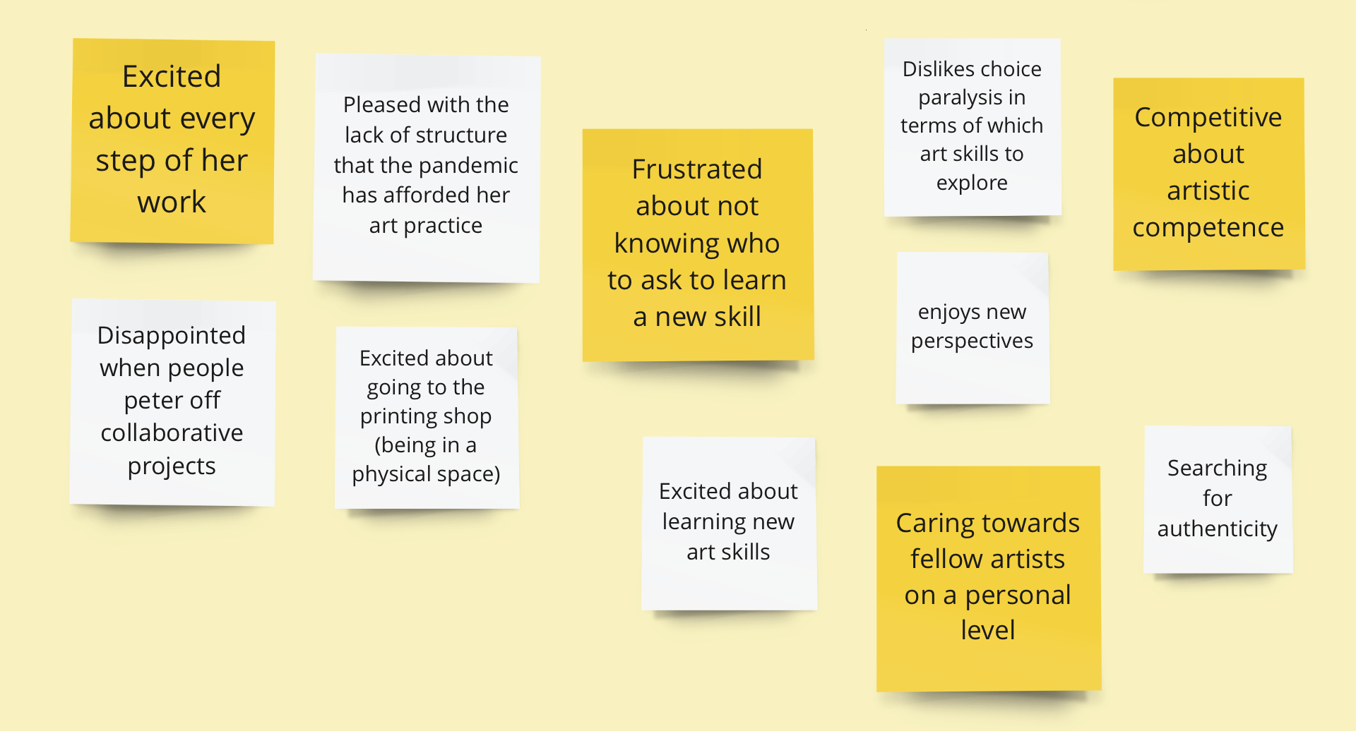
Feel
Notes:
Gold = most important
Tensions/Contradictions: Wants to reach out to people but doesn’t know how; digital print vs. physial print
Surprises: Choice paralysis amongst freedom

Slide 21
Introductions and Domain
3 Interviewees
Veronica’s Empathy Map
Analysis and Closing

Slide 22
Introductions and Domain
3 Interviewees
Veronica’s Empathy Map
Analysis and Closing

Slide 23
Insight:
Creative freedom is great, but the directions a new project can take are overwhelming.
“It’s like you have all of these paths that can unfold in different ways...You have to learn to let go of your original ideas.”
Need:
Ways to explore artistic possibilities while not getting overly committed.
Notes:
Inferences, Conclusions, Questions: Depth-First Search of paths
A way to explore those possibilities. Ties into second?

Slide 24
Insight:
Finding an expert is crucial for feedback and learning skills, even for masters.
“Seeing somebody do something with the same means I have is powerful. If they can do it, I can do it.”
Need:
Ways for artists to connect with experts in art fields of interest.
Notes:
Insight: excited about every steps of the process, but is also frustrated about not knowing who to ask to learn a new skill
Inferences, Conclusions, Questions: what if way to socially link artists, with emphasis on education
A way for artists who are exploring a new field to more easily find and connect with experts in that field.

Slide 25
Insight:
Transitioning to a new medium can unexpectedly change it—for better or for worse.
“It’s a double-edged sword. There’s both excitement and frustration.”
Need:
Ways to explore artwork in a new medium while retaining the original design.
Notes:
THE METICULOUS BOOKPRINTING vs THE CORRUPTED DESIGN

Slide 26
Insight:
Off-screen time needs to be scheduled for digital artists.
“You start to get caught up in this weird logic where everything looks terrible.”
Need:
Ways to cultivate regular off-screen time.
Notes:
Her digital work does not require her to have in-person interactions, so she must schedule off-screen time.
Need: A way to cultivate regular off-screen time.

Slide 27
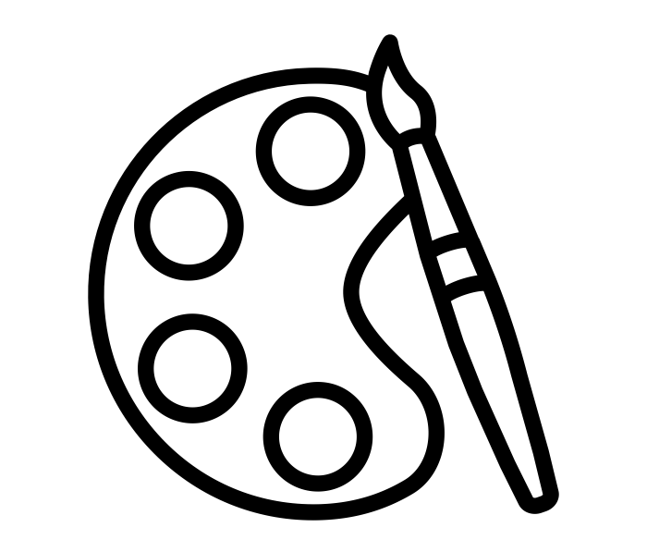
Our conclusions:
Career artists desire authentic self-expression when doing work for others.
Though creative freedom and independence is important, artists need community and expertise to guide their work.
Notes:
NEED: Though representing varieties in career experience, also need clients of commissions; performance art

Slide 28
Questions?

