Slide 1


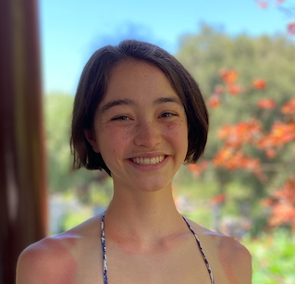
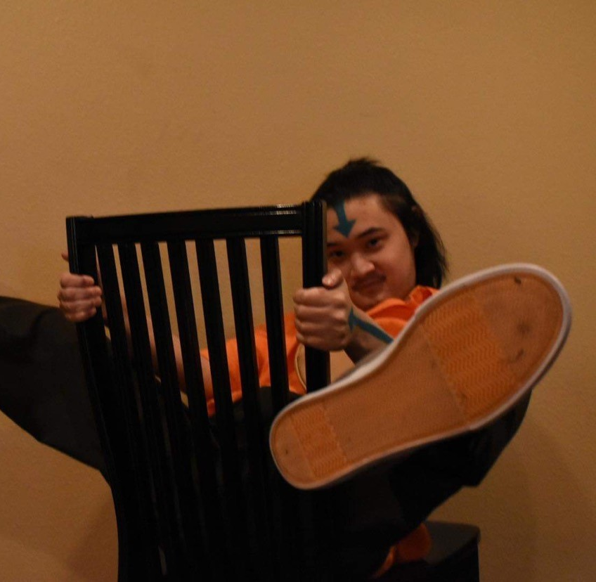
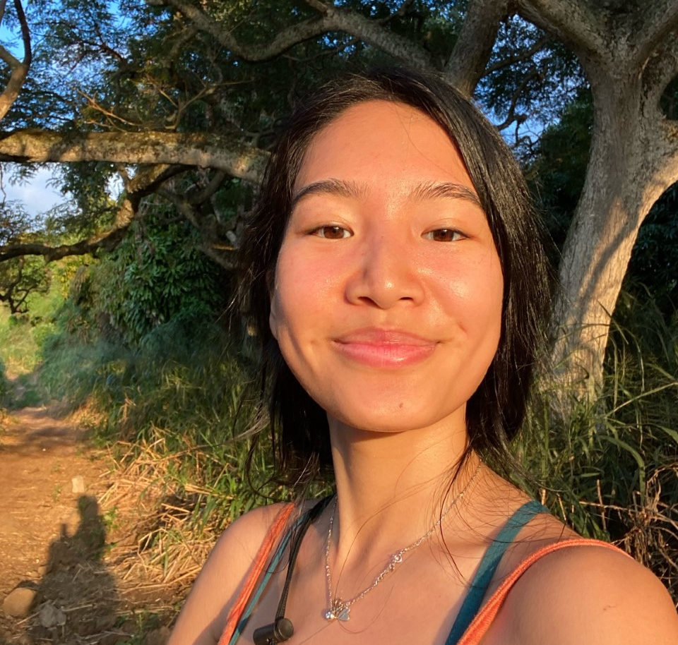
Midway Milestone: Week 9 Presentation
Team Peek
Notes:
https://graphicriver.net/item/native-minimalist-powerpoint-template/21228594?ref=BrandEarth&clickthrough_id=1421637368&redirect_back=true

Slide 2
Intro
HE Results & Design Changes
Prototype Implementation
Demo
Summary
Questions

Slide 3
Our value statement
Give and take inspiration

Slide 4
Problem
-
Collaborating with other artists feels more like work than play. It takes effort to establish a network of artists, and it takes time to get exciting feedback.
Solution
-
What if collaboration was less talking and more making?
peek encourages artists to take inspiration from other artists, and then show the world their newfound perspectives in return.

Slide 5
Intro
HE Results & Design Changes
Prototype Implementation
Demo
Summary
Questions

Slide 6
Heuristic Evaluation Summary
18 total Heuristic violations of severity 3-4 → 8 main fixes
27 total Heuristic violations of severity 1-2 → 6 main fixes
Most violated heuristics: H3 (User Control), H4 (Consistency and Standards), and H6 (Recognition, not Recall)
2 main error domains
  Confusing functionality
  Lack of user control

Slide 7
Confusing Functionality (CF)
Computer Vision Feature
Collaboration Tab

Slide 8
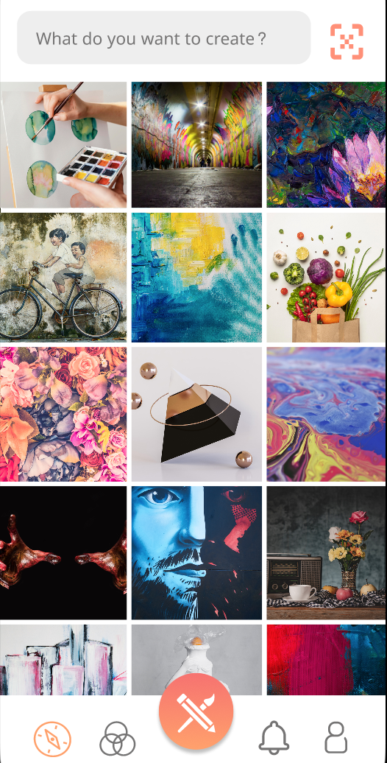
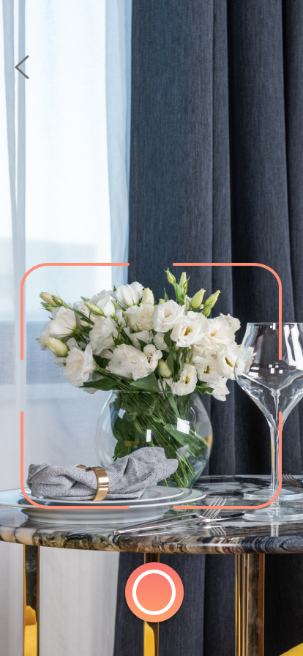
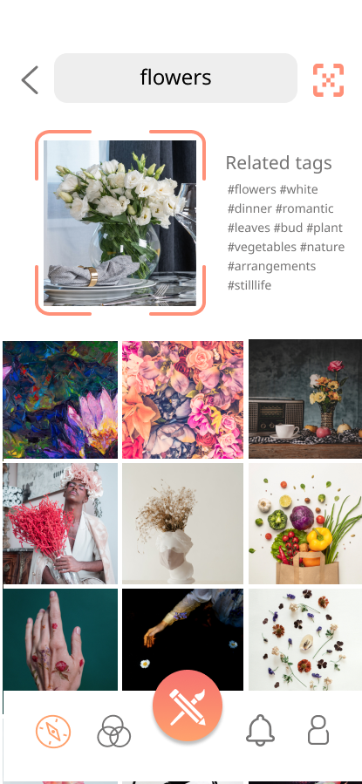
Severity 4: Computer Vision View Problem
Heuristic Violations & Fixes: Confusing Functionality
!
The function of the computer vision view is confusing.
Notes:
Users had a difficult time figure out that clicking the camera button in the computer vision view would prompt the app to scan the subject of the picture and search for art that was related to that picture. Specifically, users said that having the camera button implied that the user was capturing an image to share.

Slide 9
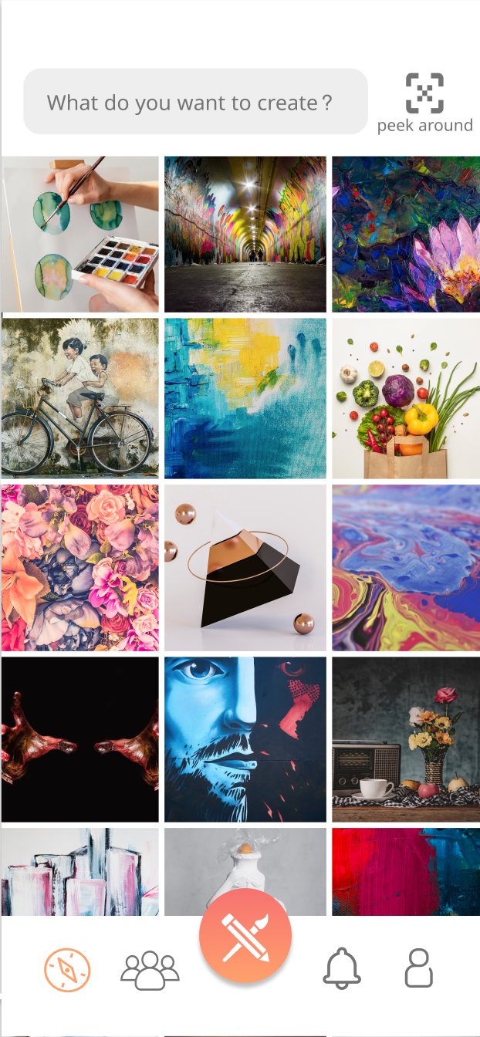
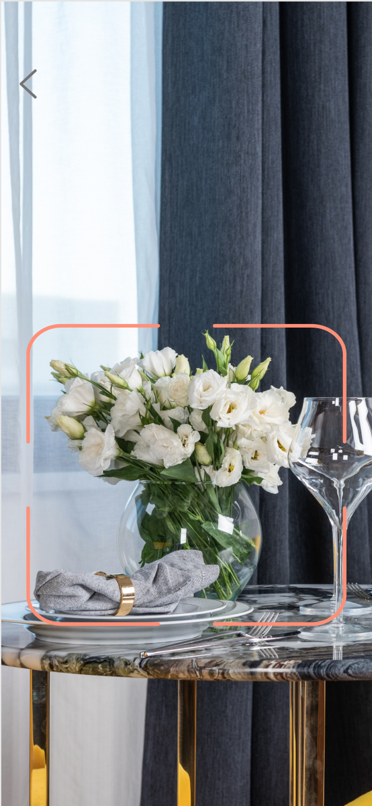
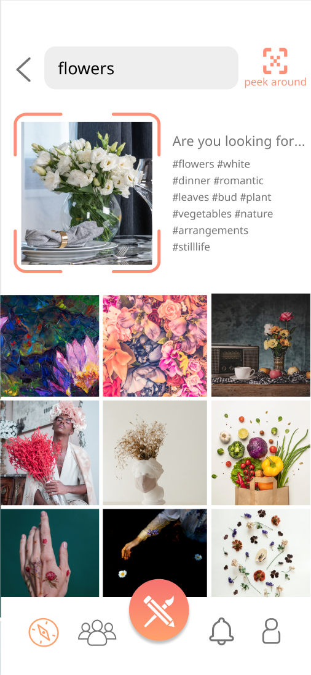
Severity 4: Computer Vision View Fix
Heuristic Violations & Fixes: Confusing Functionality
✓
Removed the camera button.
Notes:
We fixed this by removing the camera button. Now, the computer vision view will scan the first subject that the user focuses their camera on. It will then take them to a page with artwork related to that subject.

Slide 10
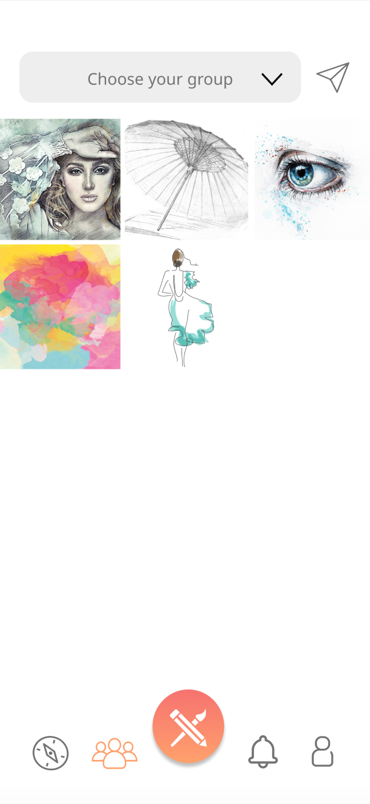
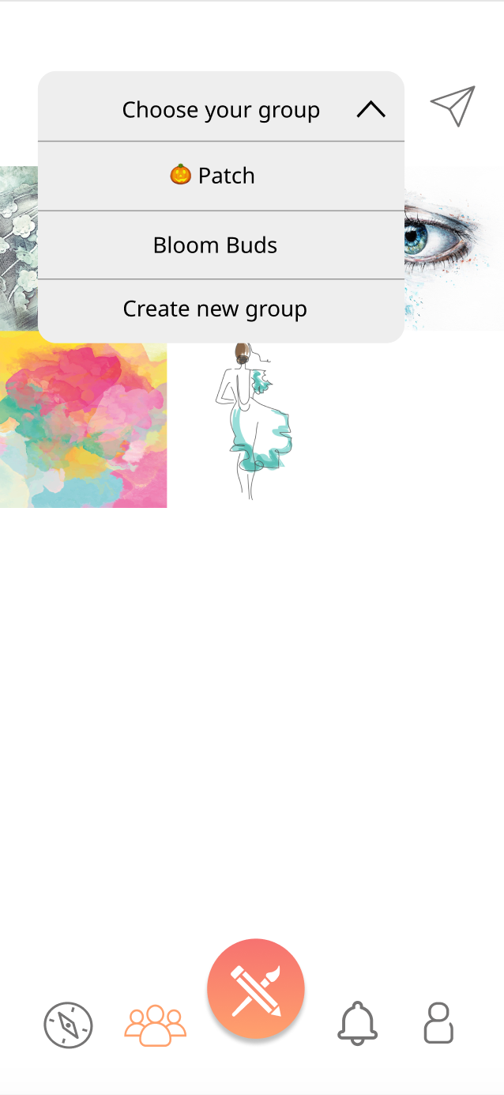

Severity 4: Purpose of Collab Problem
Heuristic Violations & Fixes: Confusing Functionality
!
It is unclear how the Collab tab differs from the Explore tab.
Notes:
Users mentioned that because the Collaboration tab opened onto a “feed” view that was similar to the explore view, the difference between the Collaboration tab and the Explore tab was not immediately apparent.

Slide 11
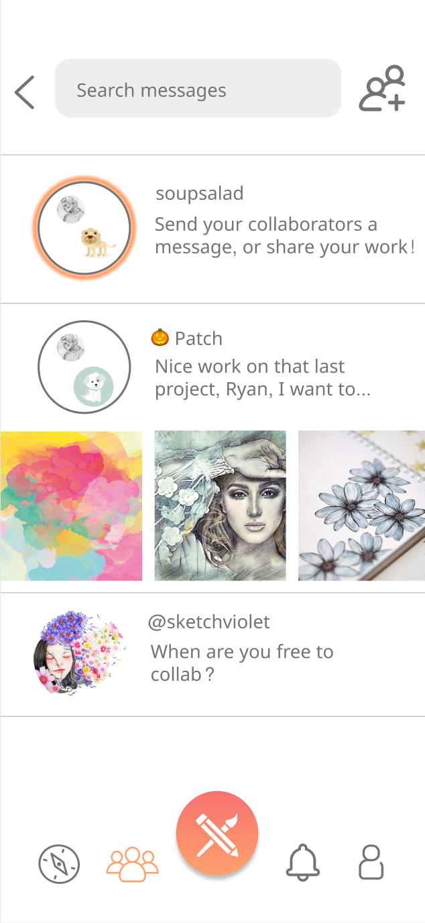
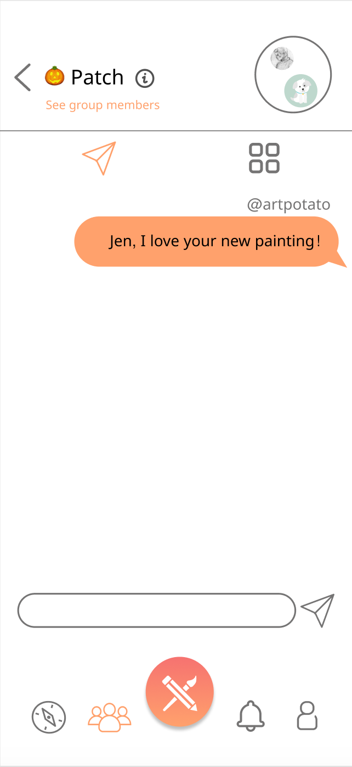
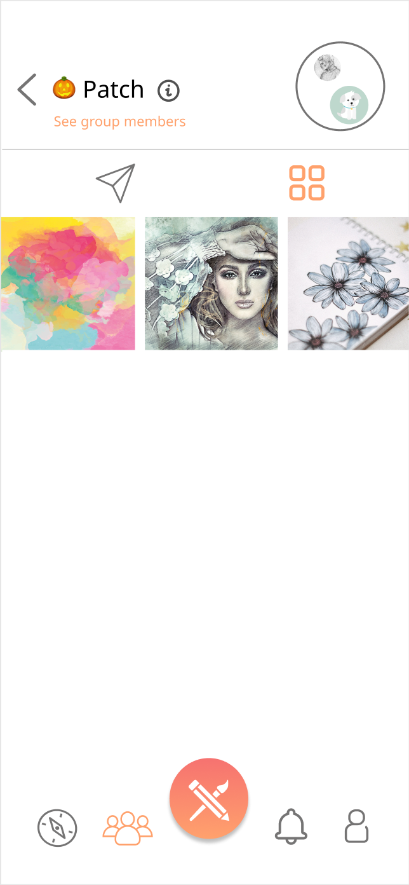
Severity 4: Purpose of Collab Fix
Heuristic Violations & Fixes: Confusing Functionality
✓
Changed the layout of Collab tab
Notes:
We fixed this by combining the functionalities of the existing Collab tab and the Messages button for individual other users.
The Collab tab now opens on a messages page. Users click into a specific group or individual to see the messages and art from that group or individual.
This way, all feeds that the user sees in the Collaboration tab are tied to one particular group, as well as the conversations going on in that group. This differentiates it from the Explore tab by making it clearer that art in the collaboration tab is meant to be iterated on within the group. This also fixes another Severity 3 issue, which was that a user would have to navigate to another user’s profile in order to find their messages together. Now, individual messages and group messages are centralized in the Collaborations tab.

Slide 12
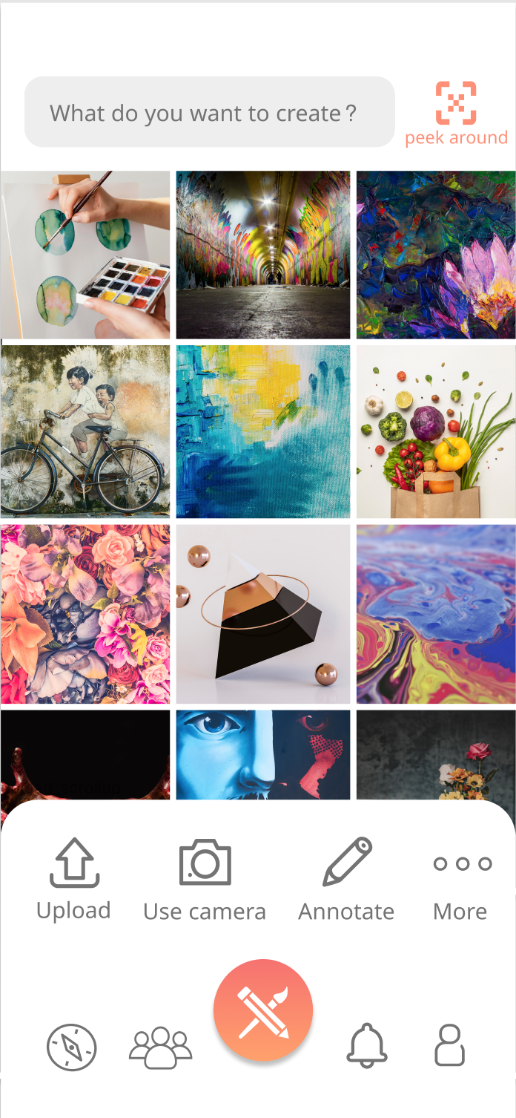
Severity 3: Annotate function Problem
Heuristic Violations & Fixes: Confusing Functionality
!
Annotate enabled in the upload pop-up everywhere
Notes:
Users had a difficult time figure out that clicking the camera button in the computer vision view meant that

Slide 13
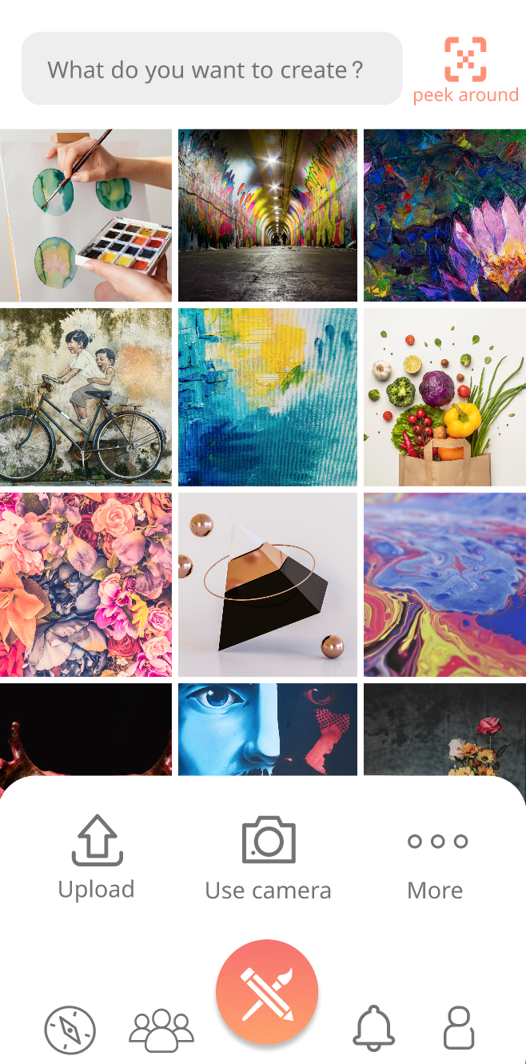
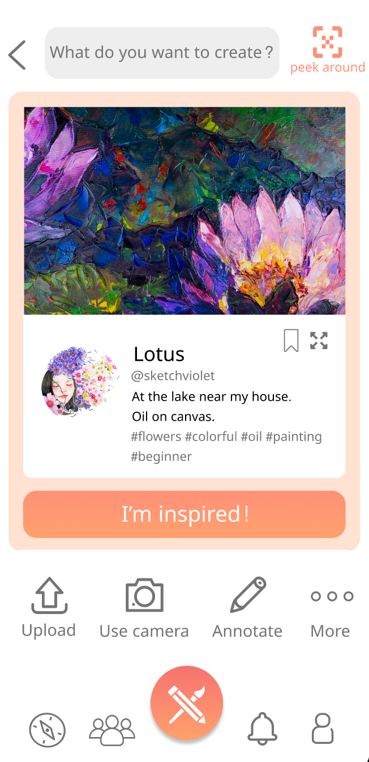
Severity 3: Annotate function Fix
Heuristic Violations & Fixes: Confusing Functionality
✓
“Annotate” function is limited to only when viewing a specific artwork
Notes:
Users had a difficult time figure out that clicking the camera button in the computer vision view meant that

Slide 14
Severity 4: “Remix” is confusing Problem
Heuristic Violations & Fixes: Confusing Functionality
!
Unclear where “remix” is, or what it means
Deeper issue: context-aware button is unintuitive
Notes:
Users had a difficult time figure out that clicking the camera button in the computer vision view meant that

Slide 15
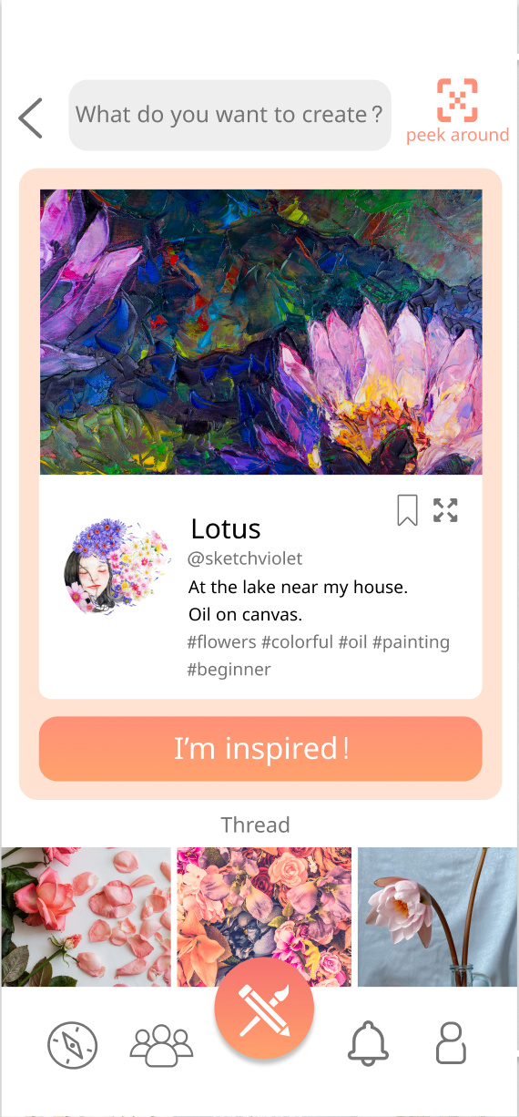
Severity 4: “Remix” is confusing Fix
Heuristic Violations & Fixes: Confusing Functionality
✓
Use a more understandable phrase
Added an “I’m inspired” button under all art pieces.

Slide 16
Lack of User Control
Managing collaboration groups
Searching for users
Commenting in groups
Managing personal profile
Back buttons
Clarity of other icons

Slide 17
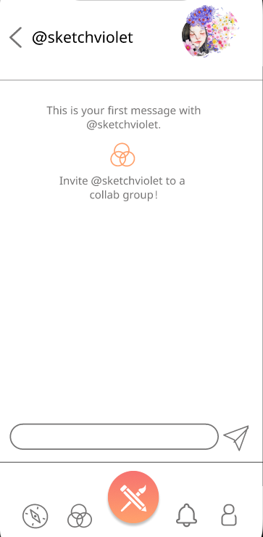
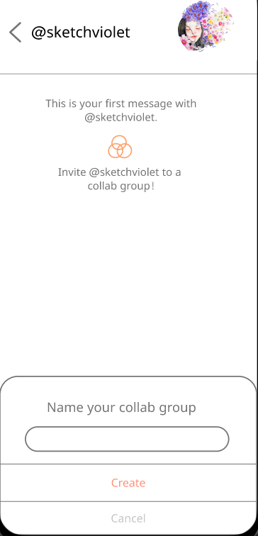
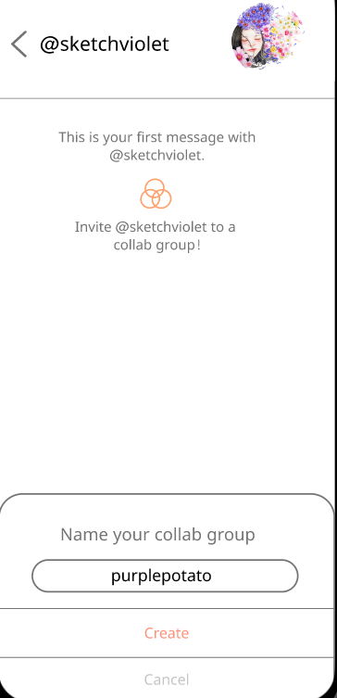
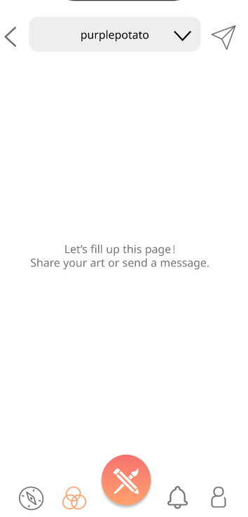
Severity 4: Invite to Collab Problem
Heuristic Violations & Fixes: User Control
!
When User A invites User B to collab, User B cannot reject the invitation.

Slide 18
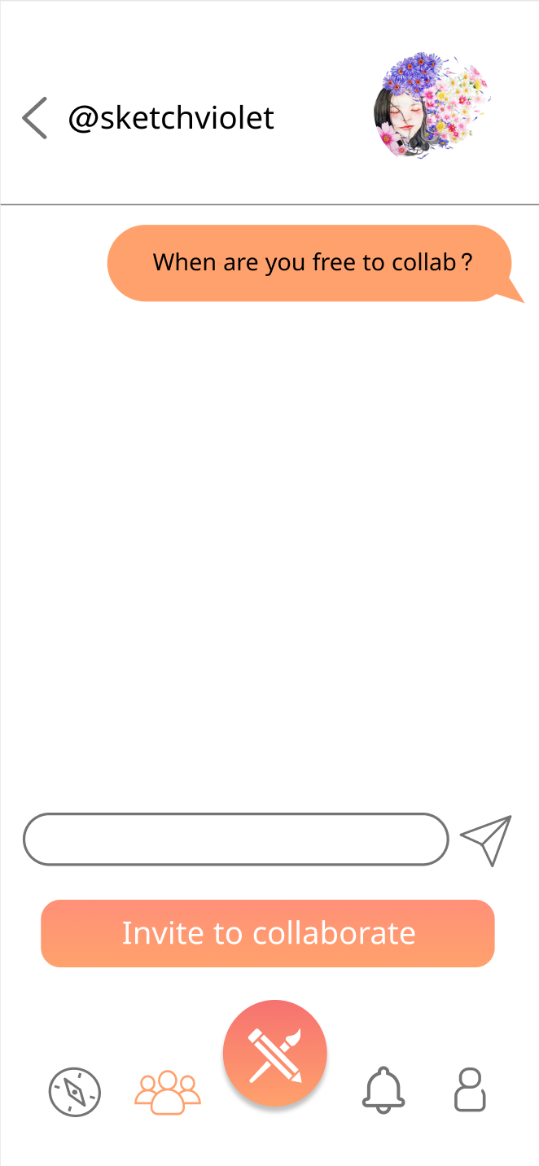
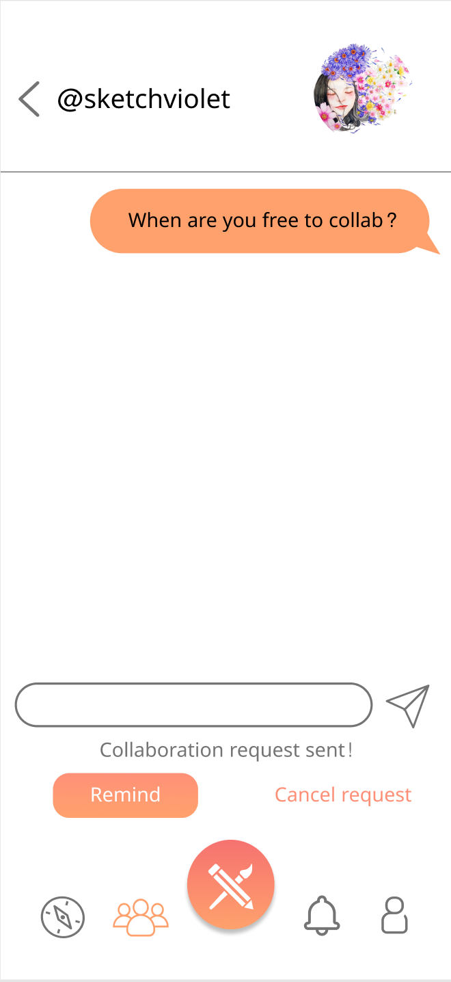
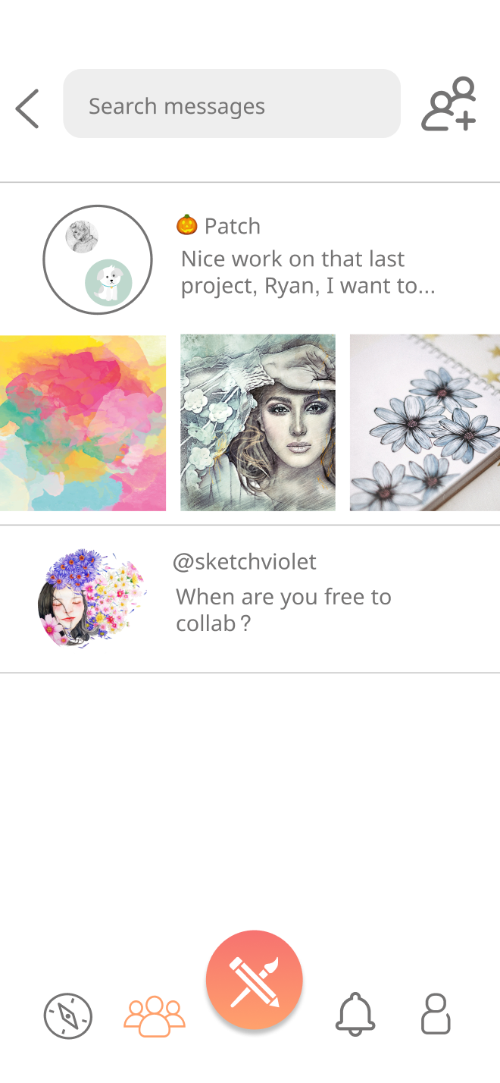
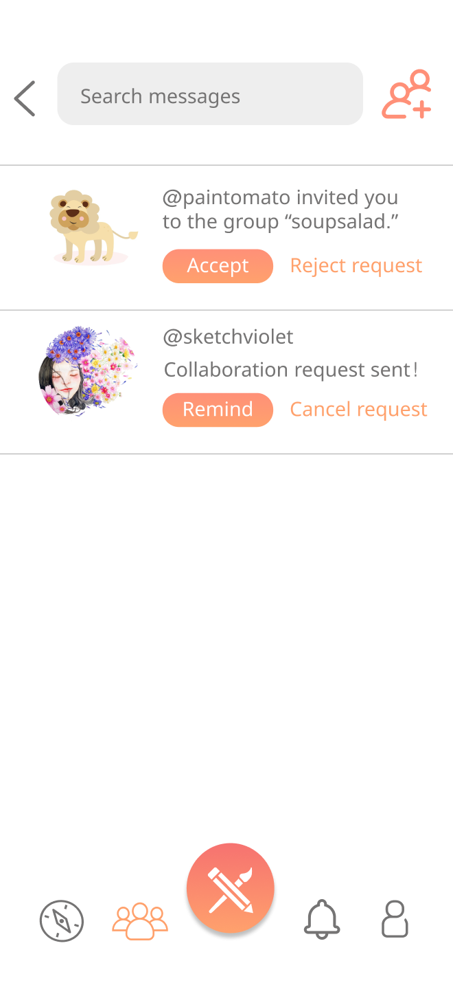
Severity 4: Invite to Collab Fix
Heuristic Violations & Fixes: User Control
✓
Invitations can be accepted or rejected via Notifications center.
Notes:
To fix this, we implemented a feature where User A sends a collaboration invitation to User B instead of simply creating a Collab group with User B. We then implemented a notifications button inside the Collaborations tab, in which User B can decide whether to accept or reject the invitation, and User A can monitor the status of the invitation.

Slide 19
Severity 4: Leave Collab Groups Problem
Heuristic Violations & Fixes: User Control
!
There is no way to quit a collaboration group.
Notes:
Similarly...

Slide 20
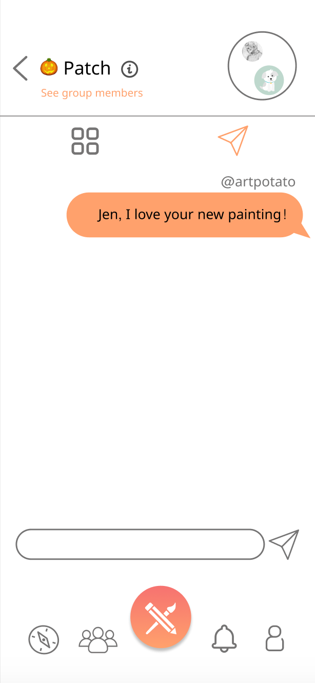
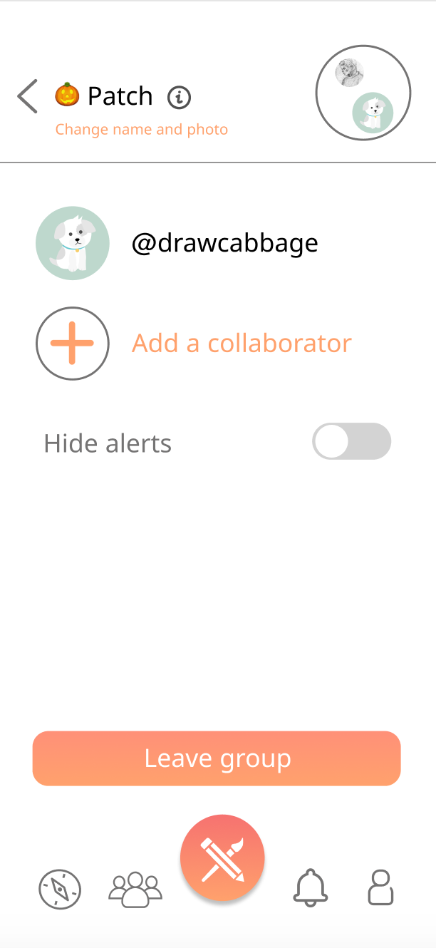
Severity 3: Leave Collab Groups Fix
Heuristic Violations & Fixes: User Control
✓
“Leave group” button
Notes:
To fix this, we implemented an “information” button beside each group name. Inside that information is the option to leave the collaboration group as well as the names of the other group members and the option to add more collaborators to the group. This also fixes two other Severity 3 violations, which are that new users could not be added to existing groups, and users cannot see their group members.

Slide 21
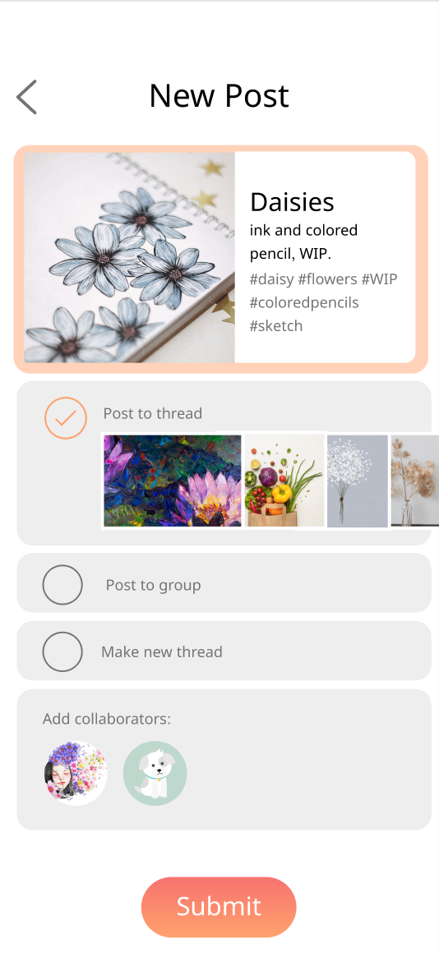
Severity 3: Add Collaborators Problem
Heuristic Violations & Fixes: User Control
!
Difficult to navigate with a lot of collaborators

Slide 22
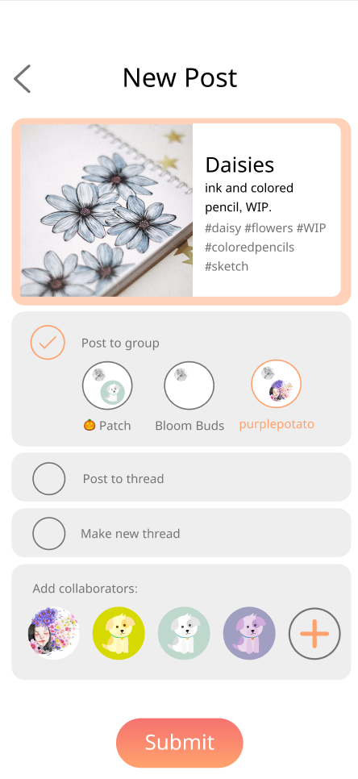
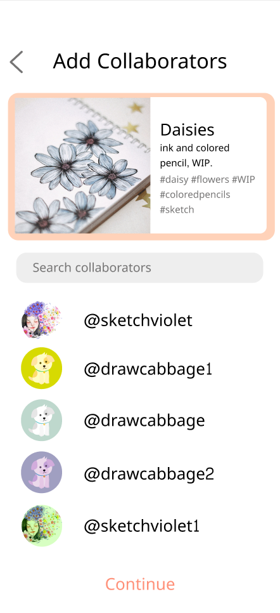
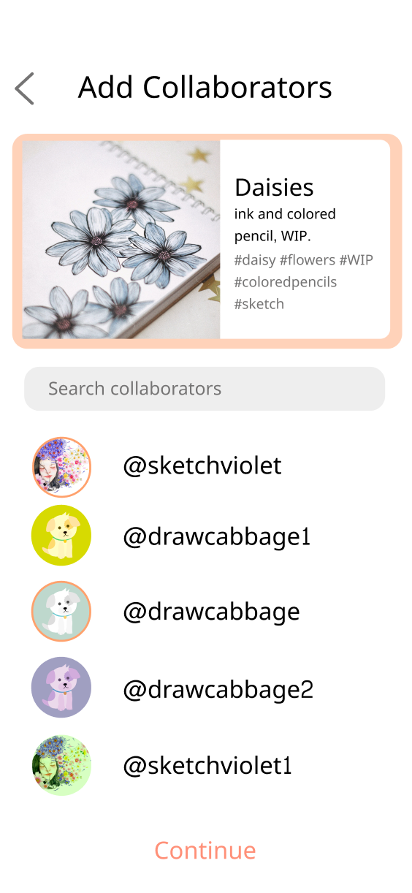
Severity 3: Add Collaborators Fix
Heuristic Violations & Fixes: User Control
✓
Added an “add” button & ability to search for collaborators

Slide 23
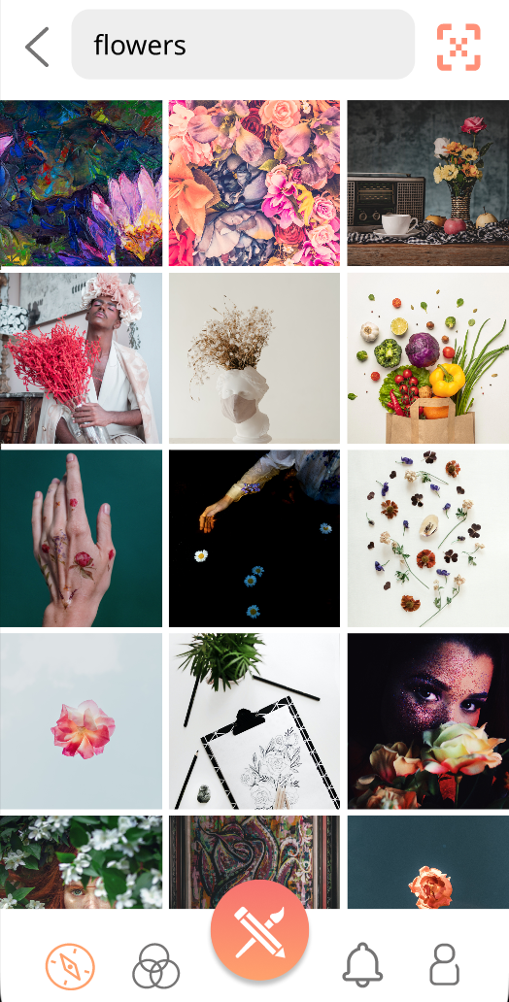
Severity 3: Search for users Problem
Heuristic Violations & Fixes: User Control
!
No way to easily search for users.
Notes:
Users had a difficult time figure out that clicking the camera button in the computer vision view meant that

Slide 24
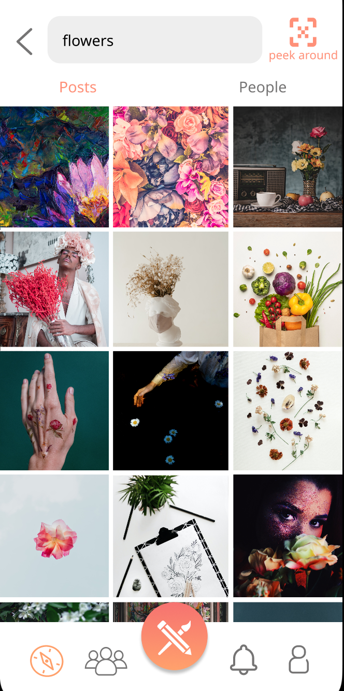
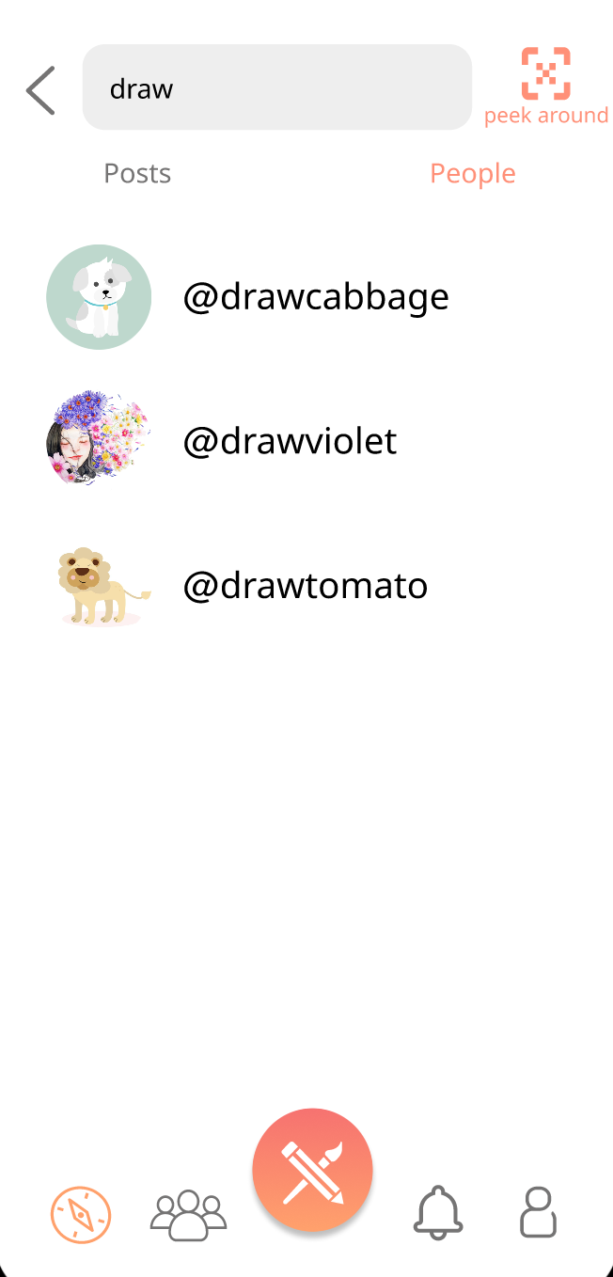
Severity 3: Search for users Fix
Heuristic Violations & Fixes: User Control
✓
Added a tab in “Explore” to search for users

Slide 25
Severity 3: Comment function in collab groups
Heuristic Violations & Fixes: User Control
!
No comment function in collab groups
Fix:
In collab groups, users can message each other.
Good idea for public posts, but no time to implement.
Notes:
Users had a difficult time figure out that clicking the camera button in the computer vision view meant that

Slide 26
Severity 3: No place for user’s name
Heuristic Violations & Fixes: User Control
!
User profile only shows user’s handle. Users can only view other users’ identities through their handles.
Fix:
Artists value anonymity (insights from needfinding interview)
If users really want to display their name, they can do it on their bio.
Notes:
Users had a difficult time figure out that clicking the camera button in the computer vision view meant that

Slide 27
Severity 1-2 Fixes
Heuristic Violations & Fixes: User Control
✓
Add “Cancel” button to all screens during uploading.
Add back buttons to all screens (except home screen)
Make Invite to Collaborate button more noticeable.
Add functionality to collaborate group settings (add collaborators, leave group, etc.)
Add About section (including FAQ page)
Make icons accurately reflect system status (bookmarked vs unbookmarked, highlighted tabs)

Slide 28
Intro
HE Results & Design Changes
Prototype Implementation
Demo
Summary
Questions

Slide 29



Tools Used
Notes:
We chose to develop using React Native, a cross-platform mobile app framework. Firebase performs lightweight database operations

Slide 30
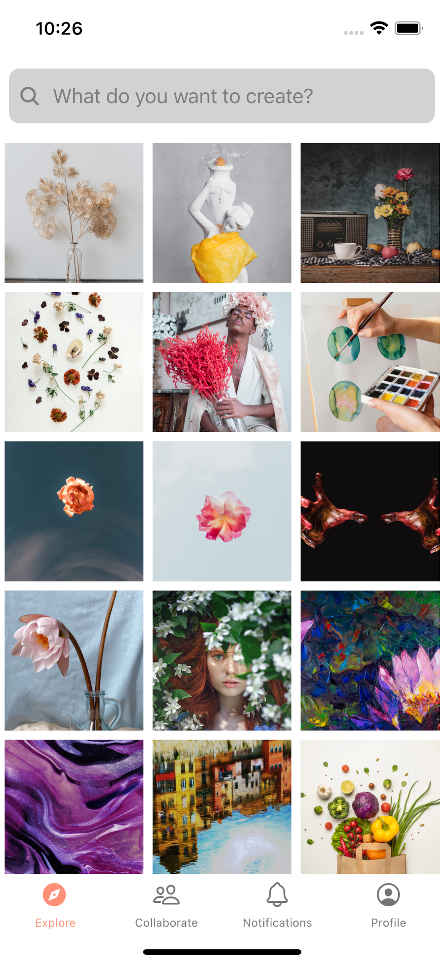
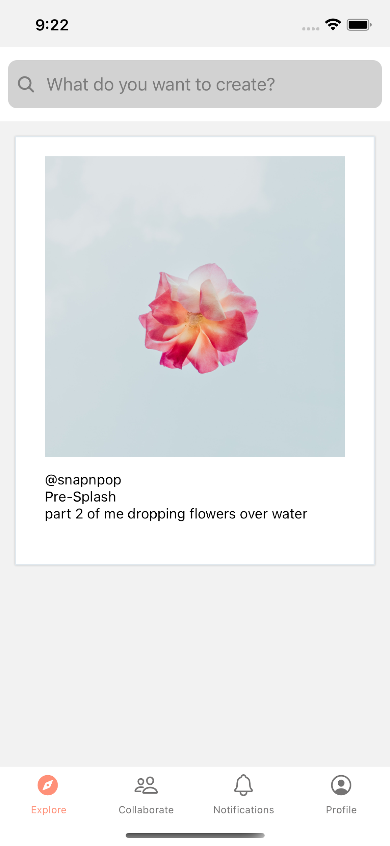
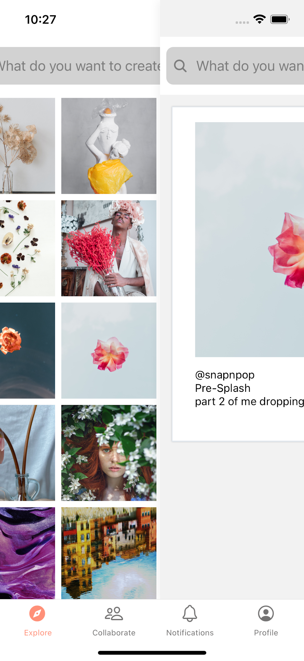
Implemented Features
Simple Task: Browse Explore page for inspiration

Slide 31
Unimplemented Features and Plan
Moderate Task: Upload art by another user
Camera page
Upload screen
Complex Task: Create collaboration groups
Info page
Login screen
Messages
More user profiles
Notes:
Create additional pages // don't worry too much about backend functionality but focus on user experience
Task 2: Remix
Task 3: Collaborate
- Information page
- Login screen
- User interactions
- Message interactions // use existing APIs for messaging
- Camera page
- Upload screen
- Create user profiles // can hardcode
Task 2 is still unimplemented. To implement this task, we plan to…
[same for task 3]

Slide 32
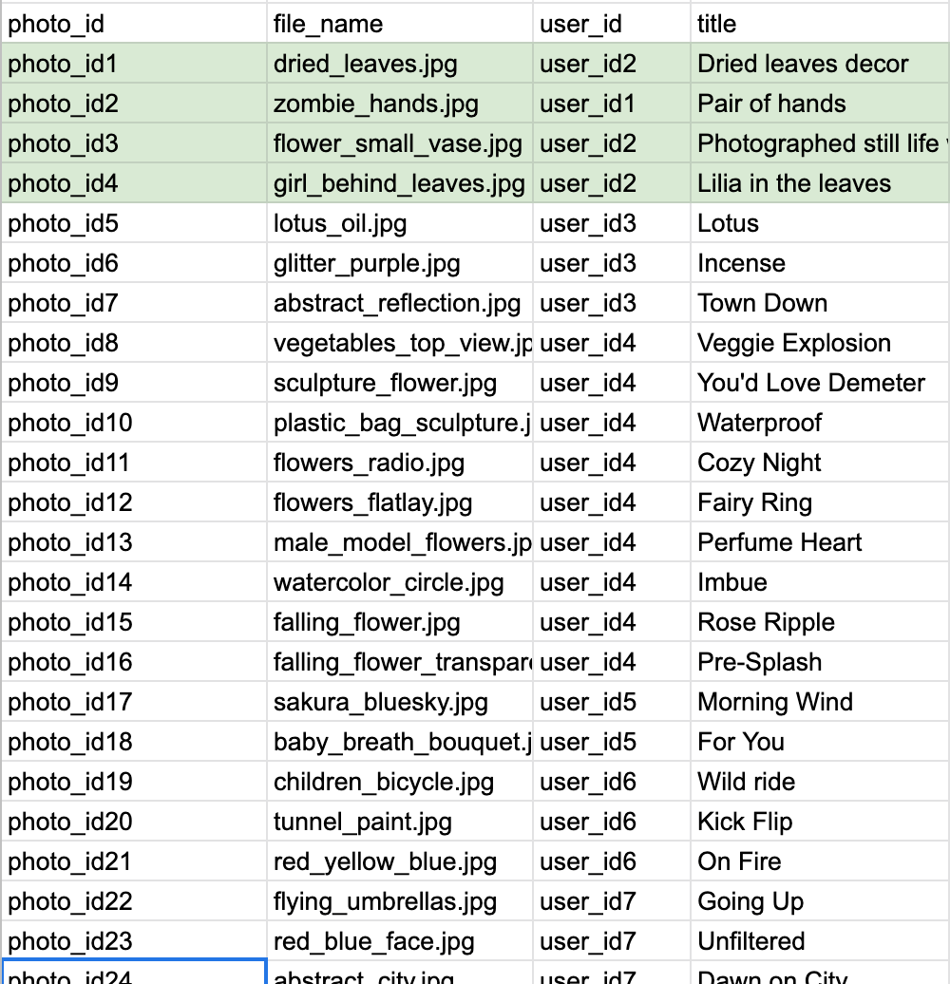
Hard-coded data
Most “user” information and uploaded art is hard-coded.
User is assigned a “beginning user” profile to log-in and register
  Includes threads and artworks that you’ve “already uploaded”
Notes:
All other platform “user” information and uploaded content is artificially constructed and curated.
To get more of the “feel” of the app, we assign a “beginning user” profile to log-in and register the prototype, so you can explore threads and artworks that you’ve “already uploaded.”

Slide 33
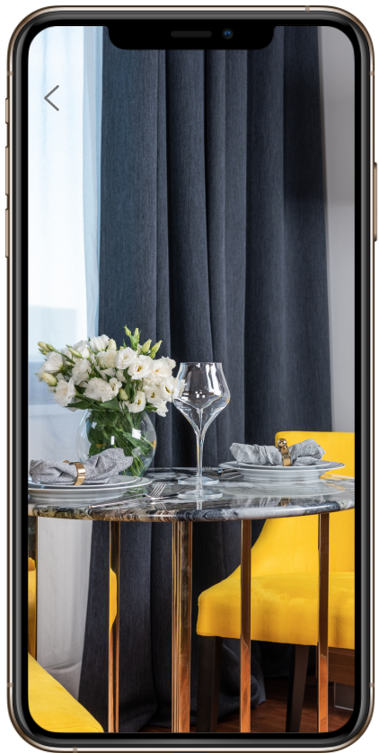
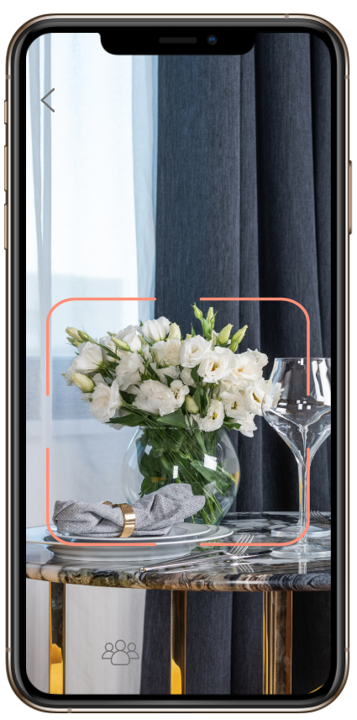
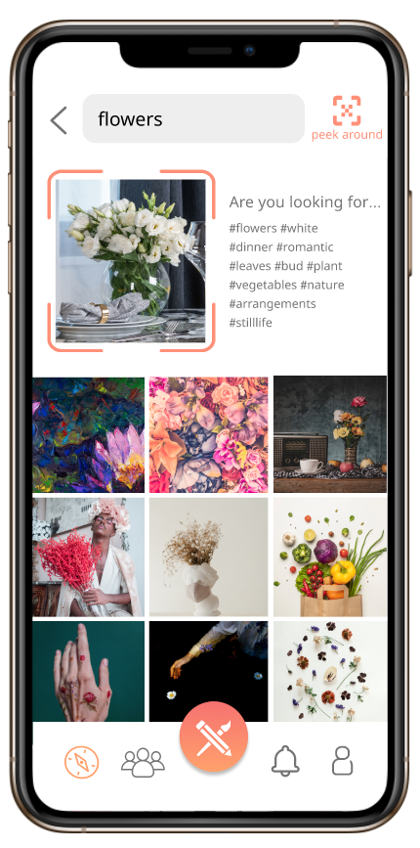
Wizard of Oz Techniques
Computer Vision

Slide 34
Intro
HE Results & Design Changes
Prototype Implementation
Demo
Summary
Questions

Slide 35

Demo

Slide 36
Intro
HE Results & Design Changes
Prototype Implementation
Demo
Summary
Questions

Slide 37
Summary
14 major design changes based on Heuristic Evaluation
Implemented:
  Simple Task: Browse Explore page
To implement:
  Moderate Task: Upload art inspired by another user
  Complex Task: Create collaboration groups
On track to finish by the deadline!

Slide 38
Intro
HE Results & Design Changes
Prototype Implementation
Demo
Summary
Questions

Slide 39
Questions
Is the “I’m inspired” button more intuitive now?
Questions for us? :)

