Slide 1
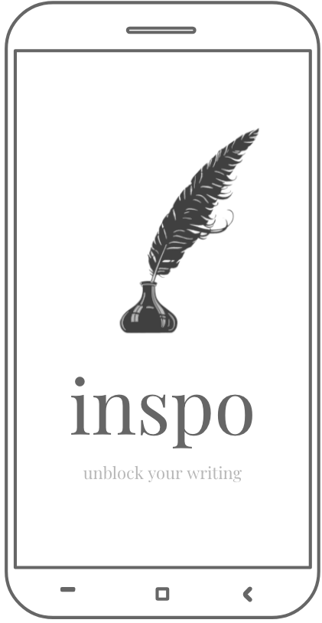
High-fi Prototype
team euphoria
assignment 8

Slide 2
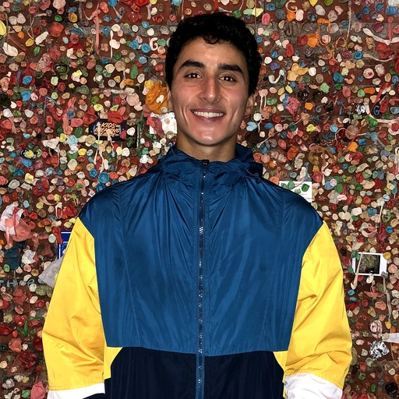
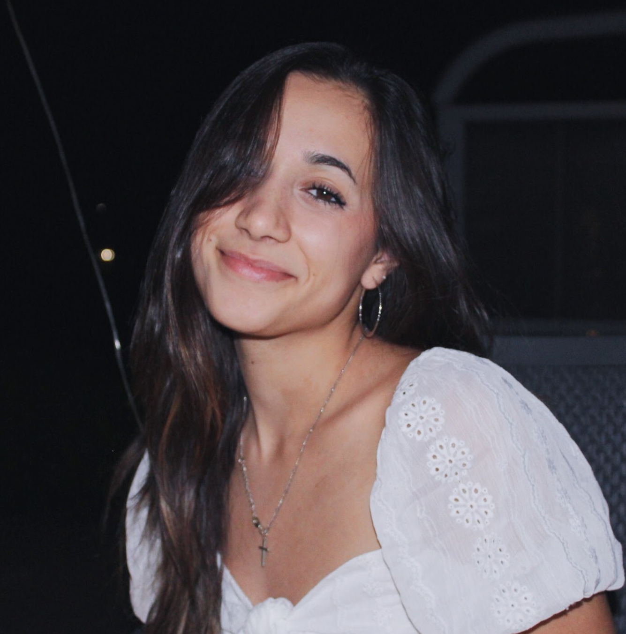


team euphoria
david e. ‘21
sam m. ‘22
anatole s. ‘20
jake w. ‘21

Slide 3
Value Proposition
The Problem
Our Solution
Unblock your writing.
Writer’s block is an age-old problem, plaguing all creators alike, from novelists to song-writers to poets. Every individual has a different process for how they generate their ideas, but it’s clear that a few prevail in consistently inspiring creativity when it just won’t come.
Inspo provides writers with prompts, old writing samples, and a minimalist workspace for creators not just to write, but to thrive. Our hope is that we’ll be able to create the most conducive space for artistry and imagination that makes writing more intuitive and empowers creators with tools they need to inspire creativity and fuel the writing process.

Slide 4
Presentation Overview
Revised Design
Demo
what were the results?
where are we now?
it’s in the title
what can we do better?
Heuristic Eval Results
Prototype Implementation

Slide 5
heuristic evaluation results
Notes:
How might we help artists recognize difference between reputable sources and non-reputable ones.

Slide 6
result overview
19 total severity 3-4 violations
28 total severity 1-2 violations
most violated heuristics: user control (10 violations), consistency and standards (12 violations), and minimalist design (9 violations)
arts & culture

Slide 7
revised interface design

Slide 8



the big changes
Exit Ability: Provide the user with easier navigation
Clear Terminology: Unifying the words used to maintain consistency
Redefine Icons: Some icons were confusing so we changed them to be more intuitive
arts & culture

Slide 9
Exit Ability: provide the user with easier navigation
change: when users were trying to save their drafts they could not easily navigate away from the writing page and modals lacked exit buttons.
arts & culture

Slide 10
Clear Terminology: Unifying the words used to maintain consistency
change: participants were confused by the use of “Save” or the interchangeability of “Drafts” and “Graveyard” so we made it more consistent and plan to draw a larger distinction between “Drafts” and “Graveyard”
arts & culture

Slide 11
Redefine Icons: Some icons were confusing so we changed them to be more intuitive
change: instead of using ambiguous icons like the “done” button we instead used text, and we also plan to clarify our more niche functionality with the tutorial
arts & culture

Slide 12
prototype implementation

Slide 13

our prototyping tool
pros:
cons:
Widely used and very well documented
Reusable components and easy to create interactions and data transfer
Team experience
Styling in CSS
Difficult making it as pretty as Figma
Small details can be more difficult to fine-tune.

Slide 14
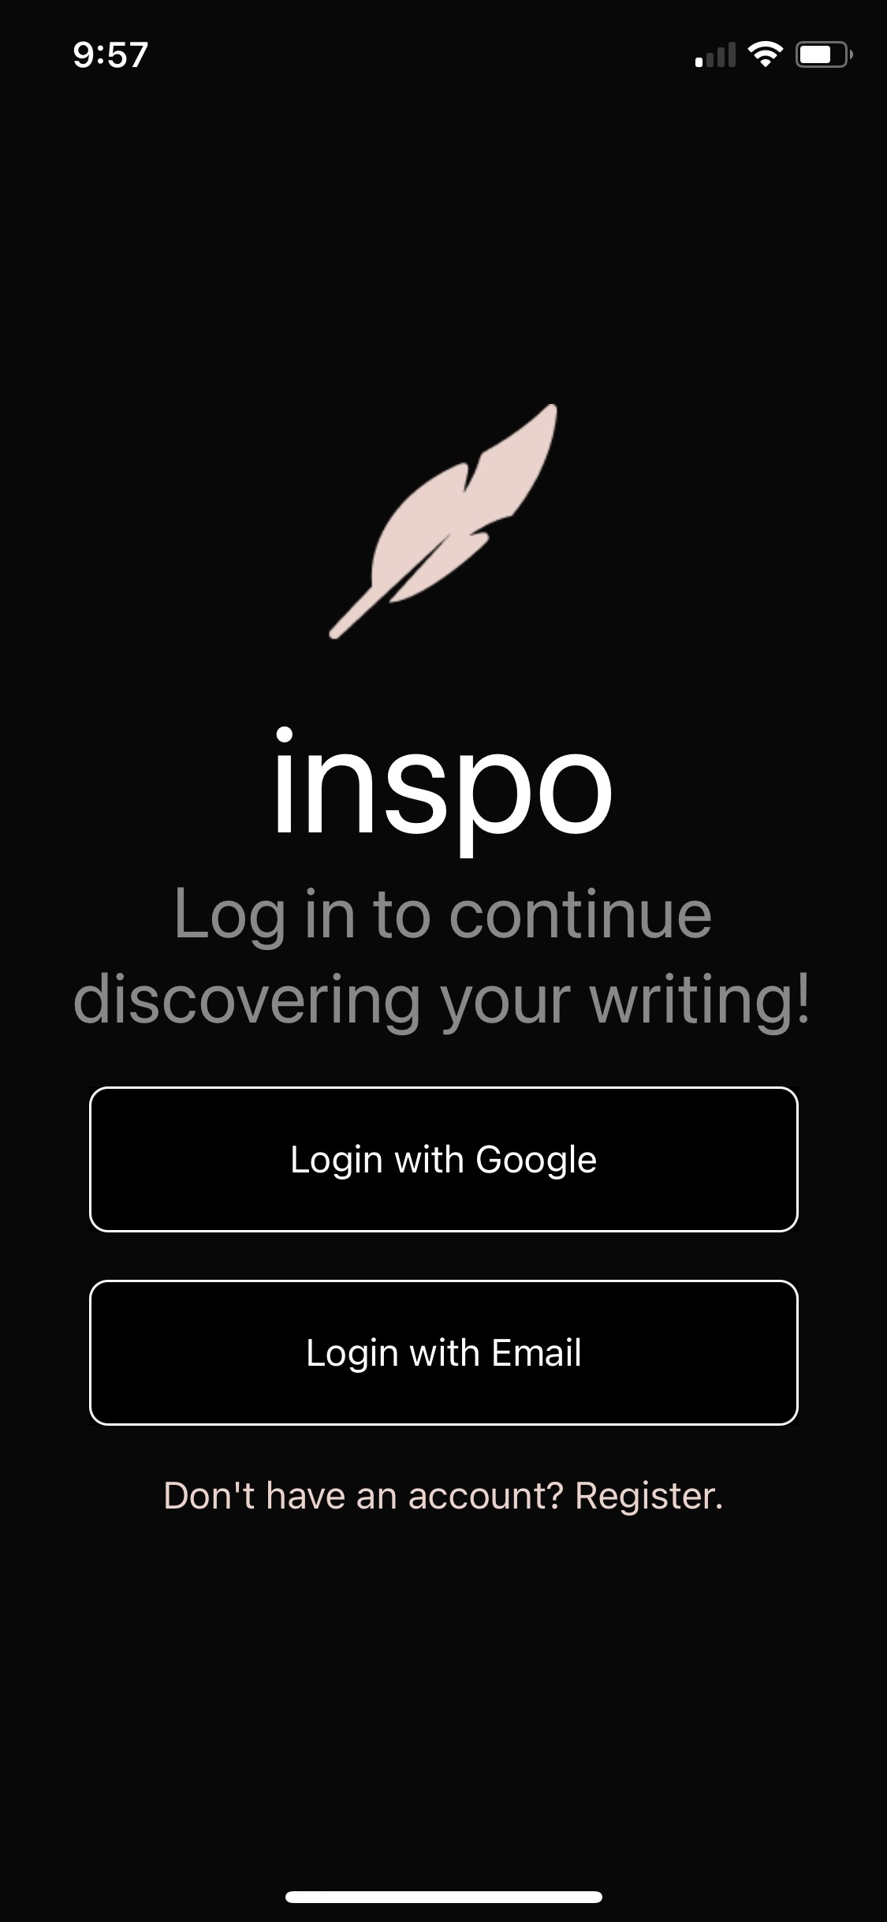
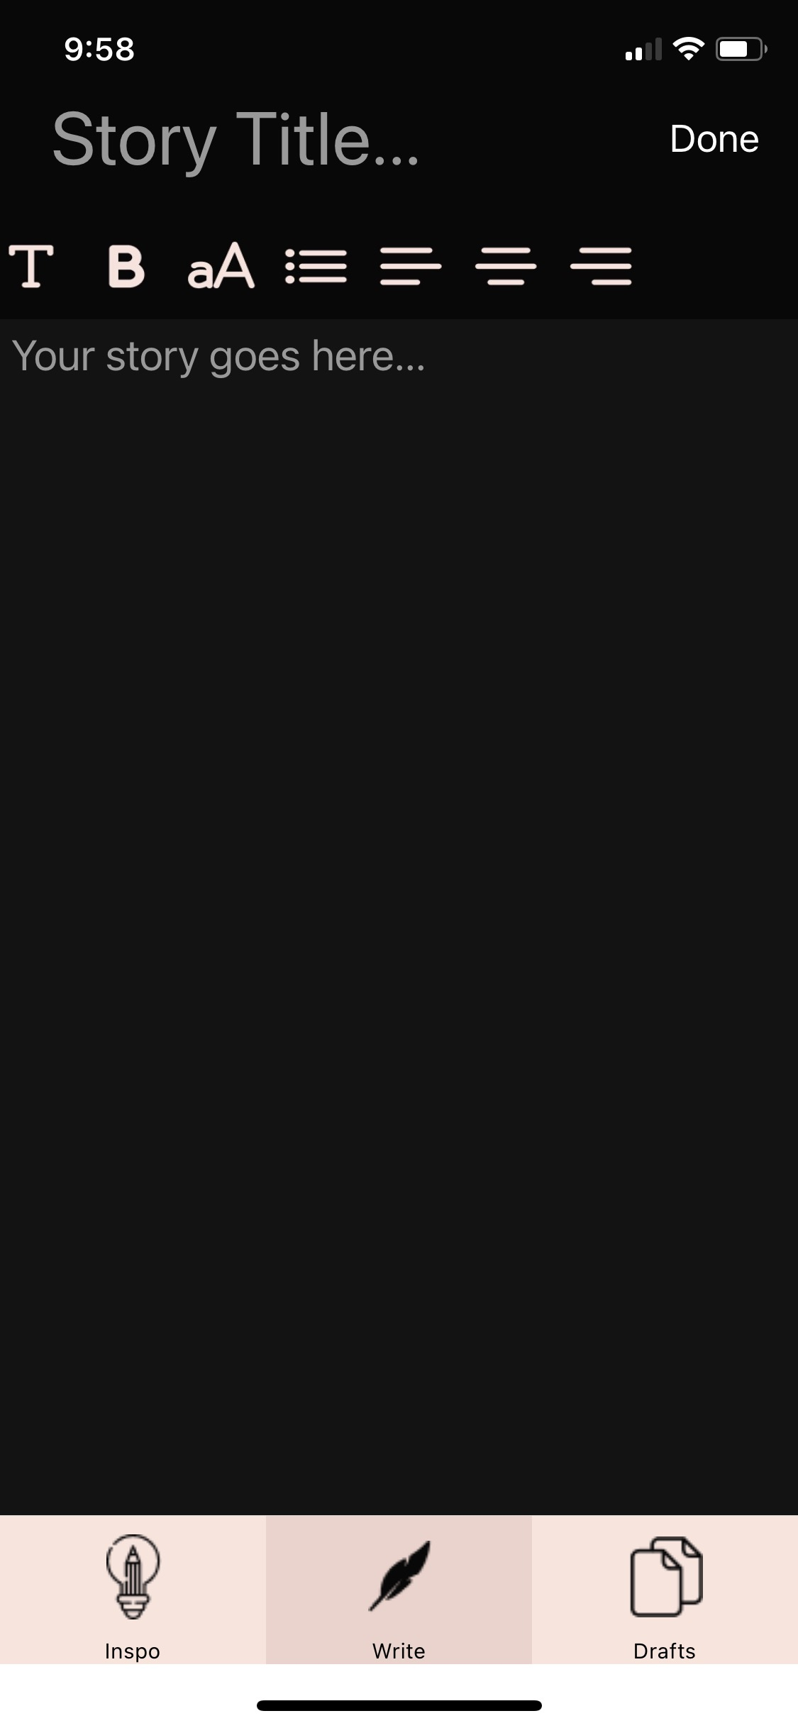
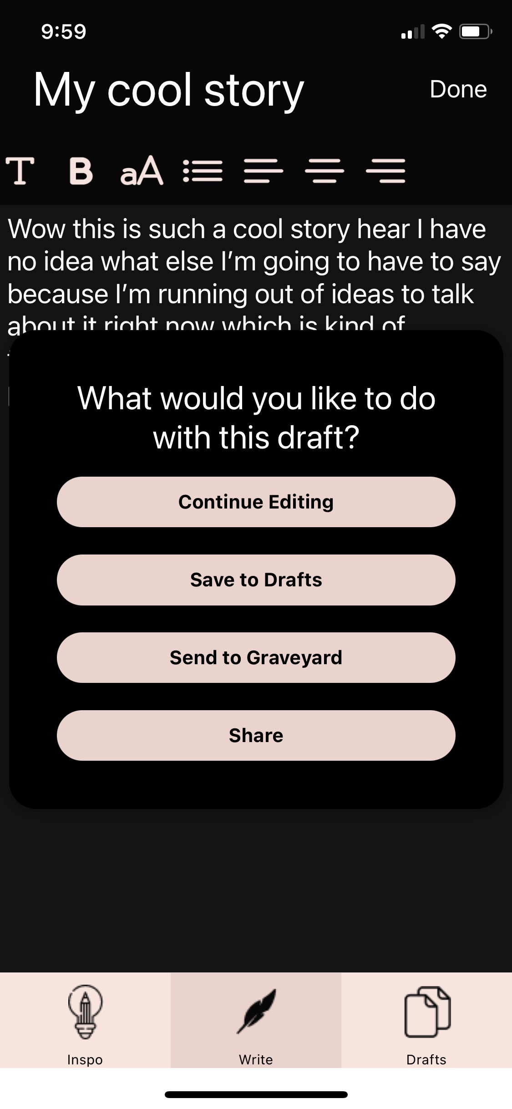
implemented features
the prototype successfully handles login and registration, draft writing, and storing your drafts after writing is complete.

Slide 15
to implement features
prompting, sharing, and home pages
this means...
If a user wants a prompt while working on drafts, they are out of luck. This is a key feature of our application and will be implemented as a component within the drafting page
Users can’t share their drafts with other people
Users have no central location to see all of their content from the Graveyard, their friends, or prompts

Slide 16



~ wizard of oz techniques ~
AI Graveyard work selection
Friends sharing works with user
Prompt generation and recommendation
arts & culture

Slide 17
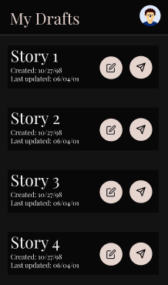
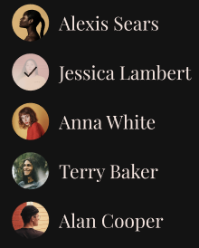
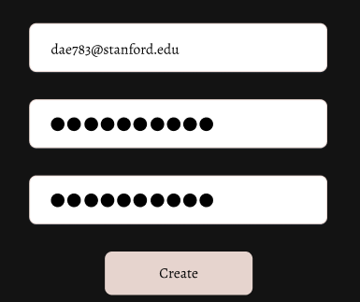
hard coded features
User’s drafts
User’s friends
User’s login info

Slide 18
issues/questions
CSS styling
Implementation speed with React Native

Slide 19
demo

Slide 20
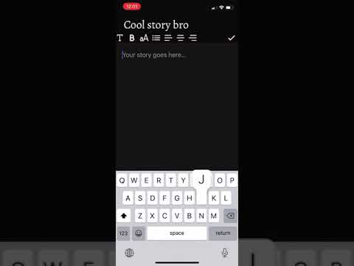
Notes:
EMBED VIDEO RECORDING HERE

Slide 21
Presentation Summary
Revised Design
Where we are going
power to the people. user control and freedom
login/register and draft creation
icon updates and stylistic consistency
sharing, prompting, and home pages galore
Heuristic Eval Results
Prototype Implementation

Slide 22
our website and github
https://web.stanford.edu/class/cs147/projects/ArtsandCulture/Inspo/
https://github.com/daestrada22/inspo

