Slide 1
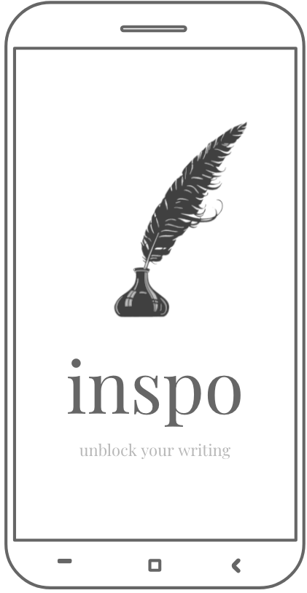
Med-fi Prototype
team euphoria
assignment 6

Slide 2
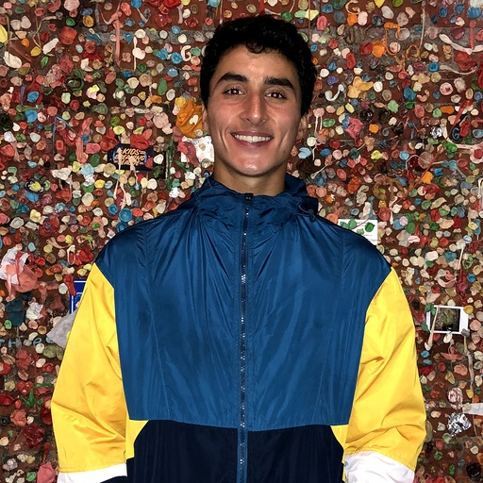
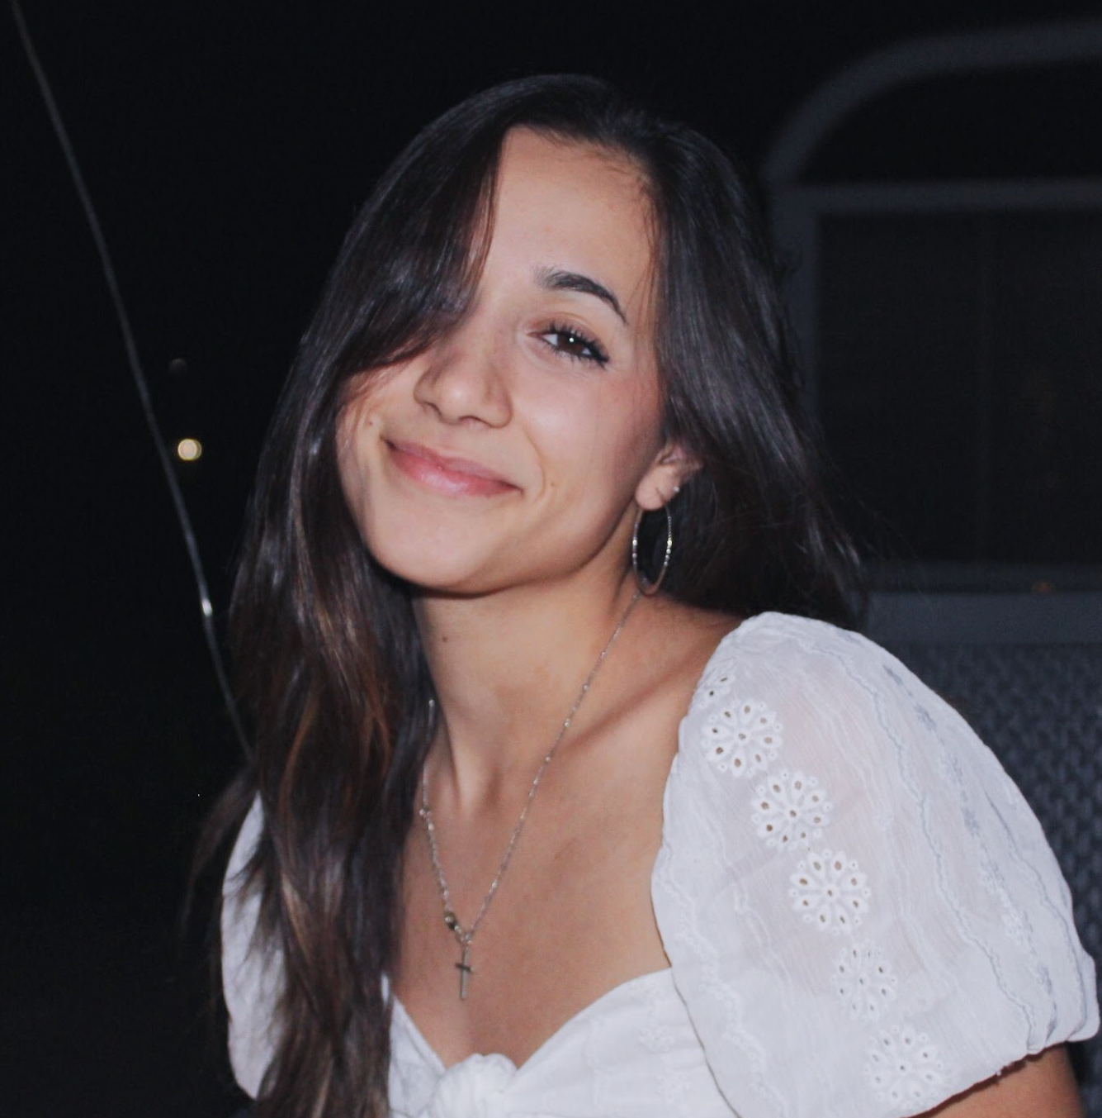

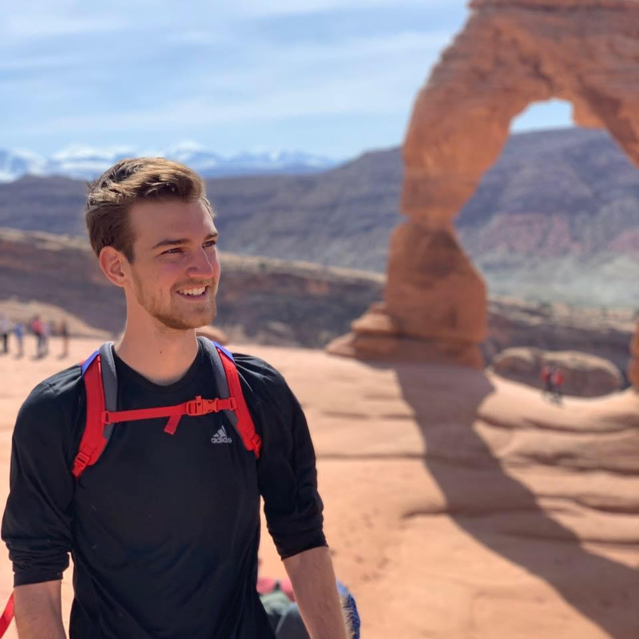
team euphoria
david e. ‘21
sam m. ‘22
anatole s. ‘20
jake w. ‘21

Slide 3
Value Proposition
The Problem
Our Solution
Unblock your writing.
Writer’s block is an age-old problem, plaguing all creators alike, from novelists to song-writers to poets. Every individual has a different process for how they generate their ideas, but it’s clear that a few prevail in consistently inspiring creativity when it just won’t come.
Inspo provides writers with prompts, old writing samples, and a minimalist workspace for creators not just to write, but to thrive. Our hope is that we’ll be able to create the most conducive space for artistry and imagination that makes writing more intuitive and empowers creators with tools they need to inspire creativity and fuel the writing process.

Slide 4
tasks
Notes:
How might we help artists recognize difference between reputable sources and non-reputable ones.

Slide 5



our revised core tasks
Simple task: Choose a story in your drafts section and share it.
Moderate Task: Create a new work either as a standalone or using a prompt as inspiration.
Complex Task: Go to your writing graveyard, choose a work you’ve already written, and edit it
arts & culture
Notes:
Previously, these were:
Simple Task: Scroll through a prompt and start writing
Moderate Task: Go to your writing graveyard, choose a work you’ve already written, and edit it
Complex task: Choose a story in your drafts section and share it

Slide 6
our overarching change
we wanted to focus much more on this 3 group segmentation of revision, creation, and sharing. by redefining our tasks, we’re able to execute a task in each group.
Simple task -> Sharing -> Choose a story in your drafts section and share it.
Moderate Task -> Creation -> Create a new work either as a standalone or using a prompt as inspiration.
Complex Task -> Revision -> Go to your writing graveyard, choose a work you’ve already written, and edit it
arts & culture

Slide 7
simple task: choose a story in your drafts section and share it.
**change: we changed this task from just writing to choosing a story and sharing it, as we believe the sharing process is much easier than the writing process in the context of inspo.
arts & culture

Slide 8
moderate task: create a new work either as a standalone or using a prompt as inspiration.
**change: originally the simple task, this task has now been modified to show that the writing process can be approached from two ways. when choosing to write a new story, the user can choose to generate a prompt in the writing document itself, but doesn’t have to go through a separate flow to get a prompt
arts & culture

Slide 9
complex task: go to the writing graveyard, choose an abandoned work, and edit it.
**change: this was originally the moderate task but has been changed to reflect the comparative complexity to the other two tasks.
arts & culture

Slide 10
revised interface design

Slide 11
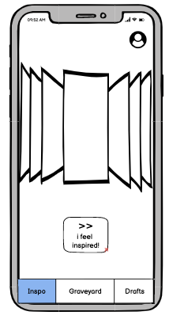
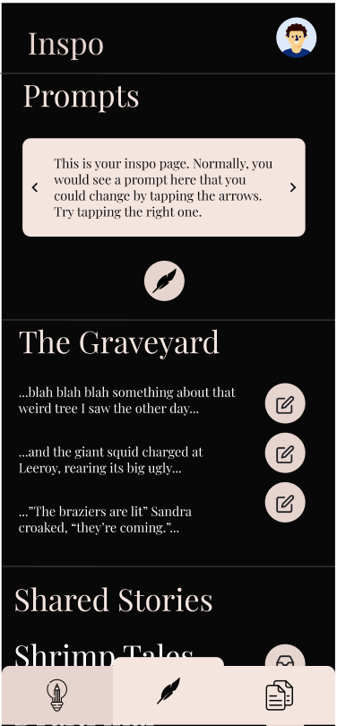
design change #1:
combination of graveyard/prompts

Slide 12
before:
after:
Users struggled with understanding the point of the graveyard, and it was clear that having the graveyard as its own separate tab didn’t make sense. Prompts was also a little cumbersome, as users had to pick a prompt before beginning the writing process, which many didn’t like.
We combined both the graveyard and the prompts into one tab called “inspiration” that serves as the hub for generating creativity. We wanted to have one place where if users needed inspiration, they could look at old works or use prompts, making it much more intuitive about when to use that tab.
prototype #1

Slide 13
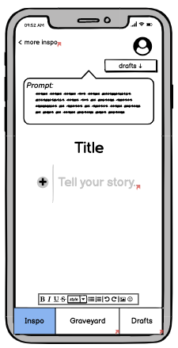
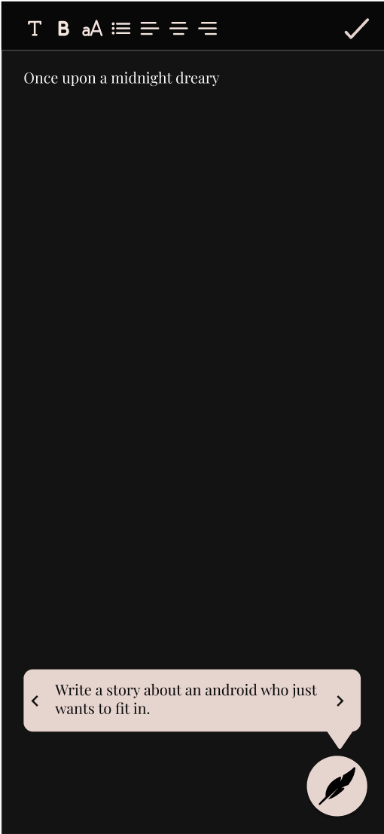
design change #2:
change of prompt
display

Slide 14
before:
after:
The prompt feature forced a writer to be constantly reminded of the prompt and confined to a writing space with the prompt at the top. It also made it difficult to switch prompts in the middle, so even if a prompt had been exhausted or the user didn’t want to use it anymore, they had no way of getting rid of it.
We created a quill button at the bottom that allows for inspiration to be sought in the middle of writing a new draft, and offers easy browsing through other prompts with the different areas. The prompt can also be minimized by re-clicking the button.
prototype #1

Slide 15
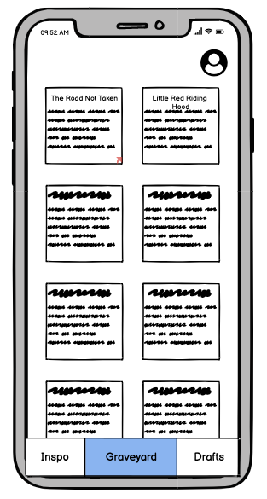
design change #3:
graveyard view

Slide 16
before:
after:
The graveyard tile view was cute in theory but made it difficult to actually see the stories & titles, especially on a phone. The graveyard in the way it was currently created also made it easy to confuse for unfinished works that would instead make more sense to categorize as drafts.
We created a list view for the graveyard in the inspiration tab that made it much less similar to the drafts and much more focused on abandoned lines or phrases that could be used to inspire new work.
prototype #1

Slide 17
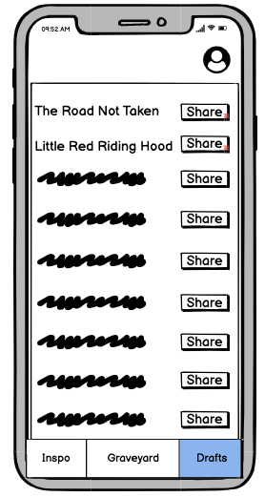
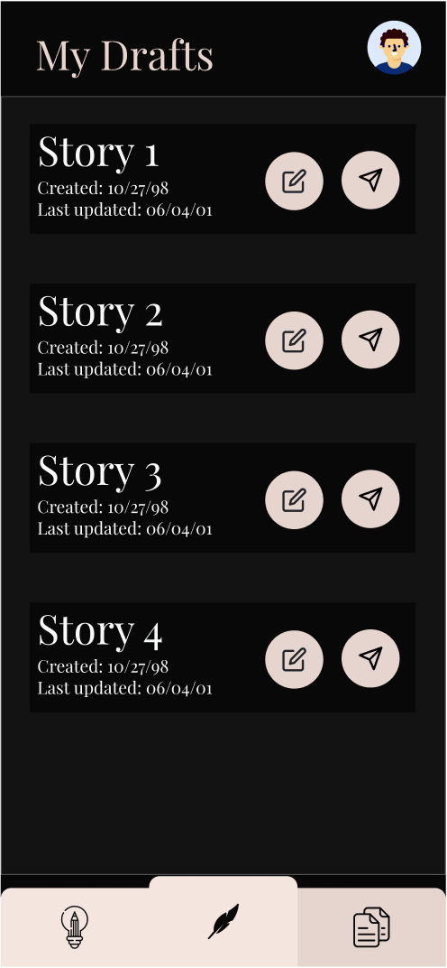
design change #4:
editing accessibility
and details from drafts

Slide 18
before:
after:
The drafts only had one button which was to share. There was no editing accessibility from the drafts, and also gave no details about the actual work itself / the date last edited.
We created a new button palette to facilitate both editing and sharing. We also included a “date created” and “date last edited” tag to each story to encourage individuals to reflect on which stories were most recently edited and ready to share.
prototype #1

Slide 19
med-fi task flows

Slide 20
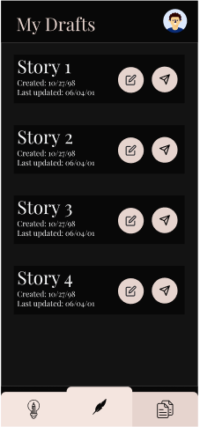
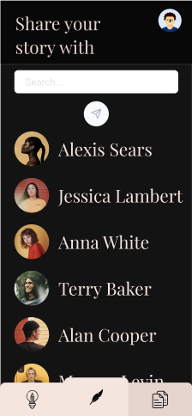
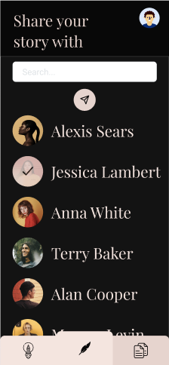
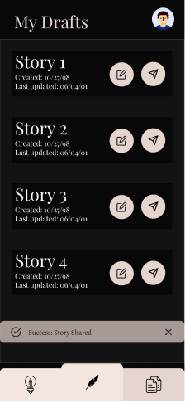
simple task: share a draft
choose a story
browse sharing options
pick a person
get the confirmation

Slide 21
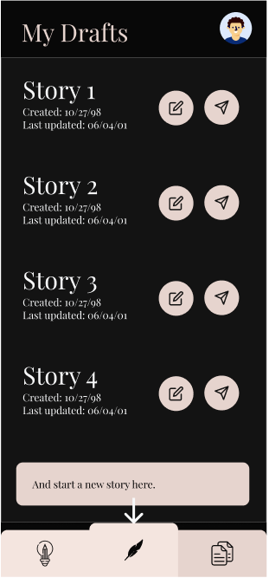
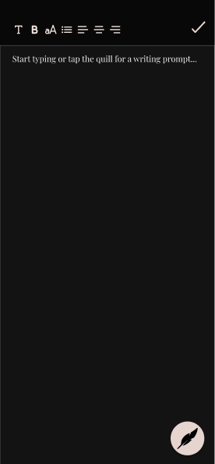
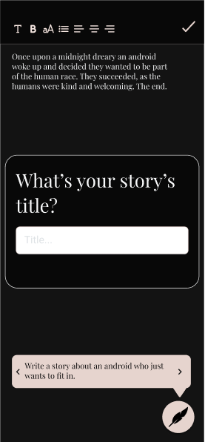
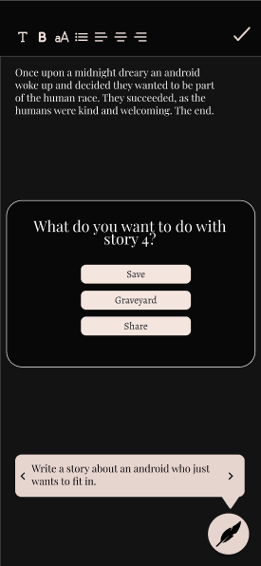
moderate task: create a new work (way 1)
click quill
write w or w/o prompt
pick title
choose where to save

Slide 22
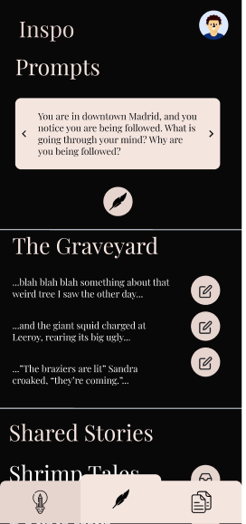
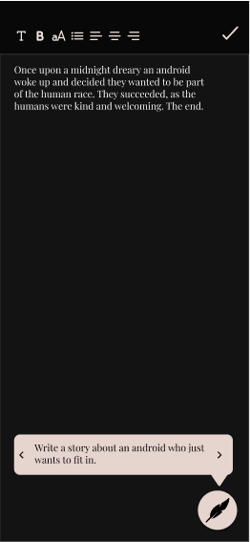
moderate task: create a new work (way 2)
go to inspo
choose a prompt
pick title
choose where to save

Slide 23
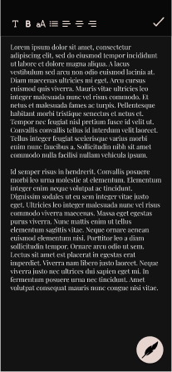
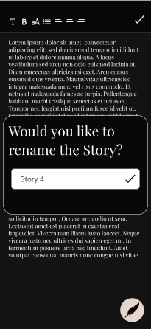
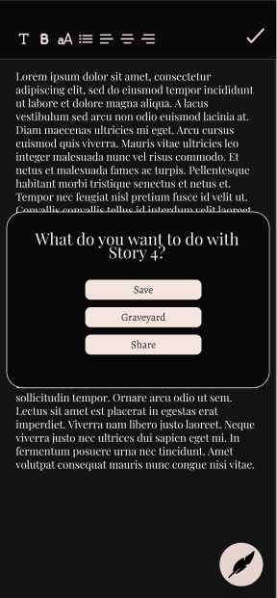
complex task: revise a work
choose a story
edit/add to the story
rename the story if want
choose where it goes

Slide 24
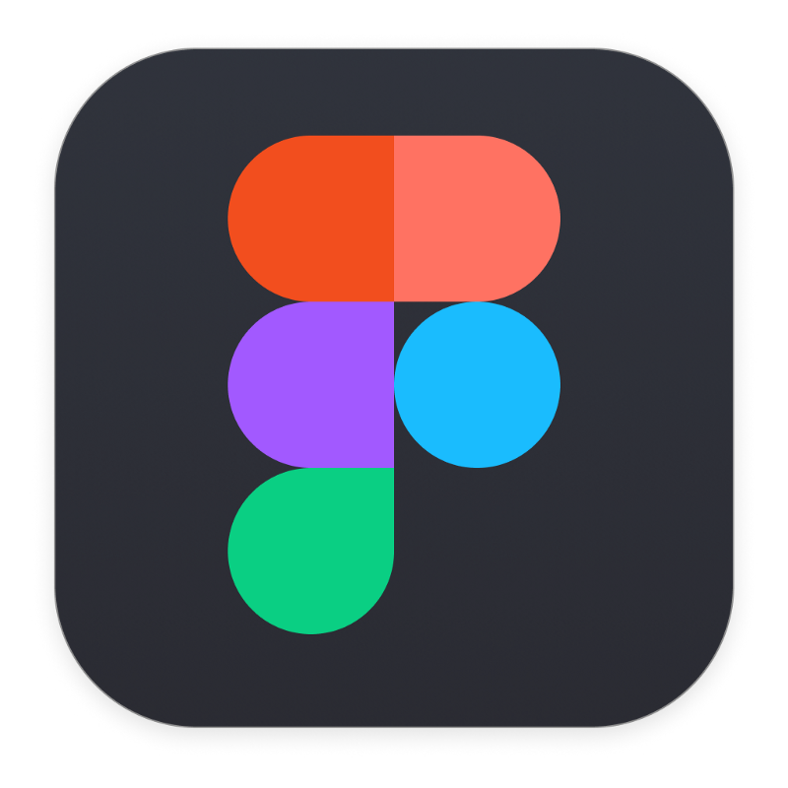
our prototyping tool
Figma
pros:
cons:
Real-time collaboration across team
Reusable components and easy to update design system with fonts and colors (we changed this so many times)
Community feature made it easy to be inspired and find components
Smallest variations required entirely new wireframes
Difficult to explore actual user functionality beyond just clicking things - like real time writing!
Hard to create original graphics

Slide 25
limitations
the prototype fails to encapsulate the one thing the app is really about: the creation of content & the writing experience.
it also...
Doesn’t include access to the wide database of prompts the actual app will have. Instead it includes a few preloaded ones.
Doesn’t display the proper animations when certain buttons are pressed like the popping in and out of the prompt.
Has some incorrect selection instances when jumping from wireframe to wireframe due to the sheer magnitude of small variant wireframes that would be required (for ex: the exact prompt the user chose out of 5 being the one displayed when writing)

Slide 26



~ wizard of oz techniques ~
Success banners
The login page
Friends sharing works with user
arts & culture

Slide 27
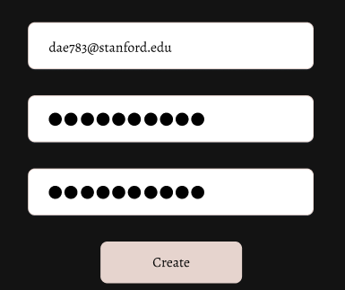
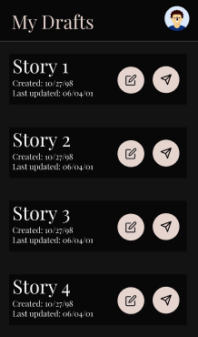
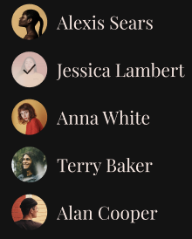
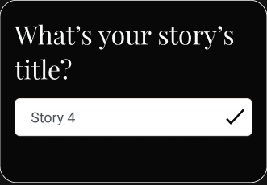
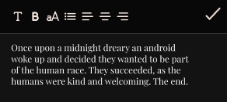
hard coded features
User’s drafts
User’s friends
User’s login info
User’s written story
User’s assigned title

Slide 28
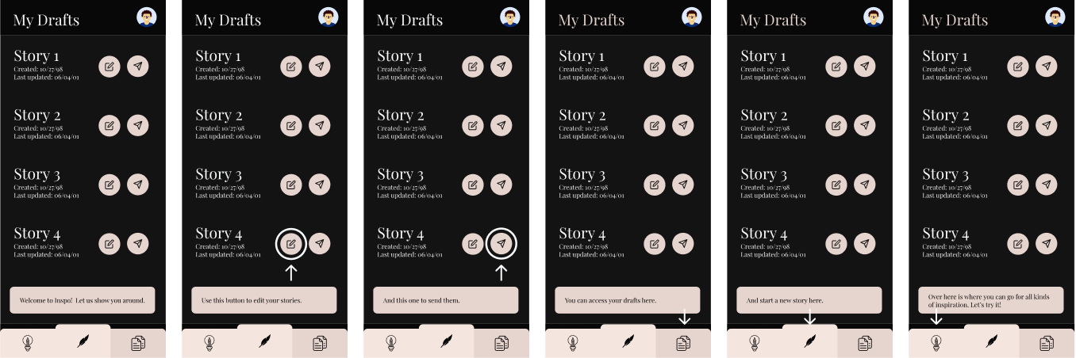
other flows: onboarding process in drafts

Slide 29
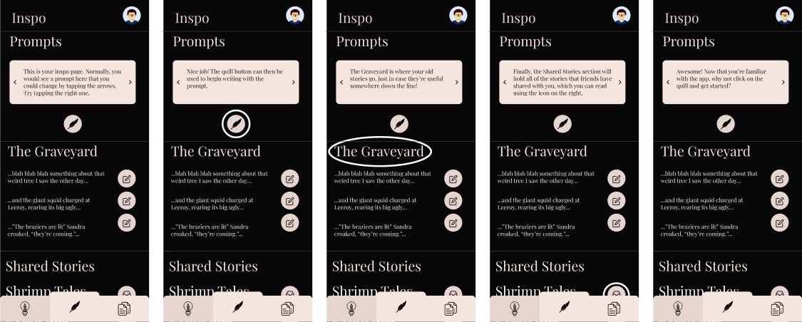
other flows: onboarding process in inspo tab

Slide 30
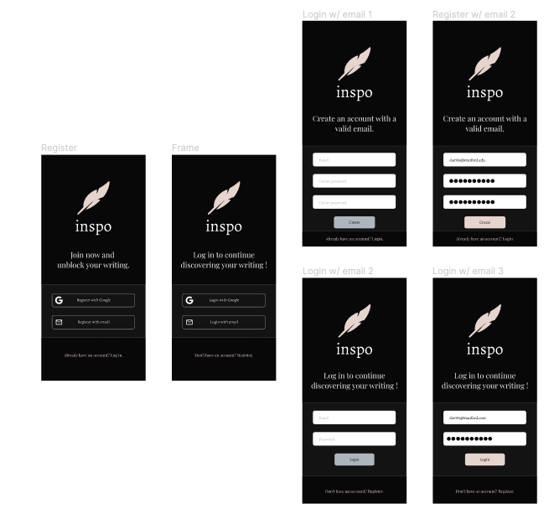
other flows: login process

Slide 31
other flows: login process

Slide 32
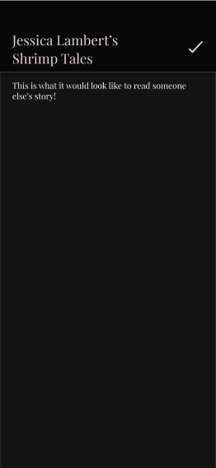
other flows: exploring a friend’s work

Slide 33
our link
https://www.figma.com/proto/ppEaWYjtRMic2qQgKqaSsG/med-fi?node-id=55%3A1141&viewport=-121%2C87%2C0.4683326482772827&scaling=scale-down

