Slide 1

inspo
- unblock your writing -

Slide 2
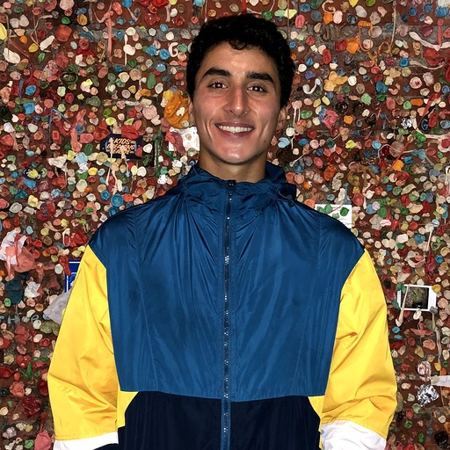



team euphoria
david e. ‘21
sam m. ‘22
anatole s. ‘20
jake w. ‘21
Notes:
Hey everyone! We’re team Inspo: myself (anatole), Sam, David and Jake, and we’re trying to help you write.

Slide 3
Overview
01
02
03
04
our need
how to fill it
what is the need we’re trying to fill?
how are we going to go about filling it?
solution & testing
adapting
what does our solution look like? how was it received?
what are we going to adapt about our solution?
Notes:
We’re going to go through
The need we’re trying to fill
How we’re going to go about filling it
What our solution looks like
How we tested our solution
And, finally, what we’re probably going to change about our solution

Slide 4
Mission Statement
We aim to unblock your writing and fuel your writing process.
arts & culture

Slide 5
Value Proposition
we think there is an opportunity to provide artists with a writing method-agnostic platform that at once spurs creativity through prompts and inspiration from other authors and previous work
arts & culture

Slide 6
2 main interface choices
mobile
web
Notes:
We were considering two options mainly: web vs. mobile (I wanted to do a google glass extension but the rest of my team didn’t :(

Slide 7
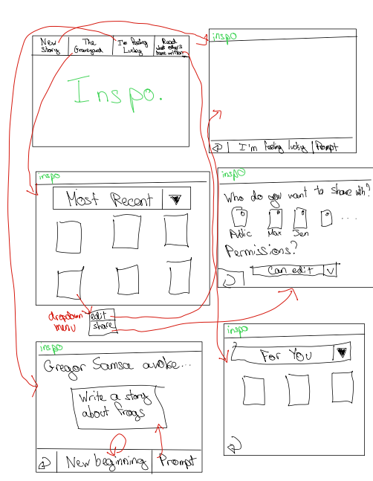
why web
our interviews have shown that people mainly write/edit on computers
Notes:
In a lot of ways, doing the design for web makes sense when it comes to a writing app: our interviews have shown that people mainly write on their computers and use phones only for communicating or notes.

Slide 8
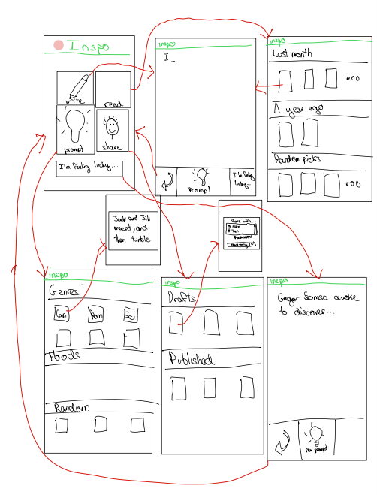
why mobile
our interviews have also shown that people use phones for ideation
e.g. notes app
Notes:
But in other ways, our app made more sense for mobile, because it isn’t really about the writing part, we realized. It’s about the generating part.

Slide 9
mobile wins
inspo
unblock your writing
ultimately, mobile makes more sense for our idea!
user gets instant access even when on the go, making it ideal for looking for inspiration or jotting down notes
Notes:
Ultimately, the mobile version makes more sense for our idea because the user will almost always have instant access to their phone -- making it an ideal place to look for inspiration or to use to write down some notes quickly when inspiration strikes.

Slide 10
inspo
inspo
unblock your writing
unblock your writing
Notes:
Ultimately, the mobile version makes more sense for our idea because the user will almost always have instant access to their phone -- making it an ideal place to look for inspiration or to use to write down some notes quickly when inspiration strikes.

Slide 11
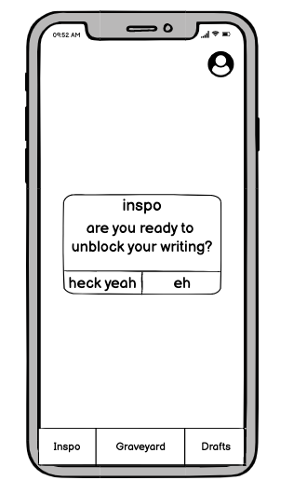
low-fi prototype structure
Balsamiq
Phone interface
Clean/minimal design
3 tabs at bottom: prompts, sharing, graveyard
Notes:
Here’s our lo-fi prototype made with Balsamiq
Inspo Mobile app with three tabs at the bottom: one for prompts, one for sharing, and one for the graveyard

Slide 12
our core tasks
Simple Task: Scroll through a prompt and start writing
Moderate Task: Go to your writing graveyard, choose a work you’ve already written, and edit it
Complex task: Choose a story in your drafts section and share it
arts & culture

Slide 13
simple task: pick a prompt and use it as inspo to start writing
arts & culture

Slide 14
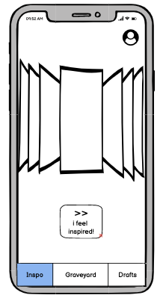
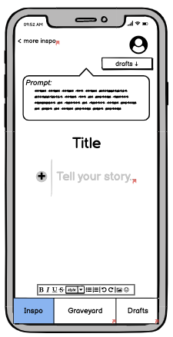
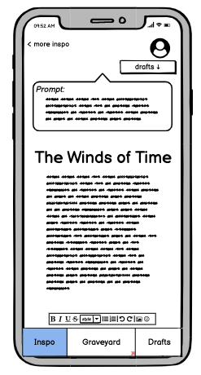
select a prompt
pick a title
get to writing

Slide 15
moderate task: go to your writing graveyard, choose a work you’ve already written, and edit it
arts & culture

Slide 16
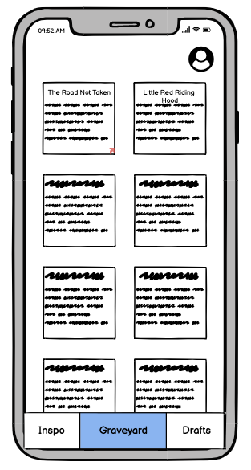
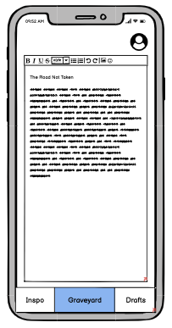
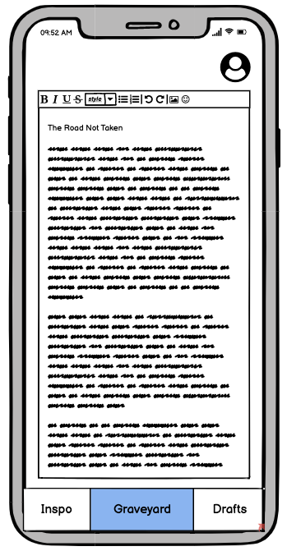
go to graveyard
pick an old work
get to editing

Slide 17
complex task: choose a story in your drafts and share it with Anatole
arts & culture

Slide 18
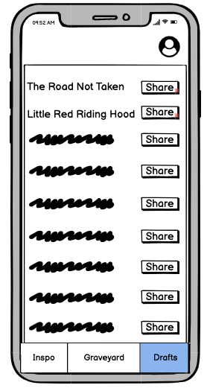
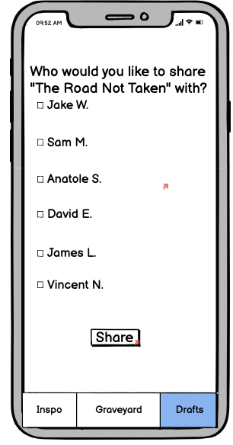
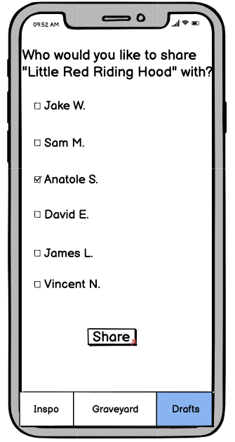
choose a story
browse sharing options
pick a person

Slide 19
our experiment participants
Jason
Peyton
Lauren
a philosophy major, who finds himself writing several times throughout the day
an English major at Western Oregon University, who writes short stories and wants to author her own piece
a retired entrepreneur turned author who has years of experience in user testing and interface design
Notes:
Interviewed Lauren, Peyton, and Jason -- all creators, all decently tech-savvy, used to apps.

Slide 20
our experimental method
medium:
zoom call
method: shared screen on zoom and walked through Balsamiq
process: we gave each user an overview of their task intention and watched how they interacted with interface
Notes:
We had one person running through the balsamiq, doing whatever was asked of them, and one person taking notes. We told each participant what we wanted them to do and let them at it.

Slide 21
successes
UI was commented on as “straightforward” and “easy to use”
users liked that design and task flow was uncluttered and minimal
Notes:
In general, our UI was relatively straightforward and easy to use. People liked how uncluttered and minimal it was.
One question we got often was: How are drafts different from the graveyard? What would make a user choose to go to one over the other?
Writing down dreams, grocery lists, and any other “junk” that comes to mind helps with creativity and discarding thoughts and getting rid of the negative energy and thoughts and self-criticism.

Slide 22
not so successful
there was confusion about the difference between graveyard and drafts
dislike around the idea of picking between all the same prompts again
Notes:
Another was: how will we generate prompts? Will they be the same every day? I don’t really want to have to pick between all the same prompts again.
Writing down dreams, grocery lists, and any other “junk” that comes to mind helps with creativity and discarding thoughts and getting rid of the negative energy and thoughts and self-criticism.

Slide 23
UI Change #1
when choosing a prompt, the user will be able to simply click the prompt to start writing rather than a separate button
Notes:
when choosing a prompt you’ll just click on it (instead of a separate button) to begin writing

Slide 24
UI Change #2
the user will be able to share a prompt even from the writing workspace
Notes:
You’ll be able to share a document from the writing tab

Slide 25
UI Change #3
be able to choose between list view or summary view
Notes:
when choosing a prompt you’ll just click on it (instead of a separate button) to begin writing

Slide 26
UI Change #4
add a date last edited when viewing piece snippets
Notes:
You’ll be able to share a document from the writing tab

Slide 27
UI questions we still have
Is it helpful to have infinite prompts available? Do we want to force a user to use a singular prompt rather than choose between them?
Should we limit the time a user can spend writing for certain exercises?
Should we have the user make goals for how much they want to write and how often?
arts & culture
Notes:
But some larger questions we have abbout how our UI encourages writing and how we can improve it:
Is it helpful to have infinite prompts available? Maybe forcing the user to use a singular prompt (or choose between a few) will force them to think more about the writing than the prompting.
Should we limit the time a user can spend writing for certain exercises?
Should we have the user make goals for how much they want to write and how often?

Slide 28
summary
what does it take to get someone to generate writing?
minimalism is our friend
some of our ux/naming
isn’t the most intuitive
we’ve confirmed 3 areas to help any user generate writing
Notes:
An agno

Slide 29
thank you for your time!
hit us with your feedback
Notes:
Our low-fi testing really made us think about what it takes to get someone to generate writing. Oftentimes you only need some blank space. Sometimes you need a prompt or two to get started. And sometimes you’ll want to look at some old writing for inspiration. Fortunately, whatever you need, we have you covered.

