Slide 1

write on
- enhancing writing creativity -

Slide 2
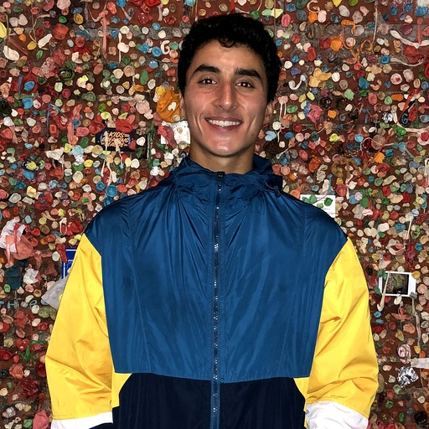
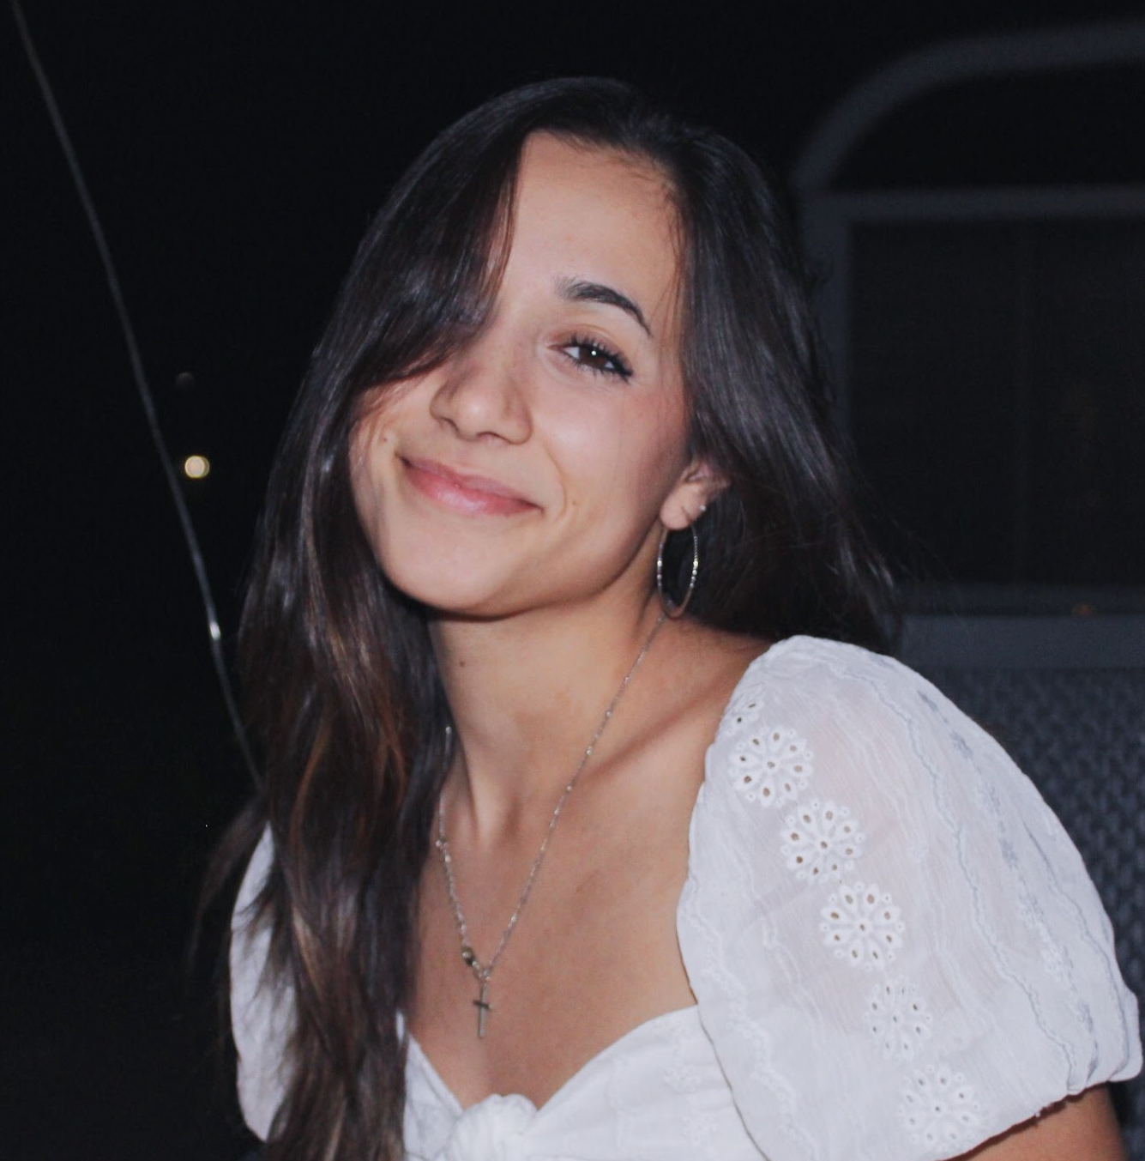

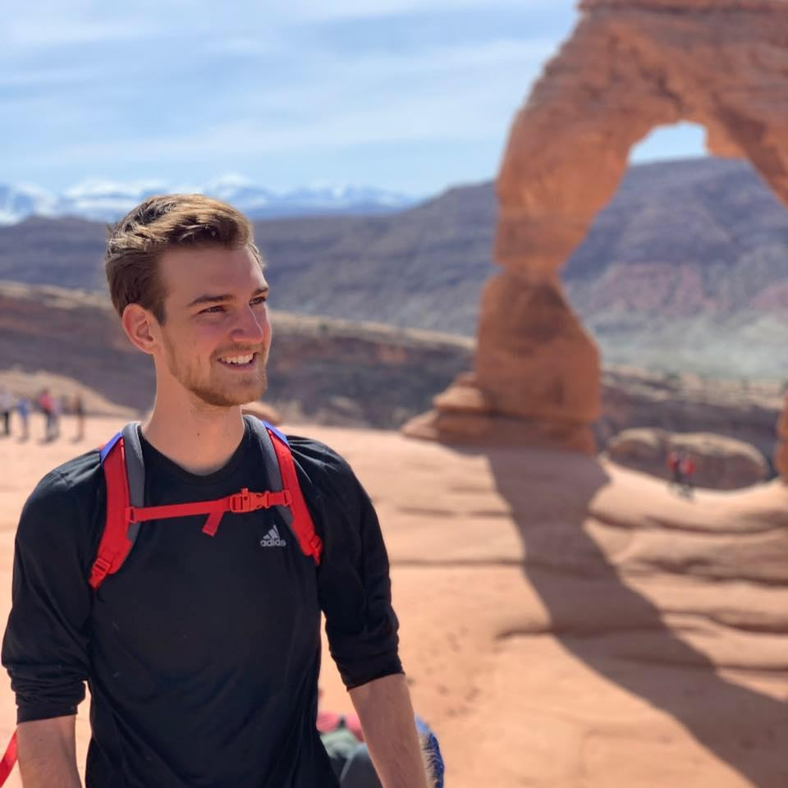
team euphoria
david e. ‘21
sam m. ‘22
anatole s. ‘20
jake w. ‘21

Slide 3
our writing problem space
song
fiction &
non-fiction
poetry
casual
{journaling}
arts & culture

Slide 4
our problem domain
creation
revision
sharing
arts & culture

Slide 5
initial pov
We met Scott, a 22 year old author studying at Princeton while in Australia.
We were amazed to realize that he waits for inspiration to strike before he starts his writing process.
It would be game-changing if we could find a way to inspire his creativity and encourage more writing topics.

Slide 6
finding more needs
meet beatriz & tommy

Slide 7
needfinding: tommy
We interviewed Tommy, a 22-year old singer-songwriter from the Seattle area who has released music on Spotify.
We noticed that writing daily is key to getting through writer’s block, and we also learned that reviewing one’s previous works can provide inspiration for new pieces.
Notes:
1) making yourself journal/write for 15-30 minutes a day can be key to getting through writer’s block
3) it can be important to stay up to date on cultural trends for your art

Slide 8
needfinding: beatriz
We interviewed Beatriz, a middle-aged woman who has dedicated the last couple of years to writing classes and pursuing her creative interests.
We learned of the importance of writing daily, often during the same hour of the day.
Notes:
Discipline is very important!
Writing down dreams, grocery lists, and any other “junk” that comes to mind helps with creativity and discarding thoughts and getting rid of the negative energy and thoughts and self-criticism.

Slide 9
pov’s
Notes:
How might we help artists recognize difference between reputable sources and non-reputable ones.

Slide 10
pov #1
We met Beatriz, a grandmother studying at the University of Miami who writes every day and is working on her autobiographical novel.
We were amazed to realize she meditates everyday before beginning her writing to clear her mind.
It would be game changing if we could make writing more carefree.
Notes:
Sampling HMWs:
HMW create a safe space for writers to experiment in?
HMW create an environment more conducive for writing?
HMW create better prompts for writers to draw inspiration from?
HMW remove the stress of writing/ideation?
HMW remove the stress of writer's block?
HMW make writers more comfortable in sharing work with strangers?
HMW make writing meditative?
HMW find and share productive writing habits?
HMW cater to the needs of individual writers?
HMW remove the roadblocks to writing?

Slide 11
for beatriz, how might we...
create a safe space for writers to experiment in
make writing personal and meditative
make writers more comfortable in sharing work with strangers
remove the roadblocks to writing
find and share productive writing habits
Notes:
Sampling HMWs:
HMW create a safe space for writers to experiment in?
HMW create an environment more conducive for writing?
HMW create better prompts for writers to draw inspiration from?
HMW remove the stress of writing/ideation?
HMW remove the stress of writer's block?
HMW make writers more comfortable in sharing work with strangers?
HMW make writing meditative?
HMW find and share productive writing habits?
HMW cater to the needs of individual writers?
HMW remove the roadblocks to writing?

Slide 12
pov #2
We met Christian, a 24 year-old aspiring rapper from Houston, TX who will be releasing his debut album in Spring 2021.
We were amazed to realize how difficult it was for him to find legitimate sources, both in information and people.
It would be game changing if we could provide crucial and legitimate information for aspiring artists.
Notes:
Sampling HMWs:
HMW connect aspiring artists to legitimate figures in the industry?
HMW help artists recognize difference between reputable sources and non-reputable ones?
HMW compile a source of relevant information for entering diverse industries?
HMW show the most important and relatable content to specific artists?
HMW establish legitimacy for established artists?
HMW determine what is crucial information for individual artists?
HMW disseminate disinformation to new artists?
HMW provide creators with mentors from similar fields?
HMW provide artists with useful information and opportunities?
HMW introduce creators to people who could help them in the industry?

Slide 13
for christian, how might we...
connect artists to reputable industry figures
disseminate info to
new artists
provide creators with mentors from similar fields
focus on providing
more structured, informational guides
validate legitimacy of established artists
Notes:
Sampling HMWs:
HMW connect aspiring artists to legitimate figures in the industry?
HMW help artists recognize difference between reputable sources and non-reputable ones?
HMW compile a source of relevant information for entering diverse industries?
HMW show the most important and relatable content to specific artists?
HMW establish legitimacy for established artists?
HMW determine what is crucial information for individual artists?
HMW disseminate disinformation to new artists?
HMW provide creators with mentors from similar fields?
HMW provide artists with useful information and opportunities?
HMW introduce creators to people who could help them in the industry?

Slide 14
pov #3
We met Noelle, a writer and actor in New York who abhors sharing early stages of her written work.
We were amazed to realize that Noelle uses twitter as a space to find prompts and work with other writers.
It would be game changing if we gave authors a space to collaborate and communicate at any time.
Notes:
Sampling HMWs:
HMW make authors socialize and learn from one another?
HMW create trending prompts/topics for quick ideation similar to twitter?
HMW create a public space for drafts?
HMW match writers with similar interests?
HMW show popular feedback based on audience consensus?
HMW show writers immediate + frequent feedback?
HMW give authors a way to share their unfinished story ideas/inspirational moments with other authors?
HMW introduce authors to one another?
HMW allow authors to share drafts w/o the fear of negative criticism?
HMW make the GitHub of story writing?

Slide 15
for noelle, how might we...
make the GitHub of story writing
introduce authors
to one another
give authors a way to share their unfinished story ideas
create trending prompts for quick ideation similar to Twitter
show writers immediate and frequent feedback
Notes:
Sampling HMWs:
HMW make authors socialize and learn from one another?
HMW create trending prompts/topics for quick ideation similar to twitter?
HMW create a public space for drafts?
HMW match writers with similar interests?
HMW show popular feedback based on audience consensus?
HMW show writers immediate + frequent feedback?
HMW give authors a way to share their unfinished story ideas/inspirational moments with other authors?
HMW introduce authors to one another?
HMW allow authors to share drafts w/o the fear of negative criticism?
HMW make the GitHub of story writing?

Slide 16
[#1] how might we...
provide more sources of inspiration for artists
We met Beatriz, a grandmother studying at the UofM who writes every day and is working on her novel. We were amazed to realize she meditates everyday before beginning her writing to clear her mind.
It would be game changing if we could make writing more carefree.

Slide 17
[#2] how might we...
compile relevant information for entering diverse industries
We met Christian, a 24 year-old aspiring rapper from Houston, TX.
We were amazed to realize how difficult it was for him to find legitimate sources.
It would be game changing if we could provide crucial information for aspiring artists.

Slide 18
[#3] how might we...
create a comfortable space for writers to experiment in
We met Noelle, a writer and actor in New York, who hates collaborating in real time.
We were amazed to realize that Noelle uses Twitter to find prompts.
It would be game changing if we could give authors a space to collaborate/communicator.

Slide 19
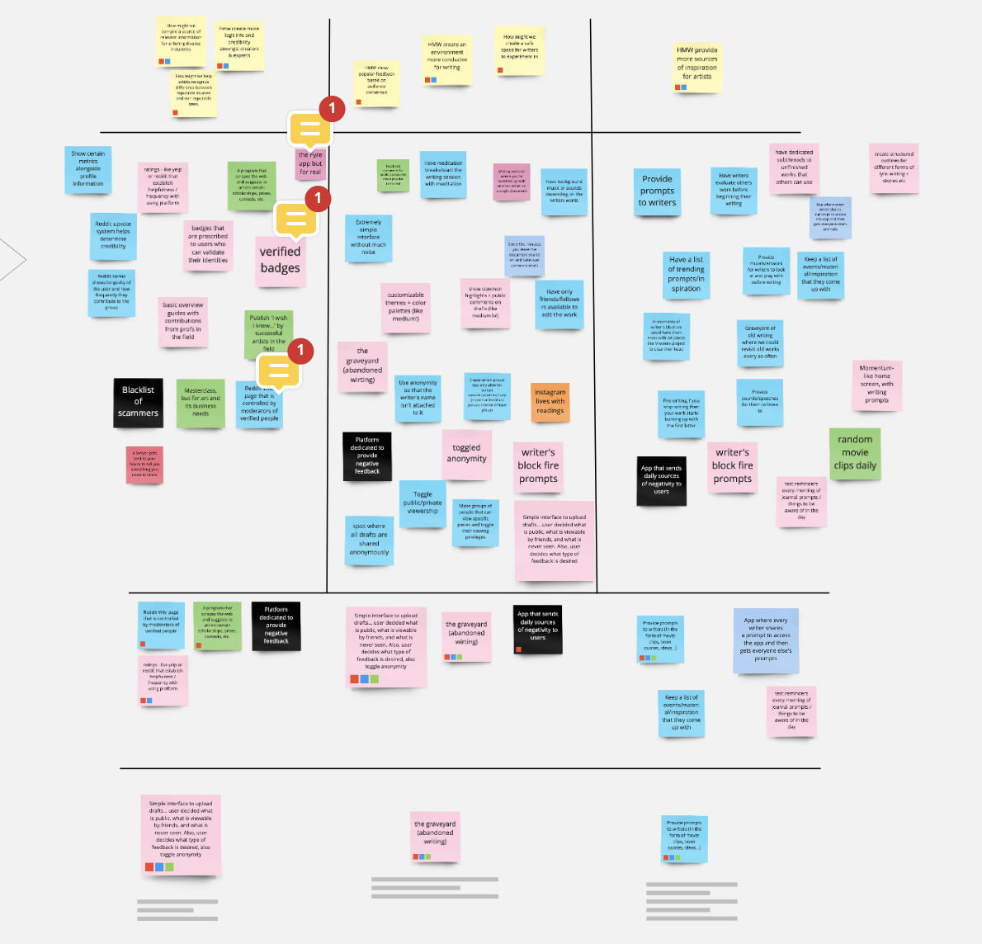
solutions
&
experience
prototypes

Slide 20
our assumption:
our solution:
Users fear negative feedback and will alter their viewing permissions on further publications dependent on feedback. The typical user will publish anonymously to everyone but will offer their name to friends
An interface that allows for writing to be uploaded with toggled viewing permissions. Users can decide viewing, feedback, and anonymity options
prototype #1

Slide 21
experience
prototype
#1
we wanted to see how prompts / feedback would affect permission toggling
user picks a prompt and then writes for 2 minutes
user picks permissions (anonymity and who to share w/)
arbitrary feedback given

Slide 22
prototype #1 insights
felt a bit confused by the task at hand, since some prompts are not built to receive feedback (the personal ones, especially). also, giving canned feedback was not ideal.
he sees identity as an opportunity for writers to connect with audiences. he would choose anonymity if a topic is contentious.
we learned that the prompt that he wrote about changed the audience he chose to share the piece with.
simar
a 26 yr-old who constantly journals
Notes:
and if the writer would suffer from being attached
VALID: not really, since we saw that what changed the publishing behavior was the type of piece, not the feedback received - more complex than expected

Slide 23
our assumption:
our solution:
Users want prompts and prompts push individuals out of writer’s block and into creative flow.
Provide prompts or rapid fire questions to writers in the form of videos, quotes, questions, book quotes, and unfinished writing to promote creativity.
prototype #2

Slide 24
experience
prototype
#2
we wanted to see how helpful prompts would be in encouraging creativity
user writes without a prompt
user writes with a prompt
compare the results

Slide 25
prototype #2 insights
we found that the amount of writing was roughly equal with or without prompts - he didn’t feel different.
during the free-write he continued a thought he had earlier in the day, while the prompts led him to personal reflections.
we learned that an artist’s mental state tends to be different with fiction vs. non-fiction.
aris
a middle aged man pursuing writing

Slide 26
our assumption:
our solution:
Viewing old writing will spark creative inspiration, encouraging better revisions and increasing output from the writer.
The Graveyard: provide writers with a platform to rediscover their previous work.
prototype #3

Slide 27
experience
prototype
#3
we wanted to see how old writing would inspire new writing
allow writer 5 minutes to read over old writing and then 5 minutes to write more
observe how old work influences new writing and whether writer revised vs restarted
user brings 3 old pieces they’ve written in the past

Slide 28
prototype #3 insights
she opted for editing and adding to her previous work. she acknowledged the friction of starting a new piece.
fresh eyes gave her space to see what words (in retrospect) could be clearer.
the time constraint also encouraged her to edit/revise instead of starting fresh.
valo
a 22 year old poet
Notes:
It takes a lot of mental energy to write something as concise as a poem
To craft an entire scene in your mind with only 100 words is challenging
VALID: yes bc artists can feel the emotional pulse of the piece and think critically about it, evoking new ideas the second time around

Slide 29
our solution
Toggle Permissions:
diversity in publishing options
Writer’s Block:
rapid fire creative exercises
we think there is an opportunity to provide artists with a writing method-agnostic platform that at once spurs creativity and provides a safe medium through which to share work as they please.
The Graveyard:
keeping a record of all past work
Daily Write: encouraging writing more often

Slide 30
summary
01
02
03
04
artists benefit from writing ideas down and revisiting their old ideas
writing is different for everyone
writing is personal at first but eventually worth sharing
getting rid of writer’s block requires persistent engagement
Notes:
An agno

Slide 31
thank you for your time!
hit us with your feedback

