Slide 1
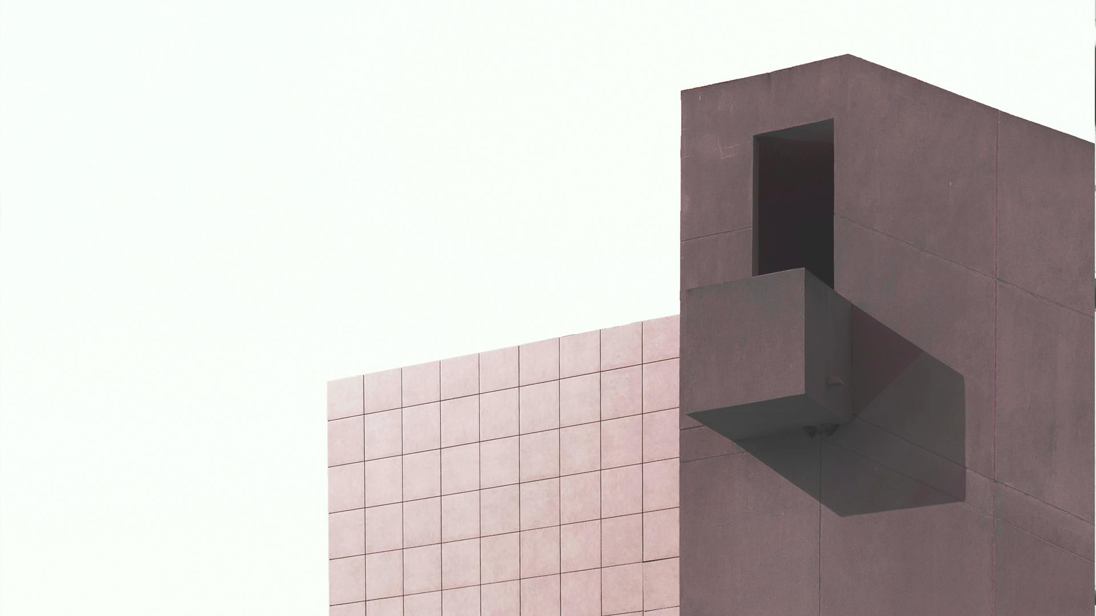
Arts and Culture
Building Blocks of the Mind // The Creative Process

Slide 2
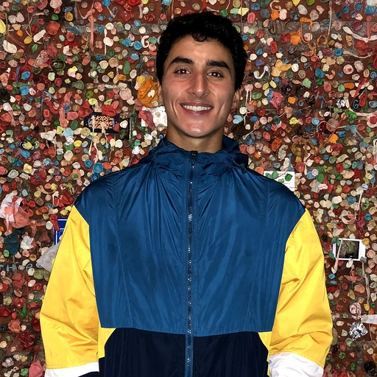
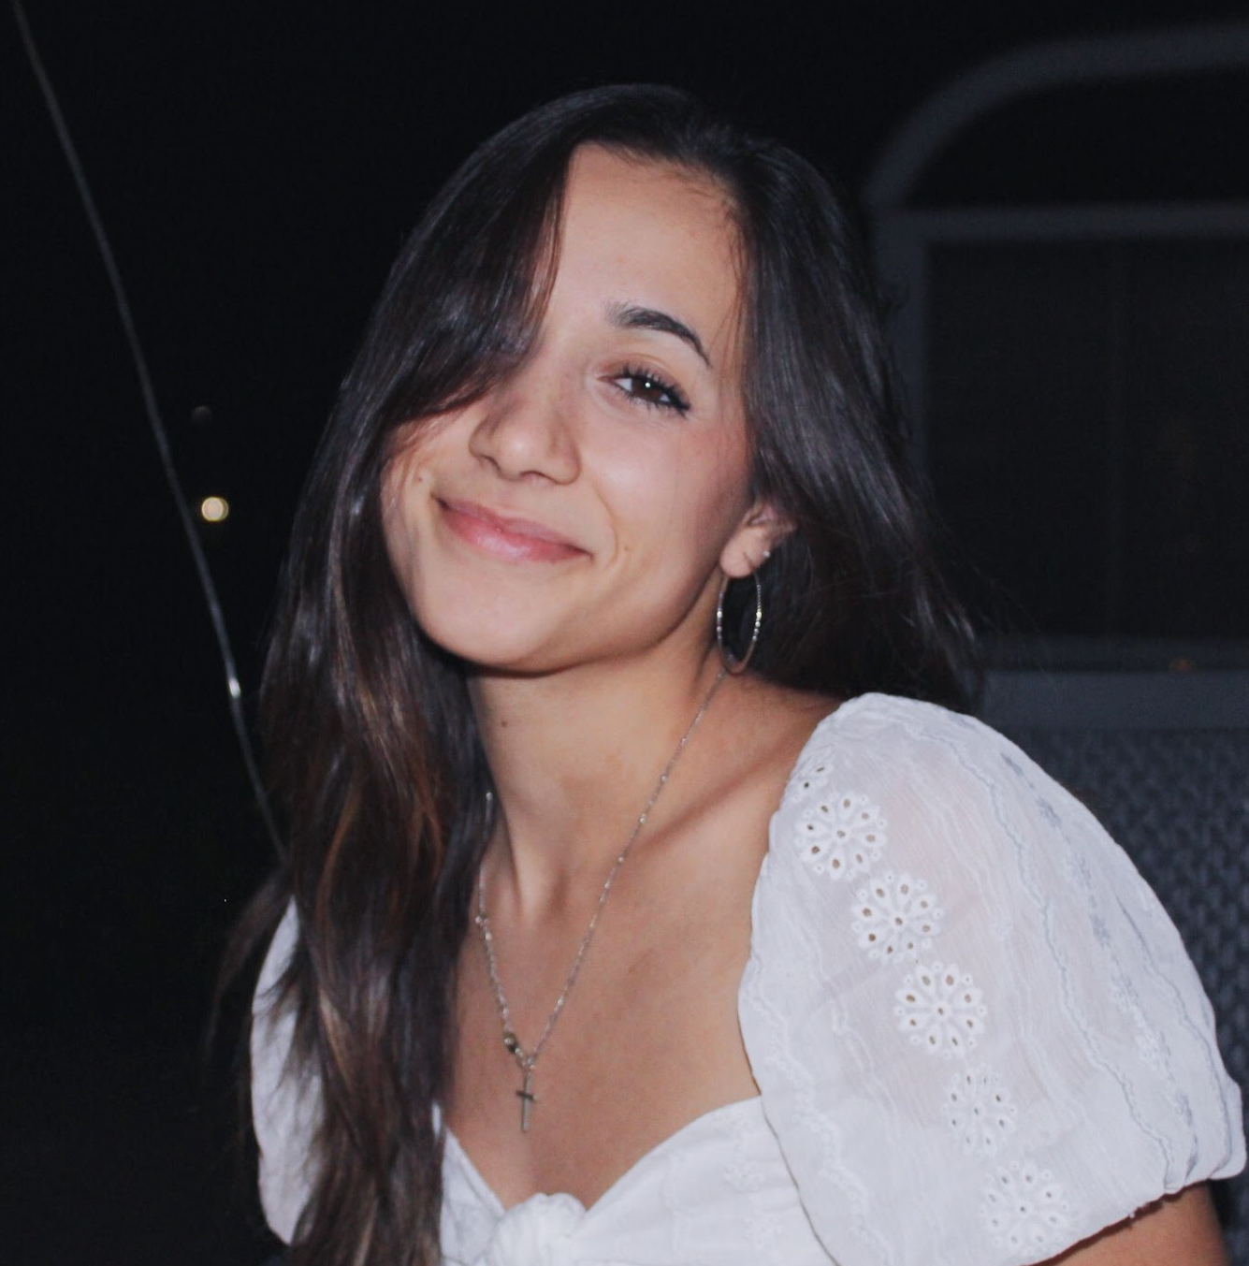

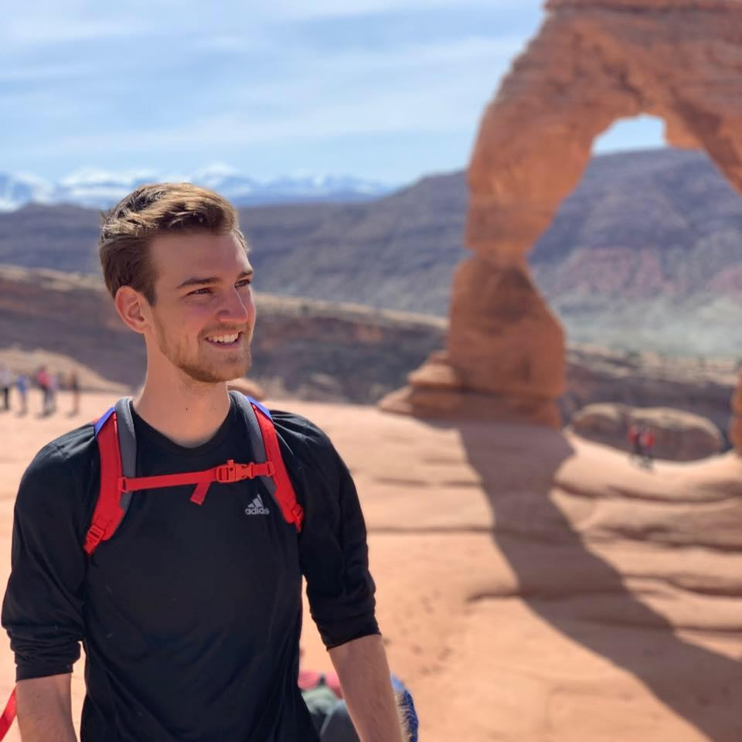

meet the team ☃︎☀︎
DAVID E. ‘21
SAM M. ‘22
ANATOLE S. ‘20
JAKE W. ‘21

Slide 3
The Creative Process
Methodology
Needfinding

Slide 4
The Creation Space
Fiction Writers short stories, novels, plays, screenwriting
Non-Fiction Writers Biographies, news articles, memoirs, journalism
Song Writers artists, rappers, singers
Poets prose, free verse, narrative, short form
Casual Writers
notes app, diaries, gratitude journaling

Slide 5
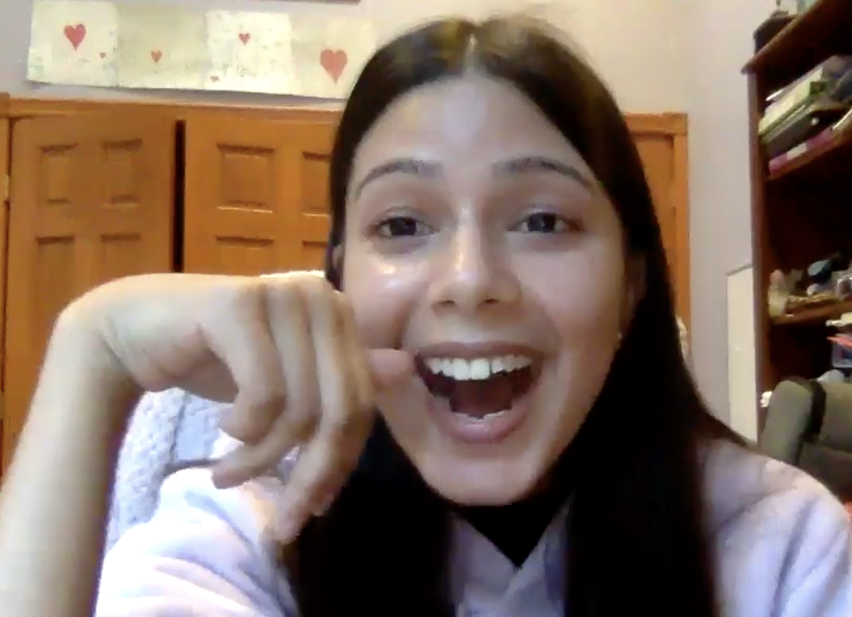
Participant #1: Sohenee
needfinding methodology
Who: a Tufts pre-med junior with a side passion for singing/writing
Why: a representation of a casual user who still ideates and constantly creates
How: team member’s High School

Slide 6
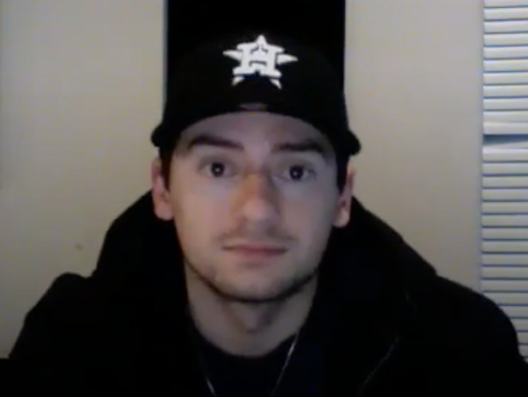
Participant #2: Christian (aka C-Detty)
needfinding methodology
Who: 24 yo aspiring rapper
Why: diverse perspective of writing in the context of musical spaces
How: team member’s High School
Notes:
He has been acquired by a label and so he has an interesting perspective on what the music industry is like especially with professionals and not independently
Has 3 singles out on all platforms and plans to release an album in March
Chosen because he gave us an alternative perspective on lyric writing and how the creative process may be different in the musical setting.
Recruited by direct contact through one of our team members
Interviewed over Zoom, he was in his house where he has his own music production studio (super cool!)
What was is like getting acquired by a label? What did the lyric writing process look like? How did he get inspired? What did his day-to-day look like?

Slide 7
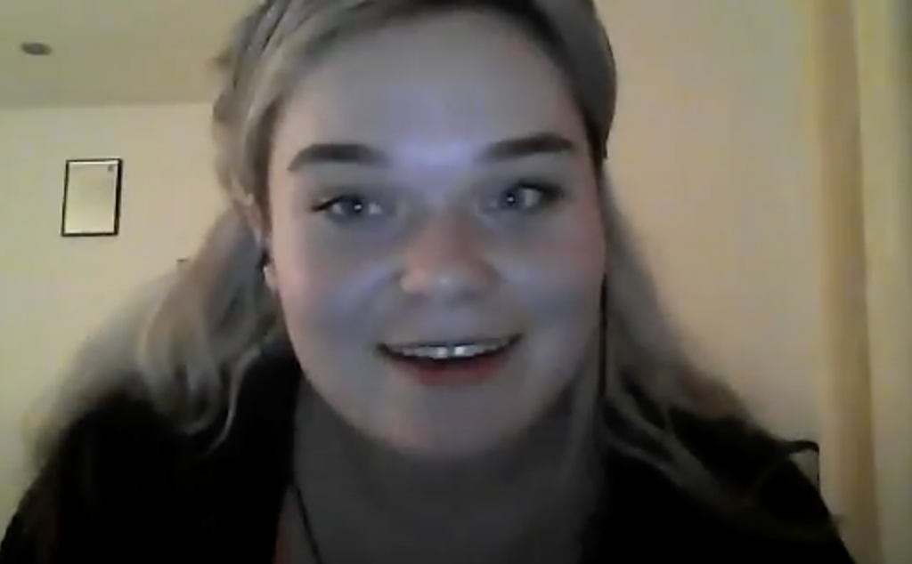
needfinding methodology
Participant #3: Noelle
Who: 21 yo actress graduated from American Academy of Dramatic Arts
Why: visual + written arts and how they come together
How: acting program with team member
Notes:
He has been acquired by a label and so he has an interesting perspective on what the music industry is like especially with professionals and not independently
Has 3 singles out on all platforms and plans to release an album in March
Chosen because he gave us an alternative perspective on lyric writing and how the creative process may be different in the musical setting.
Recruited by direct contact through one of our team members
Interviewed over Zoom, he was in his house where he has his own music production studio (super cool!)
What was is like getting acquired by a label? What did the lyric writing process look like? How did he get inspired? What did his day-to-day look like?

Slide 8
needfinding methodology
Participant #4: Scott
Who: 22 yo author w/ published memoir @ Princeton
Why: started and finished a novel while being a student with a general lack of resources
How: snowball recruiting
Notes:
He has been acquired by a label and so he has an interesting perspective on what the music industry is like especially with professionals and not independently
Has 3 singles out on all platforms and plans to release an album in March
Chosen because he gave us an alternative perspective on lyric writing and how the creative process may be different in the musical setting.
Recruited by direct contact through one of our team members
Interviewed over Zoom, he was in his house where he has his own music production studio (super cool!)
What was is like getting acquired by a label? What did the lyric writing process look like? How did he get inspired? What did his day-to-day look like?

Slide 9
needfinding methodology
who constitutes the team around you?
do you share your work publicly when it’s done? through what mediums?
how do you feel about revising other people’s work?
?
how do you combat writer’s block?
how would you describe your artistic process?
what does your revision process look like?
what tools do you use?
how does tech supplement or detract?
anonymous sharing?
what do you write?

Slide 10
The Creative Process
Results
Interview

Slide 11
“I have to get all the ideas down and edit later. The most important part is getting the ideas down. Everybody has enough material to write a book, but nobody ever keeps track of their thoughts.”
-Scott, the author

Slide 12
“ For me, writing is like sharing a piece of my heart. This is me communicating my emotions, and it’s personal. It requires that level of trust. ”
-Sohenee, the casual writer

Slide 13
“ Watching [other artists] helped me learn and was crucial to my development. Before that, I wasn’t really in the industry.”
-Christian, the artist

Slide 14
“ I don’t like the confrontation of working with others in real time. Maybe that’s why I just like sending drafts back and forth. ”
-Noelle, the actress

Slide 15







main technologies

Slide 16
The Creative Process
Map
Empathy

Slide 17
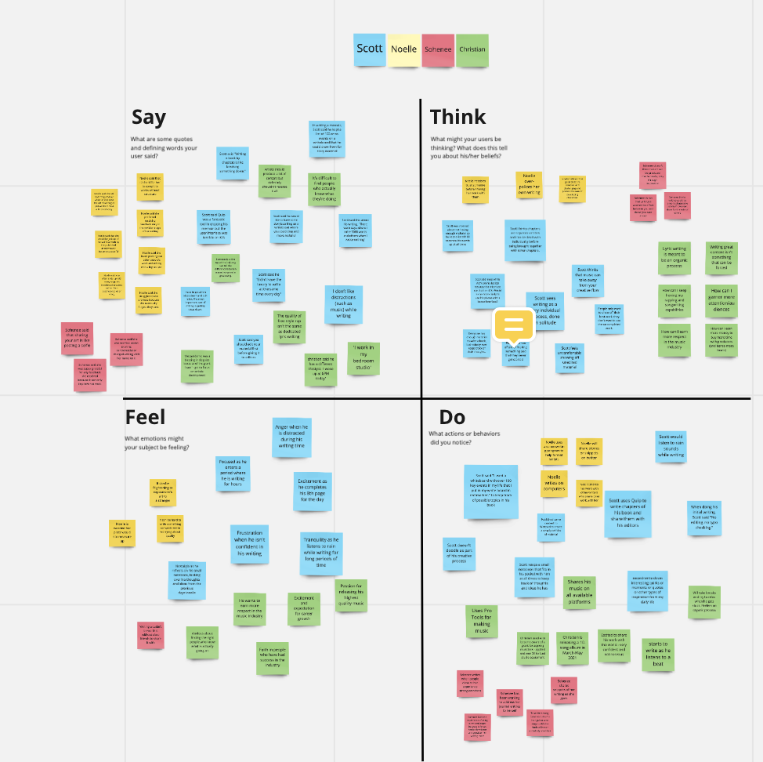
zoomed out

Slide 18
say:
“i would be jealous of myself if my anonymous work did well”
“writing a book by chapters is like breaking something down”
“artists should produce a lot of content but not release it all.”
“sharing your art is like posting a selfie”
“i worry about writing something controversial”
“i forget i wrote answers to prompts until i find them years later”
“there were days where I could write 5000 words and others when i couldn’t write.”
“i think you should edit before you give it to your editors”
“i wish someone could give me structure so i could write it out”
“somebody in the industry can tell the difference between a good song and a great song”
“feedback is only ever a good thing”
“i kept a list of 100 events I could draw from for story material.”

Slide 19
think:
i wish i could get more insight from people of different genres
i want to show off my best work not my uncompleted work
people have enough content they just need a place to write it
I need to trust the people I’m sending my work to
i’m worried I’ll say something wrong
writing is a collective effort between you and the people you trust
how can i get a larger audience that has more feedback for me
i wish there was an easier way to deal with writer’s block
i need to learn from the people around me who are doing it better
i need more structure to be able to convey what i want to
i over-police my work
i need more money to be able to produce more and better work

Slide 20
do:
used a whiteboard to keep track of thoughts
uses Quip to write chapters and share them with his editors
listened to rain sounds while writing
used AI to find grants
used evernote for anything and everything writing related
uses pen and paper to write down initial thoughts
releases a lot of music on Instagram and Youtube
strums a guitar over and over again to find lyrics
published content to wattpad to get a small portfolio
uses Twitter as an ecosystem for prompts and feedback
shared in his music on all platforms
uses voice memos to write down initial thoughts

Slide 21
feel:
frustration around lack of confidence
passion for releasing high quality projects
tranquility when in the groove of writing
nostalgia when looking through old writing samples
worry about sharing something controversial
anger when distracted
grateful for feedback and comments
hunger for more respect in his field
inadequacy about not finishing things
surprise when finding old writing samples
faith in the process and the people who have helped him
frightened about showcasing vulnerable writing

Slide 22
The Creative Process
insights + needs
Analysis

Slide 23
insight
need
There is a vulnerability around writing, especially in the case it is received poorly. There is no credit desired for work that is controversial or poorly acclaimed.
A way to toggle when the author of a work is credited versus when it is anonymous.

Slide 24
insight
need
Writers often forget about the mini writing that they do and rediscover their writing later.
A centralized way to store drafts, writing, and prompts that allows for easy access in the future to build off of.

Slide 25
insight
need
Creators want feedback from all types of audiences, particularly from people critically acclaimed in their specific field as well as generalized genres for diversity of thought.
A platform through which sharing, revising, and editing each other’s work from differing genres is possible.

Slide 26
insight
need
All creators experience writer’s block. It’s just a part of the process.
A way to encourage stream of consciousness (prompts, music, a more structured outline, etc) so that creativity can be born anew.

Slide 27
insight
need
A writer has a very individualized process for creation that is most conducive for them to create in the way they desire.
A “safe space” customized with appropriate color palettes, background music, limited distractions.

Slide 28
insight
need
Most authors have no centralized way to store a writing portfolio. Many just add writing samples to their websites or make personal instagrams.
An aesthetic portfolio for all types of writing, from poetry to song lyrics to short stories.

Slide 29
01
Our problem space is creation
02
We heard voices from all types of creators.
SUMMARY OF INSIGHTS
03
We discovered varying processes but similar problems
04
Writers shared similar sentiments of excitement, frustration, and vulnerability
We know people need: betters ways to organize, a solution for writer’s block, and a way to share/revise.
Our next steps are to fill in gaps around how tech can do better.
05
06

Slide 30

THANKS
any questions? :)

