Slide 1
Usability Testing
March 3, 2021
Notes:
90 minutes 1st half + 3 min break + (midterm review slides with remaining 15 minutes)
(should have been 60 minutes… went WAY long)

Slide 2

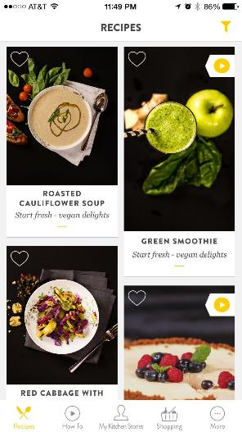
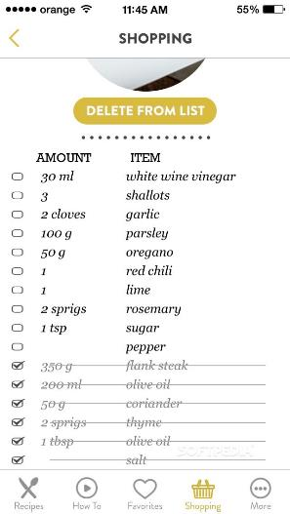
Hall of Fame or Shame?
Kitchen Stories

Slide 3

Hall of Fame!
Kitchen Stories
Like
  Large pictures of recipes
  Photos & videos
  Shopping list that marks off as you purchase
Wish
  ?

Slide 4
Usability Testing
March 3, 2021
Notes:
90 minutes 1st half + 3 min break + (midterm review slides with remaining 15 minutes)
(should have been 60 minutes… went WAY long)

Slide 5
Outline
Why do usability testing?
Choosing participants
Ethical considerations
Designing & conducting the test
Using the results
Experimental options & details

Slide 6
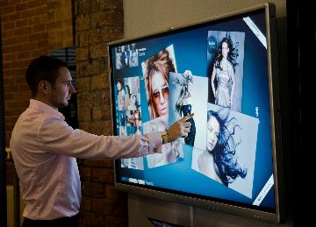
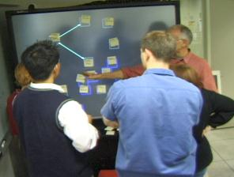

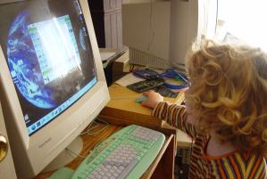
Why do Usability Testing?
Can’t tell how good UI is until?
  people use it!
Expert review methods are based on evaluators who may?
  know too much
  not know enough (about tasks, etc.)
Hard to predict what real users will do

Slide 7
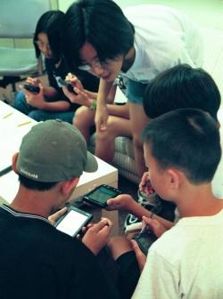
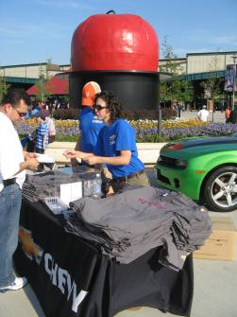
Choosing Participants
Representative of target users. How so?
  job-specific vocab / knowledge
  tasks
Approximate if needed
  system intended for doctors?
    get medical students or nurses
  system intended for engineers?
    get engineering students
Use incentives to get participants
  t-shirt, mug, free coffee/pizza
Notes:
Michigan State Image from http://www.nytimes.com/2009/01/01/business/01student.html

Slide 8

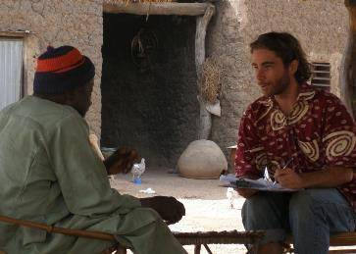
Ethical Considerations
Usability tests can be distressing
  users have left in tears
Testing/fieldwork can be coercive if there is a power imbalance (e.g., in under resourced communities)
People may feel no option but to speak to you or give you their time even though they may not get anything of value in return.
http://centread.ucsc.edu/CenTREAD%20photos/BrianDowd2.JPG
Notes:
Doing fieldwork in under resourced communities has a number of pitfalls for researchers coming from an empowered group (whether by race, education, or other institutional privilege).
You cannot just drop in to some rural village wearing your African shirt. It just isn’t ethical.
Even paying money can be coercive because they may NOT be able to turn you down

Slide 9

Ethical Considerations
You have a responsibility to alleviate these issues
  make voluntary with informed consent (form)
  avoid pressure to participate
  let them know they can stop at any time
  stress that you are testing the system, not them
  make collected data as anonymous as possible
Often must get human subjects approval (IRB)
http://research.uthscsa.edu/irb/images/IRBmeeting4.jpg

Slide 10
Usability Test Proposal
A report that contains
  objective
  description of system being testing
  task environment & materials
  participants
  methodology
  tasks
  test measures
Get approved & then reuse for final report
Seems tedious, but writing this will help “debug” your test

Slide 11

Selecting Tasks
Tasks from low-fi design can be used
  may need to shorten if
    they take too long
    require background that test user won’t have
Don’t train unless that will occur in real deployment
Avoid bending tasks in direction of what your design best supports
Don’t choose tasks that are too fragmented ?
  fragmented = do not represent a complete goal someone would try to accomplish with your application
  e.g., phone-in bank test
Check if your friend has called, find out what time he will be going to the club.

Slide 12


Two Types of Data to Collect
Process data
  observations of what users are doing & thinking
  qualitative
Bottom-line data
  summary of what happened
    time, errors, success
  i.e., the dependent variables
  quantitative
http://allazollers.com/discovery-research.php
http://www.fusionfarm.com/content/uploads/2012/10/analyzing-data.jpg

Slide 13
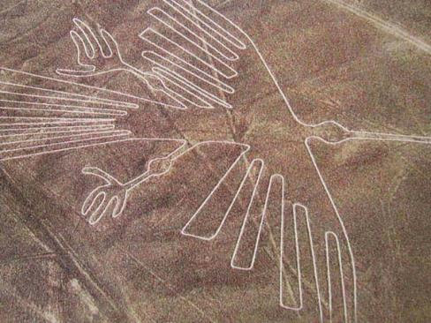
Which Type of Data to Collect?
Focus on process data first
  gives good overview of where problems are
http://www.redicecreations.com/ul_img/24592nazca_bird.jpg
Notes:
One of the most mysterious places on Earth, the Nazca Lines in Peru are pictographs etched in the desert.
http://www.azquotes.com/quote/1137013

Slide 14

Which Type of Data to Collect?
Focus on process data first
  gives good overview of where problems are
Bottom-line doesn’t tell you ?
  where to fix
  just says: “too slow”, “too many errors”, etc.
Hard to get reliable bottom-line results
  need many users for statistical significance
http://netbreak-ph.blogspot.com/2012/09/Hitleap-get-traffic-views-on-site.html

Slide 15

The “Thinking Aloud” Method
Need to know what users are thinking, not just what they are doing
Ask users to talk while performing tasks
  tell us what they are thinking
  tell us what they are trying to do
  tell us questions that arise as they work
  tell us things they read
I’ll click on the checkout button

Slide 16
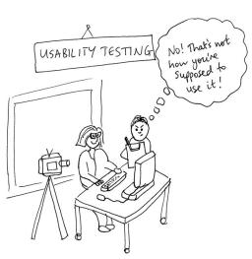
Thinking Aloud (cont.)
Prompt the user to keep talking
  “tell me what you are thinking”
Only help on things you have pre-decided
  keep track of anything you do give help on
Make a recording & take good notes
  make sure you can tell what they were doing
  use a digital watch/clock
  record audio & video
    or even event logs
http://jennycham.co.uk/wp-content/uploads/2011/08/200911221250225481.jpg

Slide 17
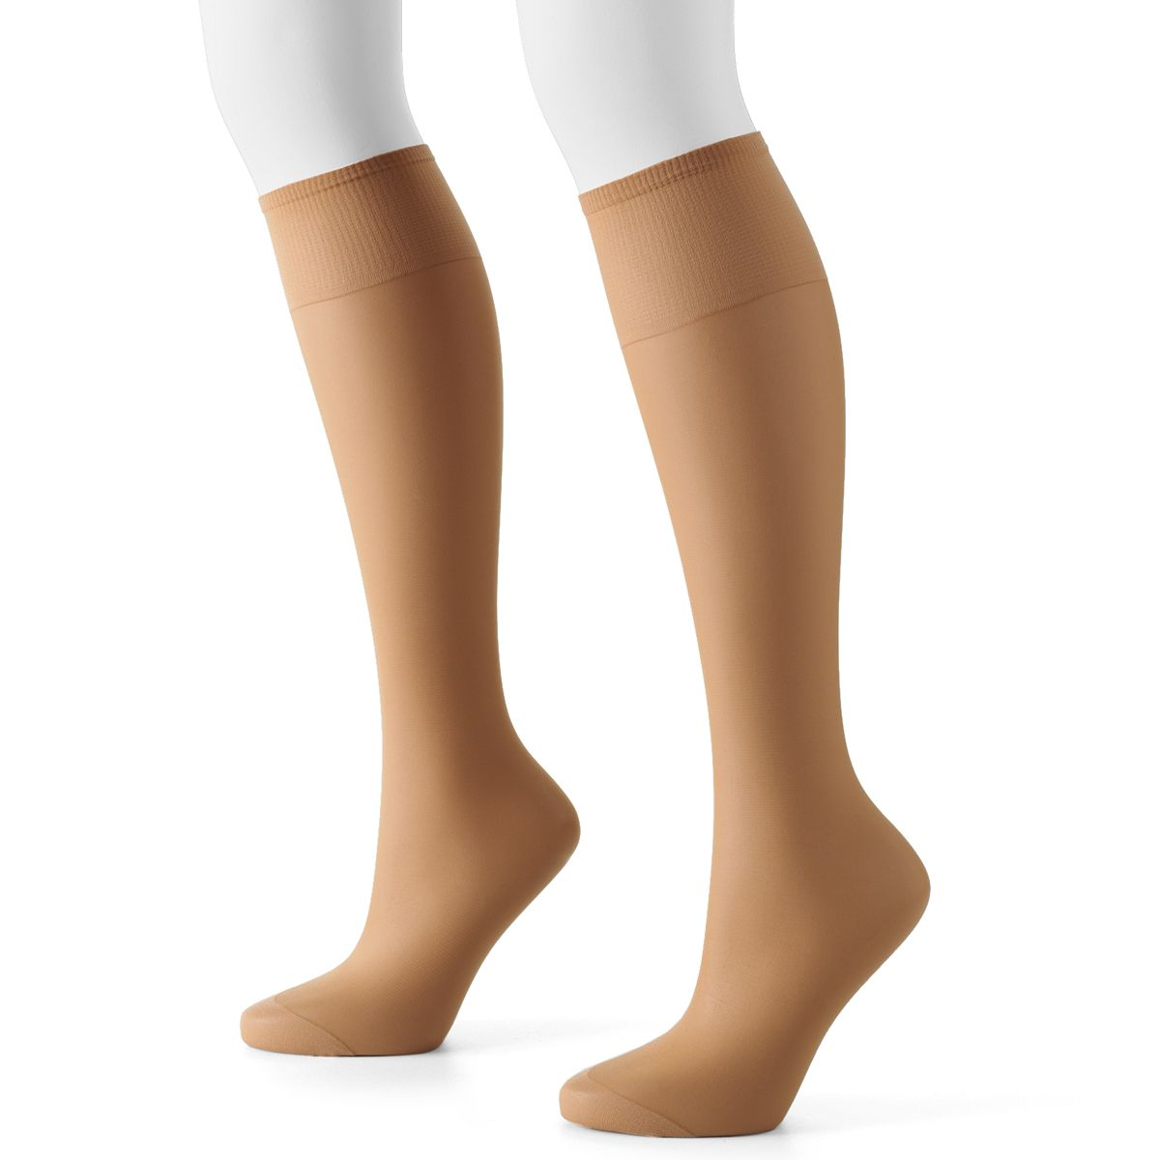
Will thinking out loud give the right answers?
Not always
If you ask, people will always give an answer, even it is has nothing to do with facts
  panty hose example
→Try to avoid specific questions
(especially that have binary answers)
Notes:
Did an experiment: had someone sit outside a supermarket with 2 pairs of pantyhose and asked which was more sheer
There was a statistically significant different between the one on the right and left
…but they were the same product!
Moral: be careful what you ask – people will try to give you the answer they think you want

Slide 18
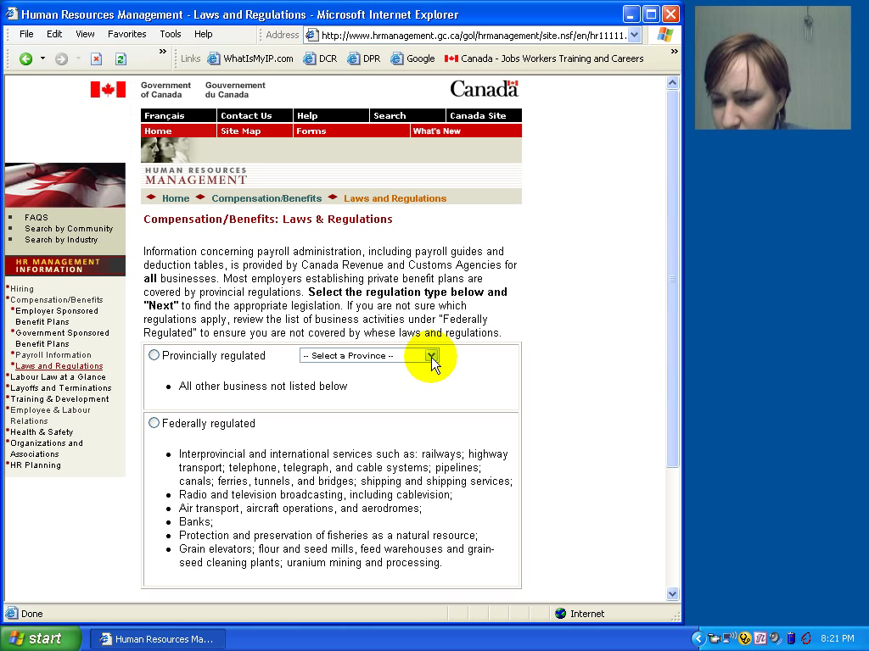
Notes:
Watch her face and listen to the tone of her voice. These are the types of things you cannot get with A/B testing or other more automated methodologies that we will talk about later.

Slide 19
Try it out!
Use the think aloud protocol to test one task in your medium-fi prototype.
In a moment, we will break you out into your teams. You have 3 minutes to identify which task to study. Select one person to rotate into the next breakout room down (within your studio, 1->2, 4->1). If possible, this should be someone who has not done a HE on that team’s prototype.
When they arrive, ask your visitor to complete the task while speaking their thought process aloud. Take notes!

Slide 20

Using the Test Results
Summarize the data
  make a list of all critical incidents (CI)
    positive & negative
  include references back to original data
  try to judge why each difficulty occurred
What does data tell you?
  UI work the way you thought it would?
    users take approaches you expected?
  something missing?
http://www.hhs.gov/ocr/privacy/hipaa/enforcement/data/index.html

Slide 21
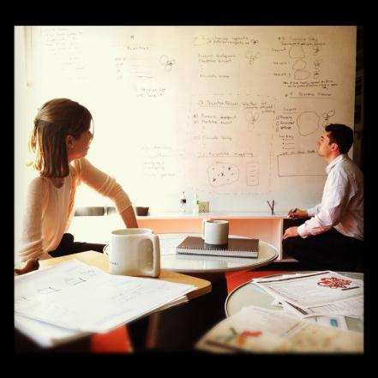
Using the Results (cont.)
Update tasks & rethink design
  rate severity & ease of fixing CIs
  fix both severe problems &
  make the easy fixes
http://www.thetomorrowplan.com/exchange/policies-prairie-chickens-and-parking/

Slide 22
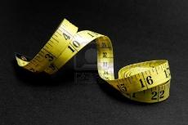
Measuring Bottom-Line Usability
Situations in which numbers are useful
  time requirements for task completion
  successful task completion %
  compare two designs on speed or # of errors
Ease of measurement
  time is easy to record
  error or successful completion is harder
    define in advance what these mean
Do not combine with thinking-aloud. Why?
  talking can affect speed & accuracy

Slide 23

Analyzing the Numbers
Example: trying to get task time ≤ 30 min.
  test gives: 40, 5, 20, 90, 10, 15
  mean (average) = 30
  median (middle) = 17.5
  looks good!
Did we achieve our goal?
Wrong answer, not certain of anything!
Factors contributing to our uncertainty?
  small number of test users (n = 6)
  results are very variable (standard deviation = 32)
    std. dev. measures dispersal from the mean

Slide 24
Analyzing the Numbers (cont.)
This is what basic statistics can be used for
Crank through the procedures and you find
  95% certain that typical value is between 5 & 55
Notes:
95% (or alpha=5%) is the standard confidence interval used in HCI

Slide 25
Analyzing the Numbers (cont.)

Slide 26
Analyzing the Numbers (cont.)
This is what basic statistics can be used for
Crank through the procedures and you find
  95% certain that typical value is between 5 & 55
Usability test data is highly variable
  need lots to get good estimates of typical values
  4x as many tests will only narrow range by 2x
    breadth of range depends on sqrt of # of test users
  this is when online methods become useful
    easy to test w/ large numbers of users

Slide 27
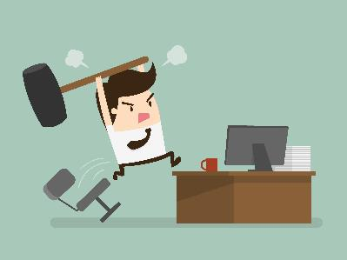
Measuring User Preference
How much users like or dislike the system
  can ask them to rate on a scale of 1 to 10
  or have them choose among statements
    “best UI I’ve ever…”, “better than average”…
  hard to be sure what data will mean
    novelty of UI, unrealistic setting …
If many give you low ratings → trouble
Can get some useful data by asking
  what they liked, disliked, where they had trouble, best part, worst part, etc.
  redundant questions are OK

Slide 28

Comparing Two Alternatives
1
2
Between groups experiment
  two groups of test users
  each group uses only 1 of the systems
Within groups experiment
  one group of test users
    each person uses both systems (cheaper)
    can’t use the same tasks or order (learning)
  best for low-level interaction techniques
    e.g., new mouse, new swipe interaction, …
1
2

Slide 29
Comparing Two Alternatives
Between groups requires many more participants than within groups
See if differences are statistically significant
  assumes normal distribution & same std. dev.
Online companies can do large AB tests
  look at resulting behavior (e.g., buy?)

Slide 30
Experimental Details
Order of tasks
  choose one simple order (simple → complex)
    unless doing within groups → counterbalance order
Training
  depends on how real system will be used
What if someone doesn’t finish
  assign very large time & large # of errors or remove & note
Pilot study
  helps you fix problems with the study
  do two, first with colleagues, then with real users

Slide 31
Instructions to Participants
Describe the purpose of the evaluation
  “I’m testing the product; I’m not testing you”
Tell them they can quit at any time
Demonstrate the equipment
Explain how to think aloud
Explain that you will not provide help
Describe the task
  give written instructions
  one task at a time
Check if your friend has called, find out what time he will be going to the club.
Notes:
Try to get the variance down by being consistent in how you do these things.

Slide 32
Details (cont.)
Keeping variability down
  recruit test users with similar background
  brief users to bring them to common level
  perform the test the same way every time
    don’t help some more than others (plan in advance)
  make instructions clear
Debriefing test users
  often don’t remember, so demonstrate or show video segments
  ask for comments on specific features
    show them screen (online or on paper)

Slide 33
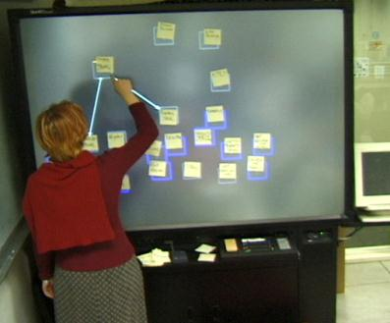

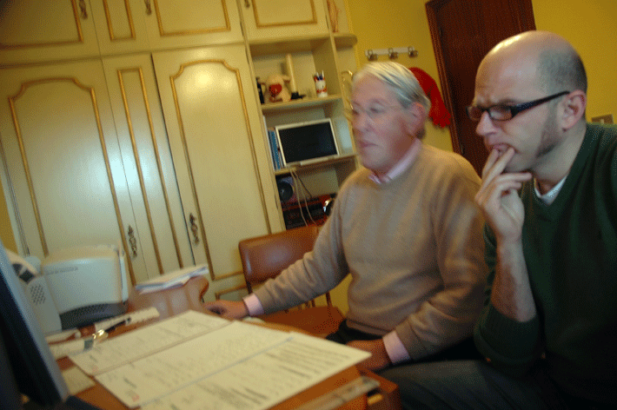
Reporting the Results
Report what you did & what happened
Images & graphs help people get it!
Video clips can be quite convincing

Slide 34
Heuristic Evaluation vs. User Testing
HE is much faster
  1-2 hours each evaluator vs. days-weeks
HE doesn’t require interpreting user’s actions
User testing is far more accurate (by def.)
  takes into account actual users and tasks
  HE may miss problems & find “false positives”
Good to alternate between HE & user testing
  find different problems
  don’t waste participants

Slide 35
Summary
User testing is important, but takes time/effort
Use ????? tasks & ????? participants
  real tasks & representative participants
Be ethical & treat your participants well
Want to know what people are doing & why? collect
  process data
Bottom line data requires ???? to get statistically reliable results
  more participants
Difference between between & within groups?
  between groups: each subject participates in only one of n conditions
  within groups: everyone participates in multiple conditions

Slide 36
Further Reading on Ethical Issues With Community-based Research
Children and Families “At Promise, Beth B. Swadener, Sally Lubeck, editors, SUNY Press, 1995, http://www.sunypress.edu/p-2029-children-and-families-at-promis.aspx
“Yours is better!” Participant Response Bias in HCI, Proceedings of CHI 2012, by Nicola Dell, et al., http://research.microsoft.com/pubs/163718/CHI2012-Dell-ResponseBias-proc.pdf
“Strangers at the Gate: Gaining Access, Building Rapport, and Co-Constructing Community-Based Research”, Proceedings of CSCW 2015, by Christopher A. Le Dantec & Sarah Fox, http://dl.acm.org/citation.cfm?id=2675133.2675147&coll=DL&dl=ACM
“Imperialist Tendencies” blog post by Jan Chipchase, http://janchipchase.com/content/essays/imperialist-tendencies/
“To Hell with Good Intentions” by Ivan Illich, speech to the Conference on InterAmerican Student Projects (CIASP), April 20, 1968, https://www.southwestern.edu/live/files/1158

Slide 37
Next Time
Lecture
  Midterm (“open-book”, open notes, NO collaborating or asking other people for help)
Studio
  Hi-fi prototype planning session
Notes:
Broke for midterm review at 60 min in

