Slide 1
Akhil Jariwala, Matthew Landis,
Autumn Warren, Kaughlin Caver
Online/Local Community
November 22, 2019

Slide 2
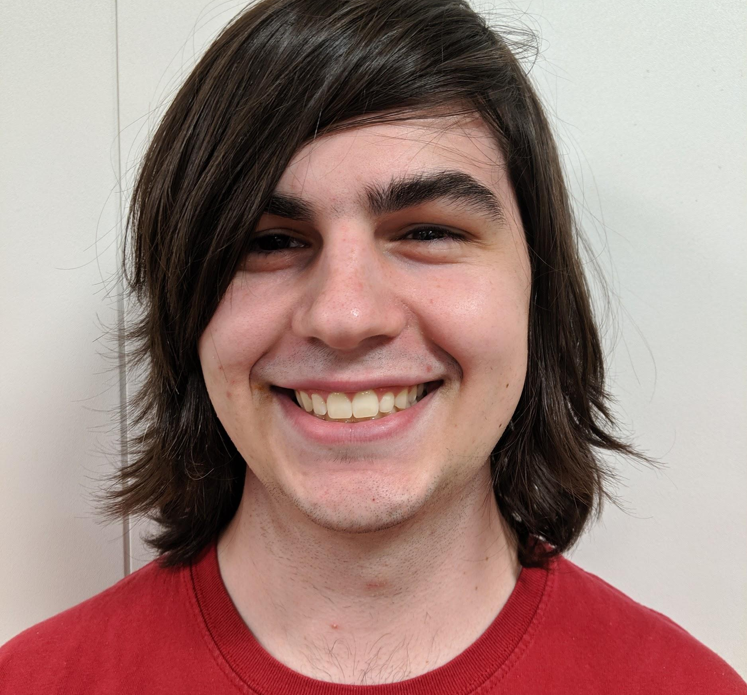
Meet the 2Fit Team!
Matthew Landis
Computer Science
Junior
Fun Fact: I love apple juice
Kaughlin Caver
Computer Science
Senior
Fun Fact: Singer/Songwriter
Akhil Jariwala
Business
MBA2
Fun Fact: I dance salsa!
Autumn Warren
Computer Science
Junior
Fun Fact: I can (kinda) play the uke
Notes:
This is my team

Slide 3
“To connect people with compatible fitness buddies.”
Notes:
The problem space we chose to tackle was local fitness
Our research question was: “How do people discover, practice, and commit to physical fitness in their local communities”
Our mission statement is To connect people with compatible fitness buddies.

Slide 4
Problem/ Solution Overview
Due to conflicting schedules, differing goals, and the intimidating gym atmosphere, exercisers often struggle to find and connect with a workout partner.
2Fit empowers users to connect with others who have similar abilities, goals, and schedules. Once matched, 2Fit helps workout partners reach their fitness goals together.
Notes:
The problem we are addressing consistd of difficulty of finding a workout buddy, and scheduling workouts with them. We came up with the solution to empower users to connect with other people who have similar abilities, goals, and schedules as them.

Slide 5
Overview
01
Heuristic Evaluation Results
02
Revised Design
03
Prototype Implementation
04
Demonstration

Slide 6
Heuristic Evaluation Overview
Level 3 severities: 15
Level 4 severities: 4
Major Design Changes: 3
Minor Design Changes: 3
Notes:
We had 15 level 3 severities and 4 level 4. To address these we made 3 major design changes and 3 minor design changes
-some were not addressed because we had not implemented those sections yet

Slide 7
Tools Used
React Native used to develop the app
Xcode iPhone simulator/expo used for testing
Before:
Users bypassed the schedule button and typed a message to schedule workouts. Users did not understand why the specific times were shown and felt limited in options.

Slide 8
Implementation
Completed!
Work Ahead
Before:
Find a Fitness Buddy
Task 1 - Find Buddy
Discover. Developed vertical scrolling interface for buddy selection with tappable buddy cards
Listings. Completed data architecture that fetches and displays relevant listings
Filter. Created active, dynamic filters that adjust search results based on user input
Bio. Developed main profile card view with key buddy details and connect functionality
Notes:
Scrolling
Data behind it
Working filter
Bios with details

Slide 9
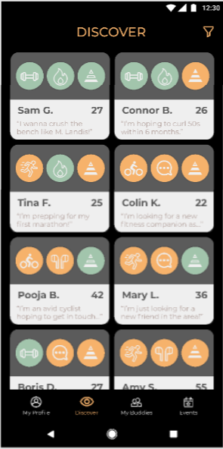
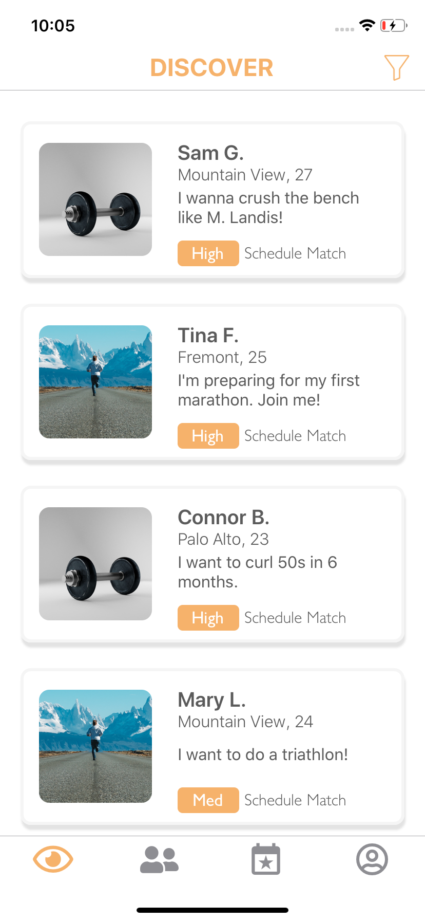
Major Design Change 1 - Discover
Type: H8 Aesthetics and Minimalist Design
Severity: 4
Issue: The discover page’s use of colors and icons is disorienting and confusing
Fix: Redesign a simpler Discover Page with minimal icons/colors
Old black background created a formal, energetic feel
New white background makes for a friendlier, casual feel
Notes:
Was disorienting and confusing -> made it simpler
White background

Slide 10
Major Design Change 1 - Discover
Type: H8 Aesthetics and Minimalist Design
Severity: 4
Issue: The discover page’s use of colors and icons is disorienting and confusing
Fix: Redesign a simpler Discover Page with minimal icons/colors
Double column presentation led to visual clutter
Streamlined presentation to single column format
Notes:
Single column format

Slide 11
Major Design Change 1 - Discover
Type: H8 Aesthetics and Minimalist Design
Severity: 4
Issue: The discover page’s use of colors and icons is disorienting and confusing
Fix: Redesign a simpler Discover Page with minimal icons/colors
Gratuitous icon use was overwhelming for user
Moved icons to bio and used single avatar photo instead
Notes:
I moved icons

Slide 12
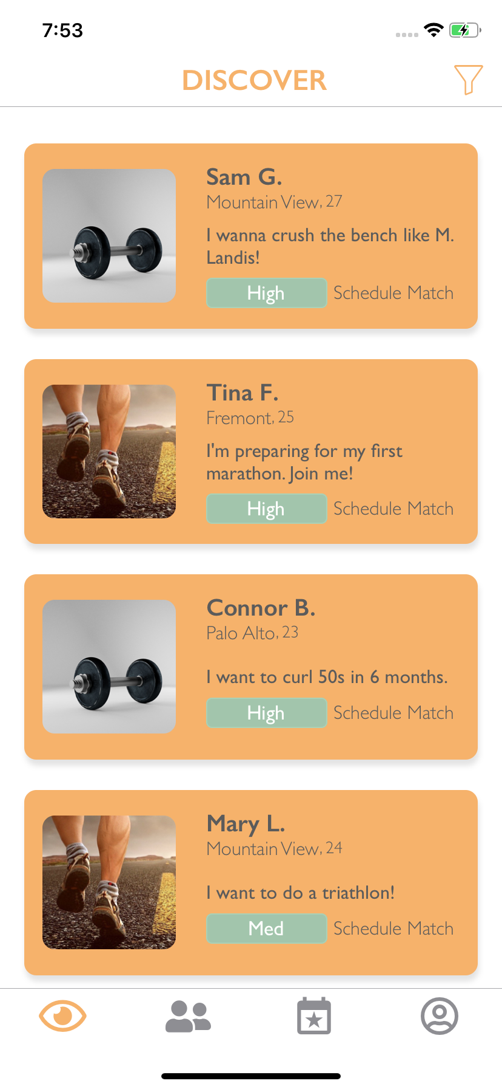
Major Design Change 1 - Discover
Type: H8 Aesthetics and Minimalist Design
Severity: 4
Issue: The discover page’s use of colors and icons is disorienting and confusing
Fix: Redesign a simpler Discover Page with minimal icons/colors
Use of orange and green accent colors led to confusion
Simplified to 3 colors, using orange as the only accent
Notes:
Accent colors

Slide 13
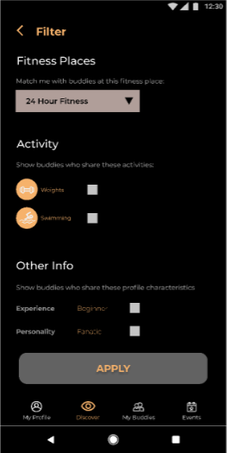
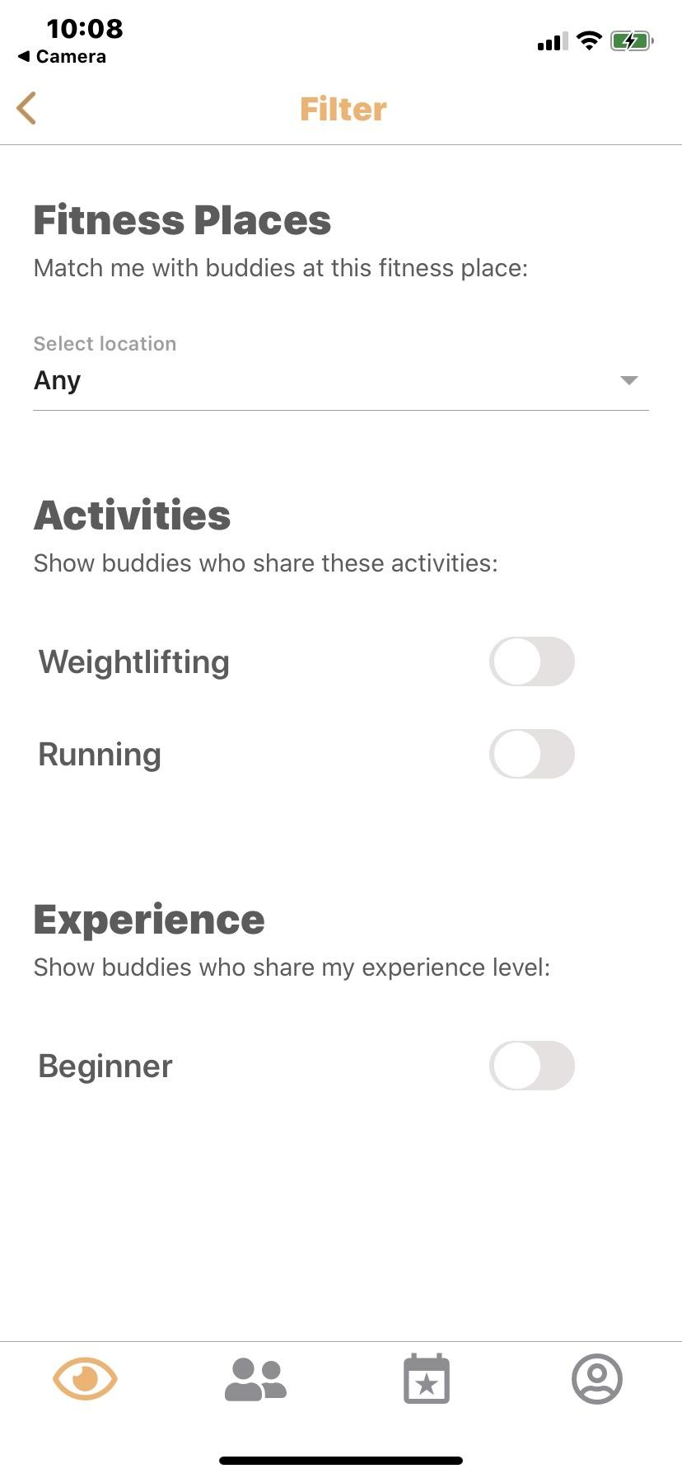
Major Design Change 2 - Filter
Type: H8 Aesthetics and Minimalist Design
Severity: 1
Issue: Discover filtering actions feel inconsistent and confusing
Fix: Simplify the filter page with on/off toggles that follow a consistent format
Checkboxes are not best for on/off filters, and unaligned
Toggle actions are right aligned and consistent
Notes:
-toggle are aligned and consistent

Slide 14
Major Design Change 2 - Filter
Type: H2 Match System and World
Severity: 1
Issue: Workout personality filter option is confusing to real-world concept
Fix: Simplify the filter page by eliminating the Workout Personality detail
Personality concept was confusing to filter on
Eliminated Workout Personality for simplification
Notes:
No workout personality

Slide 15
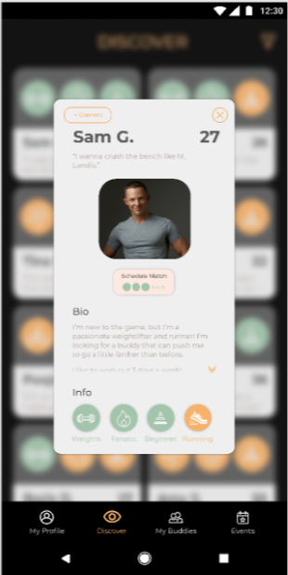
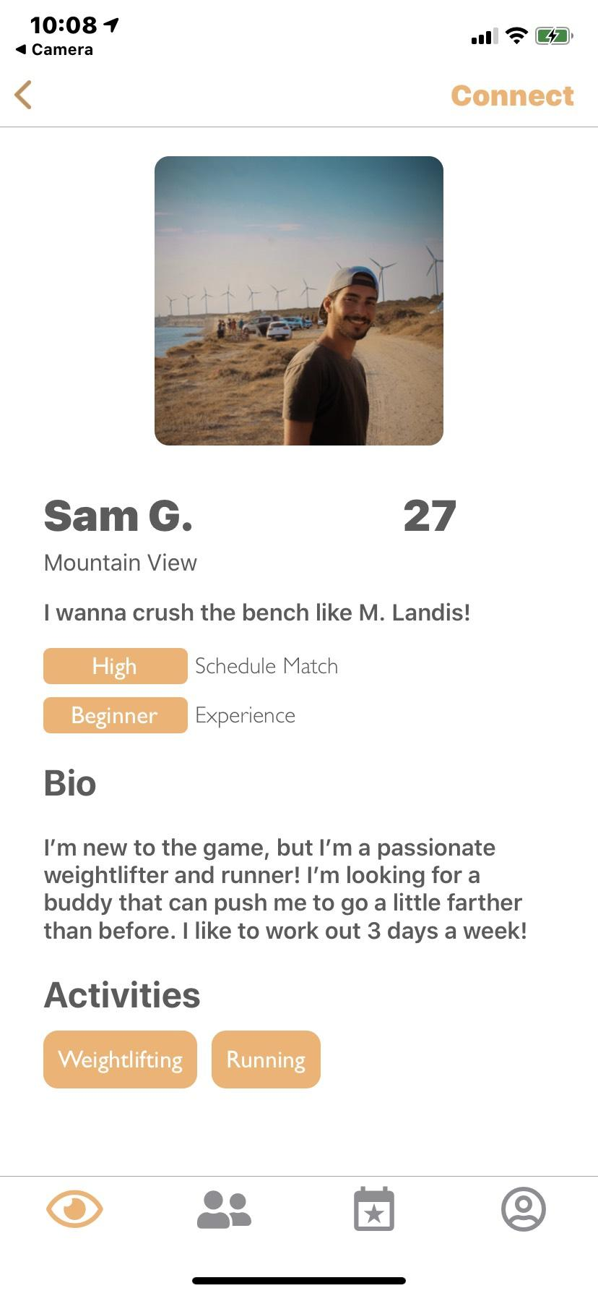
Major Design Change 3 - Buddy Profile
Type: H8 Aesthetics and Minimalist Design
Severity: 3
Issue: Connect button is difficult to see
Fix: Moved the connect button to the top right of the redesigned screen and bolded it
Connect button is difficult to see
Connect button now bolded, in a familiar place at the top
Notes:
Connect button

Slide 16
Major Design Change 3 - Buddy Profile
Type: H4 Consistency and Standards
Severity: 2
Issue: Schedule match score inconsistent with rest of bio design and takes up unnecessary space
Fix: Replaced schedule match box with a pill detail instead
Schedule match box inconsistent
Schedule match score now in consistent pill format
Notes:
Schedule match score matches

Slide 17
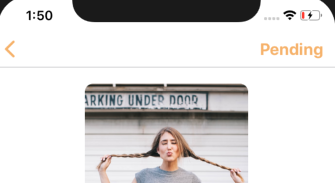
Minor Changes
Consistent color and font use
Redesigned Navigation Bar
Connection Status
After:
We wanted to make sure the users prioritize activities and workout personality and experience level before taking into consideration what other person looked liked

Slide 18
Implementation: Next Steps
Completed!
Work Ahead
Before:
Schedule Workouts
Join Group Events
Task 2- Schedule Workouts
Messaging interface with a schedule workout component
Task 3- Join Group Events
Discover events page
Beyond Tasks
User profile page
My events
Buddy/Events search (if time allows)

Slide 19
Hard coded Features
Users and Events
All user data and people that appear on the discover screen
Nearby events
The nearby locations on the filter list
Schedule overlap for buddy and user
Message history

Slide 20
Wizard of Oz Techniques
When you request a buddy, we simulate the buddy’s automatic matching response
When you schedule a workout, we simulate the buddy automatically confirming your requested time

Slide 21
Issues
Implementing scheduling interface
Keeping track of data

Slide 22
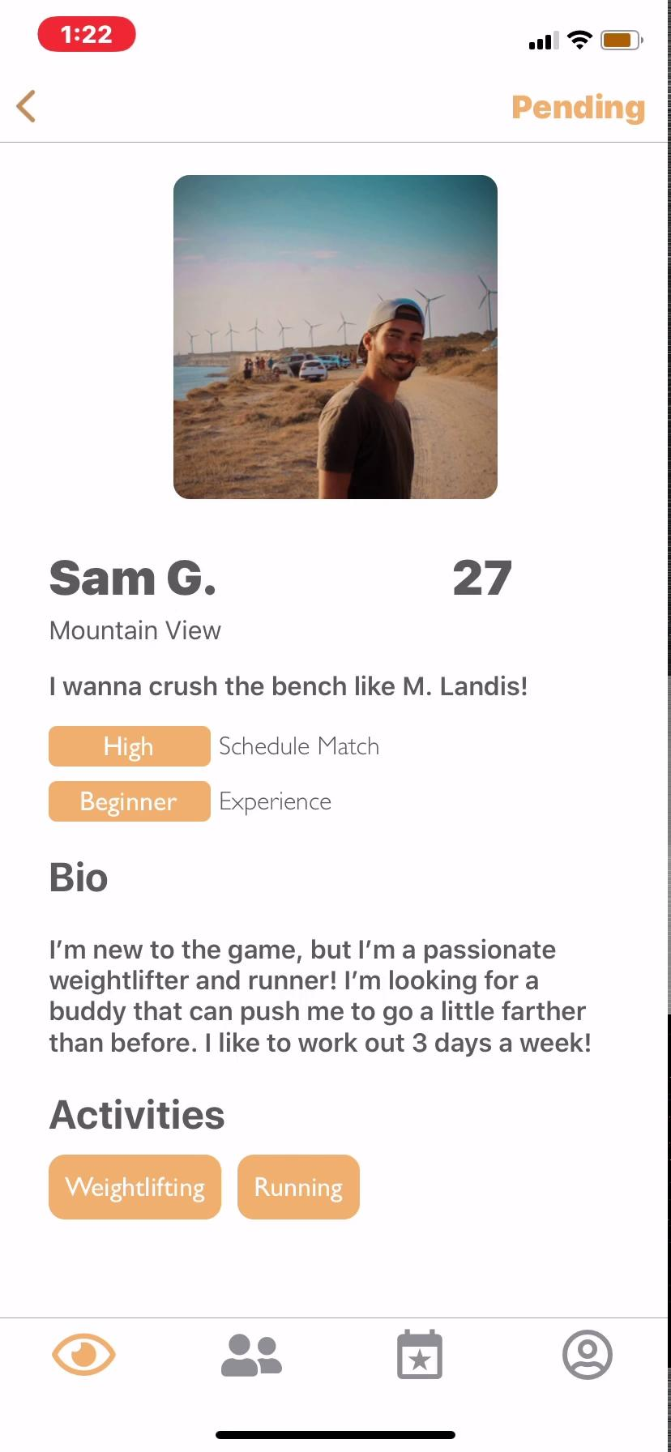
Demo

Slide 23
Summary
Started development of our Hi-Fidelity Prototype in React Native
Incorporated key recommendations from the Heuristic Evaluation to Discover, Filter, and Bio screens
Work ahead includes developing the scheduling interface, organizing events, and other supporting features

Slide 24
Thank you
From the 2Fit team

