Slide 1
- Fit Together -
Akhil Jariwala, Matthew Landis,
Autumn Warren, Kaughlin Caver
Online/Local Community
November 1, 2019

Slide 2
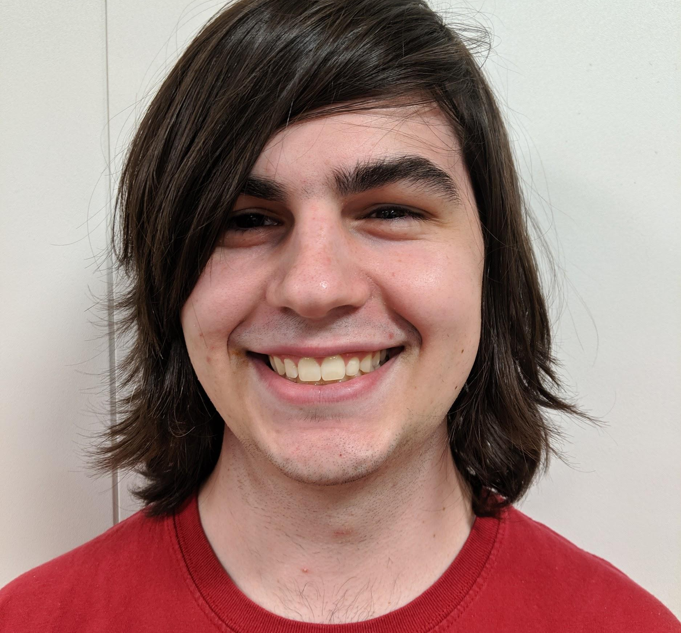
Meet the 2Fit Team!
Matthew Landis
Computer Science
Junior
Fun Fact: I love apple juice
Kaughlin Caver
Computer Science
Senior
Fun Fact: Singer/Songwriter
Akhil Jariwala
Business
MBA2
Fun Fact: I dance salsa!
Autumn Warren
Computer Science
Junior
Fun Fact: I can (kinda) play the uke

Slide 3
Outline
01
Value Proposition, Problem, Solution
02
Tasks
03
Revised Interface Design
04
Prototype Overview

Slide 4
Problem/ Solution
Notes:
Design Changes
Brand new task
Changed how they choose they workout
Card Heuristic

Slide 5
Problem/ Solution Overview
Due to conflicting schedules, differing goals, and the intimidating gym atmosphere, exercisers often struggle to find and connect with a workout partner.
2Fit empowers users to connect with others who have similar abilities, goals, and schedules. Once matched, 2Fit helps workout partners reach their fitness goals together.
- Fit Together -

Slide 6
3 Tasks

Slide 7
Tasks
Find compatible fitness buddies
complex
Schedule joint workouts
medium
Join and host group fitness events
simple
Notes:
We removed ‘send messages of support’ as a top task and replaced it with ‘Join and host group fitness events’

Slide 8
Revised Design
Notes:
Design Changes
Brand new task
Changed how they choose they workout
Card Heuristic

Slide 9
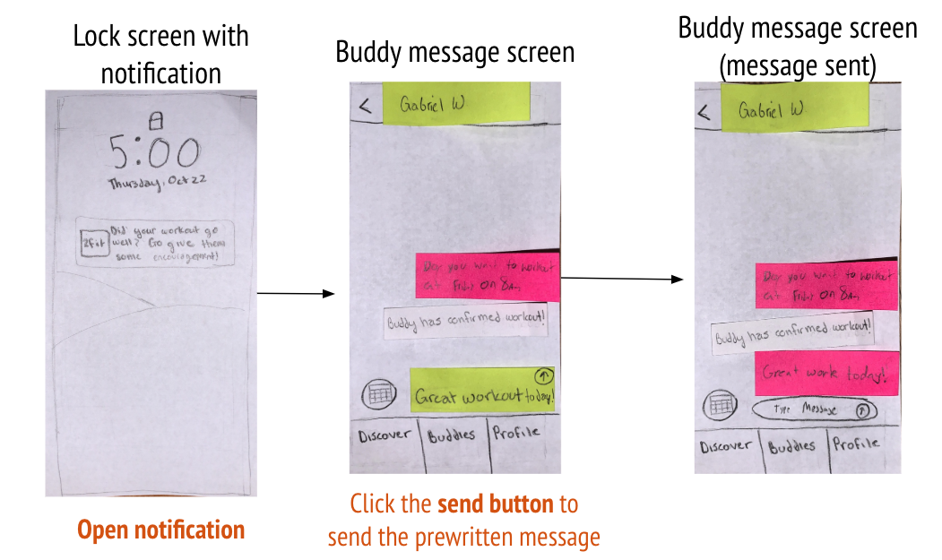
Change 1: Demoted Support task & Added Group Events
Before:
Users did not understand the importance of the support feature. Users stated the support task was too simplistic and wanted access to group oriented fitness activities.
Notes:
Each subject who tested the support task preferred writing a message rather than sending the default support message.
We received feedback on our low Fi prototype that the support task was too simplistic.

Slide 10
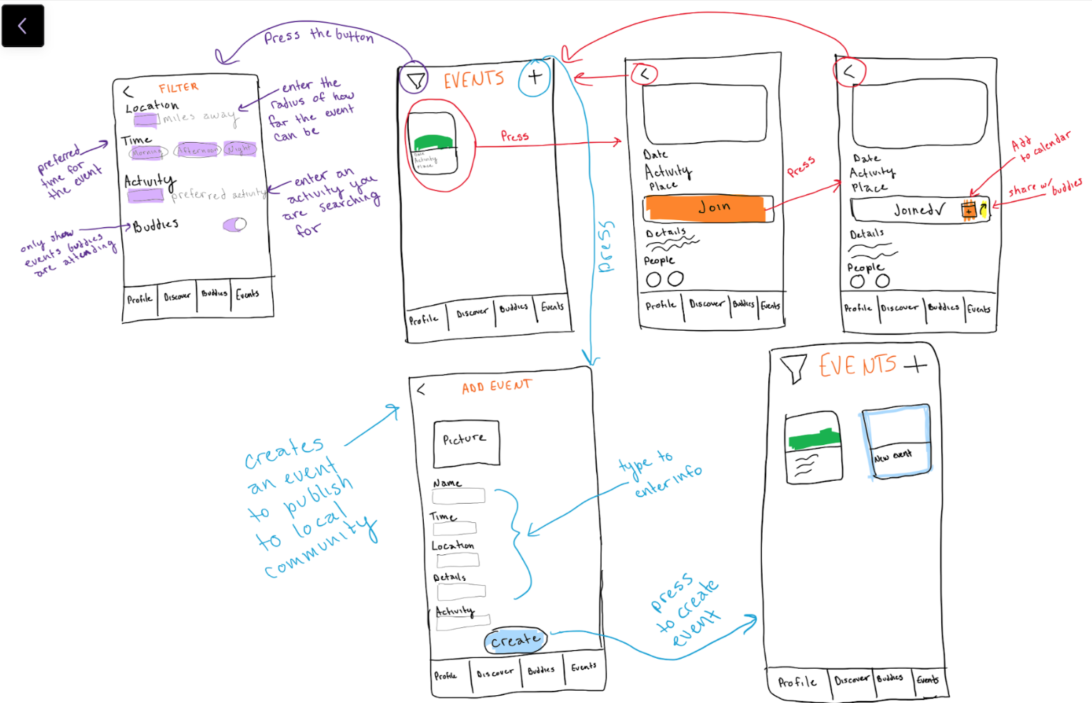
Change 1: Demoted Support task & Added Group Events
After:
We implemented a new task where users can join and host group fitness events. The support feature is now at a lower priority in our design. This allows for users to benefit from group events rather than just one to one buddy matching.
Notes:
We implemented a new task where users can join and host group fitness events.
This allows for users to benefit from group events rather than just one to one buddy matching.
The support feature is now at a lower priority in our design but is not discarded from the application.

Slide 11
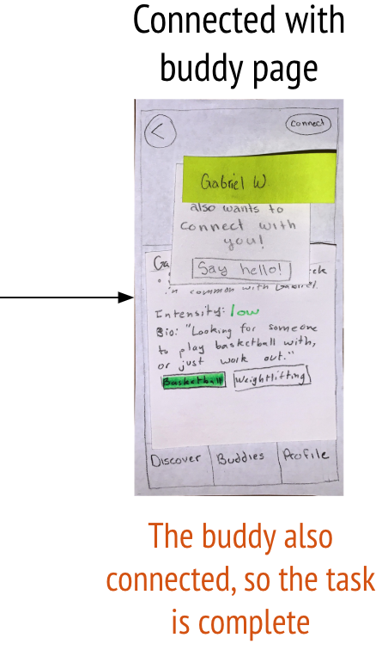
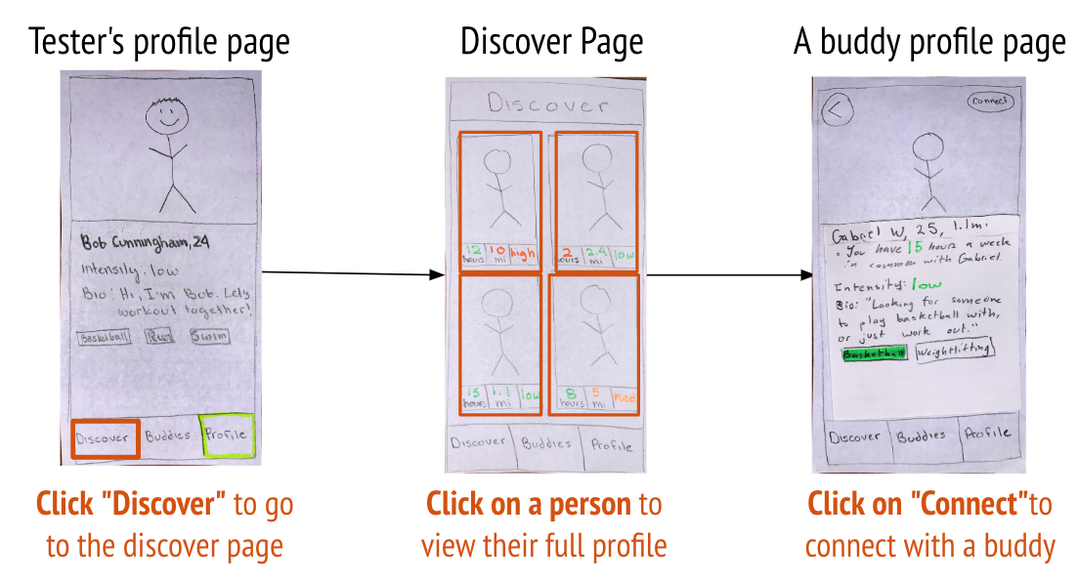
Change 2: Revised Design of Tile Heuristics
Before:
Users were confused about the meaning behind the mile and hours details on the tiles. Users also had a difficult time matching with a partner because there were so many options with no filtering preferences available.
Notes:
We realized detail clarification was an important necessity for our application. Subjects were confused by the ‘miles’ and ‘hours’ details which were supposed to indicate distance away and hours of schedule compatibility. Distance away was an unuseful detail, which we will fold into filtering.
Filtering preferences also needs to be an important part of our matching process. Subjects wanted to know if the match partner was available to work out at their preferred workout spot, as opposed to if they were nearby.

Slide 12
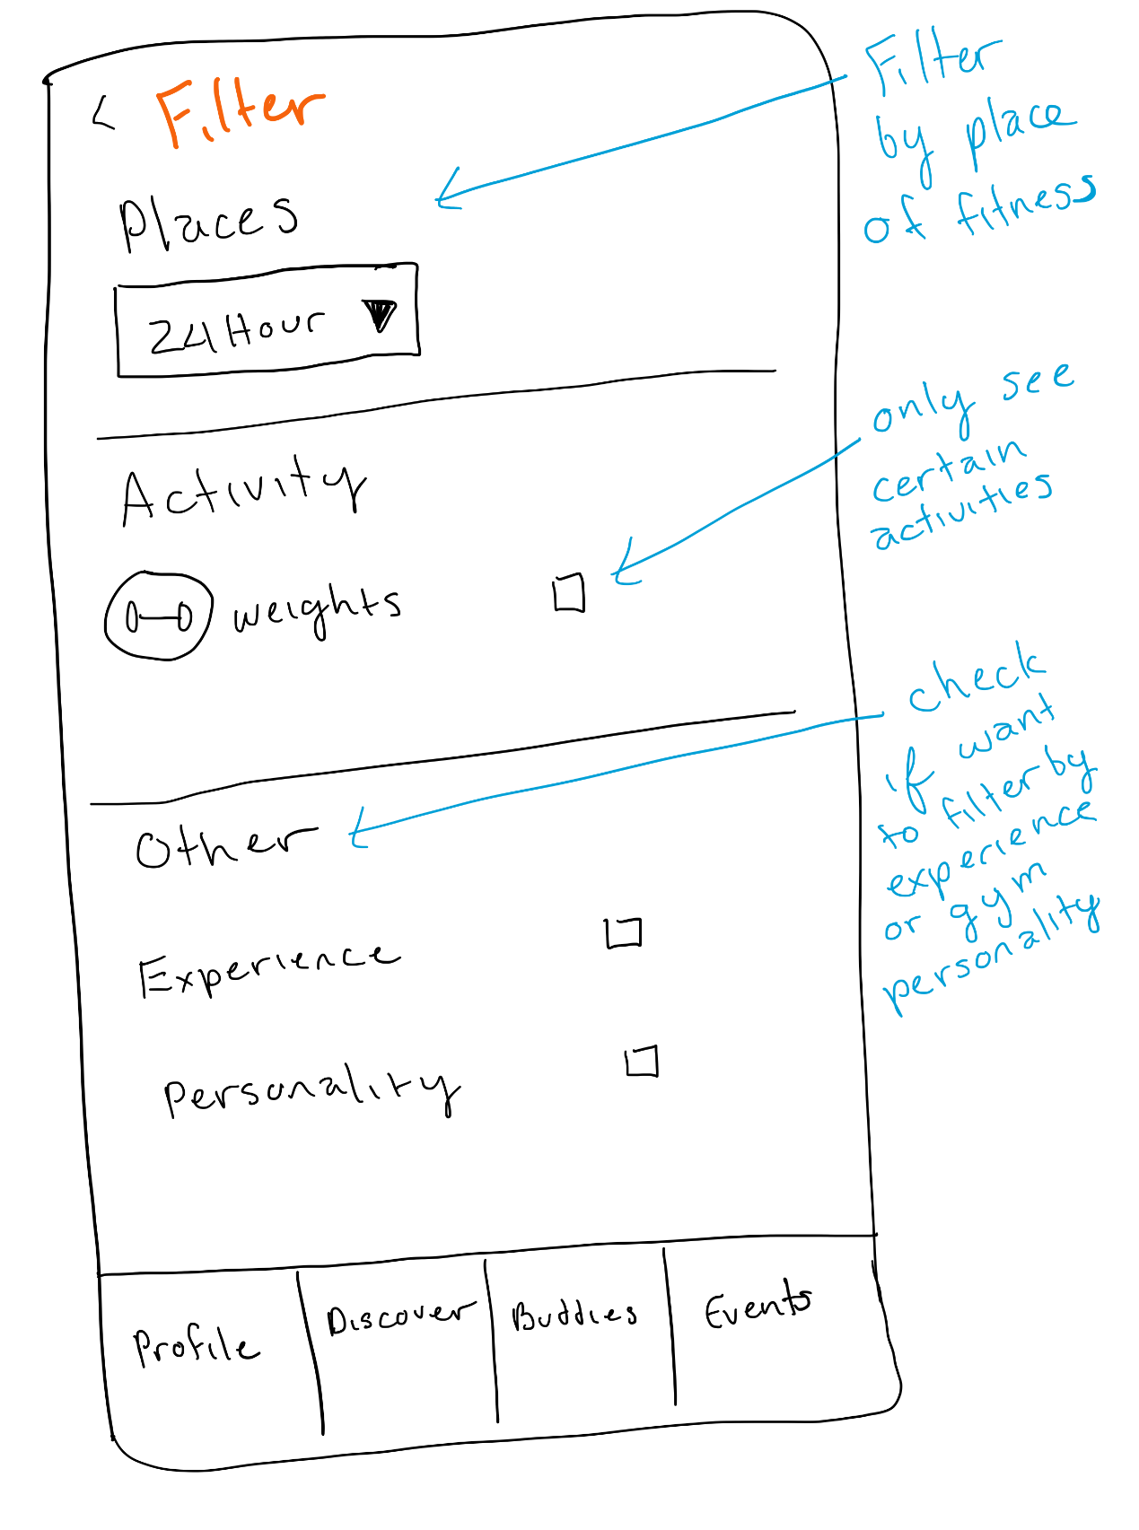
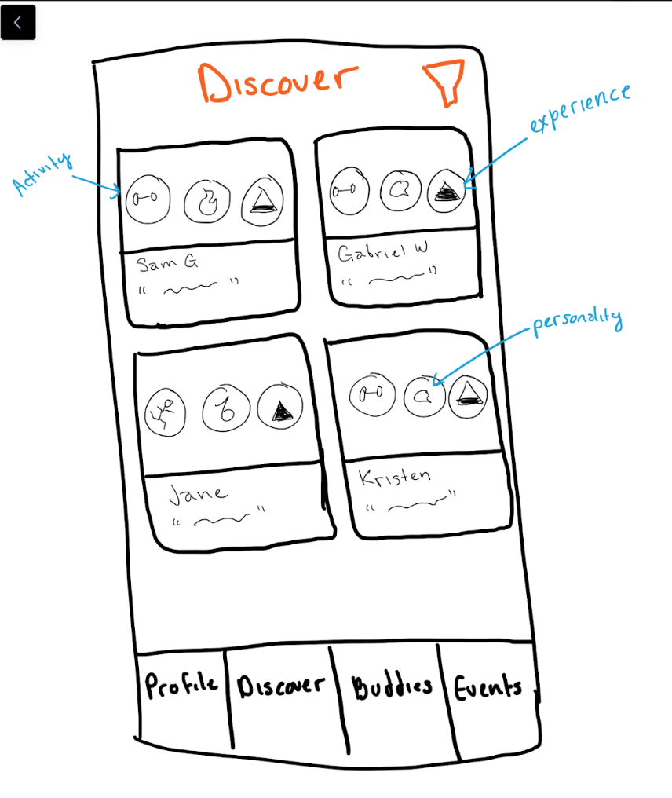
Change 2: Revised Design of Tile Heuristics
After:
We wanted to make sure the users prioritize activities and workout personality and experience level before taking into consideration what other person looked liked
Notes:
We removed profile photos from the main discover screen to ensure users would focus on the common workout attributes they shared and less on pictures.
We decided to simplify the buddy selection process by pre-filtering for buddies that had shared fitness places. We removed ‘distance away’ as a heuristic because it wasn’t useful to the user.
We also removed ‘hours in common’ and replaced that with a high-medium-low schedule score heuristic on the profile page.
Within filtering, we allowed users to filter for other details, including their experience level and workout personality

Slide 13
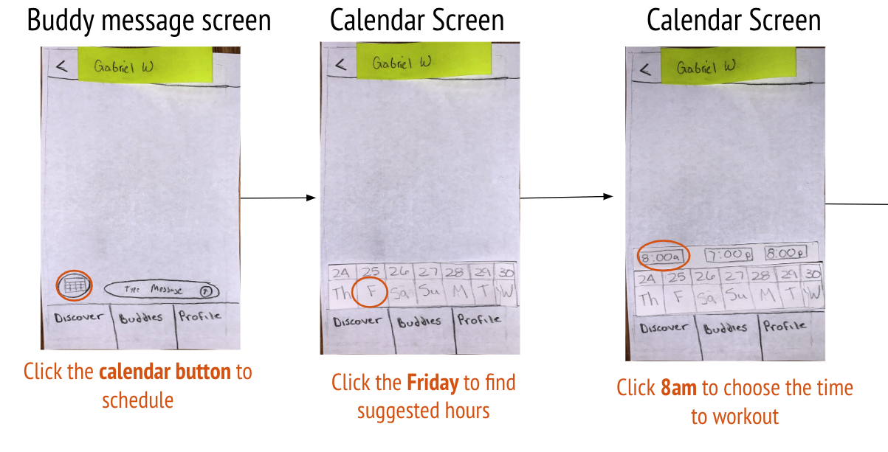
Change 3: Scheduling interface improvements
Before:
Users bypassed the schedule button and typed a message to schedule workouts. Users did not understand why the specific times were shown and felt limited in options.
Notes:
We realized improvements need to be made for our scheduling task design. Subjects forewent the schedule button in favor of sending their own unstructured time request. In addition, subjects didn’t understand where the proposed times came from when scheduling a workout. Subjects were also confused where they were going to work out and meet up with their partner. We will remedy this with a workout location selector atop the new intermediate schedule screen.

Slide 14
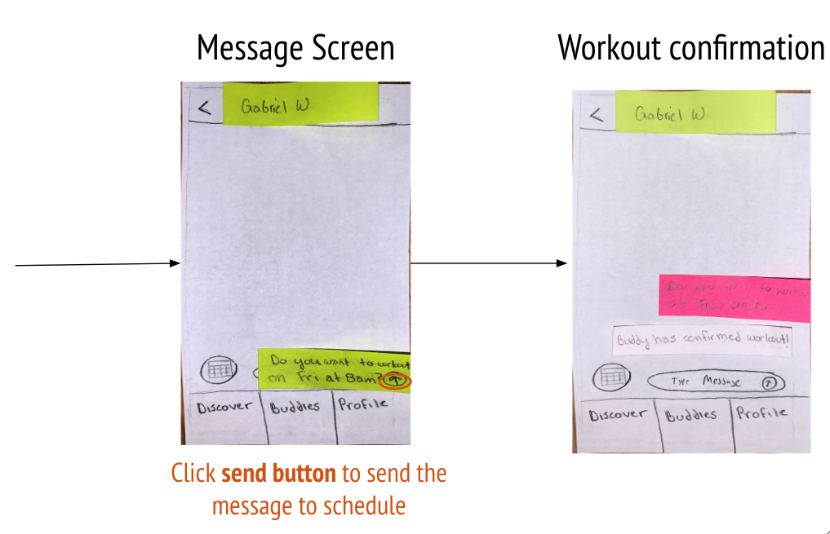
Change 3: Scheduling interface improvements
Before:
Notes:
We realized improvements need to be made for our scheduling task design. Subjects forewent the schedule button in favor of sending their own unstructured time request. In addition, subjects didn’t understand where the proposed times came from when scheduling a workout. Subjects were also confused where they were going to work out and meet up with their partner. We will remedy this with a workout location selector atop the new intermediate schedule screen.

Slide 15
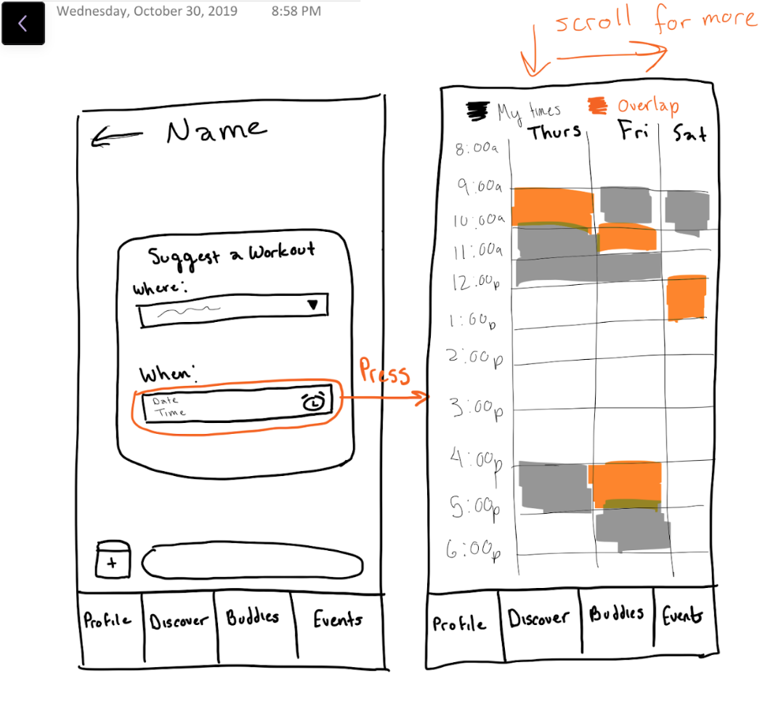
Change 3: Scheduling interface improvements
After:
We implemented a schedule design that provides the user with more options and clearly clarifies the overlaps in available times between the user and buddy
Notes:
We implemented a schedule design that provides the user with more options and clearly clarifies the overlaps in available times between the user and buddy. Subjects will now know what the proposed times (overlaps in schedule) mean and will have more variety to choose from. We also implemented a where option so that users can schedule a place to workout with their buddy in addition to the time.

Slide 16
Task
Flow 1

Slide 17
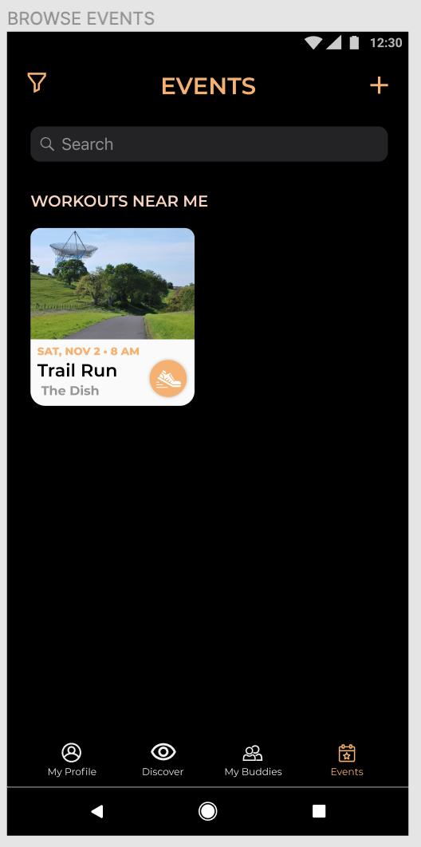
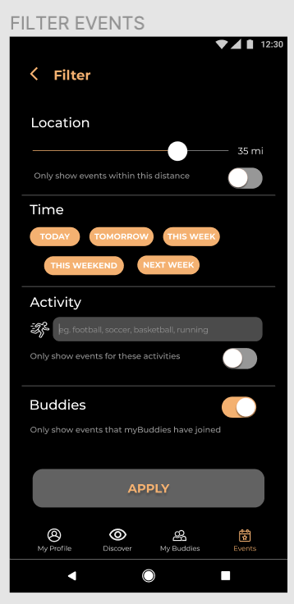
Task Flow 1: Filter event
Notes:
The user can click the filter button to go to the filter screen that allows them to filter events based on location distance, time, activity, and whether or not a buddy is going

Slide 18
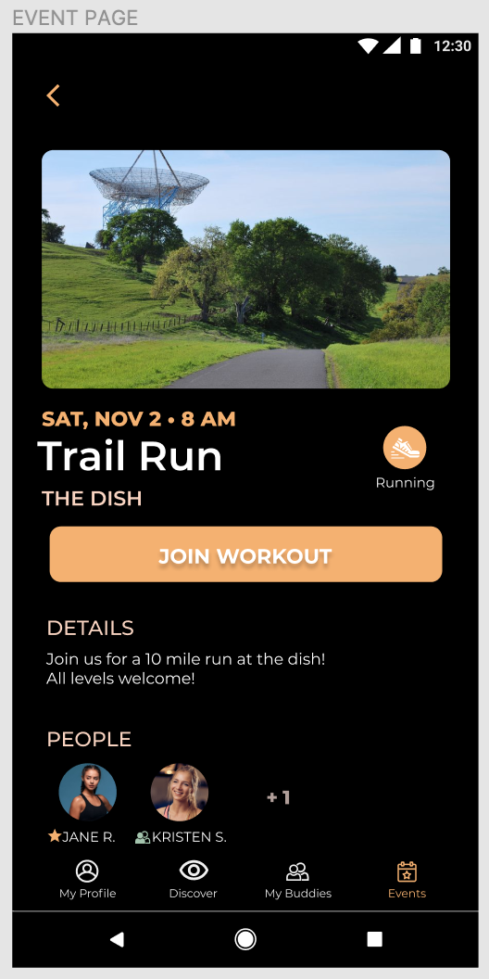
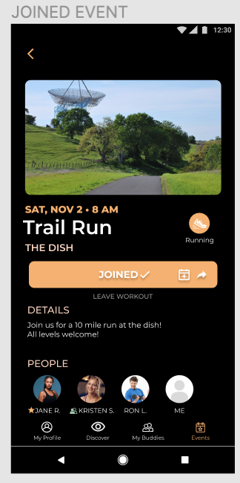
Task Flow 1: Joining Event
Notes:
This continuation of the task includes the ability to join a posted event. The subtasks of this task includes adding the event to their schedule and sharing it with buddies. This task has a simple flow that includes pressing the "join workout button". Once this is pressed the rest of the people that have joined are displayed and a person can add it to their calendar.

Slide 19
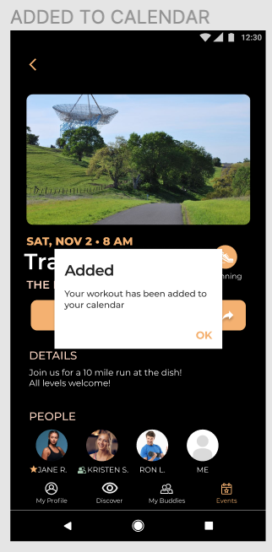
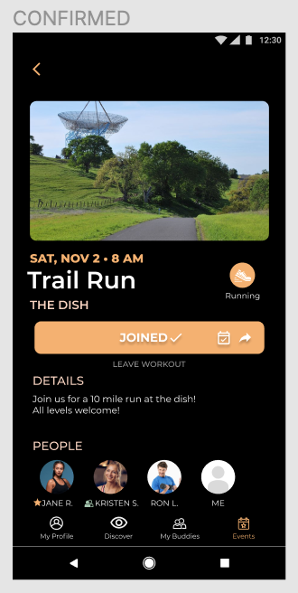
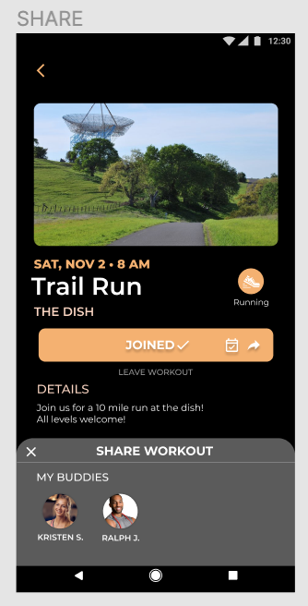
Task Flow 1: Joining Event Continued
Notes:
The user can also share this event with buddies by clicking the "Share button" then the option to send the workout to their already connected buddies pops up.

Slide 20
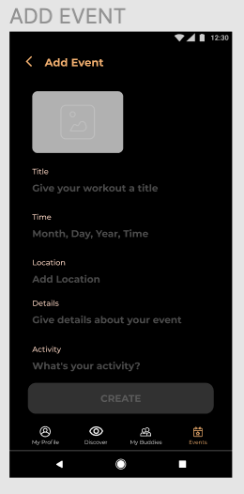
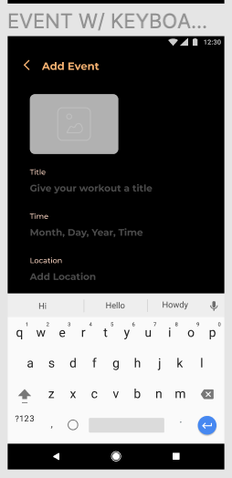
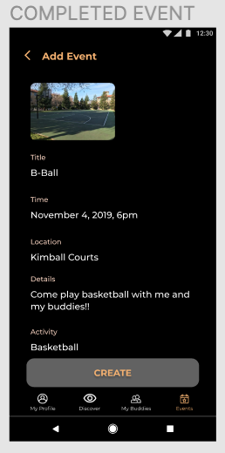
Task Flow 1: Host Event
Notes:
This task also includes the ability to host an event. An event can be created using the "+"button on the main screen. Once this is chosen, this first screen pops up which allows the user to enter information about their event, including a picture. The user can then create the event to post.

Slide 21
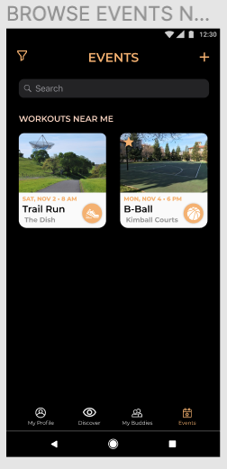
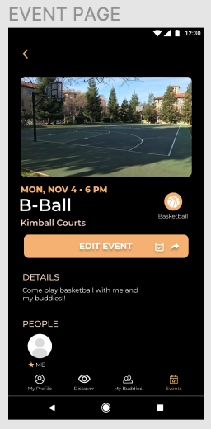
Task Flow 1: Host Event Continued
Notes:
Once the event is posted, the user can see their hosted event (denoted with a star) and edit it if necessary.

Slide 22
Task
Flow 2

Slide 23
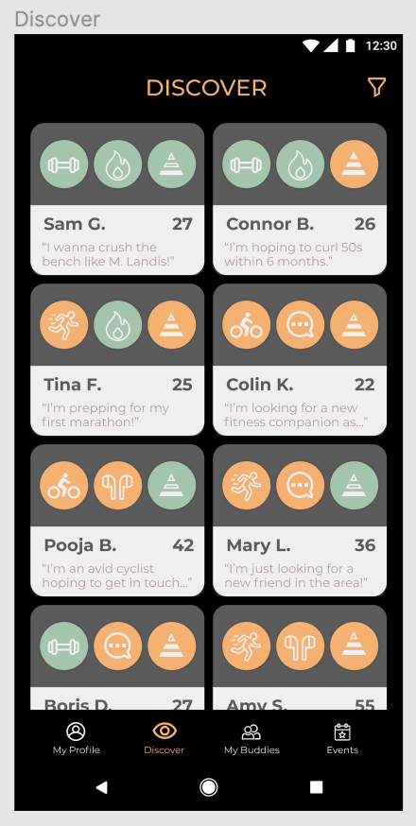
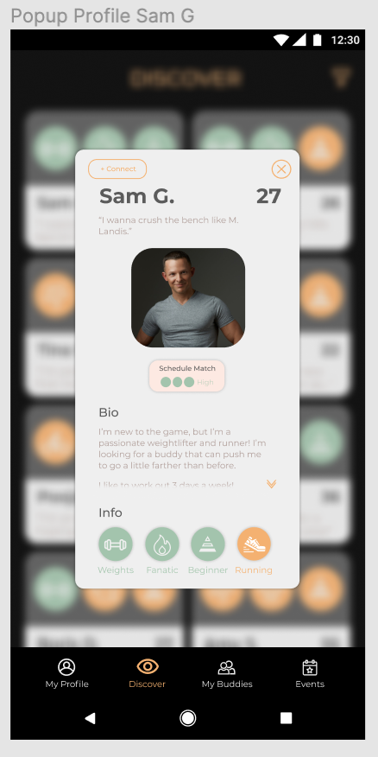
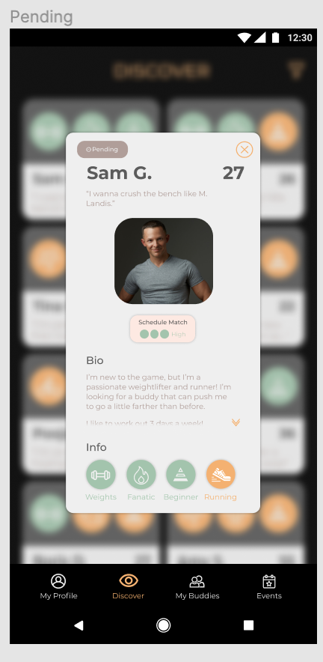
Task Flow 2: Discover Fitness Buddies
Notes:
When the user lands on the discover tile, they are presented with a host of options of possible fitness buddies to match with. On the discover page, users are provided with each buddy’s name, age, and goal statement. The user is also presented with three buddy details (1) the buddy’s top activity, (2) the buddy’s workout personality, and (3) the buddy’s experience level.
Buddy workout personalities can vary from socialyte to focused to fanatic. Buddy experience levels vary from beginner to intermediate to advanced. Buddy activities vary widely from weights to running to cycling.
The users tap on a buddy card to pull up more information about the potential match. The buddy profile popup contains additional information such as the buddy’s picture as well as their schedule match heuristic (high-medium-low) and a short bio.
The user can tap the + Connect button at the top let to propose a connection with a potential fitness buddy. While the buddy is considering the request, the button reflects a pending status.

Slide 24
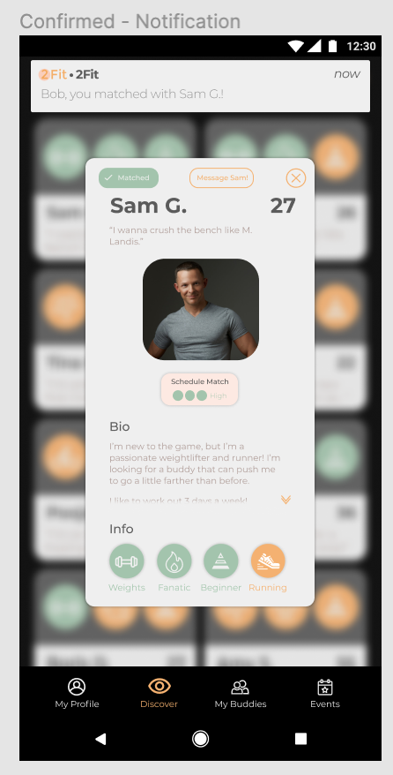
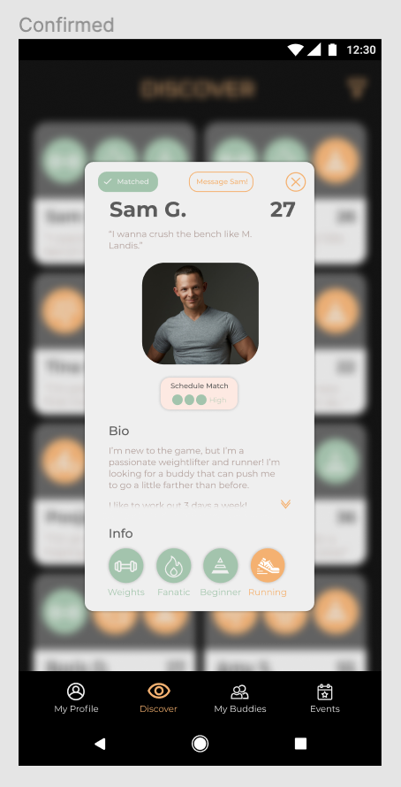
Task Flow 2 Continued
Notes:
When the fitness partner confirms, the buddy receives a popup notification that they have a new match.
The buddy may then tap to message their buddies using the ‘Message Sam’ button that appears on the popup profile card.

Slide 25
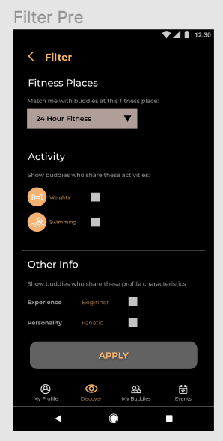
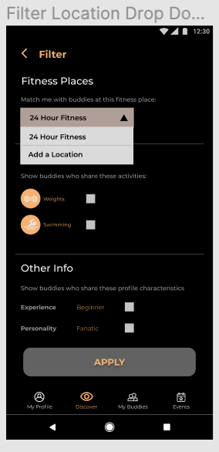
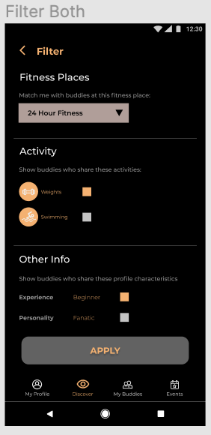
Task Flow 2: Filter Fitness Buddies
Notes:
By default, 2Fit filters for buddies who share a fitness place in common with you. Users may add to this default filter by tapping the filter button at the top right of the screen.
In the filter menu, users may select a different fitness place if they so choose. Users may also apply new filters if they want to limit their matches to buddies who either share a common activity with them or share other workout characteristics with them.

Slide 26
Task
Flow 3

Slide 27
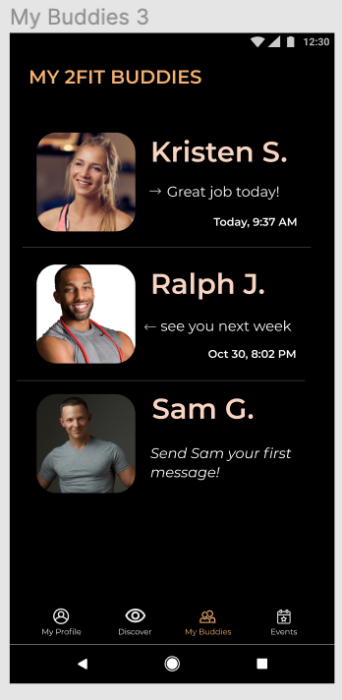
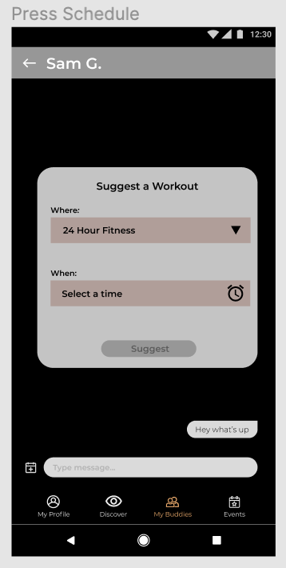
Task Flow 3
Notes:
For the scheduling task, we start the user in their “my buddies” screen.
Then, they click on their newly-added buddy, Sam G, which navigates to the messaging screen.
3 . After clicking the “type message” box to send an initial message, they can press the calendar icon next to the messaging box to schedule a workout.
4. This brings up a “Suggest a Workout” template, which allows the user to select a time and location.

Slide 28
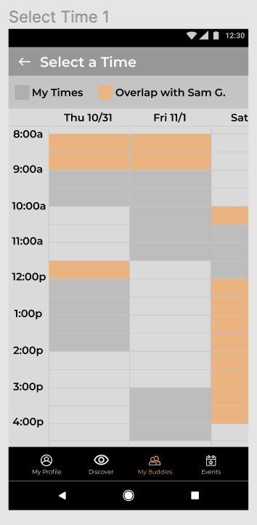
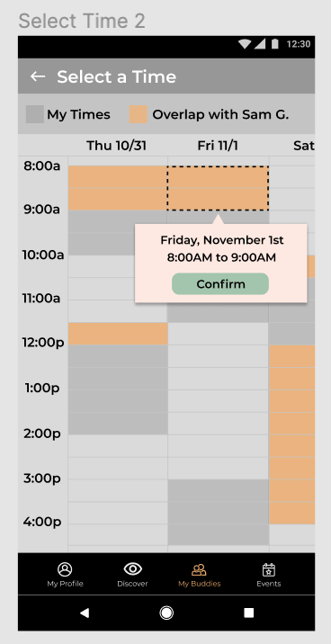
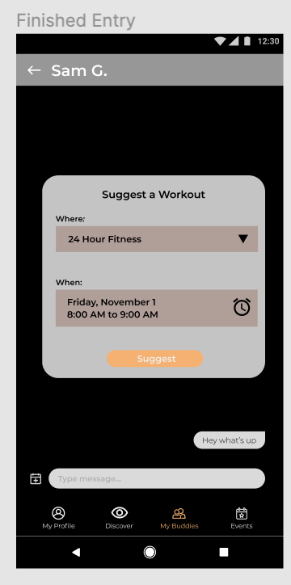
Task Flow 3
Notes:
If the user chooses to select a new time (ostensibly, it would be pre-populated with the previous time they worked out with this person, if there is one), it brings them to this “select a time” screen. This screen displays the user’s free time based on the weekly schedule they’ve entered, as well as seeing highlighted the times where their free time overlaps with their partner’s.
By long pressing and then dragging, the user can select a time slot (presumably one that overlaps, but it doesn’t have to). This will show a popup confirmation in words what time they have selected, and if they press the confirm button, this time is entered into the suggestion window.
The user has filled out the required fields and can now press suggest.

Slide 29
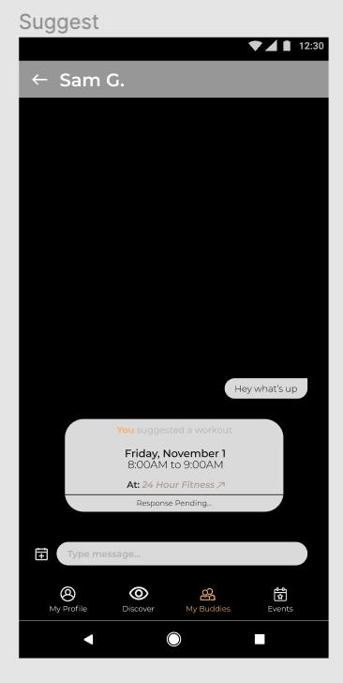
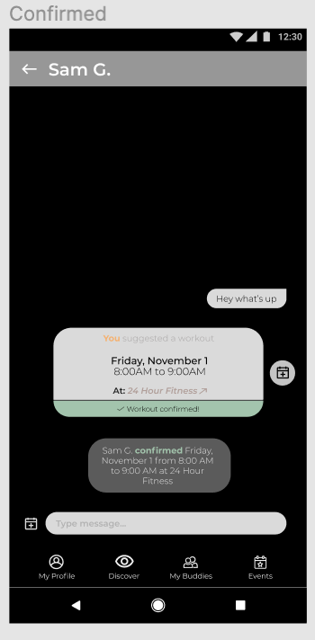
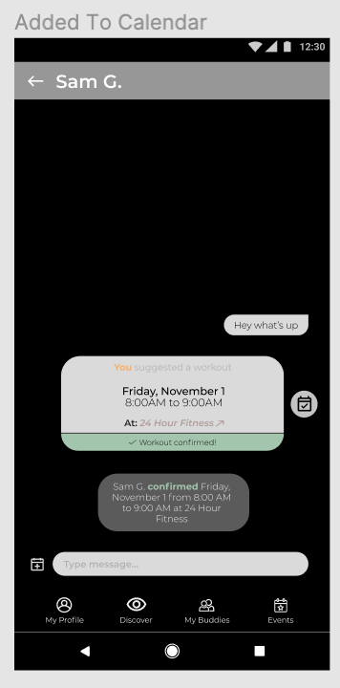
Task Flow 3
Notes:
By pressing “Suggest”, an invite block is sent to the other person, which in this case gets confirmed by Sam G (on his screen, the “Response pending” would be replaced with button options to accept, reject, or reschedule).
Once Sam G. confirms the workout, in addition to the “Response pending” turning green and changing to “workout confirmed,” a status message appears in chat.
Once a workout is confirmed, both parties are able to add it to their (google) calendar via the small calendar bubble that appears to the side.

Slide 30
Prototype Overview

Slide 31
Prototype tools
Tools Used:
Figma
What was easy?
Very easy design and prototyping software.
Has clear optimizations for ease of use.
What was hard?
Did not allow for scrolling
Fixed path between screens thus you can not try every profile in a flow
Did not allow for user to input data.

Slide 32
Limitations/ Tradeoffs of current prototype
Our prototype only allows for a user to travel through a single flow in the matching process.
Users must use the profile we provide to them and can not create their own profile.
In the schedule selection section users can only view their schedule and the overlaps with the partner schedule. User can not view full partner schedule.
Users can not adjust the preset filters to their preferences.
Notes:
Single flow for users.
We can only see your schedule and overlap for schedule selection
User schedule overlaps of both schedules and not the schedule of the matched partner
Filters are available more for display rather than action being able to be adjusted
Can not create profile, Fixed partner to match with, Fixed person to message, Nothing you do is saved because no data storage, You can not share with friends, You can not apply filters, Can not export to calendar, You must Choose Default Location

Slide 33
Wizard of Oz Techniques/ Hard coded Features
All user profile data (such as user schedule) are hardcoded because figma does not allow for a user to input data and there is no backend with a database of user information.
Users must follow a fixed path through our prototype. For example they are only able to view Sam G.’s profile and there is a fixed time slot they can match with Sam G. on.
We also had to hardcode the inter-user interactions, such as match acceptance and buddy messaging.
Notes:
We don't have any Wizard of Oz features, but we do have several hardcoded features. We created a mock profile for the user, mock users, and mock descriptions. For example, there is only one buddy the user can match and schedule with. The user can also only choose one day and time for the scheduling task. In addition, there is only one event the user can join. Finally to add an event, all the user inputs are predetermined.

Slide 34
Thank you
From the 2Fit team

