Slide 1
- Fit Together -
Akhil Jariwala, Matthew Landis,
Autumn Warren, Kaughlin Caver
Online/Local Community
October 25, 2019

Slide 2
Outline
01
Mission Statement
02
Prototype Structure
03
Experiment & Results
04
Proposed Changes

Slide 3
-Fit Together-
“To connect people with compatible fitness buddies.”
Notes:
The problem space we chose to tackle was local fitness
Our research question was: “How do people discover, practice, and commit to physical fitness in their local communities”
Our mission statement is To connect people with compatible fitness buddies.

Slide 4
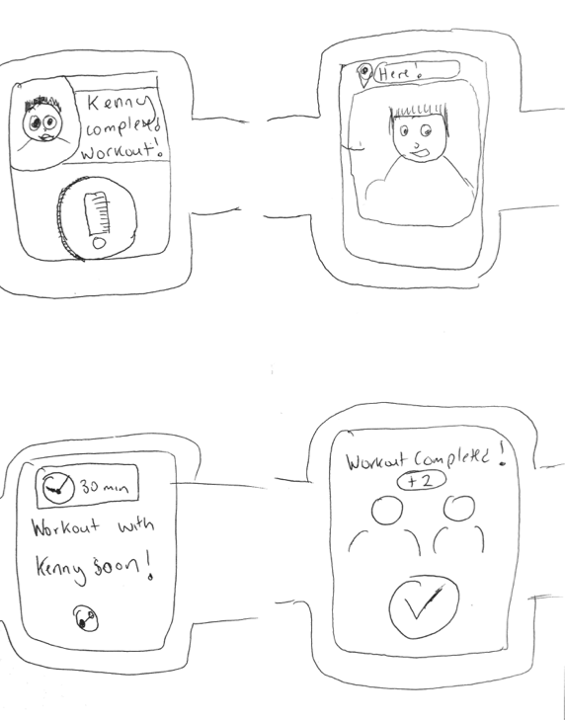
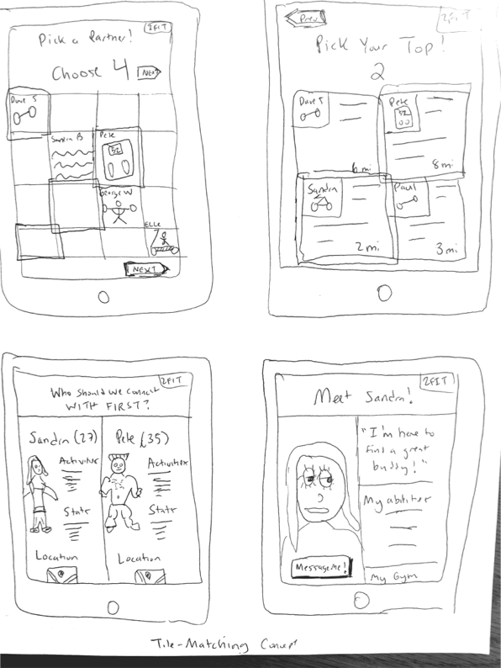
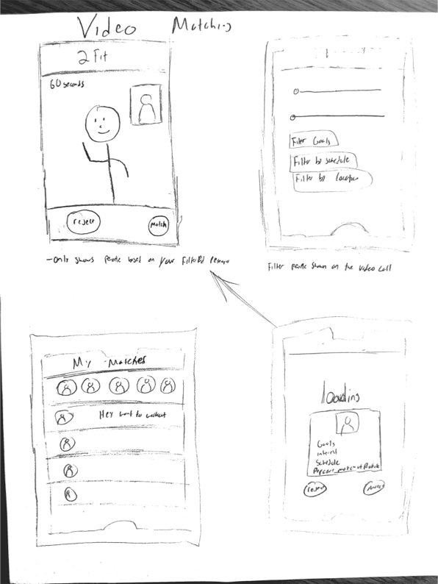
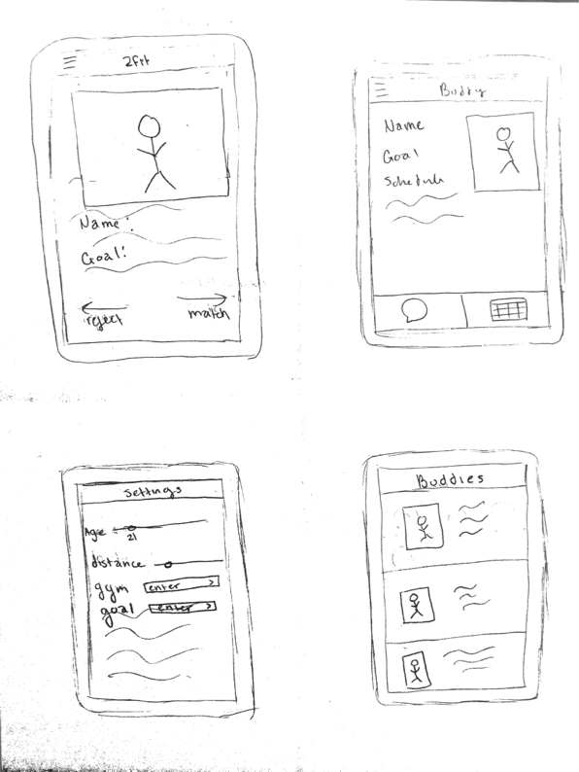
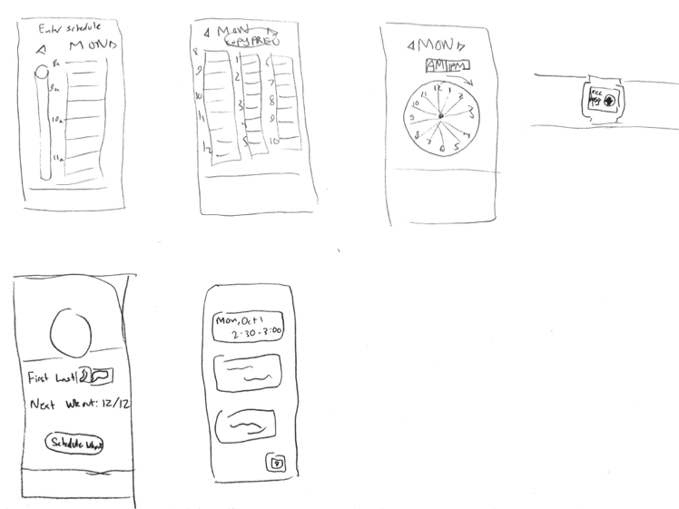
Interface Sketching

Slide 5
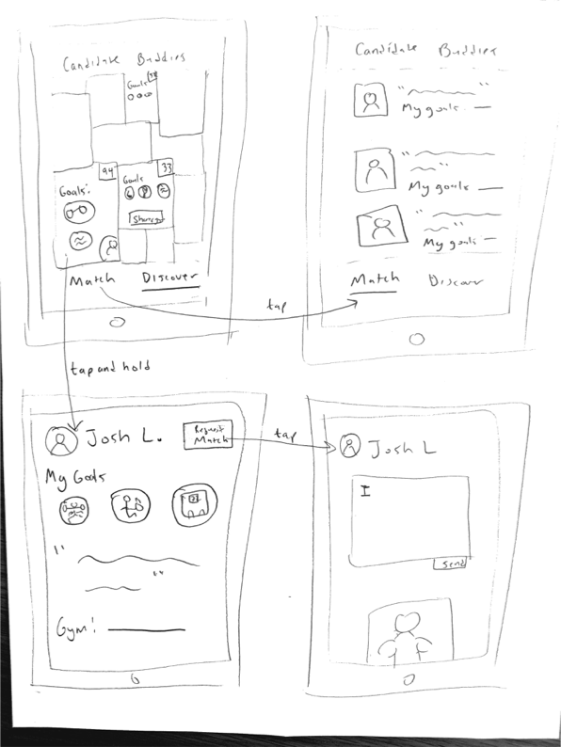
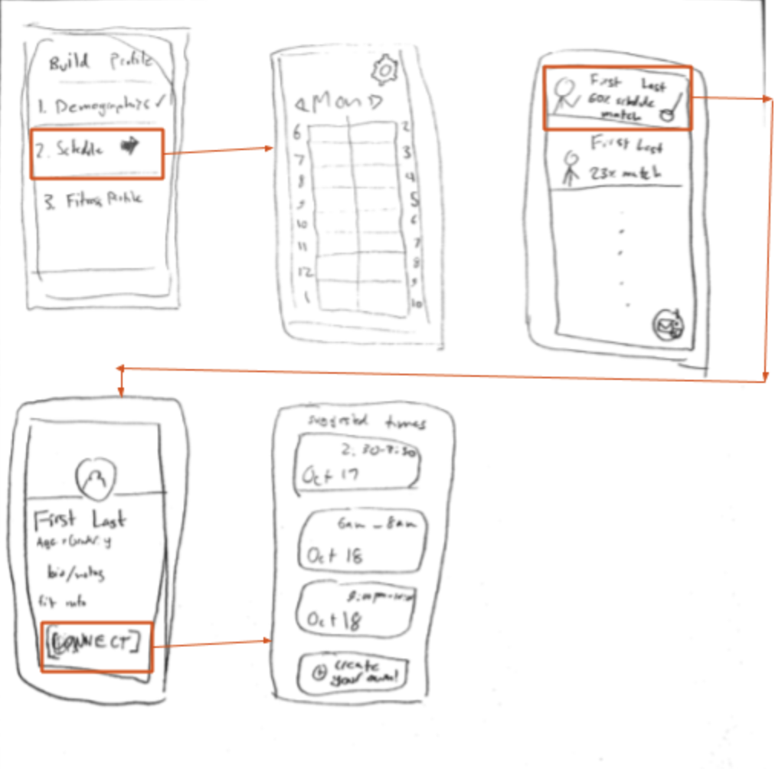
Interface Sketching

Slide 6
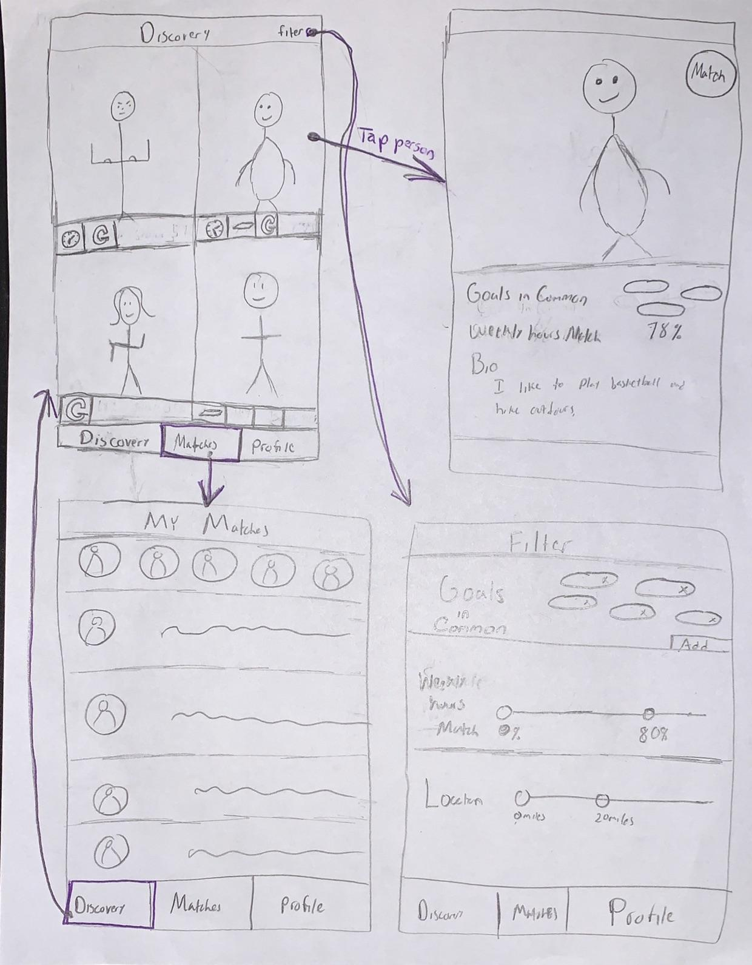
Selected Interface
Pros:
- Complex schedule entry leads to easy workout scheduling
- Intuitive scrolling system
Cons:
- Hard to tell a good fit at a glance

Slide 7
Tasks
Find compatible fitness buddies
complex
Schedule joint workouts
medium
Support and hold each other accountable
simple

Slide 8
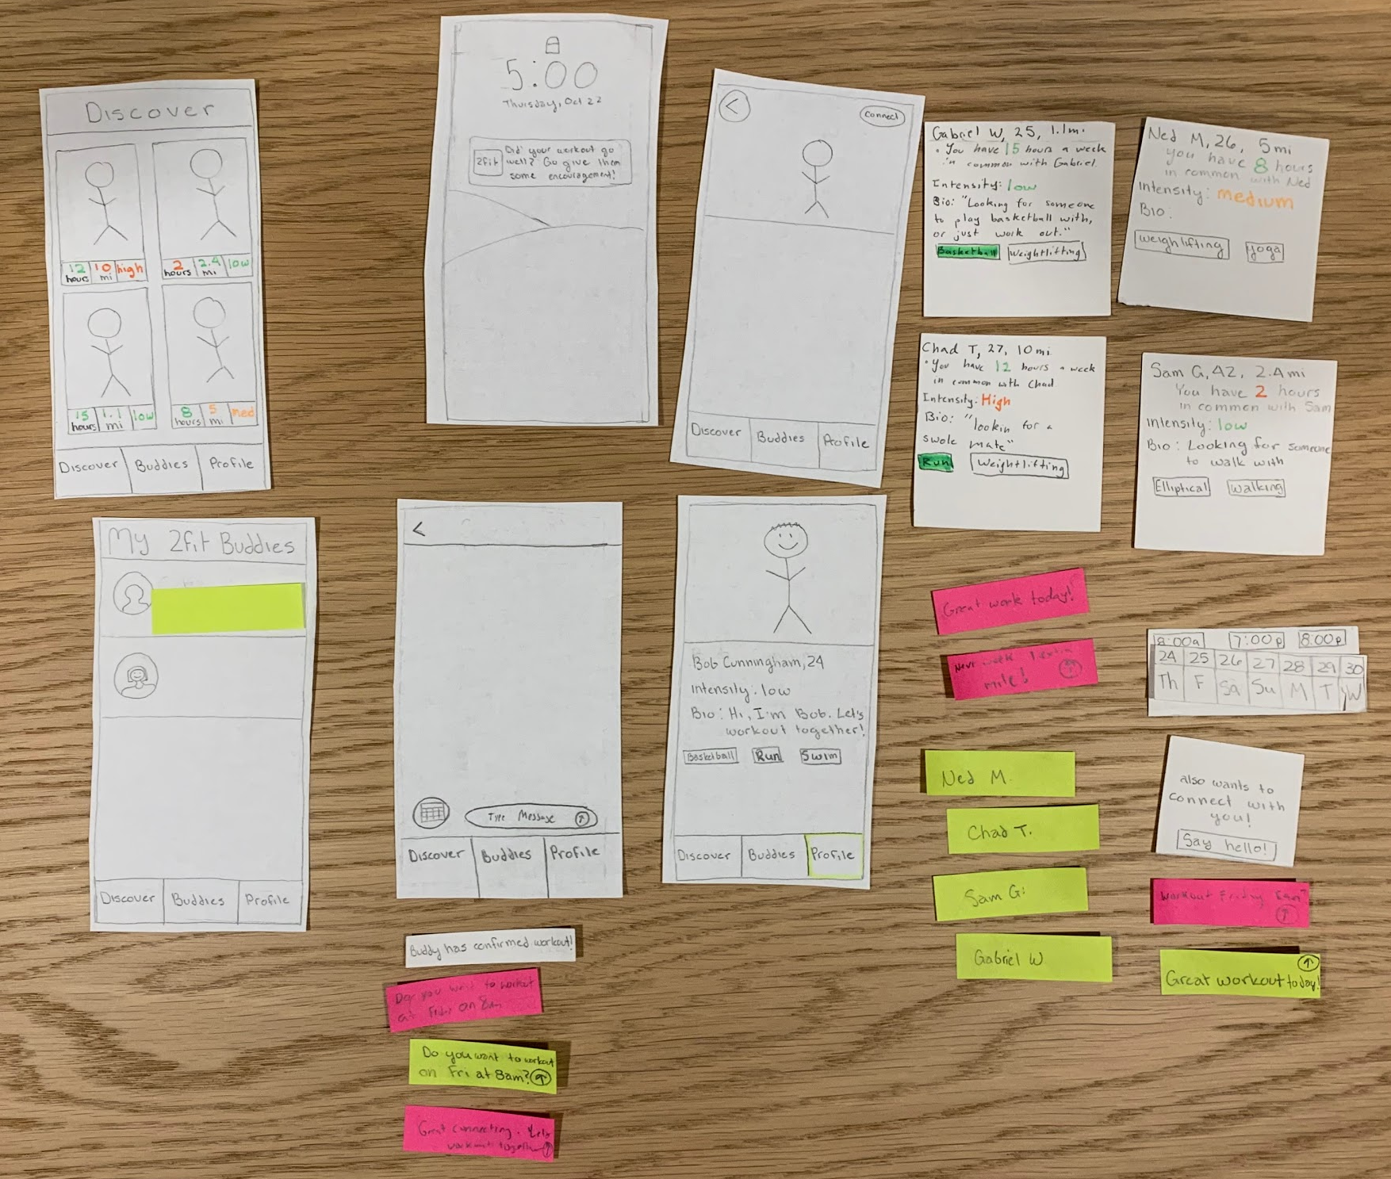
Low-Fi prototype Structure

Slide 9
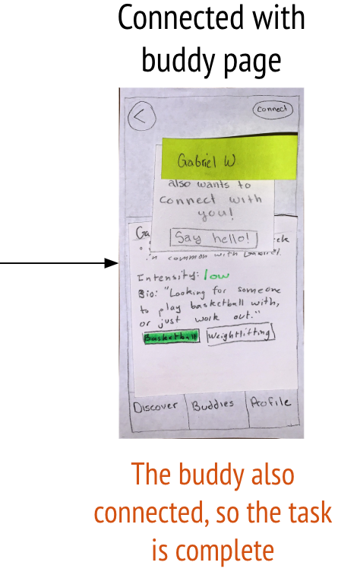
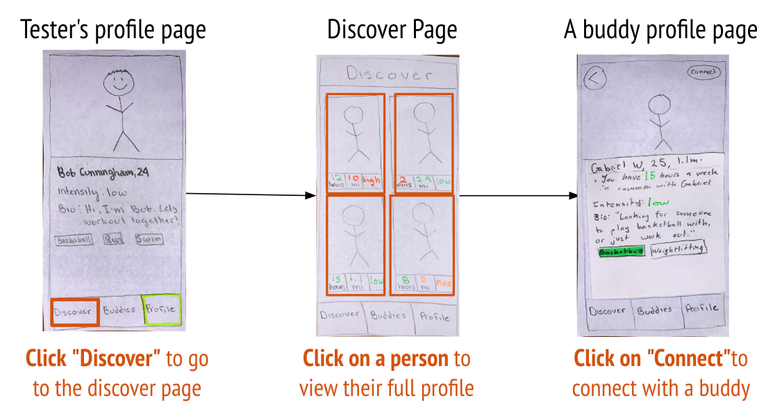
Task 1 - “Find a buddy”

Slide 10
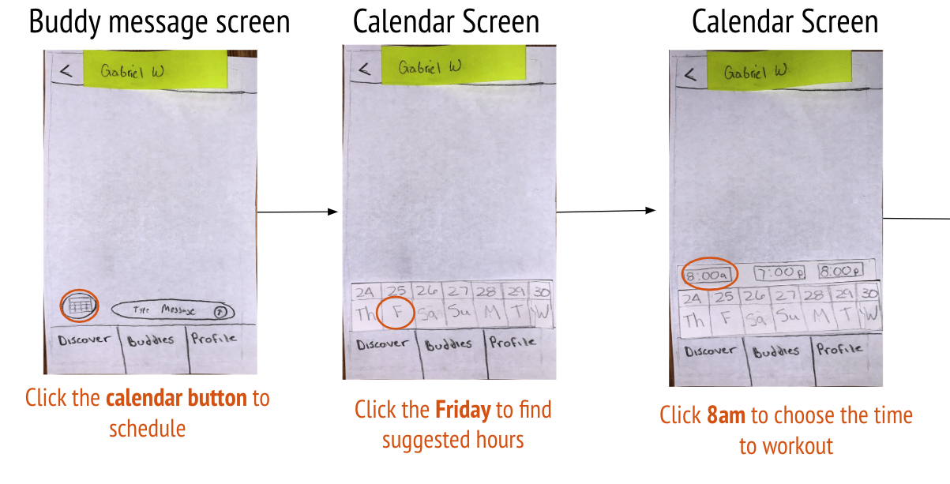
Task 2 - “Schedule a workout”

Slide 11
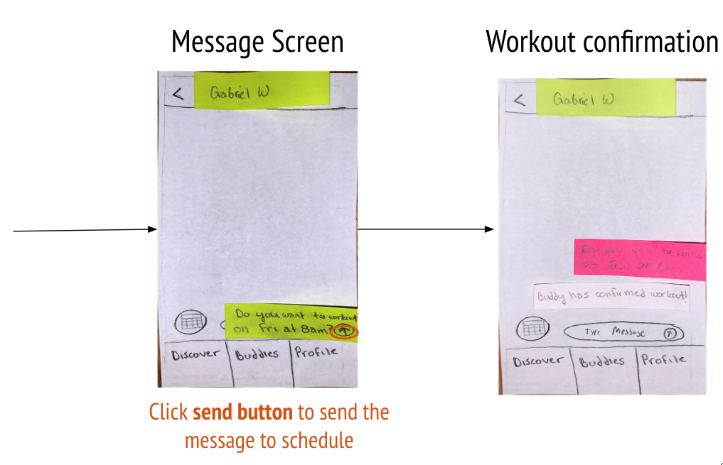
Task 2 - “Schedule a workout”

Slide 12
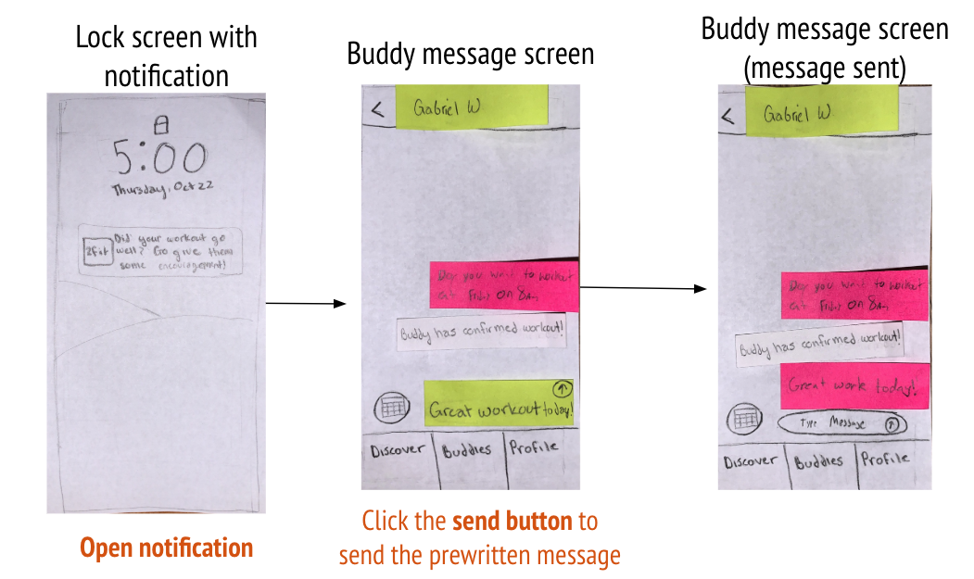
Task 3 - “Send words of support”

Slide 13
Experimental Method
01
Set up prototype
and camera
Introduce the class,
the project, and sign
consent form
02
Explain each task,
wait for completion,
take notes
03
Debrief and
overall thoughts
04

Slide 14
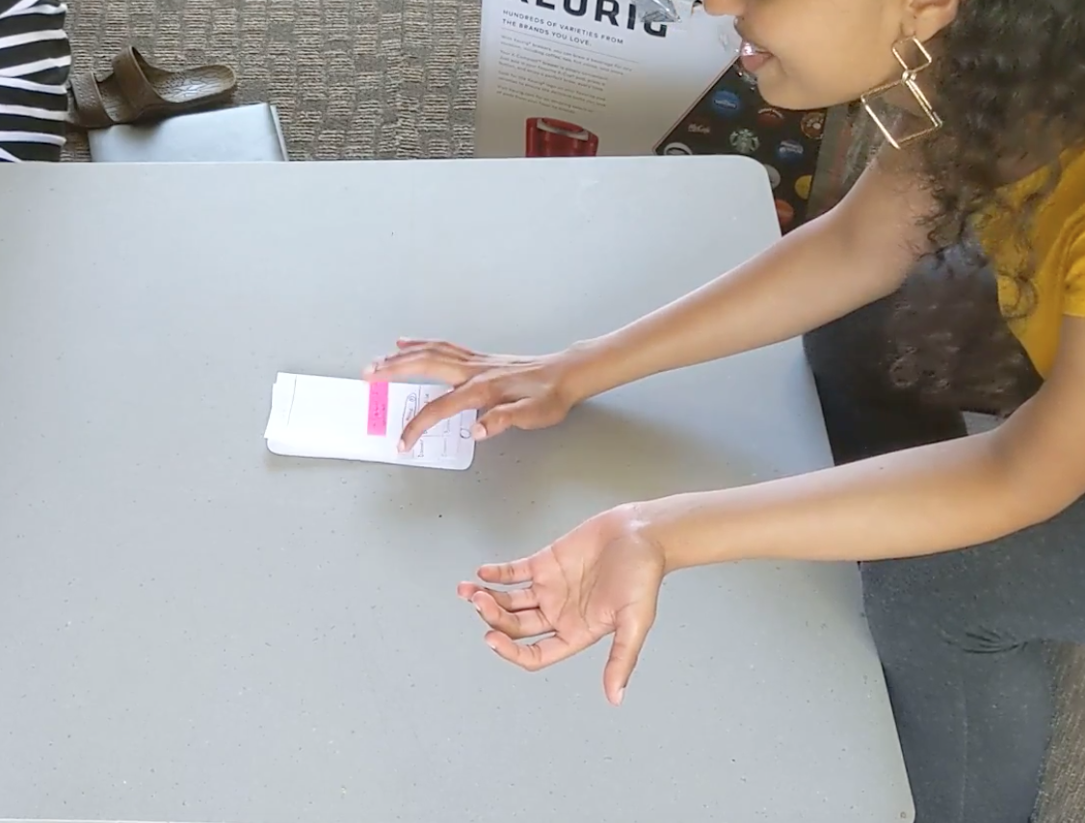
Test Subject 1
- The information she wanted wasn’t available at first glance
- Went back and found better matches
- Opted to direct message, both for workout scheduling and words of support

Slide 15
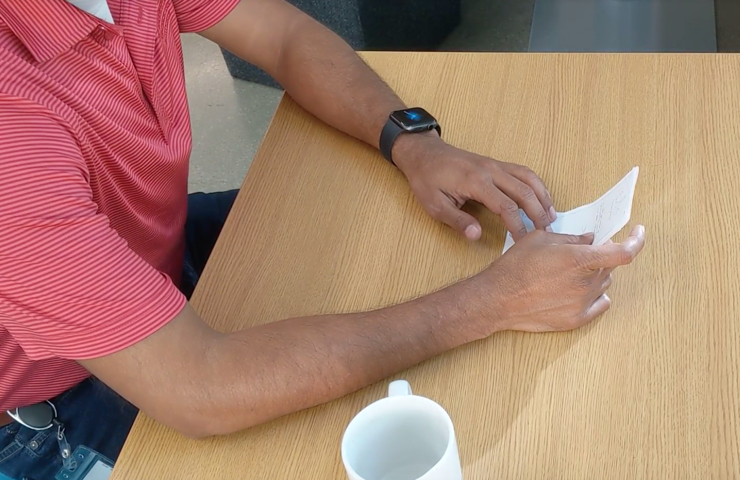
Test Subject 2
- Didn't have the information he wanted, refused to make a choice
- Also opted to direct message for scheduling a workout
- “I don’t think the app can assume that my workout went well”

Slide 16
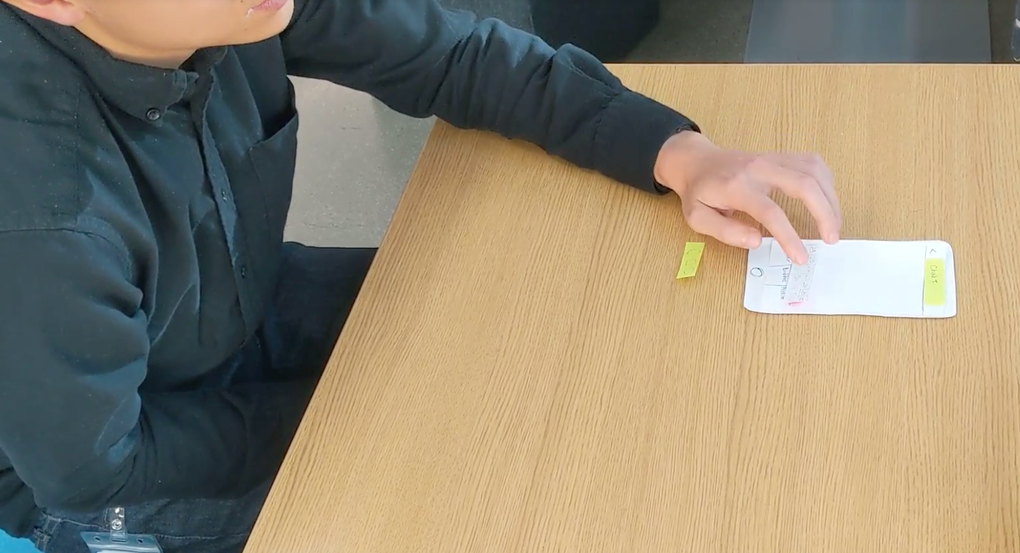
Test Subject 3
- Also had a hard time interpreting heuristics
- Matched with the first profile he looked at
- Used the schedule workout button
- Wanted to add to the pre-generated support message

Slide 17
Suggested UI Changes - Task 1
Detail Clarification
Pre Filtering
Connect Quick
Notes:
Detail clarification. Subjects were confused by the ‘miles’ and ‘hours’ details which were supposed to indicate distance away and hours of schedule compatibility. For the next prototype, we would like to move to a schedule match tiering (low, medium, high). Distance away was an unuseful detail, which we will fold into pre-filtering.
Pre-filtering. Subjects wanted to know if the match partner was available to work out at their preferred workout spot, as opposed to if they were nearby. We will change the location filter to become a pre-filter location match based on workout places that are identified during profile configuration.
Connect quick button. Participants wanted to be able to match right away from the discover screen, so we will add a connect button to each card.

Slide 18
Suggested UI Changes - Task 2
Improve Schedule Button
Time Selector
Place Selector
Notes:
Schedule button prominence. Subjects forewent the schedule button in favor of sending their own unstructured time request. We will improve the visual prominence of the button.
Time selector. Subjects didn’t understand where the proposed times came from. We will add an intermediate schedule screen with a visual interface to provide additional context.
Place selector. Subjects were confused where they were working out. We will remedy this with a workout location selector atop the new intermediate schedule screen.

Slide 19
Suggested UI Changes - Task 3
Words of support default text
Notes:
Proposed default text. Participants were confused about the behavior of the default proposed text. We will adjust the proposed text flow to populate the message box to allow for message extension.

Slide 20
Summary
We’re moving forward with a mobile app where users enter their schedule and build a profile, and see users that match with that.
Front-loads the work of scheduling and matching
Our biggest insights from testing were:
The three “heuristics” were hard to understand
People opted to direct messages instead of scheduling feature
Moving forward, we’ll increase the role of filtering and change the time and location scheduling process.
Notes:
Tinder for fitness supported our assumption however suggest that their may be more to explore besides just fitness ability in the matching process

Slide 21
Thank you
From the ²Fit team

