Slide 1
- Fit Together -
Akhil Jariwala, Matthew Landis,
Autumn Warren, Kaughlin Caver
Online/Local Community
October 18, 2019

Slide 2
Problem/ Solution Overview
Due to conflicting schedules, differing goals, and the intimidating gym atmosphere, exercisers often struggle to find and connect with a workout partner.
2Fit empowers users to connect with others who have similar abilities, goals, and schedules. Once matched, 2Fit helps workout partners reach their fitness goals together.
- Fit Together -

Slide 3
Tasks
Find compatible fitness buddies
complex
Schedule joint workouts
medium
Support and hold each other accountable
simple

Slide 4
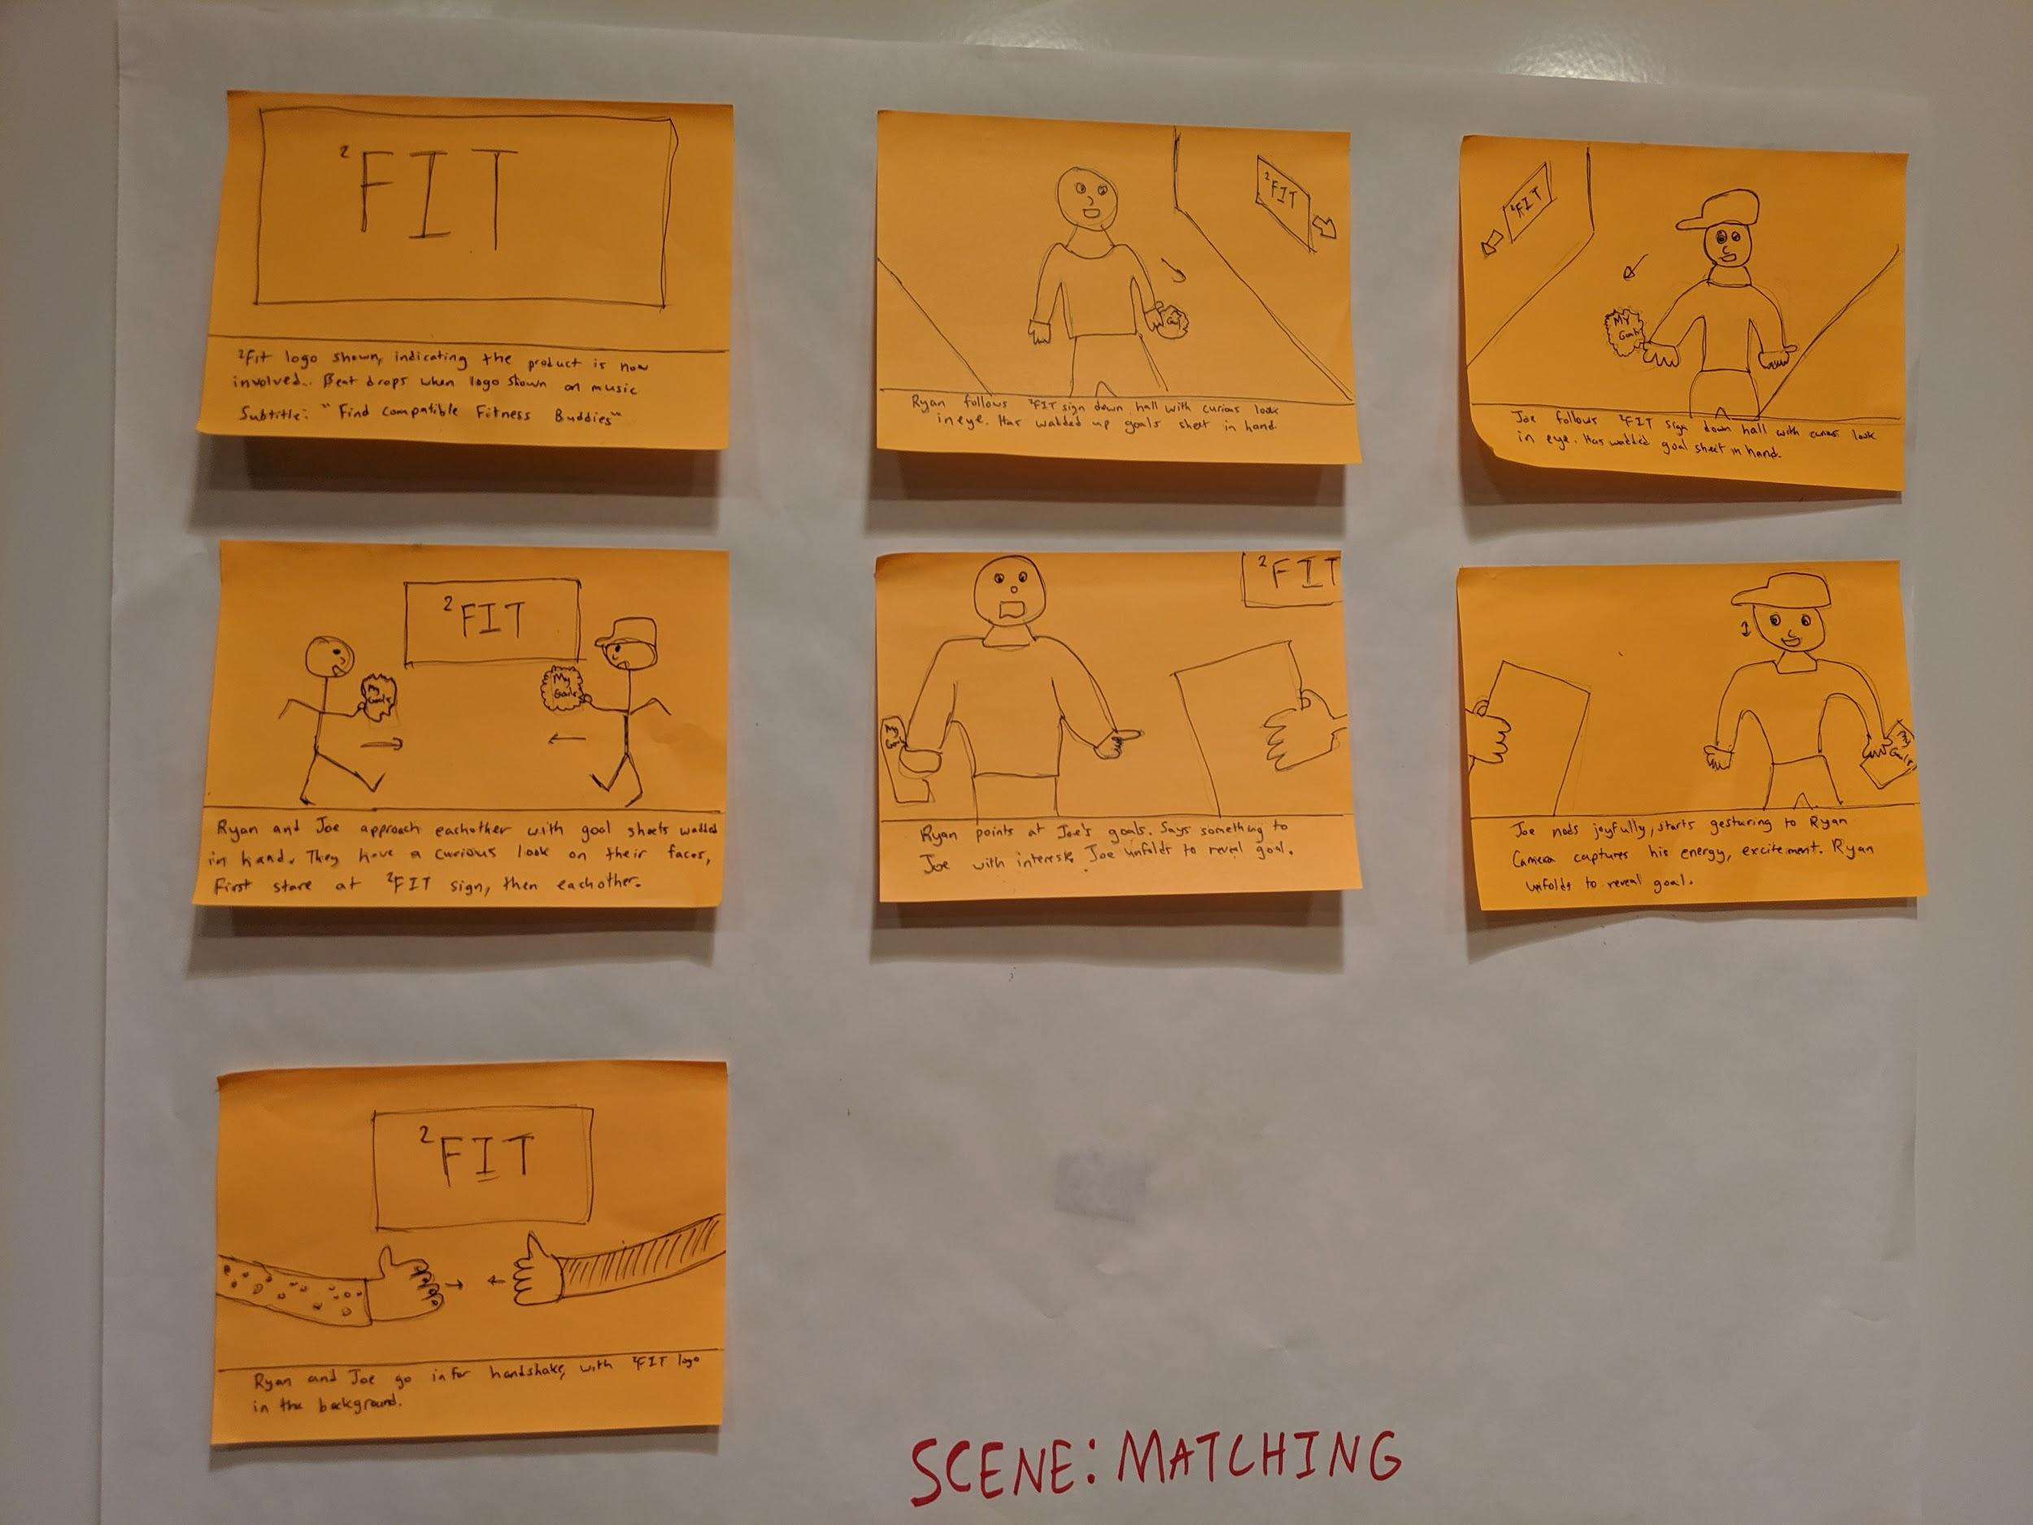
Storyboards - Find compatible buddies scene

Slide 5
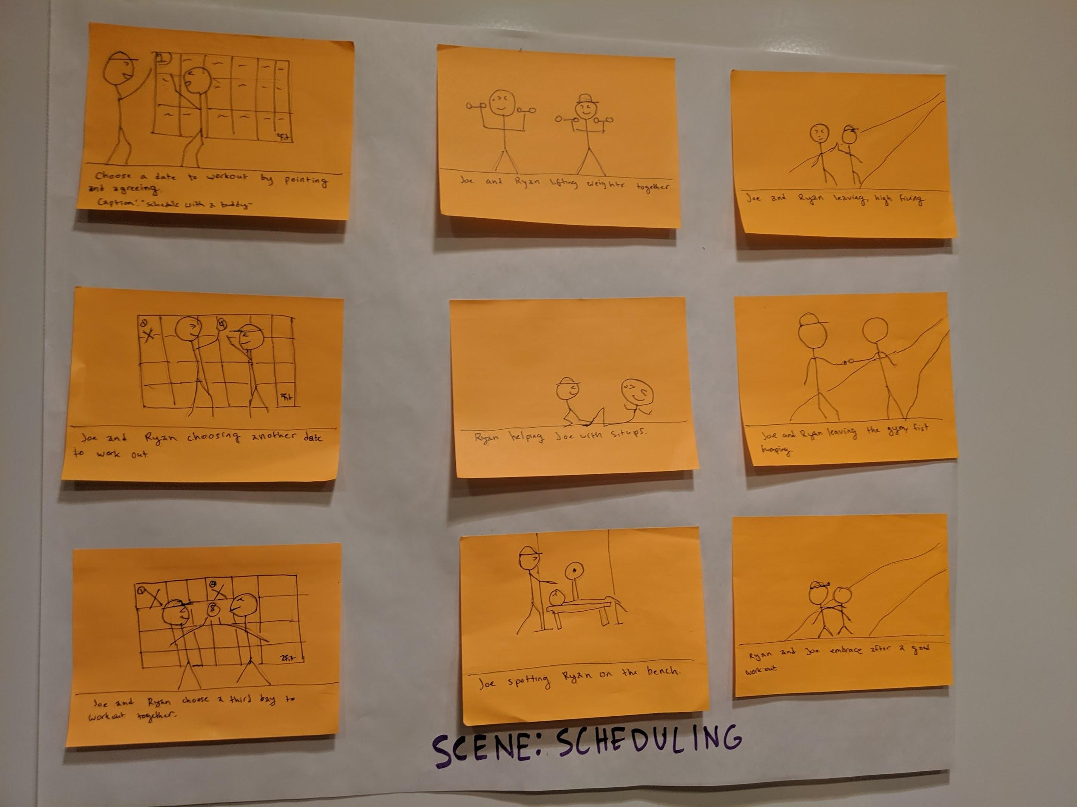
Storyboards - Schedule joint workouts scene

Slide 6
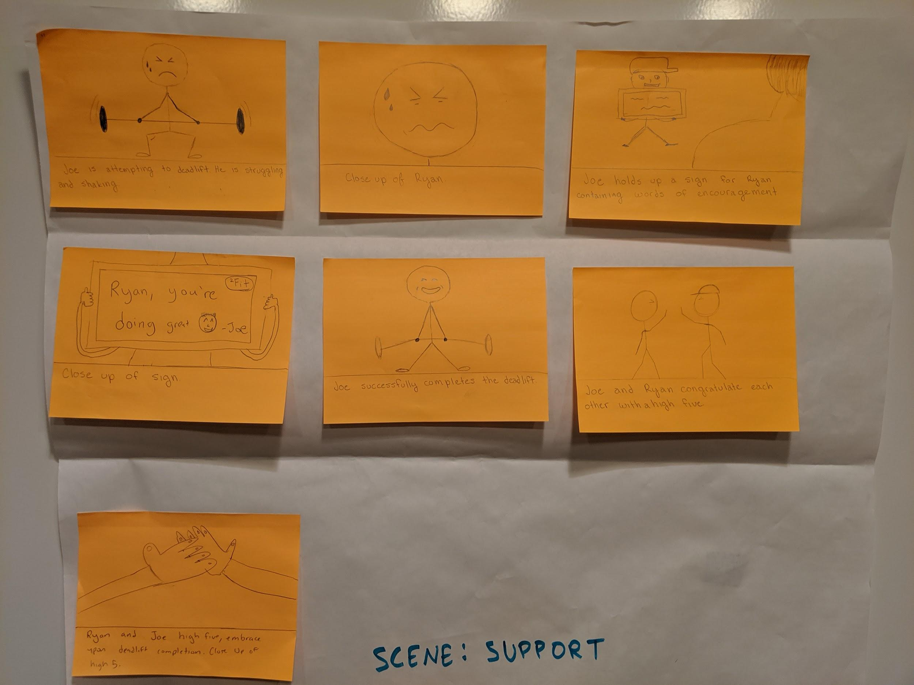
Storyboards - Receive support and be held accountable scene

