Slide 1
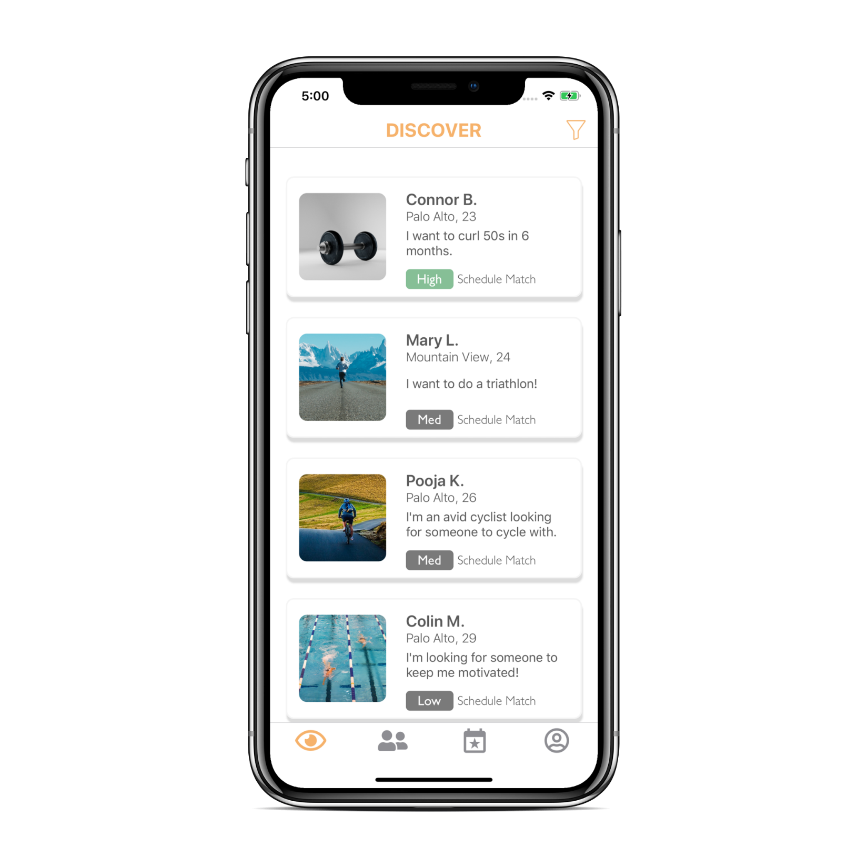
Find the perfect workout buddy for you

