Slide 1
²Fit
CS147
October 04, 2019

Slide 2
Outline
01
Needfinding Methodology
02
Interview Results
03
Analysis
04
Findings

Slide 3
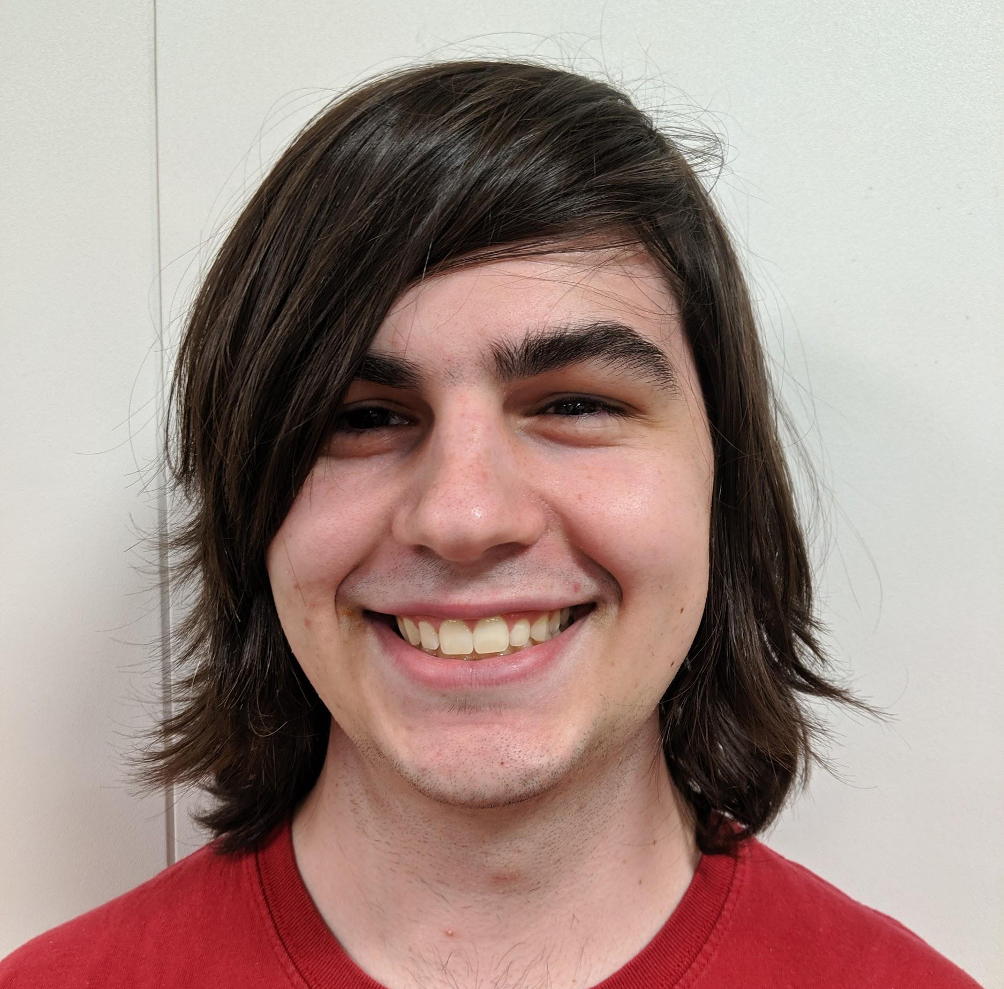
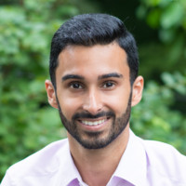
Meet the ²Fit Team!
Matthew Landis
Computer Science
Junior
Fun Fact: I love apple juice
Kaughlin Caver
Computer Science
Senior
Fun Fact: Singer/Songwriter
Akhil Jariwala
Business
MBA2
Fun Fact: I dance salsa!
Autumn Warren
Computer Science
Junior
Fun Fact: I can (kinda) play the uke

Slide 4
Local Fitness
How do people discover, practice, and commit to physical fitness in their local communities?

Slide 5
Interviews
User Segment:
Bay Area residents in early adulthood (18 - 40)
who are either physically active or considering becoming so.
Selection
Recruitment
Notes:
Why chosen?
How recruit our subjects?

Slide 6
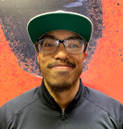
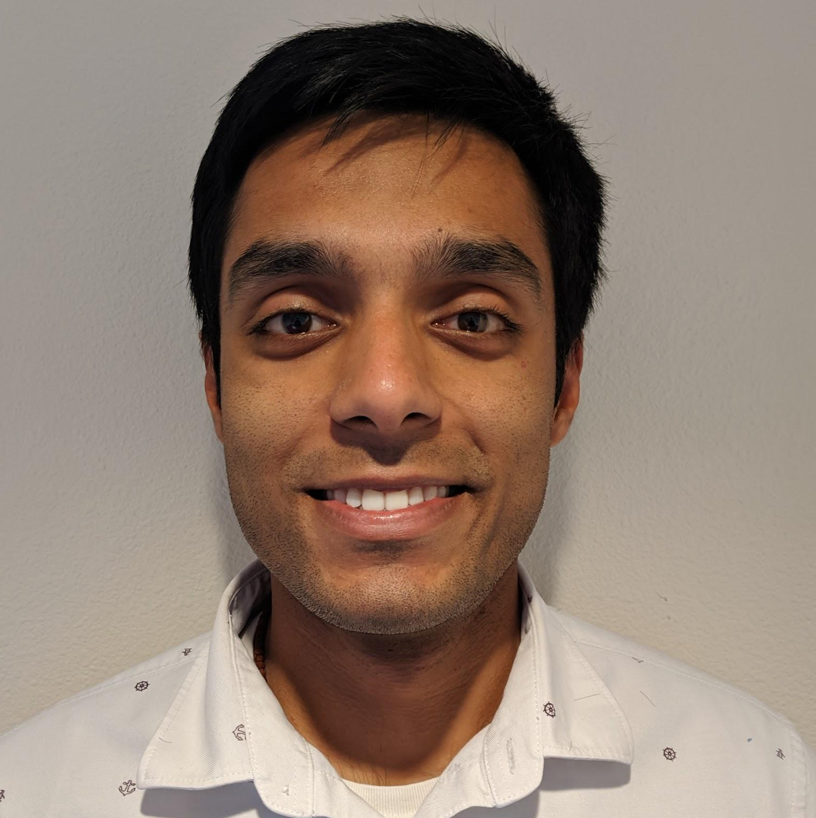
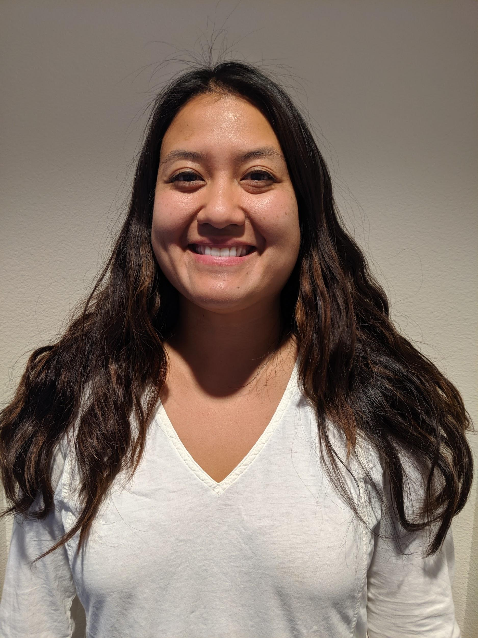
We interviewed four subjects with varying styles and levels of fitness in their lifestyles.
Kenneth
Certified Personal Trainer
Age: 26
Fitness: Bodybuilding
Matt
Res. Services Coordinator
Age: 36
Fitness: casual jogging
Extreme User
Non-User
Pulkit
Stanford GSB Student
Age: 25
Fitness: Squash, pickup
Lina
Res. Services Coordinator
Age: 29
Fitness: MMA
Average User
Average User

Slide 7
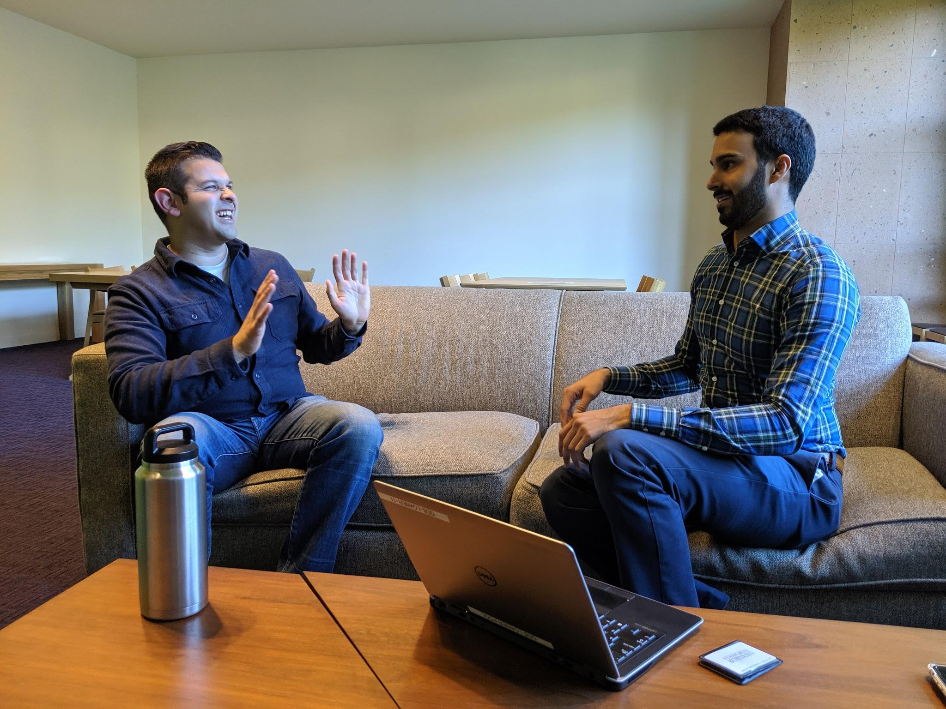
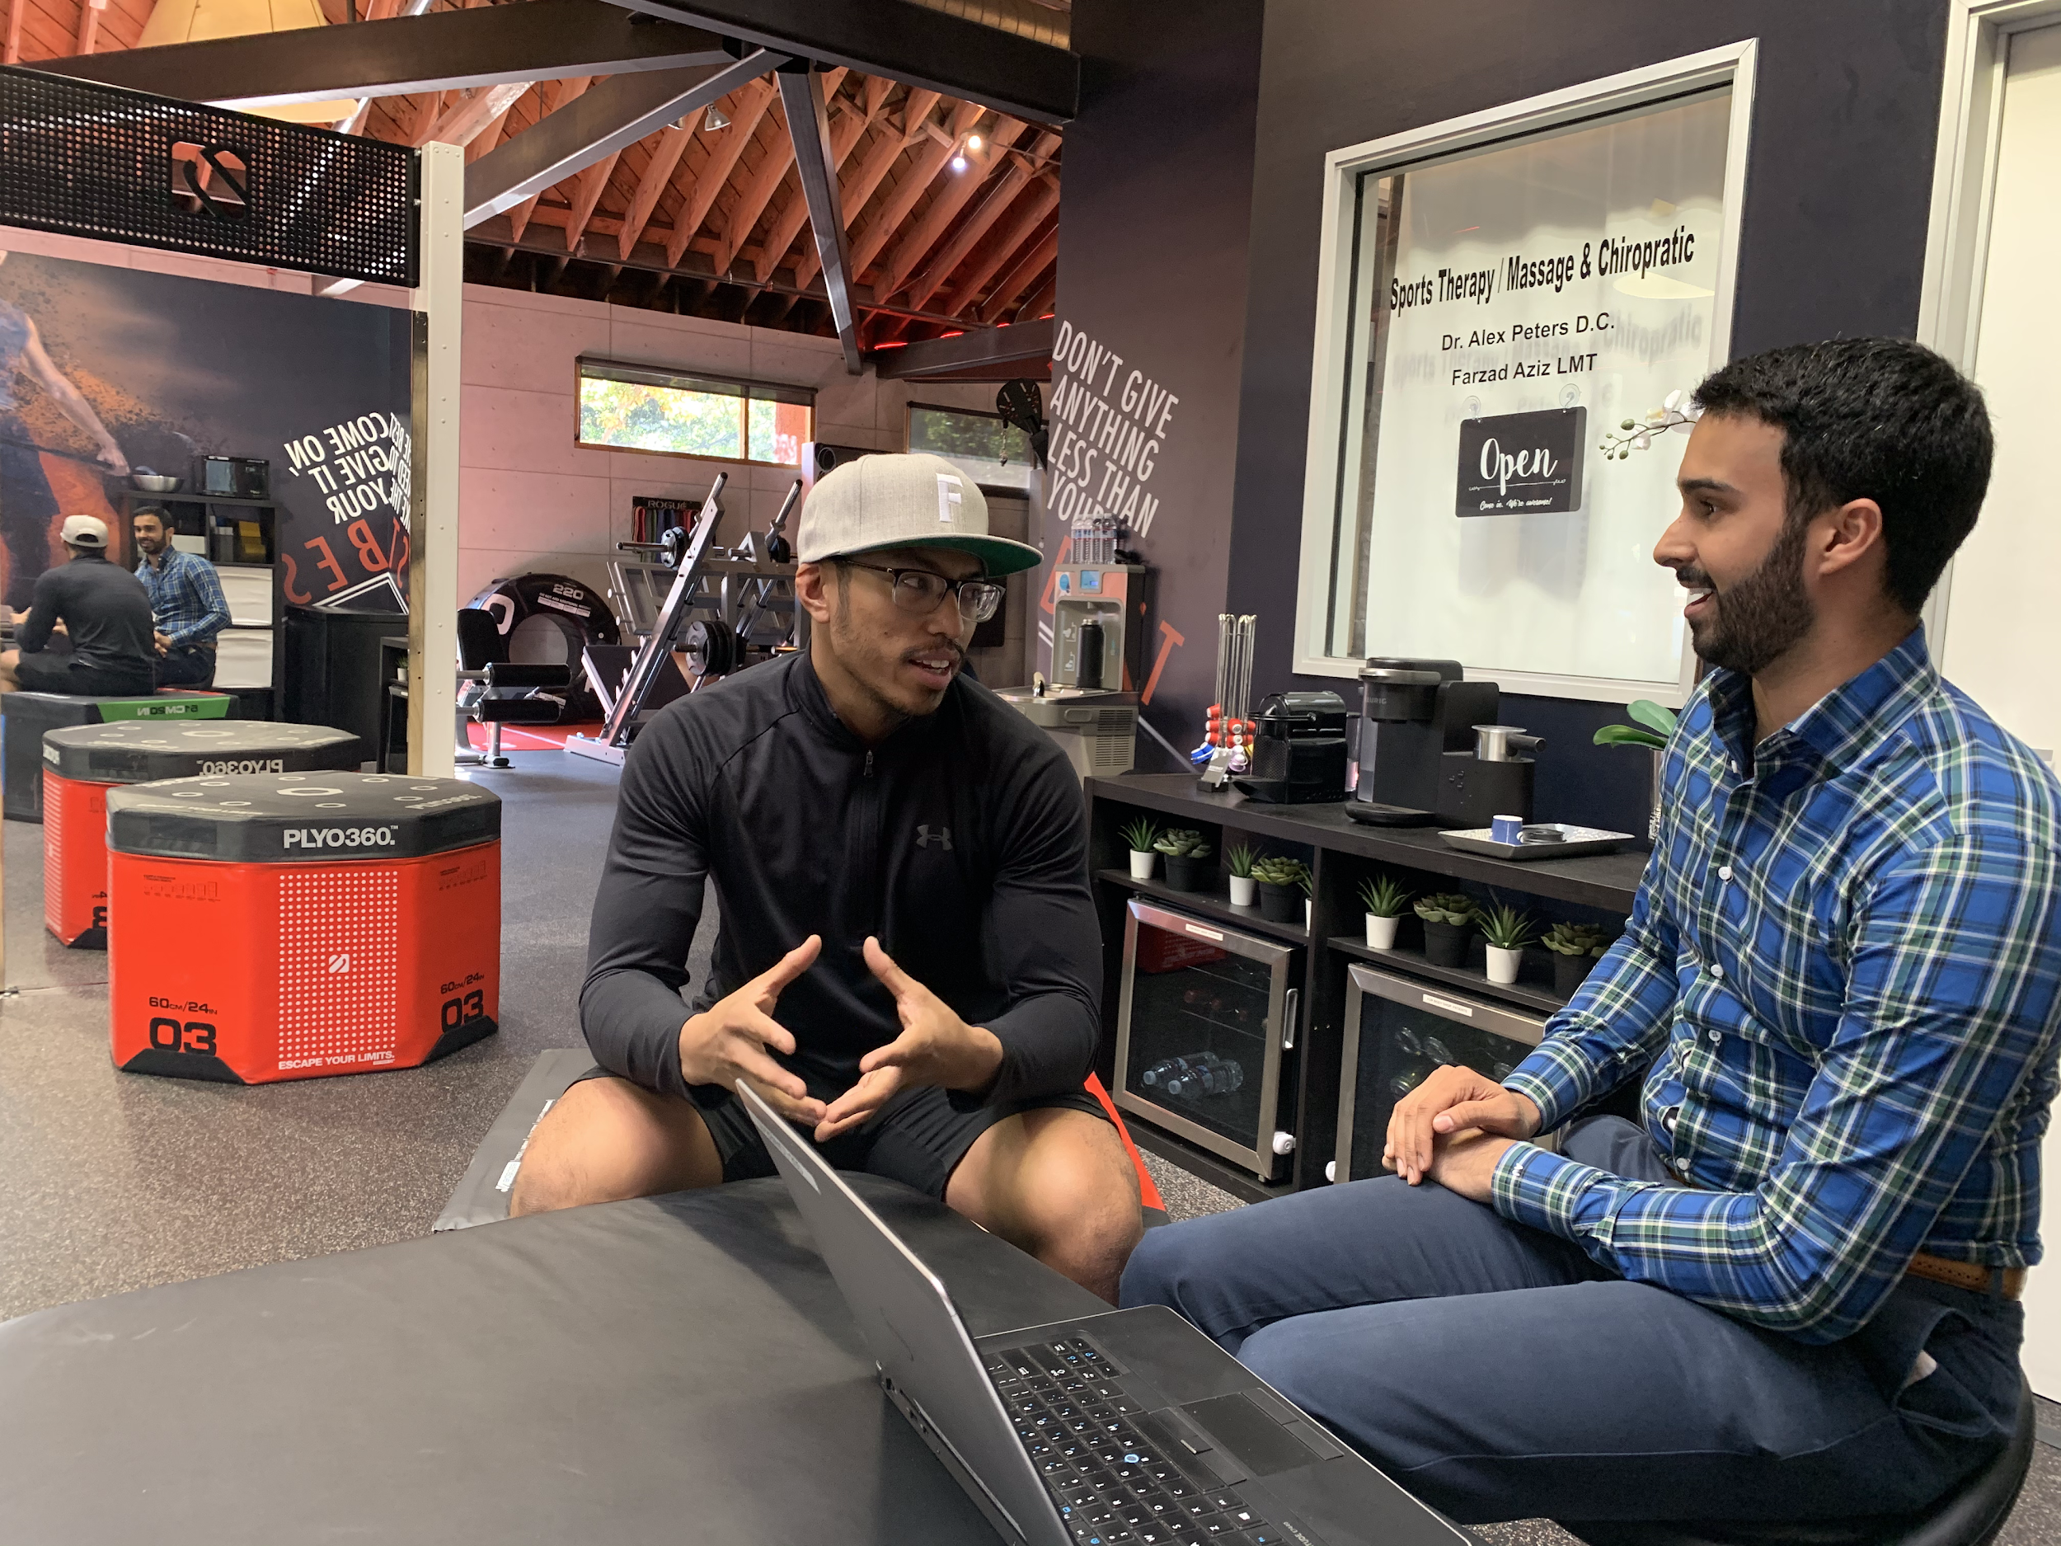
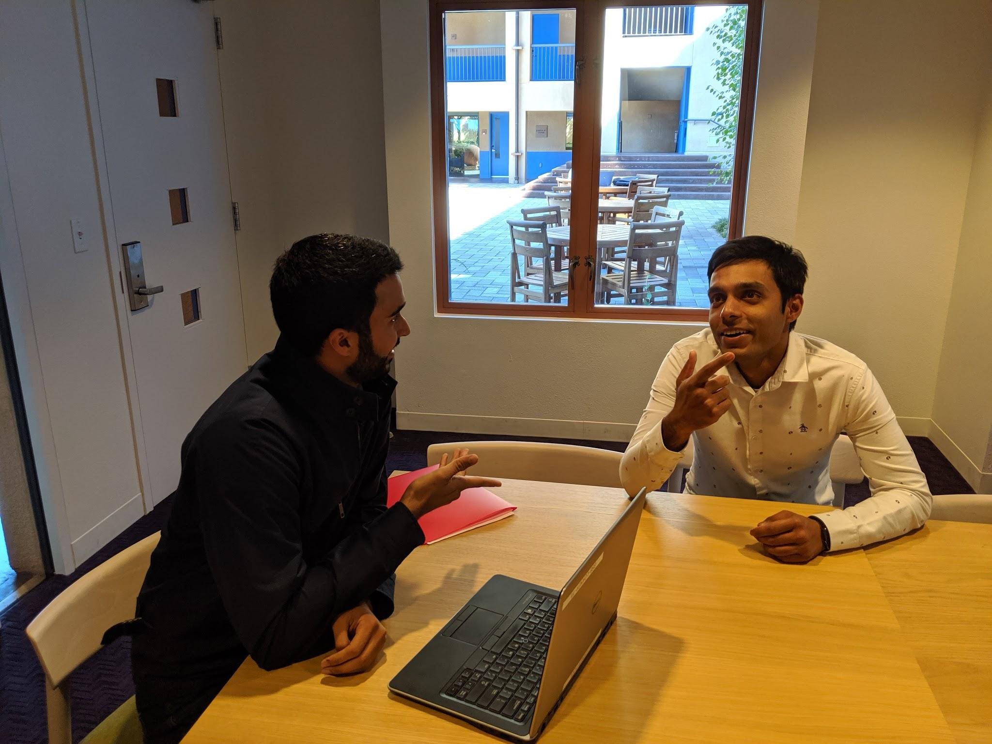
We interviewed participants at their place of exercise or at their place of work.
45 min

Slide 8
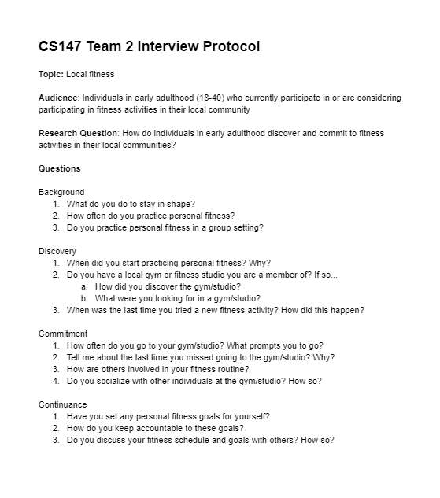
We developed an interview protocol to guide our conversations with the subjects.
Notes:
How does fitness fit in your life?
How are others involved in your fitness routine?
Do you socialize with other individuals at the gym? How?
When did you start practicing personal fitness? Why?

Slide 9
Notes:
Interviewees told us a lot about their experiences by the words they chose to use and images they painted
Matt: “Swipe right on a trainer” -> dating
Lina: “Authentic” -> real people

Slide 10
Notes:
Learned a lot about our interviewees by their actions, especially when those contradicted their words
Matt: Worked out when a friend brings it up
Pulkit: Drove an hour every day to the gym so he could work out with a friend.

Slide 11
Notes:
Values
Pulkit told us that he thought being on time and not bailing is extremely important in a buddy
Lina told us that she thought working out should be about learning a new skill

Slide 12
Notes:
Matt felt out of place at “uppity” Equinox gym.

Slide 13
Needs and Insights
Need: To see self improvement
Need: To maintain structure in his life
Insight: Enjoys working out with others, but won’t accommodate in his schedule
Insight: Feels frustrated when working out
with someone with different fitness objectives

Slide 14
Needs and Insights
Need: To improve body image
Need: To maintain physical, mental health
Insight: Relies on friends to hold him accountable for physical fitness
Insight: Expects timeliness and reliability in a workout buddy

Slide 15
Needs and Insights
Need: To keep learning new skills
Need: To be surrounded by others she likes and trusts
Insight: Feels at home at her local gym, despite the lack of women
Insight: Ventures to new fitness activities when she gets bored
Notes:
Need 2: Authenticity matters to Lina

Slide 16
Needs and Insights
Need: To feel safe and welcome
Need: To integrate fitness into his life
Insight: Engages in physical fitness after speaking to friends about exercise
Insight: Finds success in other routines
that he commits to every day

Slide 17
During our interviews, we uncovered several surprising contradictions in our participants’ values.
“It's always a pleasure to have someone [work out] there with me.”
“I wouldn’t change my schedule to accommodate someone else.”
“I wasn’t going to [work out] alone, I had to do it with someone.”
“I practice yoga alone every morning.”
“Fitness needs to be an everyday thing like coffee.”
“I’d talk to someone… Later that night I’d think… maybe I should go run”
“All the instructors are very welcoming… everyone is really friendly.”
“[The MMA gym] is a boy’s club… I wish there were more women.”

Slide 18
Three common themes emerged from our four interviews.
Importance
of a Buddy
Difficulty in
Scheduling
Cultural Fit
of the Gym

Slide 19
Thank you
From the ²Fit team

