Slide 1
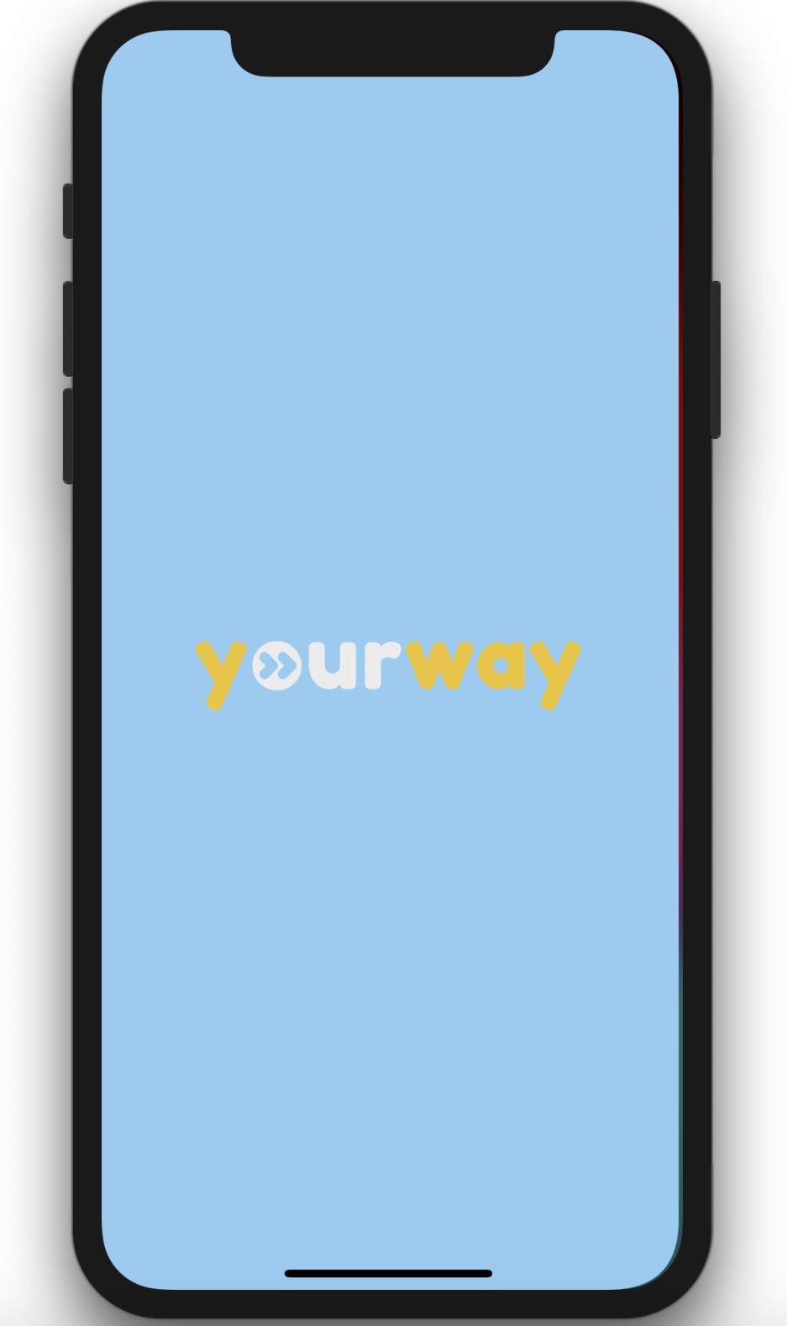
Midway Milestone Presentation
By Team Journey

Slide 2

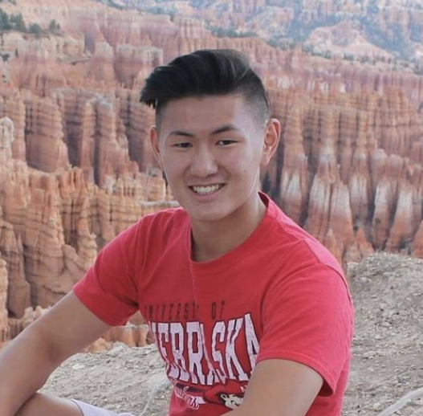

Netta
Jeff
Ray
David

Slide 3

Introduction
Heuristic Results
Design Revisions
Prototype
Demo
Summary
Notes:
For this presentation, I’m going to go first re-introduce our problem the next discuss how the results from the heuristic evaluation informed our design changes. Finally, I will cover the progress we have made with the high fidelity prototype and what our next steps are.

Slide 4
Value Proposition
Personalized Adventure On-Demand
Notes:
Our value proposition is personalized adventure on demand

Slide 5
Background
Problem: When traveling, people have difficulty finding specific next steps based on their interests without sacrificing time and spontaneity to create detailed plans.
Notes:
When traveling, people have difficulty in the moment finding specific next steps based on their interests and their goals

Slide 6
Background
Problem: When traveling, people have difficulty finding specific next steps based on their interests without sacrificing time and spontaneity to create detailed plans.
Solution: Hyperlocal, personalized, real-time recommendations to guide people through open-ended travel situations.
Notes:
Our solution is hyperlocal personalized real time recs to guide people through their open ended travel situations

Slide 7
Introduction
Heuristic Results
Design Revisions
Prototype
Demo
Summary
Notes:
A few weeks ago we demo’d our medium fidelity prototype and received feedback from the heuristic evaluation

Slide 8
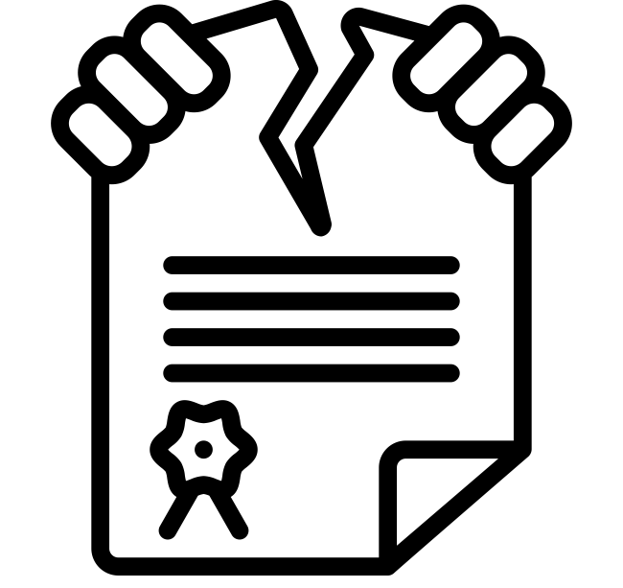

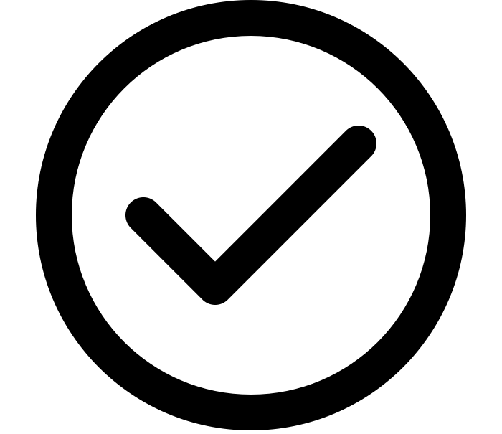
Heuristic Violations Summary
53
4
~50%
Total Heuristic Violations
Severity 3-4 Violations Resolved
Total Violations Fixed
Notes:
We resolved every severity 3 and 4 violation (we didn’t have any severity 4). For every other heuristic violation, we either fixed it or decided that it should not be fixed either because of increased complexity or low value. In total, I estimate that we fixed a bit over 50 percent of the violations and decided that the other half were either not significant usability problems, not relevant to the core functionality of the product, or required too significant of a redesign given the severity rating. We also addressed a significant amount of the TA feedback that was not directly in the heuristic violation report

Slide 9
Example of Ignored Heuristic Violation
H3 User control and freedom (Severity 1)
Issue: There’s no way to say a solid no to connecting Facebook or Google Calendar. Users may want this option, since “Later” implies that the app will inconveniently ping me about it again later.
Fix: Add button to say No
Notes:
Here is an example of a skipped Heuristic Violation

Slide 10
Severity Themes
Overly complex feedback mechanisms
Lack of user control in settings
Ambiguous social connection
Notes:
A quick overview of the high severity issues spread across three themes: overly complex feedback mechanisms, lack of user control in settings, and ambiguous social connection
We received a lot of heuristic violations and TA feedback about our feedback mechanisms. Overall, there was a lot of confusion over their complexity as well as how each worked.

Slide 11
Introduction
Heuristic Results
Design Revisions
Prototype
Demo
Summary

Slide 12
Overly complex feedback mechanisms
“I'm concerned about the complexity of the interface for this task. Is it necessary to have three different ways of communicating personal preferences (initial visual quiz, chatbot, and settings list)? Can you think of a simpler, more consistent approach?”
Notes:
Here we actually have a quote from Parastoo which although not a Heuristic Violation quote, we thought really well summarized some of our problems

Slide 13


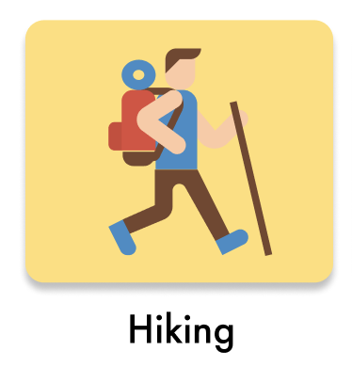

Overly complex feedback mechanisms
Before
After
Notes:
To address complex feedback mechanisms, we completely scrapped the original settings option where users could add or remove dislikes in the settings page.

Slide 14
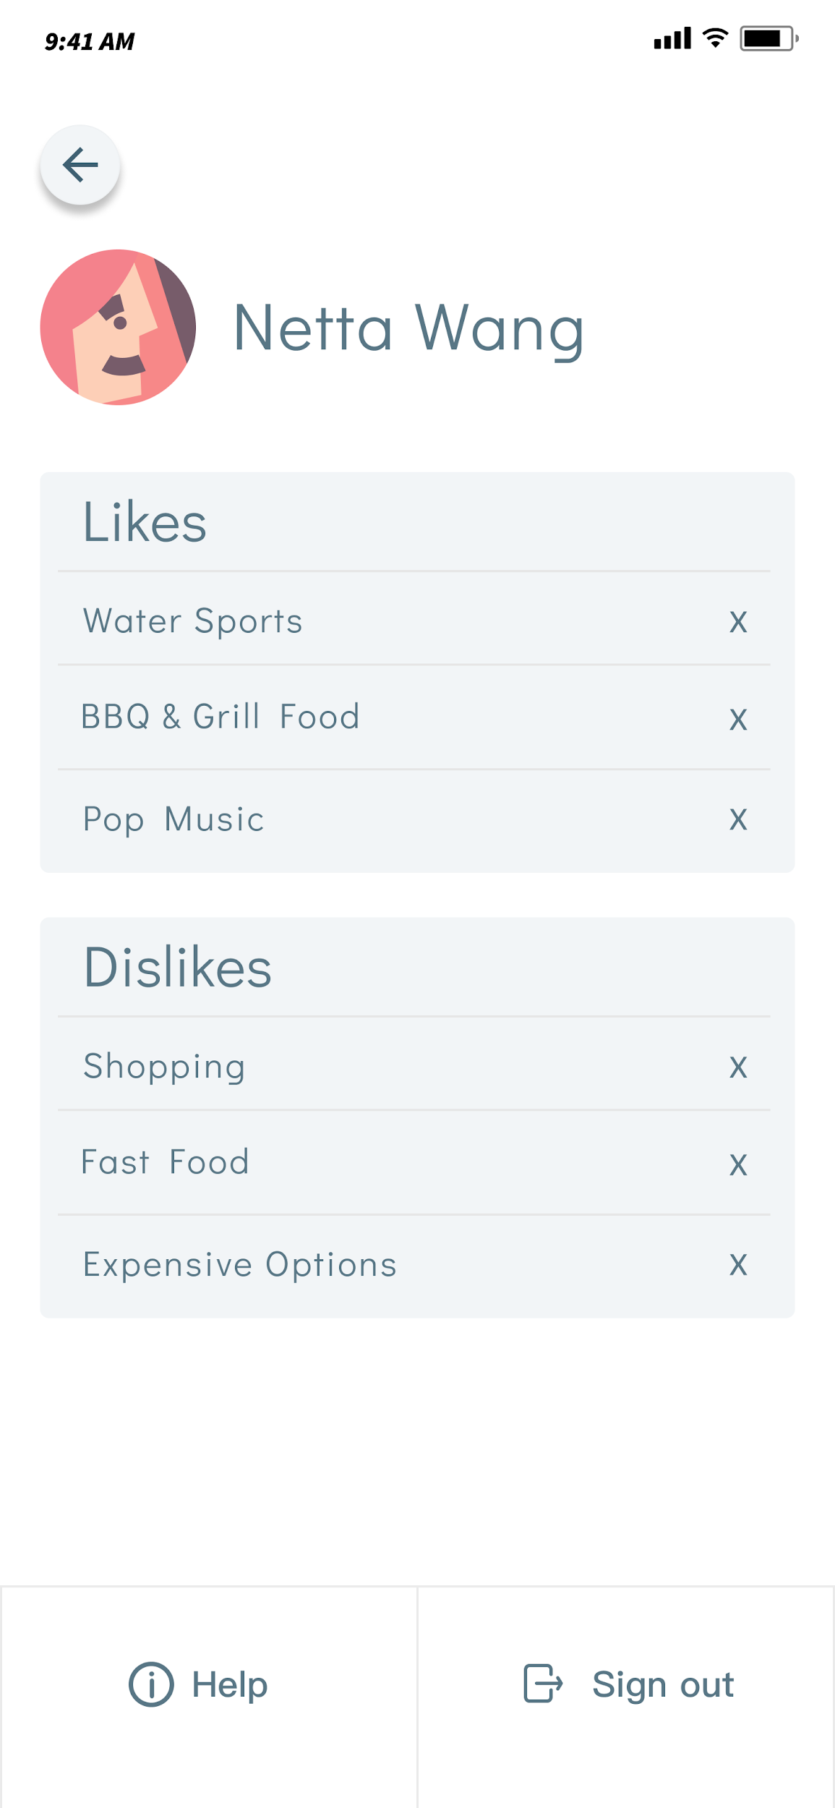
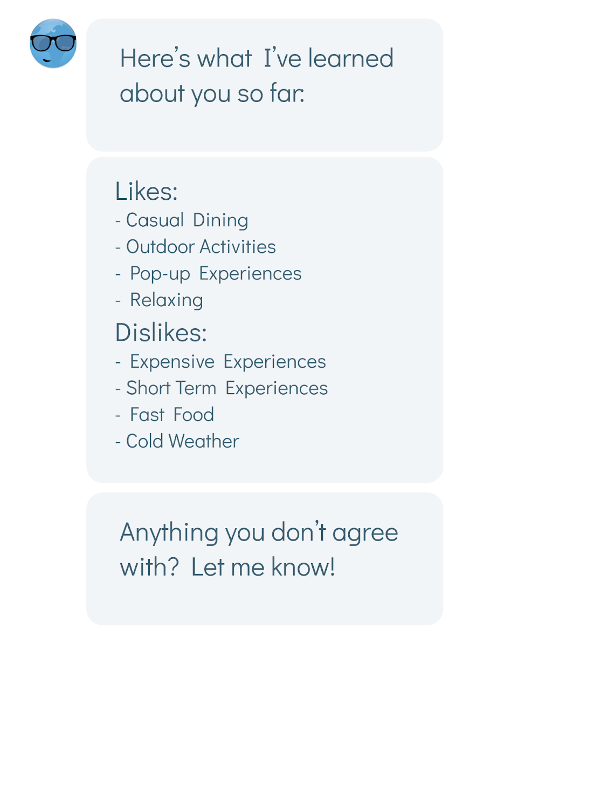
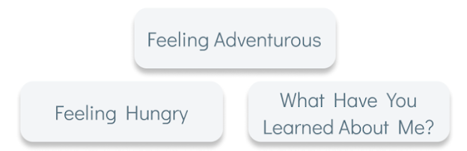
Overly complex feedback mechanisms
Before
After
Notes:
Instead we revamped the chatbot experience such that users could now press a pre-selected button “what have you learned about me” that outputs the key information. Users can then type back to the chatbot to update their preferences, consolidating the experience within one chat window, reducing the number of avenues users have to go to update there interests

Slide 15
Overly complex feedback mechanisms
Severity
3
Before
After
Notes:
This severity 3 issue was also about the confusion of the survey answers not literally mapping to the settings page. We solved this by making it more clear the survey was learning general characteristics. First we made the likes and dislikes more general

Slide 16


Overly complex feedback mechanisms
Severity
3
Before
After
Notes:
Next we made the onboarding screens state this more clearly

Slide 17
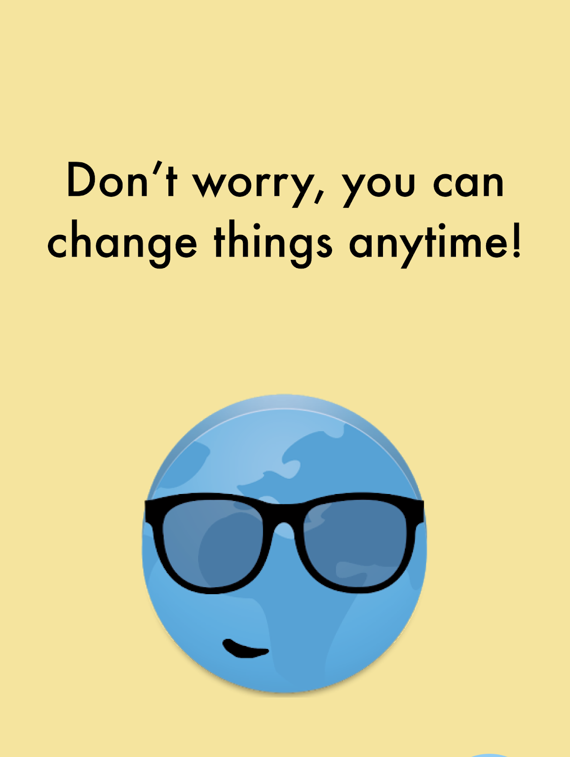
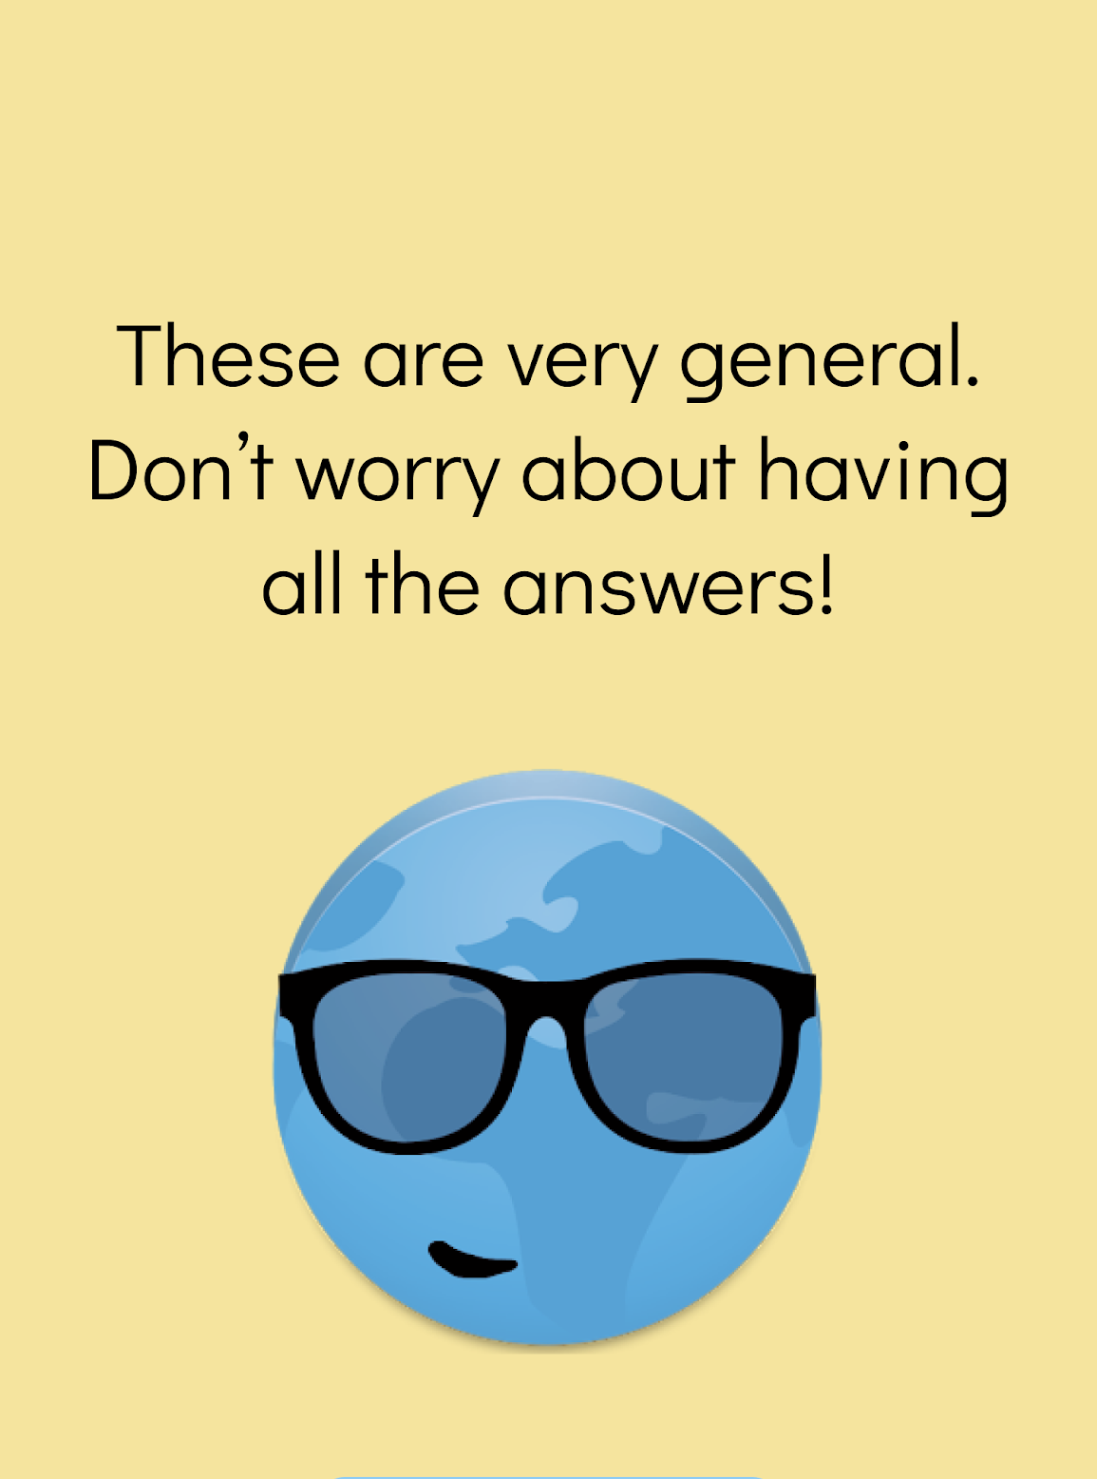
Overly complex feedback mechanisms
Severity
3
Before
After

Slide 18
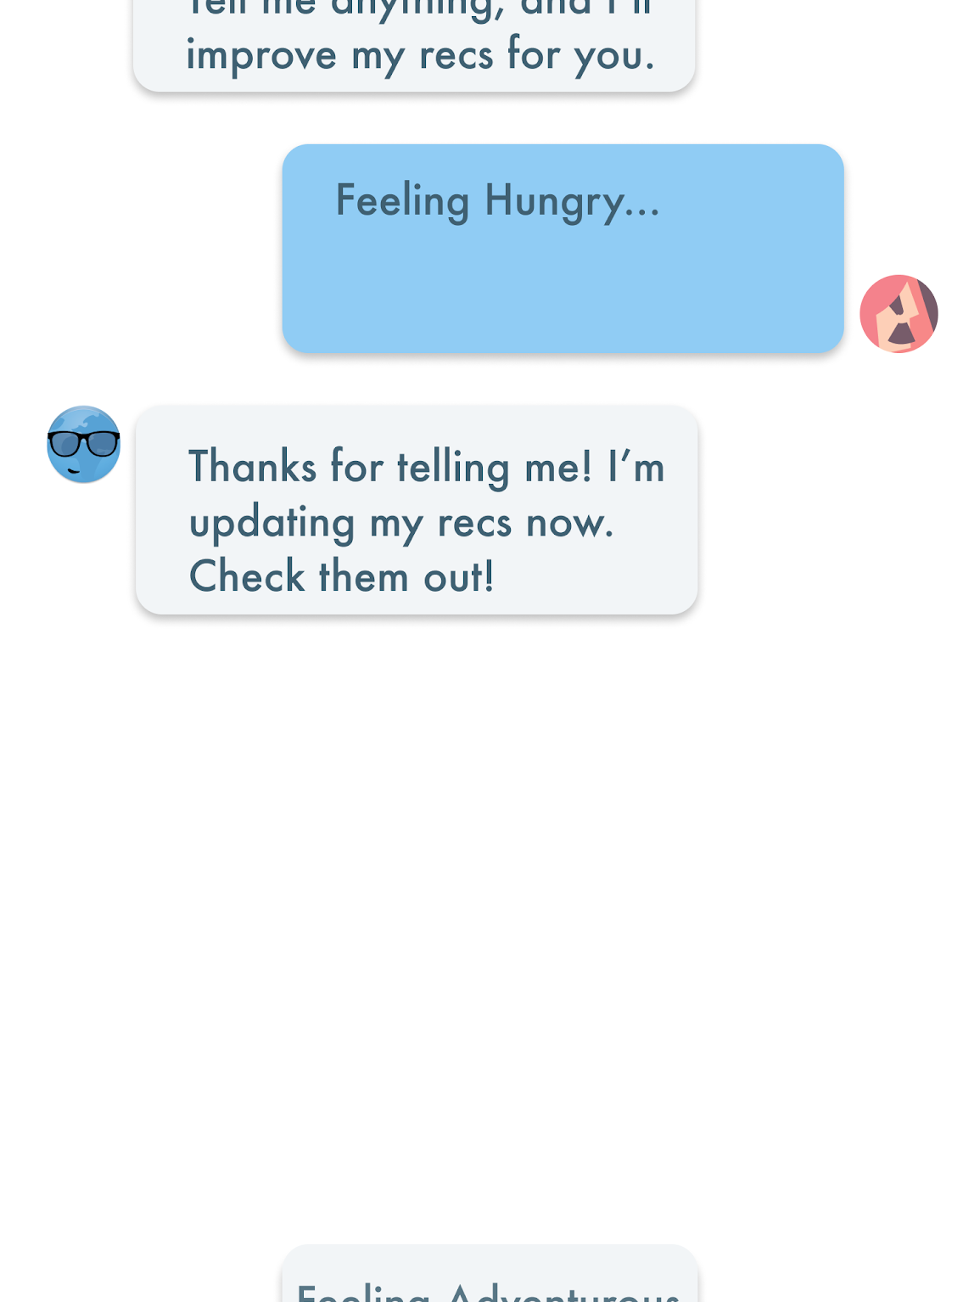
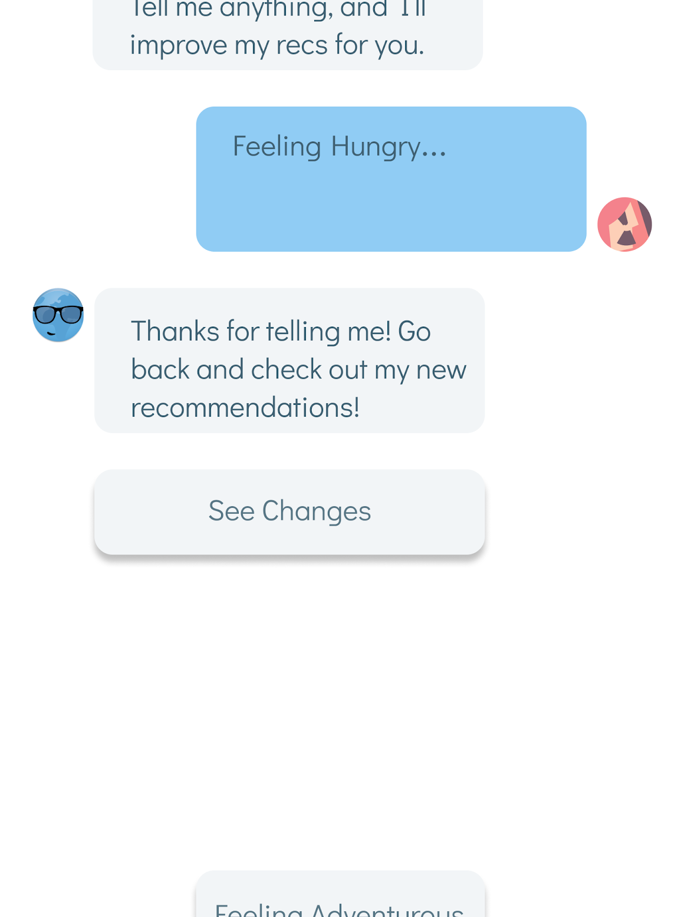
Overly complex feedback mechanisms
Severity
3
Before
After
Notes:
Another severity three issue we had was about it not being clear that recommendations on the homescreen were updated because the back button was the only way to go from the chatbot to the home screen. We’ve made that more clear through language and a clearly defined button to go back.

Slide 19
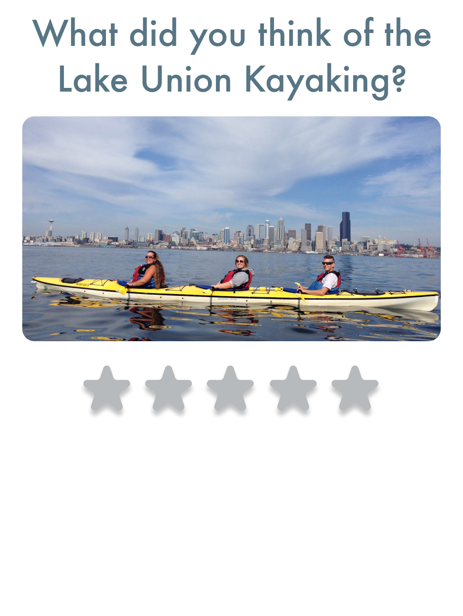
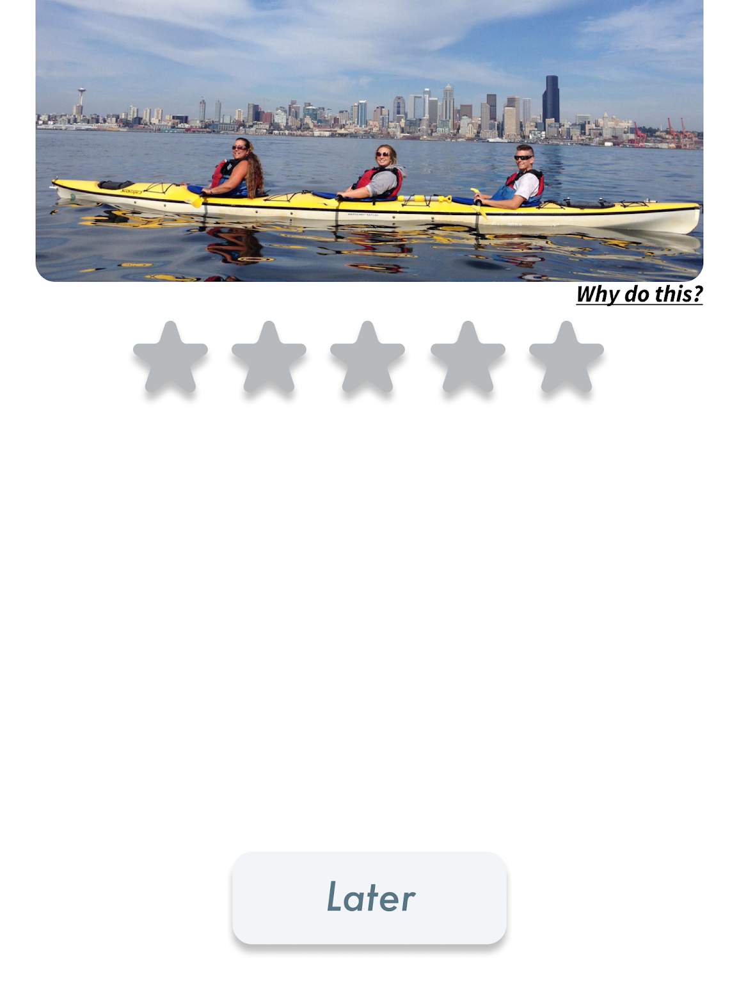
Overly complex feedback mechanisms
Before
After
Notes:
We also received feedback that our ratings feedback could use more simplification.

Slide 20
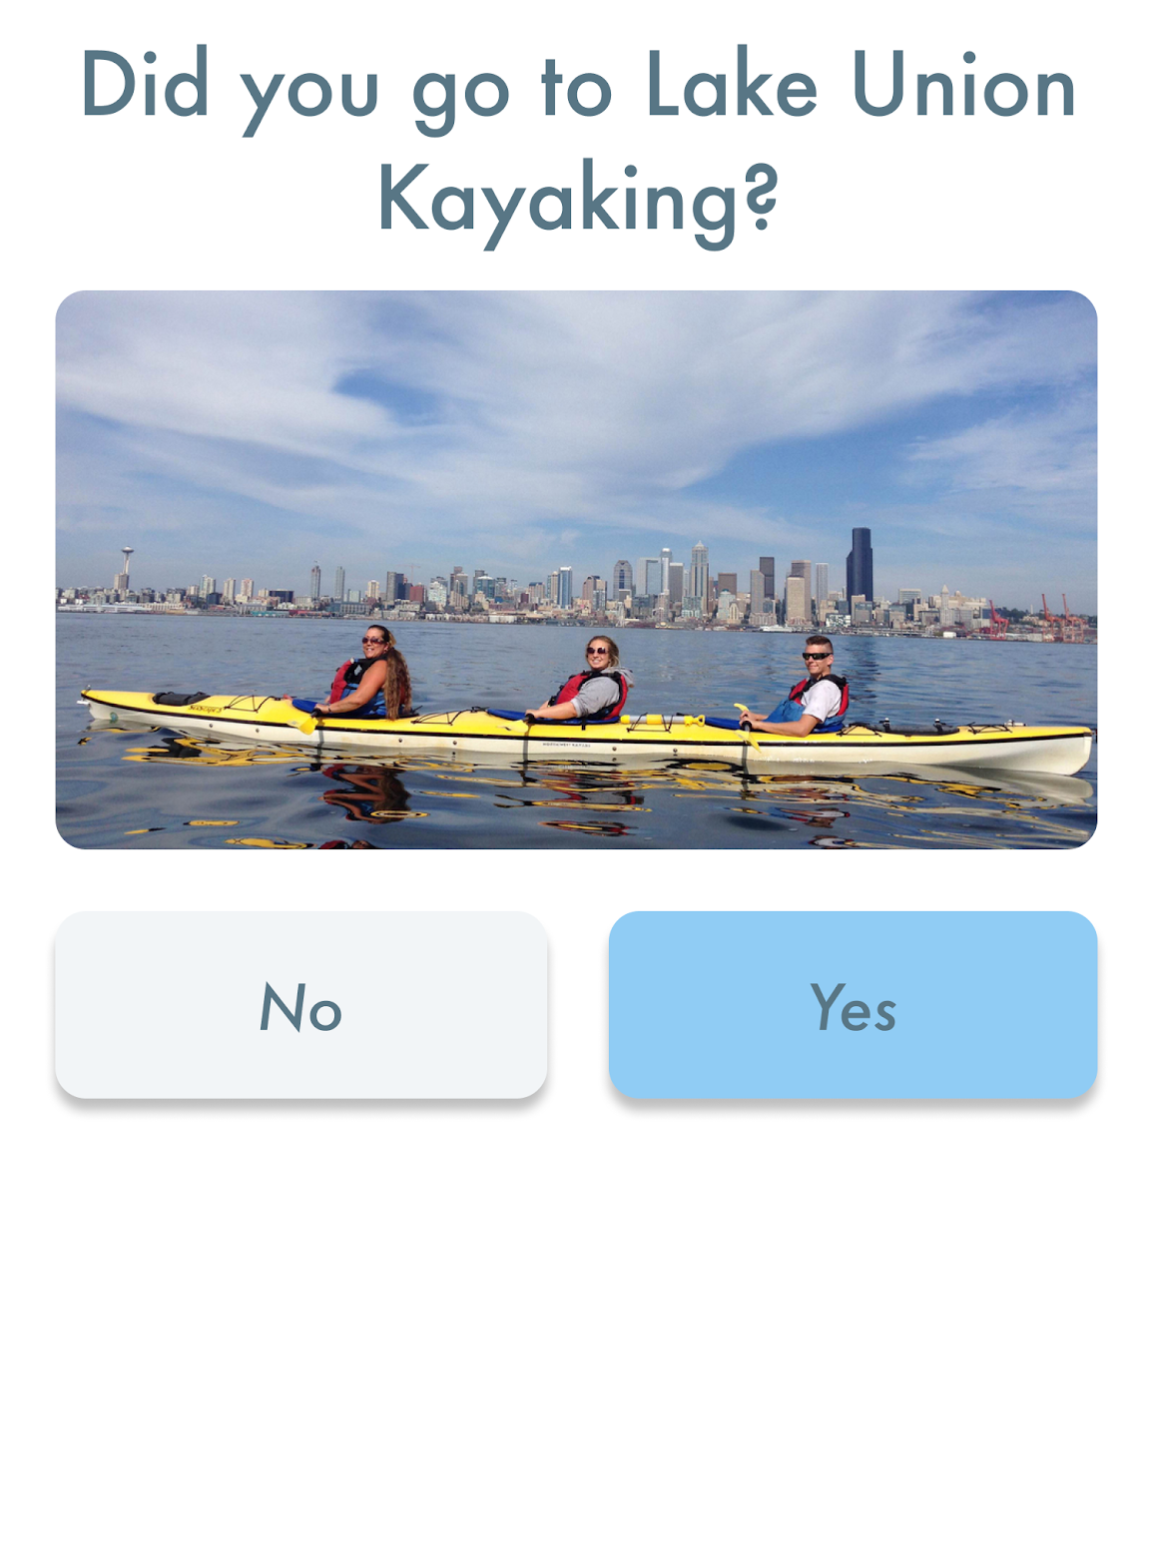
Overly complex feedback mechanisms
Severity
3
Before
After
Notes:
Furthermore, if a user did not visit a place, we provided that opt out of the feedback as well

Slide 21
Lack of user control in settings
After rating the experience, however, there is no way to go back and change the rating in case the user accidentally selected the incorrect rating. This can be a little frustrating to the user.
Notes:
For the second theme of lack of user control, we revamped our user settings to be more traditional, containing features such as FAQ, a past experiences tab to re-rate experiences, and the ability to reconnect social

Slide 22
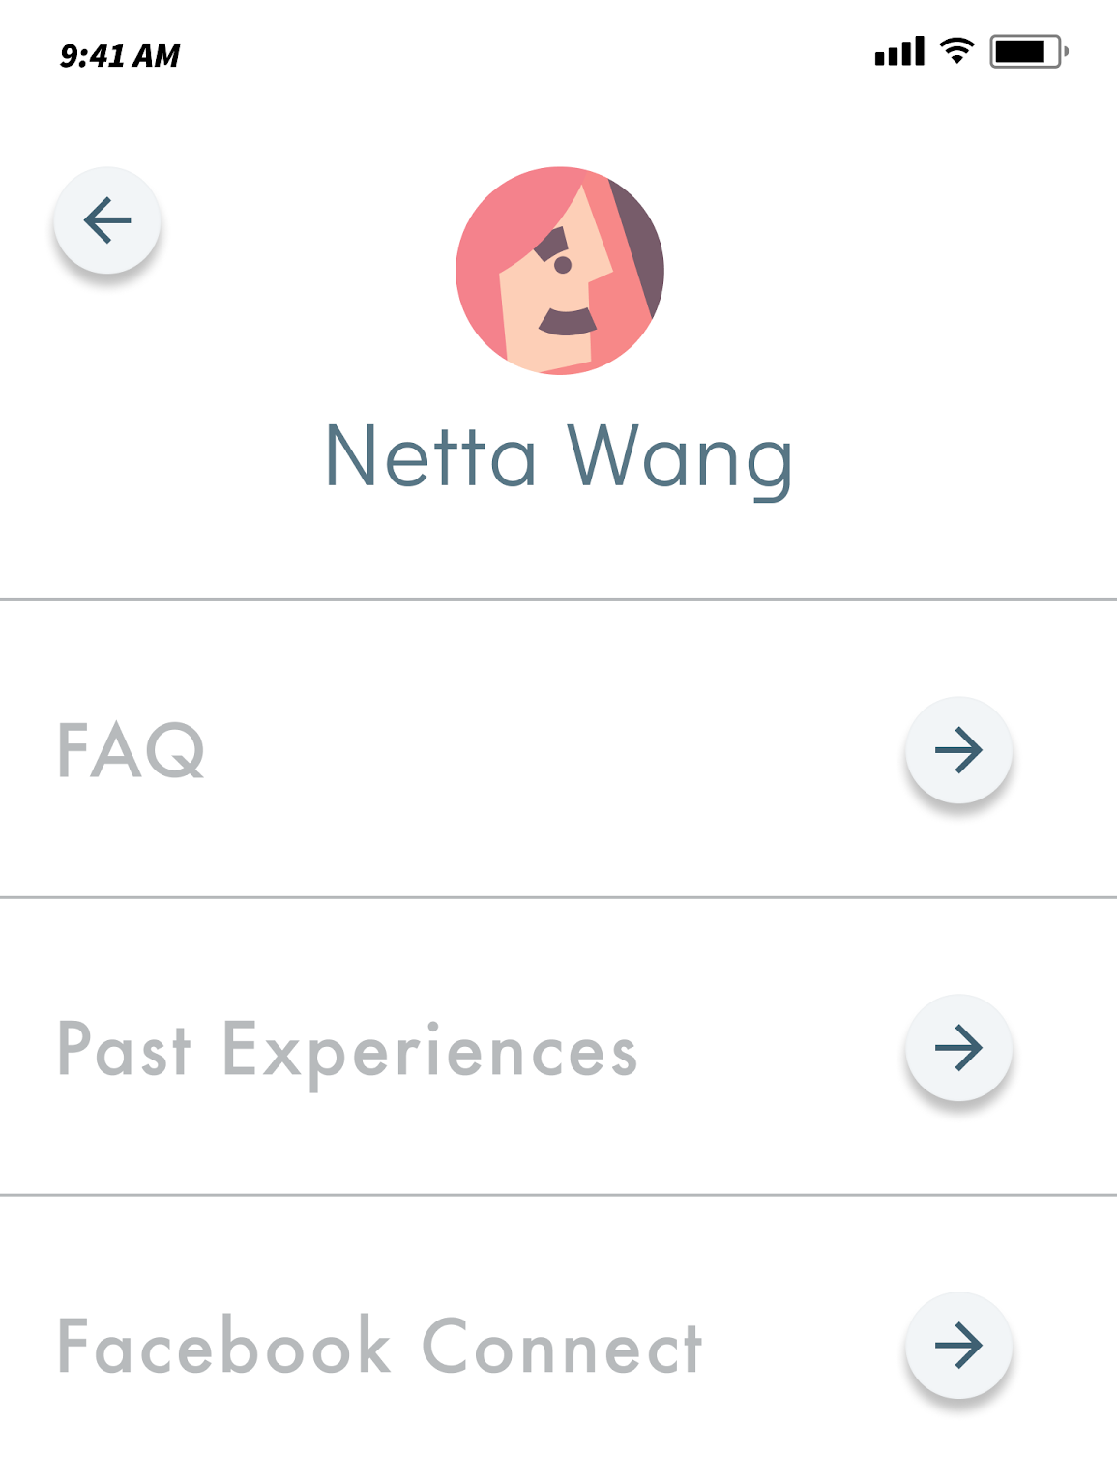
Lack of user control in settings
Before
After
Notes:
For the second theme of lack of user control, we revamped our user settings to be more traditional, containing features such as FAQ, a past experiences tab to re-rate experiences, and the ability to reconnect social

Slide 23
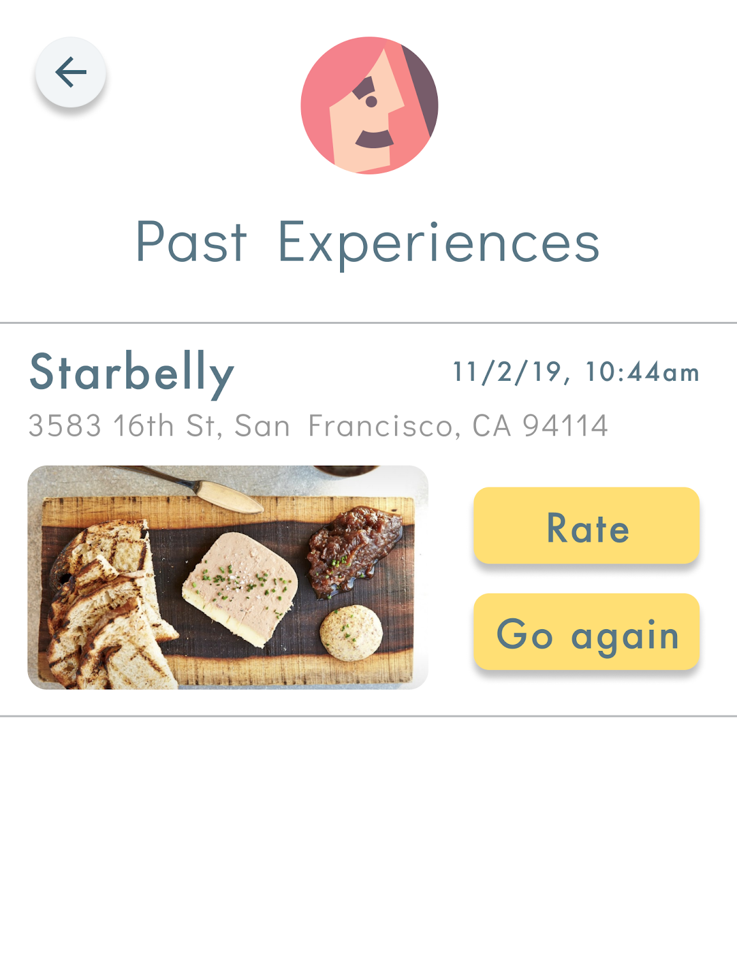
Lack of user control in settings
Before
After
Notes:
For the second theme of lack of user control, we revamped our user settings to be more traditional, containing features such as FAQ, a past experiences tab to re-rate experiences, and the ability to reconnect social

Slide 24
Ambiguous Social Connection
“When users click into a recommendation, there is no way of seeing which of their friends recommended the activity, even though profile pictures are displayed in the summary view of recommendations.”
Notes:
For the final high level severity theme, we focused on creating more transparency with social information. We put all the friends on this page so that when a user clicks on the page, they don’t have to recall which friends liked a location. We also made it more clear that the friends are on the page because they visited and enjoyed an experience

Slide 25
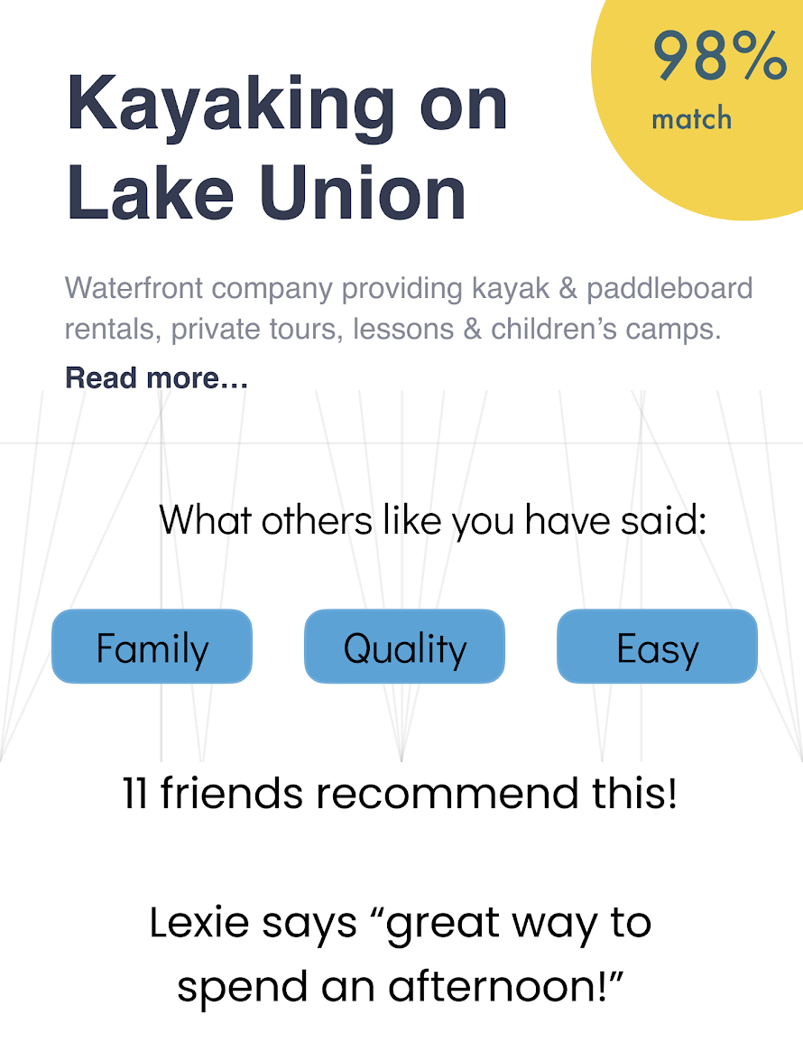
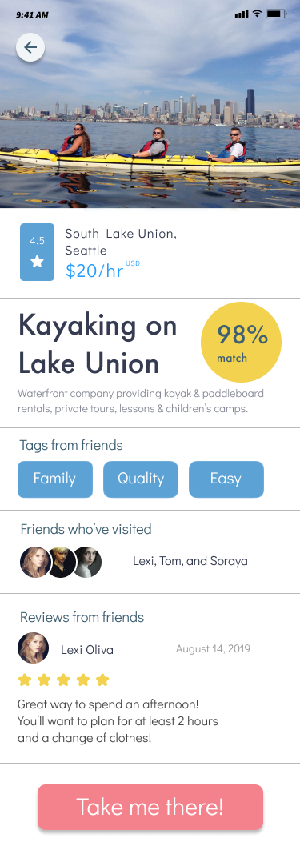
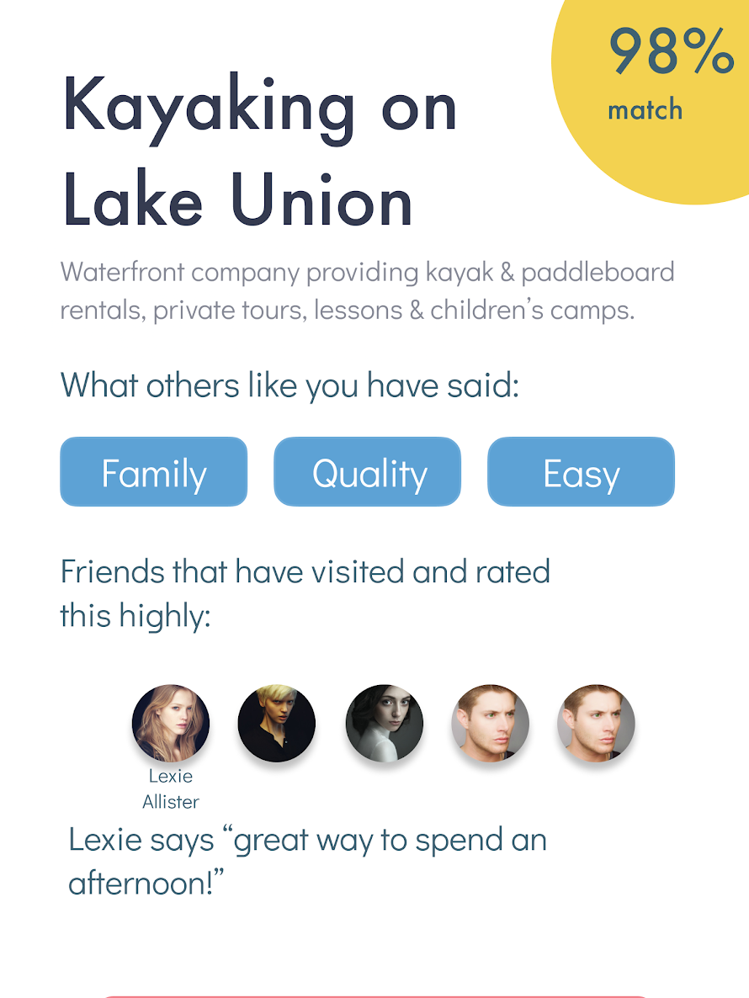
Ambiguous Social Connection
Severity
3
Before
After
Notes:
Finally, as a minor fix, if the user does not recognize someone, if they click on the user, their name shows up below

Slide 26
Introduction
Heuristic Results
Design Revisions
Prototype
Demo
Summary

Slide 27
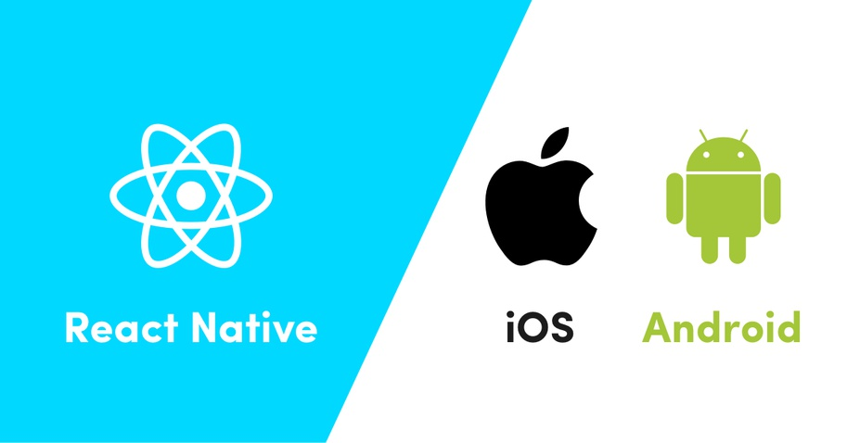
Prototype Tools
Notes:
We decided to build our high fidelity prototype in React Native for iOS. This gives team members without MacOS the ability to write code and compile for Android so we can make parallel progress on features and then merge for iOS

Slide 28
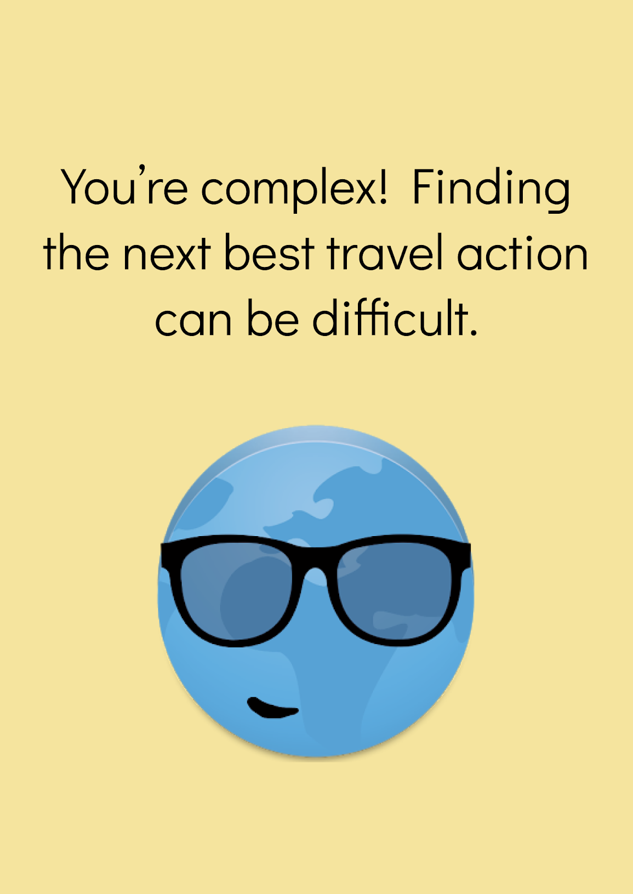
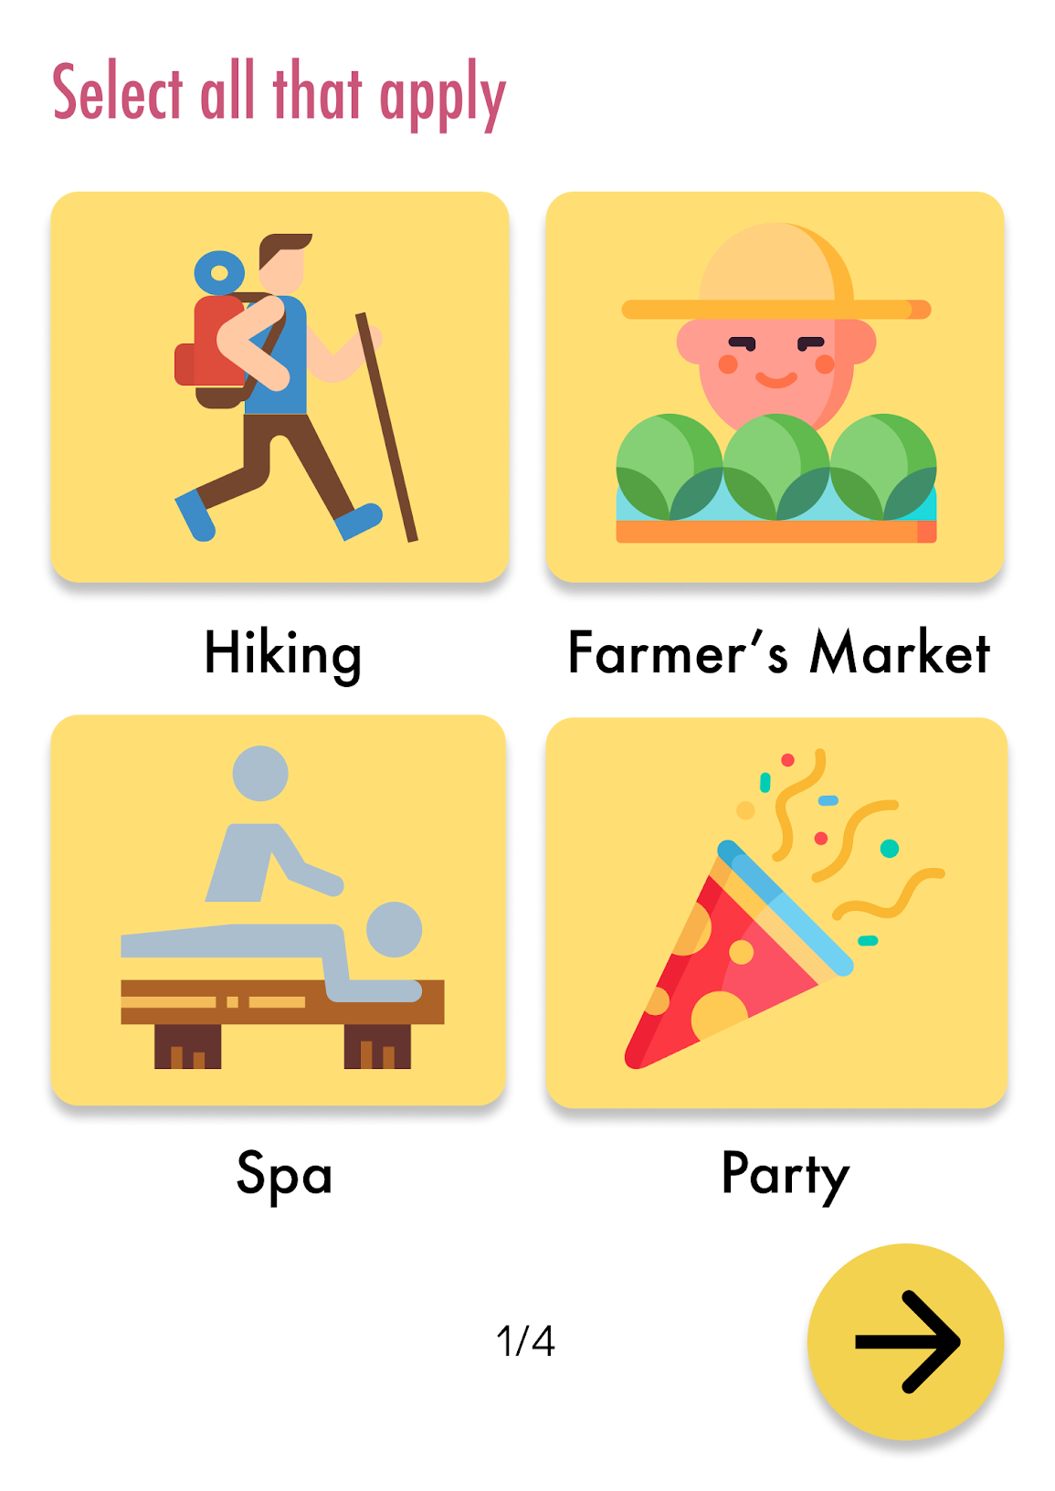
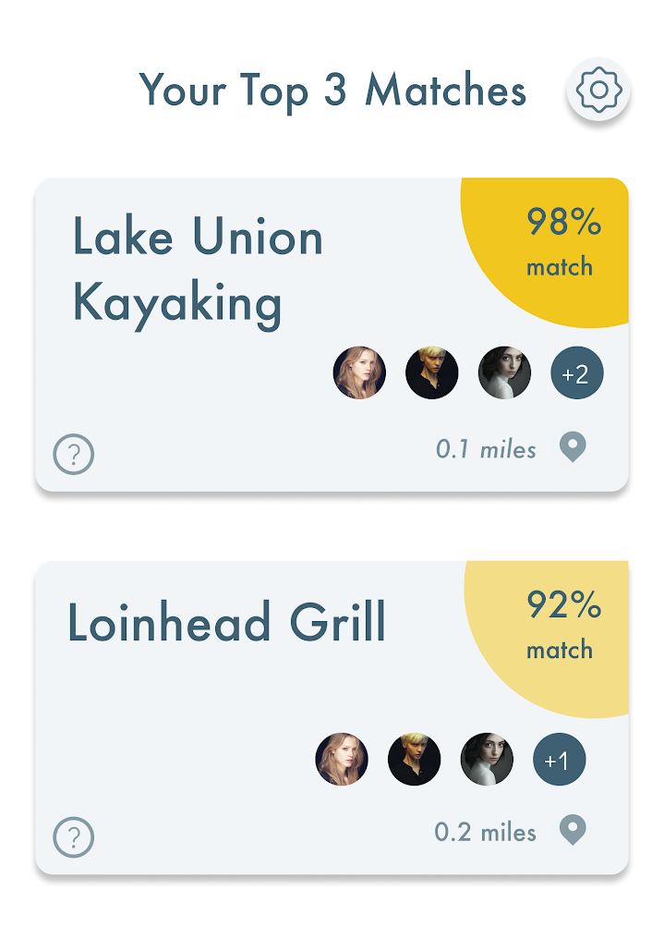
Implemented Features
Onboarding
Recommendation Survey
Home Screen Matches
Notes:
So far, we have built our codebase off of the boilerplate code, set up our environments, and have implemented Task 1, Users want to know what is around them. This has three parts to it, the onboarding flow to preface the user’s experience, the rec survey, and finally the matches that show up as a result. I will discuss this in greater detail for the demo.

Slide 29
Next Steps
Settings Page
Social Proof
Notes:
Our next steps are to implement the remaining features. Our second task is fairly trivial, and is as simple as adding a few hard coded pictures of friends on the home screen that are not currently there, so we envision that will take about an hour. For the bulk of our next round of coding, we need to implement the task 3 feedback mechanisms which includes rating and chatbot. We also want to build the settings page to create the full end to end experience based on our Figma Designs.

Slide 30
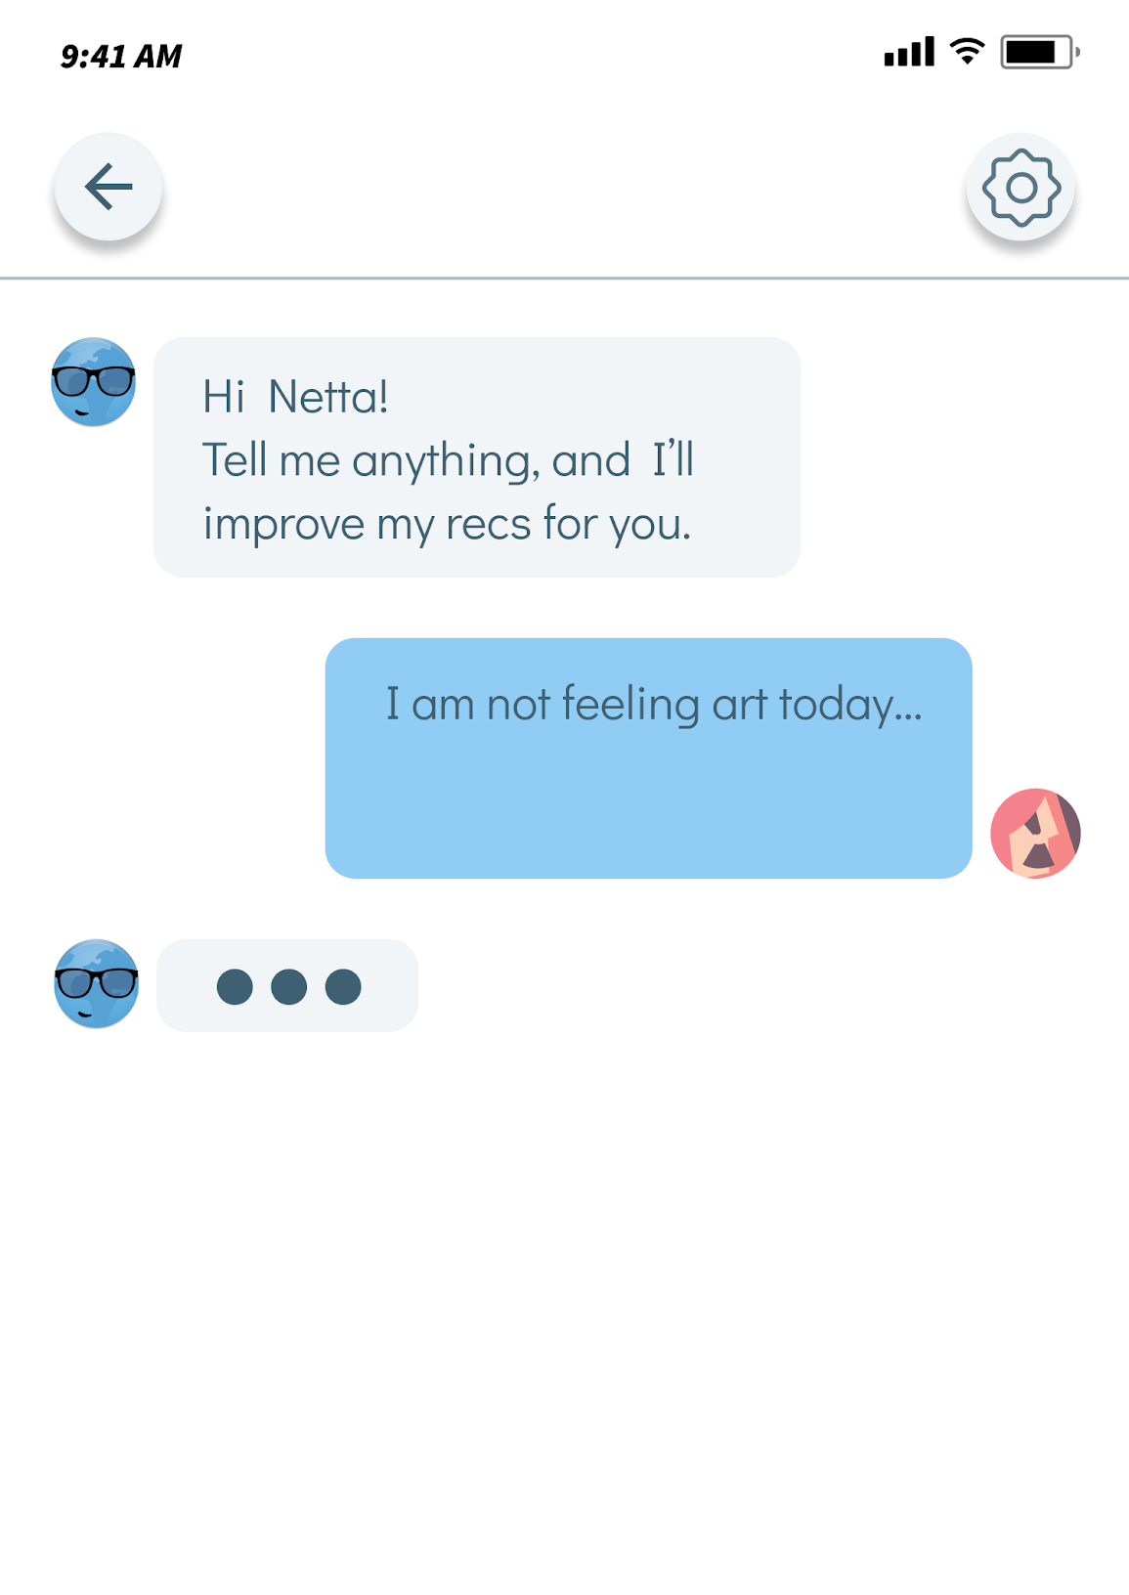
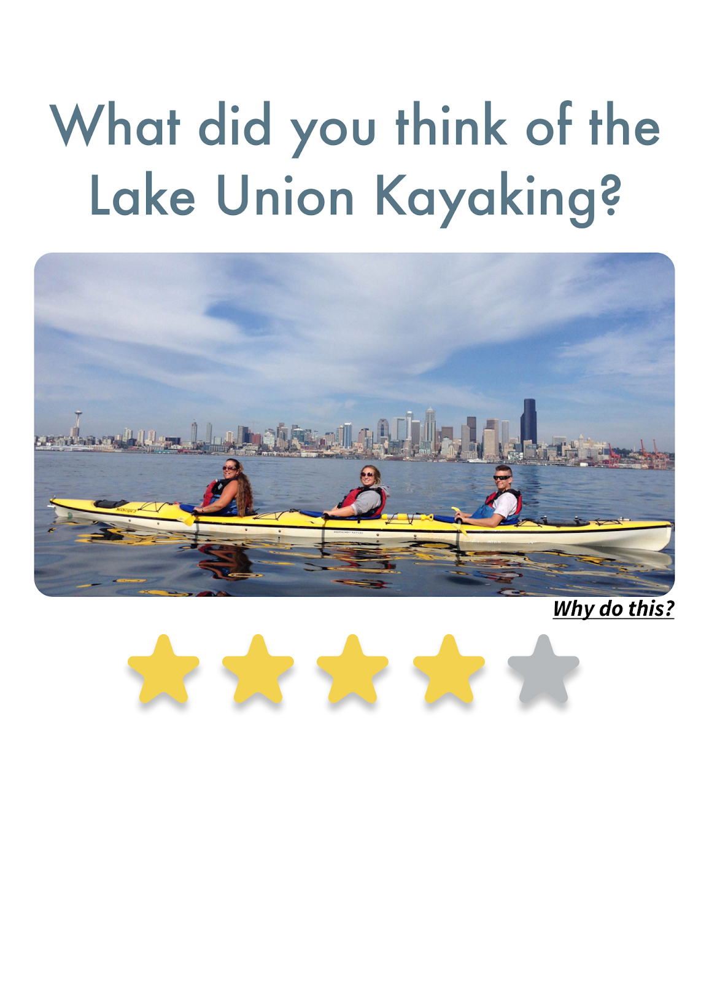
Next Steps
Chatbot Experience
Rating System
Notes:
Our next steps are to implement the remaining features. Our second task is fairly trivial, and is as simple as adding a few hard coded pictures of friends on the home screen that are not currently there, so we envision that will take about an hour. For the bulk of our next round of coding, we need to implement the task 3 feedback mechanisms which includes rating and chatbot. We also want to build the settings page to create the full end to end experience based on our Figma Designs.

Slide 31
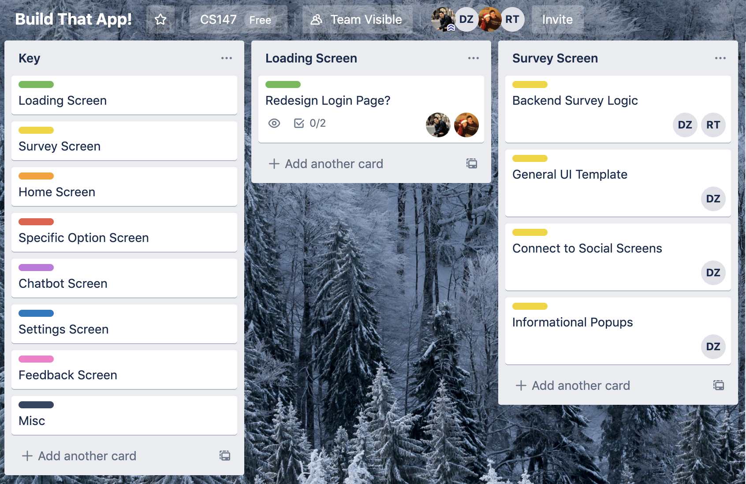
Next Steps
Notes:
We’re using Trello to organize and delegate responsibilities for the rest of the quarter. Here is an example of what our Trello board looks like.

Slide 32
Next Steps
Final Report Rough Draft
Thanks
giving
Break
Task 2 + Settings screens
Project Poster
Final Report
Final Draft
Week 10
Task 3 screens
Final Presentation slides
Notes:
We’re using Trello to organize and delegate responsibilities for the rest of the quarter. Here is an example of what our Trello board looks like.

Slide 33
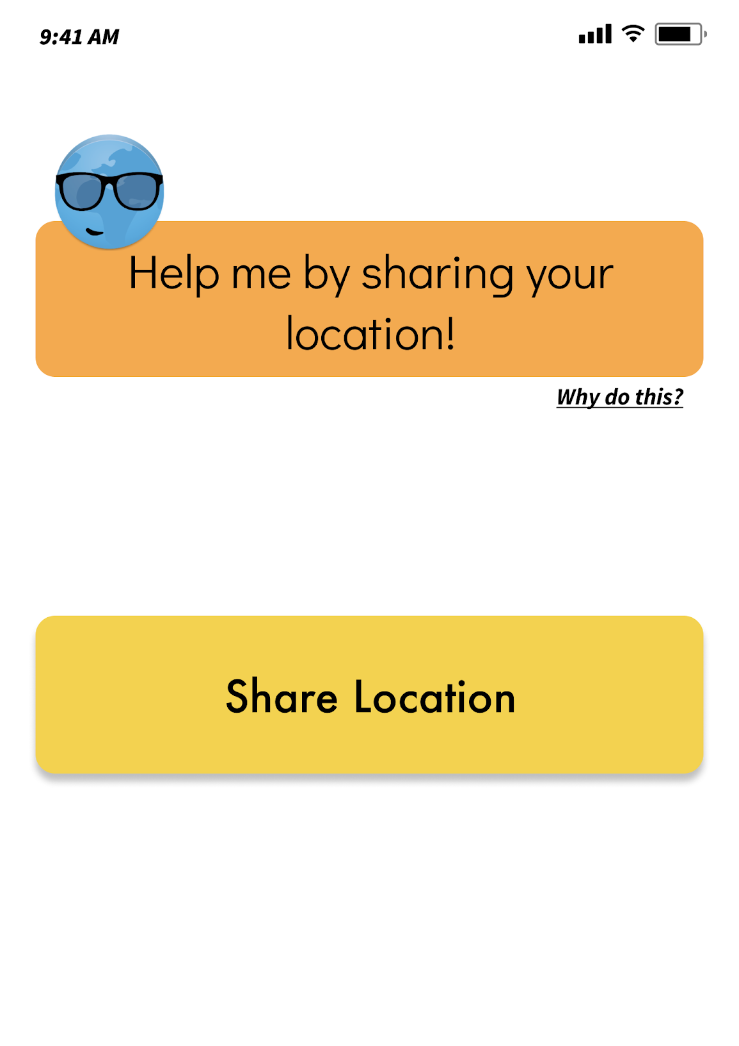
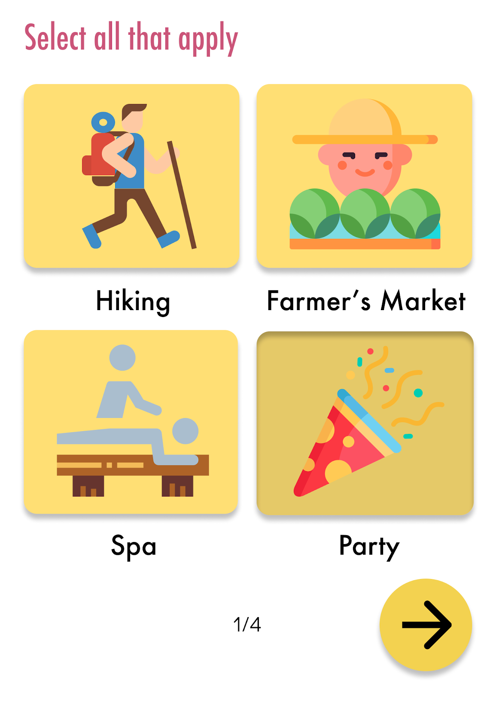
Wizard of Oz and Hard Coding
Location, Social, and Friend Data
Chatbot Experience
Survey Scoring
Notes:
Are we going to hard code the friend recommendation stuff?

Slide 34
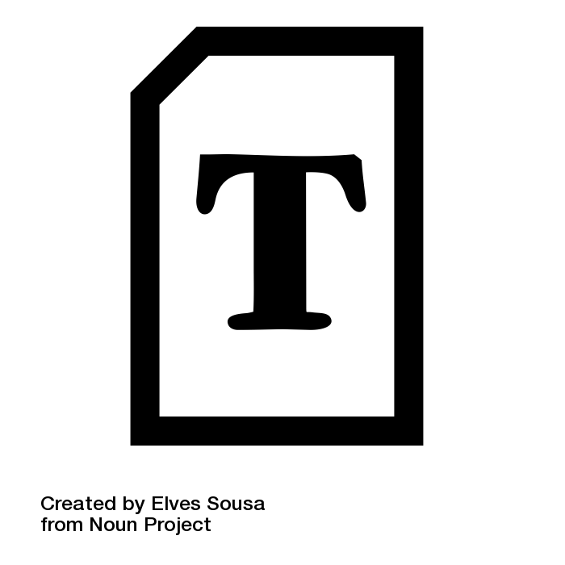
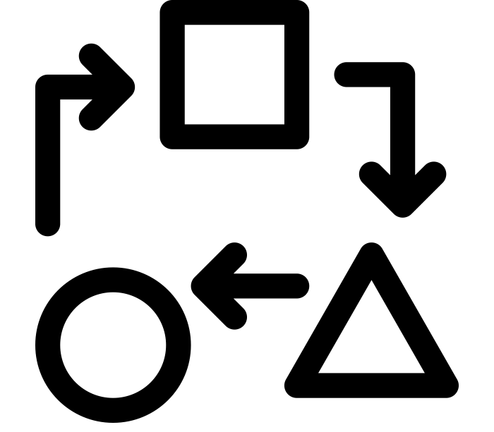

Issues & Difficulties
Custom Font Loading
React Custom Transitions
Chatbot Wizard of Oz
Notes:
We resolved every severity 3 and 4 violation (we didn’t have any severity 4). For every other heuristic violation, we either fixed it or decided that it should not be fixed either because of increased complexity or low value. In total, I estimate that we fixed a bit over 50 percent of the violations and decided that the other half were either not significant usability problems, not relevant to the core functionality of the product, or required too significant of a redesign given the severity rating. We also addressed a significant amount of the TA feedback that was not directly in the heuristic violation report

Slide 35
Introduction
Heuristic Results
Design Revisions
Prototype
Demo
Summary

Slide 36


Slide 37
Introduction
Heuristic Results
Design Revisions
Prototype
Demo
Summary

Slide 38
Summary
Fixed, addressed Heuristic Violations and TA feedback
Organized and delegated remaining responsibilities through Trello
Implemented Task 1 on React Native code base

Slide 39
Q&A

Slide 40
Appendix

