Slide 1

Value Proposition, Problem and Solution Overview
Value Proposition: Personalized Adventure On-Demand
Problem: When traveling, people have difficulty finding specific activities based on their interests unless they sacrifice time and spontaneity to make detailed itineraries
Solution: Hyperlocal, personalized, real-time recommendations to guide people through open-ended travel situations.

Slide 2
Simple Task: Figure out what you can do nearby
* This task and our moderate task remain unchanged but our complex task was changed.

Slide 3
Moderate Task: Figure out what your friends have done before

Slide 4
Complex Task: Personalize your travel experience
Sub-task 3a: Choose an option and evaluate it
Sub-task 3b: Inform app that you don’t like the options
Sub-task 3c: Inform app of your preferences to get recommendations
Sub-task 3d: Edit your interests to get better recommendations
Changes: This task was edited from being a two-part task comprised of only sub-task 3a and 3b. We extended the subtasks to encompass our complete app functionality (i.e. filling out the initial preferences survey and editing in-app interests)

Slide 5
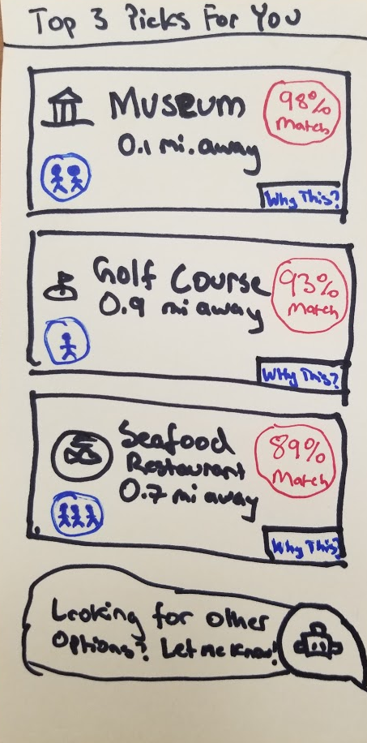
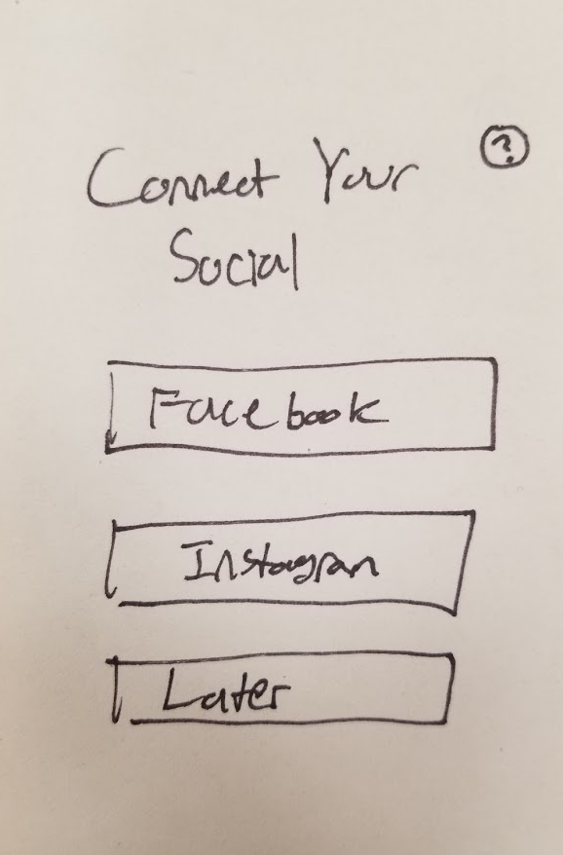
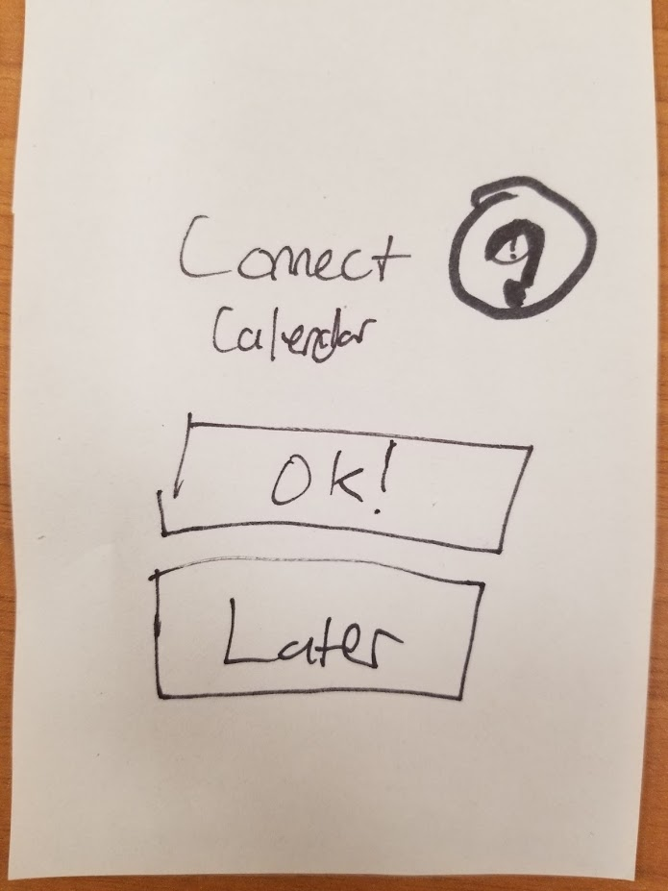
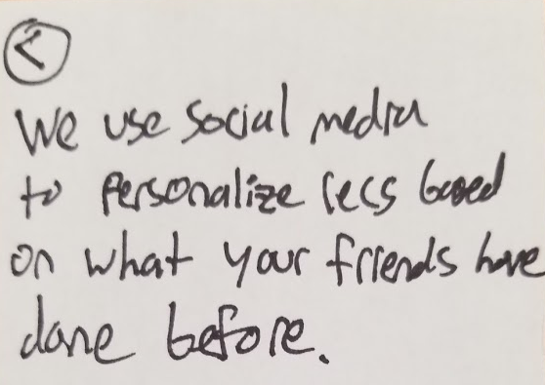
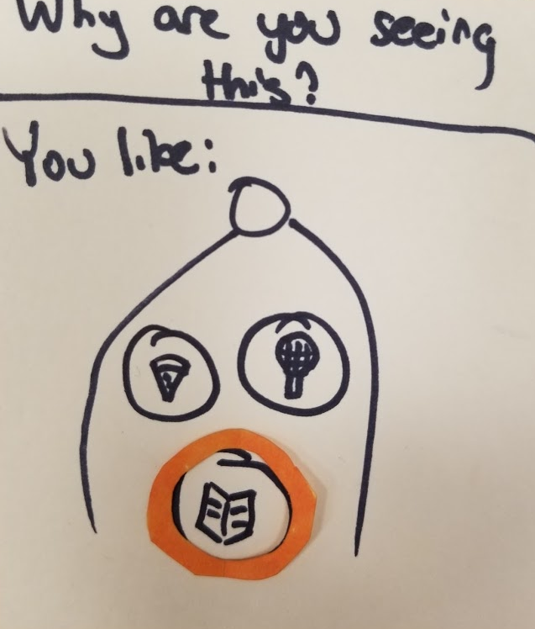
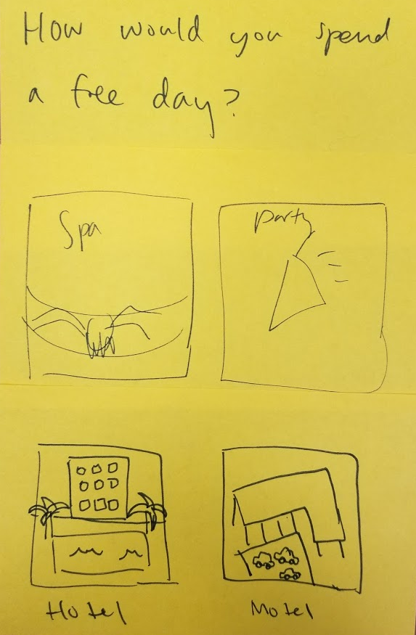
Main Screen & AI Explainability Pictures
Onboarding Pictures
More survey questions
Notes:
We ran a second round of low fidelity prototypes to test some of our major redesigned features.

Slide 6
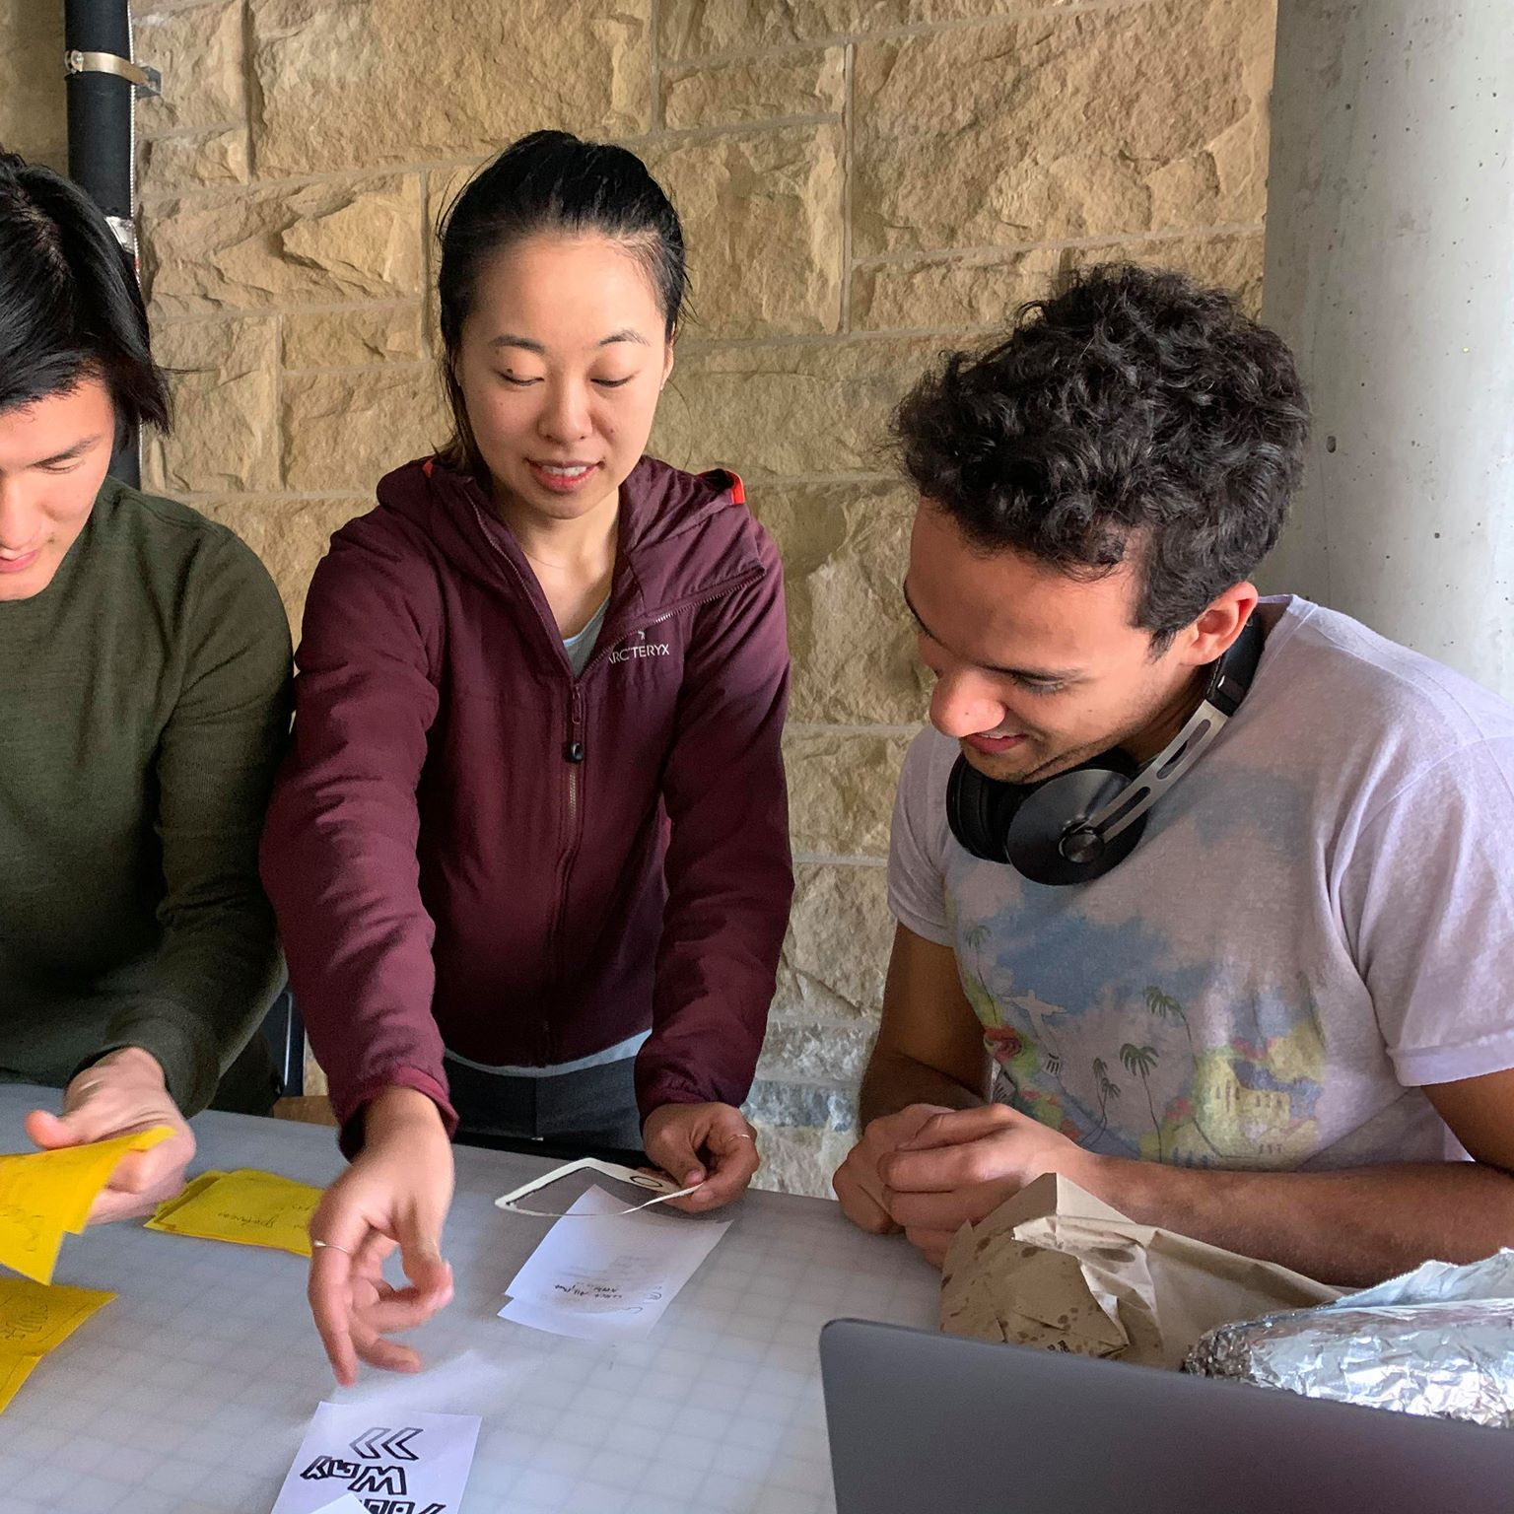
Additional Low-fi Prototyping
Rationale: After receiving user feedback, we realized that we should make substantial changes to our user onboarding process and main screen. We also were curious about an AI explainability feature
Medium: Used previous low-fi prototype with new paper cutouts to simulate new features
Methodology: We cold-approached two strangers in the d.school, Greg (pictured) and Jack
Notes:
We ran the study with one student and one non-student

Slide 7
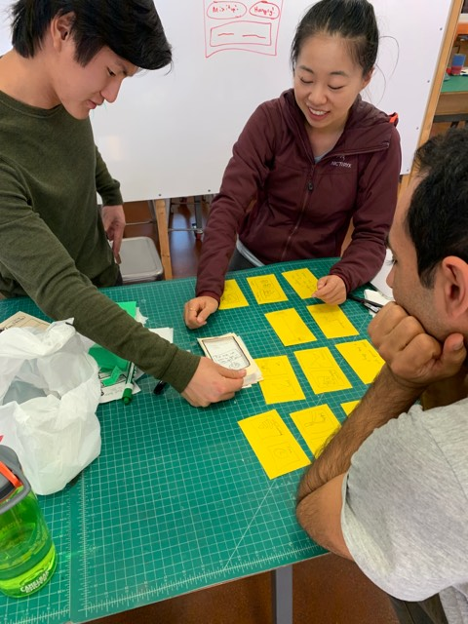
Low-fi Prototype Results
AI Explainability
Jack (pictured) clicked on the AI explainability feature in our main menu without any prompting
Jack liked that he could see why the app made decisions. However, he thought the icons on the AI explainability screen were confusing
Main Page
Both users correctly guessed the meaning of the social icon. They both liked quickly checking how popular an attraction was.

Slide 8
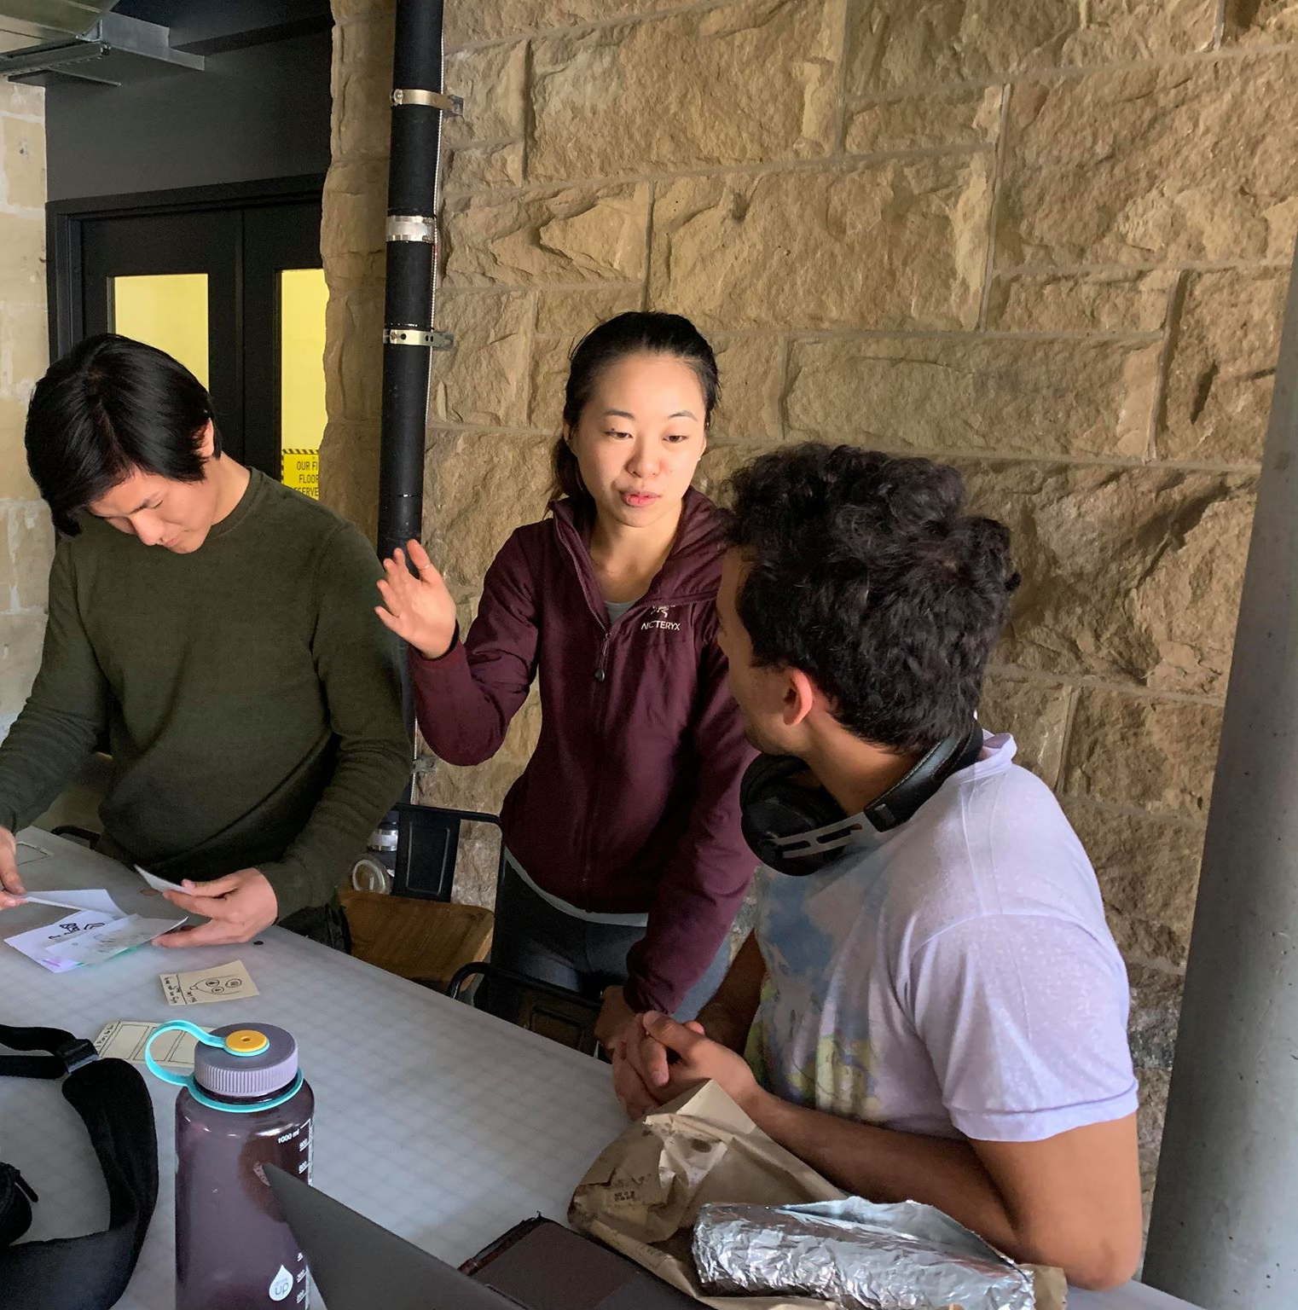
Low-fi Prototype Results Continued
Onboarding
Users enjoyed the new onboarding process. They felt the quiz was enjoyable and straightforward
Greg wanted an AI assistant that was cute and not robotic
Users liked seeing why we asked for their social/calendar integration. However, they had trouble finding the buttons that provides our explanations for the integrations.

Slide 9
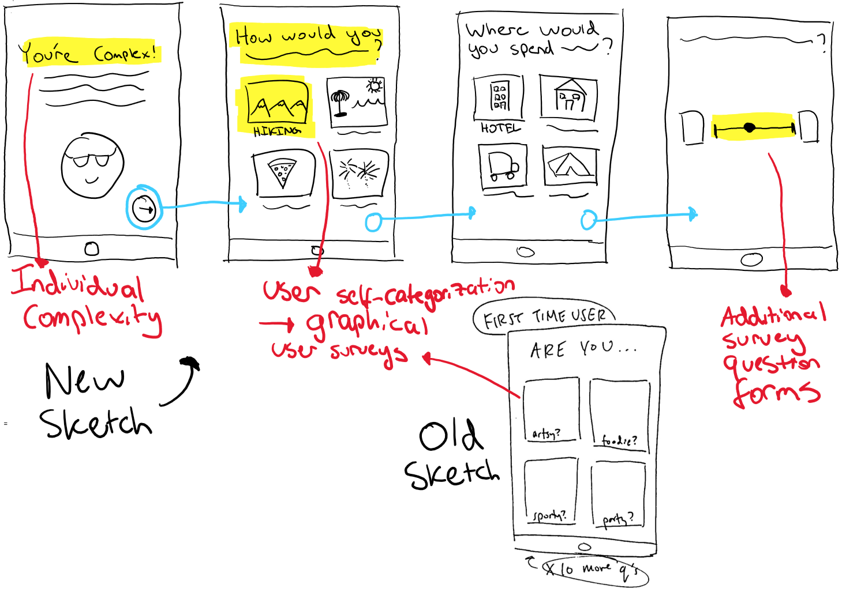
Design Change: Onboarding
Core Changes:
Splash screens explaining the need for complexity
Use graphical, limited- choice user surveys
Rationale:
Users dislike discretizing their personalities
Users are complex and we need to see different aspects of personality
Clarity reduces survey purpose confusion

Slide 10
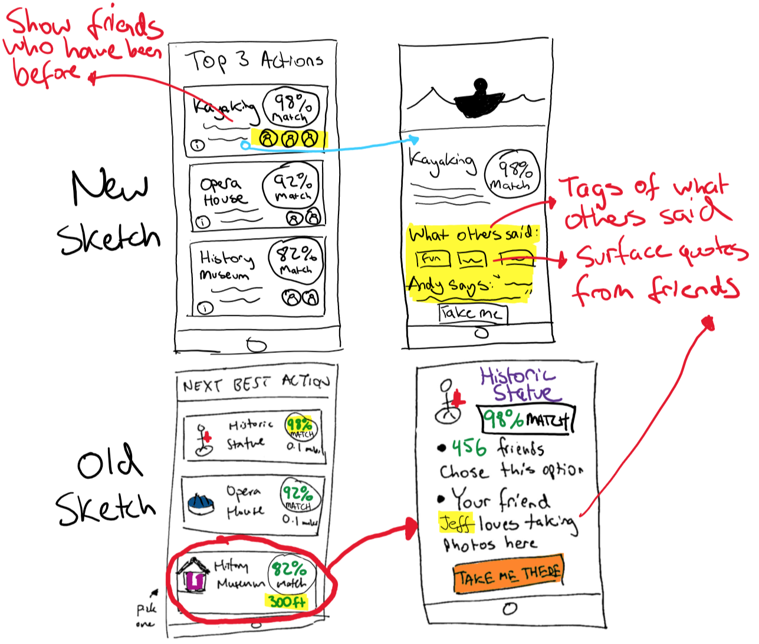
Design Change: Main Page
Core Changes:
Added icons of friends who have done each activity on main page
Added descriptive tags and quotes from friends in activity page
Rationale:
People should not have to click on each option to see “social proof”
Clicking on a particular activity option should surface more detailed information

Slide 11
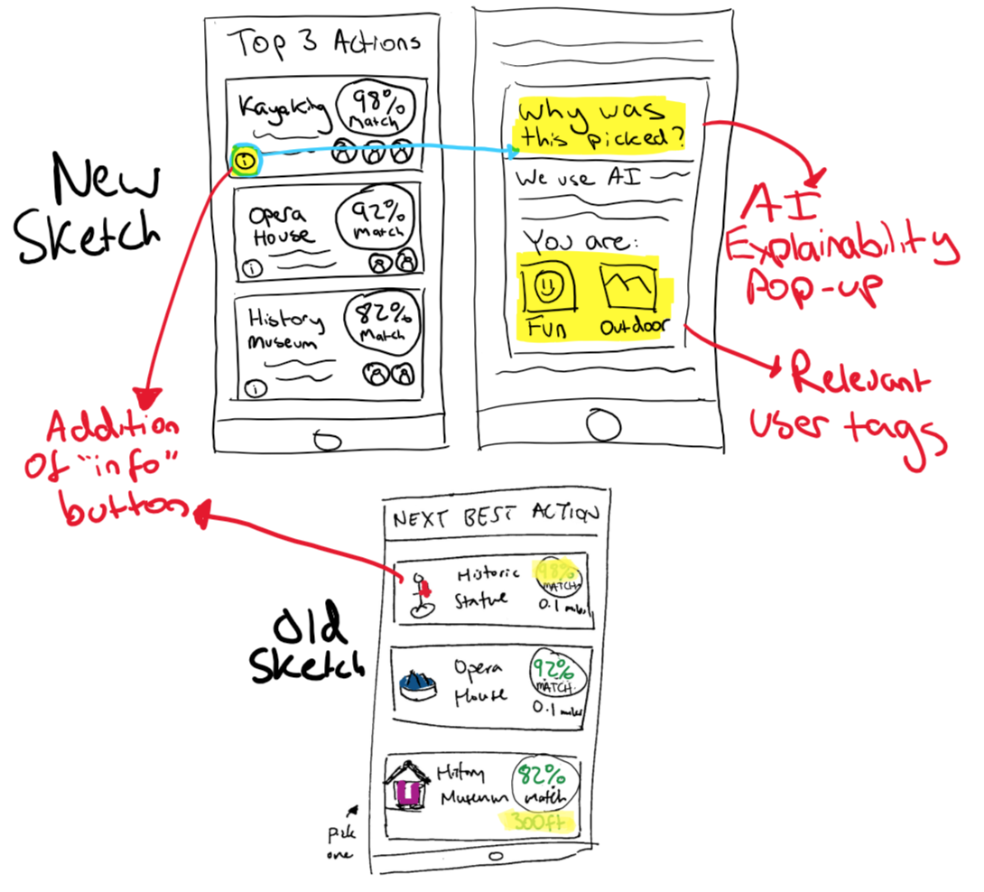
Design Change: AI Explainability
Core Changes:
Added “info” button to main page, which opens an AI explainability pop-up describing why that action was surfaced (i.e. user tags)
Rationale:
Users should see how their interests affect their recommendations
Users should have clarity on AI recs to build trust with system

Slide 12
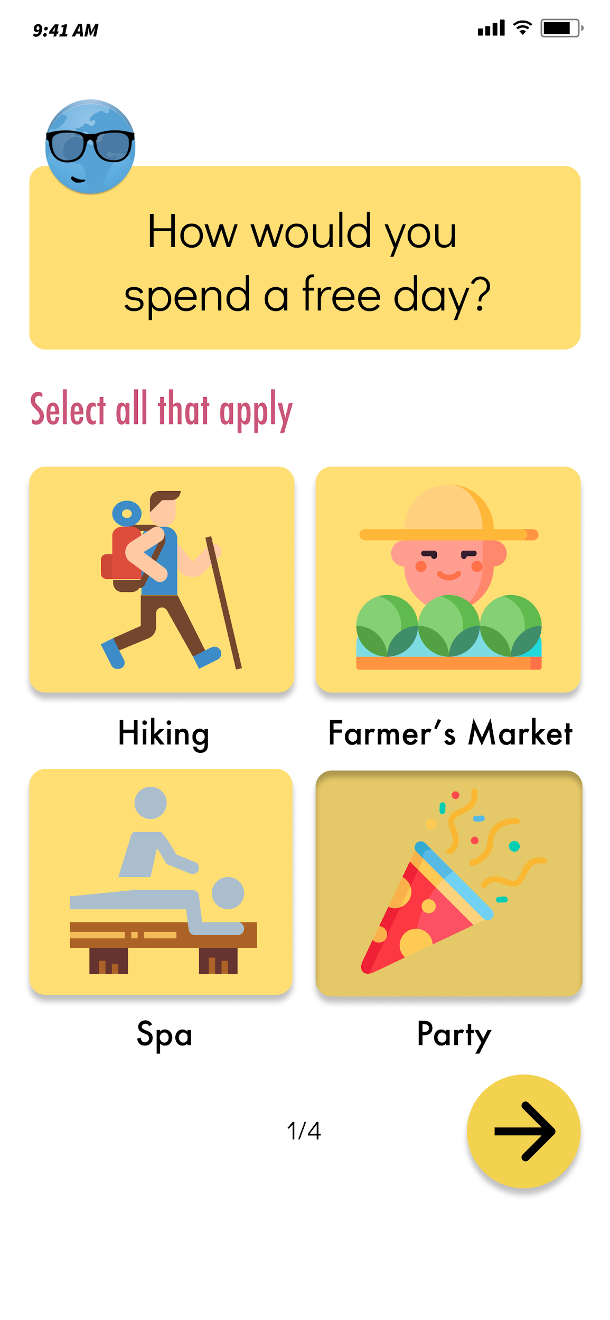
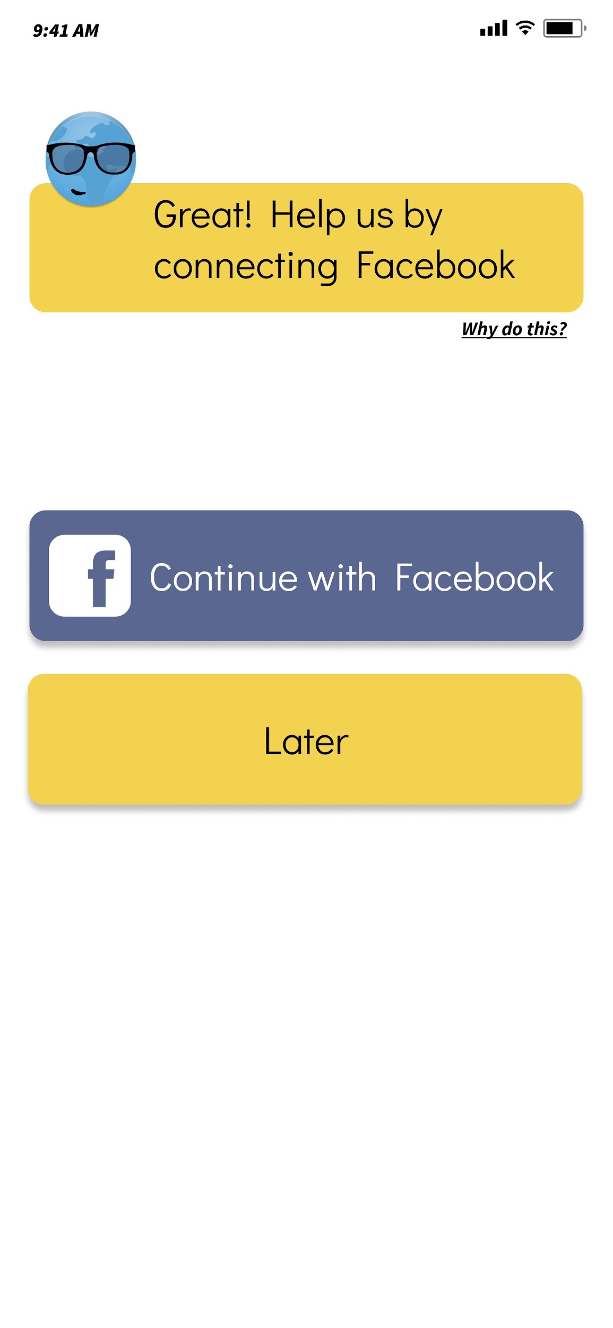
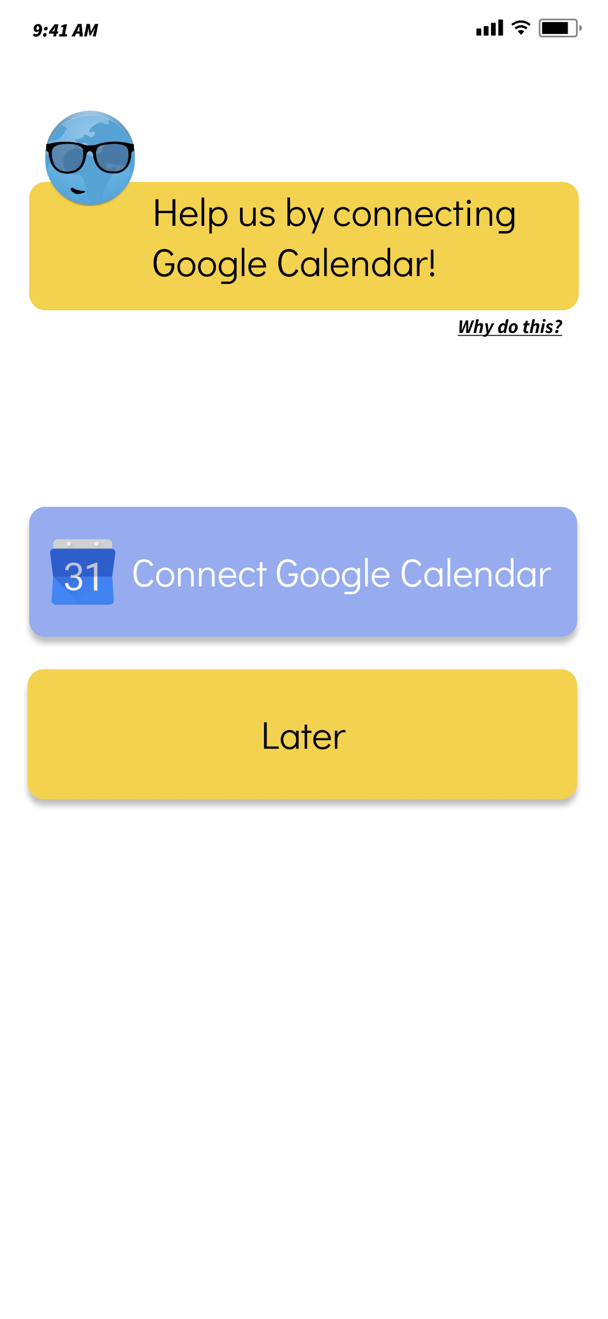
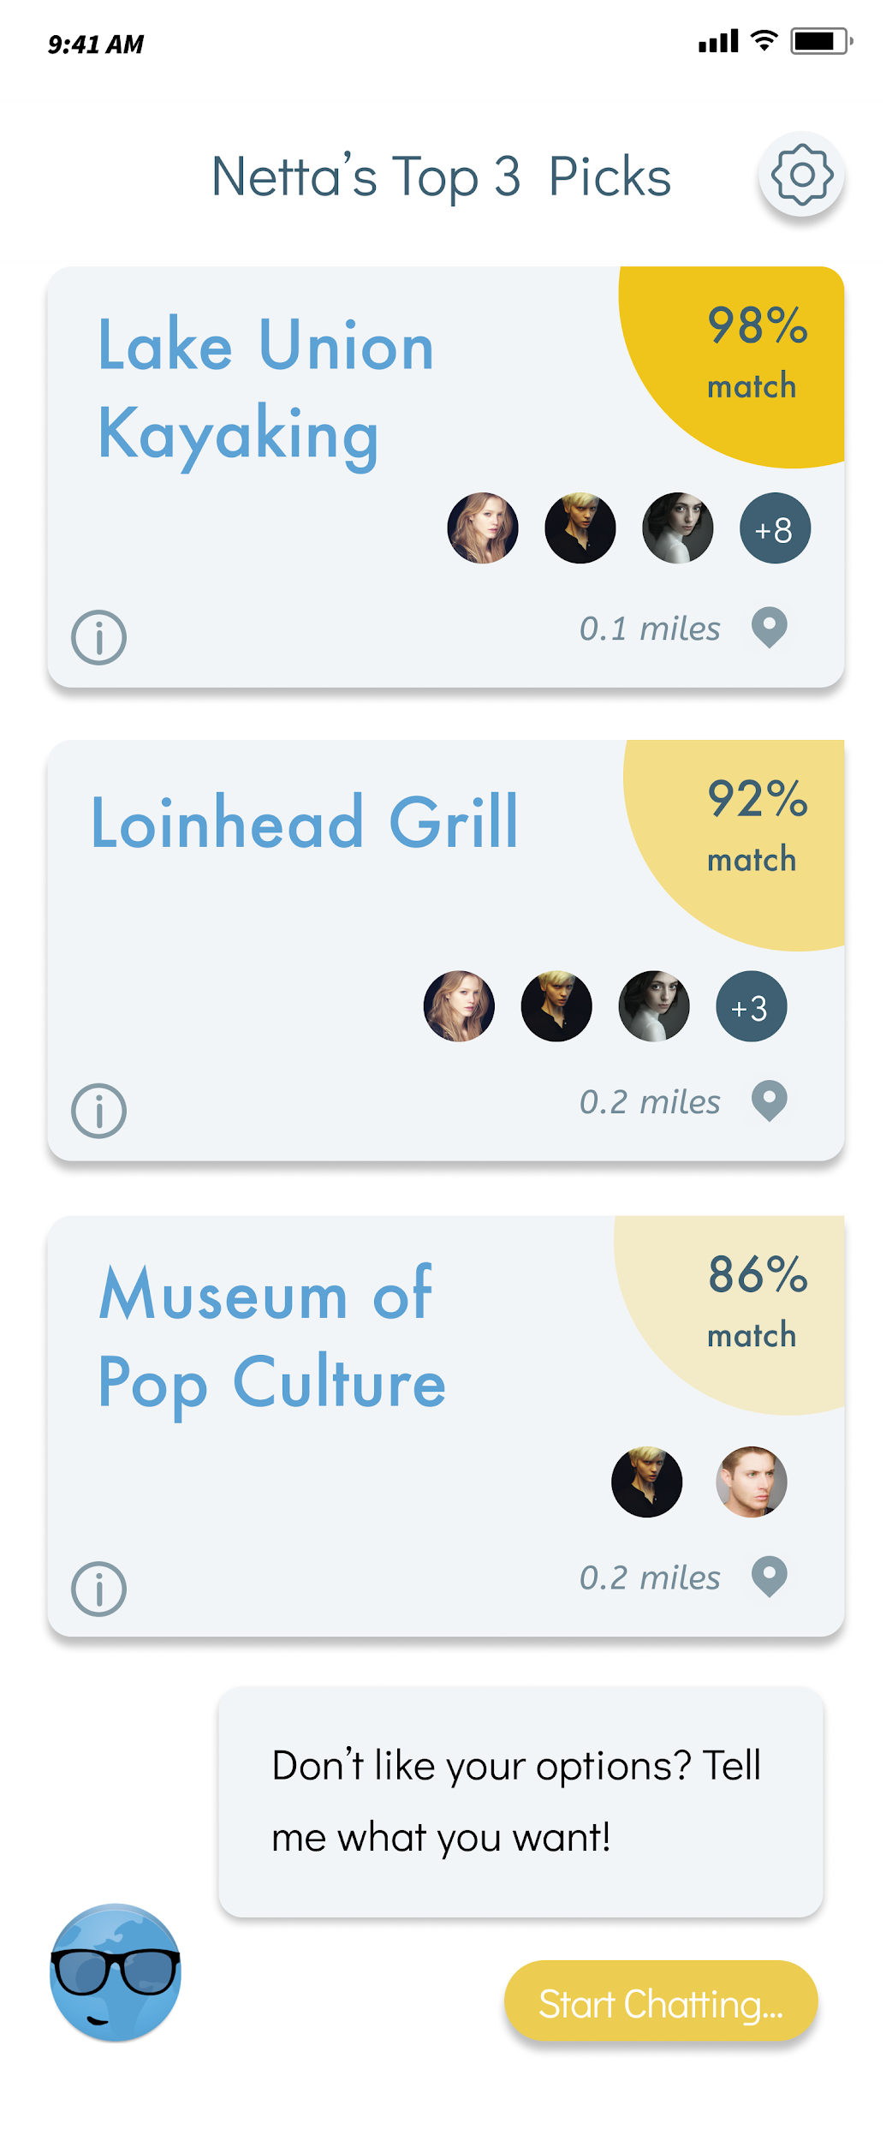
Task #1: Figure out what you can do nearby
More questions
Notes:
For Task 1, we want users to walk through the onboarding of first time usage to then be given their first batch of options for the next best travel action

Slide 13
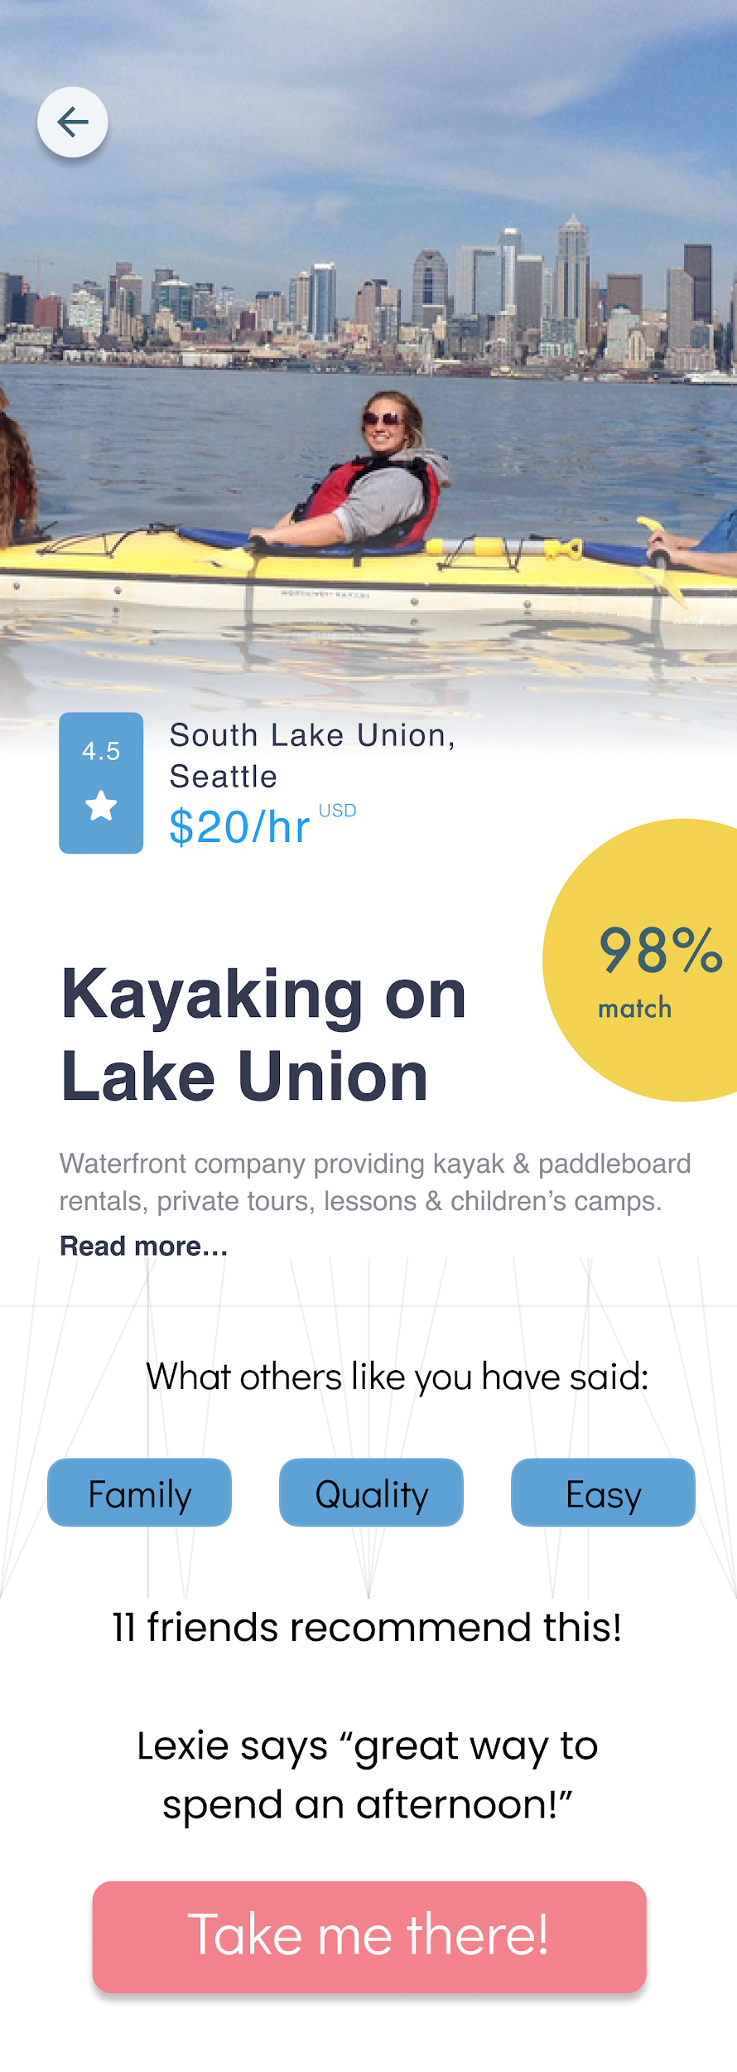
Task #2: Figure out what your friends have done before
Notes:
Users can see what their friends have done before on the home screen or click on specific options for even more granular detail about social proof

Slide 14

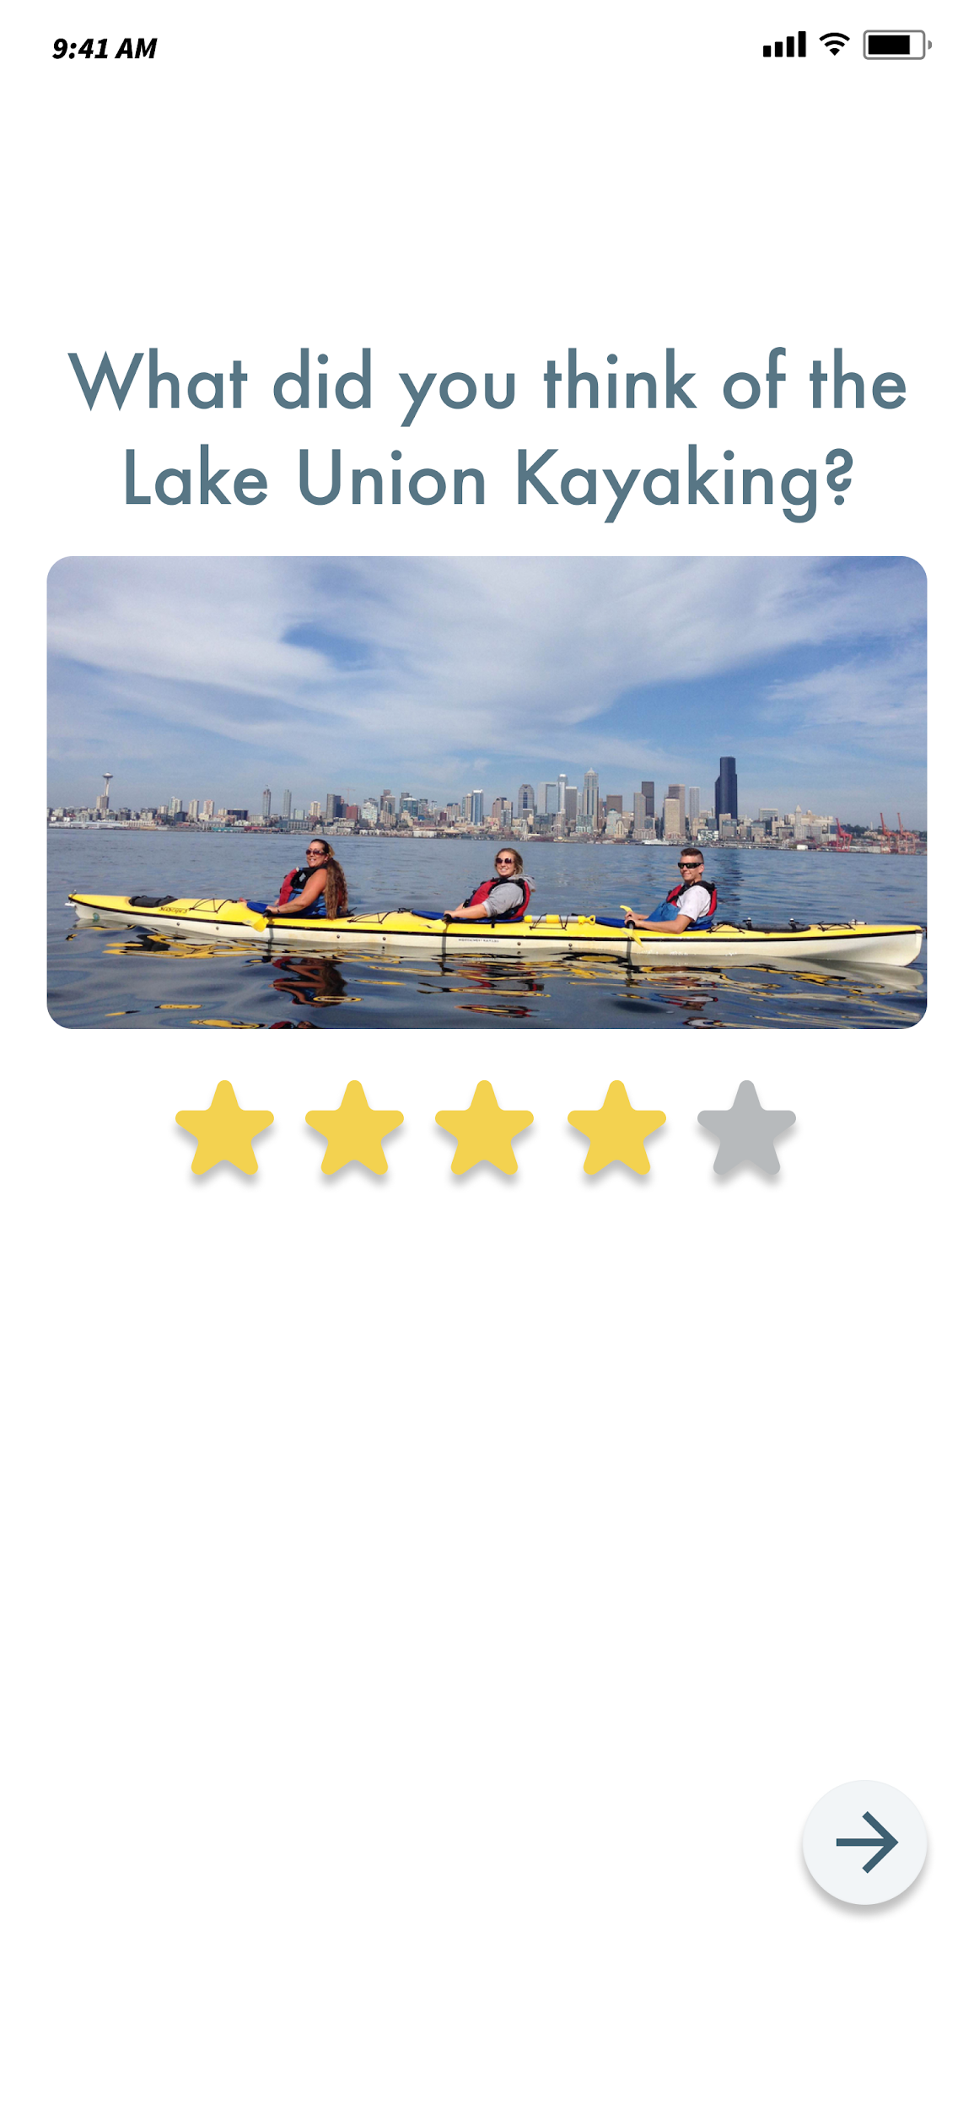
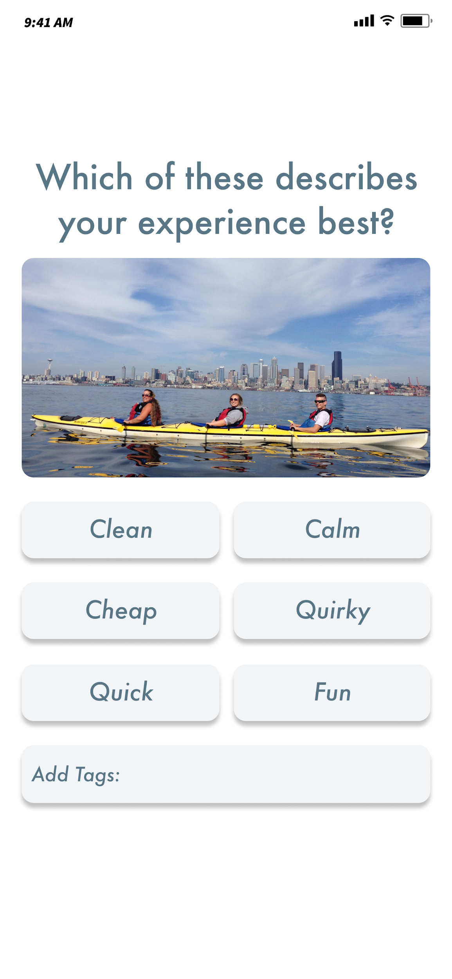
Task #3: Personalize your travel experience
#3a: Choose an option and evaluate it
Notes:
Users after they select a travel experience will be prompted to provide feedback so that the AI can tune its recs in the future. Feedback consists of a star rating and characteristic tags

Slide 15
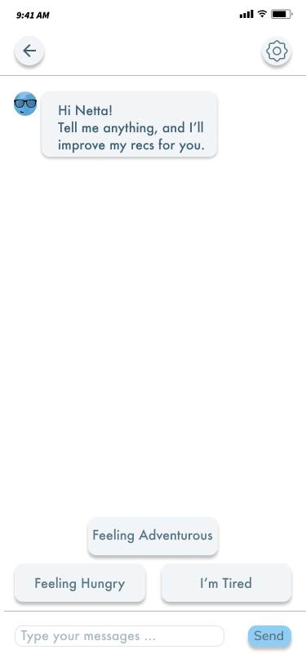
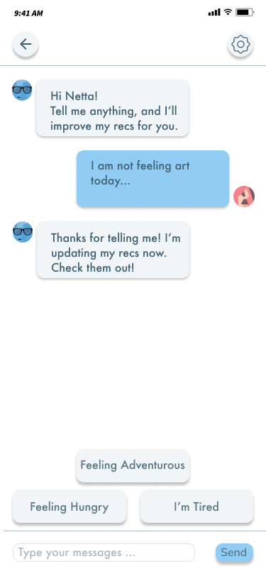
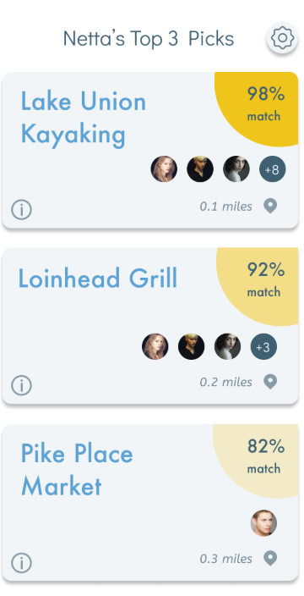
Task #3: Personalize your travel experience
#3b: Inform app that you don’t like the options
Notes:
Use the chatbot to customize actions in real time if unsatisfied. Use shortcuts or type out a message. The AI learns from this and updates your next best actions. The AI tries to interpret what the user means and updates accordingly

Slide 16
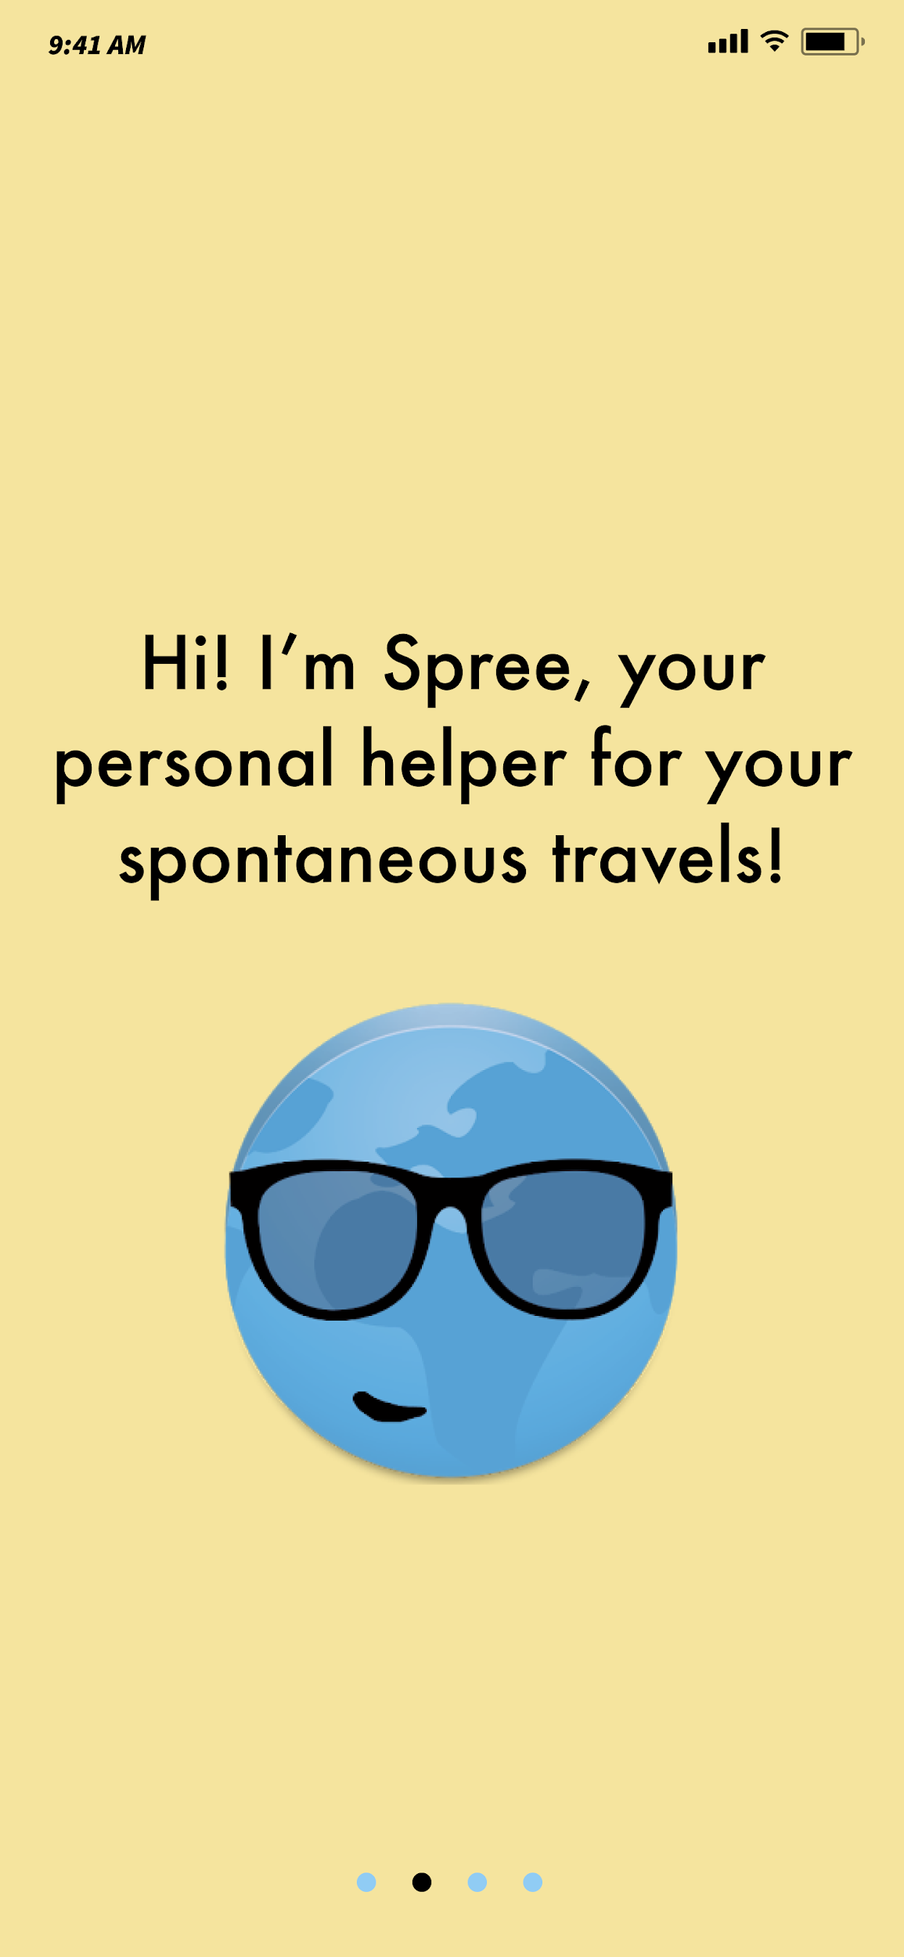

Task #3: Personalize your travel experience
#3c: Inform app of your preferences to get recommendations
More explanation slides
More questions
Notes:
The survey at the beginning helps the AI personalize the travel experience for the user

Slide 17
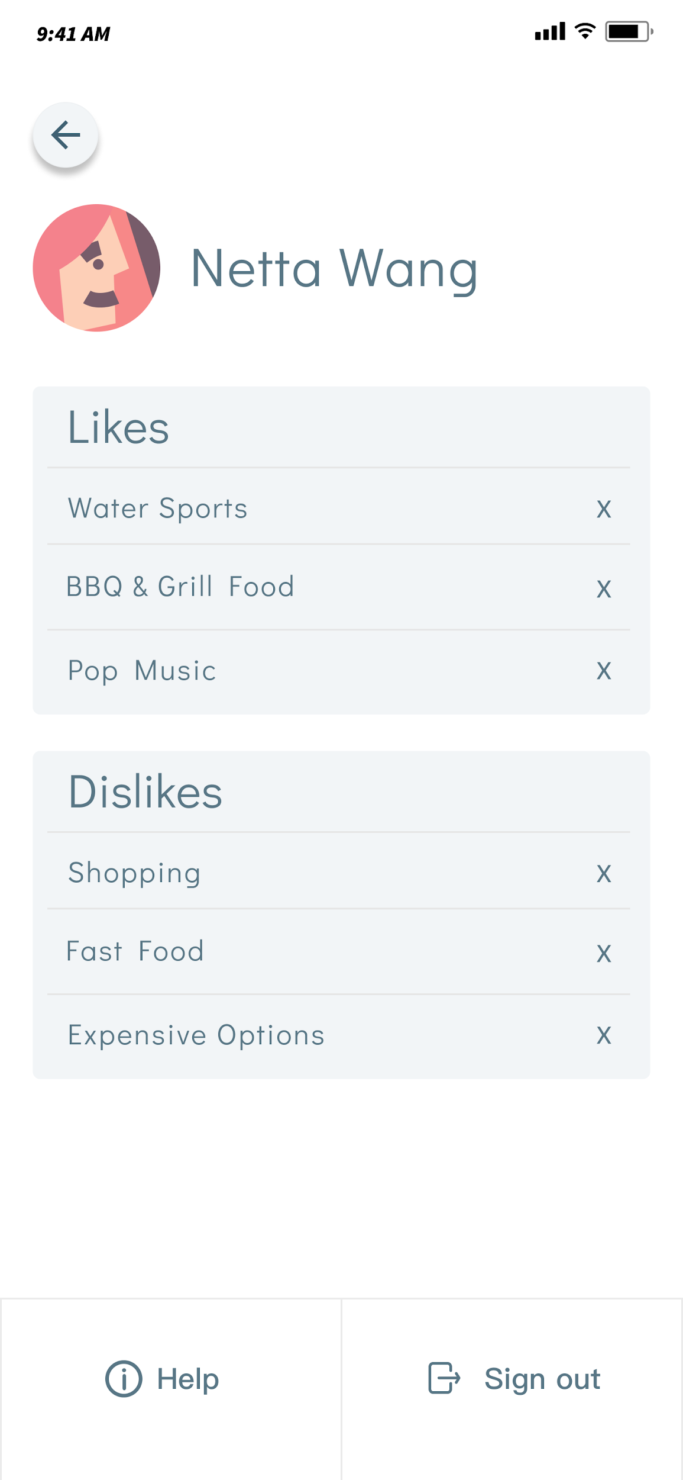
Task #3: Personalize your travel experience
#3d: Edit your interests to get better recommendations
Notes:
Users can update their likes and dislikes MANUALLY that the AI has surfaced from learning. Unlike the other update processes, the user can MANUALLY delete preferences if they know exactly what they want to change.
NOTE: We did not mock up the direct interaction of removing Likes or Dislikes in Figma for branching simplicity

Slide 18


Tools
Helpful Aspects
Unhelpful Aspects
Marvel helped us quickly create screens using the iPhone template
Marvel helped us mock up how users would swipe/interact with the app
Figma helped us quickly try different graphics and color schemes
Figma:
Creating app screens
Difficulty with Figma grids due to each template having a separate grid
Cannot lock placement of items in Marvel across multiple screens
Prototyping branching is not natively supported in Marvel
Marvel:
Animating screens
Notes:
Tools: Used Figma and imported sketch templates and flat icon icons. The tools helped us create a foundation to get started on making the prototype, especially with the iPhone templates. It was hard to grid things correctly since each template had different grids, each that we had to manipulate ourselves.
Parts b c and d are in the read me

Slide 19
Prototype Wizard-of-Oz and Hardcoding
Hardcoding:
Chatbot: We use hardcoded messages to imitate natural chatbot responses
Survey options: We hardcoded survey questions, responses, and the derived user tags from the survey
Social proof: The user photo icons, descriptive tags, and quotes are hardcoded
Activity options: The three activity options, their locations and match scores are hard-coded. Options are not personalized
User information: User location and likes/dislikes are hardcoded
Wizard of Oz:
None
Notes:
Tools: Used Figma and imported sketch templates and flat icon icons. The tools helped us create a foundation to get started on making the prototype, especially with the iPhone templates. It was hard to grid things correctly since each template had different grids, each that we had to manipulate ourselves.
Parts b c and d are in the read me
We will need to Wizard of Oz our high fidelity solution, but for Figma, we are not doing anything crazy behind the scenes

