Slide 1
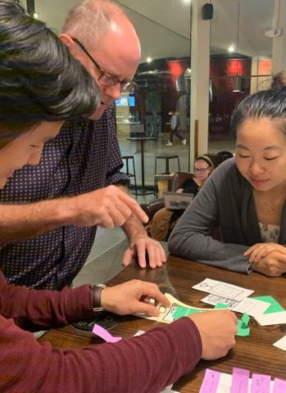
Low-Fi Prototype and Test
By Team Journey

Slide 2
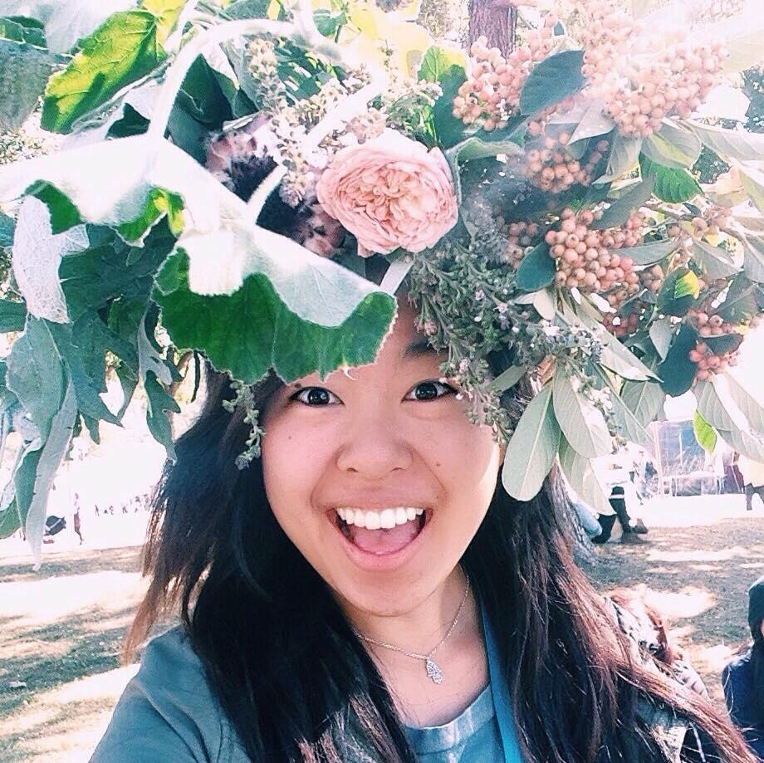
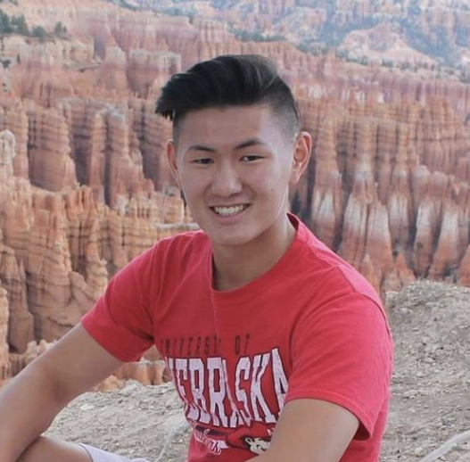
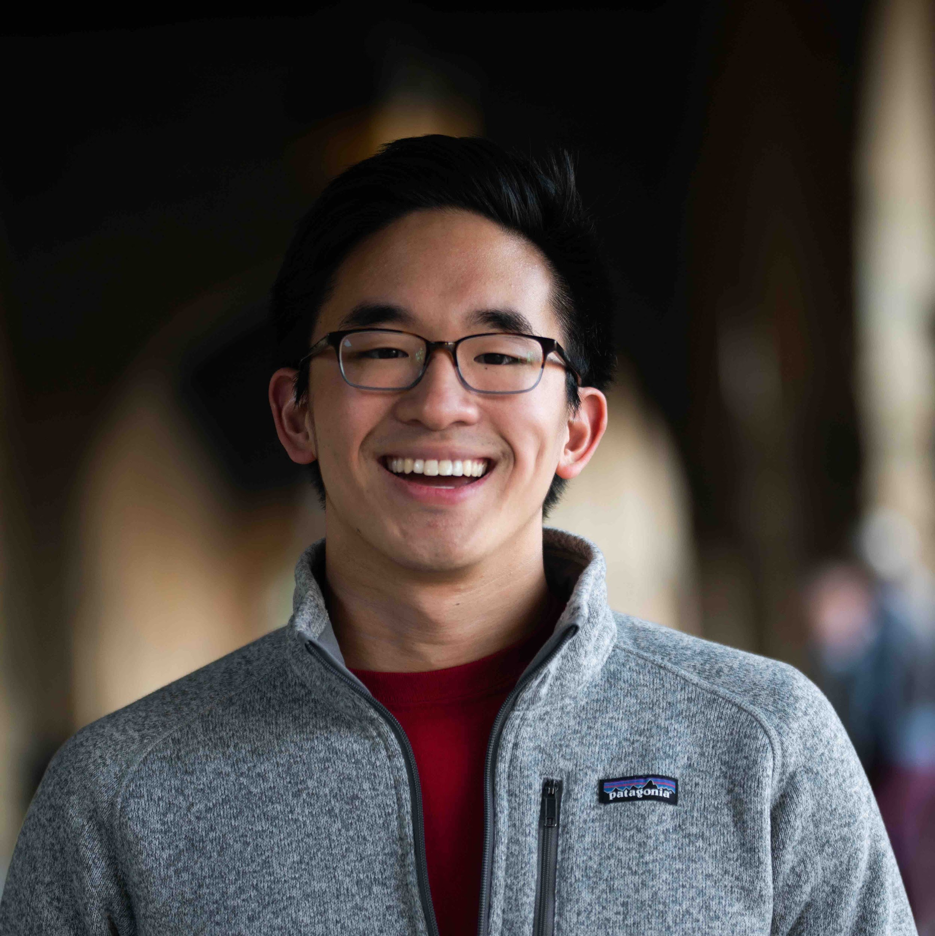
Introduction
Netta
Jeff
Ray
David

Slide 3

Mission
Interface
Prototype
Tasks
Experiment
UI Changes
Notes:
Today, will be talking about testing
Talk about what happened and what we’ll change going forward

Slide 4
Mission
Interface
Prototype
Tasks
Experiment
UI Changes

Slide 5
Background
Problem: When traveling, people have difficulty finding specific next steps based on their interests and their goals, while maintaining itineraries that enable spontaneity

Slide 6
Background
Problem: When traveling, people have difficulty finding specific next steps based on their interests and their goals, while maintaining itineraries that enable spontaneity
Solution: Hyperlocal, personalized, real-time recommendations to guide people through open-ended travel situations.

Slide 7
Mission: We’re on a quest to make travel easy and spontaneous every step of the way
Value Proposition: Personalized adventure on-demand

Slide 8
Mission
Interface
Prototype
Tasks
Experiment
UI Changes

Slide 9
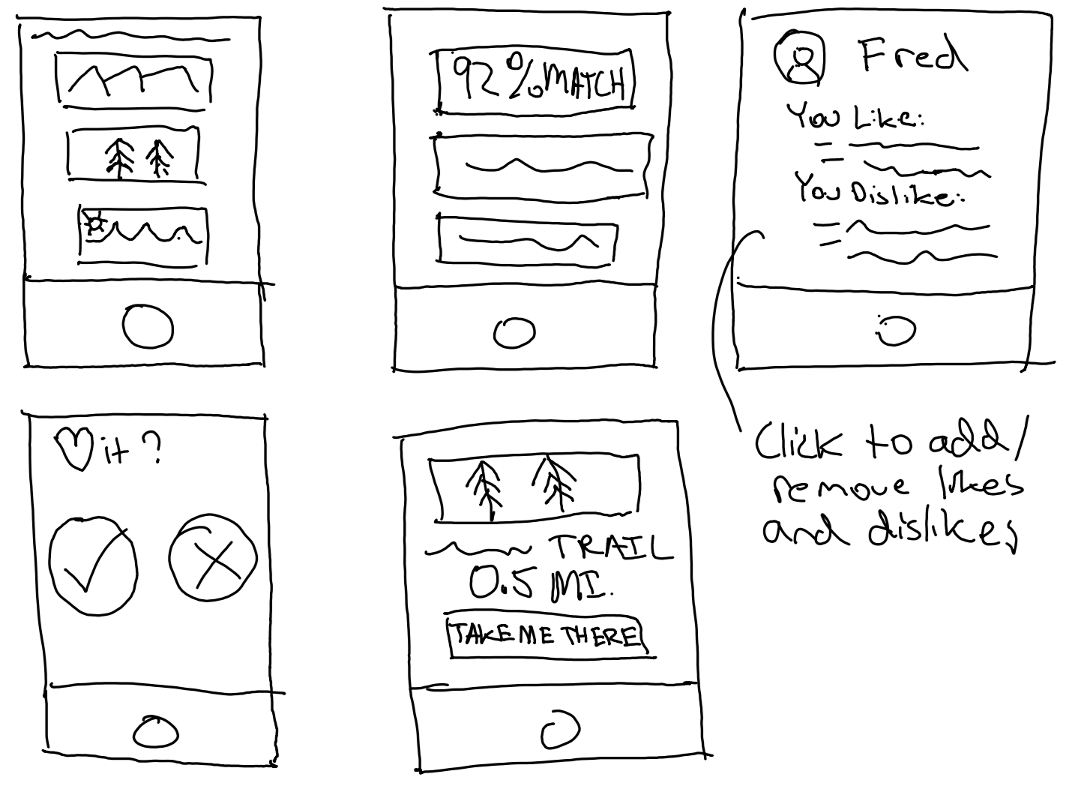
Selected Interface
Idea:
Mobile app providing a limited number of personalized activity options for the next best action
Pros:
Focus on activities
Simple, user-friendly UI
Limited choices avoid overwhelming users
Notes:
Reason we went with app is focus on options
Can dedicate more screen real estate to show what each option entails and how it matches their preferences
App

Slide 10
Mission
Interface
Prototype
Tasks
Experiment
UI Changes

Slide 11
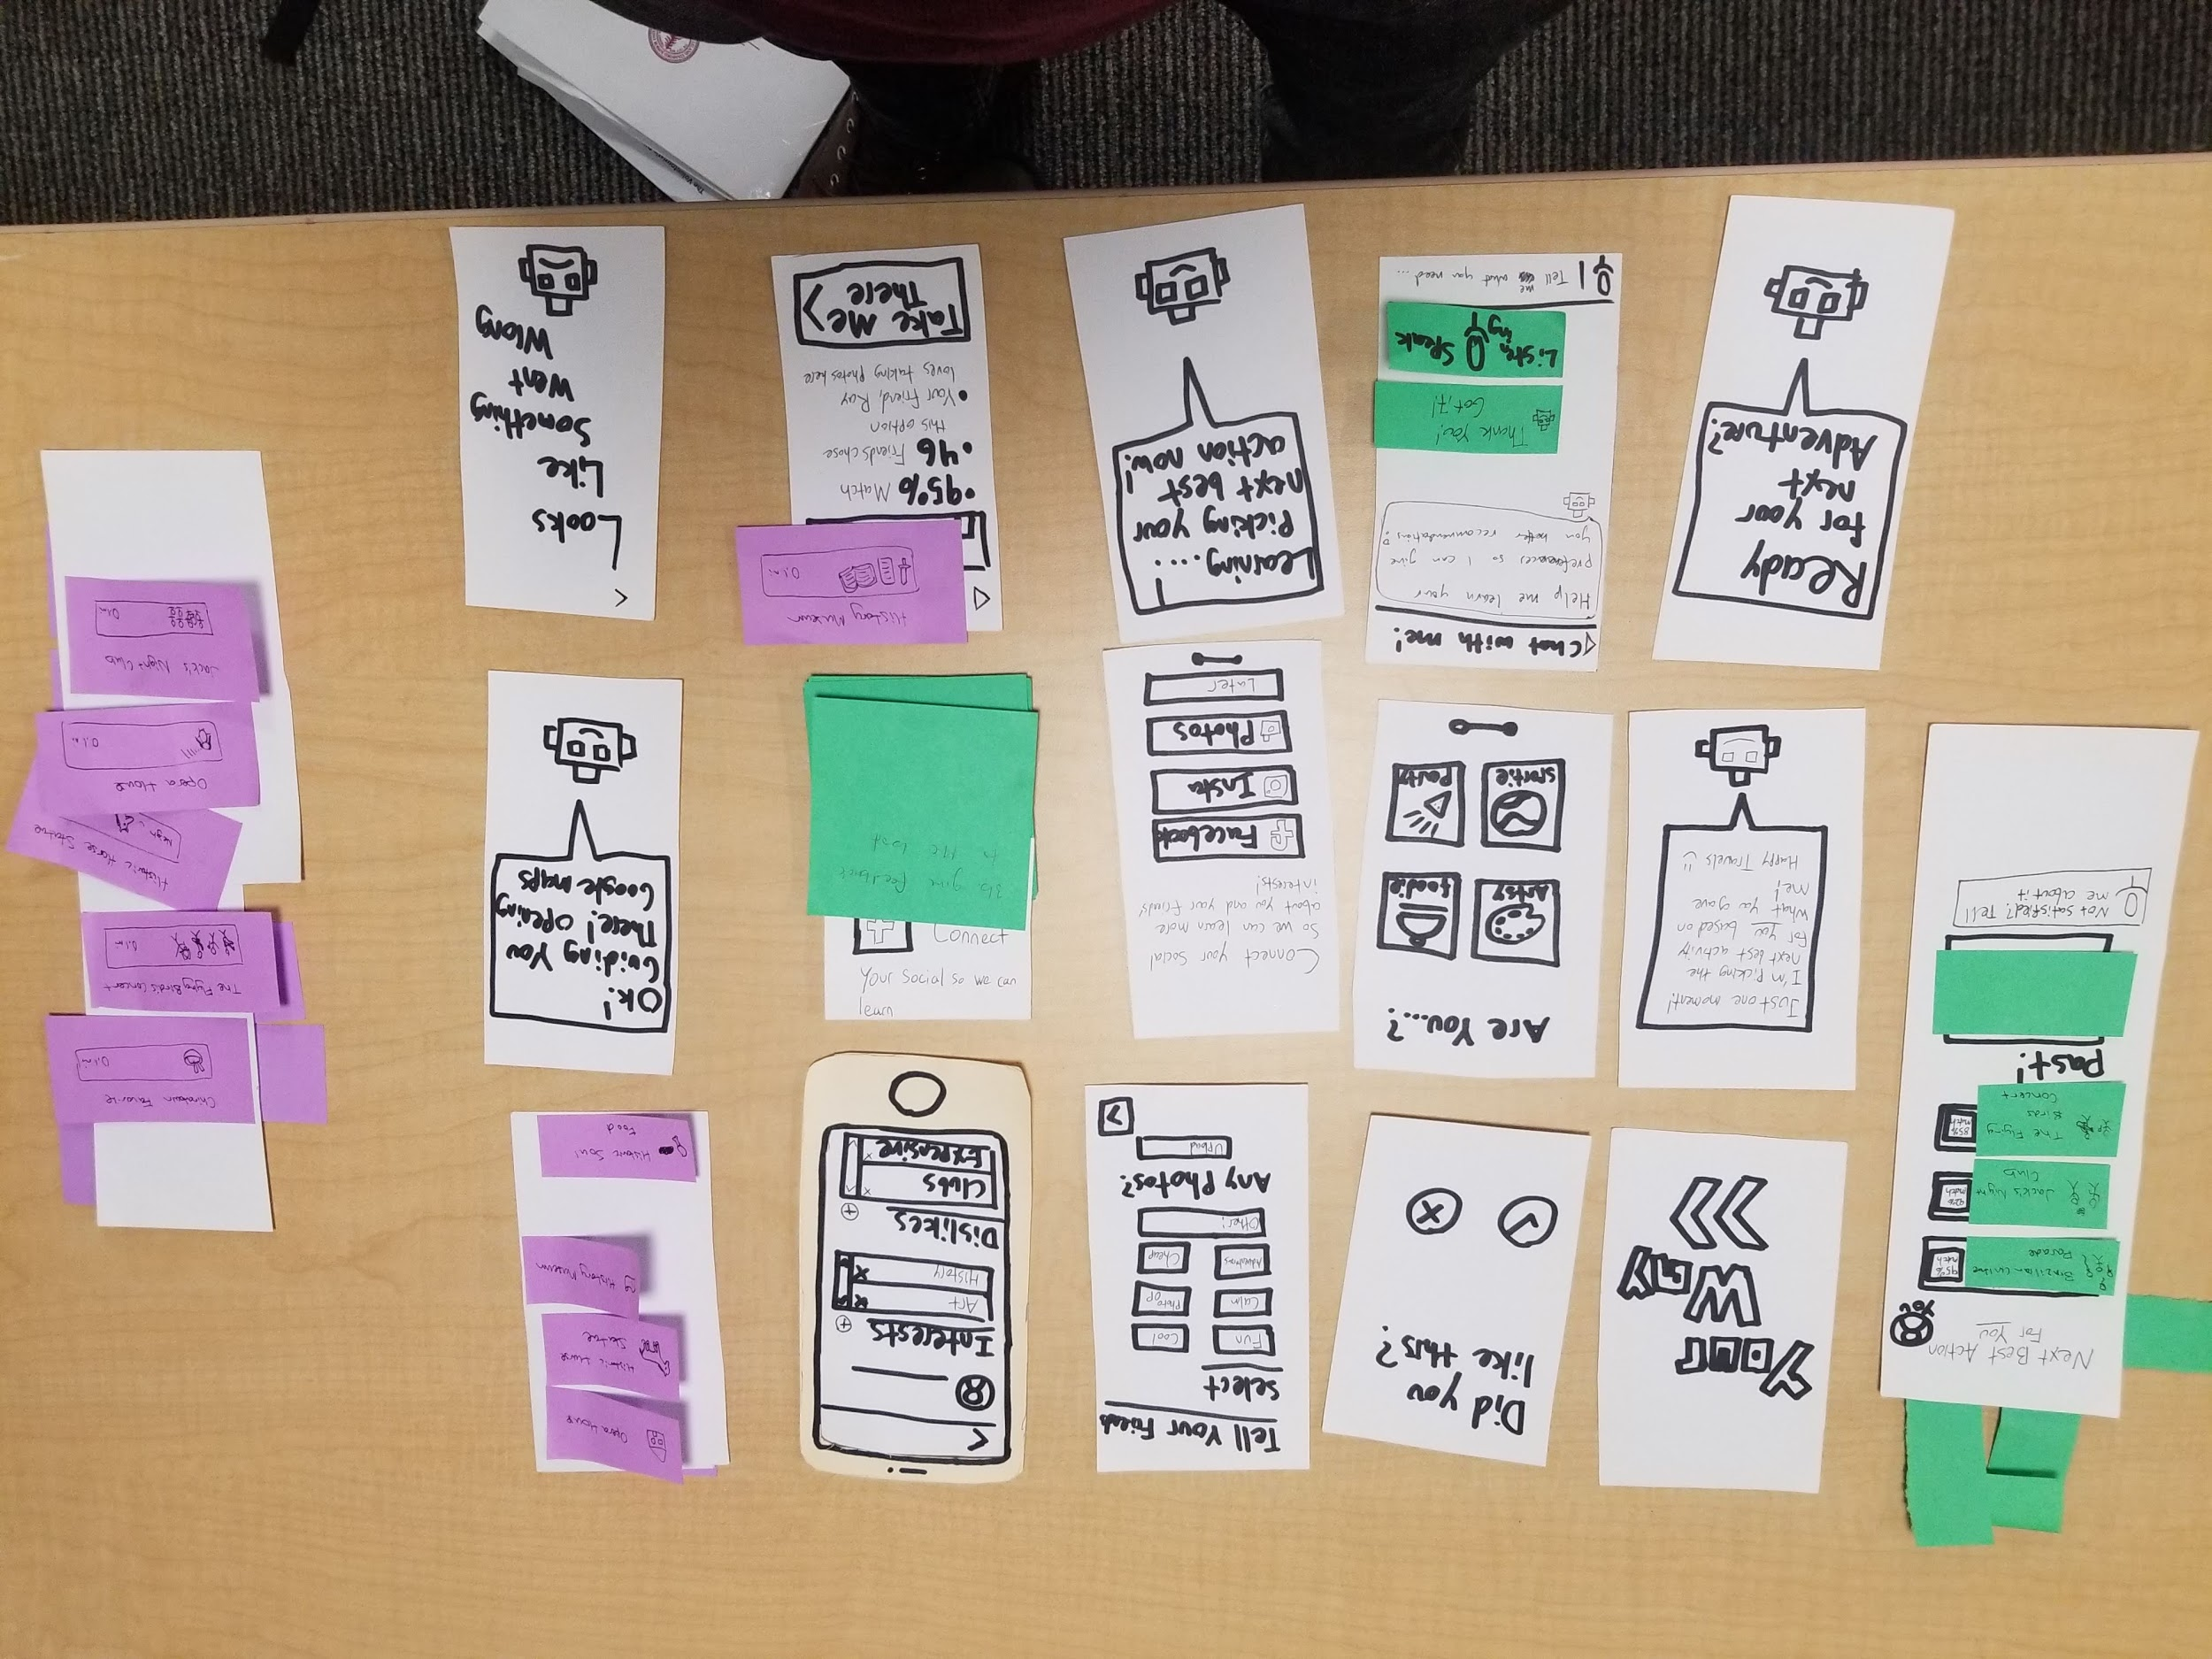
Notes:
Used paper prototype because interacting w/ paper mimicked app
Visually easy to see
As one of our interviewees put it “it already feels like I’m using a real phone”

Slide 12
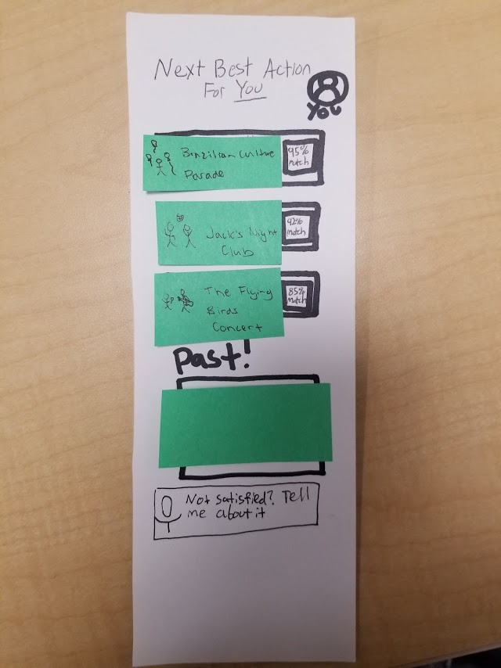
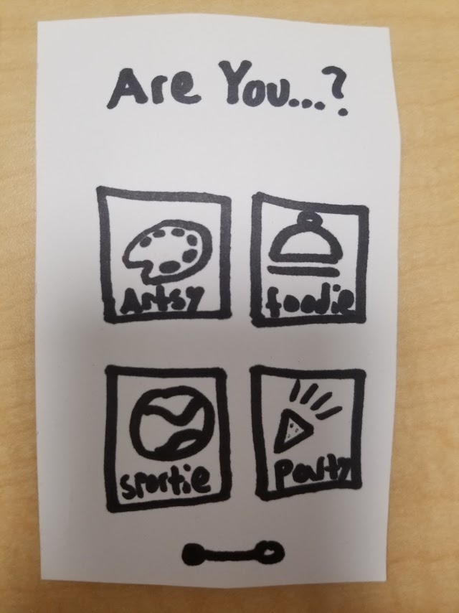
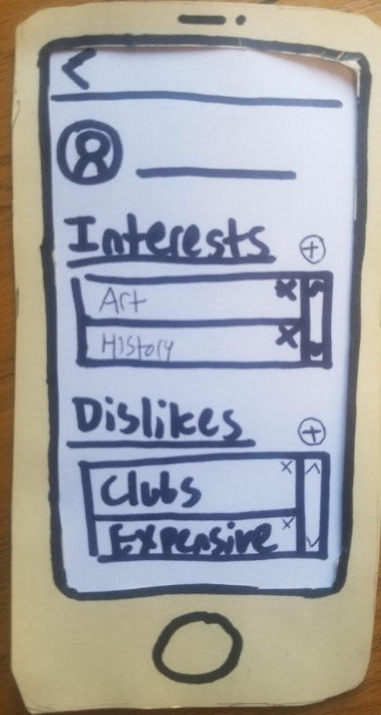
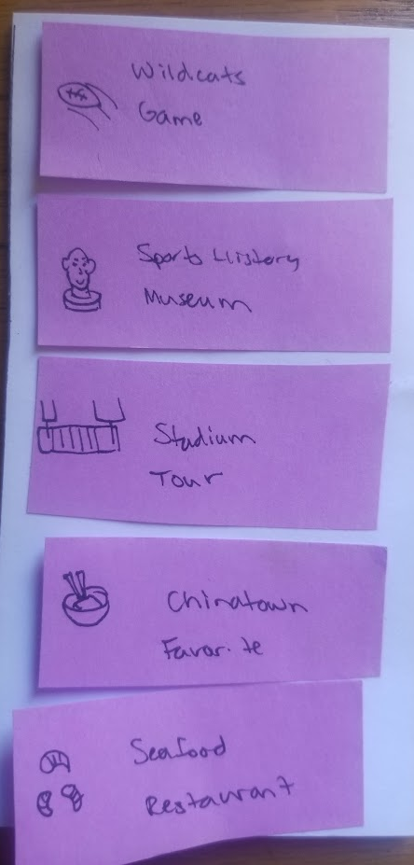
Prototype - Functionality & Reasoning
Notes:
Closest thing to real phone
Concrete text

Slide 13
Mission
Interface
Prototype
Tasks
Experiment
UI Changes

Slide 14
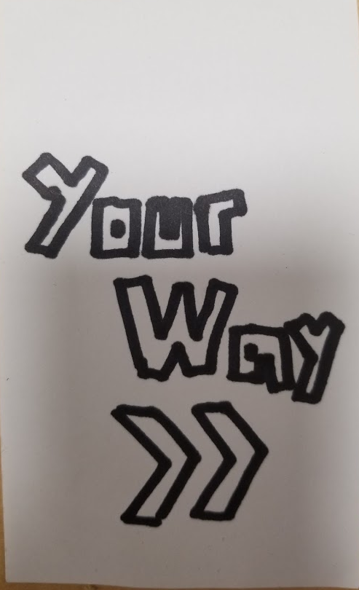
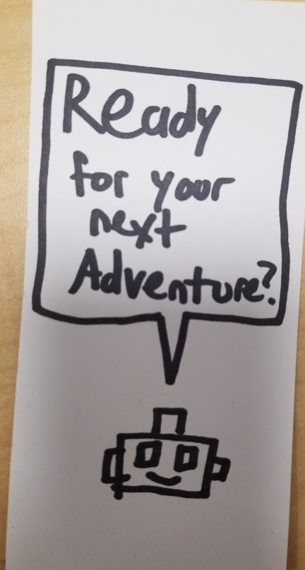
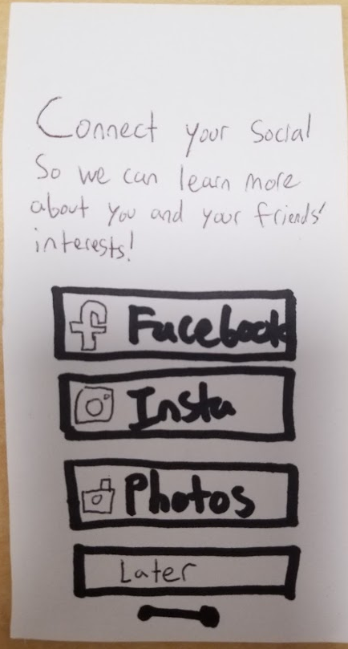
Task #1: Figure out what you can do nearby
Notes:
Past option shows what they did in the past. We would update this as they went along
Options were shown as sticky notes. OPtions you see on right are for party
Past starts out blank and we’d move the sticky notes representing previous options there later

Slide 15
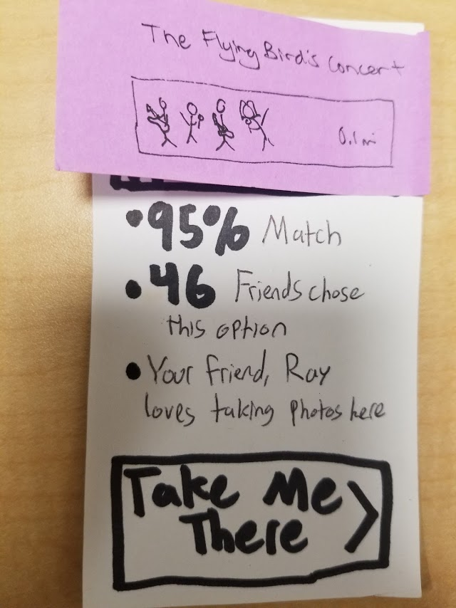
Task #2: Figure out what your friends have done before

Slide 16
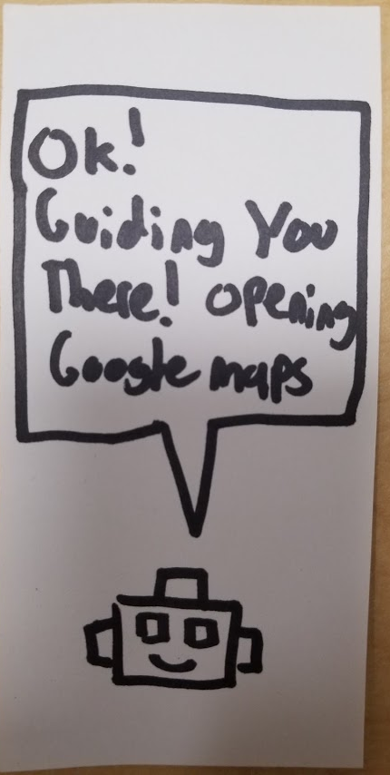
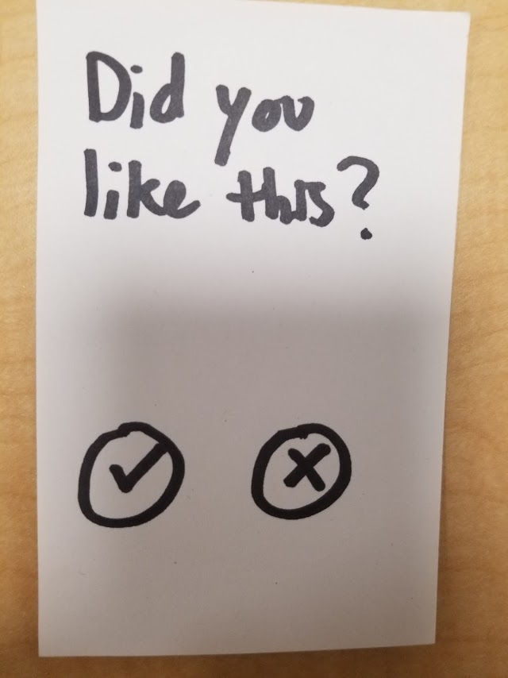
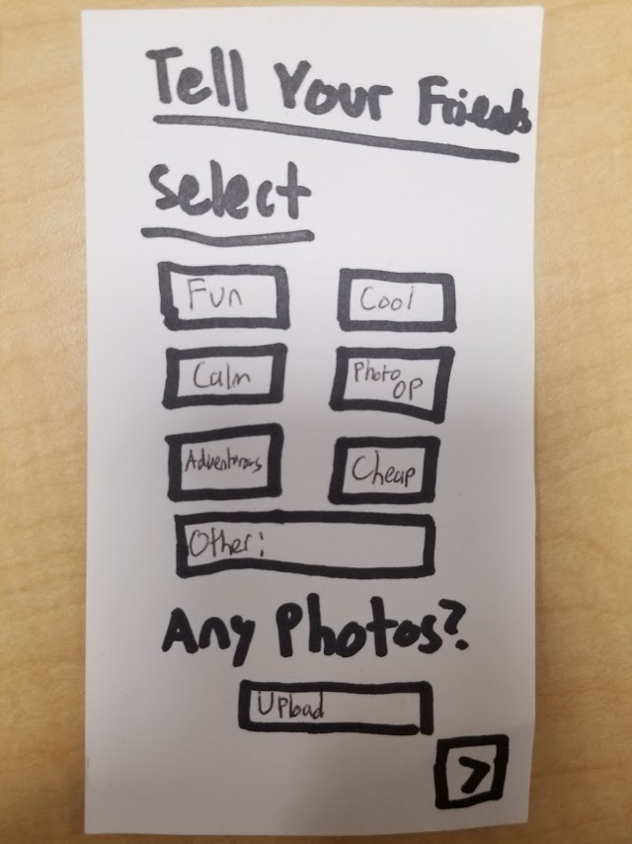
Task #3a: Choose an option and evaluate it

Slide 17
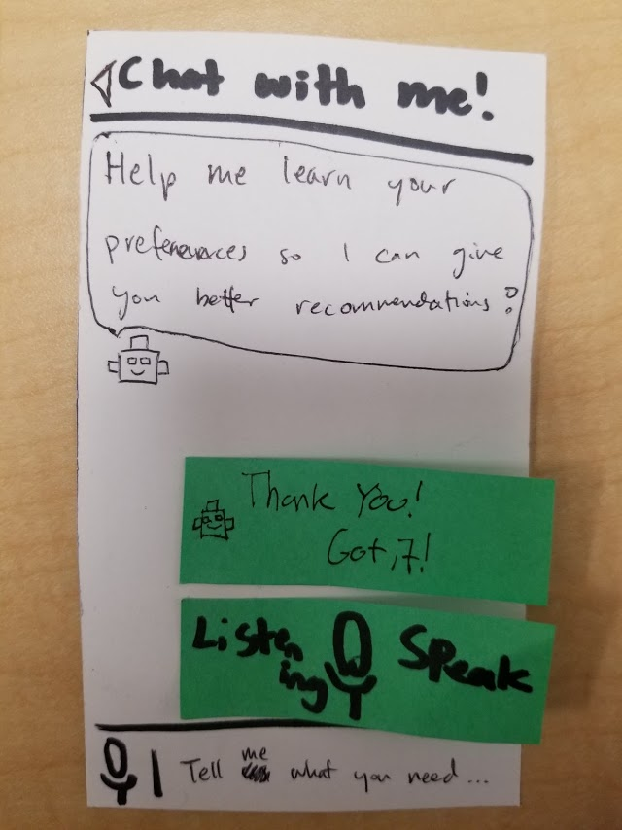
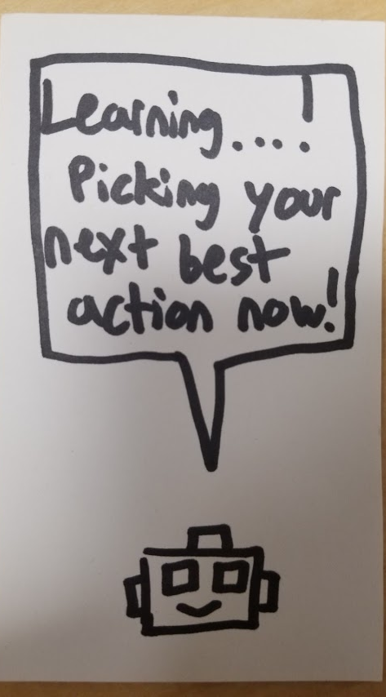
Task #3b: Inform app that you don’t like the options
Notes:
Screen would go back to the first afterwards but an options would change to reflect feedback

Slide 18
Mission
Interface
Prototype
Tasks
Experiment
UI Changes

Slide 19

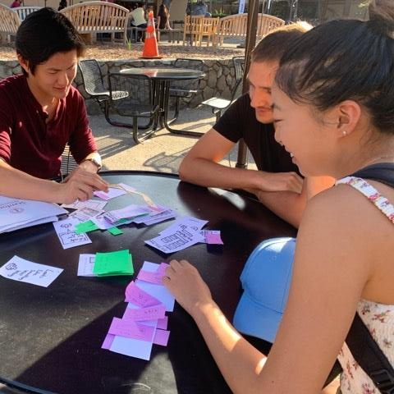

Testing
Fing
Off-campus
Prefers planning trips in advance
Helen*
Stanford Student
Prefers light trip planning
Arthur
On-campus
Enjoys having rough trip itinerary
Christian*
Stanford student
Likes spontaneity
Leon
On-campus
Statistician at large tech company
* stock photo
Notes:
Conducted 5 interviews by cold approaching strangers in Palo Alto, the Nitery, and Tressider. Jeff and Netta got really good at handling rejection
Started with Fing. Got bad feedback where Fing preferred to research trips first. Realized that he wasn’t target
Started screening then by asking users how they preferred to travel/research before the interview. Ended up with 4 ppl on right
First is Helen, Stanford student.
Like Helen, Arthur likes rough trip itinerary. Non-stanford student that we found in tressider
Christian is student and likes spontaneity, same with Leon, a statitician we found in the Starbucks Tressider

Slide 20
Experiment Results - Method
Screened users
Established setting
Walked users through sample task
Asked them to complete each task
Experiments all took place on a table in a quiet setting. Ray acted as the computer and Netta was the facilitator.
Notes:
Completed our 3.5 tasks
Took note of expressions, comments, and struggles

Slide 21
Experiment Results - Successes
App Idea - Enabling spontaneity
Tasks completed successfully
Delight at finding options
App was fun
Preference incorporation/personalization
Notes:
Prototypes were generally good
Personalization: Liked being able to change what got displayed for them
App idea: Helped spontaneity. “I always thought something like this should exist”
Users, liked seeing options and liked the app in general

Slide 22
Experiment Results - Growth Areas
Onboarding User Preferences
Incorporating Prior Plans
Notes:
Incorporating prior plans -> what fing said and what arthur said.Not helpful if you’re set somewhere
Onboarding user preferences -> People don’t like grouping themselves in 1 bucket. “Whether I’m a sporty person or artsy depends on the place I’m going” Bucket depended on what they already aimed to doCan I choose 2?
Incorporating Prior Plans -> “I already know that I want to go to the Van Gogh museum.

Slide 23
Experiment Results - Growth Areas Continued
Wanted All Info
Disliked Using Voice
Notes:
Users wanted variety in what they could do. Wanted all info and wanted option of spicing things up
Wanted to buy tix
Chat bot preference incorporation did not go over well

Slide 24
Experiment Results - Surprises
Specific Friends: “I’d like to see what my friend Lexie did. He’s an artist”
Place History: “Seeing what I’ve done before would be really useful”
Add Spice: “What if I want to do something that I normally wouldn’t?”

Slide 25
Experiment Results - UI Changes
Editing preferences was confused for leaving app feedback
Finding what friends did can be difficult
Having binary options for feedback is too simplistic
Photo upload is confusing

Slide 26
Summary
Prototyped app that surveyed users and displayed 3 nearby options
Users enjoyed app and liked having recommendations that enabled spontaneity
Users wanted better onboarding, more agency and a more clear UI

Slide 27
Q&A

Slide 28
Appendix

Slide 29
Personalized Adventure On Demand

