Slide 1
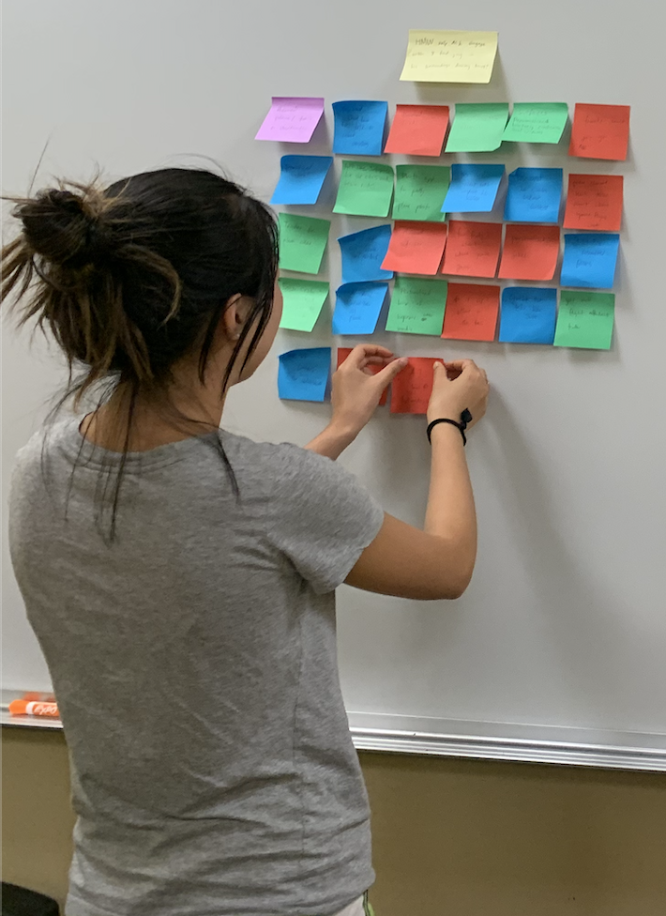
POV and Experience Prototyping
By Team Journey

Slide 2



Introduction
Netta
Jeff
Ray
David

Slide 3
Domain
Human-Centered AI
Travel
Healthy Habits
Mundane
Transit
Staying Productive
Notes:
Our studio is on HCAI, but we wanted to start broad and narrow down into AI solutions later.

Slide 4
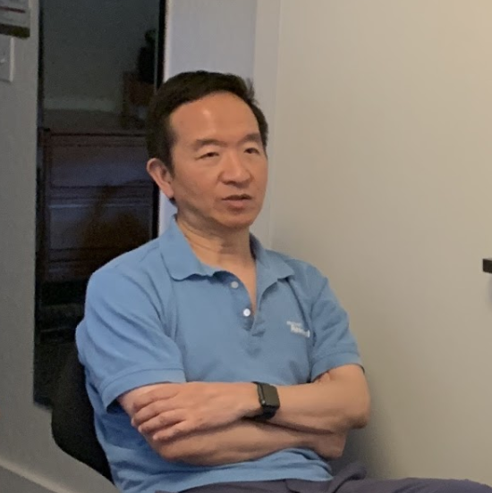
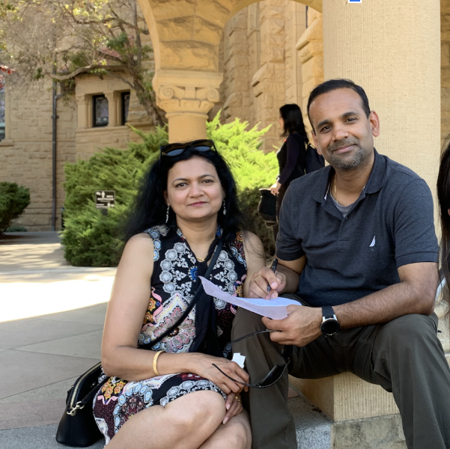

Additional Needfinding
Fred
On-campus
Frequent business commuter (4-6x/month)
Nediva & Vind
On-campus
Tourist couple from Connecticut
Helvie
In transit
Recent grad who loves commuting
Notes:
We interviewed 10 participants each ranging from 10 to 45 minutes. We’ve changed everyone’s names for anonymity. Some of our participants also requested that we do not use their photos for the presentation

Slide 5
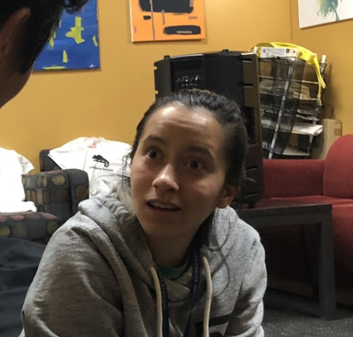

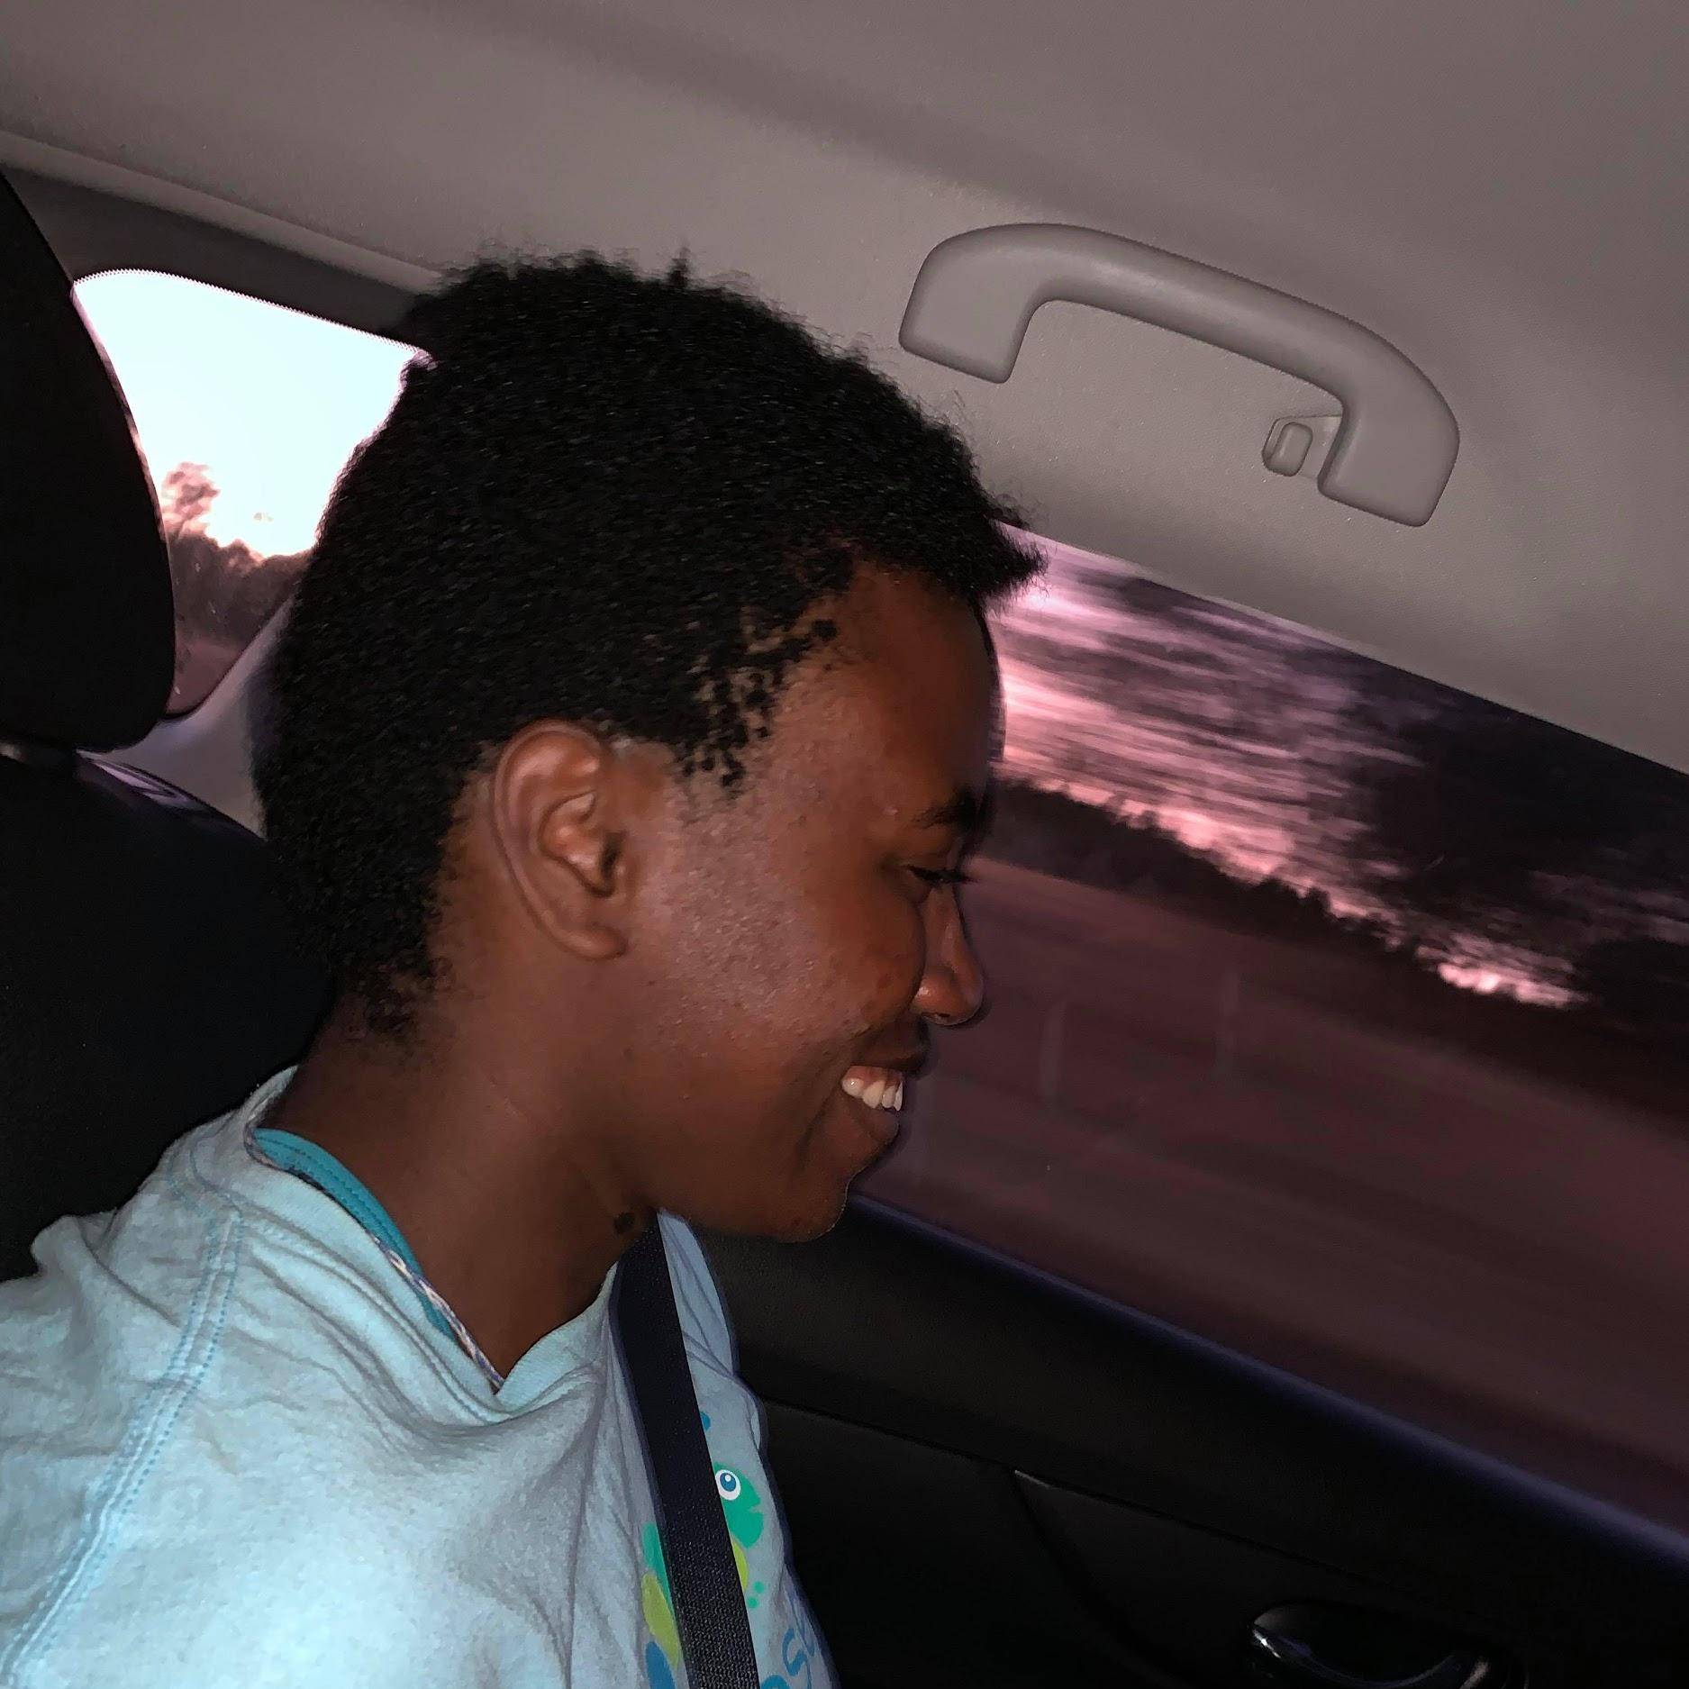
Additional Needfinding
Maddy
On-campus
Competitive biker
Jack
Off Campus
Traveling doctor
Natalia
Off campus road trip
Frequent road trips and flights
Notes:
We interviewed 10 participants each ranging from 10 to 45 minutes. We’ve changed everyone’s names for anonymity. Some of our participants also requested that we do not use their photos for the presentation

Slide 6






Recurring Threads
New Threads
Mundane Transit
Productivity in Transit
Healthy Habits
Choice Anxiety
Peace of Mind
Sharing w/ Friends
Notes:
Do we call first steps choice anxiety? Btw I get icons from here if you wanna change stuff up https://www.flaticon.com/search?word=efficient

Slide 7
POV #1
We met Alik, a curious tourist from Eastern Europe visiting Stanford University with a penchant for adventure.
We were surprised to realize that he equally disliked trains and planes as banal unless he was socializing with people.
It would be game-changing if Alik could feel like his adventure started the second he steps on the plane.
Notes:
Participants discussed how travelling was so uncomfortable that it affected their life outside of just the act of travelling

Slide 8
HMW #1
Alik
How might we empower Alik to actively engage with and find joy in his surroundings?
Notes:
Some of our participants seemed to contradict themselves. One participant confidently talked about their uneventful thoughts on travel, but then later revealed how disruptive and mentally intensive travel can be on him from a productivity and social perspective

Slide 9
POV #2
We met Connor, an international student that flies across the world for work, school, and vacation
We were surprised to notice that Connor felt so strongly that his long flights for travel were a waste of time and productivity, even though many of his tasks could be done while in transit
It would be game-changing to reframe Connor’s perception of transit time as a valuable opportunity to reach his goals
Notes:
Participants discussed how travelling was so uncomfortable that it affected their life outside of just the act of travelling

Slide 10
HMW #2
Connor
How might we enable Connor to maximize dead time spent waiting in transit to practice his habits?
Notes:
Some of our participants seemed to contradict themselves. One participant confidently talked about their uneventful thoughts on travel, but then later revealed how disruptive and mentally intensive travel can be on him from a productivity and social perspective

Slide 11
POV #3
We met Natalia, a student and thrill-seeking world traveler hungry to explore new destinations.
We were surprised to notice that the most frustrating part of traveling for her wasn’t the jet lag or the cultural barriers, but rather the difficulty of navigating through the airport and choosing what to do first.
It would be game-changing if Natalia could transform her initial indecisiveness into an opportunity to confidently shape her own path.
Notes:
Participants discussed how travelling was so uncomfortable that it affected their life outside of just the act of travelling

Slide 12
HMW #3
Natalia
How might we make Natalia feel like she has a personal tour guide to introduce her to every new destination?
Notes:
Some of our participants seemed to contradict themselves. One participant confidently talked about their uneventful thoughts on travel, but then later revealed how disruptive and mentally intensive travel can be on him from a productivity and social perspective

Slide 13
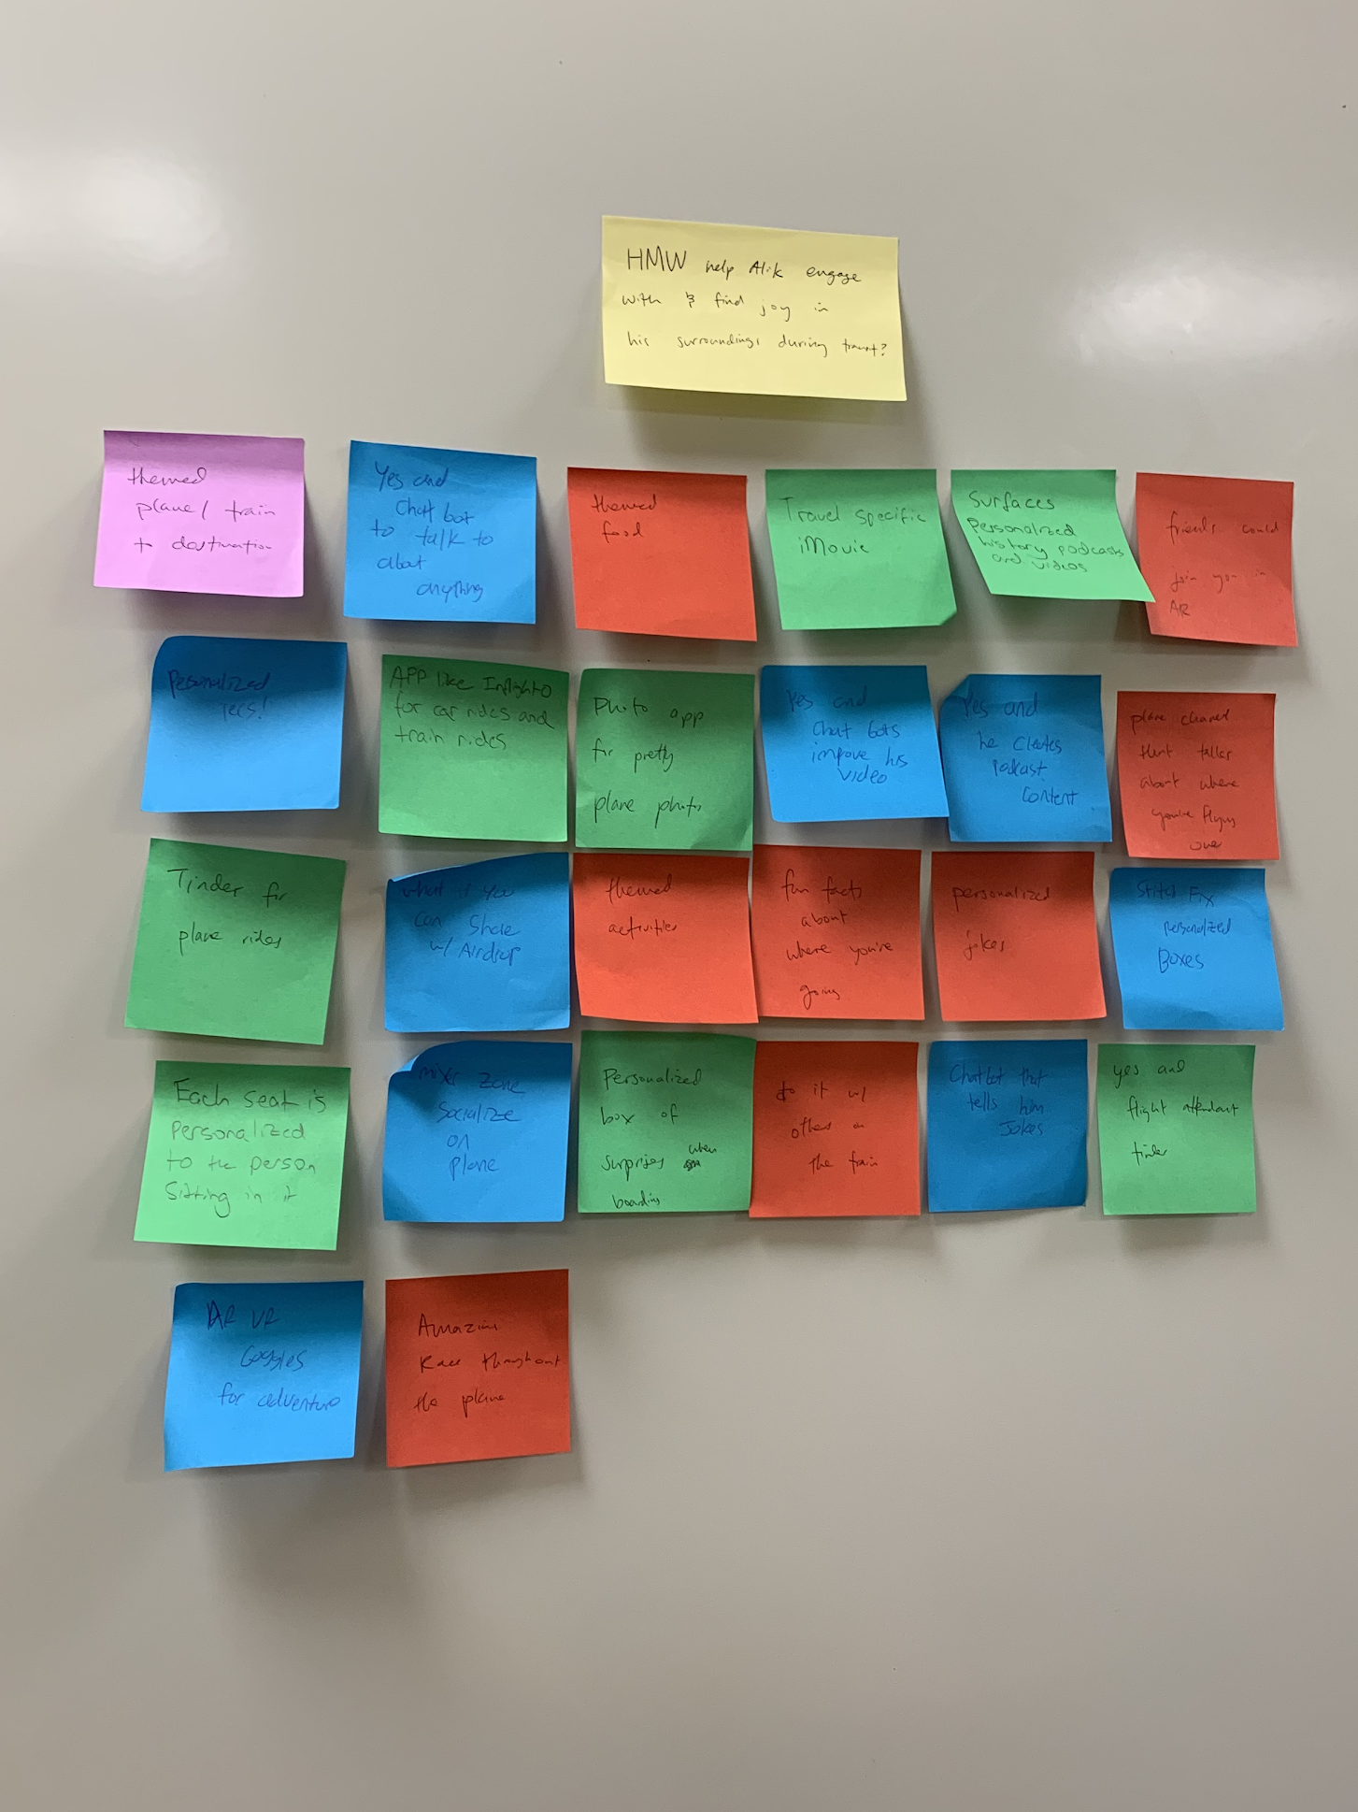
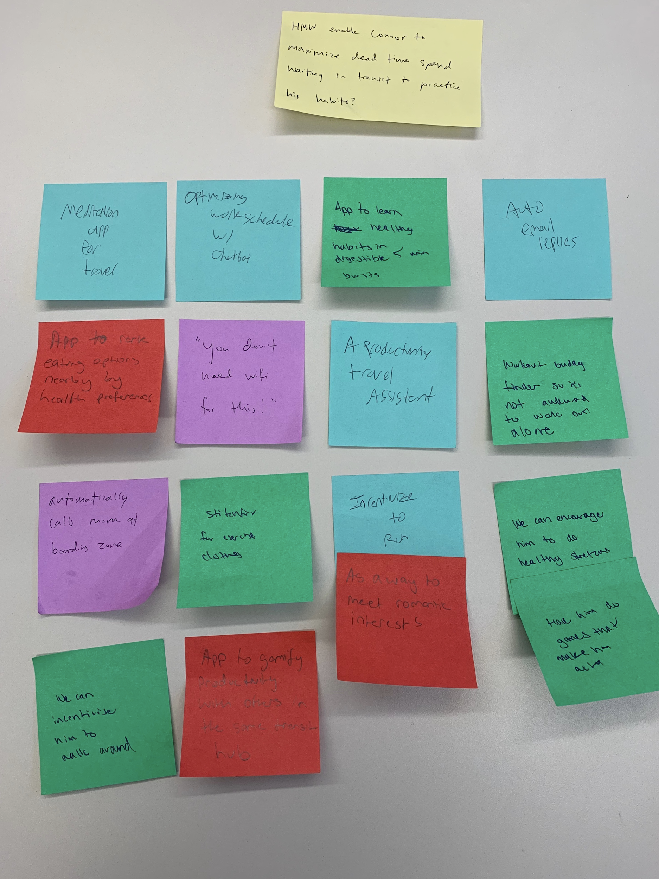
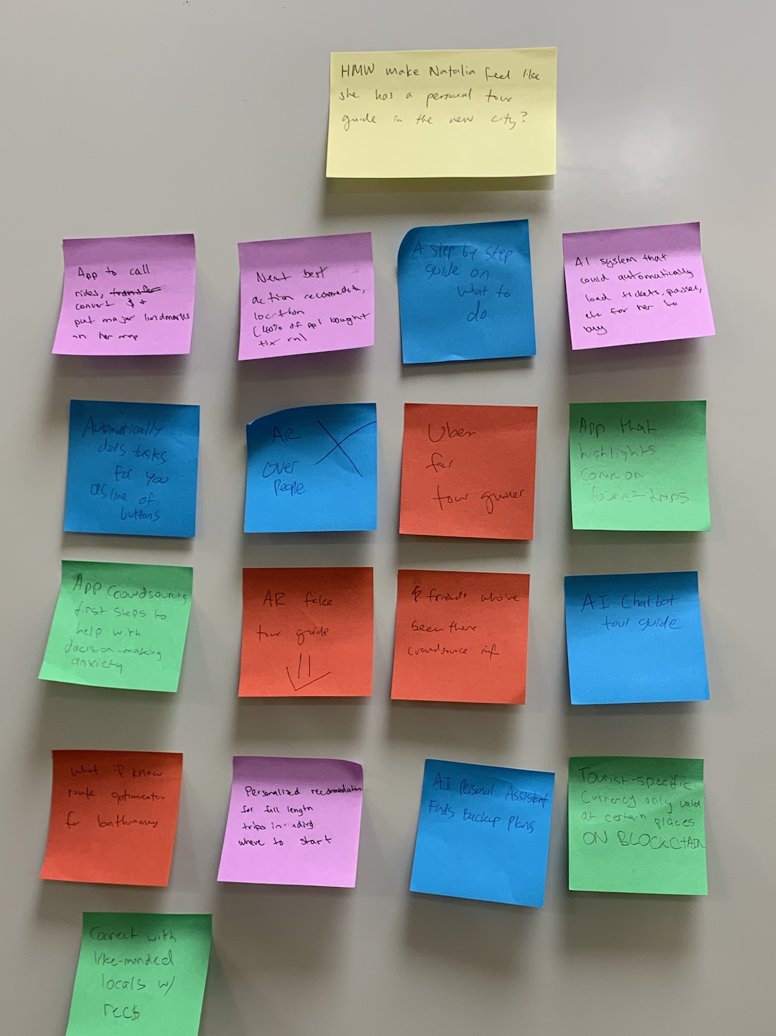
Brainstorm
HMW #1
HMW #2
HMW #3

Slide 14
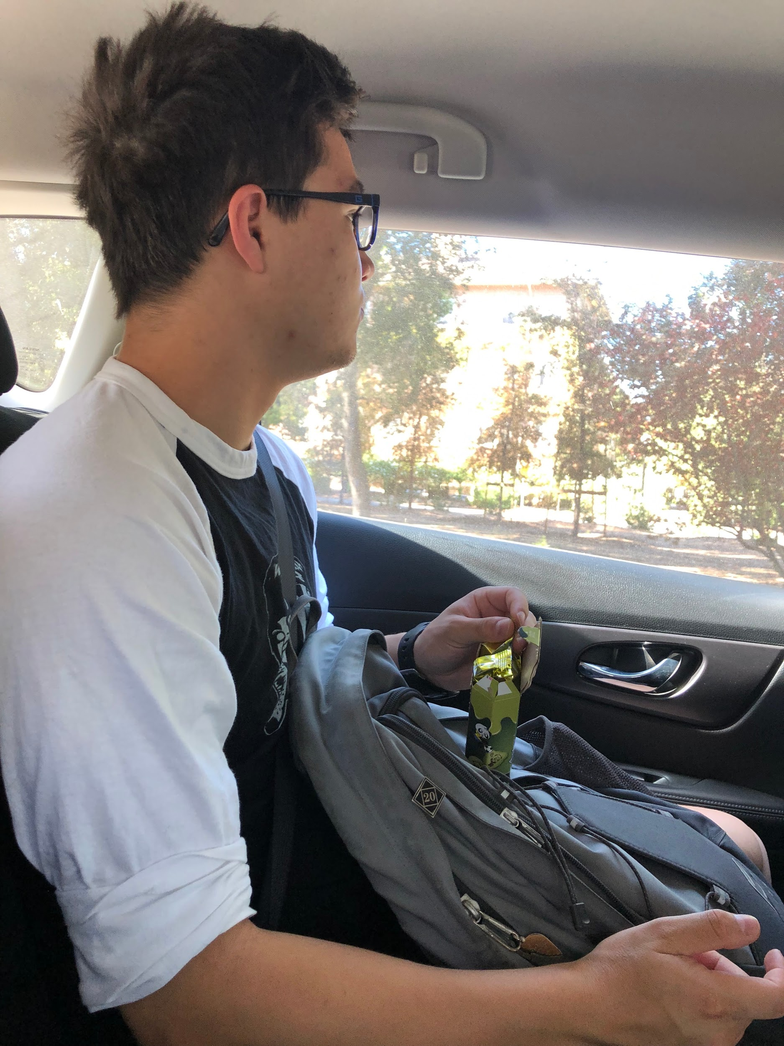
Prototype #1
Assumption: Riders are more present in-transit if they are engaged with their surroundings
Description: Audio information and interactions corresponding to landmarks (e.g. SLAC) along a car ride
Notes:
Some of our participants seemed to contradict themselves. One participant confidently talked about their uneventful thoughts on travel, but then later revealed how disruptive and mentally intensive travel can be on him from a productivity and social perspective

Slide 15
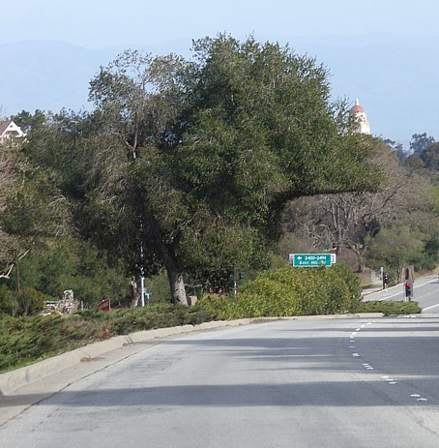
Example Soundbite
“We’re now driving on Sand Hill Road. Sand Hill Road is a road famous for its concentration of venture capital firms…”
Notes:
Some of our participants seemed to contradict themselves. One participant confidently talked about their uneventful thoughts on travel, but then later revealed how disruptive and mentally intensive travel can be on him from a productivity and social perspective

Slide 16
Prototype #1 Results
What worked: Alex paid attention to the soundbites
What didn’t: Alex thought the soundbites annoyed him and prevented him from zoning out
Surprises: Some people prefer to not be present in transit
New Learnings: It takes a compelling alternative for people to not zone out
Validity: Not valid
Notes:
For new learnings, highlight that even though people don’t like being in transit, it takes a compelling alternative for them to be present.

Slide 17
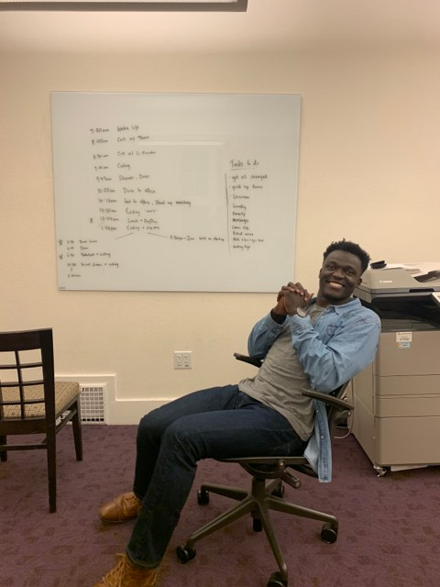
Prototype #2
Assumption: Travelers know what they want to do in dead time but don’t know how and when to do it
Description: Productivity assistant that provides users with recommendations on how to undertake desirable habits during dead time in transit
Notes:
Some of our participants seemed to contradict themselves. One participant confidently talked about their uneventful thoughts on travel, but then later revealed how disruptive and mentally intensive travel can be on him from a productivity and social perspective

Slide 18
Prototype #2 Results
What worked: Pascal loved having something encourage him to make use of his transit time
What didn’t: Pascal didn’t have enough dead time to fully optimize his tasks
Surprises: Pascal knew both his exact schedule and his to-do list but did not think to combine the two
New Learnings: People would benefit from specific suggestions about how they can incorporate preferred tasks
Validity: Valid
Notes:
For new learnings, highlight that even though people don’t like being in transit, it takes a compelling alternative for them to be present.

Slide 19
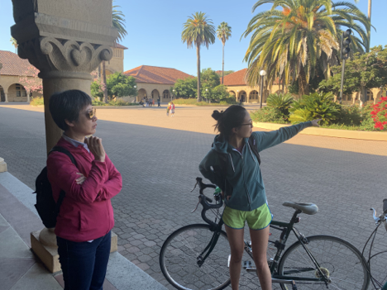
Prototype #3
Assumption: Travelers have generalized trip plans but lack step-by-step local itineraries
Description: Virtual tour guide that provides users with specific recommendations for their next destination based on their current location
Notes:
Some of our participants seemed to contradict themselves. One participant confidently talked about their uneventful thoughts on travel, but then later revealed how disruptive and mentally intensive travel can be on him from a productivity and social perspective

Slide 20
Prototype #3 Results
Example Interaction:
Netta: “Since you’re in Main Quad, would you like to see the Rodin Sculptures or the Whispering Circle? Both are right here in the quad.”
Mary: “Whispering Circle.”
Netta: “Great, follow me this way. The Whispering Circle is a fun little secret...“
Notes:
For new learnings, highlight that even though people don’t like being in transit, it takes a compelling alternative for them to be present.

Slide 21
Prototype #3 Results
What worked: Mary loved specific recommendations for her location
What didn’t: Mary also wanted to know how long things take to optimize her schedule
Surprises: Mary did no research about attractions at Stanford and didn’t plan to do any research while on campus
New Learnings: Time constraints are incredibly important in a traveler’s decision-making process.
Validity: Valid
Notes:
For new learnings, highlight that even though people don’t like being in transit, it takes a compelling alternative for them to be present.

Slide 22
Future Solutions (2 of them!)
Auto Planner
Hyperlocal Tour Guide
Notes:
That brings us to our future solutions. We’re excited about the Auto Planner and Hyperlocal Tour Guide. Both are equally interesting to us, and actually share some overlap. Both solutions would have to include looking at one’s schedule, and making specific activity recommendations based on one’s time and location constraints. So, there may be an opportunity to blend some of these themes together.

Slide 23
Summary
Boredom in transit and need for productivity continue to be major threads
New thread: Being excited about travel but confused on what to do
Successful HMW/brainstorming led to 3 experience prototypes
Next Steps: diving deeper into our successful auto-planner and hyperlocal tour guide prototypes
Notes:
For new learnings, highlight that even though people don’t like being in transit, it takes a compelling alternative for them to be present.

Slide 24
Q&A

Slide 25
Appendix

