Slide 1
Pathways
Empowering Students Forward

Slide 2


Meet the Team
Gray W.
Pao T.
Mamadou D.

Slide 3
Mission Statement:
Pathways aims to empower and equip students with the tools needed to take charge of the college application process, and ready to give back to others seeking help during the process.

Slide 4
Value Proposition
“Empowering students forward” conveys our mission statement of wanting to propel students forward on their path to college, and aid them in taking charge of their college application process.

Slide 5
Problem:
College is seen as a goal for many students, but the college application process is confusing, complicated, and stressful.
Solution:
An single app that would allow students to ‘map’ out their college application process and connect them with similar background college students to provide mentorship and guidance.

Slide 6
Our Tasks
Create a college roadmap (simple)
Match students with a mentor of a similar background (complex)
Students should be able to receive feedback and guidance from mentor (medium)
Notes:
No changes were made to original tasks, however, do note that we added a navigation bar with links to potential future features.

Slide 7
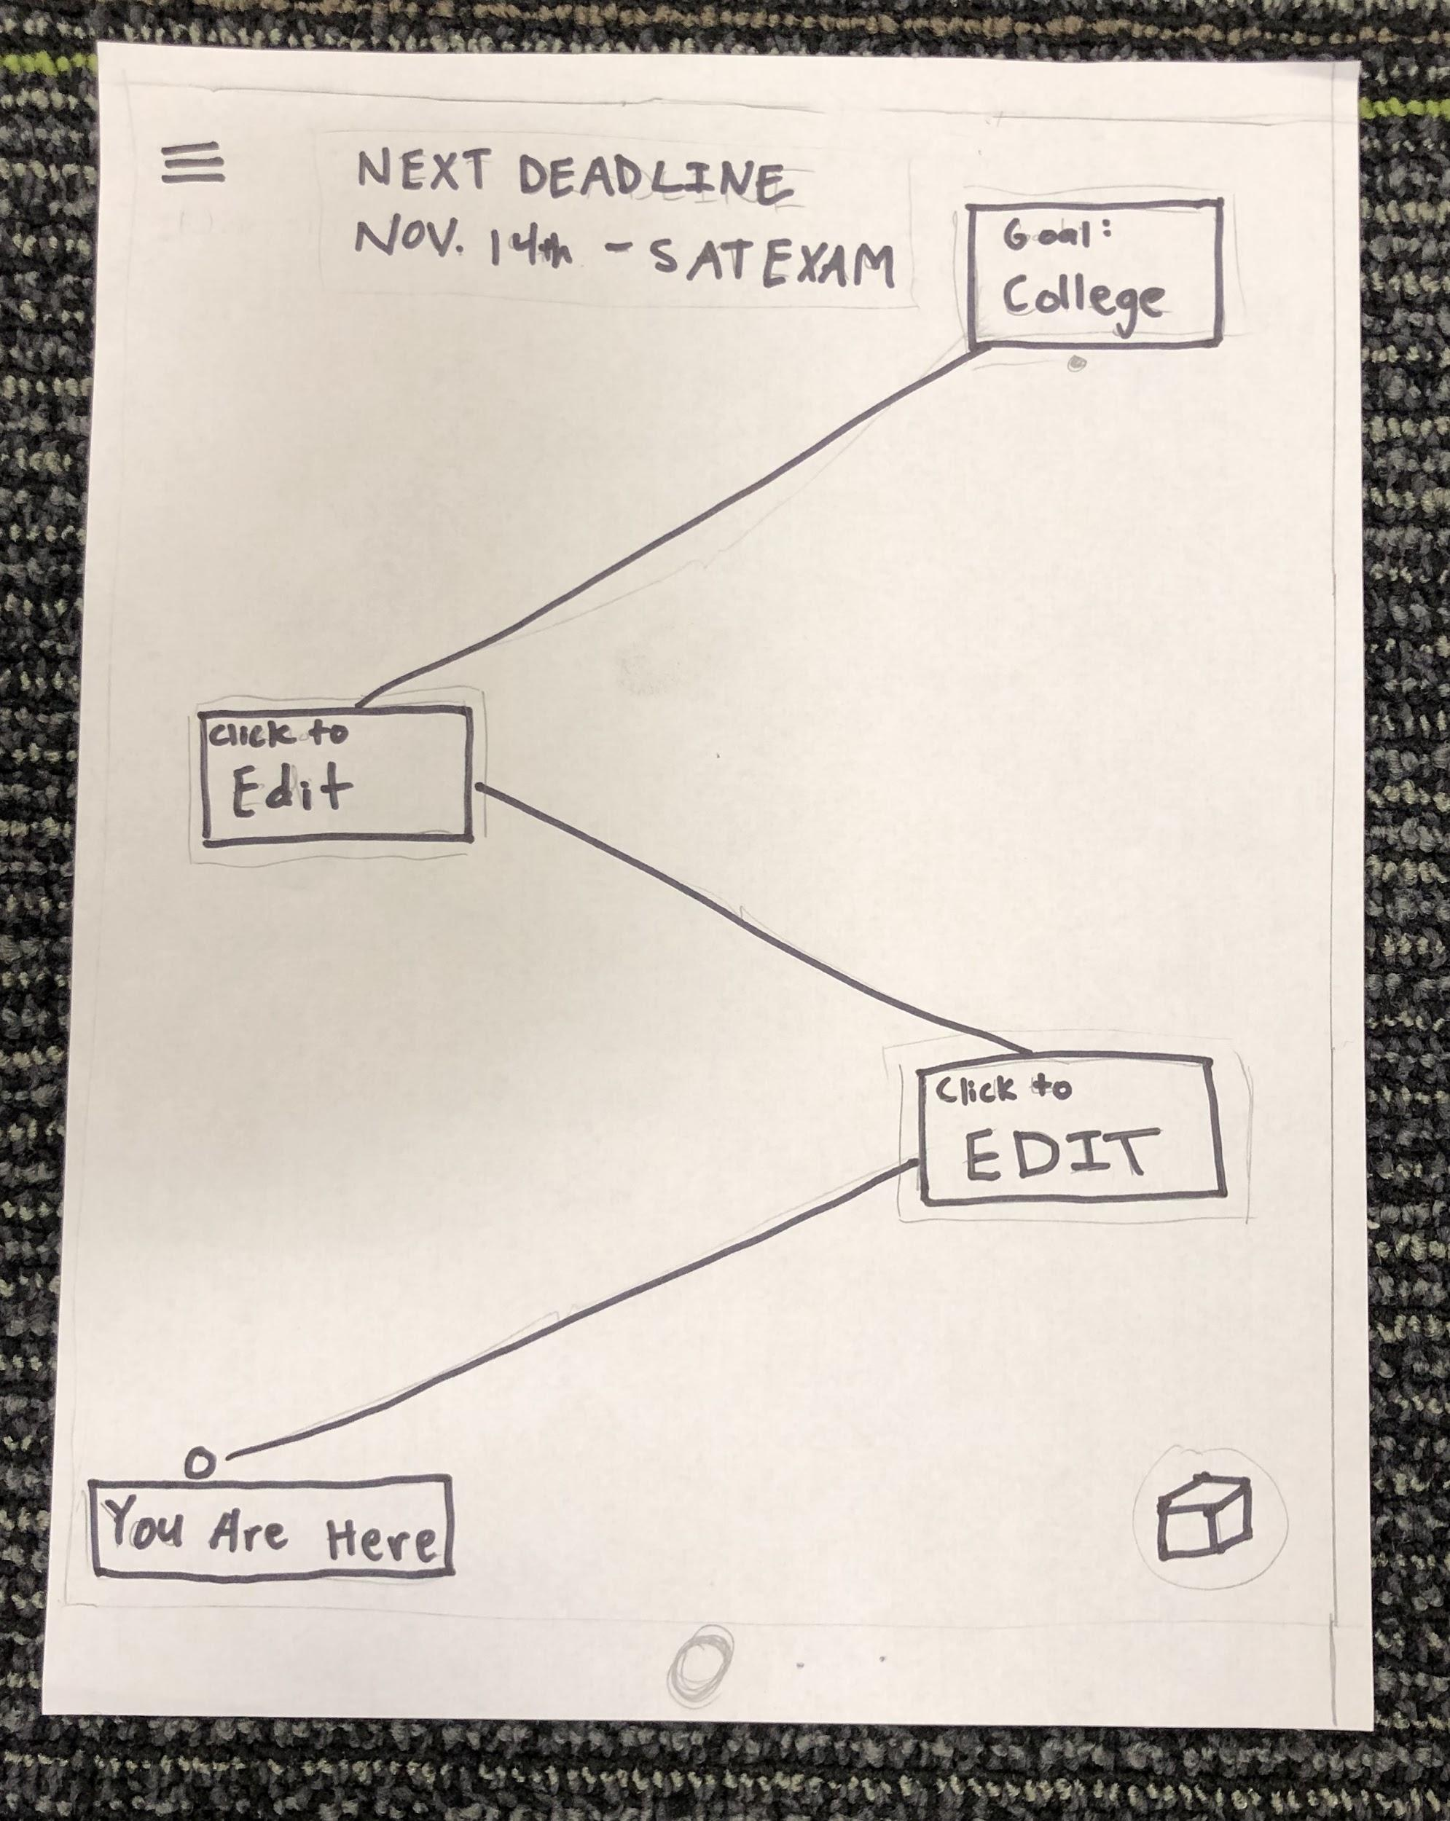
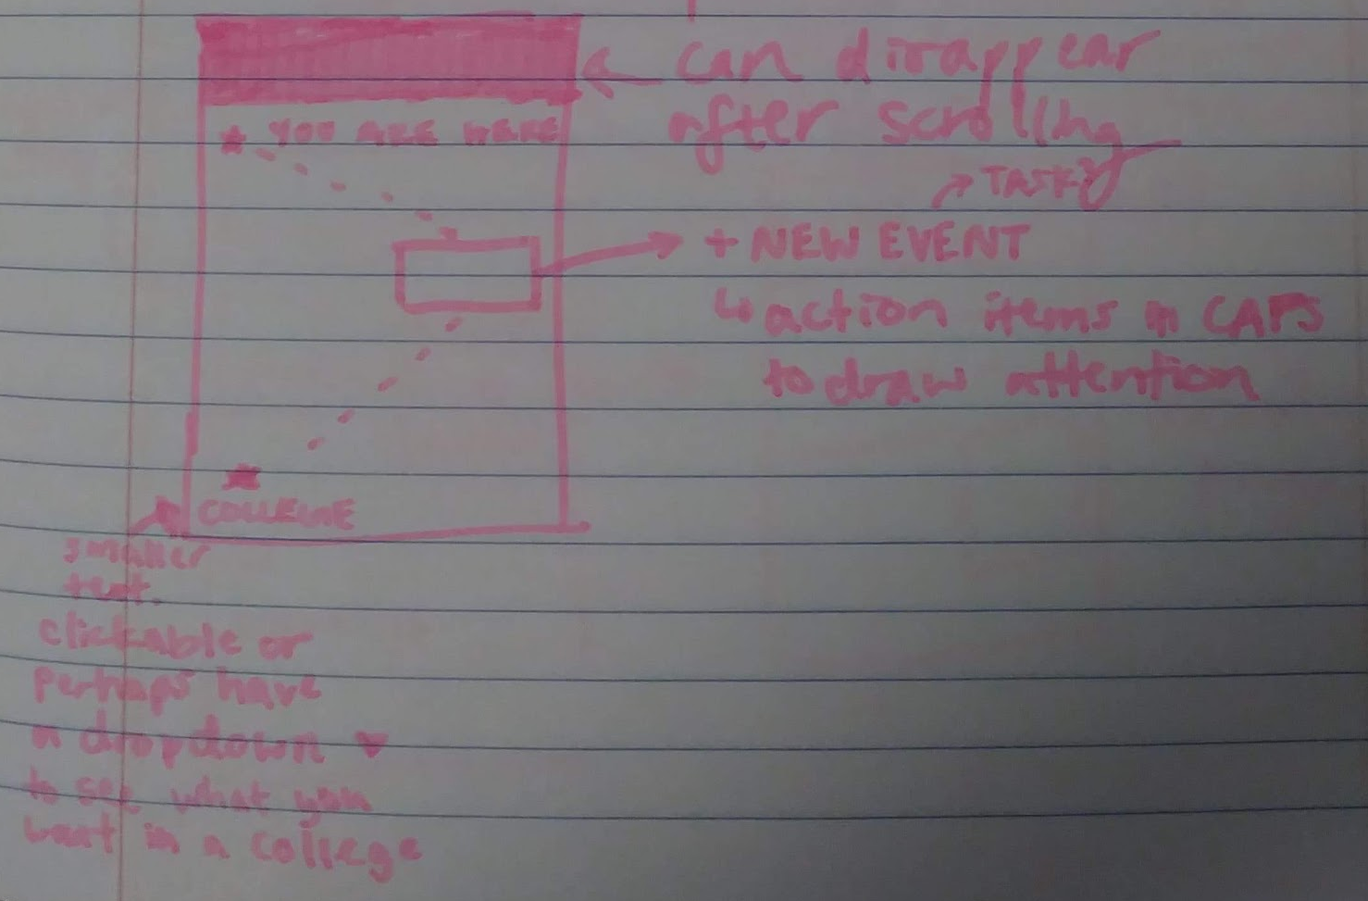
Task 1 Challenge
Before
users were confused about the possibilities of “click to edit” nodes.
After
A single node to edit and change of name to “add task”
Notes:
Rationale: As you may recall, one challenge we saw was that users didn’t know which node to click in our “Click To Edit” box nodes. We solved this by just making it so that there is only one “Click to edit” box on the screen so that could be the only box they can click.

Slide 8
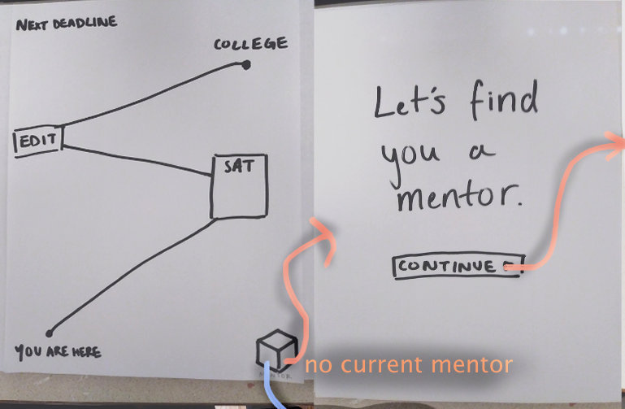
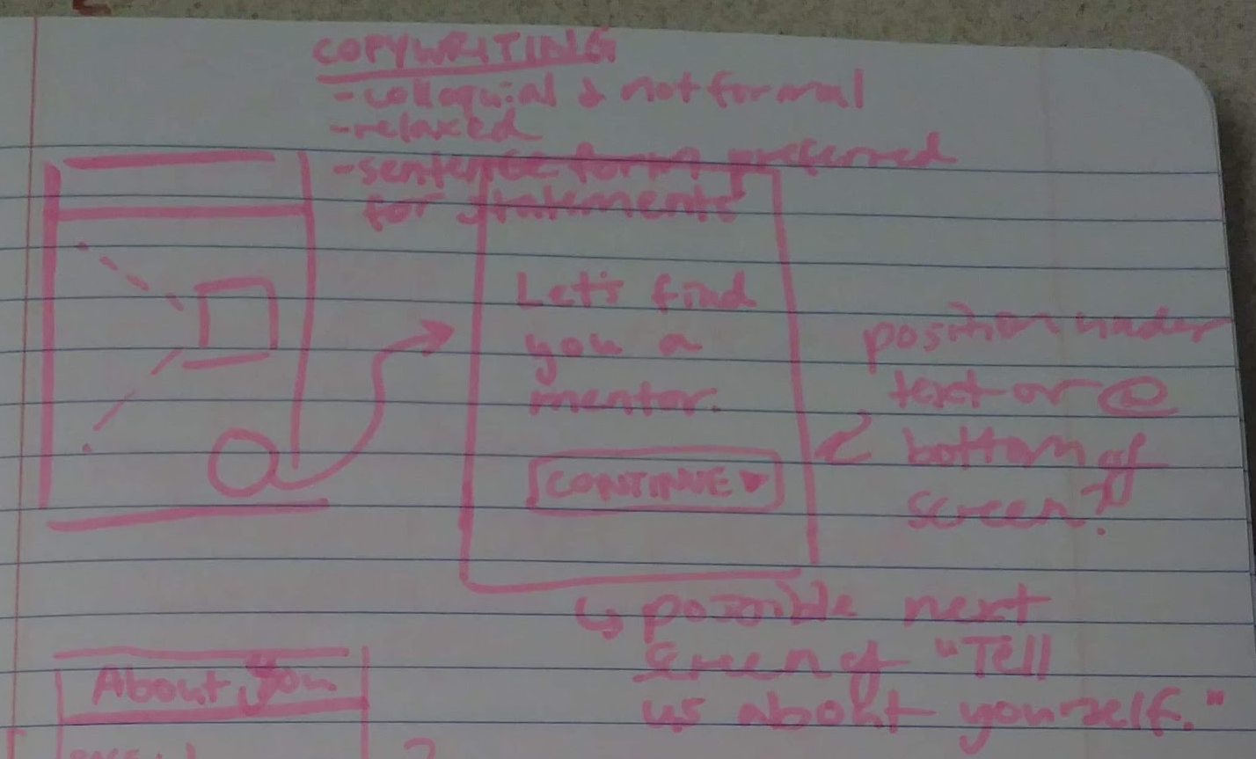
Task 2 Challenge:
Before
users were confused
about “mentor” box icon, would click “edit” instead
After
mentor box is clearly labeled and looks very clickable
Notes:
Rationale: Before, the users would click the edit node instead when we gave them the task of connecting with their mentor. They also had no idea what the mentor button did. Afterwards, we solved this by making the mentor box more clickable by having a circle around it and ensuring it said mentor directly on the box.

Slide 9
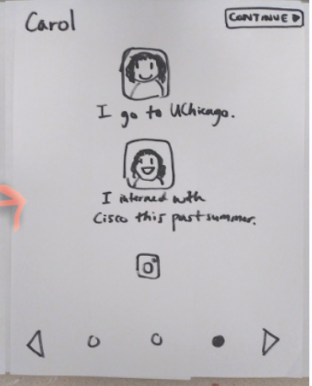
Task 2 Challenge:
Before
users couldn’t differentiate between “clickable” and “submit” buttons
After
request button is nice, clear and swipe navigation is clean
Notes:
Rationale: Before, the users couldn’t figure out how to request that profile. They didn’t know weather to click the face, the “continue” button, or the bottom right arrow in order to select a mentor. After, the request button is at the bottom of the profile all nice and clear. It is clear that the user can swipe through profiles or click through them by clicking the arrow keys on the bottom left and right.

Slide 10
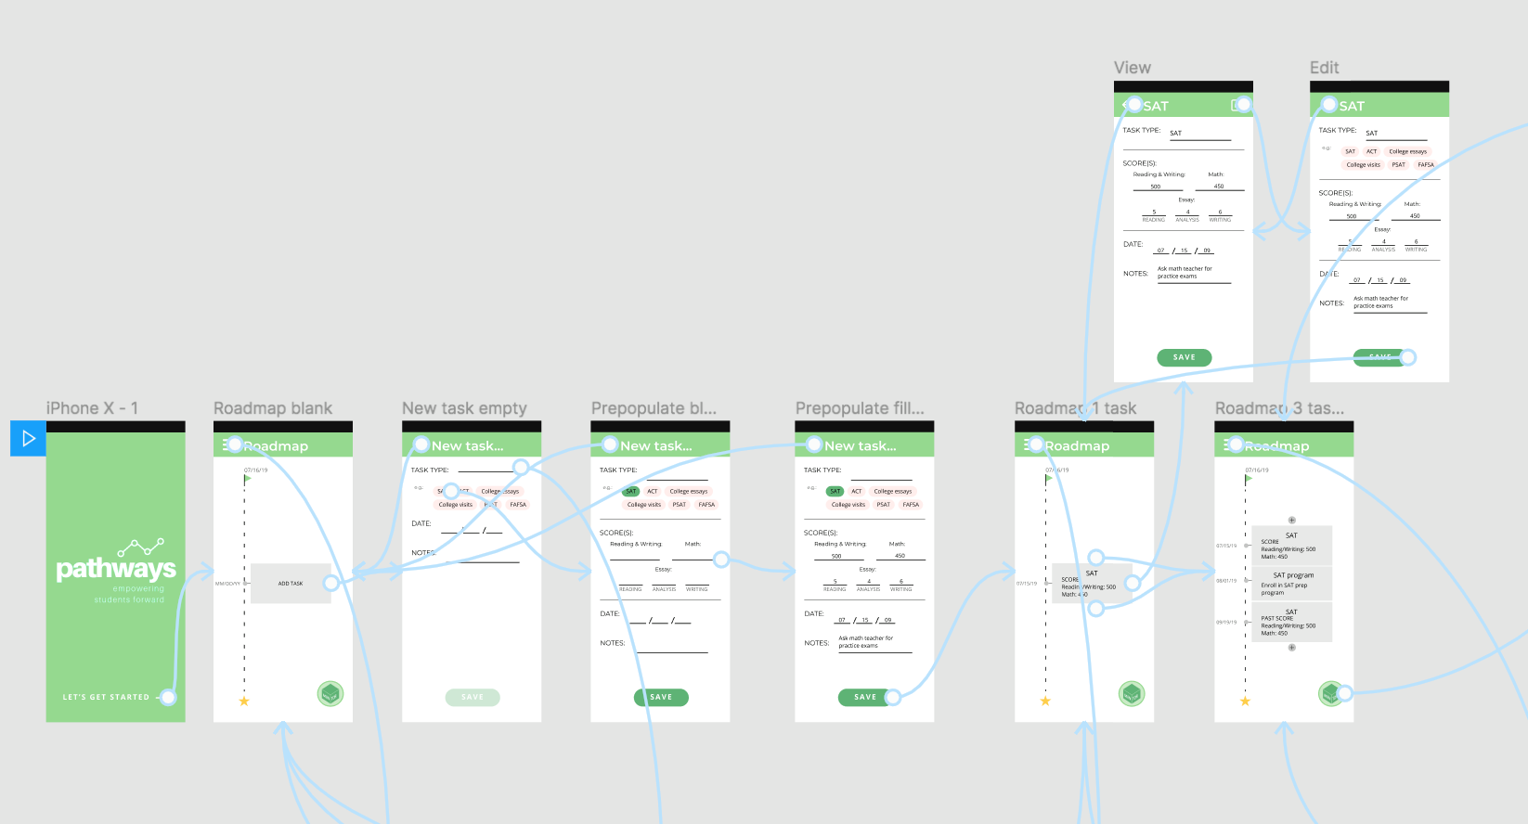
Med-Fi Task 1 Flow:

Slide 11
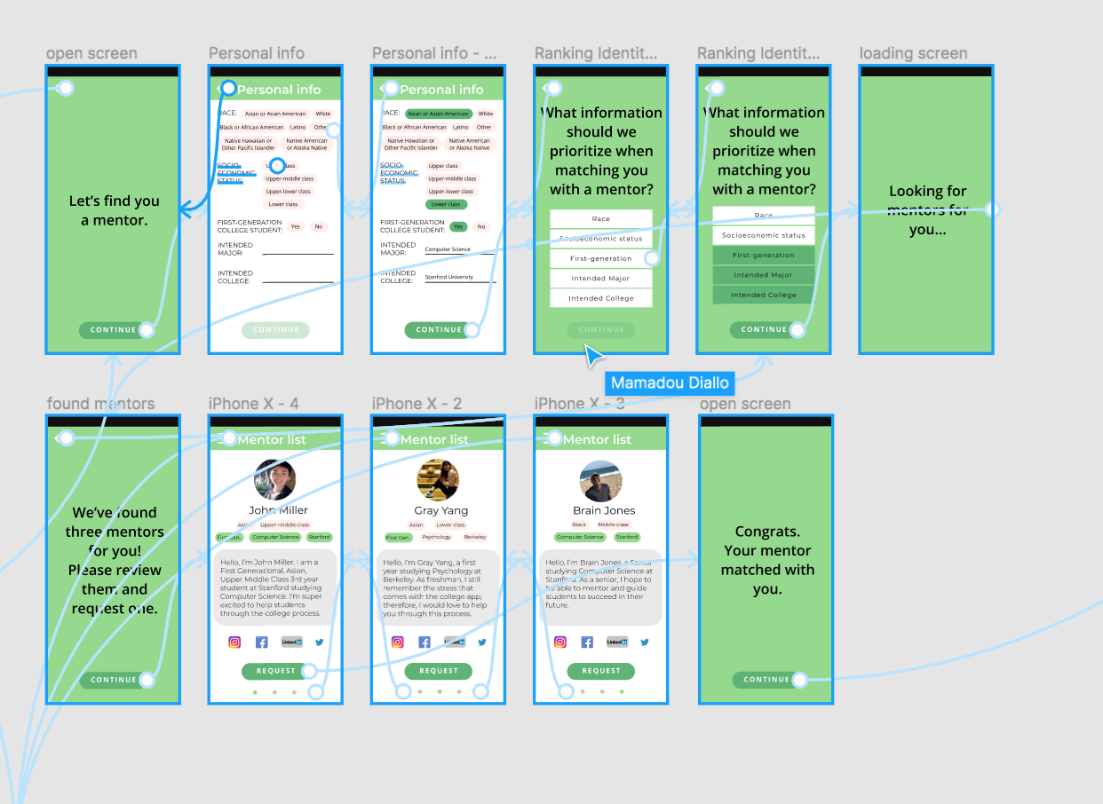
Med-FiTask 2
Flow:

Slide 12
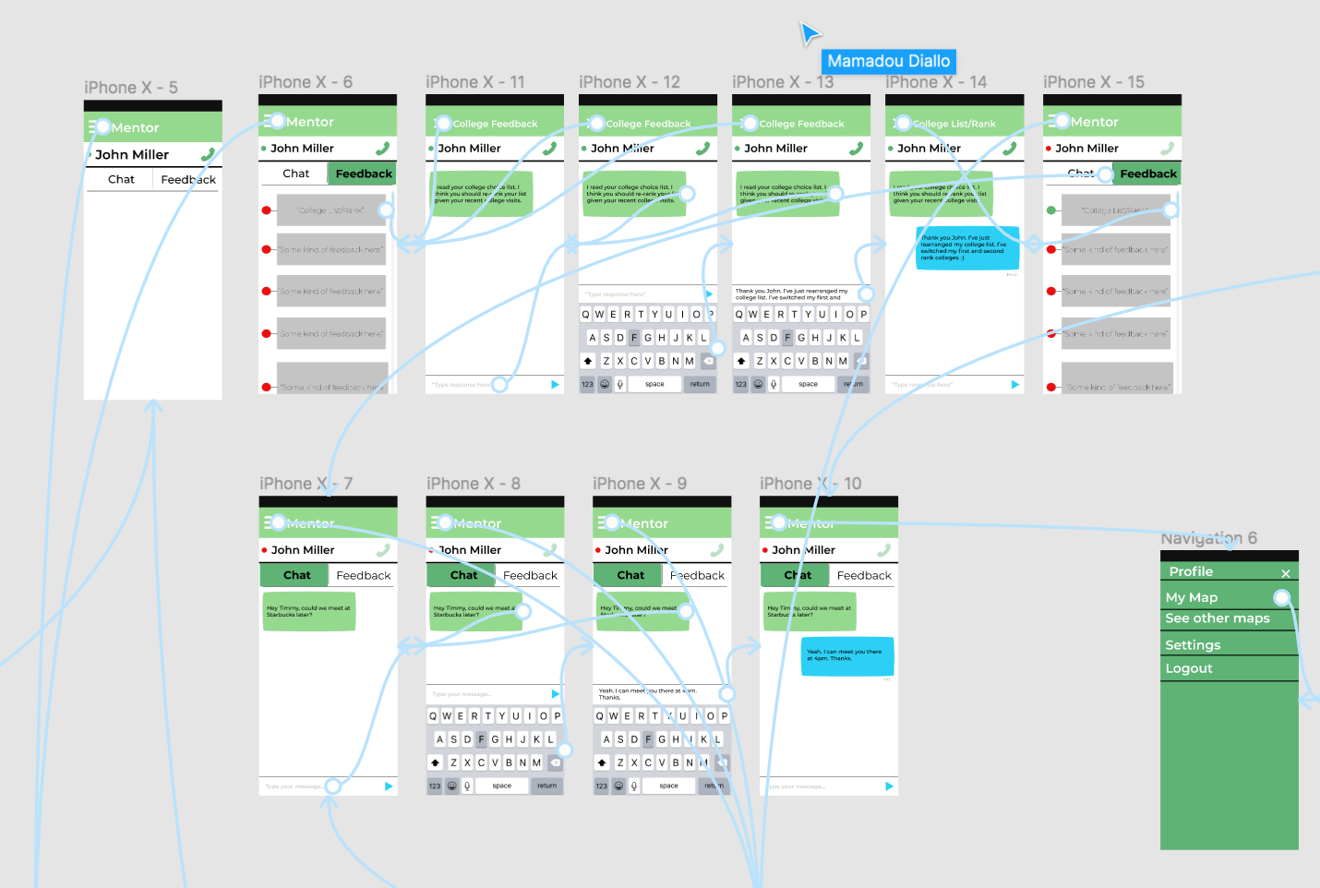
Med-FiTask 2
Flow:

Slide 13
We Used Figma
Helpful
Easy emulation of iPhone X, simulating user finger via clicks
Collaborative nature allowed team to work together efficiently
Unhelpful
Tedious creating an example chat page for mentor/mentee to simulate conversation
Difficult working when we had “all hands online” at the sametime

Slide 14
Limitations/Tradeoffs
Inability to efficiently simulate scrolling views and fancy UI animations.
  For example we were hoping our Roadmap would present as scrollable.
We left out “login” and “settings” screens because we felt like that would have a universally familiar UI interface not worth implementing

Slide 15
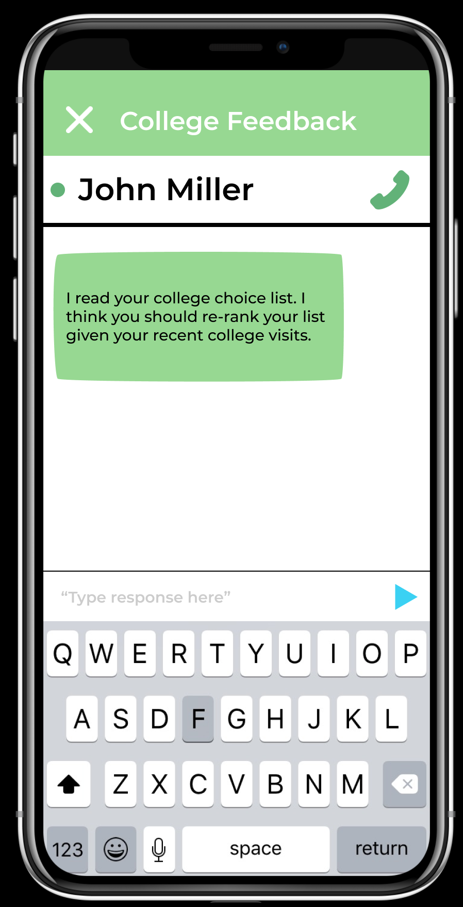
Wizard of Oz
Example WOZ mentor chatting with mentee:
Used WOZ technique in order to simulate three mentor related features.
Approve mentee request for mentorship
Provide feedback
Chat with mentee
**we had no external hard-coded features**

Slide 16
Additional Prototype Screenshots...

Slide 17
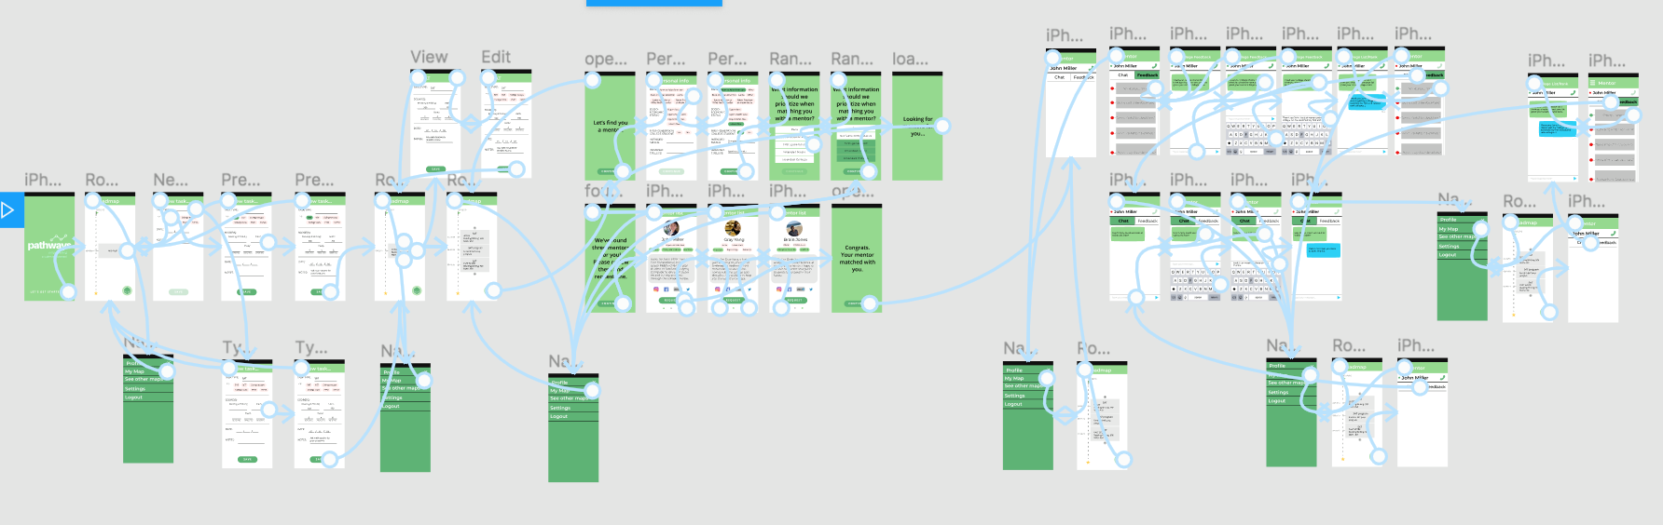

Slide 18
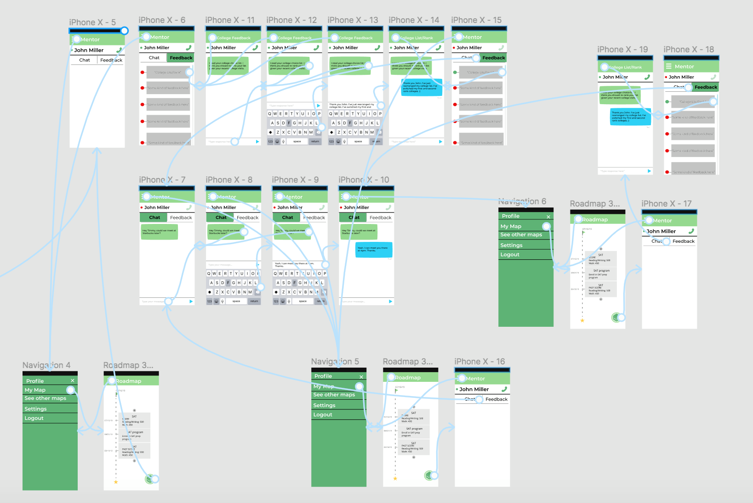

Slide 19
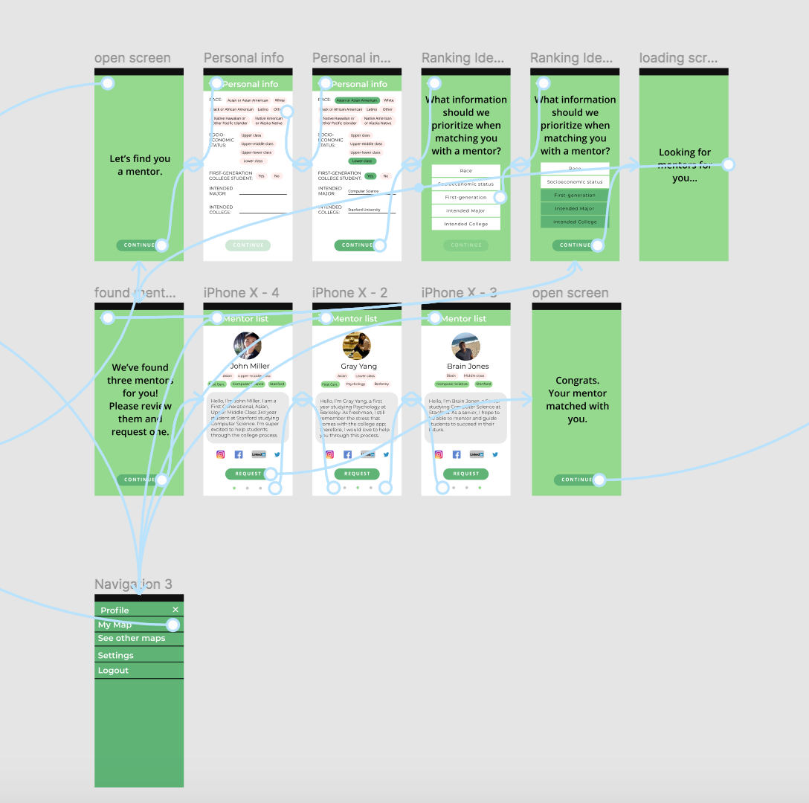

Slide 20
