Slide 1
Pathways
Empowering Students Forward

Slide 2


Meet the Team
Gray W.
Pao T.
Mamadou D.

Slide 3
Mission Statement:
Pathways aims to empower and equip students with the tools needed to take charge of the college application process, and be ready to give back to others seeking help during the process.

Slide 4
Value Proposition
“Empowering students forward” conveys our mission statement of wanting to propel students forward on their path to college, and aid them in taking charge of their college application process.

Slide 5
Problem:
College is seen as a goal for many students, but the college application process is confusing, complicated, and stressful.
Solution:
An single app that would allow students to ‘map’ out their college application process and connect them with similar background college students to provide mentorship and guidance.

Slide 6
Pathways
Selected Interface:
1. People are already comfortable with phone UIs, so there won’t be a steep learning curve.
2. Accessibility; most people have a phone, meaning it’s accessible to underrepresented and under-resourced students.
3. Phones that have messaging capabilities make connecting with a mentor more feasible.
Place your screenshot here
Empowering Students Forward

Slide 7
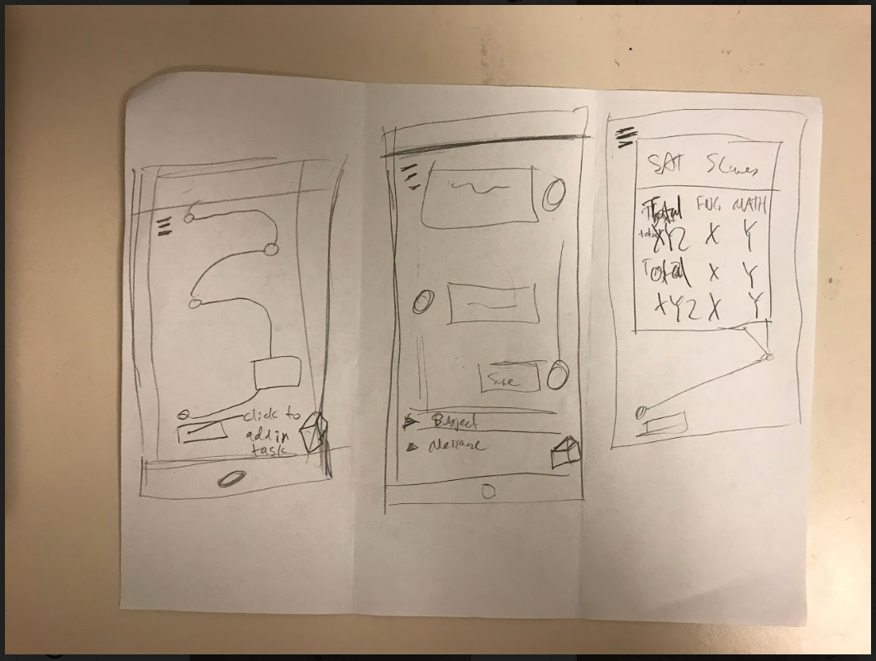
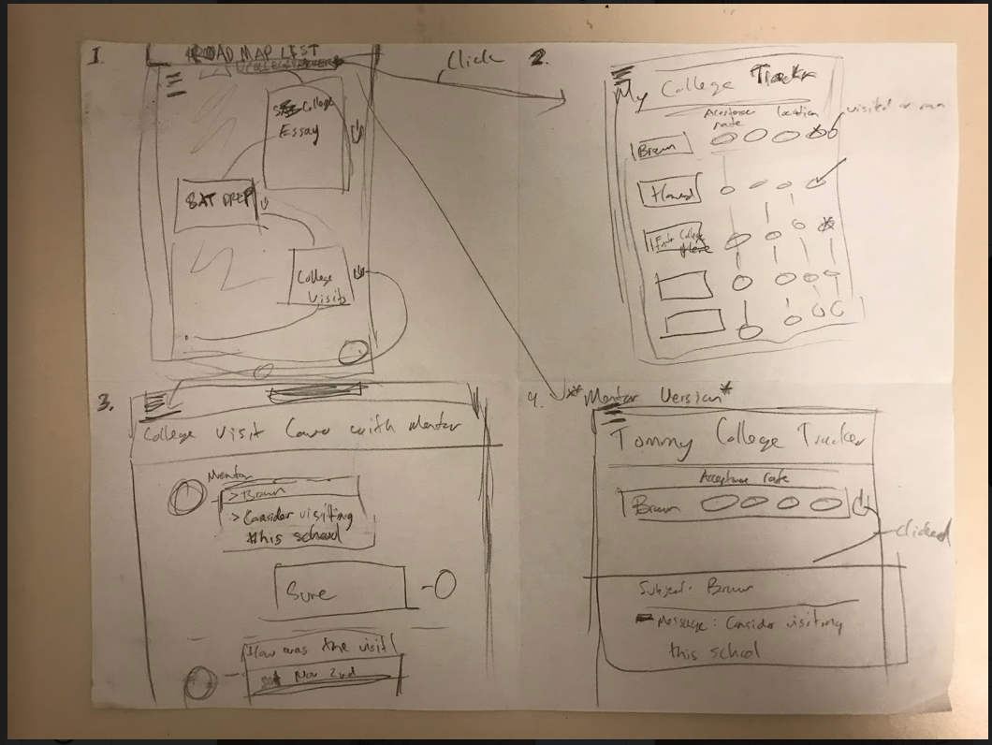
Low-Fi Prototype:

Slide 8
Our Tasks
Create a college roadmap
Match students with a mentor of a similar background
Students should be able to receive feedback and guidance from mentor

Slide 9
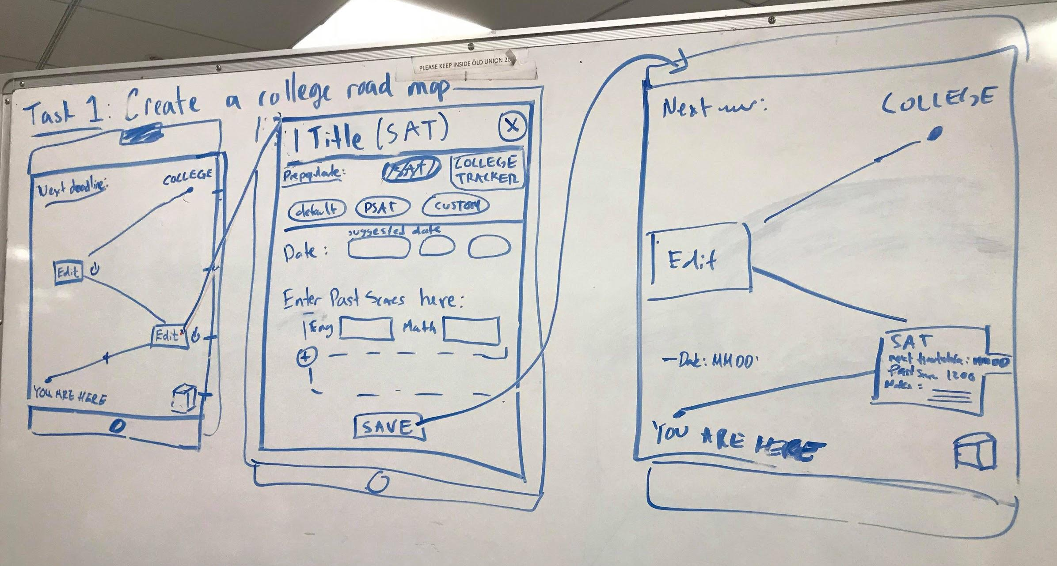
Task 1 flow:

Slide 10
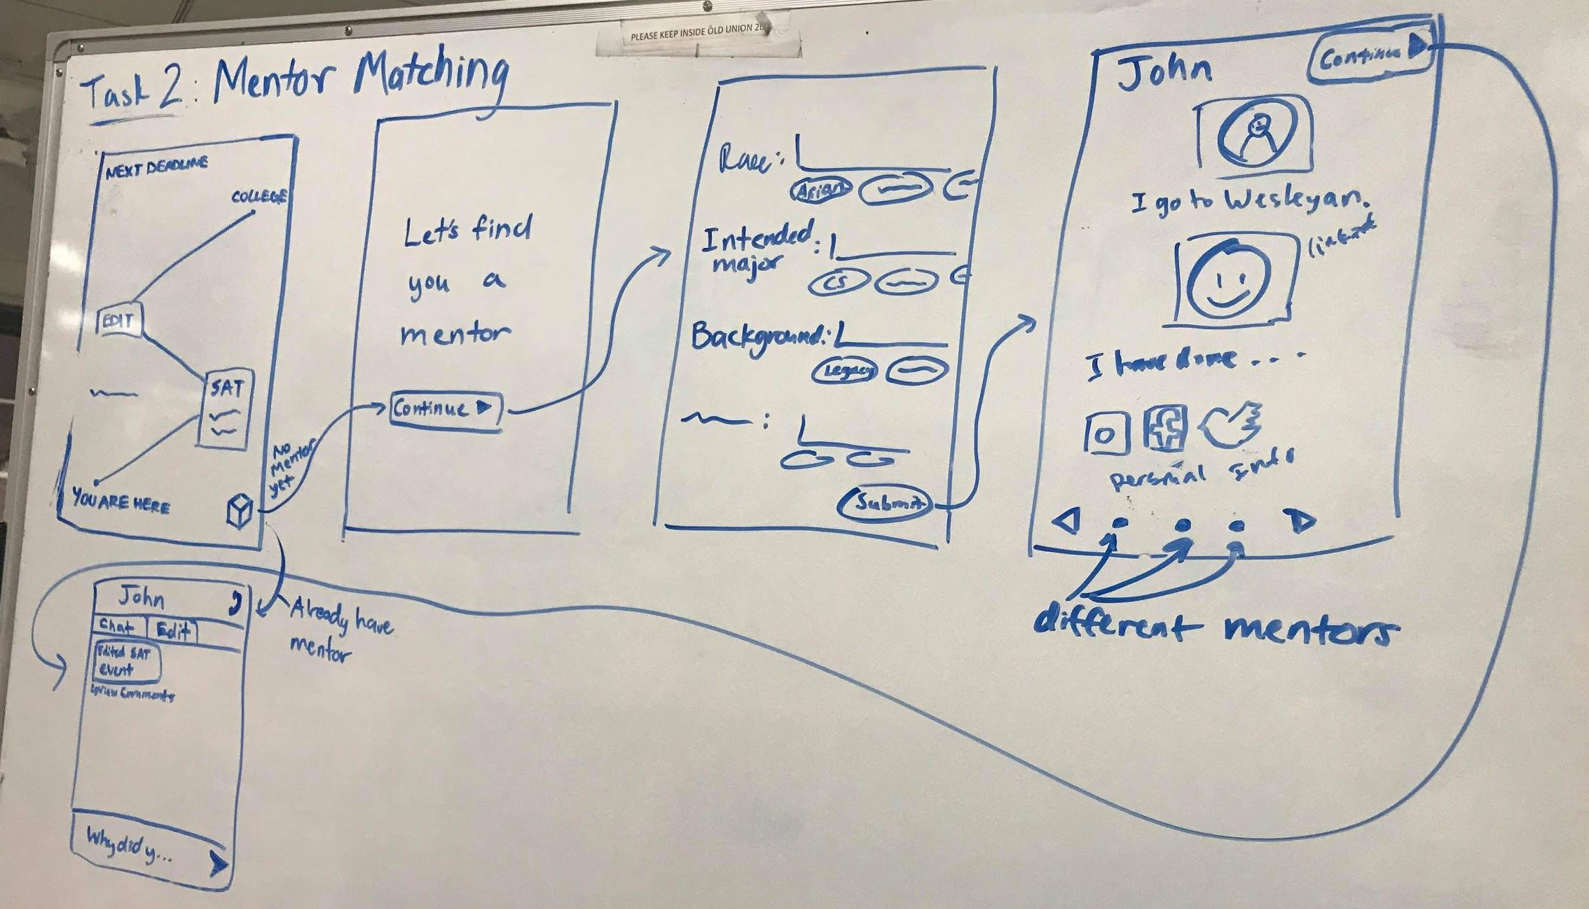
Task 2 flow:

Slide 11
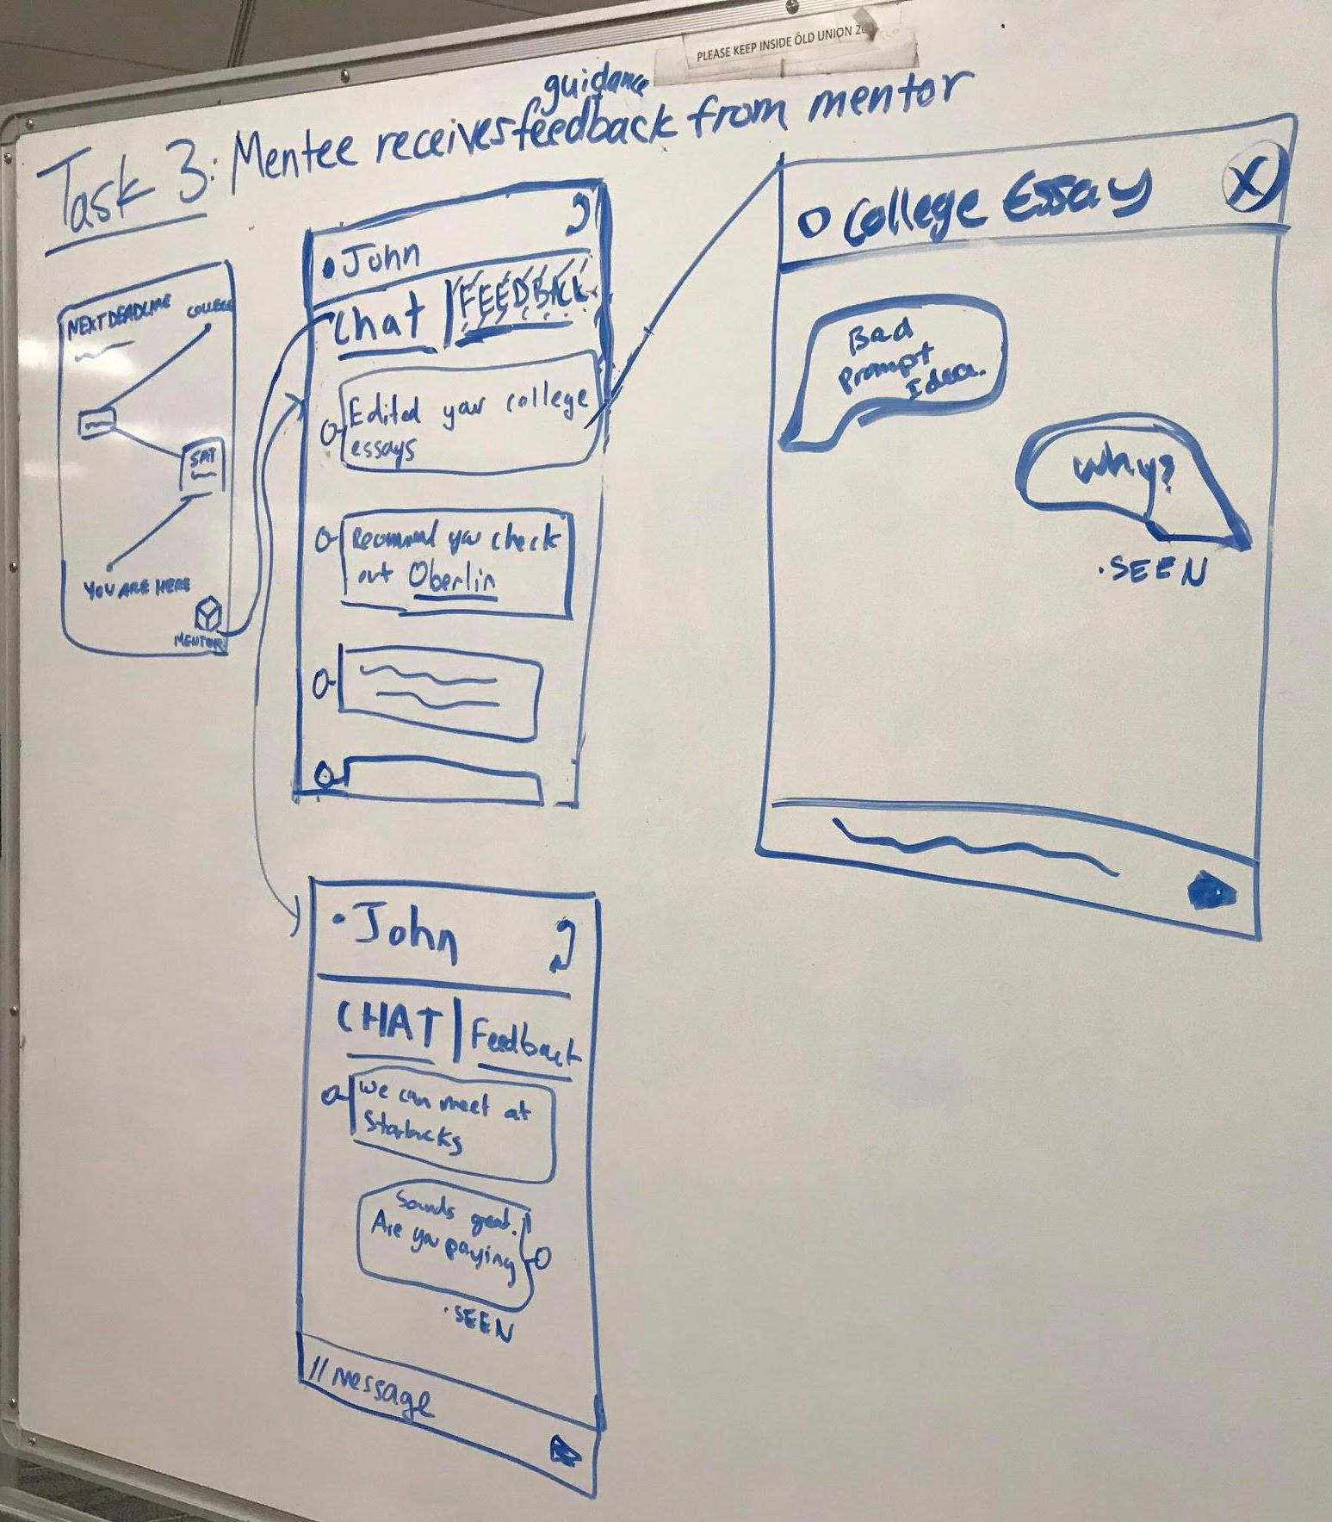
Task 3 flow:

Slide 12
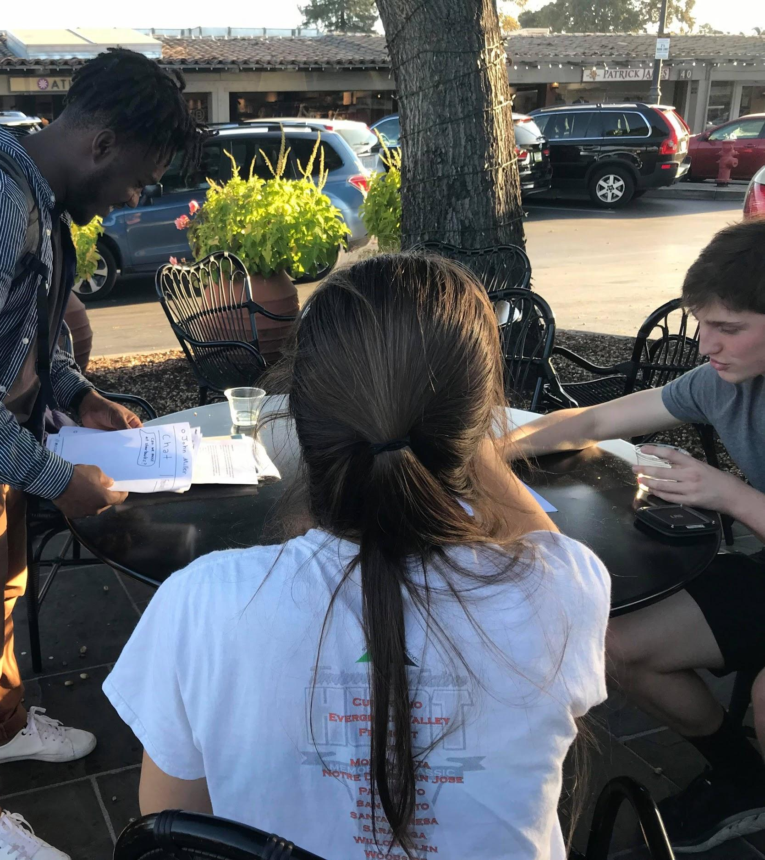
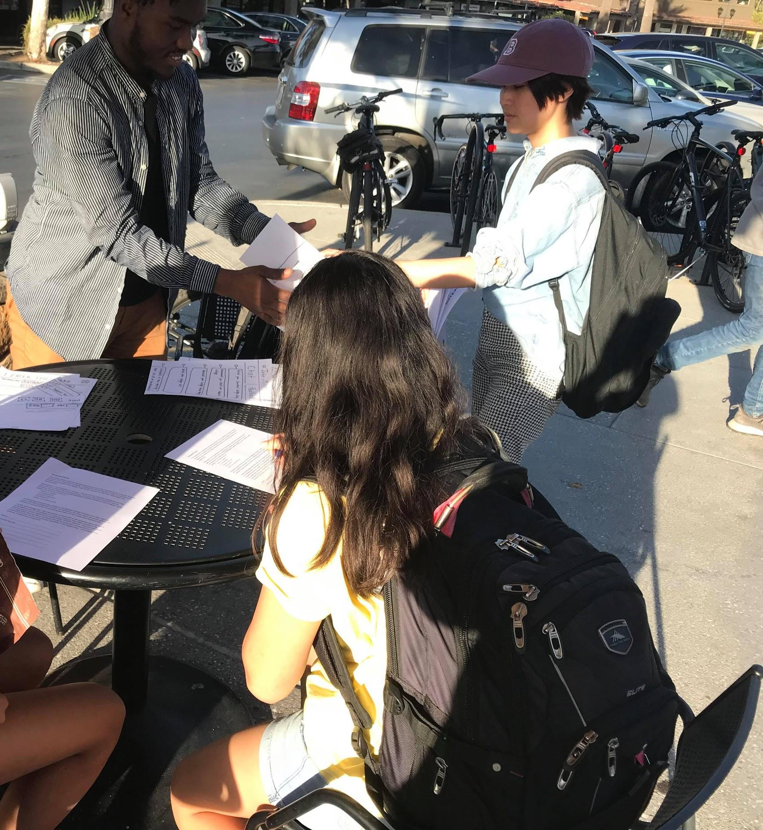
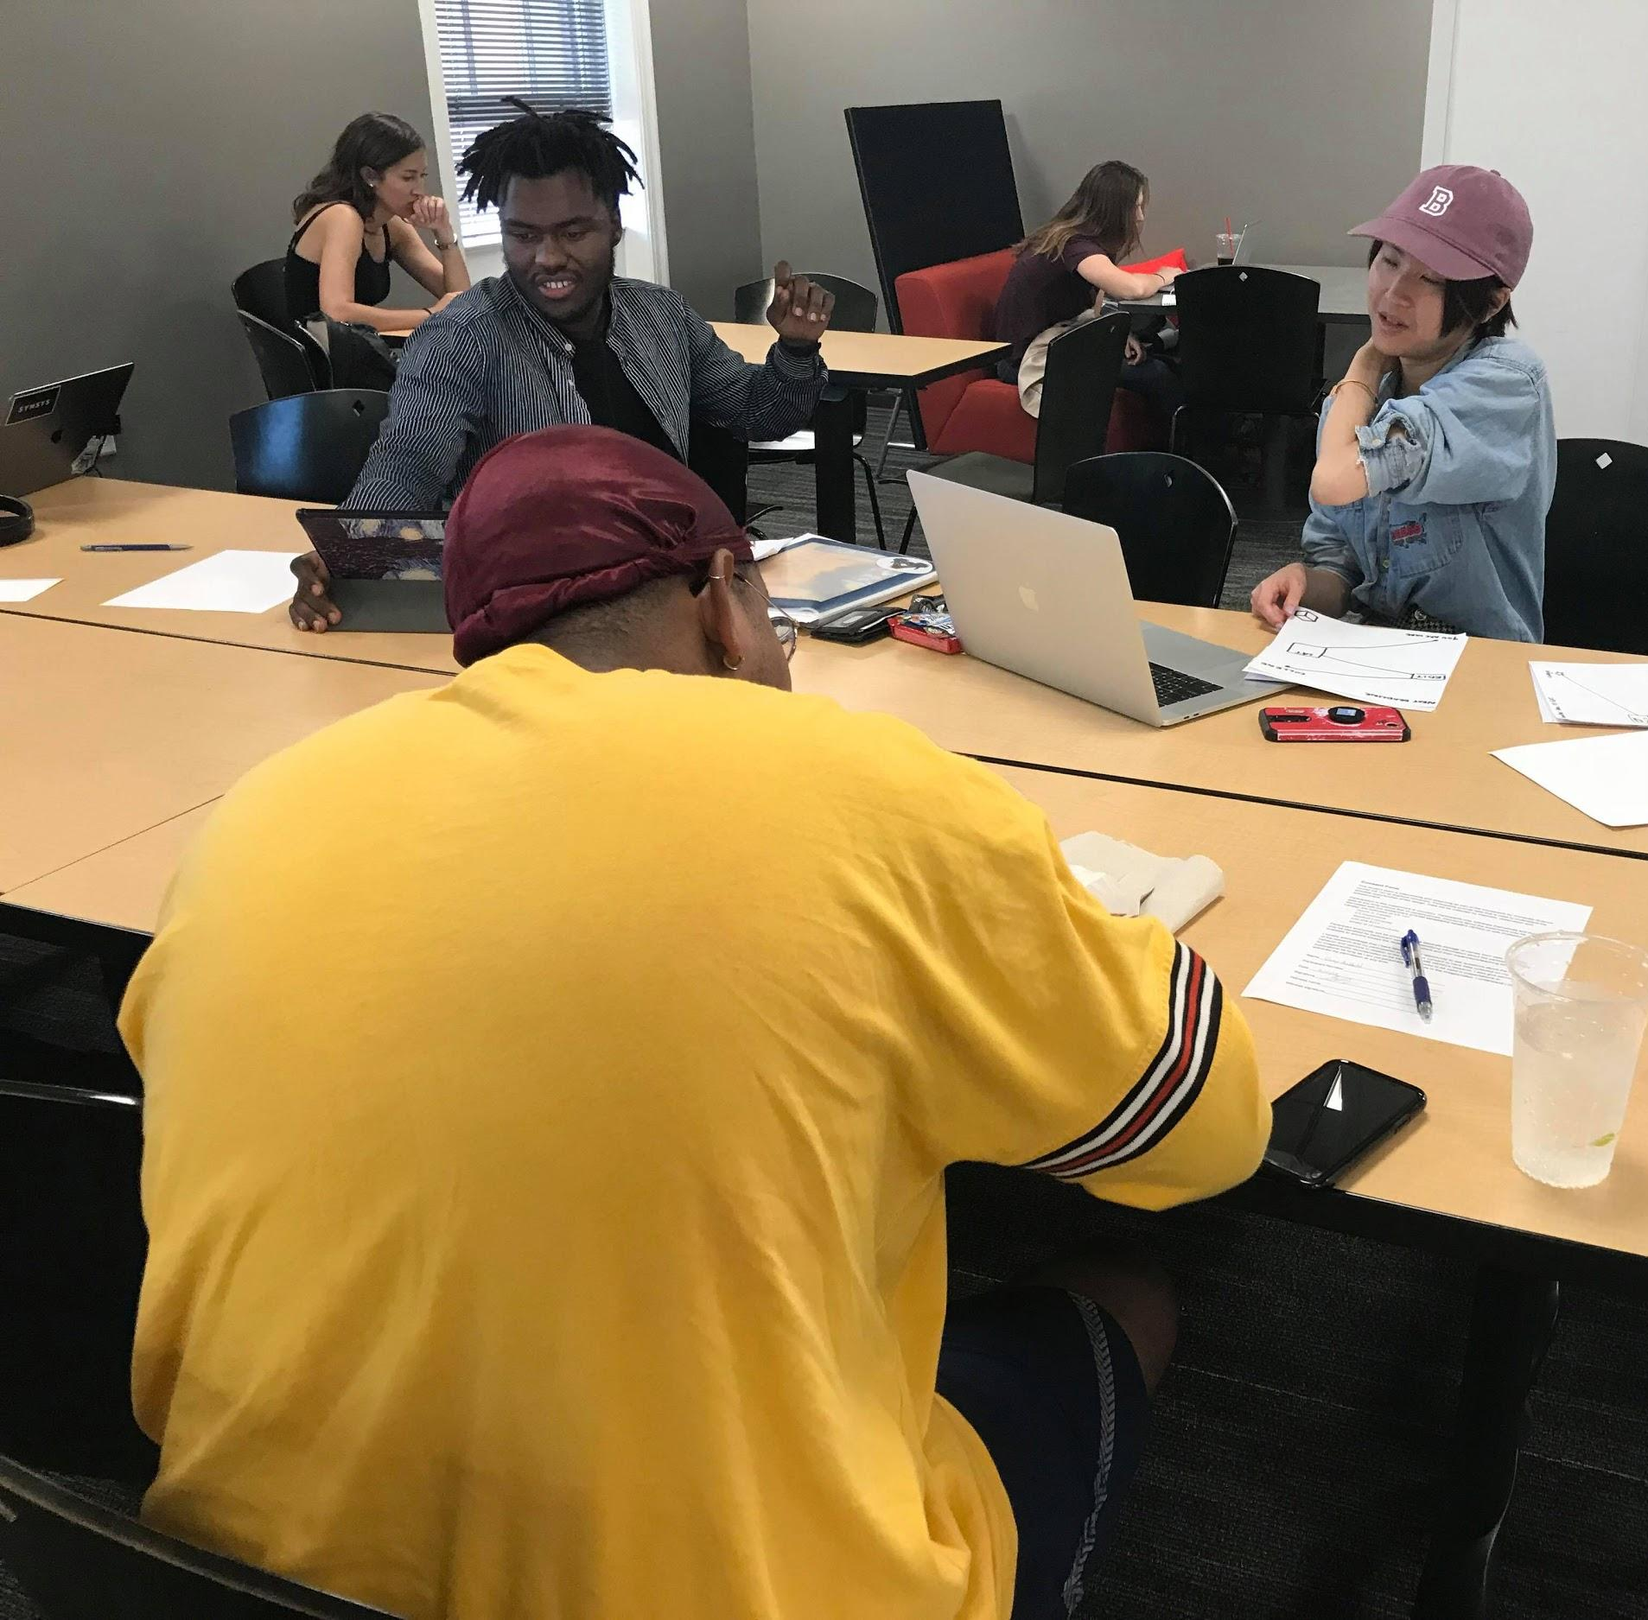
Experimental Method
Test Participants: 2 High Schoolers & 1 College Student
Prompt: Given the only the mission statement of Pathways and 3 tasks, observe how the user navigates to accomplish each of the three tasks.

Slide 13
Experiment Results Overview
Aesthetic
Functionality
Feedback:
Task 1
Create a college road map
Visual Design of the College Road Map was appealing
Confusion about “edit” buttons
Task 2
Match students with a mentor of a similar background
Visually appealing
Confusion about the “Mentor” box and “submit” buttons
Task 3
Students should be able to receive feedback/guidance from mentor
Intuitive and clean
Lack of appeal

Slide 14
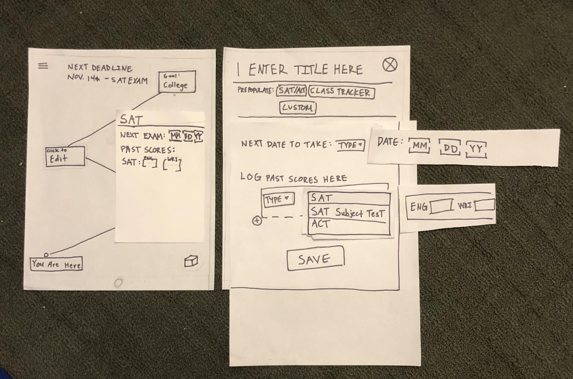
Task 1 Results:
Users liked the visualization of college road map/tasks
Confused with possibilities of “Edit” nodes
Lack of user input/choice e.g Next Date to Take …

Slide 15
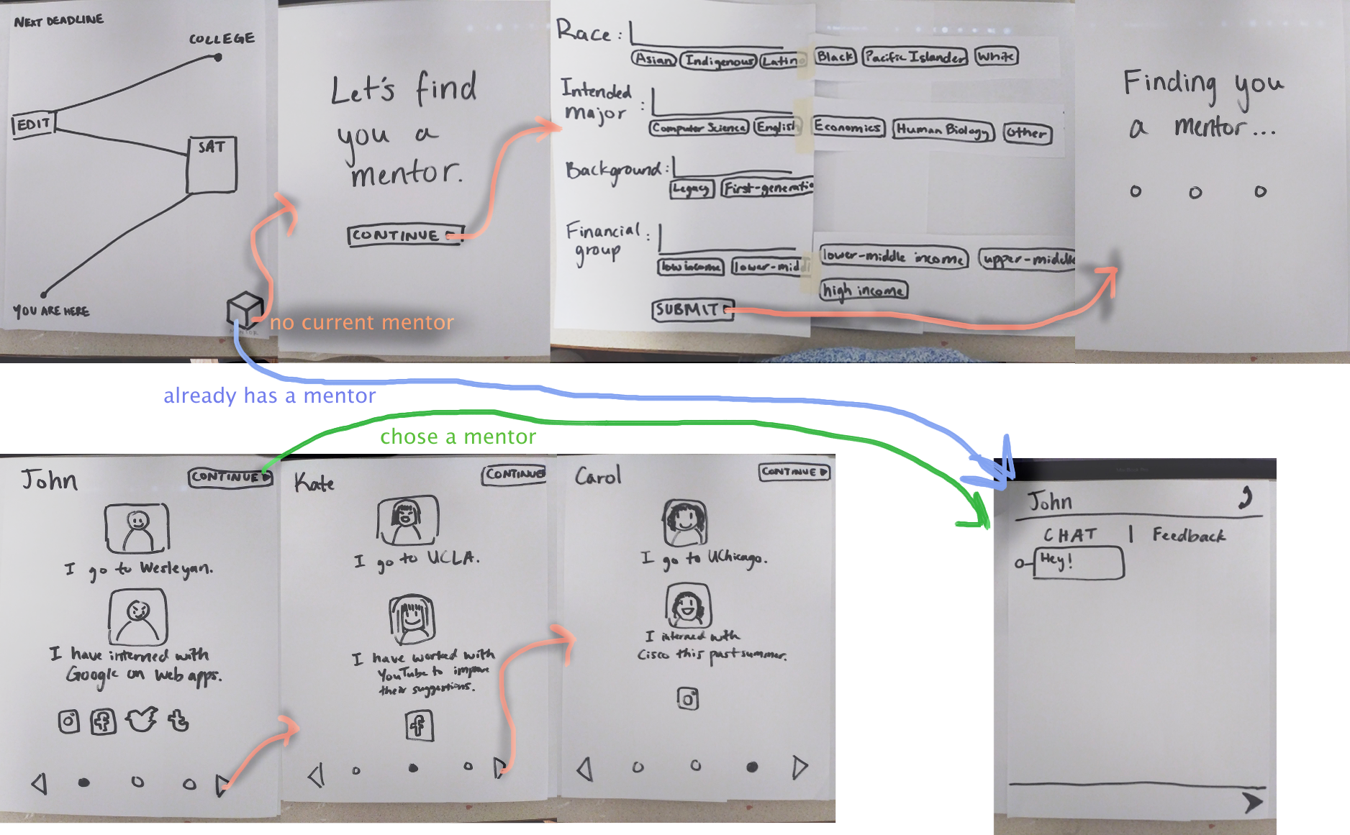
Task 2 Results:
Users liked the visual design/flow
Confusion about initial ‘Mentor’ box icon
  Clicked “Edit” nodes instead
Confusion about what is ‘clickable’ and ‘submit’ buttons

Slide 16
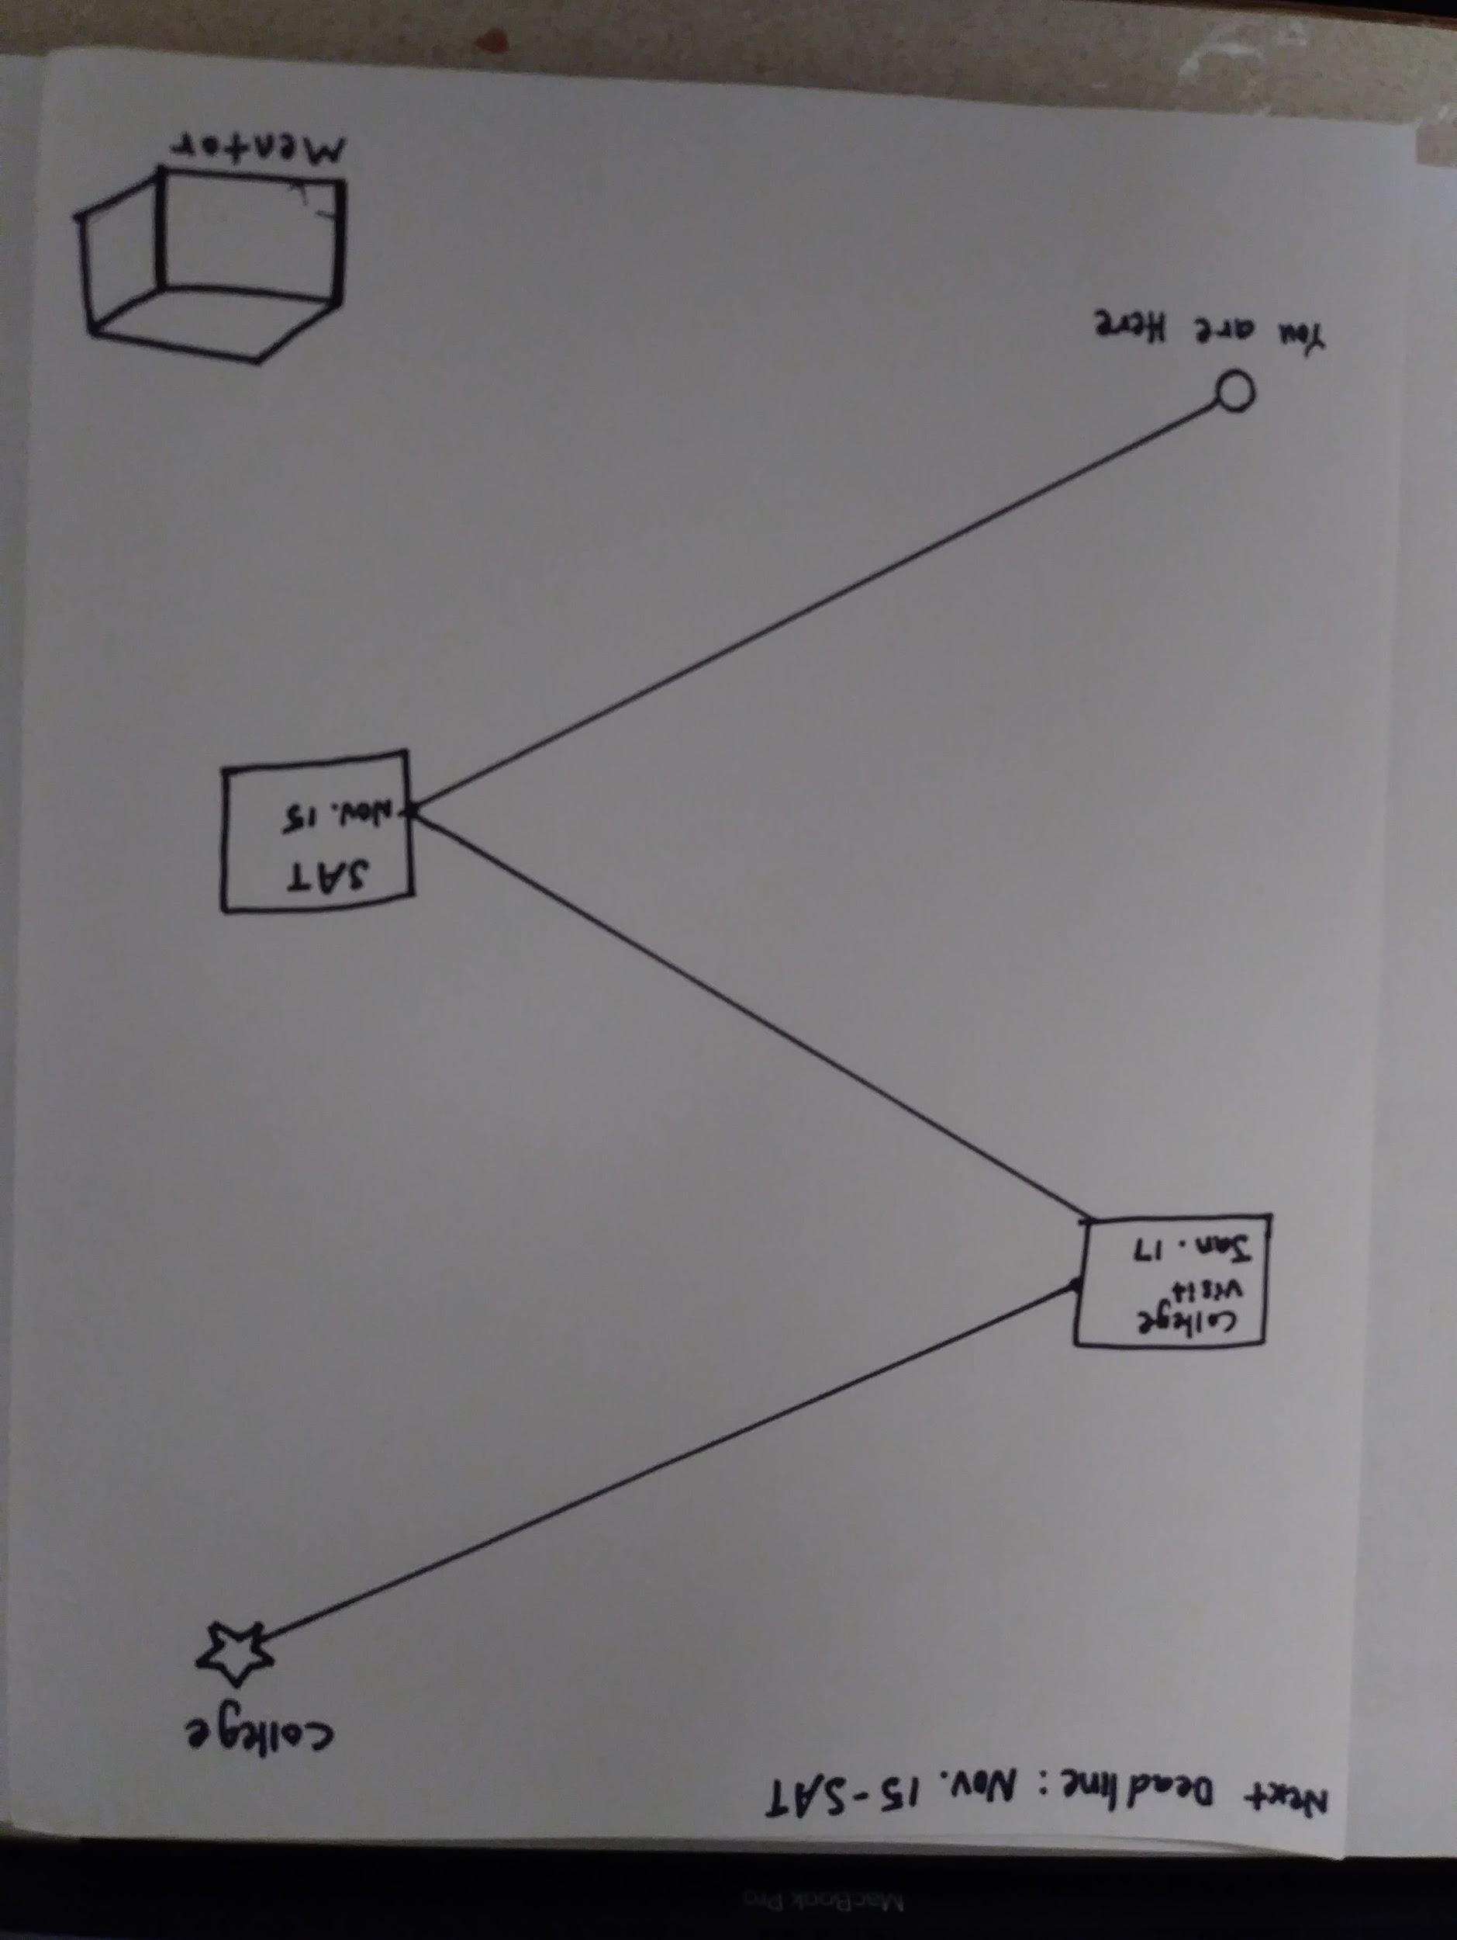
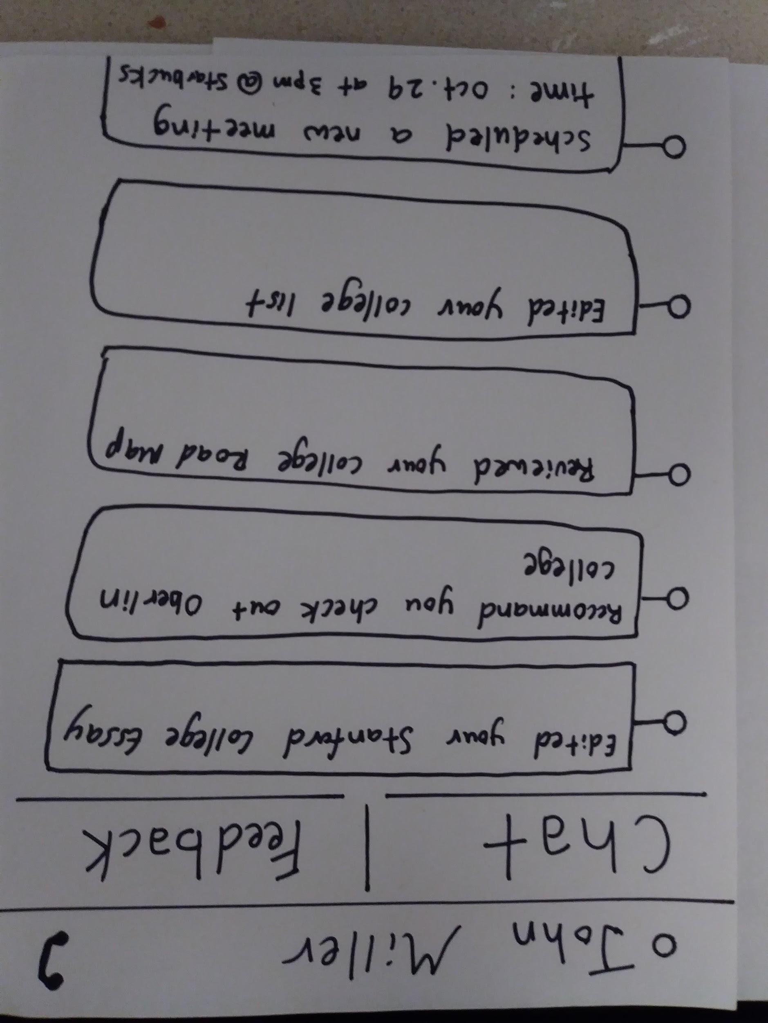
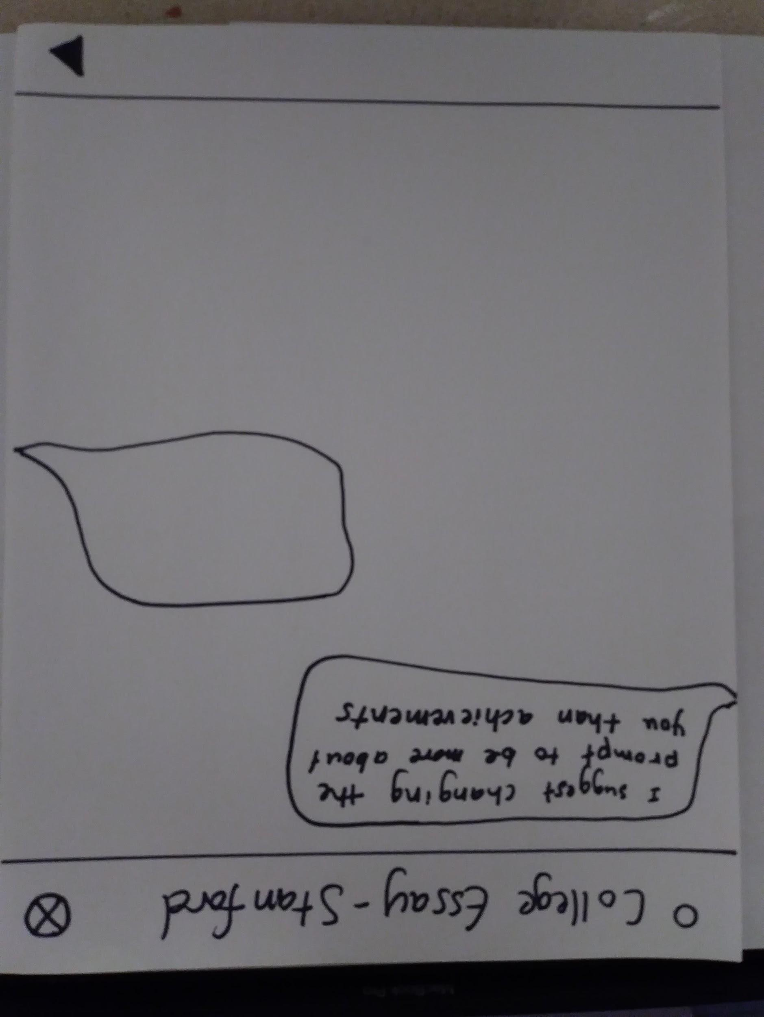
Task 3 Results:
Users found design to be clear and simple
Understood “Mentor” icon after task 2
Lack of visual appeal compared to the first two tasks

Slide 17
Pathways
Future UI Changes
Place your screenshot here
Consider adding ‘options’ for Edit boxes in RoadMap page
Change ‘Mentor’ box to be more clear of its purpose
Unify submit button locations
Empowering Students Forward

Slide 18
Summary:
All 3 tasks were accomplished with minimal guidance
People generally liked our visualization and design of our interface
Certain areas of design that needs to change for more options/clearity
Our prototype was a success!
Students stated that they think our app is a great idea!

