Slide 1
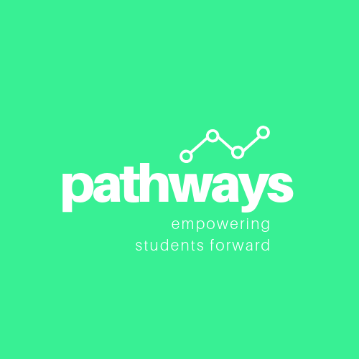
Gray W., Pao T., & Mamadou D.

Slide 2
problem overview
College is often viewed as a way forward and an agent of social mobility, making college access and guidance a pressing issue.
We aim to scaffold the college application process with Pathways, empowering students to take charge of the application process by creating their own “college roadmap”.
We hope to connect students with college students of similar backgrounds that can help provide feedback and advice on their roadmap based on past experiences.
“Empowering students forward”
Notes:
Value proposition: empowering students forward

Slide 3
our three tasks
High schoolers can…
Create a college roadmap
Connect with college students of a similar background
Receive guidance and feedback from college students

Slide 4
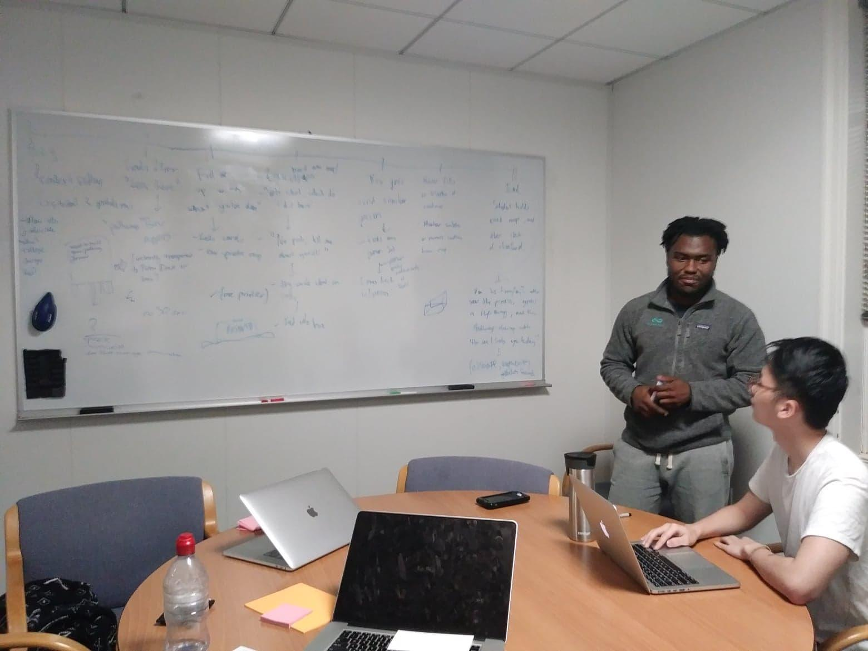
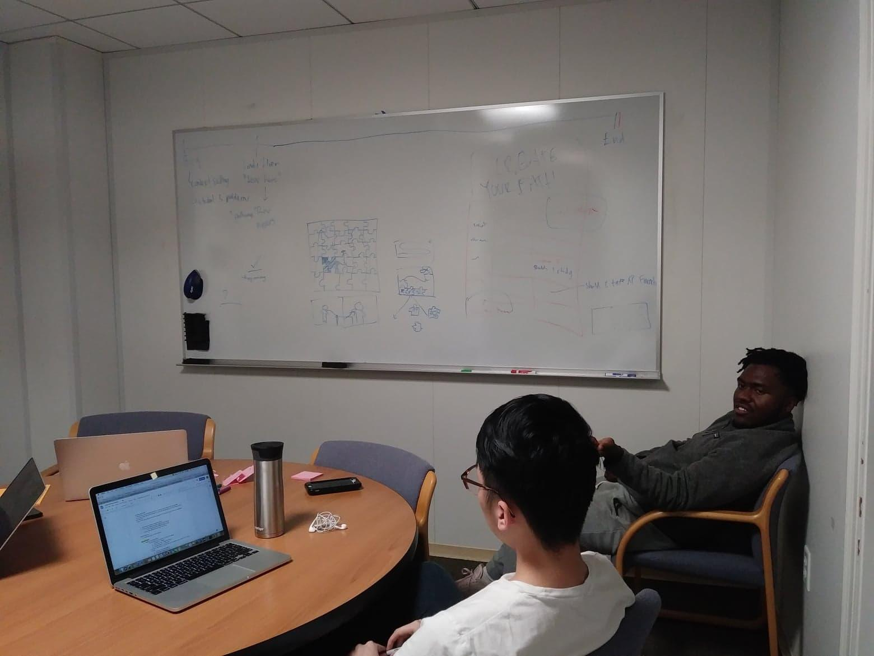
storyboards
Notes:
We got together and just started brainstorming, passing ideas back and forth.

Slide 5
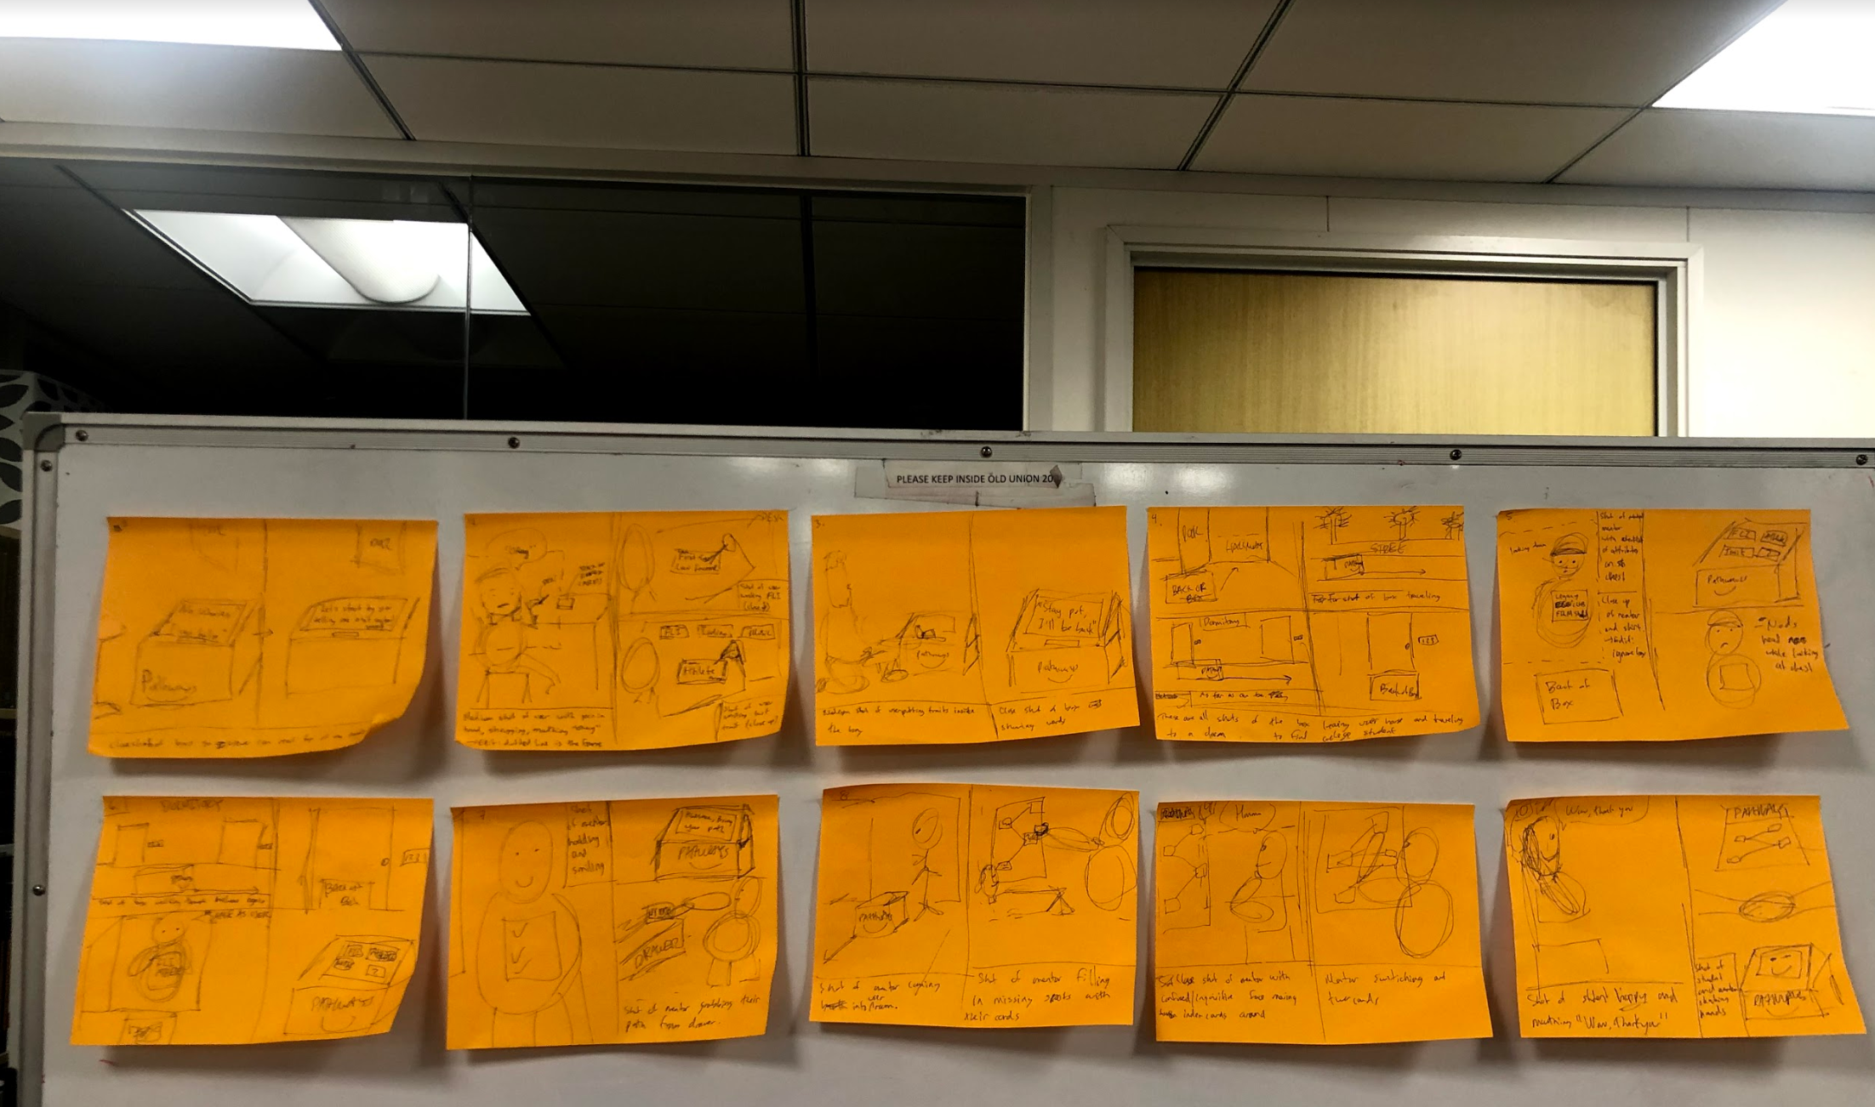
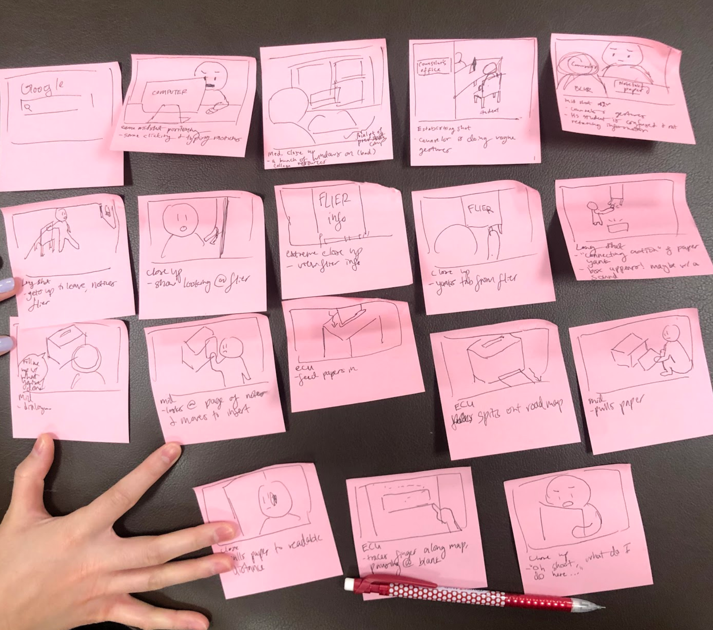
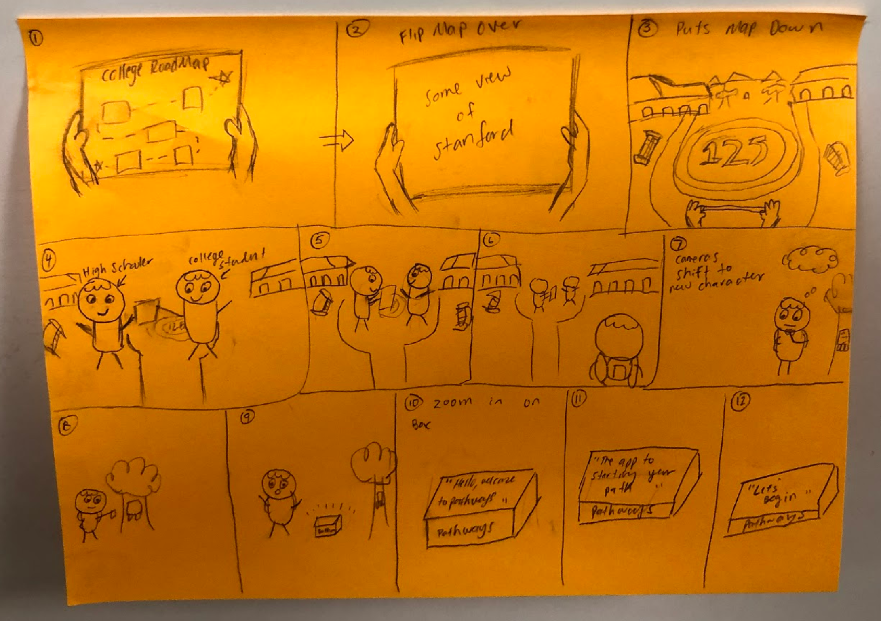
*Photos of individual post-its are in Assignment 3’s Storyboarding folder*
Notes:
A collection of our storyboards for the shots in the video.

Slide 6
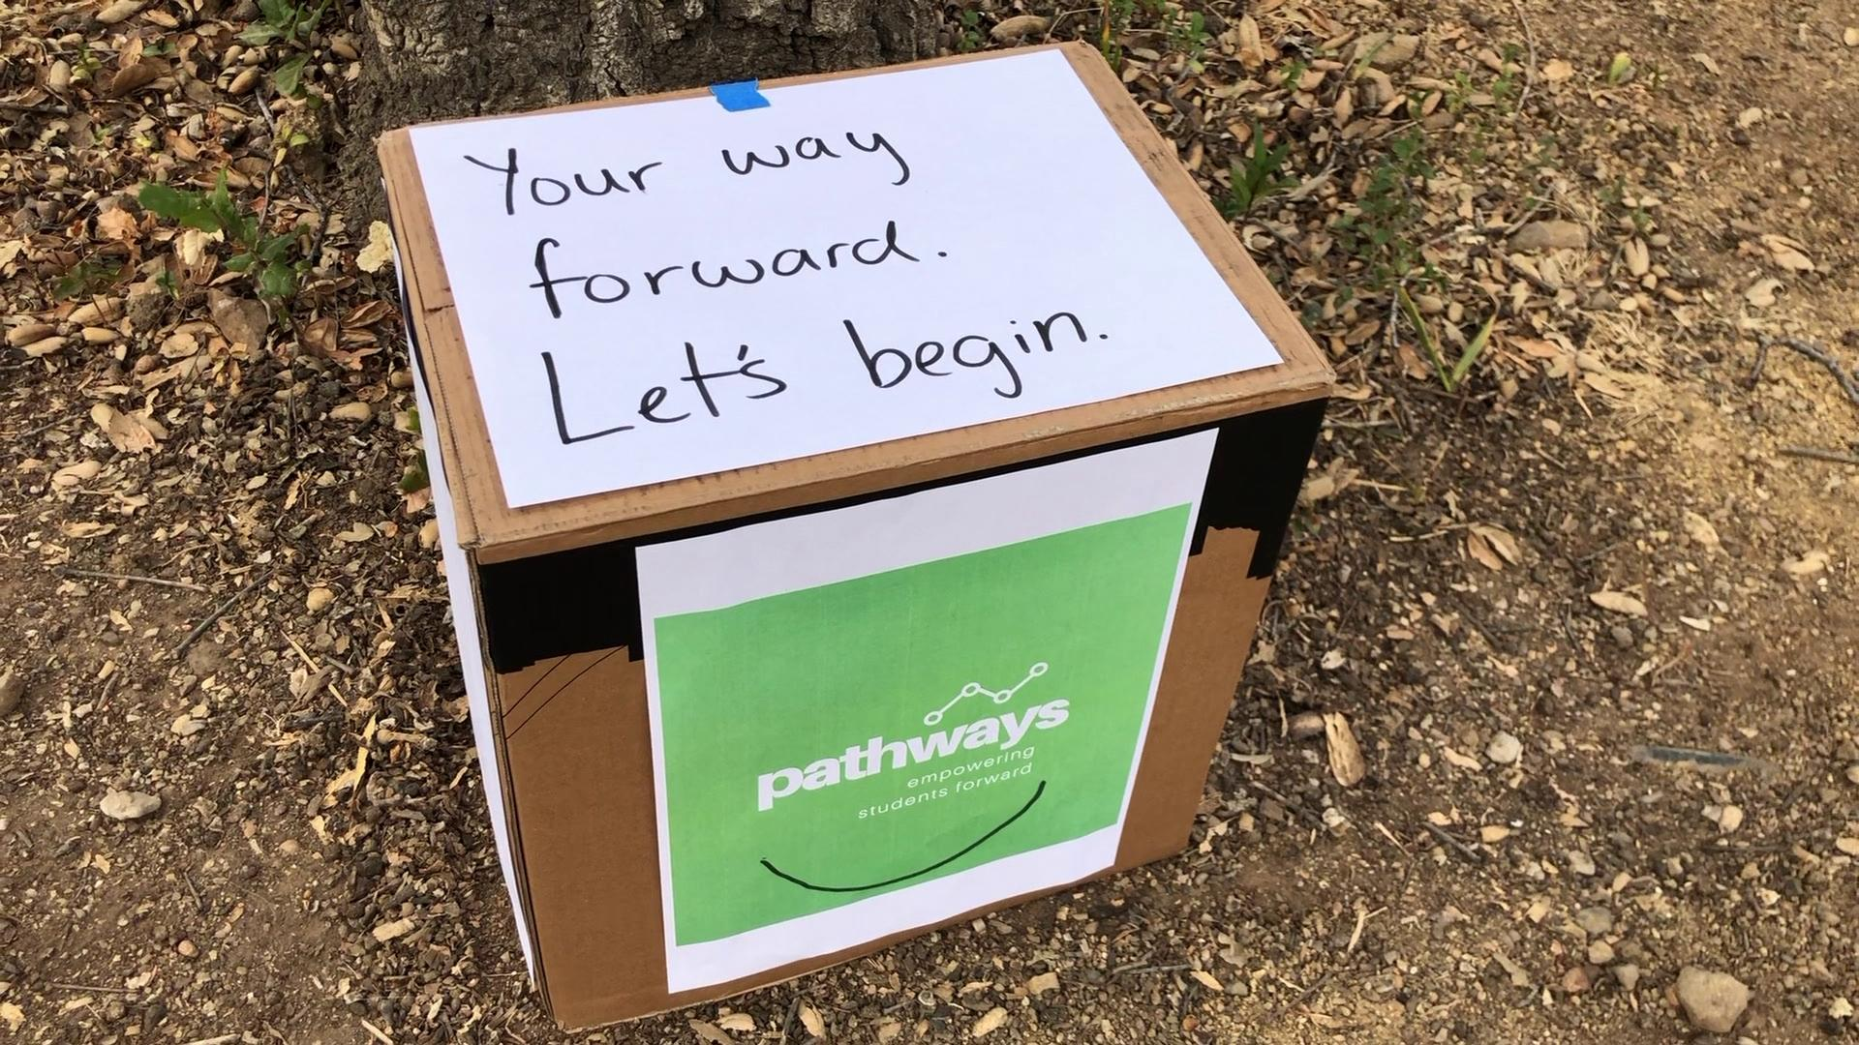
video
*video also available here: https://youtu.be/PR0aoaahsEk*

