Slide 1
College Education Equity
A Presentation by Pao, Gray, Kate and Mamadou

Slide 2
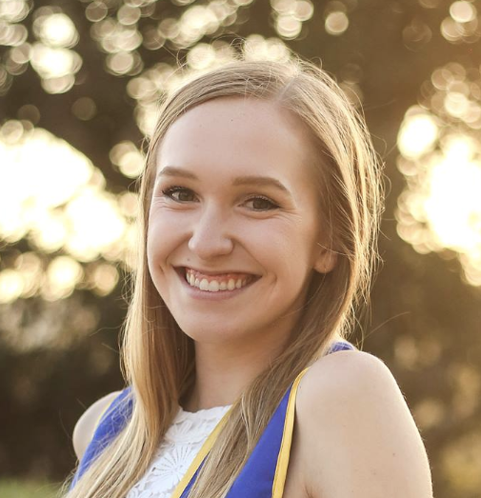
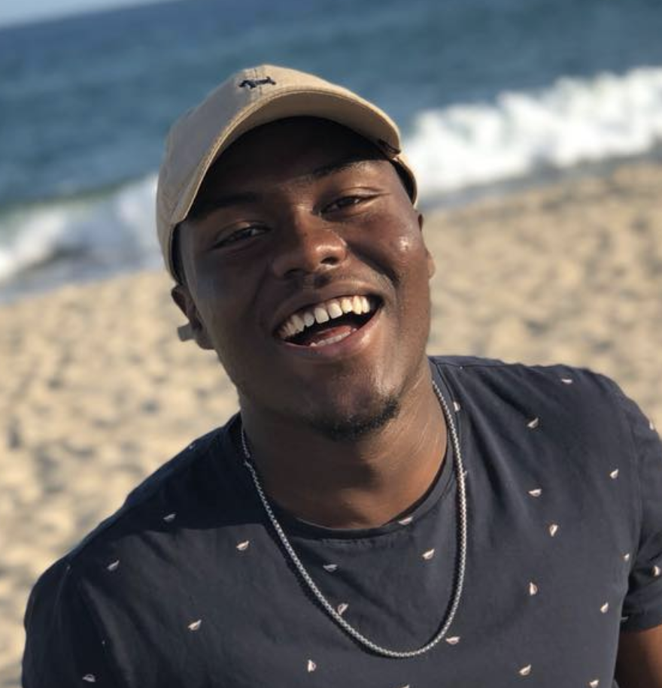
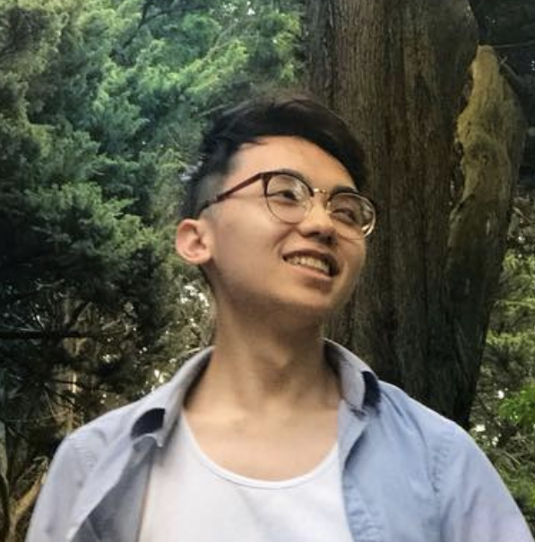
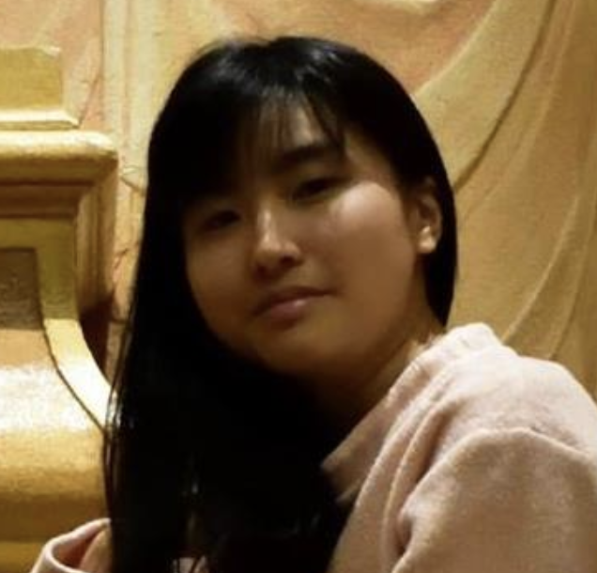
Our Team
STudio Theme: Educational Technology
Kate
Mamadou
Pao
Gray

Slide 3

Connecting students to the information they need for the college application process
https://www.theatlantic.com/education/archive/2015/10/high-stress-high-school/409735/
Notes:
Our group had shared interest of educational equity

Slide 4
How do the experiences of students from underrepresented communities differ?
Connecting students to the information they need for the college application process
What resources do students use?
What is missing?

Slide 5
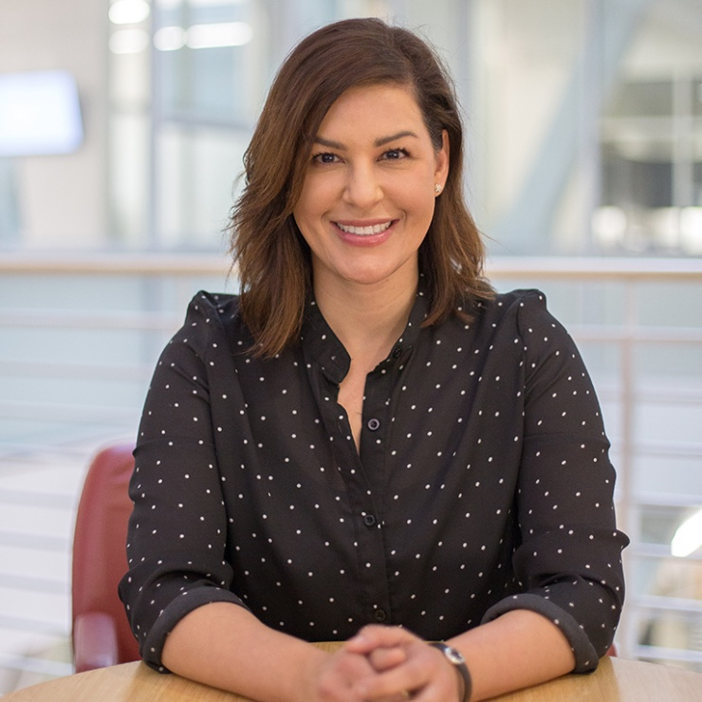

Interviewees
(4)
Domain Expert
Lourdes Andrade:
Director of Equity and Inclusion, School of Engineering Student Affairs
Extreme User
Jacob
Current Stanford Frosh
Who | Why | How
Typical User
Sarah
Current High School Senior
Typical User
Thomas
Current High School Senior
Notes:
Explain what FLI means
Lourdes
Director of Diversity in Engineering, Director of LSP (what is LSP?)
Veteran in equality of opportunity and equality of results space. Was elementary teacher and wanted more impact
Knocked on her RF door
Her Home
Jacob
Friend of FlI community
Extreme User
Reaching out to our FLI network
Dining hall
Sarah & Thomas
High school senior just going through the process who lives in Palo Alto
Wanted to get students who were literally going through the process as per assignment recommendations
Friends of friends
Met at coffee shop

Slide 6
Questions we asked
What challenges did you face while applying to college?
Why did you decide to go to college?
What resources or people did you use to help you navigate the admissions process?
How helpful were the resources offered by your school?
Were you able to visit any colleges? How did you feel on those visits?
DE: What do you think allows for students from disadvantaged backgrounds to succeed?
Notes:
After learning Lourdes (was FLI), she became an extreme user, we also asked about these experiences

Slide 7
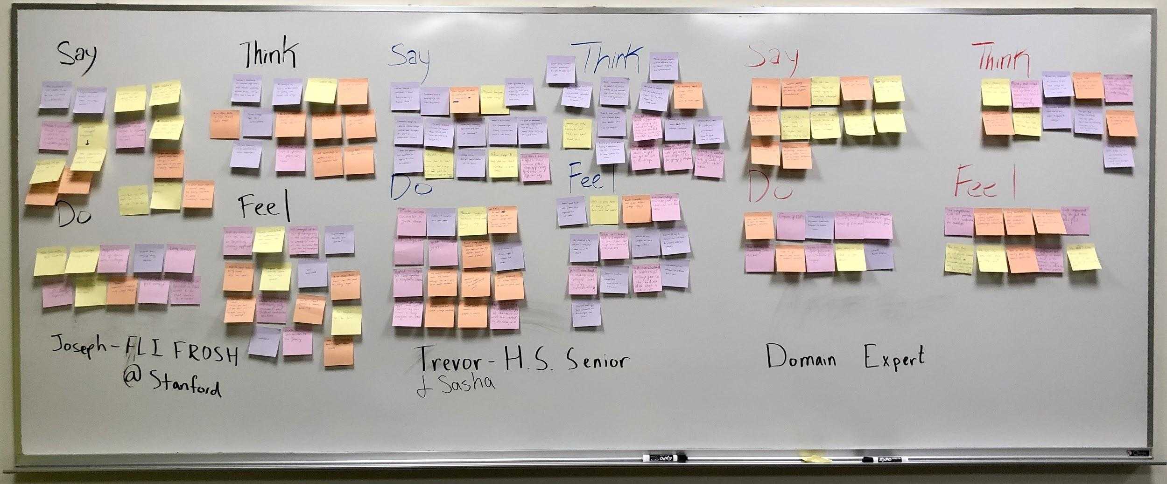
Interview Results

Slide 8
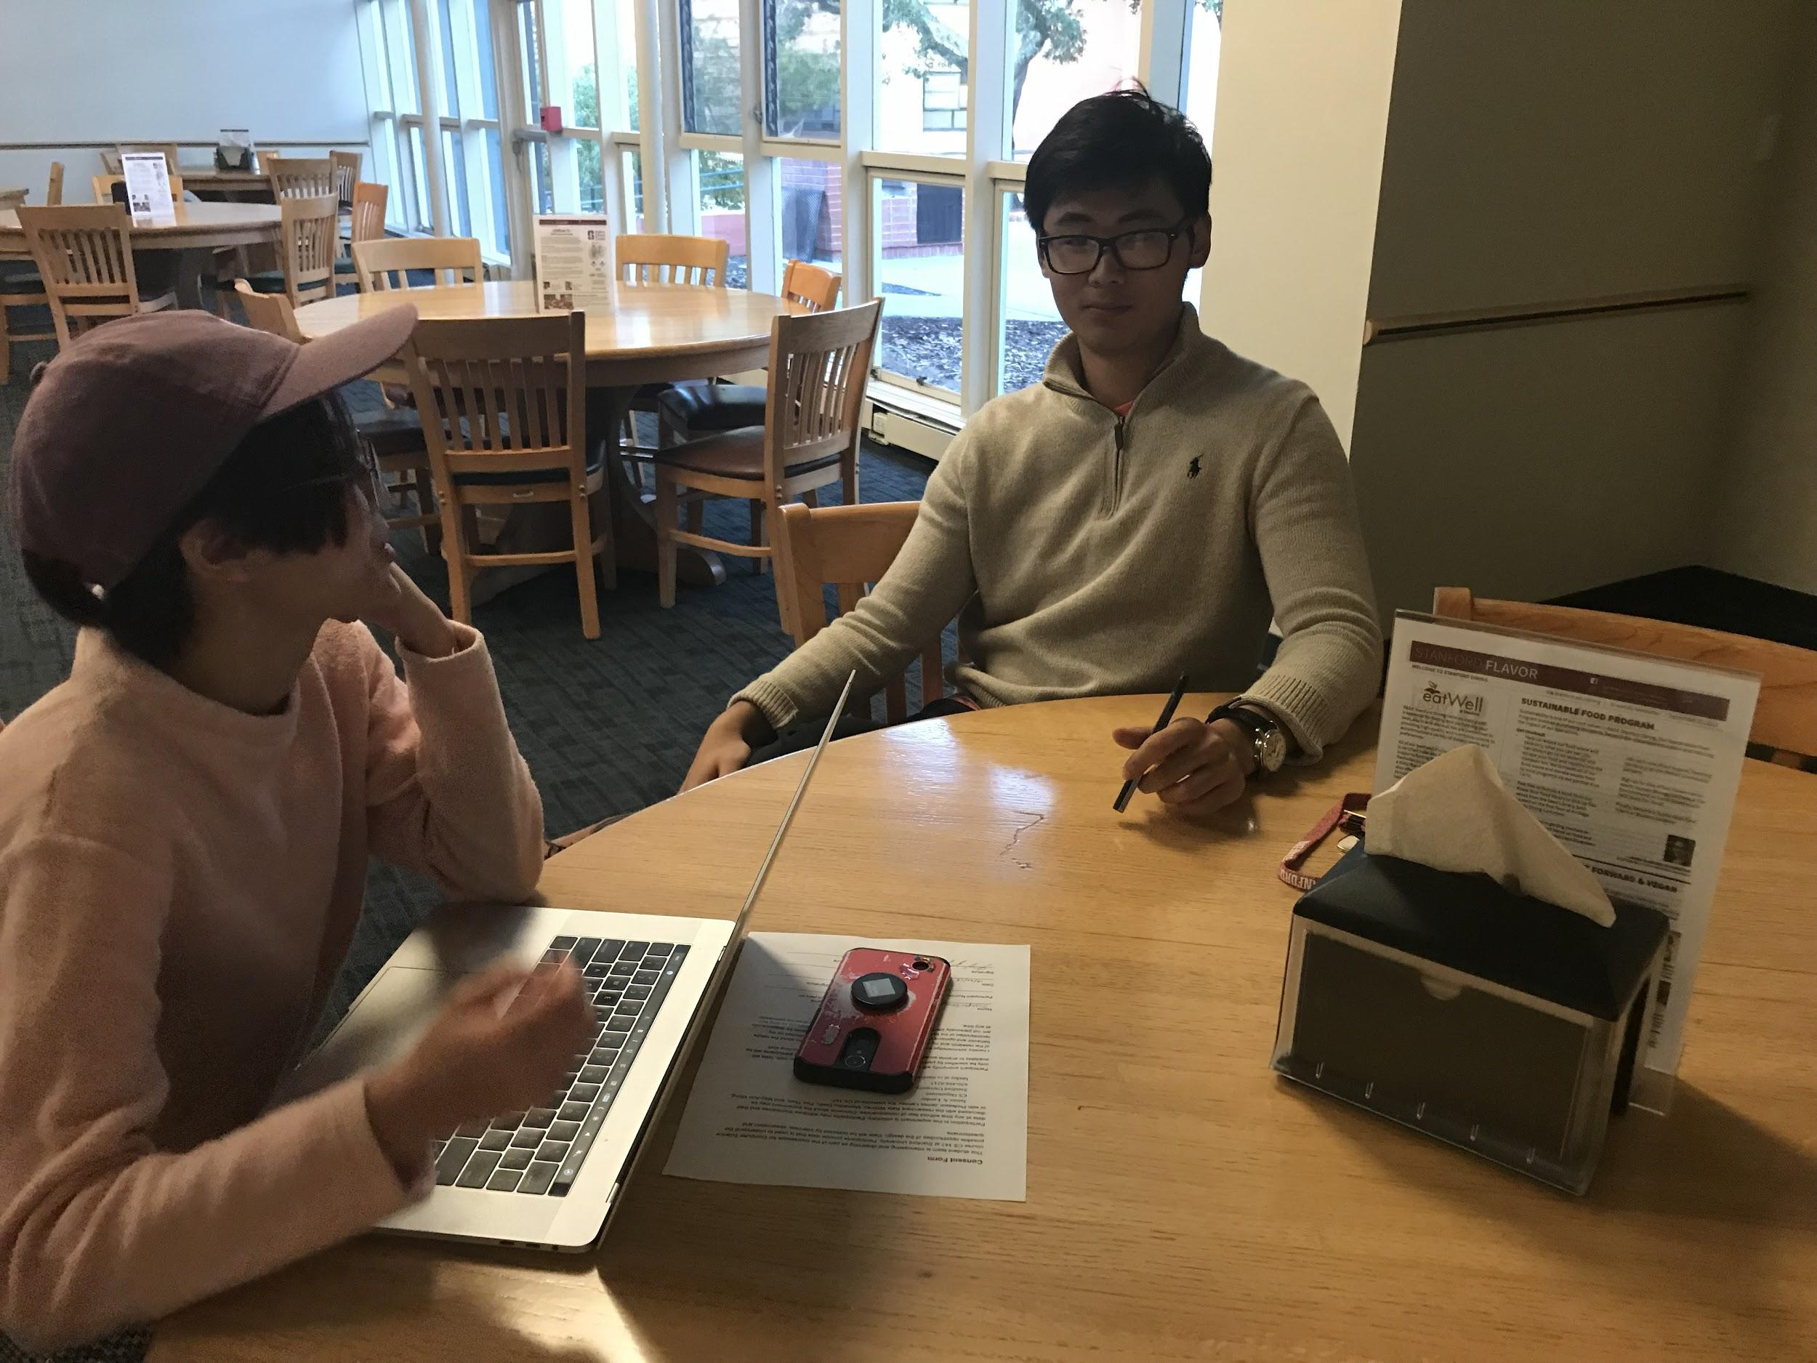
“I wanted to go to a top five college”
“The counselors was useless for me”
“Most of the things that I did was on my own”
Extreme User
Jacob:
Current Stanford Frosh
Notes:
The reason he was an extreme user was because...

Slide 9
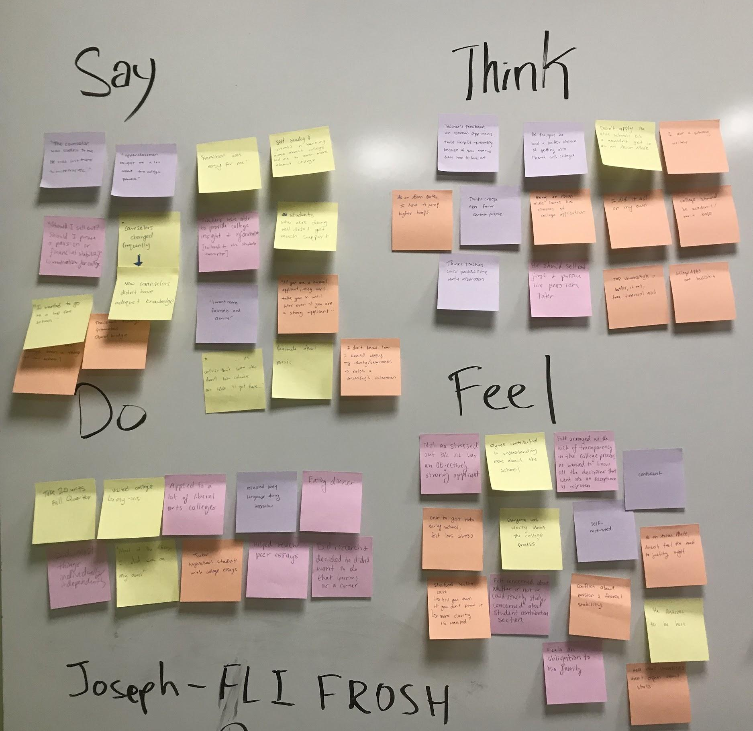

Slide 10
Say
College admissions should be based solely on academics and merit
Think
Wants more fairness & clarity on admissions
Upperclassmen taught him a lot about the college process
Counselors were useless for him
Thinks he stands a better chance applying to liberal arts colleges
College apps favor certain types/ groups of people
Wanted to go to a top 5 school
Students who weren’t doing well didn’t get much support
Relaxed body language during interview
Self-motivated
Confident
Went on college visits
Deserving of being at Stanford
Worried during the application process
Applied to Questbridge and Gates Programs
Helps peers with essays and tutors others/gives college advice
Do
Annoyed at the lack of transparency
Feel

Slide 11
“We don’t talk about it much in class...Everyone is at different stages of the college process”
“Initially at the start of writing, I didn’t know what to do”
Typical User
Thomas
Current High School Senior
Notes:
Typical users Thomas and Sarah. Why typical?

Slide 12
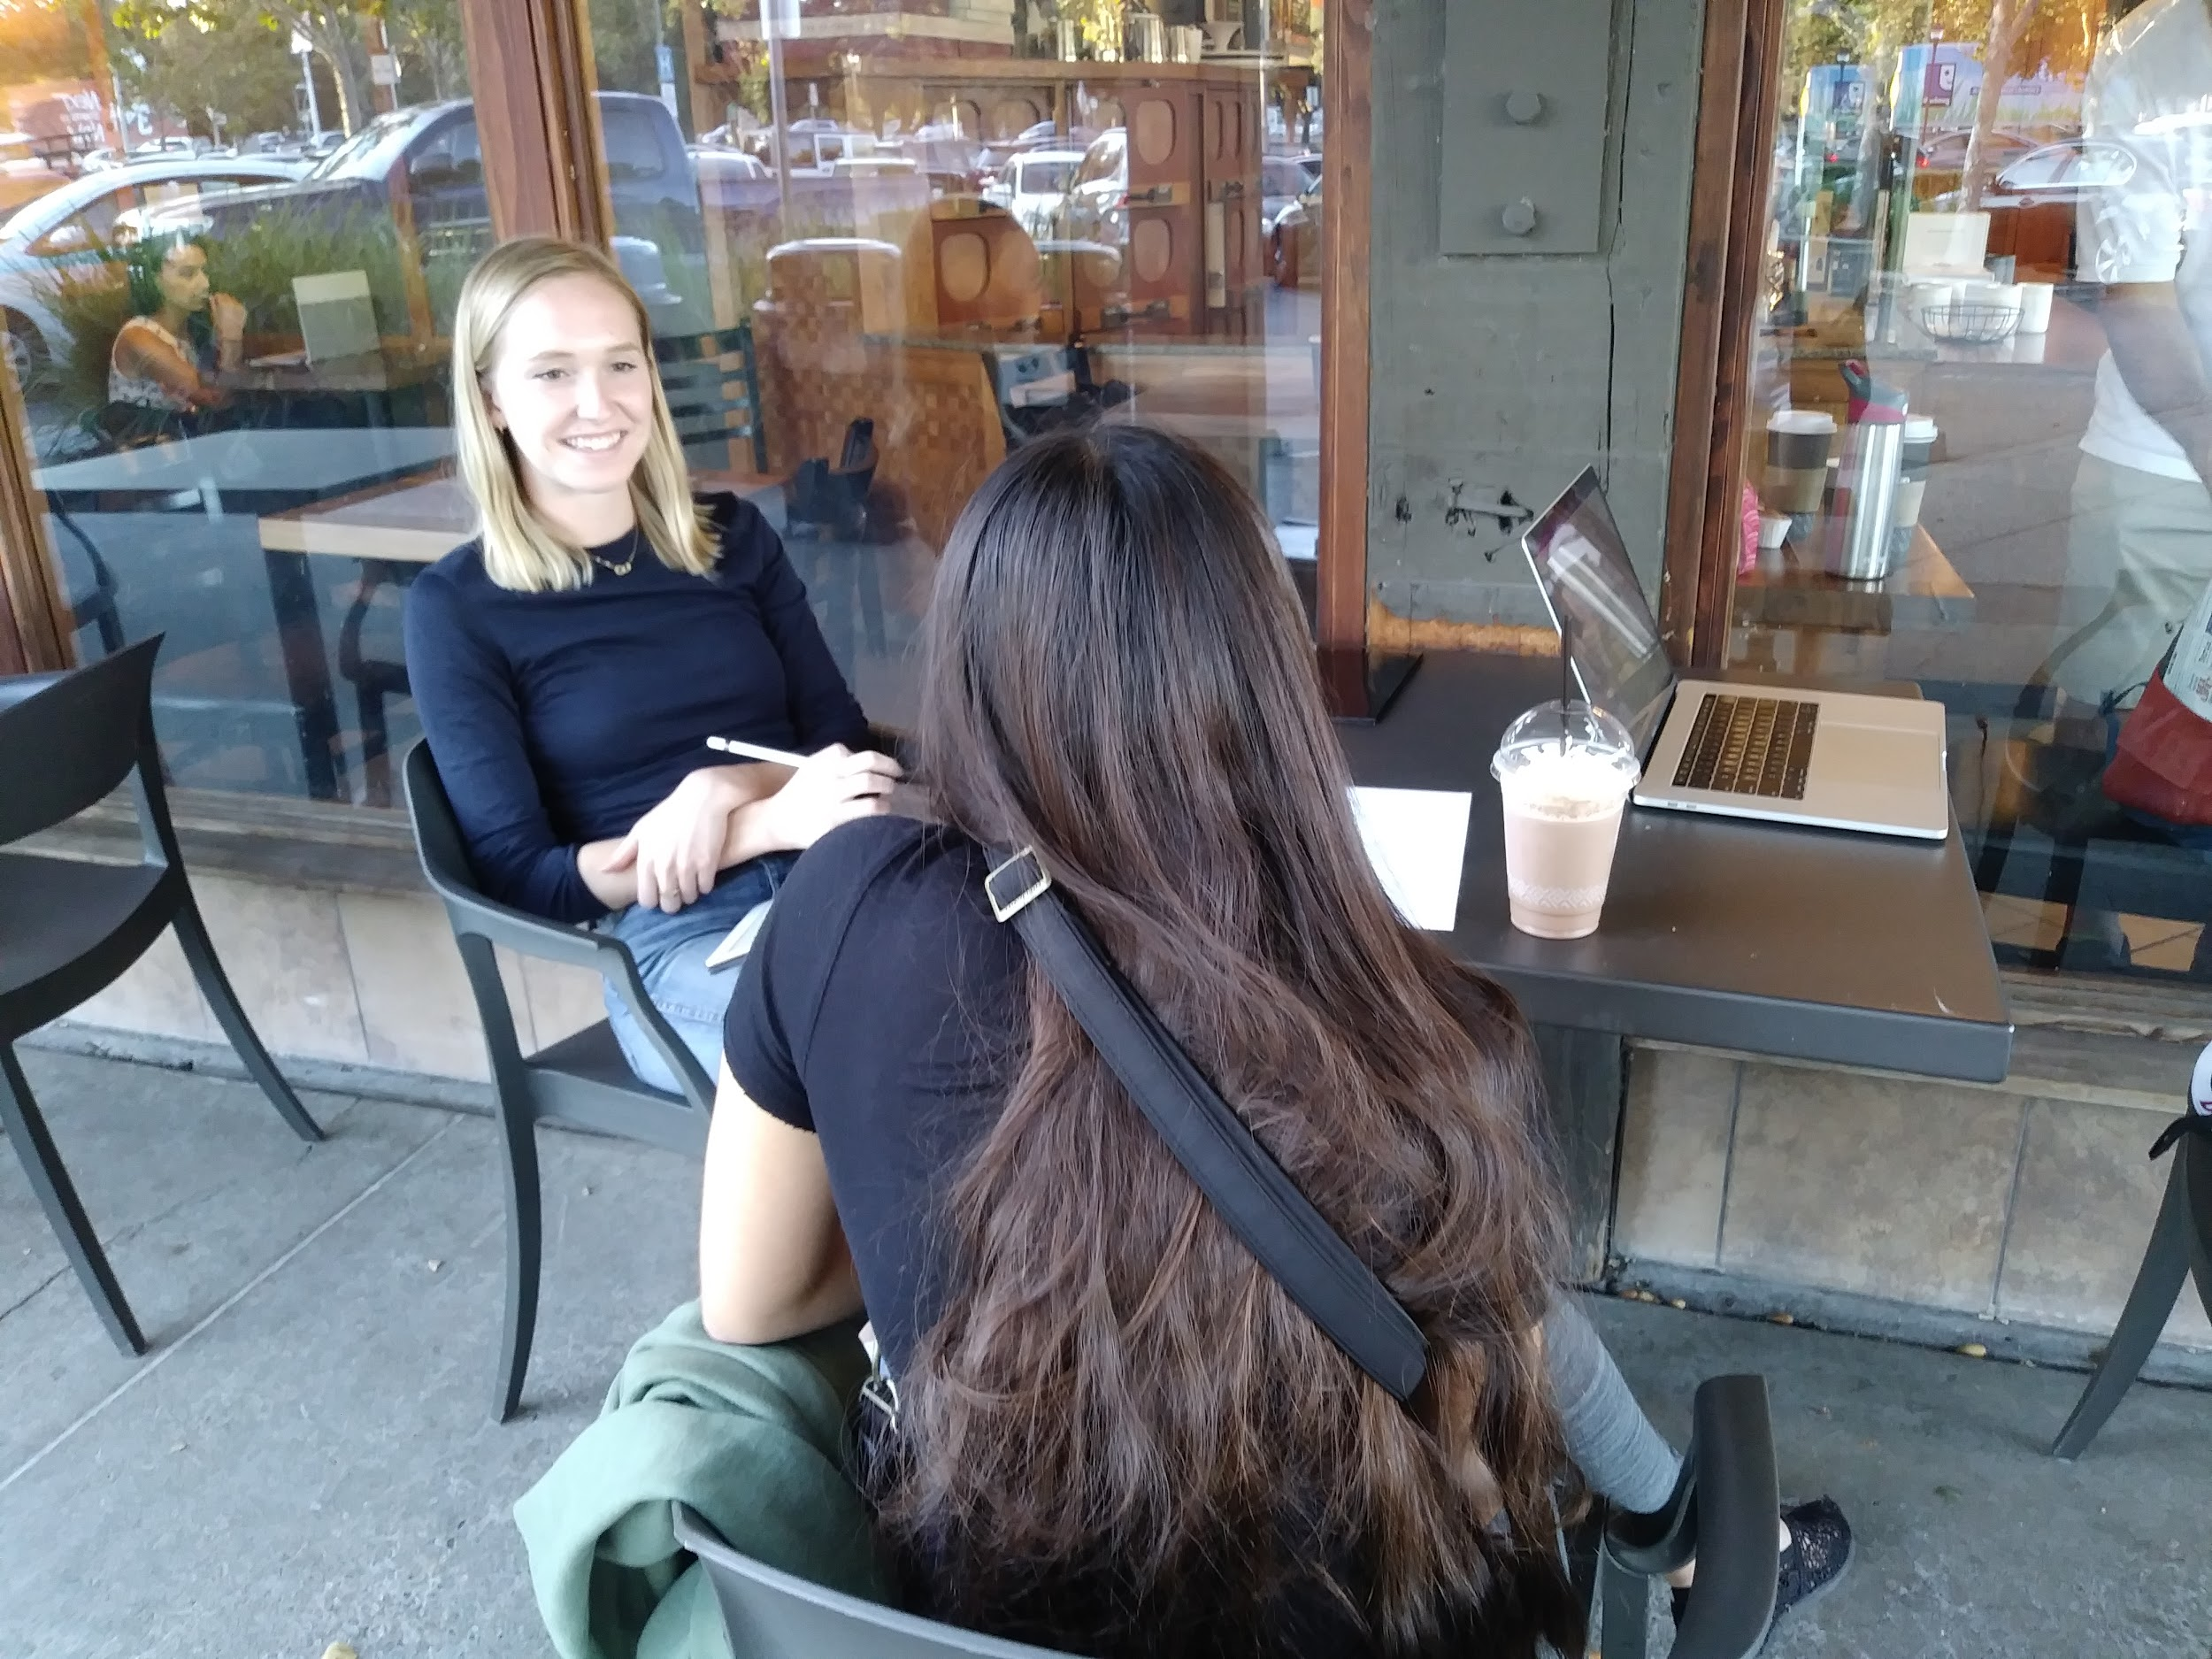
“College tours can definitely change your perspective”
“You’re trying to sell yourself to them, but you can’t just be like, ‘I’m an amazing person, you should admit me’”
Typical User
Sarah
Current High School Senior
Notes:
Didn’t know the gravity to which Sarah valued college tours

Slide 13
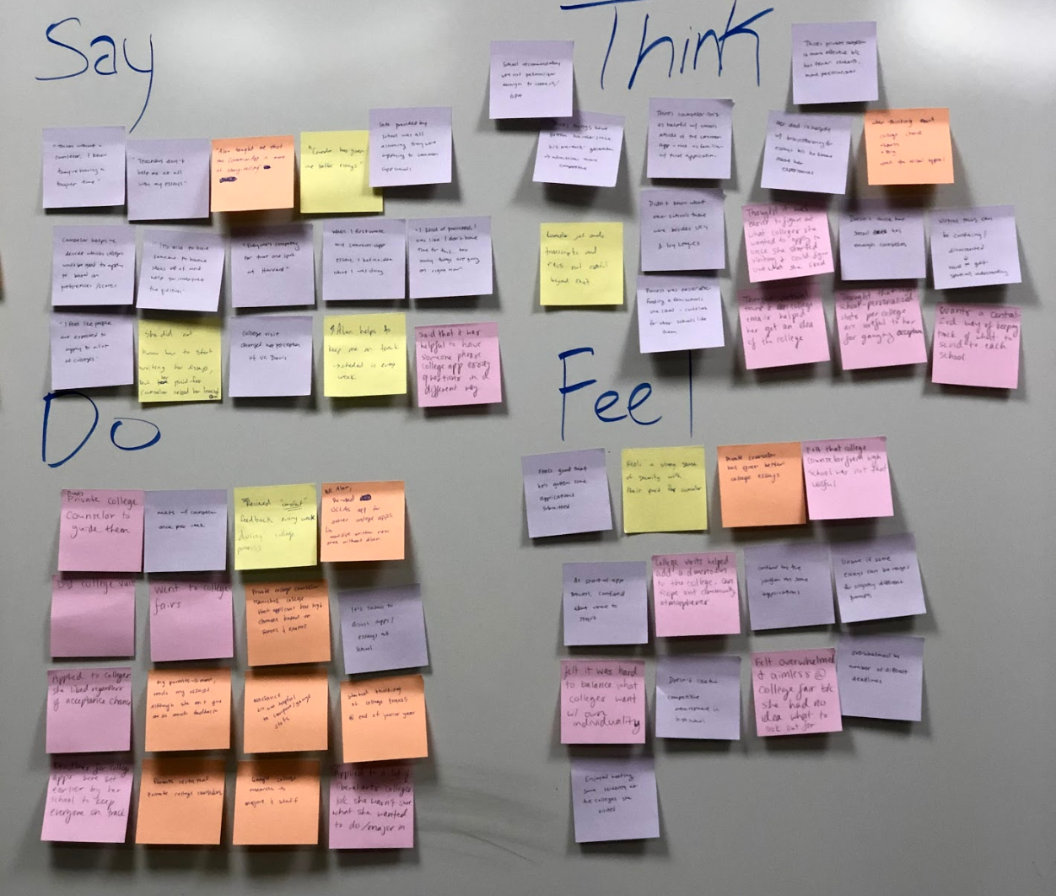

Slide 14
Say
Didn’t want to apply to colleges based on where she’d get in
Parents aren’t informed enough to give good feedback
Think
Wants a more centralized college application process
Classmates are very competitive
Campus visits changed perception of schools
Wishes her classmates gave each other more support
Their school college counselors were not helpful
Private college counselors help them stay on track
Easier to find schools after finding a few that she liked for comparison
Virtual tours are confusing
Laughed when asked how she felt about college applications
Sought the help of a private college counselor. Dubbed Alan
Confused about where to start
Overwhelmed by all of the deadlines
Disappointed by school’s generic suggestions
Spoke quickly once they got going with a story
Confused by jargon on apps
Went on college visits
Do
Use Naviance to get an idea of where they stand with stats
Feel
Relieved after submitting some applications
Notes:
Contradiction: wants to be recommended schools based on GPA (naviance), but not really when it came from her school counselor
Alan sounds like an app

Slide 15
https://engineering.stanford.edu/spotlight/lourdes-andrade
“You can’t be what you can’t see”
“Someone has to see something in you”
“Parents don’t know how to be involved in their child’s education”
Domain Expert
Lourdes Andrade:
Director of Equity and Inclusion, School of Engineering Student Affairs

Slide 16
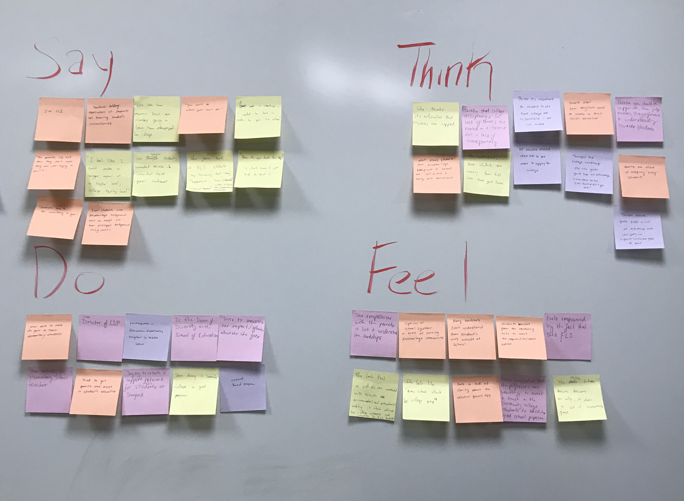

Slide 17
Say
Teachers often hold expectations of students without knowing their circumstances
Self-drive combined with environmental and psychological safety allows for a FLI student’s success
Think
“I’m FLI”
Students who often “make it” have individual drive and parent involvement
Be supportive, non-judgemental, straightforward to connect with FLI students
college acceptances are rooted in elitism
Wanted to make a bigger impact at a higher level of education
It’s ridiculous that resources are capped/limited. Why?
Initially became an elementary school teacher in the area she grew up in
Empathizes with parents and understands the hardships they go through
Cynical about the lack of help for disadvantaged students
Current Dean of Diversity in the School of Engineering
Students aren’t given the tools necessary to succeed
Was the director of the Leland Scholars Program
Do
Participated in an Educational Opportunity Program beginning in middle school
Feel
Frustrated at some professors’ unwillingness to invest and trust in disadvantaged students
Notes:
Started elementary but she felt bigger impact was for students to go into college
Everything should be moving a kid towards college

Slide 18
Needs, Insights, and Analysis

Slide 19
Insight: the college application/selection process is not transparent/clear enough
“I want more fairness and clearity … I wonder why I was selected”
Need: Clear reasons and standard of measurement of how the college process/selection work + open records of accepted college students
Notes:
From Jacob and Sarah

Slide 20
Insight: Parents may not be informed enough to get involved in the process of education
“Most parents were just following along with whatever the teachers were teaching and how they were teaching their kids”
Need: Connecting parents with their child’s education
Notes:
For Sarah, her parent just pointed her to Alan
How can parents get involved in education?
This made us want to interview some parents!

Slide 21
Insight: The college application process can feel overwhelming due to the various multiple deadlines and requirements from different schools
“My (private) counselor helps to keep me on track … I didn’t realize he would be as big of a help as he did”
Need: A way to manage multiple deadlines to feel more in control
Notes:
Again, Alan. But was still stressed about deadlines
Question: Ask mor about stress and managing stress dyring this time.

Slide 22
Insight: It’s difficult for students to get personalized advice for selecting colleges & completing applications outside of the common app
“Once you get out of the common app, it’s crazy, because everybody has different requirements, and different ways that they do things”
Need: Guidance from a source knowledgeable about the student’s background & each college’s unique application process
Notes:
We learned about how many different systems there were to apply

Slide 23
Insight: Though college visits can be very helpful, students often can’t visit all of the schools they’re interested in
“I definitely wanted to visit all of them, and if I had time I definitely would have...”
Need: A way to get a sense of the community & Personality of a school without visiting in person

Slide 24
Insight: students felt a sense of relief and security when provided a roadmap from college access programs but , “Roadmaps” were not available to all.
“Someone who was pushing me and checking me every week to make sure I was on track made it helpful”
Need: A way of providing guidance & accountability to all students entering the college process in order to reduce stress & keep students on track

Slide 25
Summary
Four interviews: 1 domain expert, 1 extreme user, and 2 typical users. Two of those interviewees come from FLI backgrounds
Overall needs:
  Connecting parents with their child’s education
  The need for an “Alan” to manage deadlines and keep them on-track
  A way to assess how well a school fits a student
  College-app guidance from someone “they can see in themselves”

Slide 26
Questions?

