Slide 1

Interactive High-Fi Prototype

Slide 2
Hello!
We are HELM

Slide 3

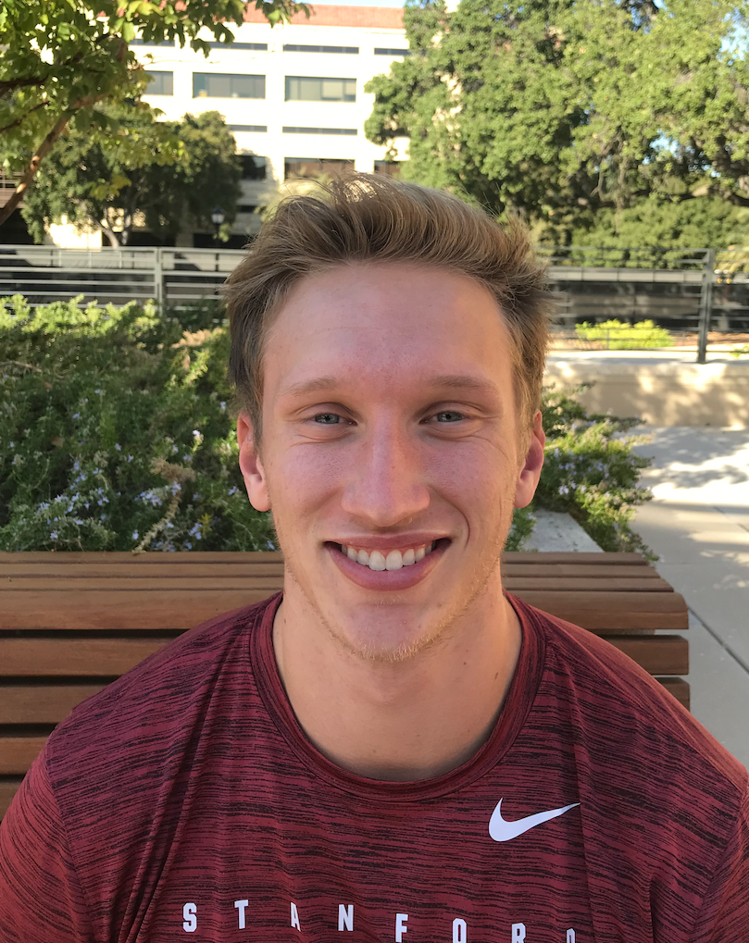
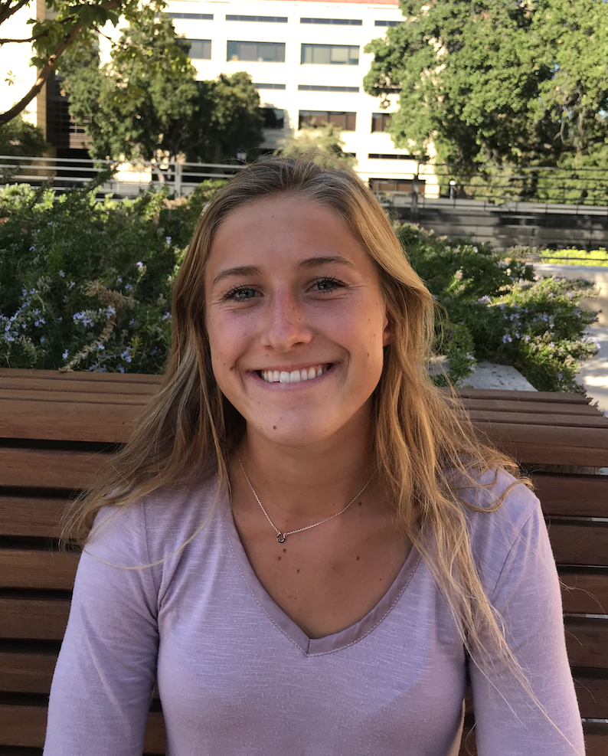


Slide 4
Value Proposition
Crowdsourced Lesson Planning and Organization

Slide 5
Problem
Successful lesson planning can be an arduous and time consuming task.
Notes:
Successful lesson planning can be an arduous and time consuming task which requires resources educators don’t always possess. Furthermore, many educators exert immense effort designing creative and effective lesson plans with no way easy way to share them. Lessonly tackles these issues by creating an online community for teachers who want to share, discover, and manage lesson plans. By assisting instructors, and providing them with tools for success, Lessonly aims to have large scale impact on the education sector through positive trickle down effect on their students.

Slide 6
Solution
Create an online community for teachers who want to share, discover, and manage lesson plans.
Notes:
Successful lesson planning can be an arduous and time consuming task which requires resources educators don’t always possess. Furthermore, many educators exert immense effort designing creative and effective lesson plans with no way easy way to share them. Lessonly tackles these issues by creating an online community for teachers who want to share, discover, and manage lesson plans. By assisting instructors, and providing them with tools for success, Lessonly aims to have large scale impact on the education sector through positive trickle down effect on their students.

Slide 7
Roadmap
Heuristic Evaluation Results
Overview of Revised Design
Prototype Implementation Status
Demonstration of Prototype
Summary

Slide 8
Roadmap
Heuristic Evaluation Results
Overview of Revised Design
Prototype Implementation Status
Demonstration of Prototype
Summary

Slide 9
Major Violations
9 Severity 3
Violations
1
Severity 4
Violation

Slide 10
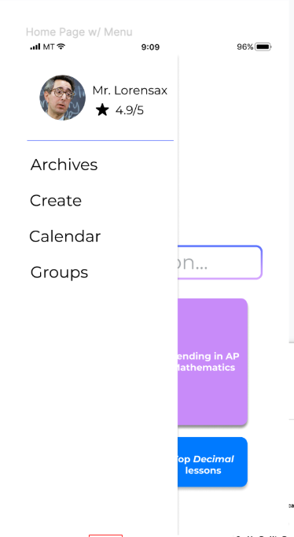

User Control and Freedom
Recurring issue across tasks
Inconsistency between hamburger, logo, and back buttons
Serious user frustration and confusion - requires significant time
Notes:
Our only severity 4 violation had to do with the menu option bringing the user back to the wrong page, another severity 3
**Not all 10 issues addressed, following slides are summary of the heuristics which were violated most

Slide 11
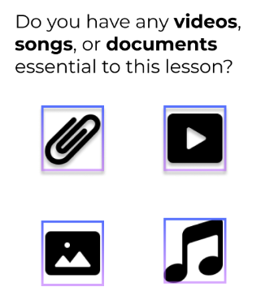
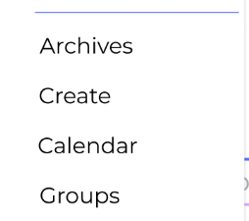
Match Between System & Real World
Misleading language
Confusing icon usage
Notes:
Instead of “Do you have any videos, songs or documents essential to this lesson?” which is a yes or no question app should say “Upload media content.”
Calendar icon takes user to their lessons

Slide 12
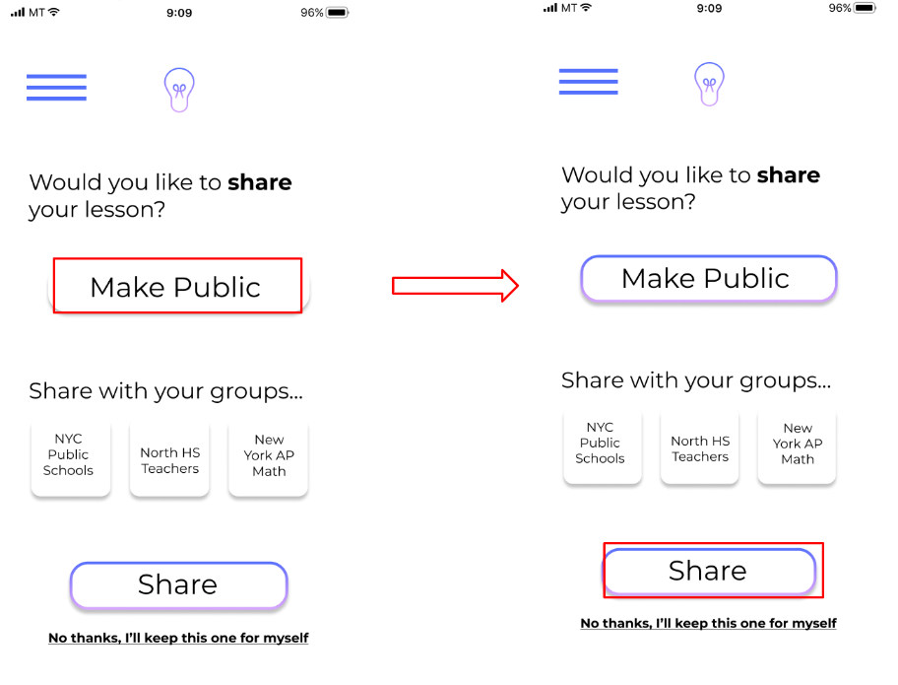
Consistency & Standards
Biggest issue: buttons
Need to be consistent about what aesthetic change to button means for the system
Must be conscientious about verbiage: specificity and direction are key (“next”)
Notes:
We had two severity 3 regarding inconsistency and they both had to do with the way buttons change when actions are made. The first was in the differences between the make public and share buttons, the second was that the functionality of the next button is unclear after a lesson is completed

Slide 13
Roadmap
Heuristic Evaluation Results
Overview of Revised Design
Prototype Implementation Status
Demonstration of Prototype
Summary

Slide 14
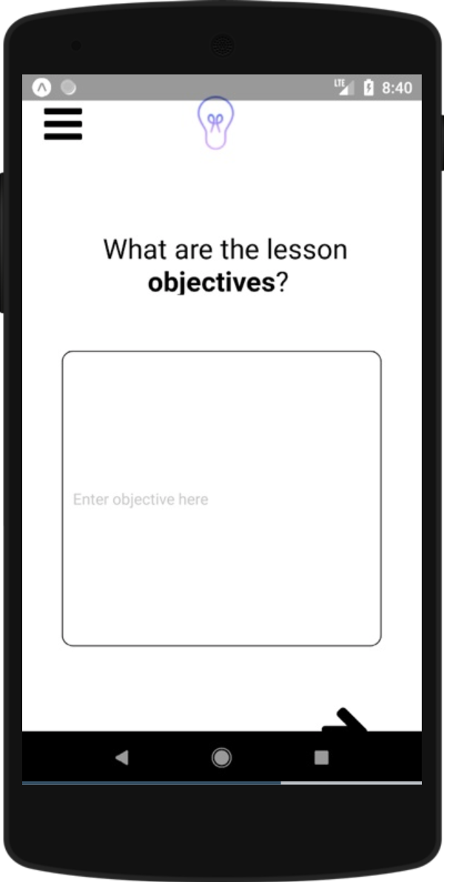
User Control Fixes
Light bulb on each page takes you to home page
Added back button to share page, naming pop-up, review
Swipe left or right functionality to open menu
Notes:
Our only severity 4 violation had to do with the menu option bringing the user back to the wrong page, another severity 3
**Not all 10 issues addressed, following slides are summary of the heuristics which were violated most

Slide 15

User Control Fixes
Light bulb on each page takes you to home page
Added back button to share page, naming pop-up, review
Swipe left or right functionality to open menu

Slide 16
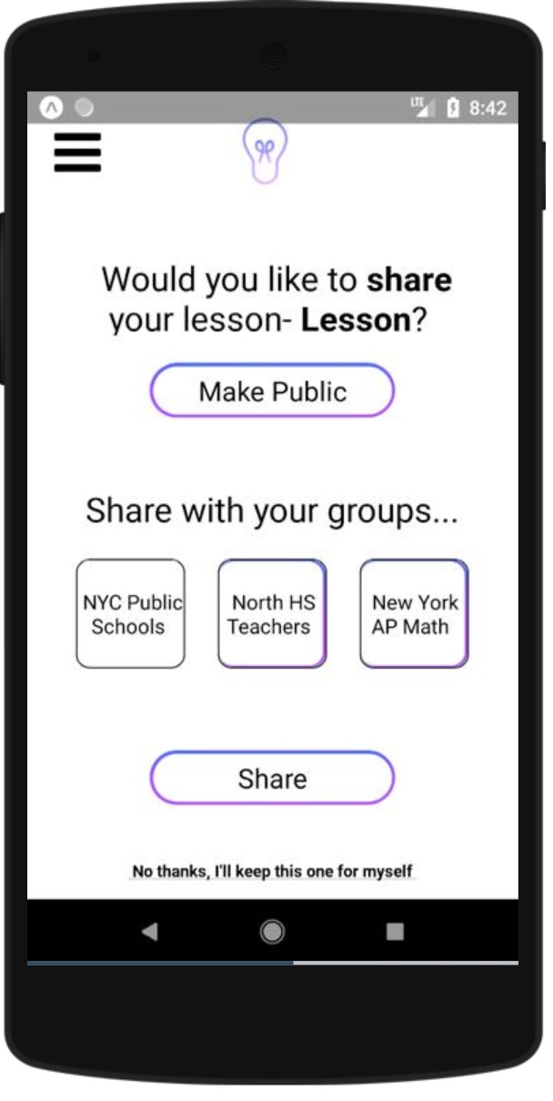
Consistency Fixes
Groups in lesson share screen are outlined
Create button on review screen is outlined
Added login/sign-up + integrated with Firebase

Slide 17

Consistency Fixes
Groups in lesson share screen are outlined
Create button on review screen is outlined
Added login/sign-up + integrated with Firebase

Slide 18
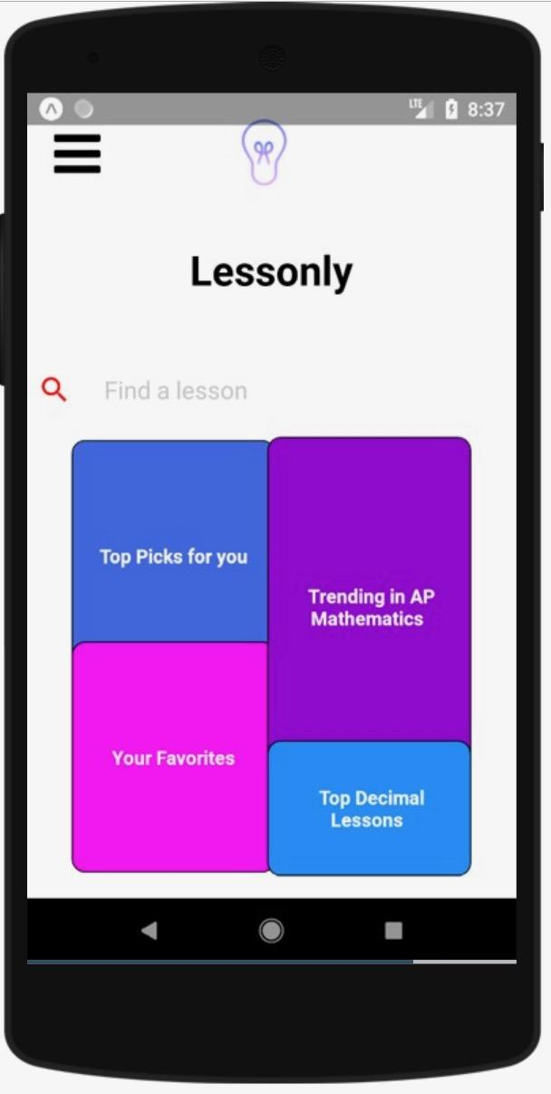
Aesthetic Fixes
Hamburger menu adjusted to be smaller
Added Lessonly title to home page
White space balance across platform

Slide 19
Roadmap
Heuristic Evaluation Results
Overview of Revised Design
Prototype Implementation Status
Demonstration of Prototype
Summary

Slide 20






Tech Stack
React Native
Expo
Npm & node
Firebase
Github & Git
Sublime
Front-end UI/UX
Test, run locally, publish on server
Package manager
authentication, data storage
Storing and managing codebase
Text editor

Slide 21
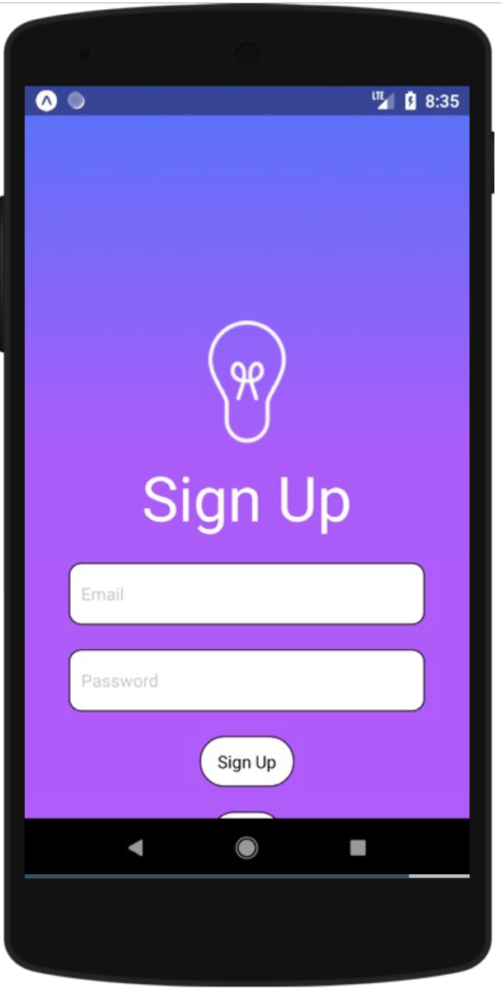
Implementation Features
Homepage
Hamburger Menu
User Network
Task 1: Create and Share Lesson

Slide 22
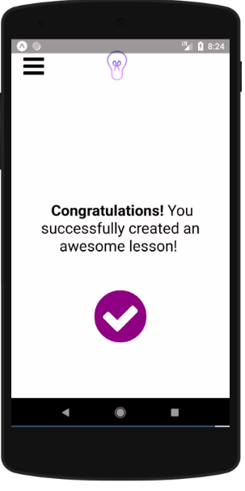
Unimplemented Features & Plan
Complex database functionality
Continued aesthetic detail
Task 2: Share a Lesson
Task 3: Provide Feedback
Notes:
Be able to save lesson plans to database
Keep tweaking and improving design

Slide 23


Wizard of Oz Techniques
Working with the user to ensure lesson plan quality/creativity
Real-time, in-lesson cues
Notes:
Discuss possibility of simulating real time lesson feedback to encourage user to build “creative” game oriented lesson
Possibility of simulating in-lesson cues about timing, possible ice-breakers/questions

Slide 24
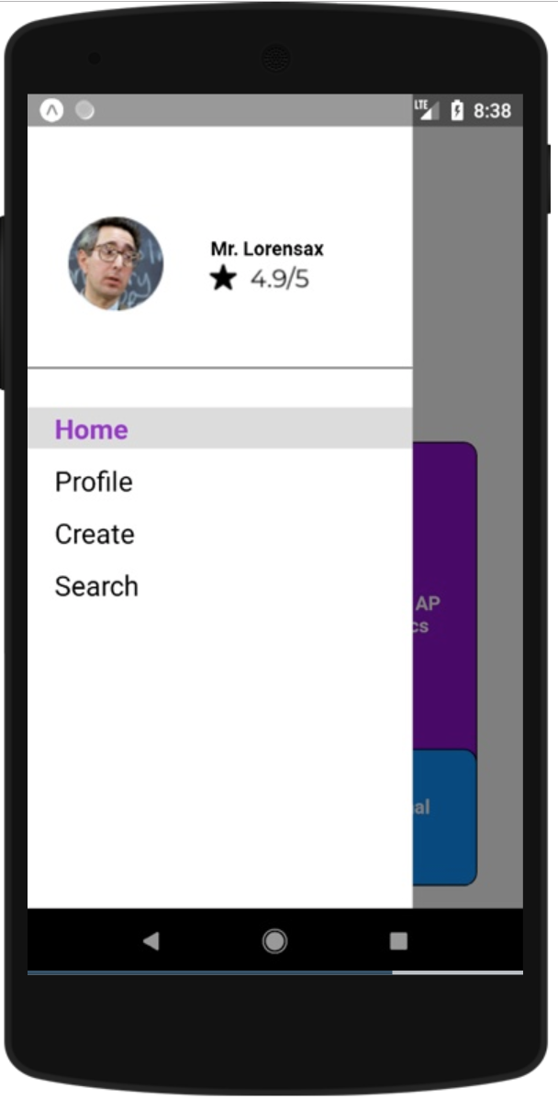
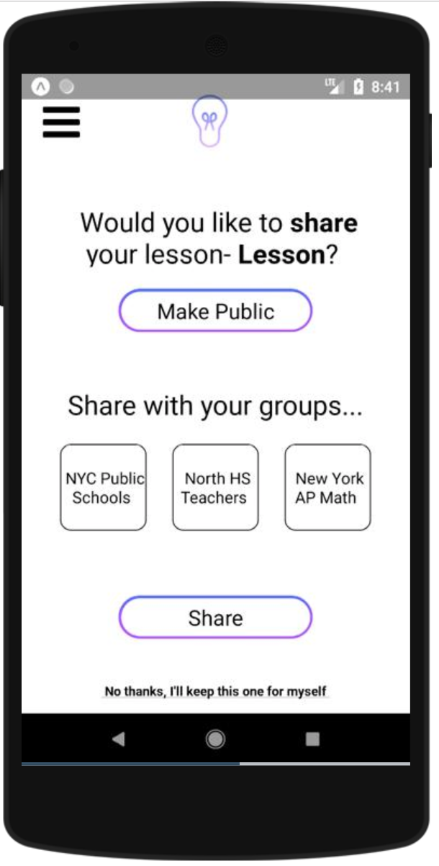
Hard Coded Data
User Profile & Rating
Groups

Slide 25
Issues/Questions
Navigation - designing how to structure the files in code to pass information effectively
Uploading images to firebase
Background gradient & color scheme

Slide 26
DEMO

Slide 27
Roadmap
Heuristic Evaluation Results
Overview of Revised Design
Prototype Implementation Status
Demonstration of Prototype
Summary

Slide 28
Summary
Corrected user confusion due to user control, inconsistencies, and mismatches with real world
Building app with React Native and Firebase
Complete: Task 1, User Database, Basic Layout
To Complete: Task 2, Task 3, Complex Functionality

Slide 29
Questions?

