Slide 1

Interactive Medium-Fi Prototype

Slide 2
Hello!
We are HELM

Slide 3


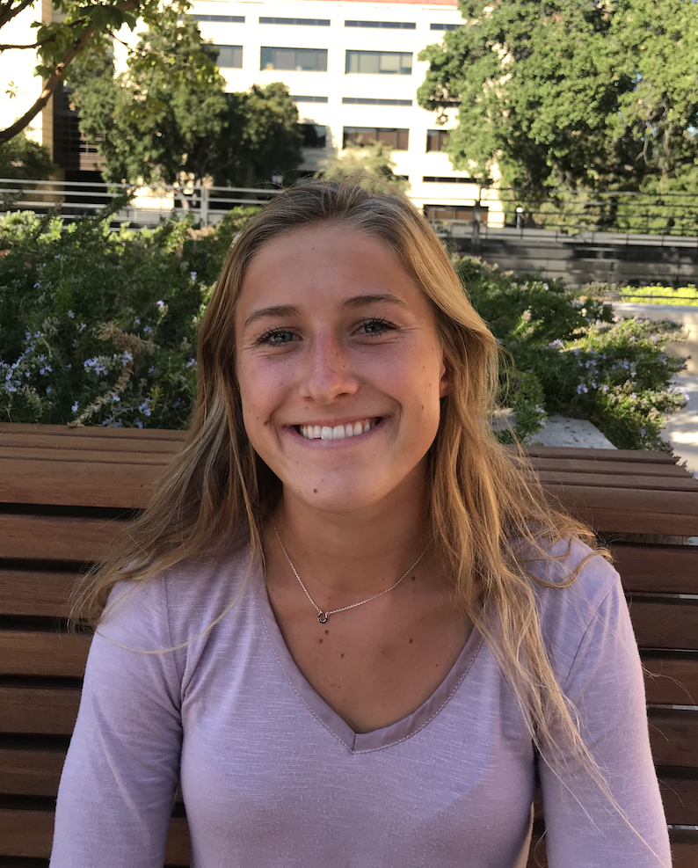


Slide 4
Value Proposition
Crowdsourced Lesson Planning and Organization

Slide 5
Problem and Solution
Successful lesson planning can be an arduous and time consuming task which requires resources educators don’t always possess. Furthermore, many educators exert immense effort designing creative and effective lesson plans with no way easy way to share them. Lessonly tackles these issues by creating an online community for teachers who want to share, discover, and manage lesson plans. By assisting instructors, and providing them with tools for success, Lessonly aims to have large scale impact on the education sector through positive trickle down effect on their students.

Slide 6
Task- Simple
Create a Lesson
This task just entails the user uploading their documents for a lesson with any comments or notes.

Slide 7
Task- Medium
Give Feedback
For this task, we expect a user to present or use a lesson and then at the end to give feedback to the author or original creator of the lesson used.

Slide 8
Task- Complex
Find a Lesson
This task involves a user searching for a specific lesson plan through multiple categories or topics (in a group, academic topic, most favorited, etc.). Then they simply choose what to do with that lesson (i.e. download it, add to calendar, share, edit, etc.).

Slide 9
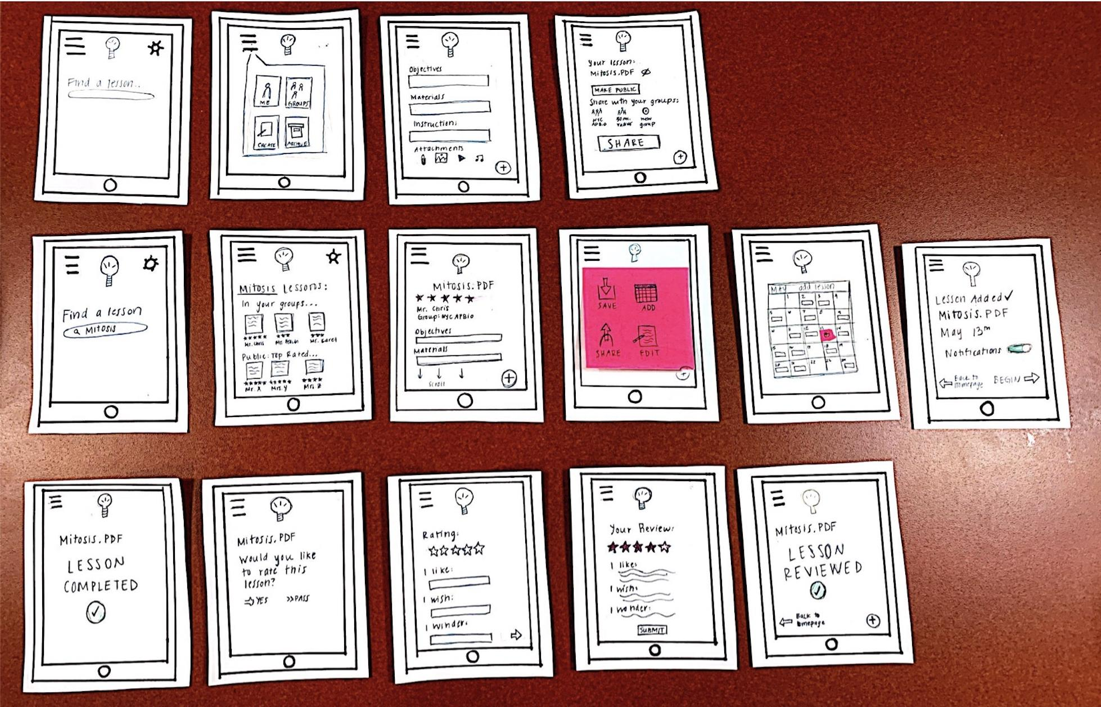
Design Change 1- Before

Slide 10
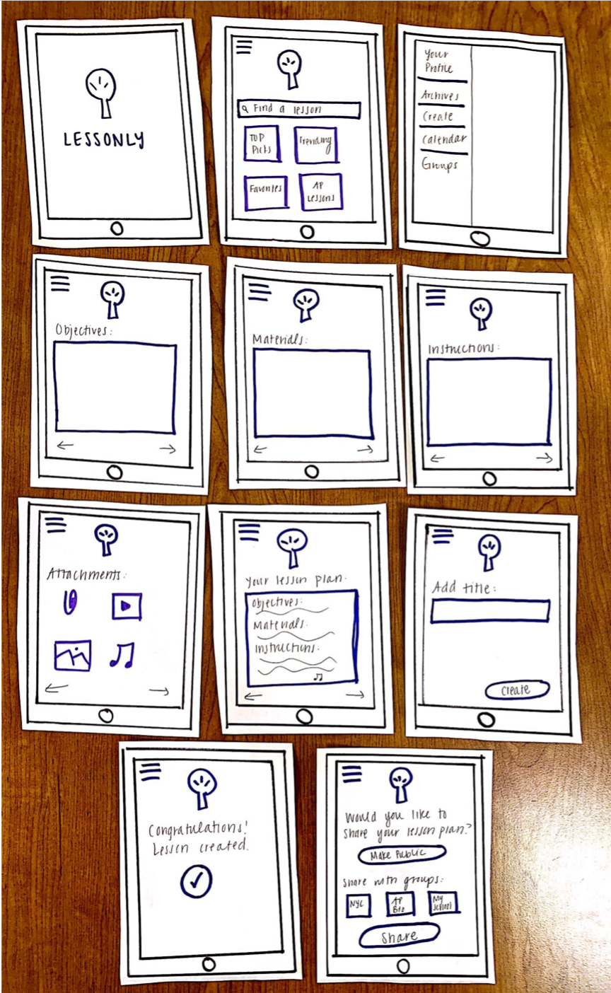
Design Change 1- After
The biggest design change here is how we added suggestions to the landing page of the app, instead of just having it be blank. We also extended the interaction between the user and the app by having a single step per page flow, instead everything on one page.

Slide 11
Design Change 2- Before

Slide 12
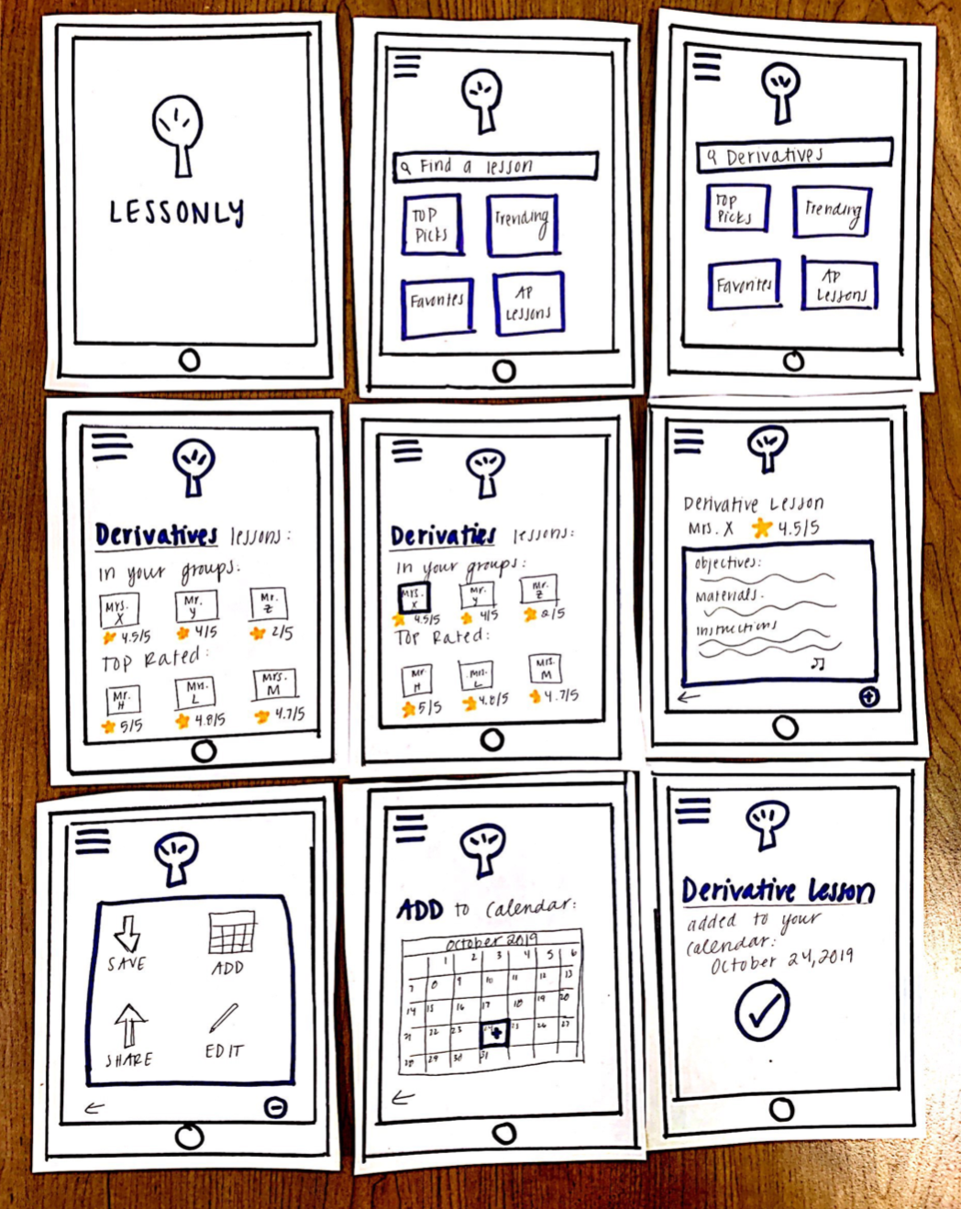
Design Change 2- After
Here, we incorporated again more pages allowing us to display each step individually. Another important change was allowing for more detailed searching filters. Before we had a general keyword search, but here we allow one to search with multiple filters (top picks, ap lesson, favorites, etc.) and the search results are categorized for quick look-ups.

Slide 13
Design Change 3- Before

Slide 14
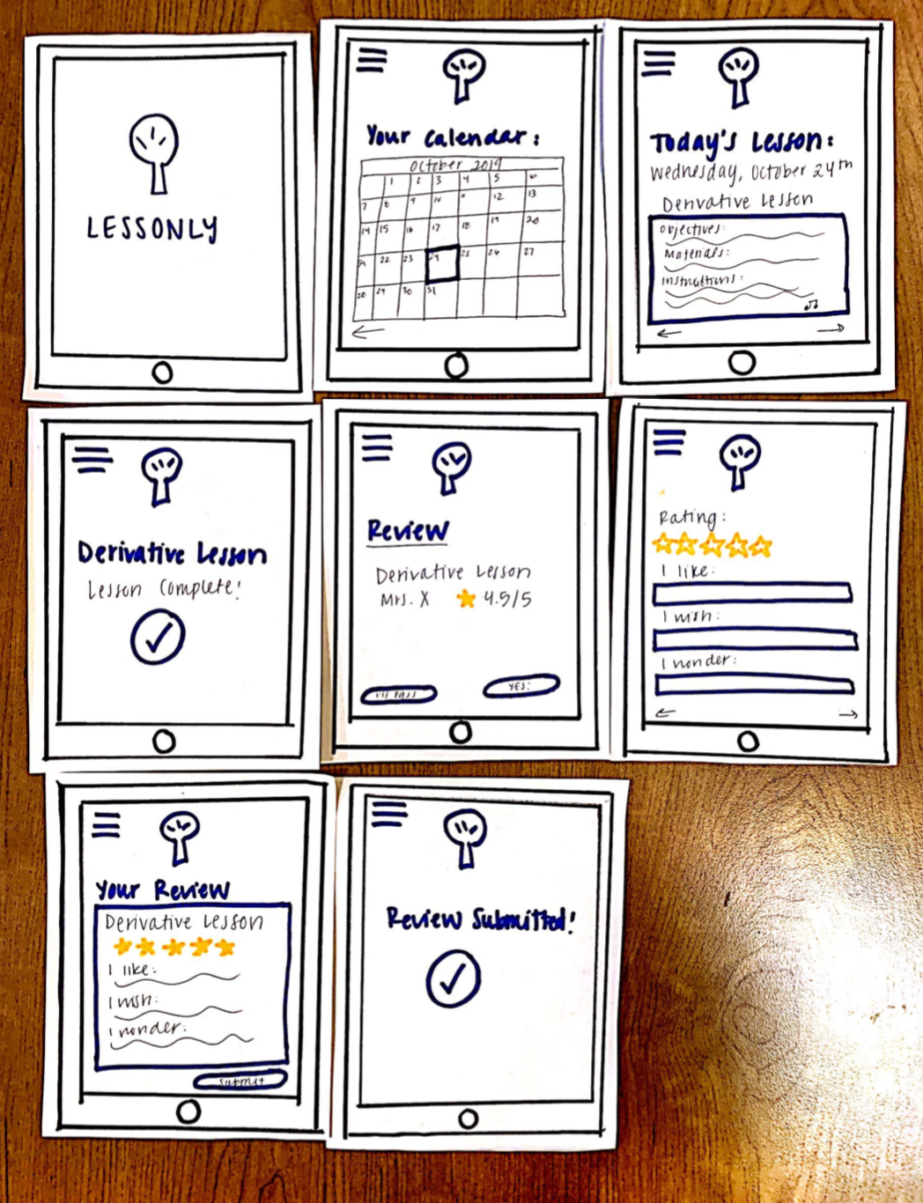
Design Change 3- After
Our biggest design change here was focused around showing how the user would select and use a lesson (i.e. from the calendar) and then be able to review the lesson. This gives us a more holistic representation of the users experience, instead of just the final result. We also added a some navigation buttons along with the pre-existing menu button (in the top left corner) and explanatory banners/messages.

Slide 15
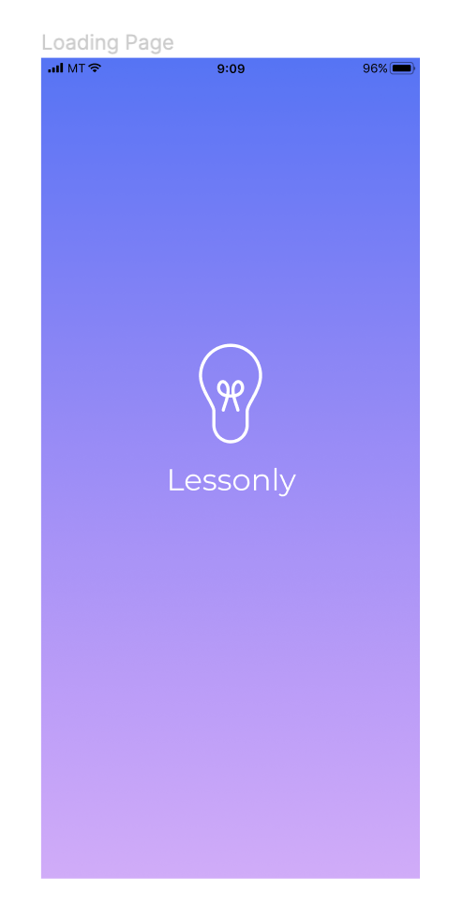
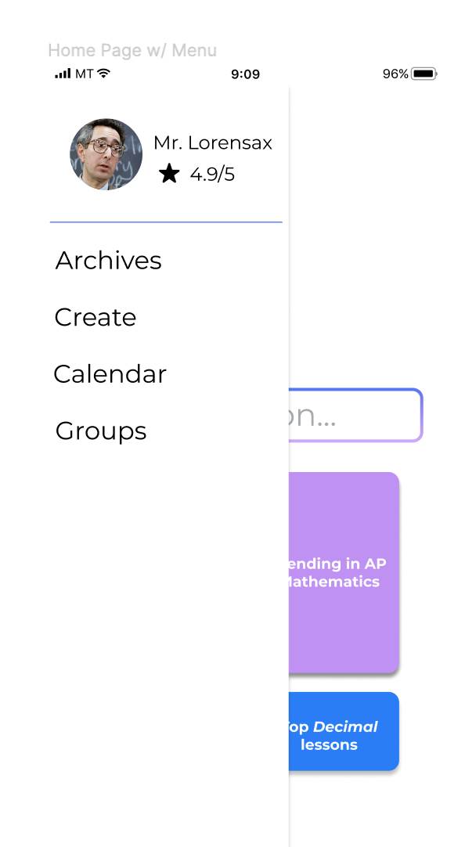
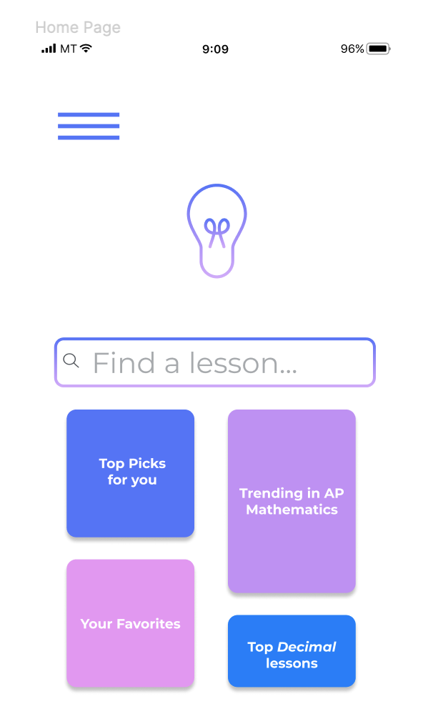
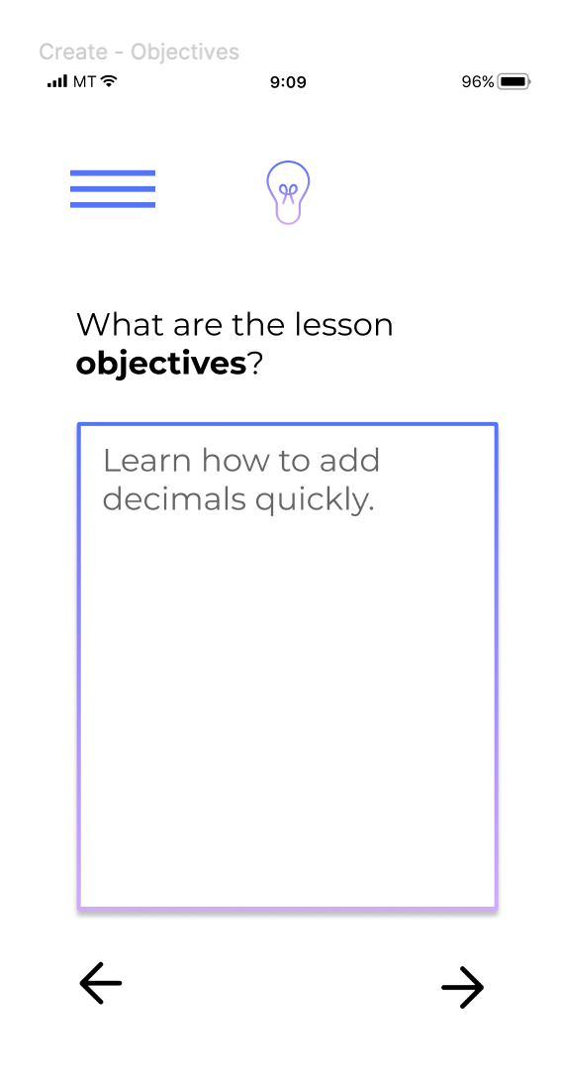
Medium-Fi Prototype Task Flow 1
Creating a Lesson

Slide 16
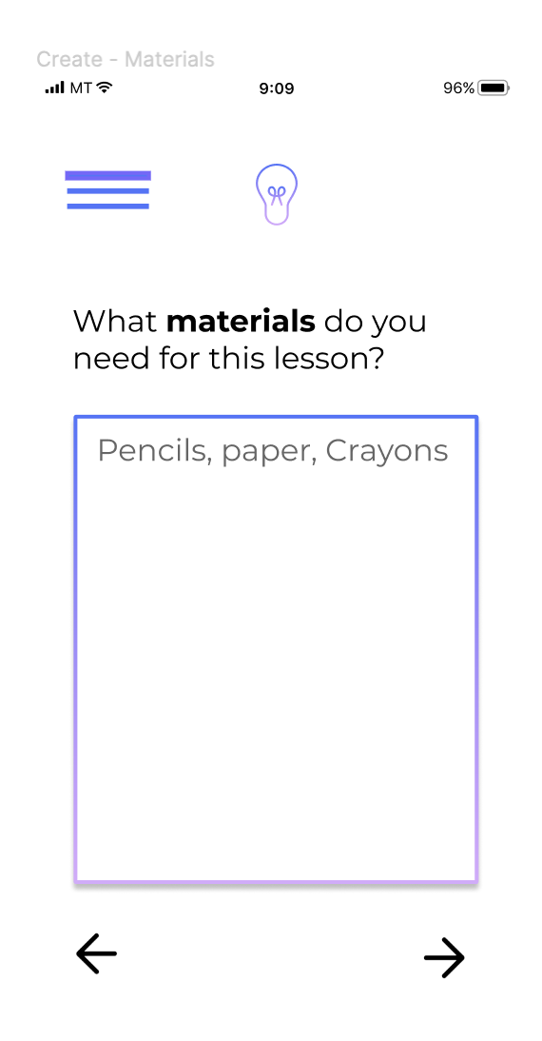
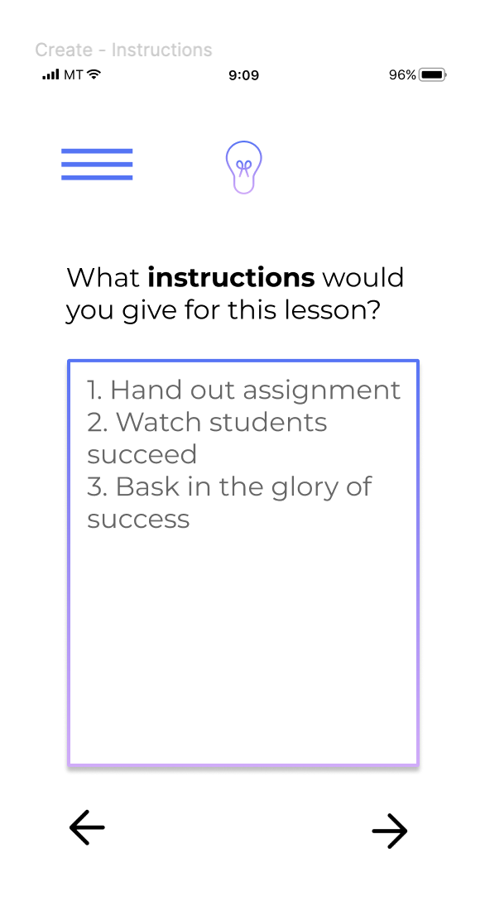
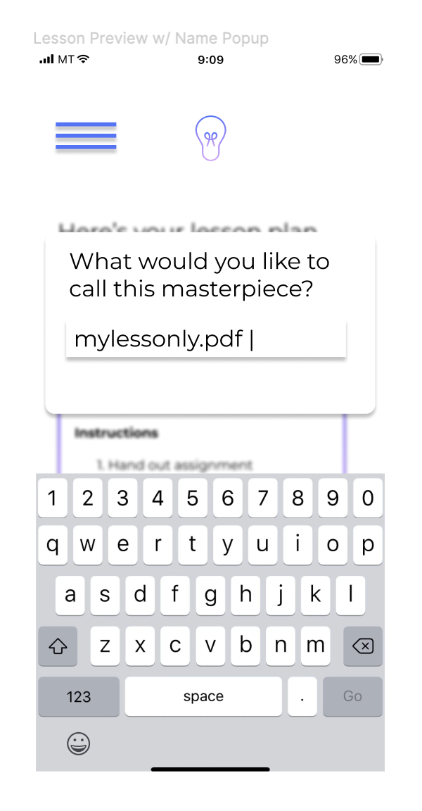
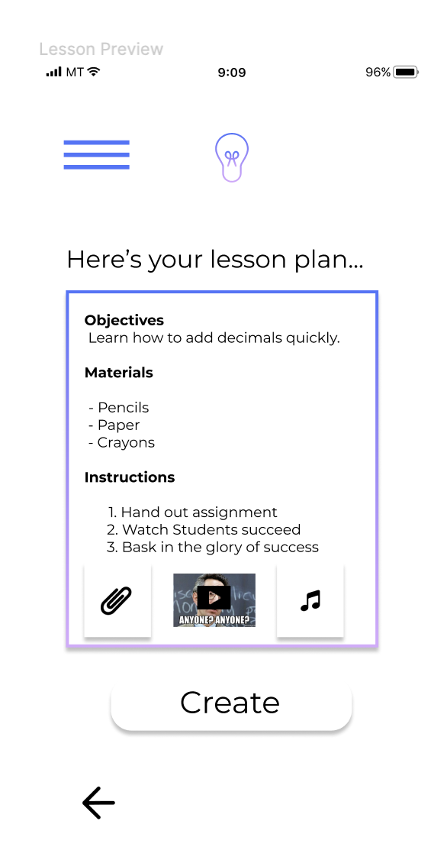
Medium-Fi Prototype Task Flow 1
Creating a Lesson

Slide 17
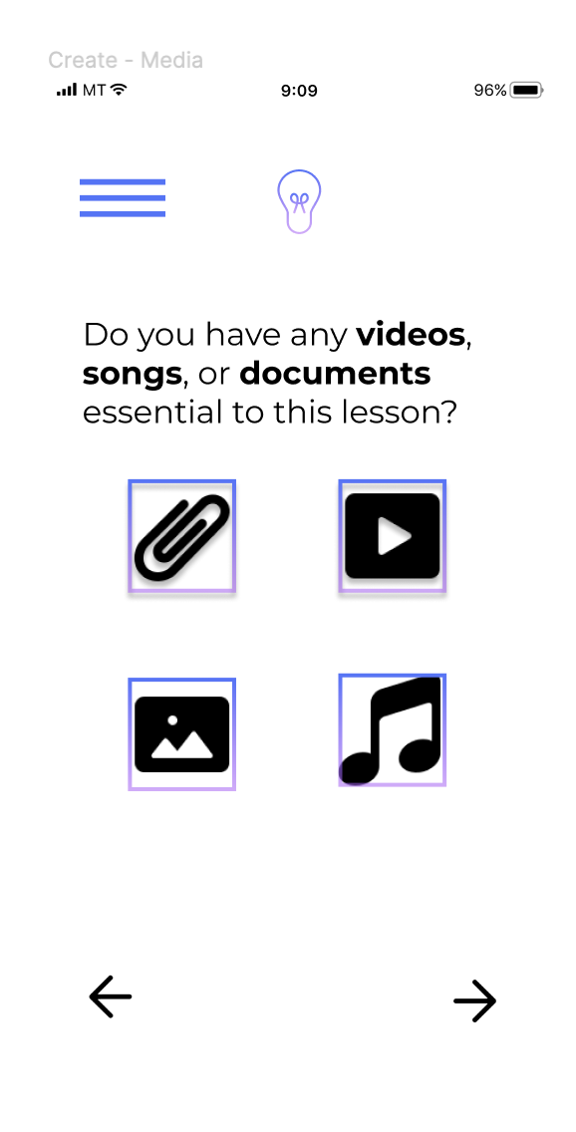
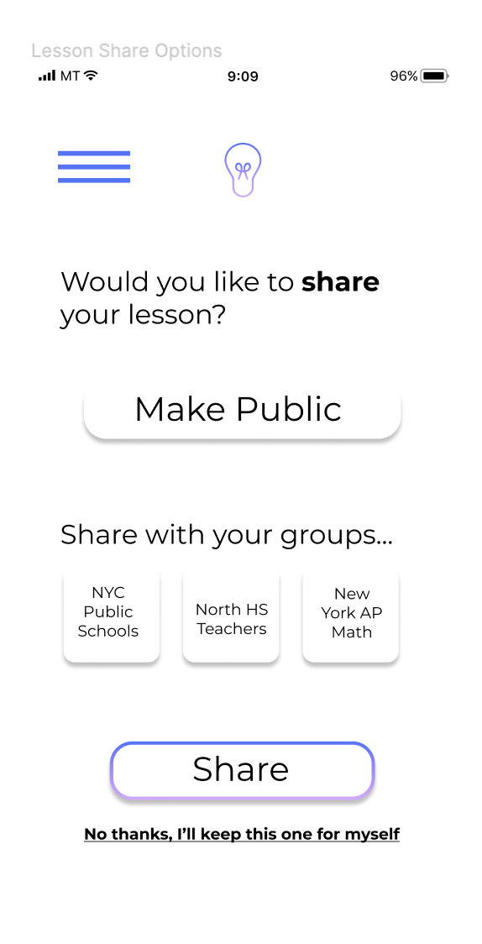
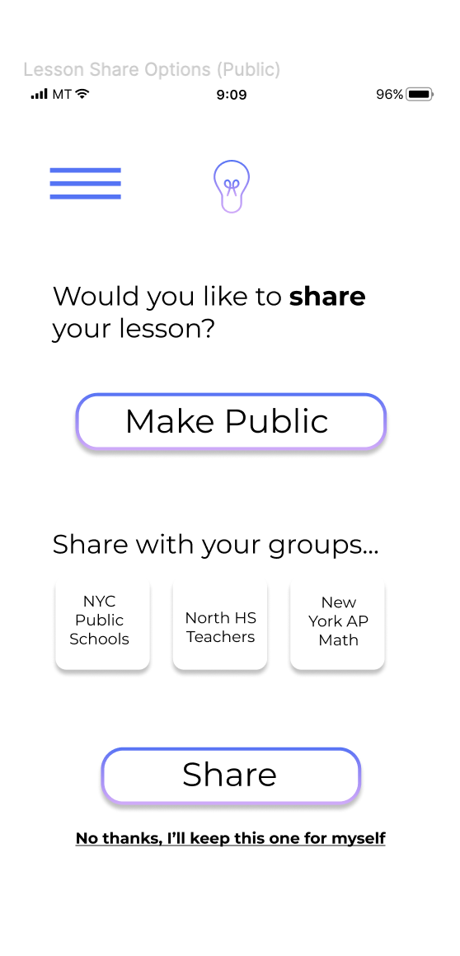
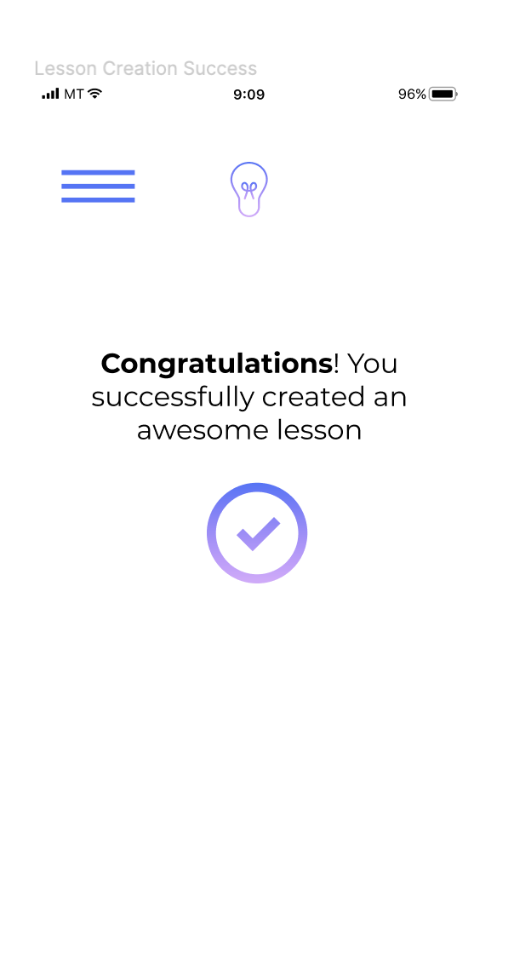
Medium-Fi Prototype Task Flow 1
Creating a Lesson

Slide 18
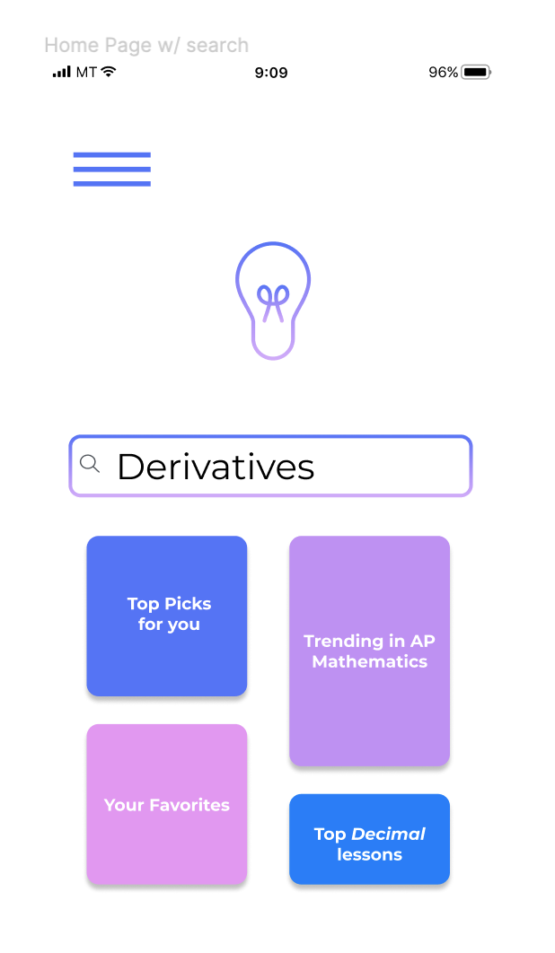
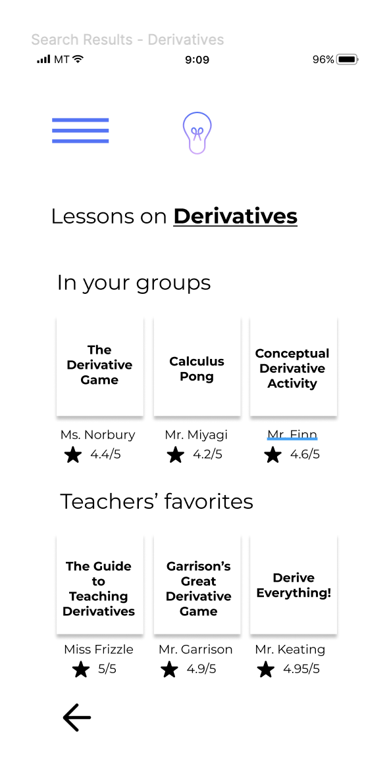
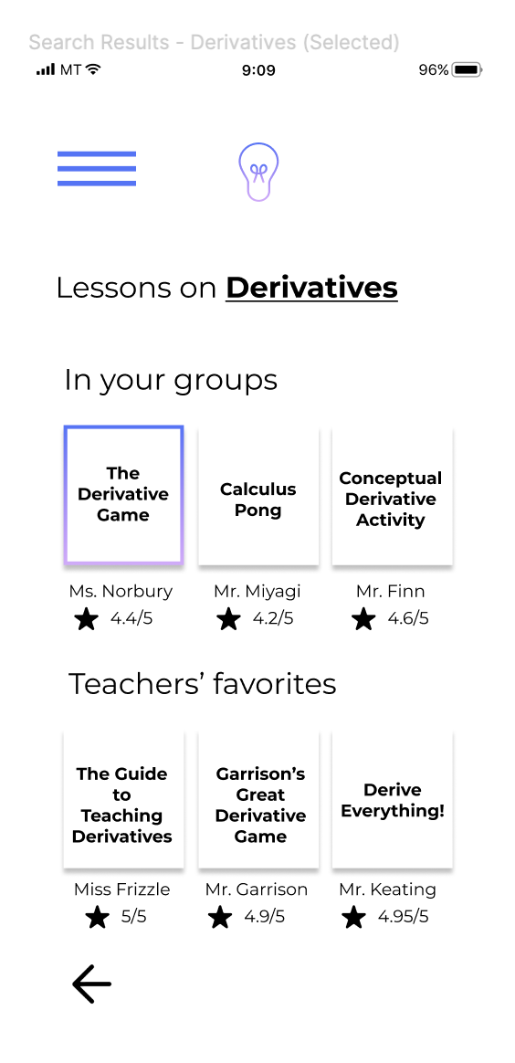
Medium-Fi Prototype Task Flow 2
Finding a Lesson

Slide 19
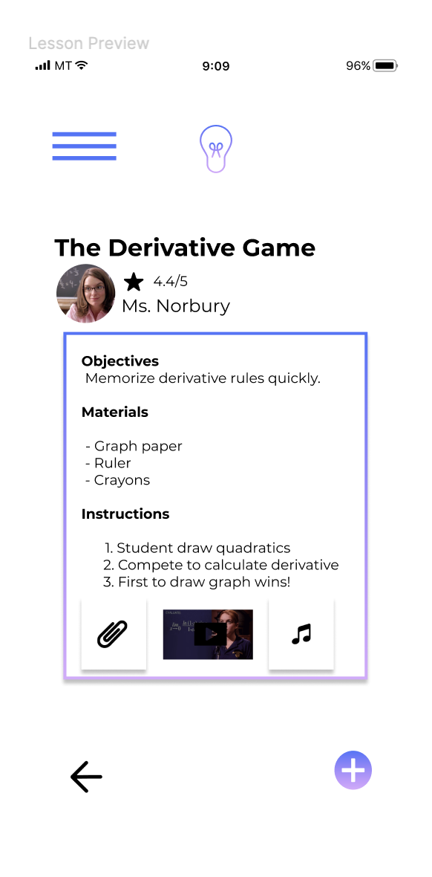
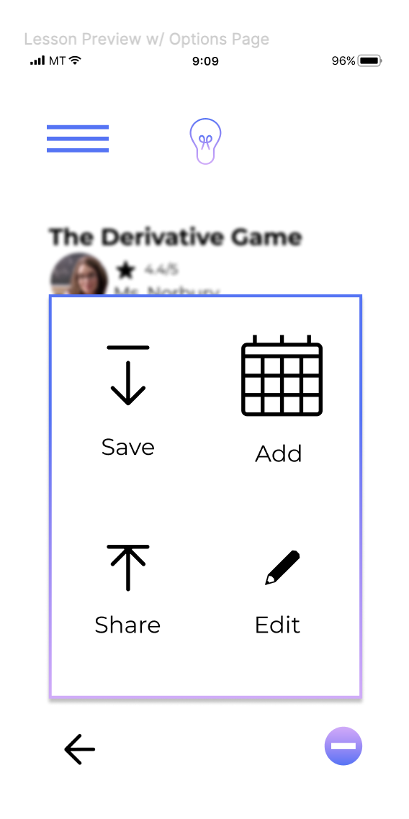
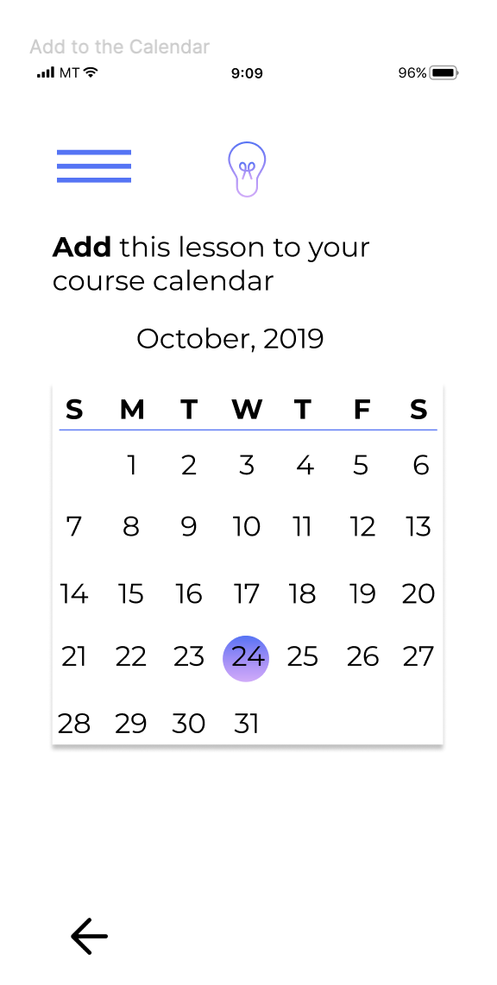
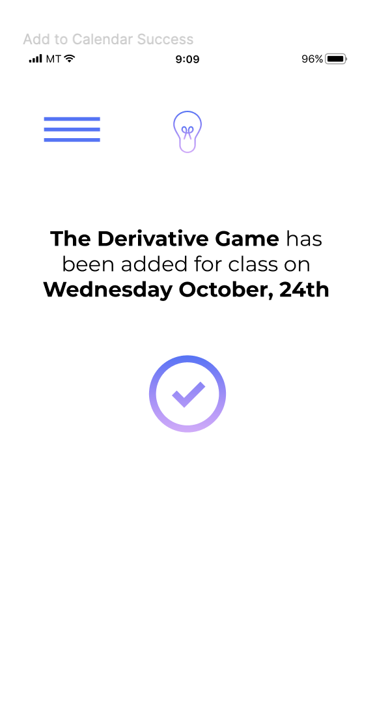
Medium-Fi Prototype Task Flow 2
Finding a Lesson

Slide 20
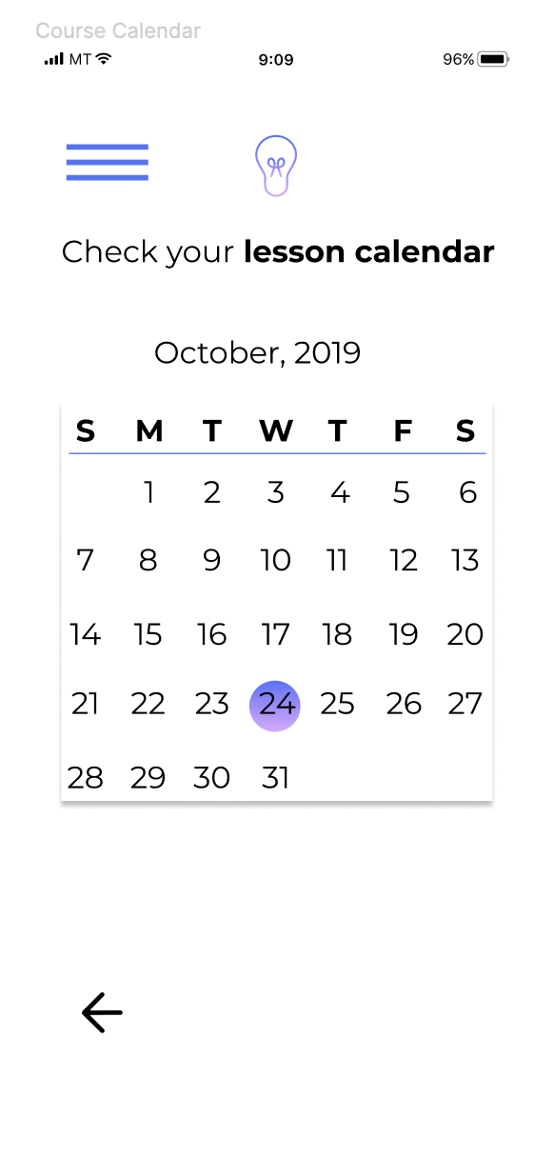
Medium-Fi Prototype Task Flow 3
Creating a Lesson
Give Feedback

Slide 21
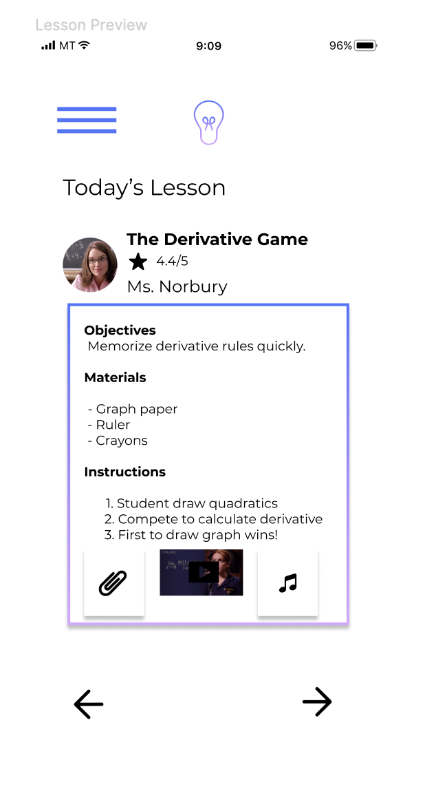
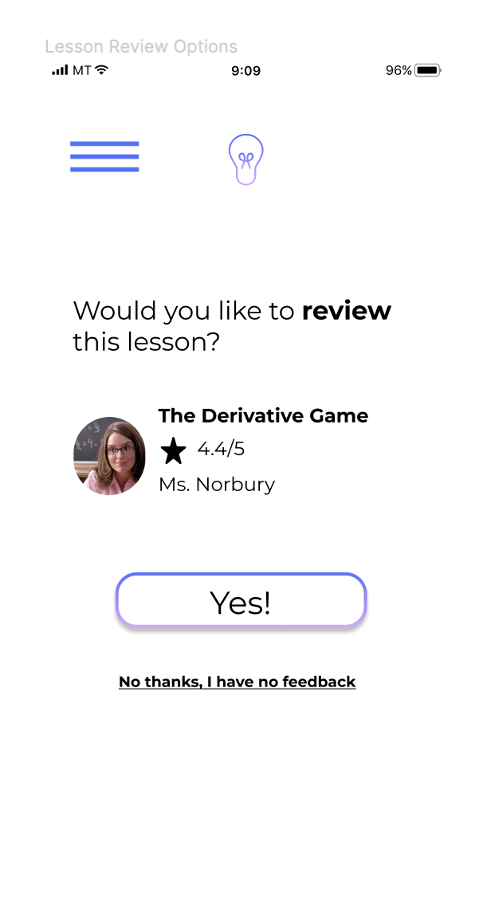
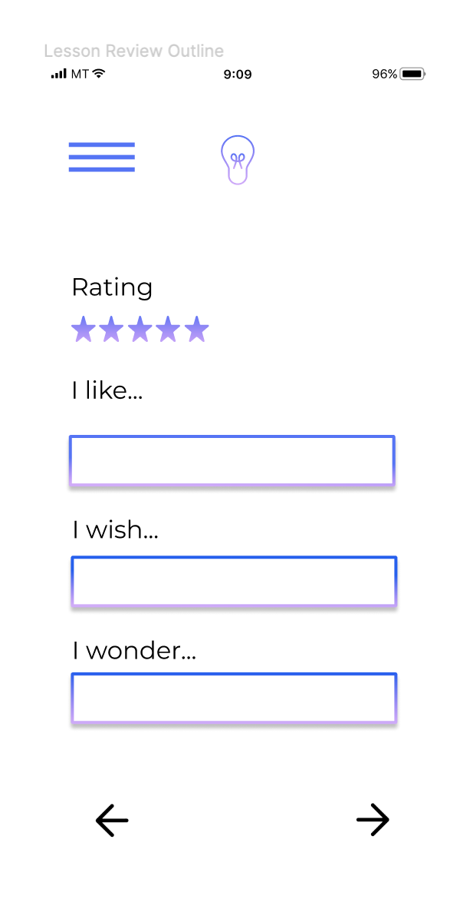
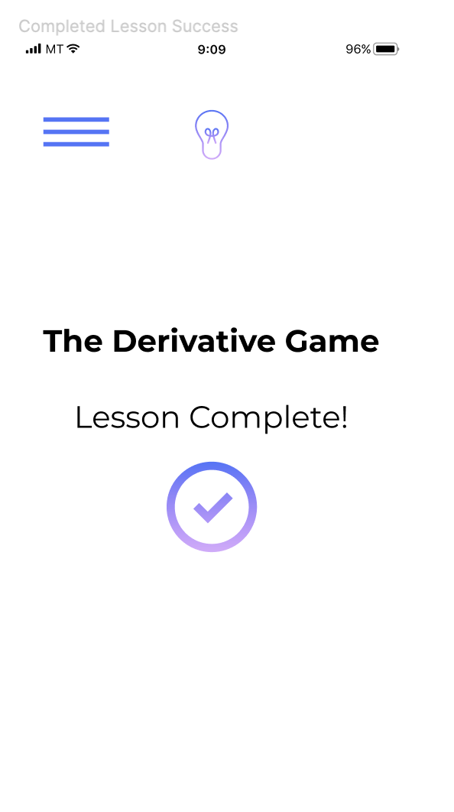
Medium-Fi Prototype Task Flow 3
Creating a Lesson
Give Feedback

Slide 22
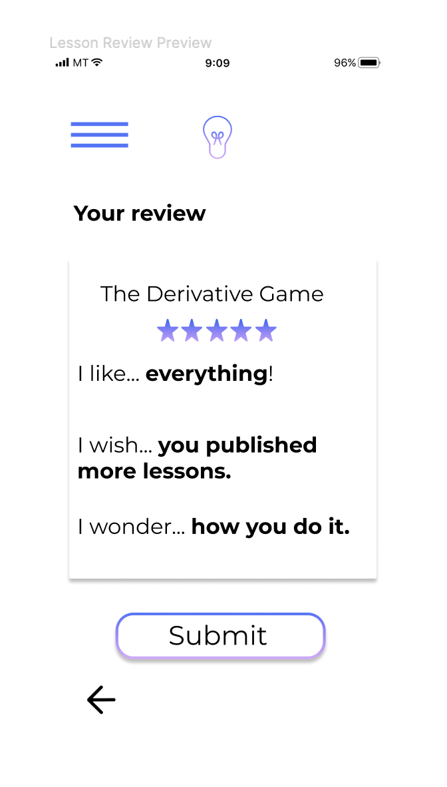
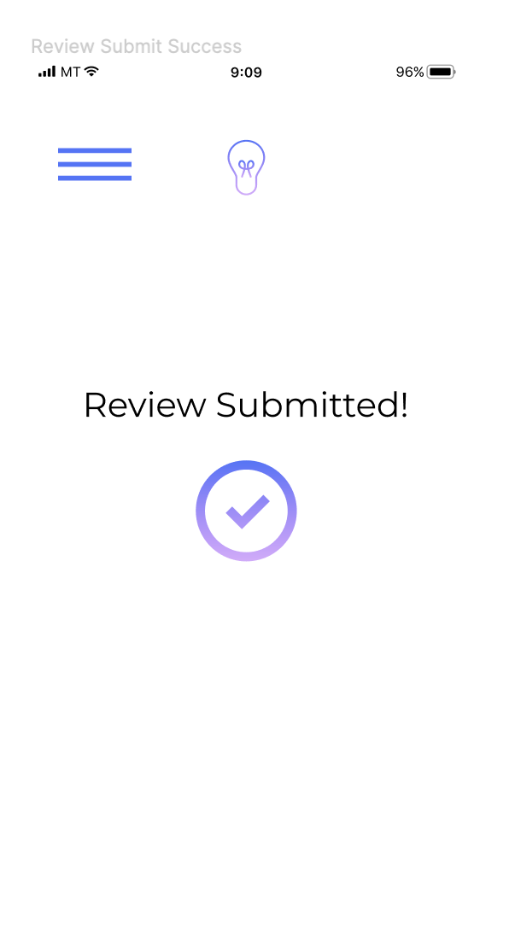
Medium-Fi Prototype Task Flow 3
Give Feedback

Slide 23
Prototype- Tools
We used Figma solely for designing and testing our medium-fi prototype.
PRO’s:
Wide applicability
Great to quickly and easily test multiple ideas
CON’s:
Tough initial learning curve
Prototyping is not that dynamic

Slide 24
Prototype- Limitations/Tradeoffs
Transferring paper sketches to Figma was difficult because we originally did not know what would be easy and what would be hard to do using a design or prototyping tool.
Difference in contrast between digital and paper form made for some minor design tweaks to free up space and de-clutter the design.
Had to draw out tasks in digital form in order to better understand and direct the user’s attention (one task per page, instead of multiple task on one page).
In summary, nothing significant was removed out, but really just simplified each page and the overall flow for each task in order to be more easily understood.

Slide 25
Prototype- Wizard of Oz/Hard-coded
Wizard of Oz
The lessons and how we were able to interact with them (giving feedback)
Hard-coded
The text being typed into the search bar
Which lesson planner you selected
Date selected
Feedback provided
Why?
There is a lot of dynamic moving parts to this product, so in order to show it effectively using Figma, most of the selections and decisions made by the user are hard-coded in.

Slide 26
Prototype Link
Sketches
Prototype

