Slide 1
Point of Views & Experience Prototypes

Slide 2
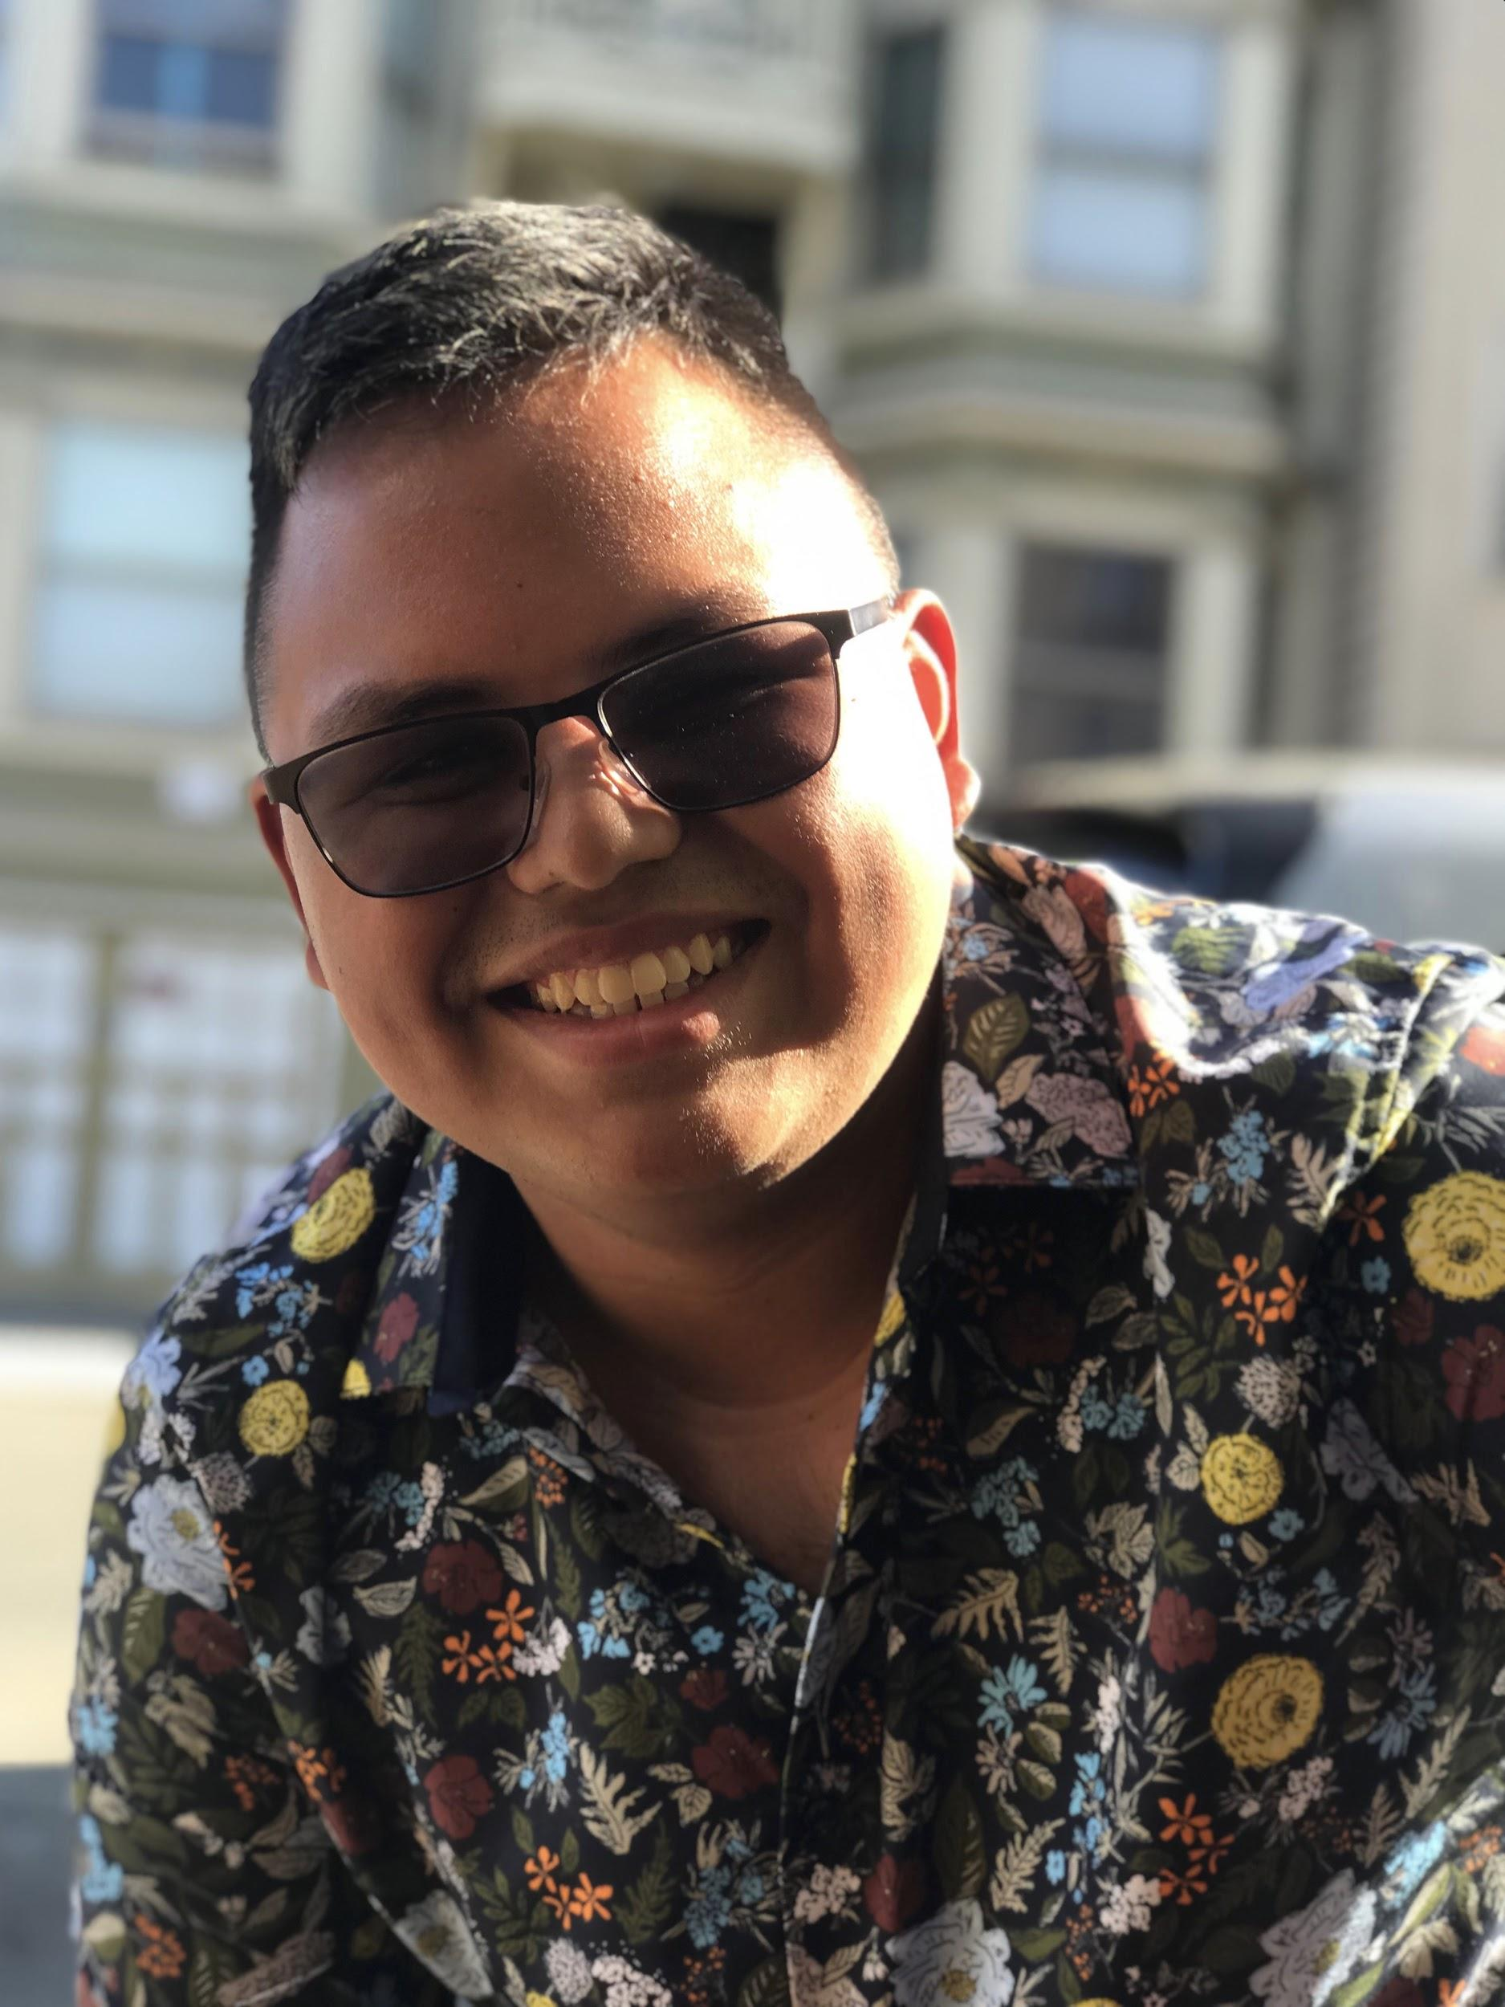
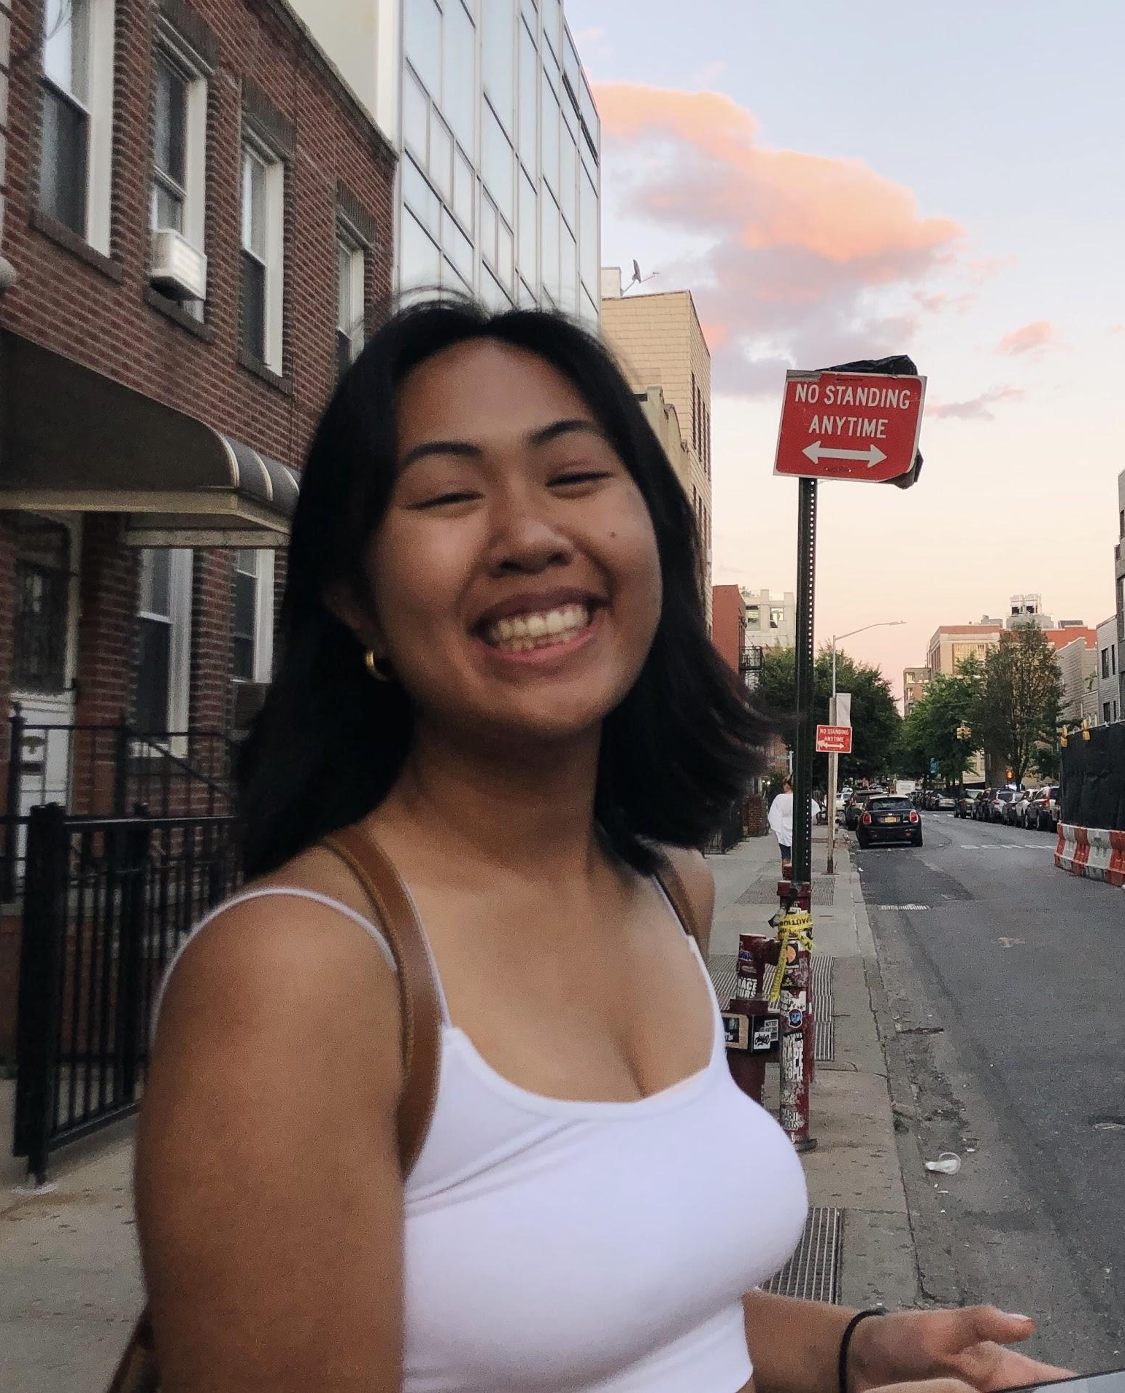
Our Team: PARG
Peter Camacho
Alyssa
Romanos
Ryan
Chen
Gabby
Delos Reyes

Slide 3
Our Team: PARG
Peter Camacho
Alyssa
Romanos
Ryan
Chen
Gabby
Delos Reyes

Slide 4
Our Team: PARG
Peter Camacho
Alyssa
Romanos
Ryan
Chen
Gabby
Delos Reyes

Slide 5
Our Team: PARG
Peter Camacho
Alyssa
Romanos
Ryan
Chen
Gabby
Delos Reyes

Slide 6
Problem Domain

Slide 7
Problem Domain
Our problem domain lies in the intersection of civic engagement and transportation in the Bay Area.

Slide 8
Problem Domain
Our problem domain lies in the intersection of civic engagement and transportation in the Bay Area.
We’ve found a tension in transportation and accessibility with civic events and decided to see what domains motivate people to be civically engaged.

Slide 9
Problem Domain
Our problem domain lies in the intersection of civic engagement and transportation in the Bay Area.
We’ve found a tension in transportation and accessibility with civic events and decided to see what domains motivate people to be civically engaged.

Slide 10
Initial POV Statement

Slide 11
We met...
Dr. Josef Hannah, an SF resident who commutes almost exclusively via public transportation.

Slide 12
We met...
Dr. Josef Hannah, an SF resident who commutes almost exclusively via public transportation.
We were amazed to realize...
that his environmentalist beliefs drove him to avoid rideshares, except when presented with the convenience of other commuters willing to take rideshares.

Slide 13
We met...
Dr. Josef Hannah, an SF resident who commutes almost exclusively via public transportation.
We were amazed to realize...
that his environmentalist beliefs drove him to avoid rideshares, except when presented with the convenience of other commuters willing to take rideshares.
It would be game-changing to...
help him connect with others who share his beliefs and commute to events through his preferred methods of transportation.

Slide 14
We met...
Dr. Josef Hannah, an SF resident who commutes almost exclusively via public transportation.
We were amazed to realize...
that his environmentalist beliefs drove him to avoid rideshares, except when presented with the convenience of other commuters willing to take rideshares.
It would be game-changing to...
help him connect with others who share his beliefs and commute to events through his preferred methods of transportation.

Slide 15
Focused Needfinding

Slide 16
Focused Needfinding
In our additional set of interviews, we focused more on how public transportation affected being civically engaged and how the two look together.

Slide 17
Our Participants

Slide 18
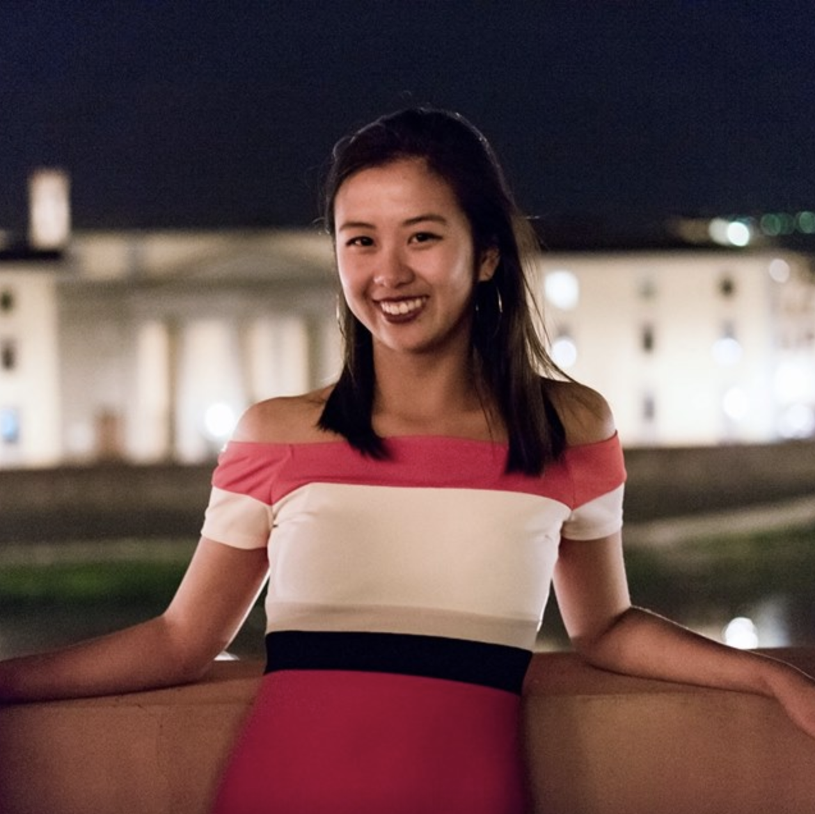
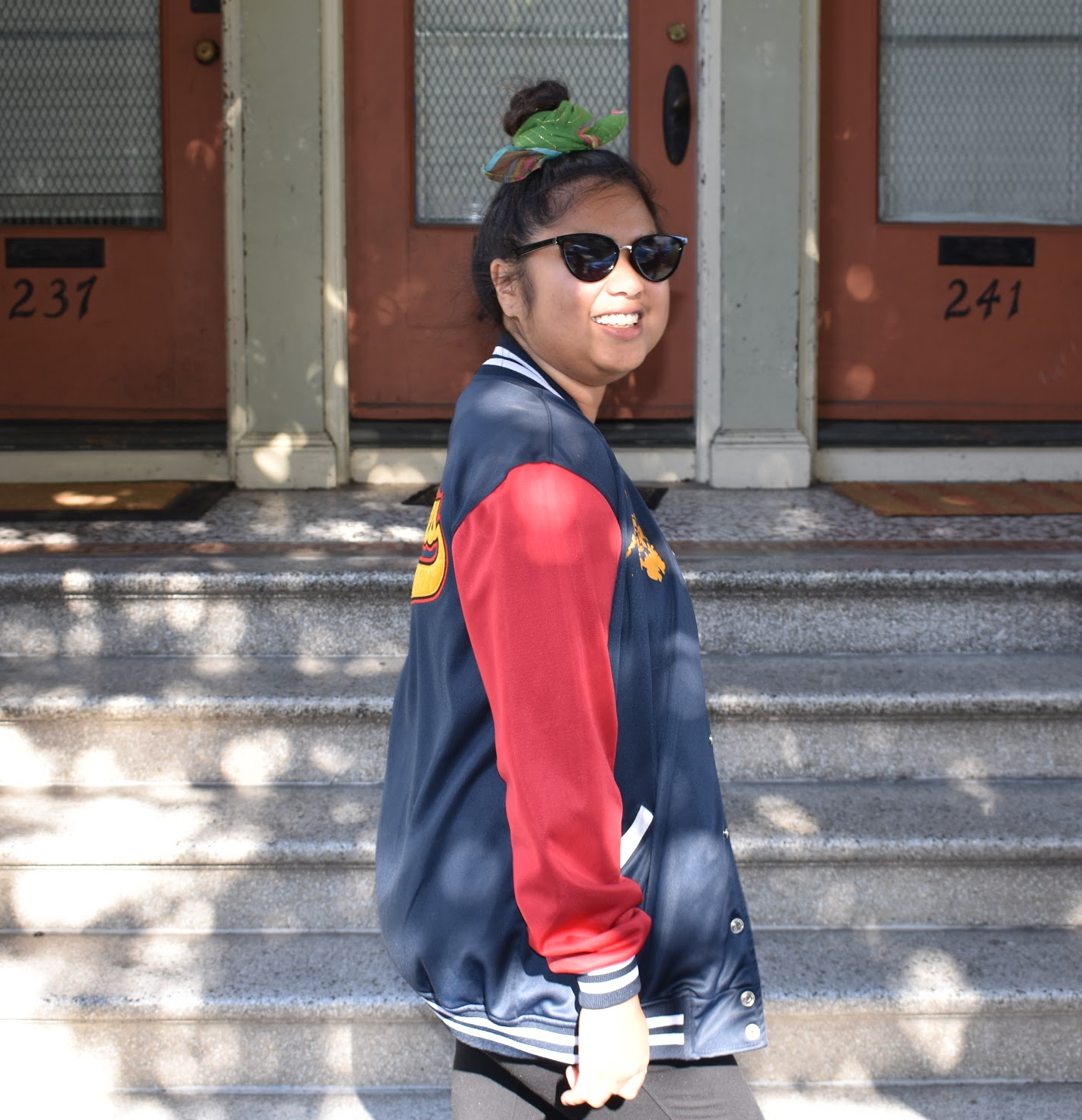
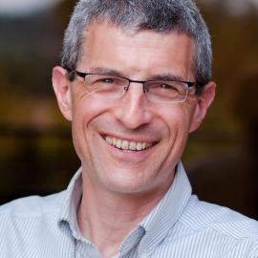
Our Participants
Christine
Win
Michael

Slide 19
Our Participants
Christine
Win
Michael

Slide 20
Our Participants
Christine
Win
Michael

Slide 21
Our Participants
Christine
Win
Michael

Slide 22
Focused Needfinding Insights

Slide 23
Focused Needfinding Insights
Civil disobedience poses potential harms to public transit

Slide 24
Focused Needfinding Insights
Civil disobedience poses potential harms to public transit
So many political events happen that people are not aware of

Slide 25
Focused Needfinding Insights
Civil disobedience poses potential harms to public transit
So many political events happen that people are not aware of
Community increases feeling of safety and enjoyability of public transit

Slide 26
Focused Needfinding Insights
Civil disobedience poses potential harms to public transit
So many political events happen that people are not aware of
Community increases feeling of safety and enjoyability of public transit
Physical presence at events is valued

Slide 27
Focused Needfinding Insights
Civil disobedience poses potential harms to public transit
So many political events happen that people are not aware of
Community increases feeling of safety and enjoyability of public transit
Physical presence at events is valued
Time and distance affect desirability of events

Slide 28
Focused Needfinding Insights
Civil disobedience poses potential harms to public transit
So many political events happen that people are not aware of
Community increases feeling of safety and enjoyability of public transit
Physical presence at events is valued
Time and distance affect desirability of events

Slide 29
Revised POV Statements

Slide 30
We met...
Christine, a young adult working at a DC nonprofit, where lots of civic engagement events occur

Slide 31
We met...
Christine, a young adult working at a DC nonprofit, where lots of civic engagement events occur
We were amazed to realize...
that despite her being involved in grassroots organizing, she was unaware of major events and movements that disrupted her daily public transportation commute.

Slide 32
We met...
Christine, a young adult working at a DC nonprofit, where lots of civic engagement events occur
We were amazed to realize...
that despite her being involved in grassroots organizing, she was unaware of major events and movements that disrupted her daily public transportation commute.
It would be game-changing to...
leverage commuter and organizer knowledge to make travel and event experiences better for both groups.

Slide 33
We met...
Christine, a young adult working at a DC nonprofit, where lots of civic engagement events occur
We were amazed to realize...
that despite her being involved in grassroots organizing, she was unaware of major events and movements that disrupted her daily public transportation commute.
It would be game-changing to...
leverage commuter and organizer knowledge to make travel and event experiences better for both groups.

Slide 34
How Might We...
make adjusting one’s typical commute a delightful experience?

Slide 35
We met...
Win, a 23 year old, part time City College of SF student who works at a pizza shop

Slide 36
We met...
Win, a 23 year old, part time City College of SF student who works at a pizza shop
We were amazed to realize...
that she actively tries scheduling bus routes with friends to make commuting a more safe and fun travel experience.

Slide 37
We met...
Win, a 23 year old, part time City College of SF student who works at a pizza shop
We were amazed to realize...
that she actively tries scheduling bus routes with friends to make commuting a more safe and fun travel experience.
It would be game-changing to...
facilitate interpersonal connections or shared interests on public transit to make a more active and enjoyable commute

Slide 38
We met...
Win, a 23 year old, part time City College of SF student who works at a pizza shop
We were amazed to realize...
that she actively tries scheduling bus routes with friends to make commuting a more safe and fun travel experience.
It would be game-changing to...
facilitate interpersonal connections or shared interests on public transit to make a more active and enjoyable commute

Slide 39
How Might We...
connect people with similar interests while waiting for a bus/train?

Slide 40
We met...
Elizabeth, an Education masters student, who lives in San Francisco.

Slide 41
We met...
Elizabeth, an Education masters student, who lives in San Francisco.
We were amazed to realize...
that she wanted casual and convenient ways to practice civic engagement.

Slide 42
We met...
Elizabeth, an Education masters student, who lives in San Francisco.
We were amazed to realize...
that she wanted casual and convenient ways to practice civic engagement.
It would be game-changing to...
help her inform herself and build community without it being too complex.

Slide 43
We met...
Elizabeth, an Education masters student, who lives in San Francisco.
We were amazed to realize...
that she wanted casual and convenient ways to practice civic engagement.
It would be game-changing to...
help her inform herself and build community without it being too complex.

Slide 44
How Might We...
make engaging civically seem like a casual dinner with friends that encourages building community?

Slide 45
Experience Prototypes

Slide 46
Experience Prototype 1
Sticky Notifications

Slide 47
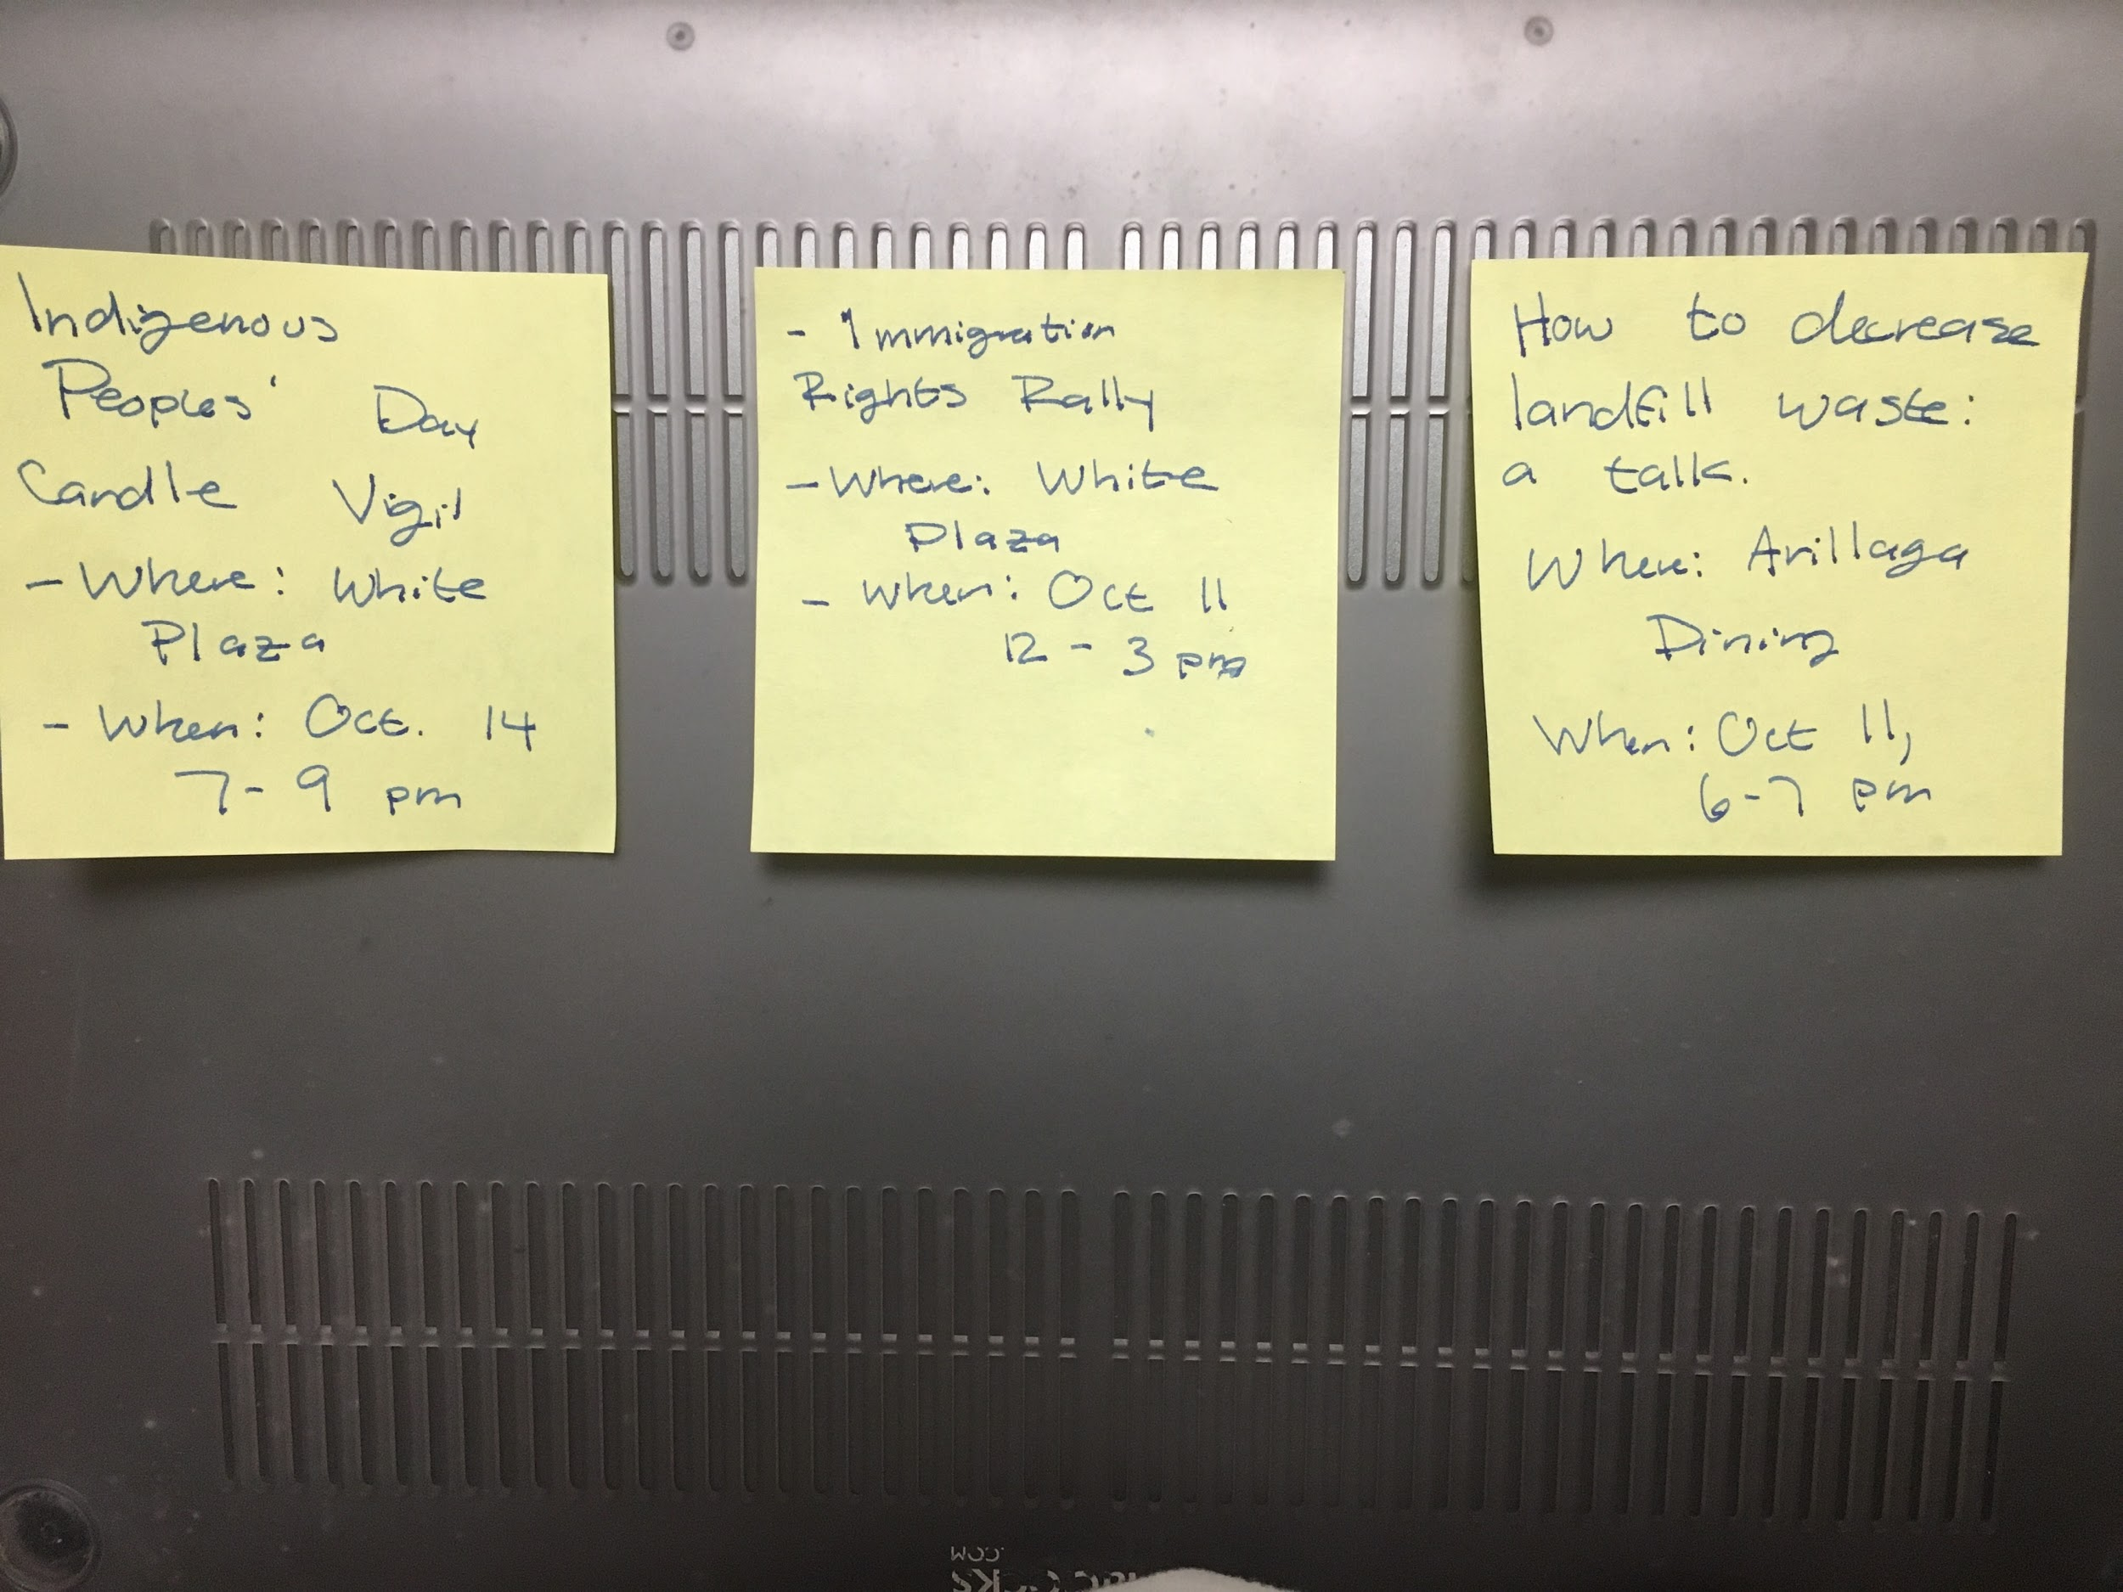
Assumption
People will be interested in events that are happening near them and want to be aware
[Image of sticky note notification of events happening locally, the subject wanted to stay anonymous]

Slide 48
+
-
Subject liked the personalized notification idea with regards to daily commute
Pre-existing time commitments can be an impediment

Slide 49
Surprises
Learnings
Busy schedules will have an impact regardless of what events a person is interested in
Interests in events increases when aligned with the daily commute

Slide 50
Experience Prototype 2
Event Hub

Slide 51
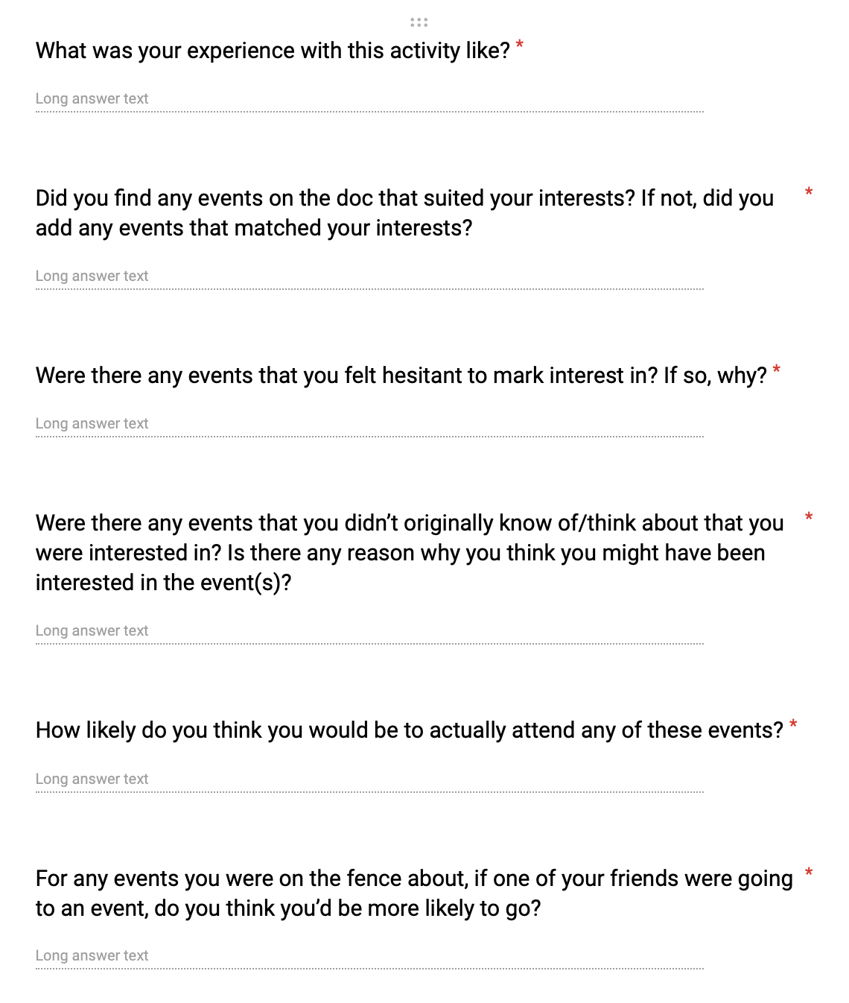
Assumption
People have an inherent want to engage in events with people around them
[Image of some of the questions from the closing survey]

Slide 52
+
-
People were very engaged in adding events/finding events of interest
Activity seemed a little crowded at time (too many people editing at once sometimes created confusion)

Slide 53
Surprises
Learnings
Influence of peers/friends seems to be less present in older people
Distance typically will decrease interest in event
People are inclined to follow along with what friends/peers are doing (paper-trail effect)

Slide 54
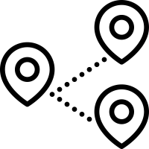
Experience Prototype 3
Destination-Based Communities

Slide 55
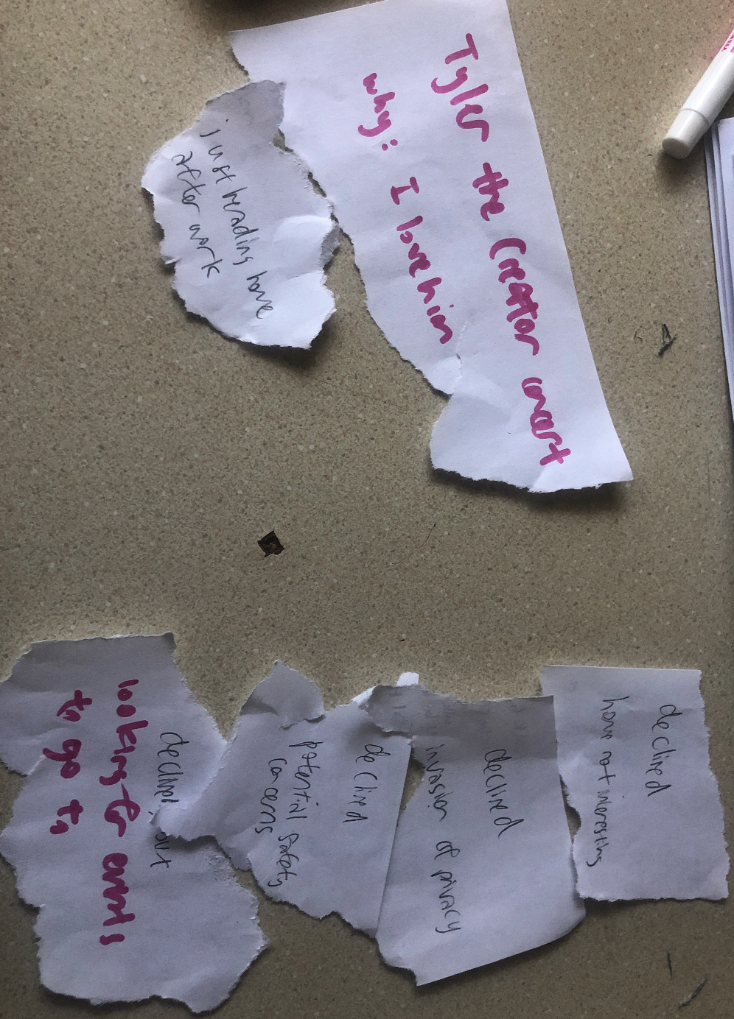
Assumption
People want to meet other people going to similar places and people want to notify strangers where they’re going to
[Image of some of the participants’ destinations]

Slide 56
+
-
People have clear reasons why they are going to their destinations
People don’t openly want to share intimate details of where they are going, particularly with daily commute

Slide 57
Surprises
Learnings
Information sharing isn’t always a two-way street
Only willing to share if event is significant

Slide 58
Moving Forward
Sticky Notifications + Event Hub

Slide 59
Summary

Slide 60
Summary
People want to engage in events with people around them (peers, friends, etc)
People are interested in and want to be aware of what’s going on around them
Next step: What is the best form(s) of delivering this information to people? How does it differ amongst different demographics?

Slide 61
Questions

