Slide 1
Civic Engagement Through Transportation

Slide 2
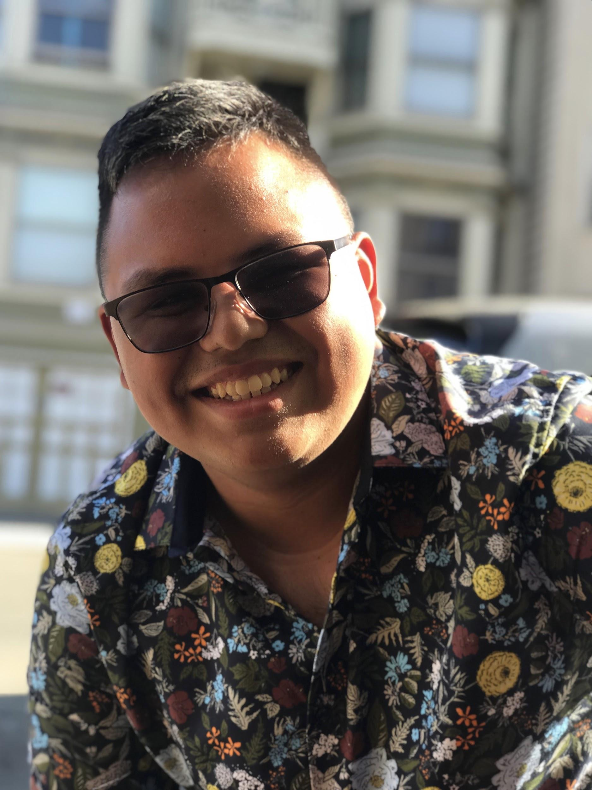
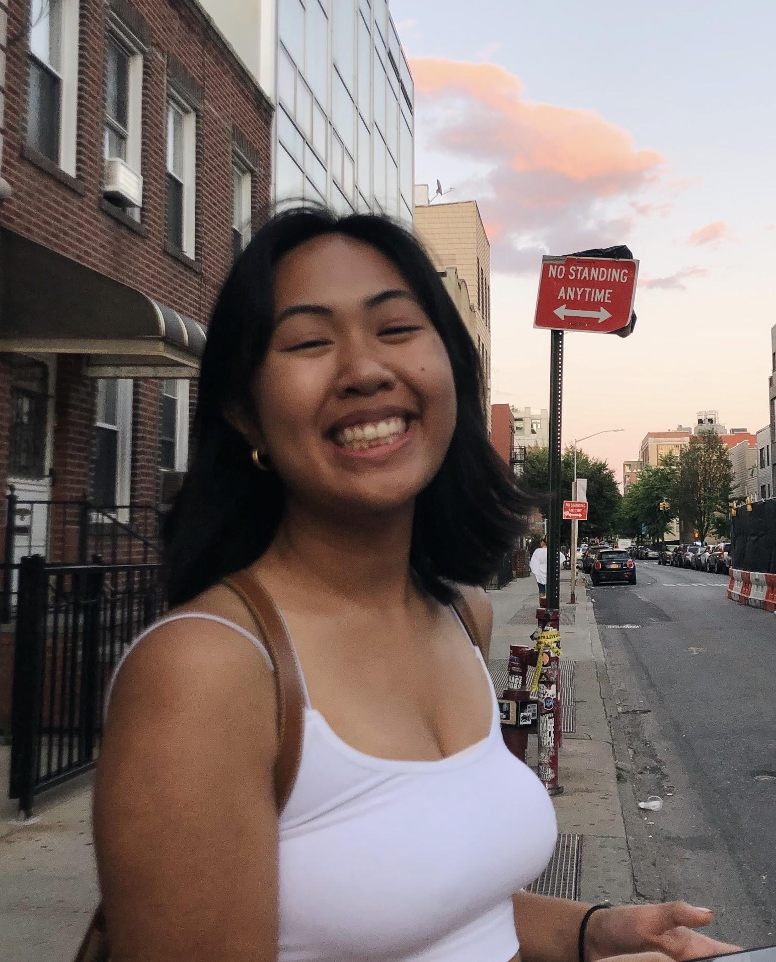
Our Team: PARG
Peter
Alyssa
Ryan
Gabby

Slide 3
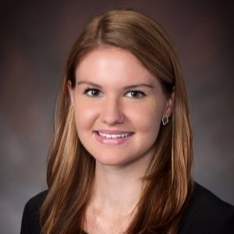
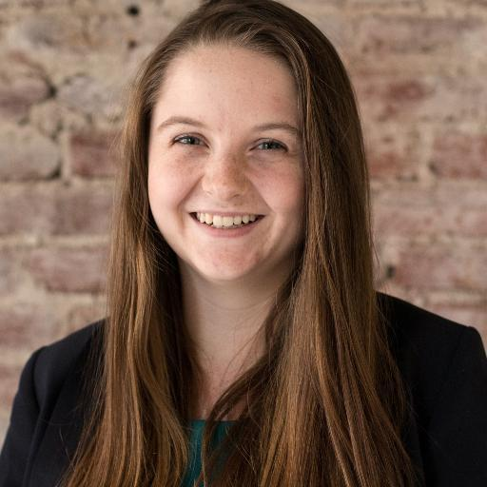
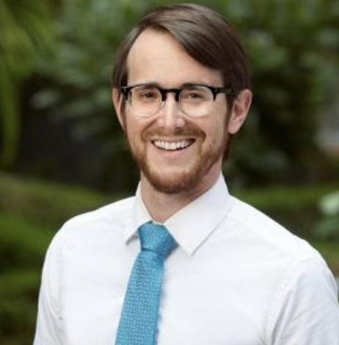
Our Participants
Lexi
Elizabeth
Joe

Slide 4
Our Participants
Lexi
Elizabeth
Joe

Slide 5
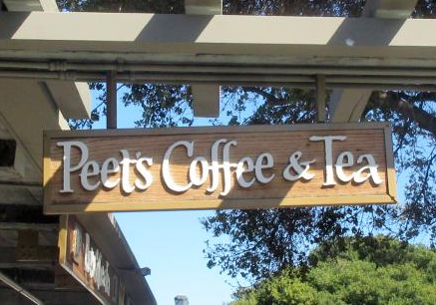
Needfinding Methodology
Who: Lexi, an engineer at Lockheed Martin
Where: Peet’s Coffee
When: Wednesday afternoon
Why: a non-user of public transportation

Slide 6
What did we ask?
What types of transportations do you use?
Why do you choose to use a car rather than public transportation?
Tell us about a time where you engaged in a rally/protest/town hall.
What do you do during your commutes to work?

Slide 7
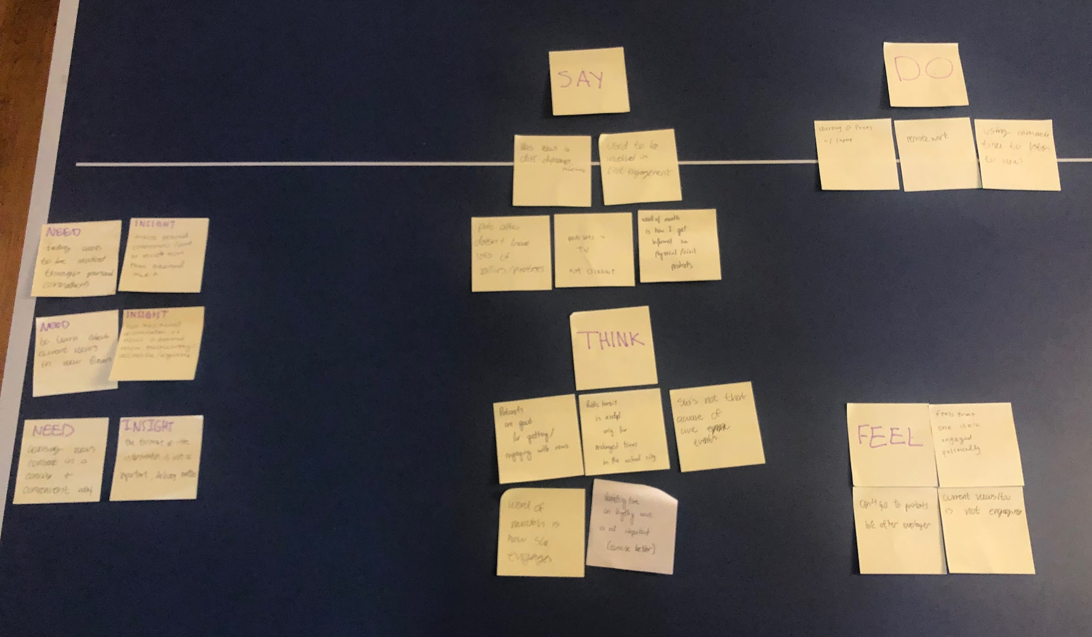
Empathy Map Results

Slide 8
SAY
DO
THINK
FEEL
Palo Alto doesn’t have many rallies or protests
Used to be more civically engaged
Remote work on laptop @ Peet’s
Likes news in different mediums
Word of mouth is how I get informed on protests
Podcasts better than TV
Uses commute time to listen to news
Thinks she isn’t too aware of political events
Feels like she cannot go to protests because of her employer
Podcasts are good for getting news & engaging with news
Public transit is only useful for prolonged times in the city
Feels that she isn’t engaged politically
Feels like current news outlets are not engaging
Thinks the more concise the news is, the better
Engages with news by word of mouth

Slide 9
Need
Insight
To learn about current news in new forms and dynamics.
The delivery of current news and politics is just as important as the content itself.

Slide 10
Need
Insight
Find ways to be involved through personal connections.
She trusts personal connections and word of mouth over traditional media.

Slide 11
Need
Insight
Accessing news content in a concise and convenient way.
Non-traditional dissemination of news is deemed more trustworthy, accessible, and digestible.

Slide 12
Our Participants
Lexi
Elizabeth
Joe

Slide 13
Needfinding Methodology
Who: Elizabeth, Education grad student @ Stanford
Where: CalTrain Station
When: Wednesday afternoon
Why: A good, average user “in action”

Slide 14
What did we ask?
Tell me about your daily commute.
Why do you choose one form of public transport over the other?
Tell us about a positive or negative experience with public transportation.
What was the experience like when you were organizing an community event?

Slide 15
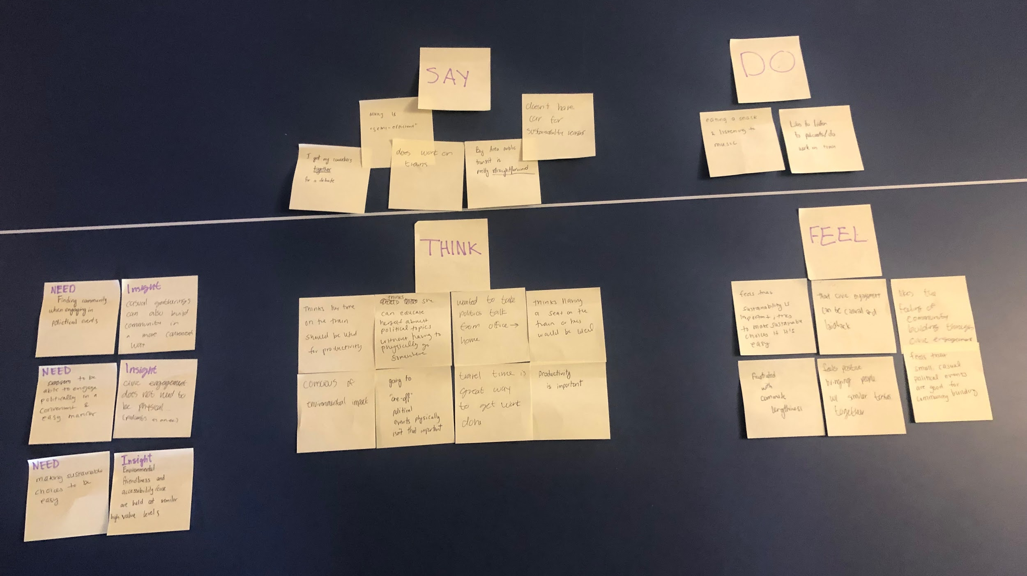
Empathy Map Results

Slide 16
SAY
DO
THINK
FEEL
Muni is semi-efficient
Bay Area public transportation is pretty straight forward
I got my co-workers together for a debate
Eating a snack and listening to music
Likes to listen to podcasts and do work on train
Does work on trains
Doesn’t have a car for sustainability reasons
Productivity is important & good use of travel time
Thinks she can educate herself about political topics without having to physically go somewhere
Frustrated by commute lengthiness
Feels that civic engagement can be casual and build community
Wanted to take politics from office to the home
Feels that sustainability is important; tries to make sustainable choices if it’s easy
Conscious of environmental impact
Attending “one-off” political events isn’t that important
Feels positive about bringing people together to discuss views, even if different
Thinks her time commuting should be used productively
Thinks having a seat on the train would be ideal

Slide 17
Need
Insight
Finding community when engaging in political/civic events.
Casual gatherings can also build community in a more convenient way.

Slide 18
Need
Insight
Making sustainable choices need to be easy.
Being environmental friendly and ease of accessibility are both held at similar high value levels.

Slide 19
Need
Insight
To be able to engage politically in a convenient and easy manner
Civic engagement does not mean you have to be physically present, there are other forms of being engaged.

Slide 20
Our Participants
Lexi
Elizabeth
Joe

Slide 21
Needfinding Methodology
Who: Joe, works at Stanford Med School
Where: CalTrain Station
When: Wednesday afternoon
Why: A good, extreme user waiting for the CalTrain

Slide 22
What did we ask?
Tell me about your daily commute.
What tools do you use to help plan your commutes?
Tell us about a time you attended a rally/protest.

Slide 23
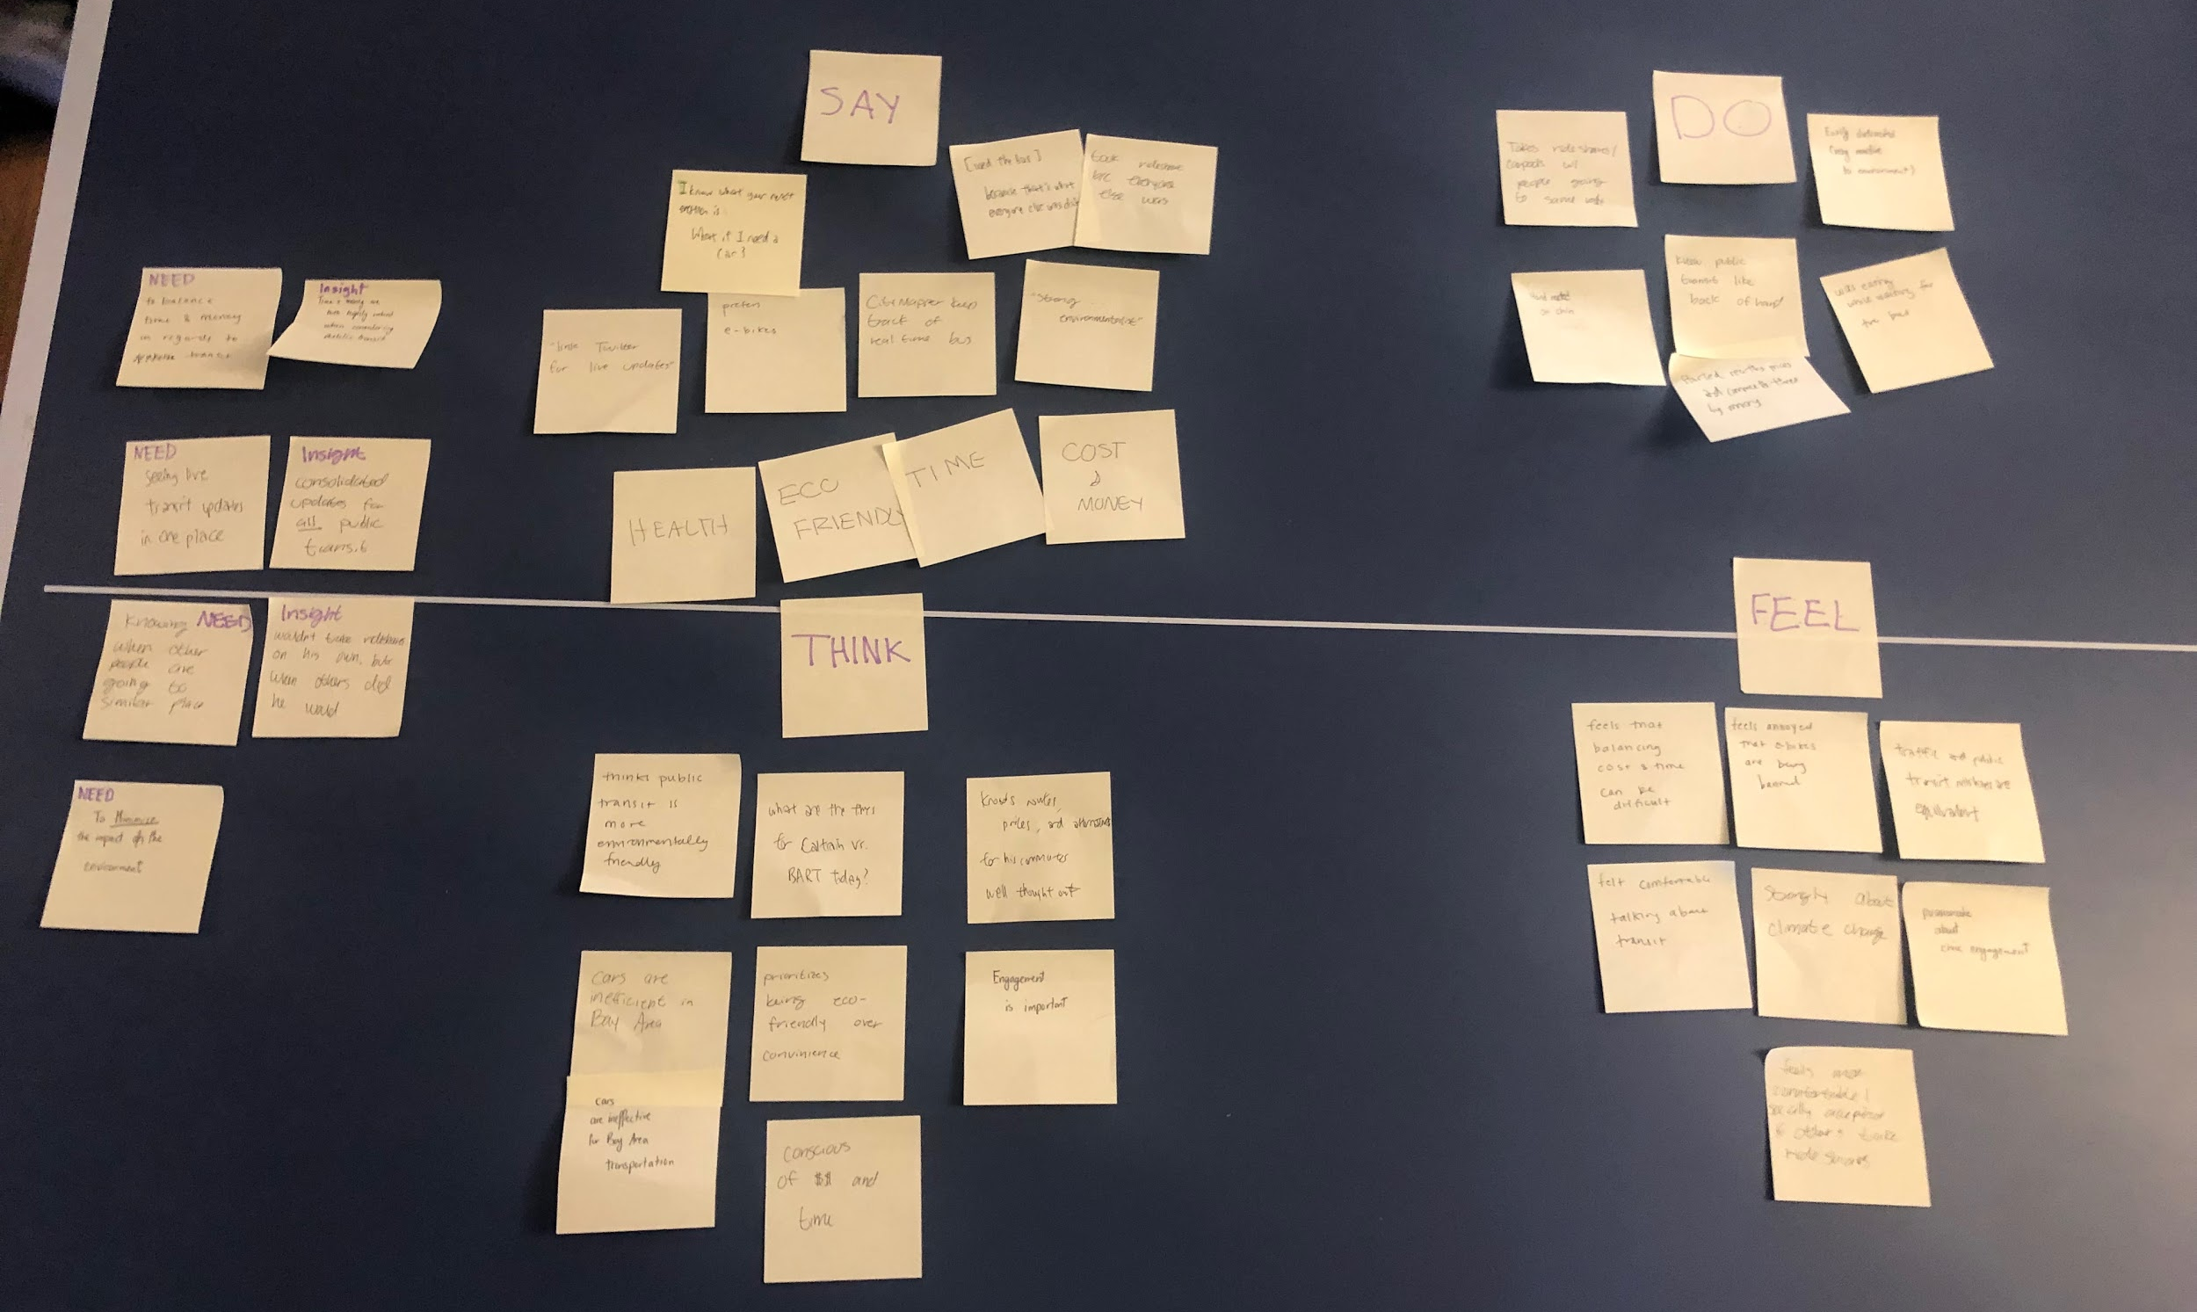
Empathy Map Results

Slide 24
SAY
DO
THINK
FEEL
Prefers e-bikes
I’m a strong environmentalist
Recited ride fares, stations, and transportation services from memory; very knowledgeable
Eating Shake Shack while waiting for train
I know what your next question is: what if I need a car?
“Link Twitter for live transit updates”
Used the bus because that’s what everyone else did
Chin rested on hand
Citymapper
Annoyed that e-bikes are being banned -- exercise, cheaper, sustainable
Cars are inefficient in the Bay Area
Prioritizes being eco-friendly over saving money
Feels comfortable/that it is socially acceptable when others also rideshare
Thinks public transit is more environmentally friendly
Feels that balancing cost & time can be difficult
Civic engagement is important
Passionate about sustainability and civic engagement

Slide 25
Need
Insight
Knowing when other people are going to similar places/areas of similar interest.
He would only take rideshares/carpool if others were taking the same form of transportation.

Slide 26
Need
Insight
To balance time and money in regards to public transit.
A combination of time and money are valued when considering public transit.

Slide 27
Need
Insight
To see live transit updates in one place.
Consolidated updates for all forms of public transit in one place.

Slide 28
Summary
People need convenience and easy access in regard to public transportation and civic engagement
Similar interests and personal relationships drive a lot of decisions
People want to be engaged, but there are convenience barriers that stop people from participating

