Slide 1
Week 6: Interactive Medium-fi Prototyping
Peter C., Ryan C., Gabby R., Alyssa R.

Slide 2
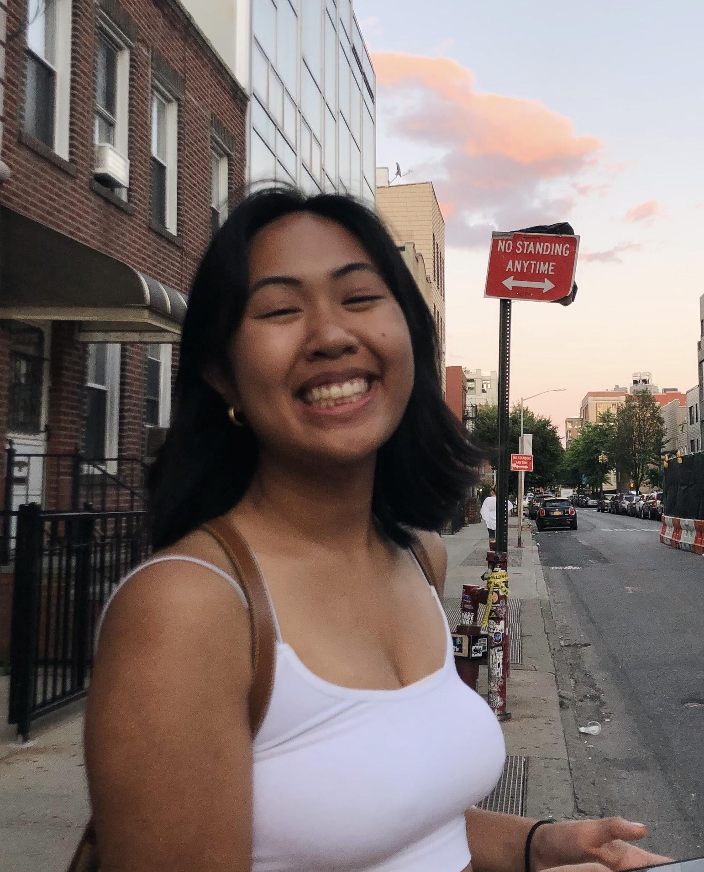
Team Members
Peter C.
Alyssa R.
Ryan C.
Gabby R.
Notes:
Today, im first going to discuss Rally’s goals. Then, I’ll talk about process by which we envisioned how Rally can achieve these goals through its user interface, and how we came to the final low-fi prototype. I will also discuss how user testing went and what changes we will implement to make Rally better!

Slide 3
Overview
Mission Statement + Value Proposition
Problem & Solution Overview
Tasks
Revised Interface Design
Major Design Changes
Medium-fi Prototype Task Flows
Prototype Overview
Notes:
Today, im first going to discuss Rally’s goals. Then, I’ll talk about process by which we envisioned how Rally can achieve these goals through its user interface, and how we came to the final low-fi prototype. I will also discuss how user testing went and what changes we will implement to make Rally better!

Slide 4
Mission Statement
We want to make civic engagement accessible, easy, and community-based.
Notes:
Rally’s Mission Statement →

Slide 5
Value Proposition
Your one stop shop for civic engagement.
Notes:
Rally’s Value Proposition

Slide 6
Problem &
Solution Overview
Going to political events can be inconvenient and uncomfortable -- RALLY makes civic engagement an easy decision, giving users transportation recommendations and connecting them with friends who want to show out to events.
Notes:
Rally’s Value Proposition

Slide 7
Tasks

Slide 8
Tasks
Task 1: Find an event → simple
Task 2: Find friends & see their interested events → medium
Task 3: Message friends in a rally
group chat → complex

Slide 9
Revisions
Task 2: We revised Task 2 such that it is not dependent on Task 1 -- instead of finding friends interested in same event, the task says to find friends and view their upcoming events
Task 3: We revised Task 3 to match our new app design and encompass multiple ways to do the same task

Slide 10
Revised Interface

Slide 11
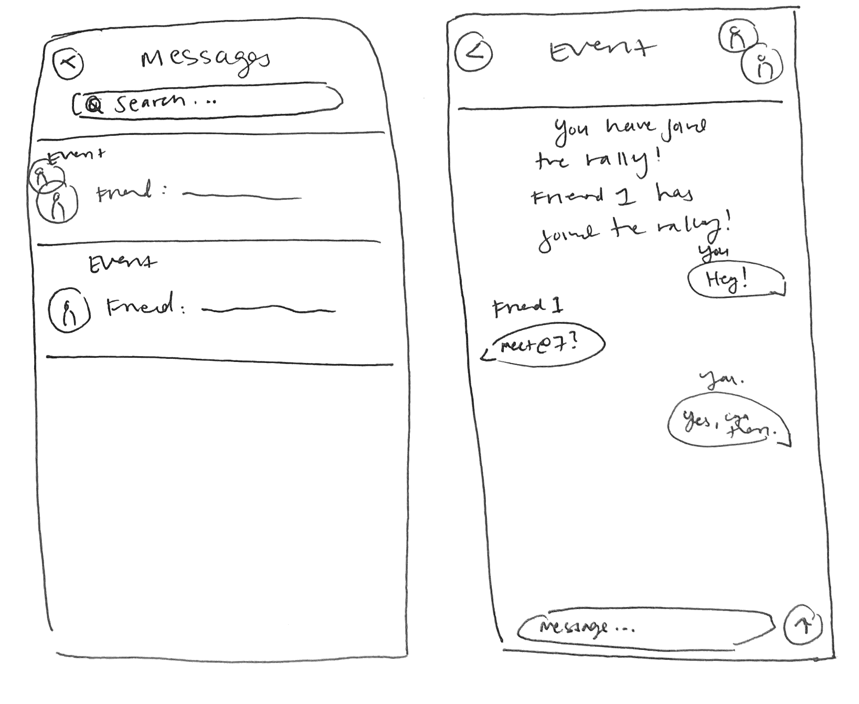
Problem 1 | Rallybot
After: After different iterations, we got rid of Rallybot, feeling that it too much confusion, and that we could implement its functionality in other ways. We improved the messaging system to look more like iMessage, and we replaced Rallybot with “rallies”, or open group chats that friends can join to organize around specific events.
Before: Users were confused by Rallybot’s role in the messaging system, which is the only time Rallybot was incorporated.

Slide 12
Problem 2 | Event-focused
After: We removed the Tinder-esque home page and replaced it with a map view to shift the focus from events to an overview of all that can be explored with Rally.
Before: Users were nudged to find events (rather than explore friends or message friends) because of the home screen, which recommends events.

Slide 13
Problem 3 | Task dependency
Before: Users were confused by the dependent flow of the tasks -- this confined the tasks to a linear flow, despite the tasks being independent in theory.
After: We redesigned the app to have the journey start with any of the three tasks by providing a map with all three icons displayed, along with filters that allow users to explore specific events, rallies, and friends specifically.

Slide 14
Medium-fi Prototype Task Flows

Slide 15
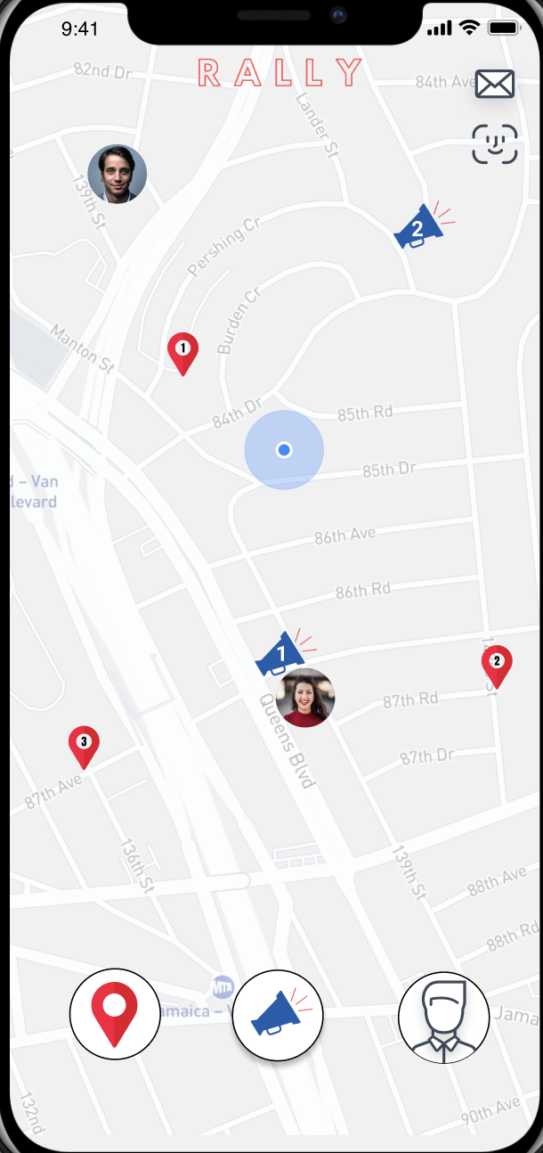
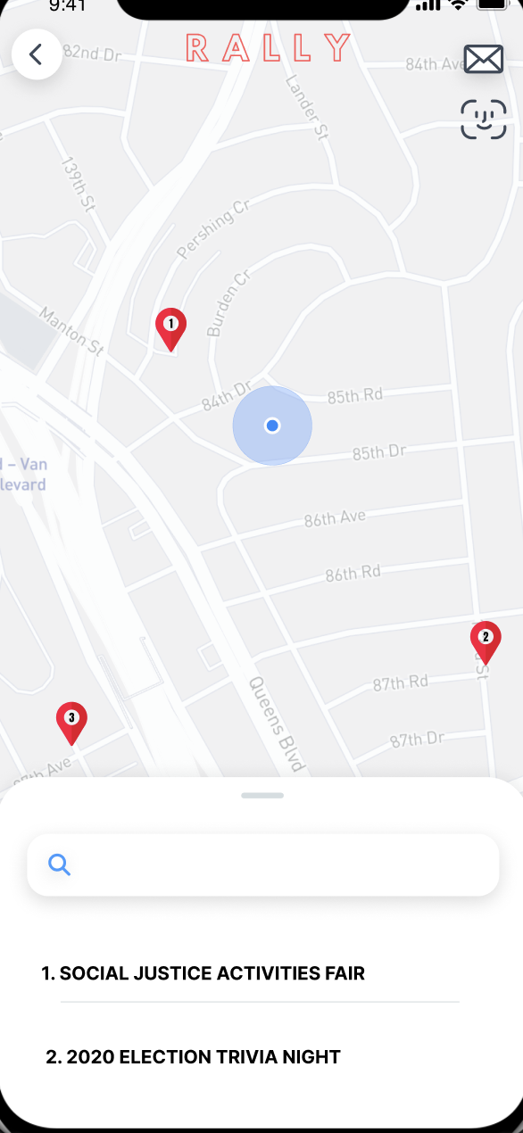
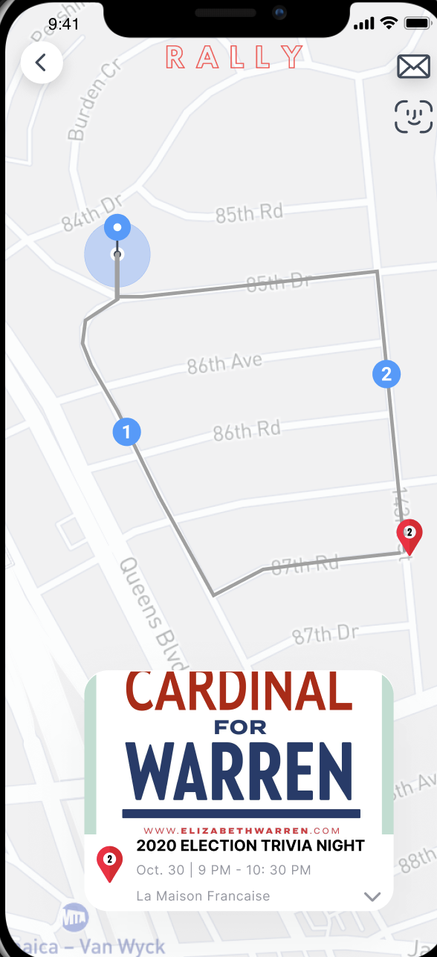
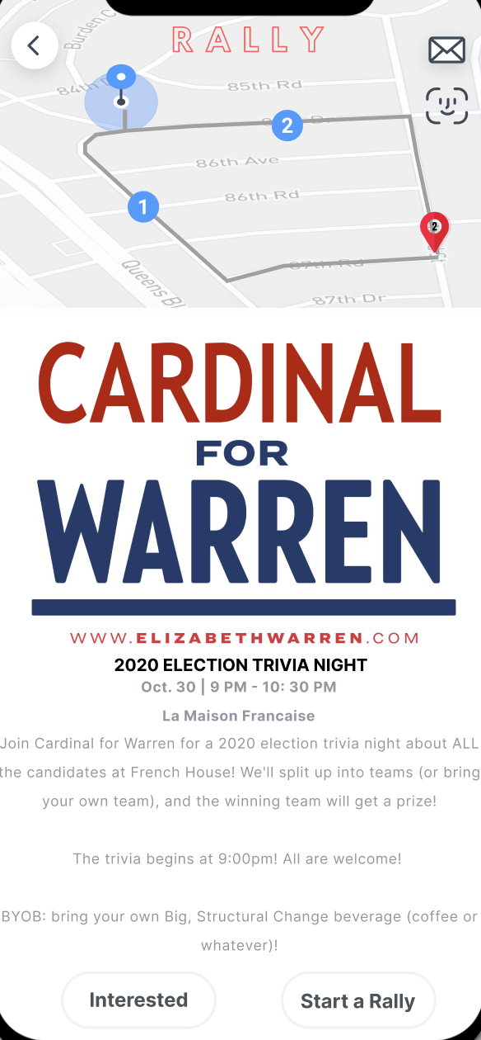
Task 1: Find an event → simple

Slide 16
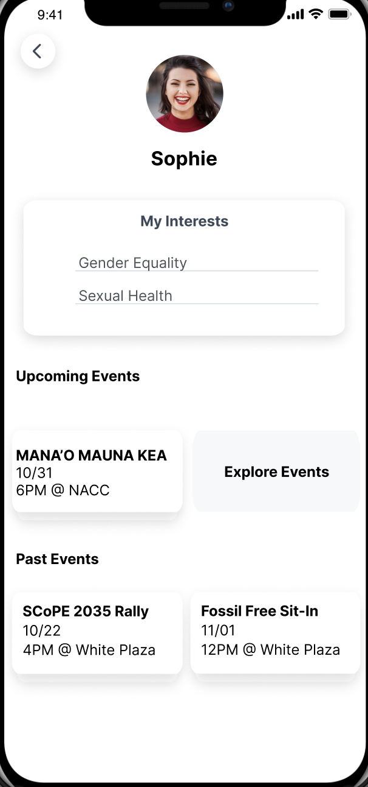
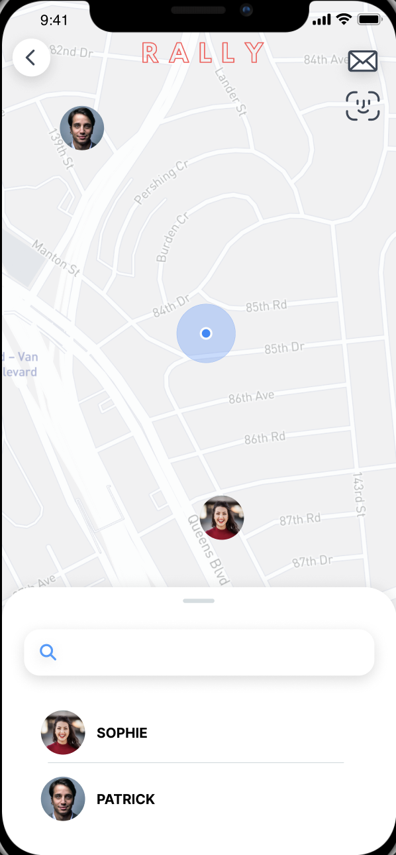
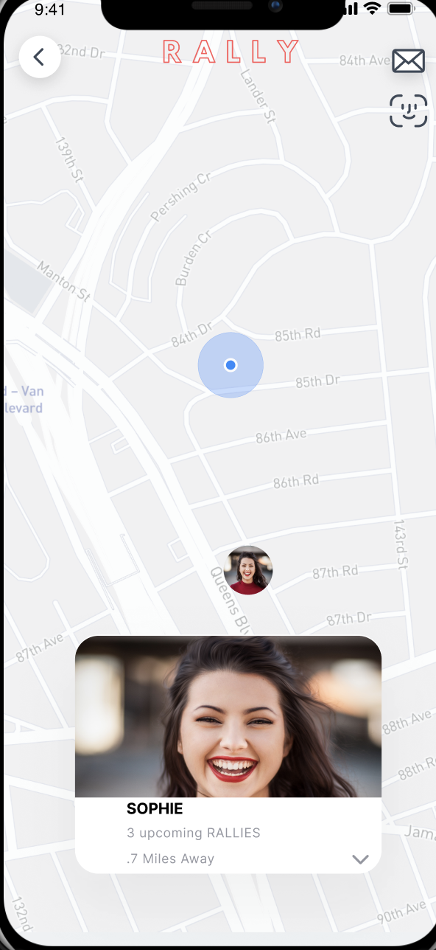
Task 2: Find friends & see their interested events → medium

Slide 17
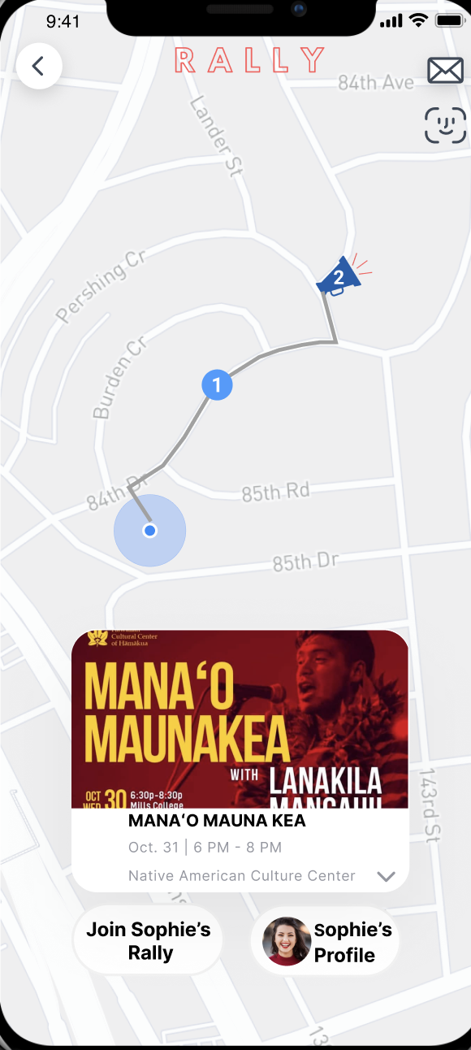
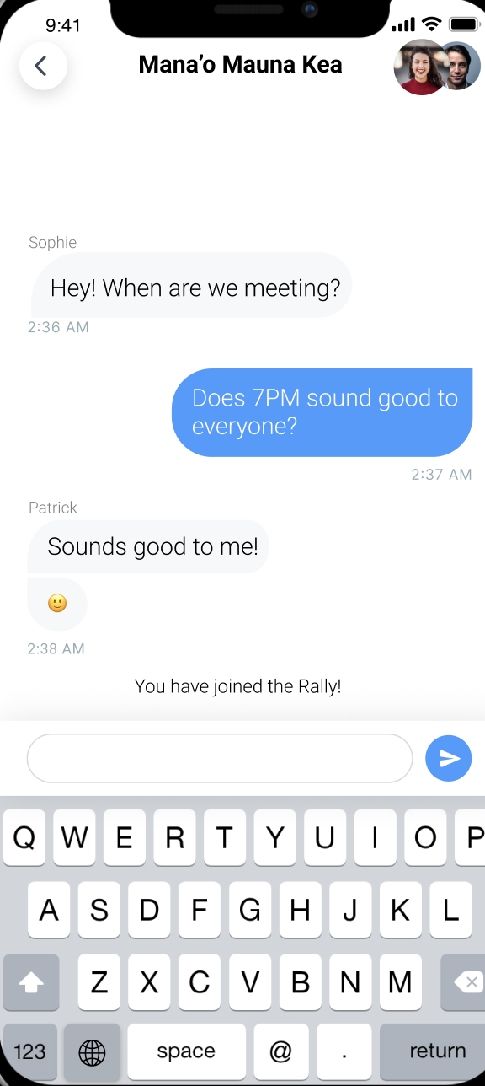
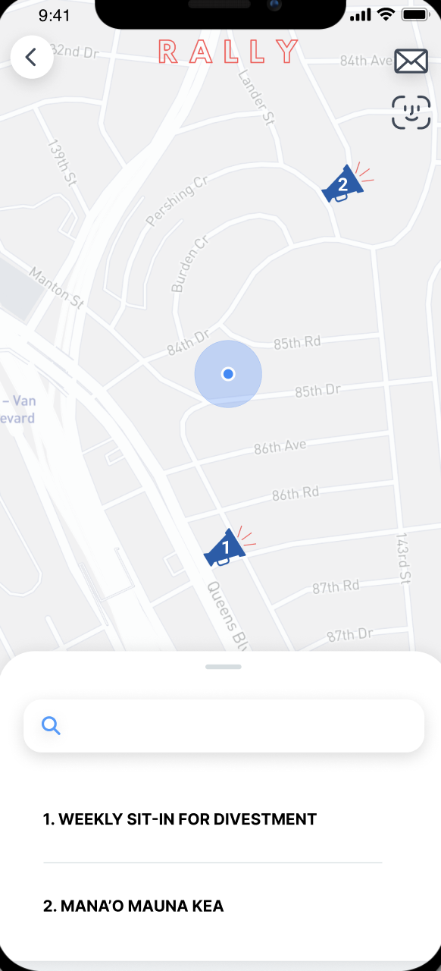
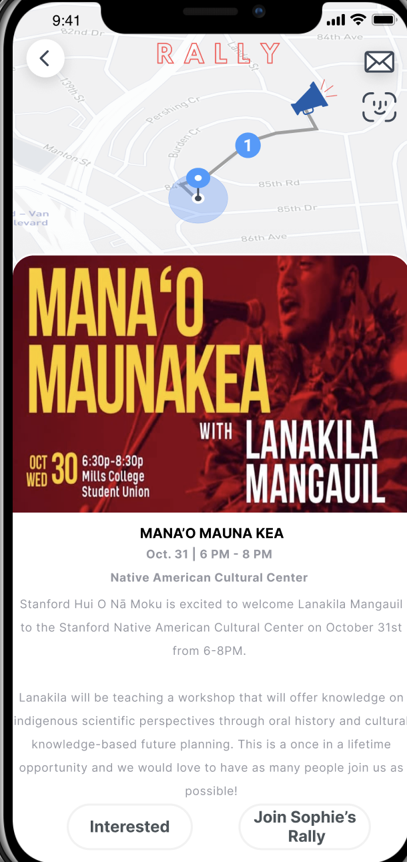
Task 3: Message friends in a rally
group chat → complex (flow 1)

Slide 18
Task 3: Message friends in a rally
group chat → complex (flow 2, pt. 1)

Slide 19
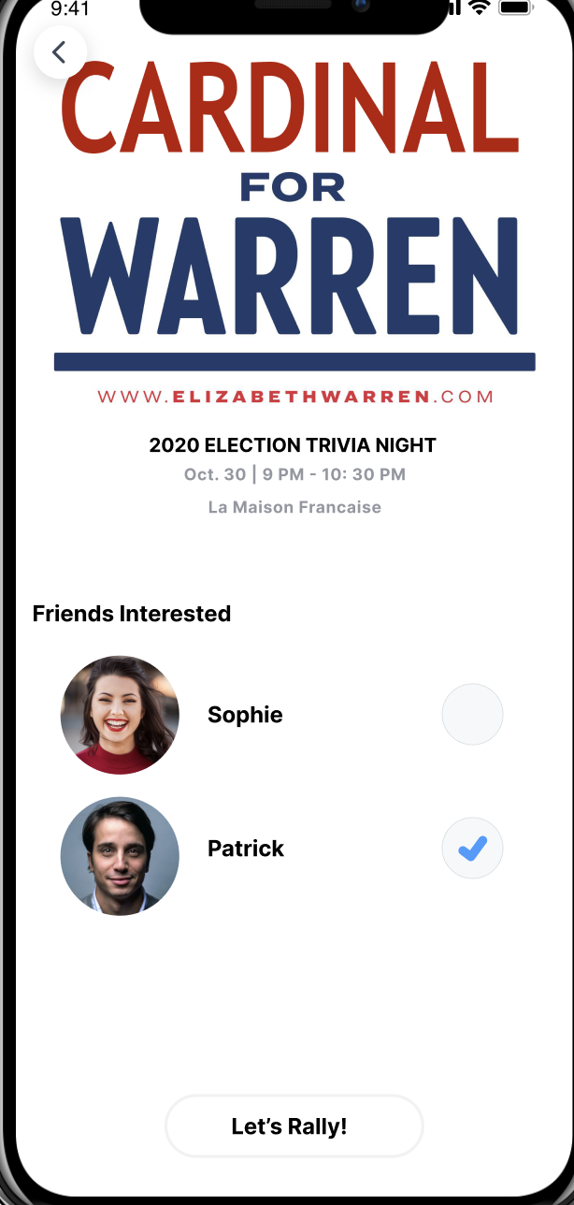
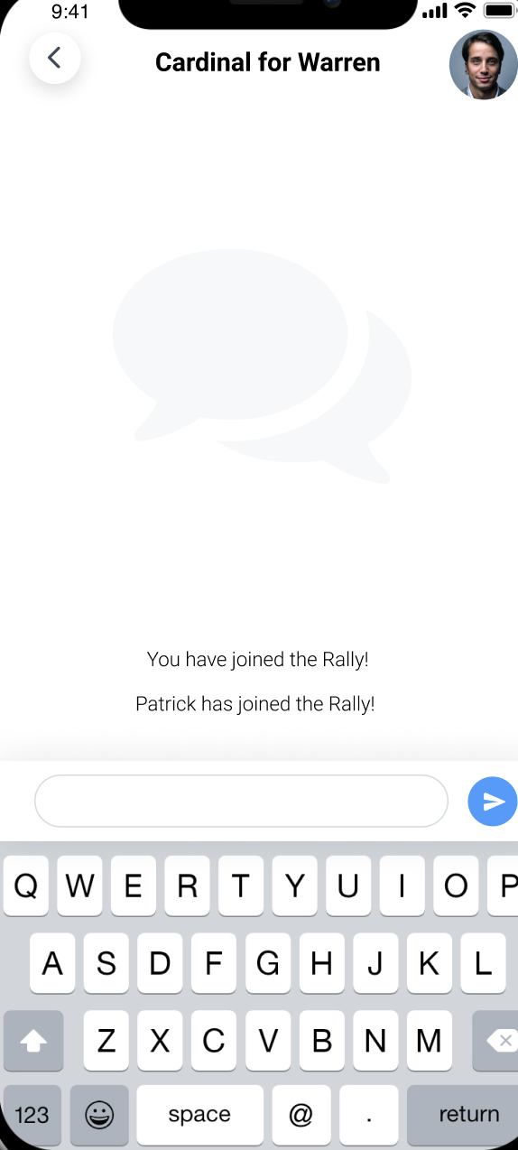
Task 3: Message friends in a rally
group chat → complex (flow 2, pt. 2)

Slide 20
Prototype Overview

Slide 21
Tools
Figma → design & prototyping tool
Many features, clean layout -- compatible with iPhones
Intuitive prototyping inerface
Building screens was finicky, didn’t copy and paste properly
Many different layers that are not explained
Figma Crush → free templates for Figma
Simple & easy to download

Slide 22
Limitations
Simplified gestures -- clicks instead of swipes (Figma limitations)
Search features not implemented (simplify task flow)
Changes not persistent -- no use of database
Did not include sign up, user onboarding, friend adding, profile creation, and settings (simplify task flow)

Slide 23
Wizard-of-Oz & Hard-Code
Wizard-of-Oz
none
Hard-Code
Pre-made events and locations
Pre-made friends/profiles
Pre-made rallies
Pre-made chats

Slide 24
Medium-Fi Prototype

Slide 25
Questions & Comments?

