Slide 1
Week 5: Low-fi Prototyping & Usability Testing
Peter C., Ryan C., Gabby R., Alyssa R.

Slide 2
Overview
Mission Statement + Value Proposition
Selected Interface
Low-fi Prototype
Experiment
Method
Results
UI Changes
Summary
Notes:
Today, im first going to discuss Rally’s goals. Then, I’ll talk about process by which we envisioned how Rally can achieve these goals through its user interface, and how we came to the final low-fi prototype. I will also discuss how user testing went and what changes we will implement to make Rally better!

Slide 3
Mission Statement
We want to make civic engagement accessible, easy, and community-based.
Notes:
Rally’s Mission Statement →

Slide 4
Value Proposition
Your one stop shop for civic engagement — find events, friends, and transportation.
Notes:
Rally’s Value Proposition

Slide 5
Selected Interface

Slide 6
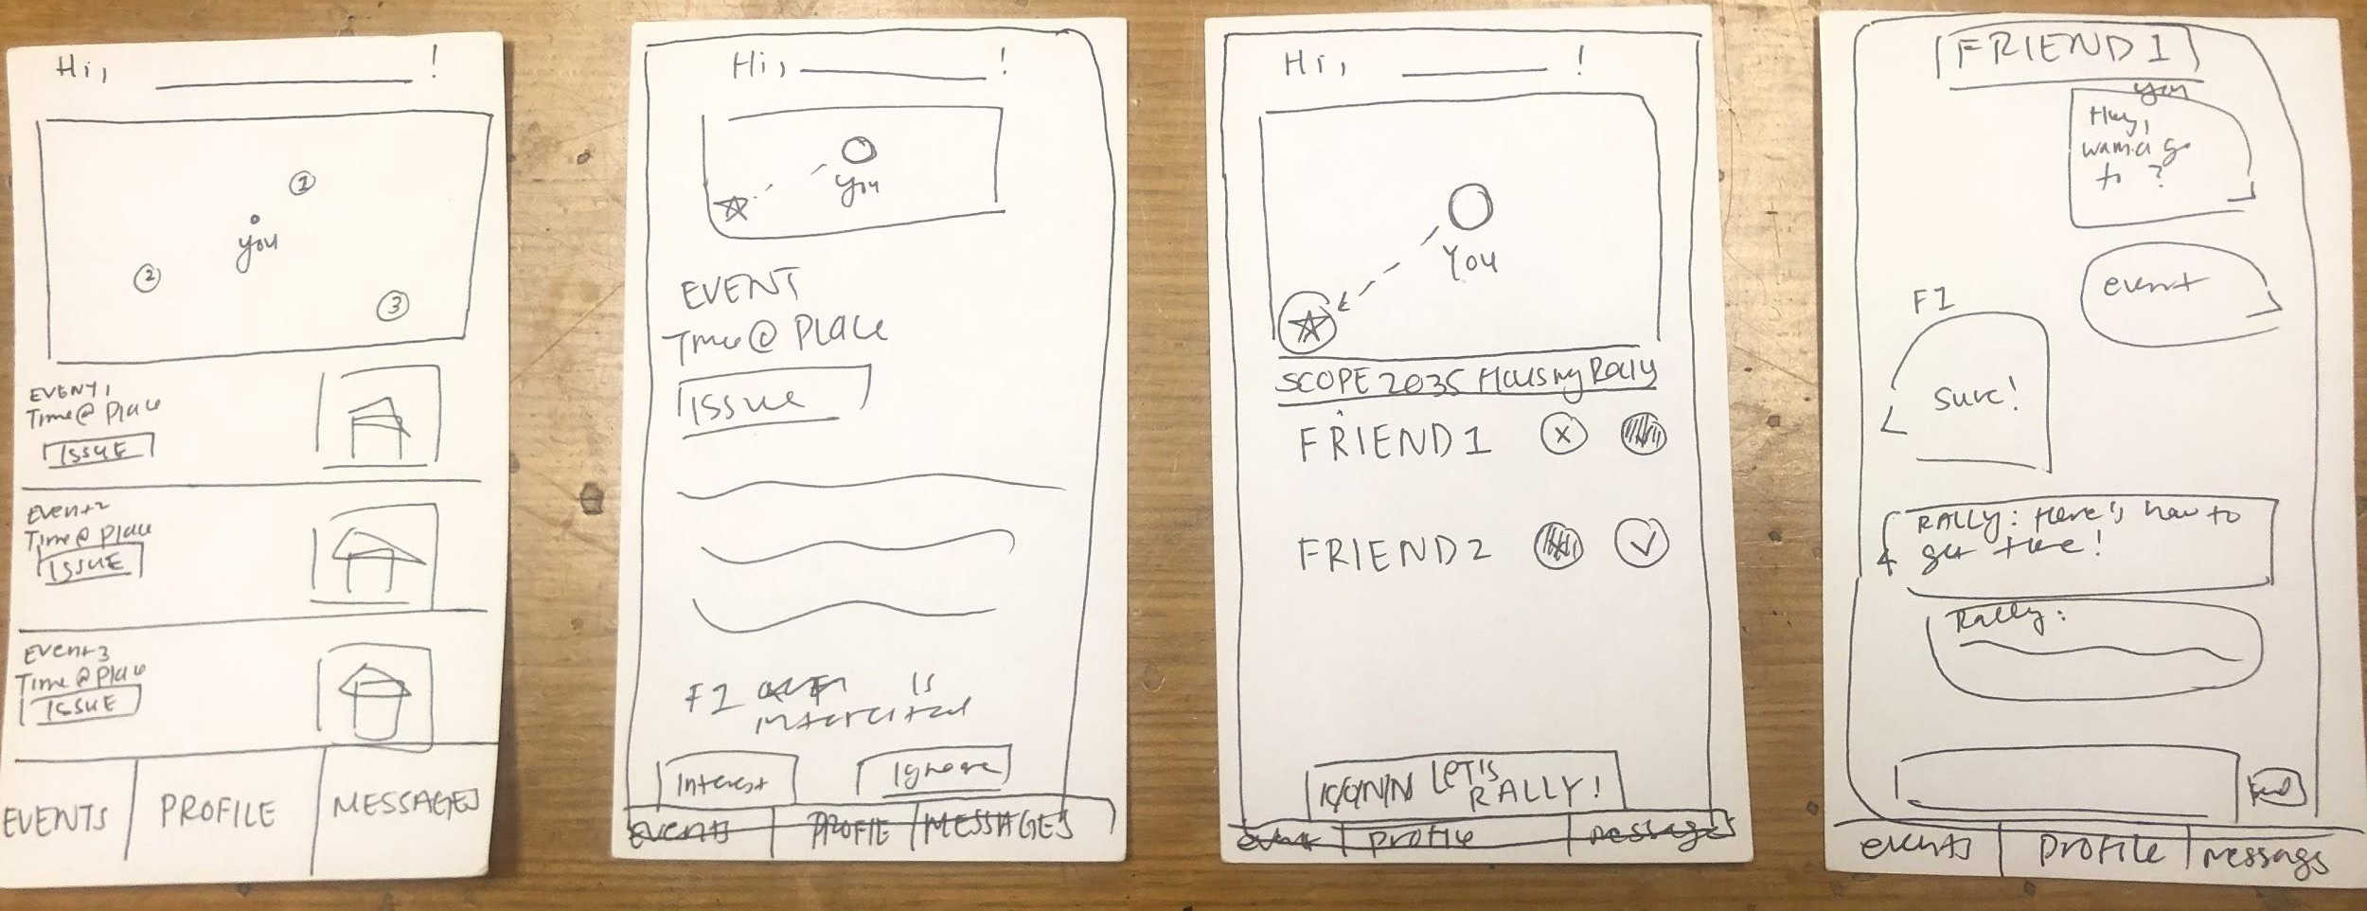
Selected Interface
Yelp-esque Design
Relevant tags
Map to visualize locations

Slide 7
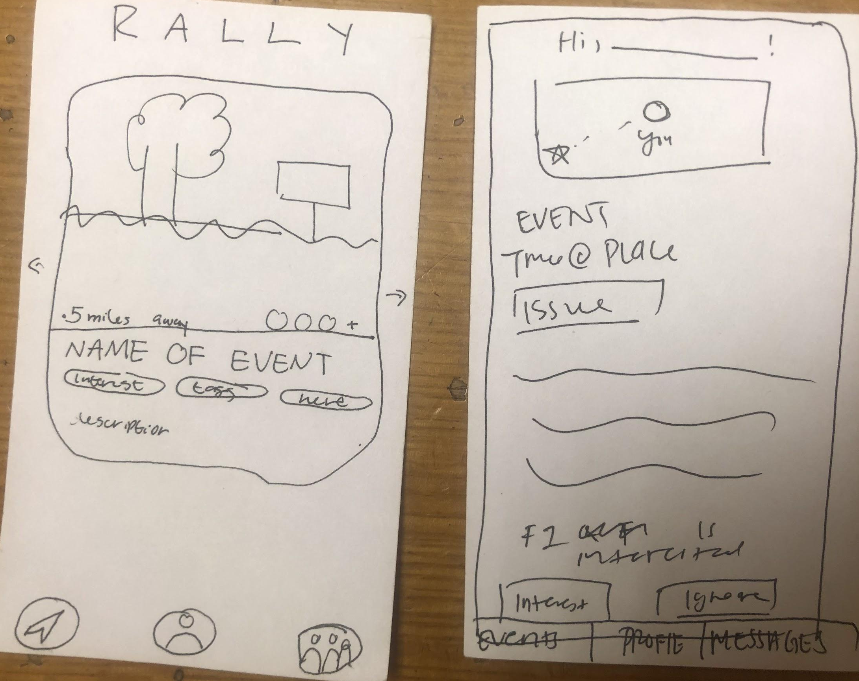
Selected Interface
Yelp-esque Design
Relevant tags
Map to visualize locations
Tinder-esque Design
Personalized events
Swipe gesture

Slide 8
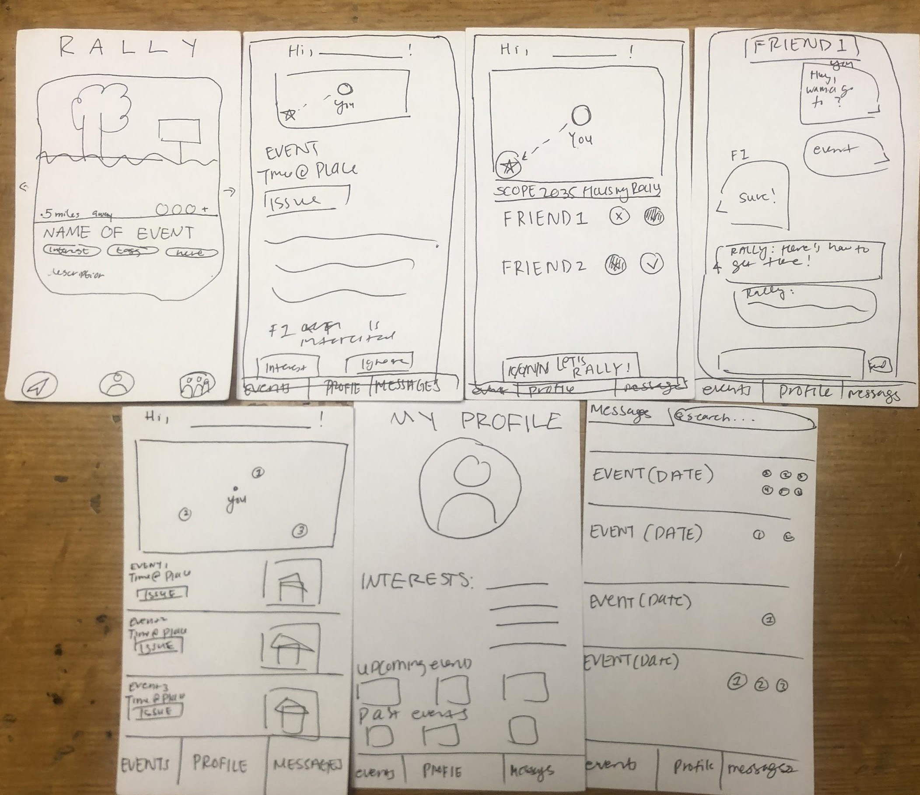
Selected Interface
A/B Tested during Prototyping
Tinder-esque design Home screen
Rotational cards
Yelp-esque Find Events screen

Slide 9
Low-fi Prototype

Slide 10
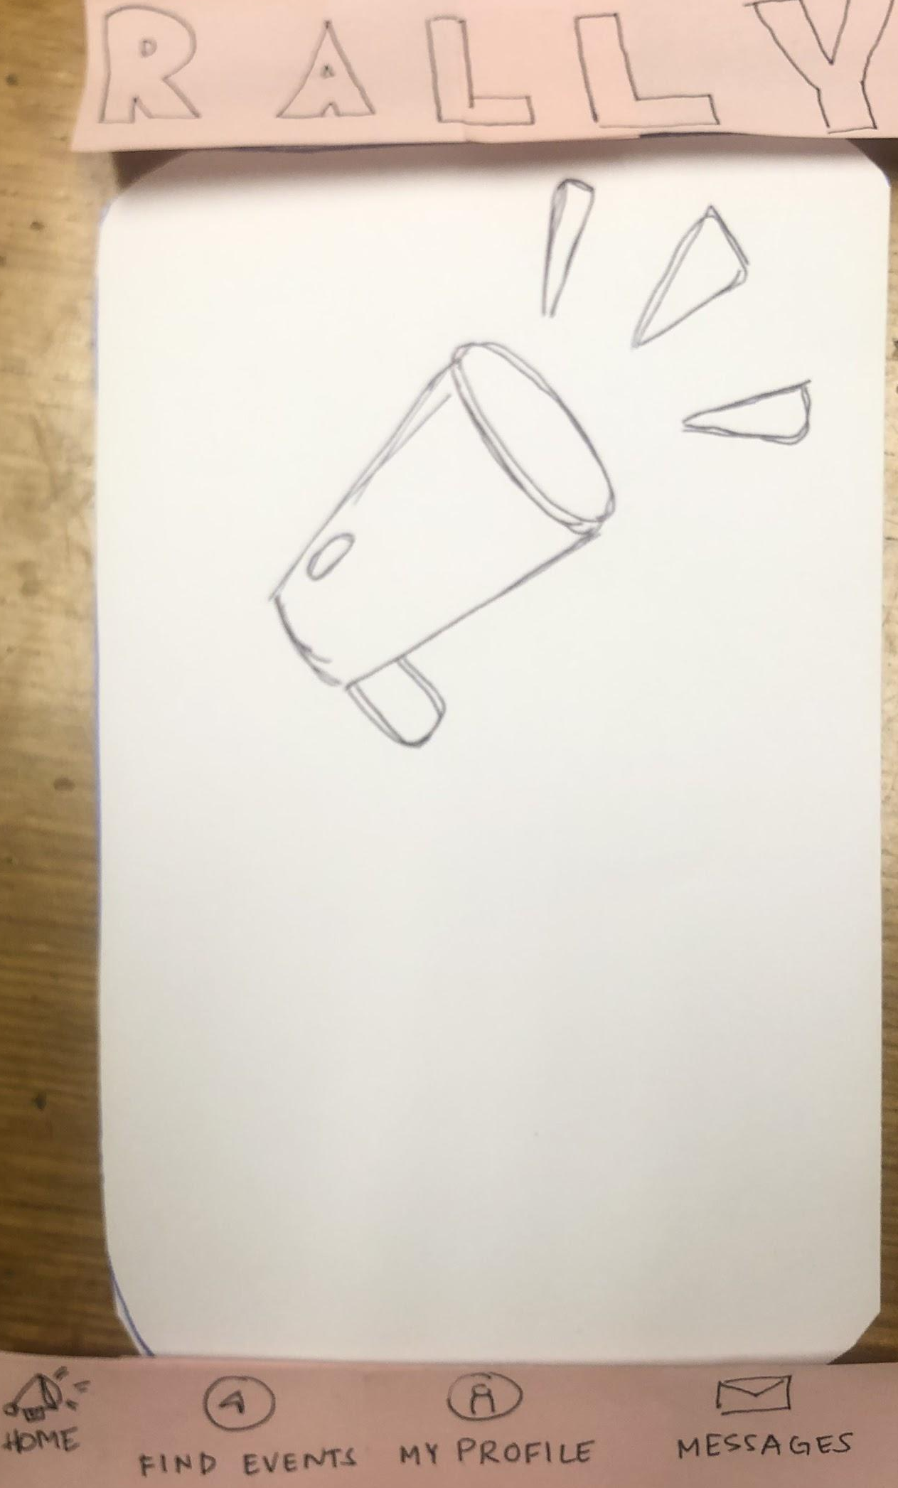
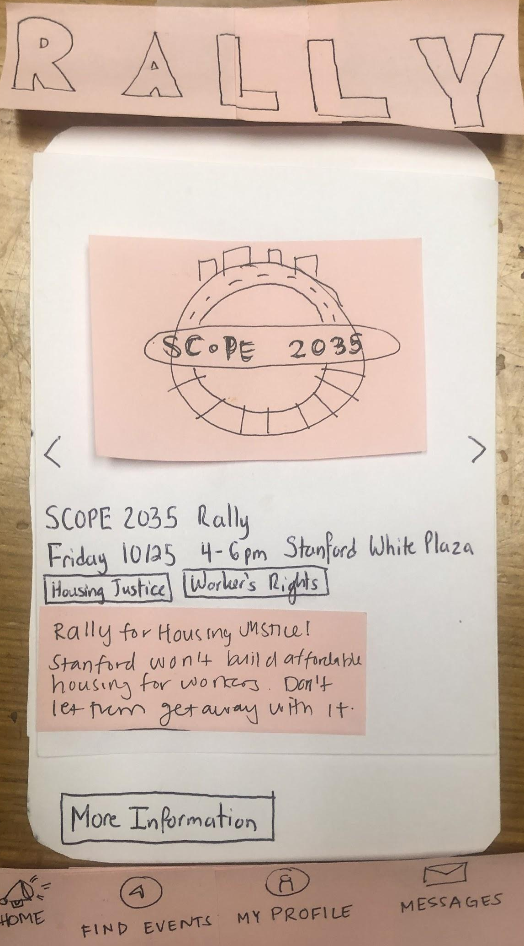
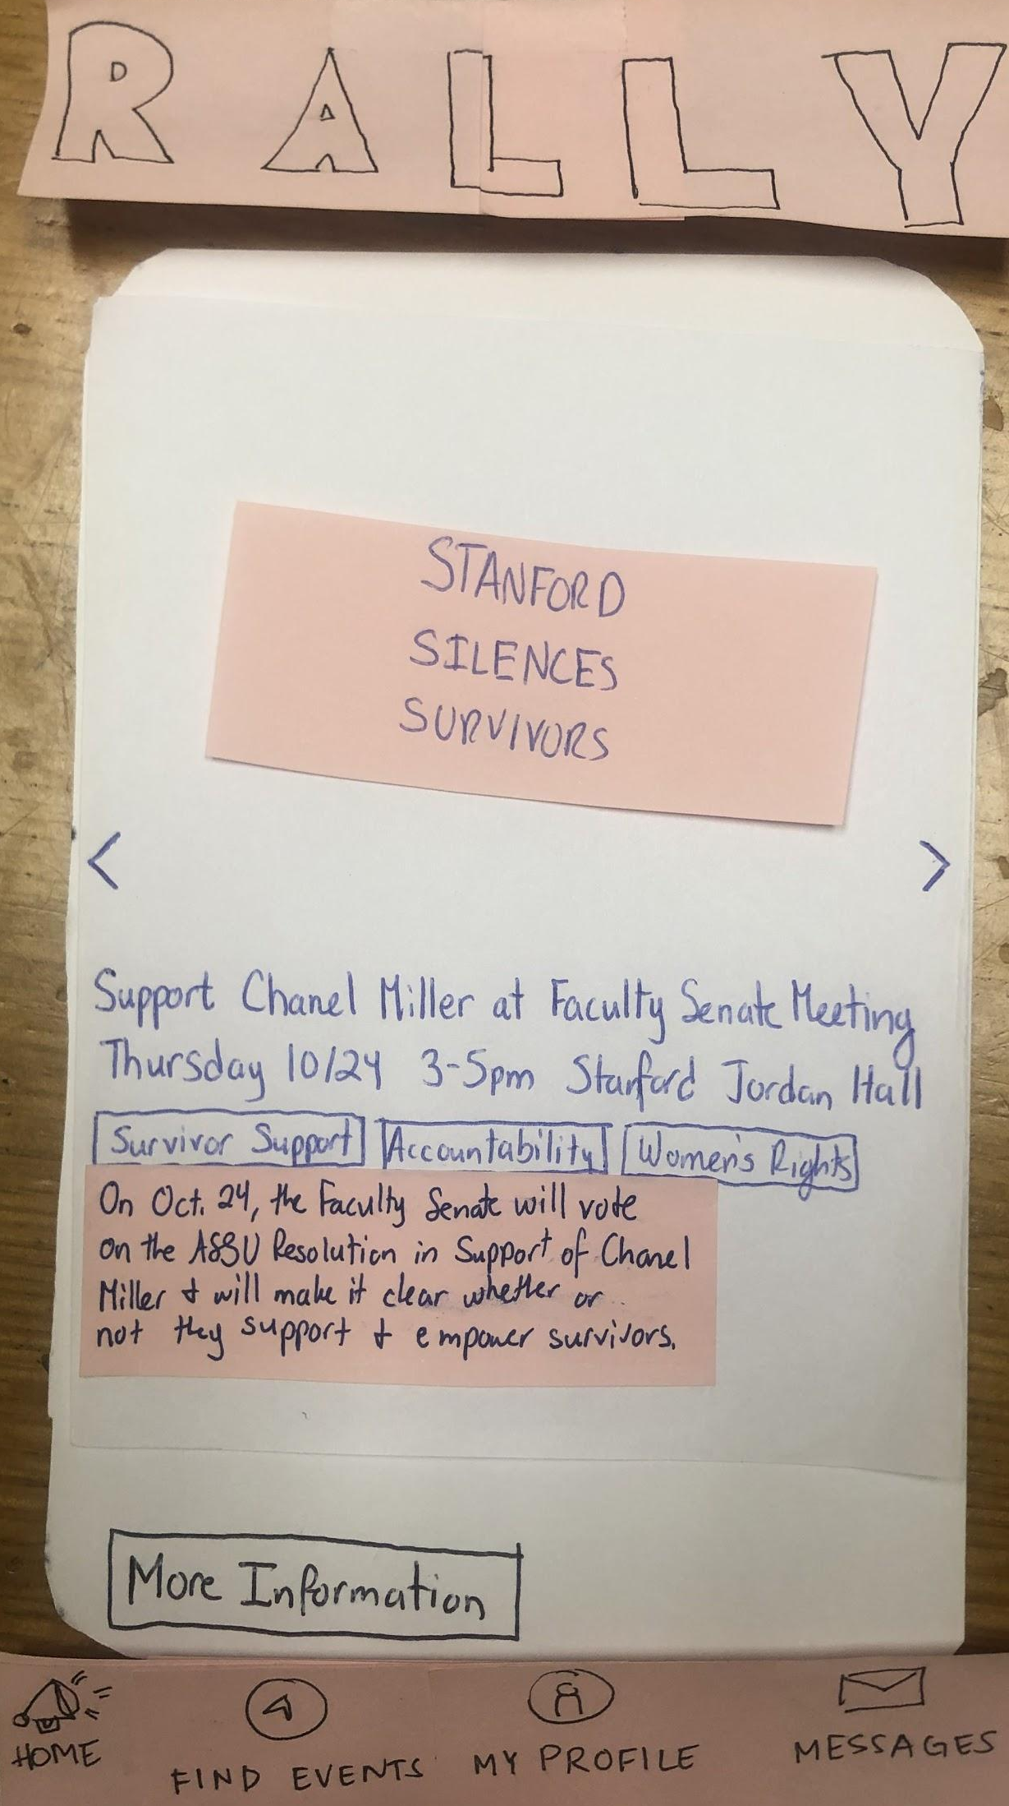
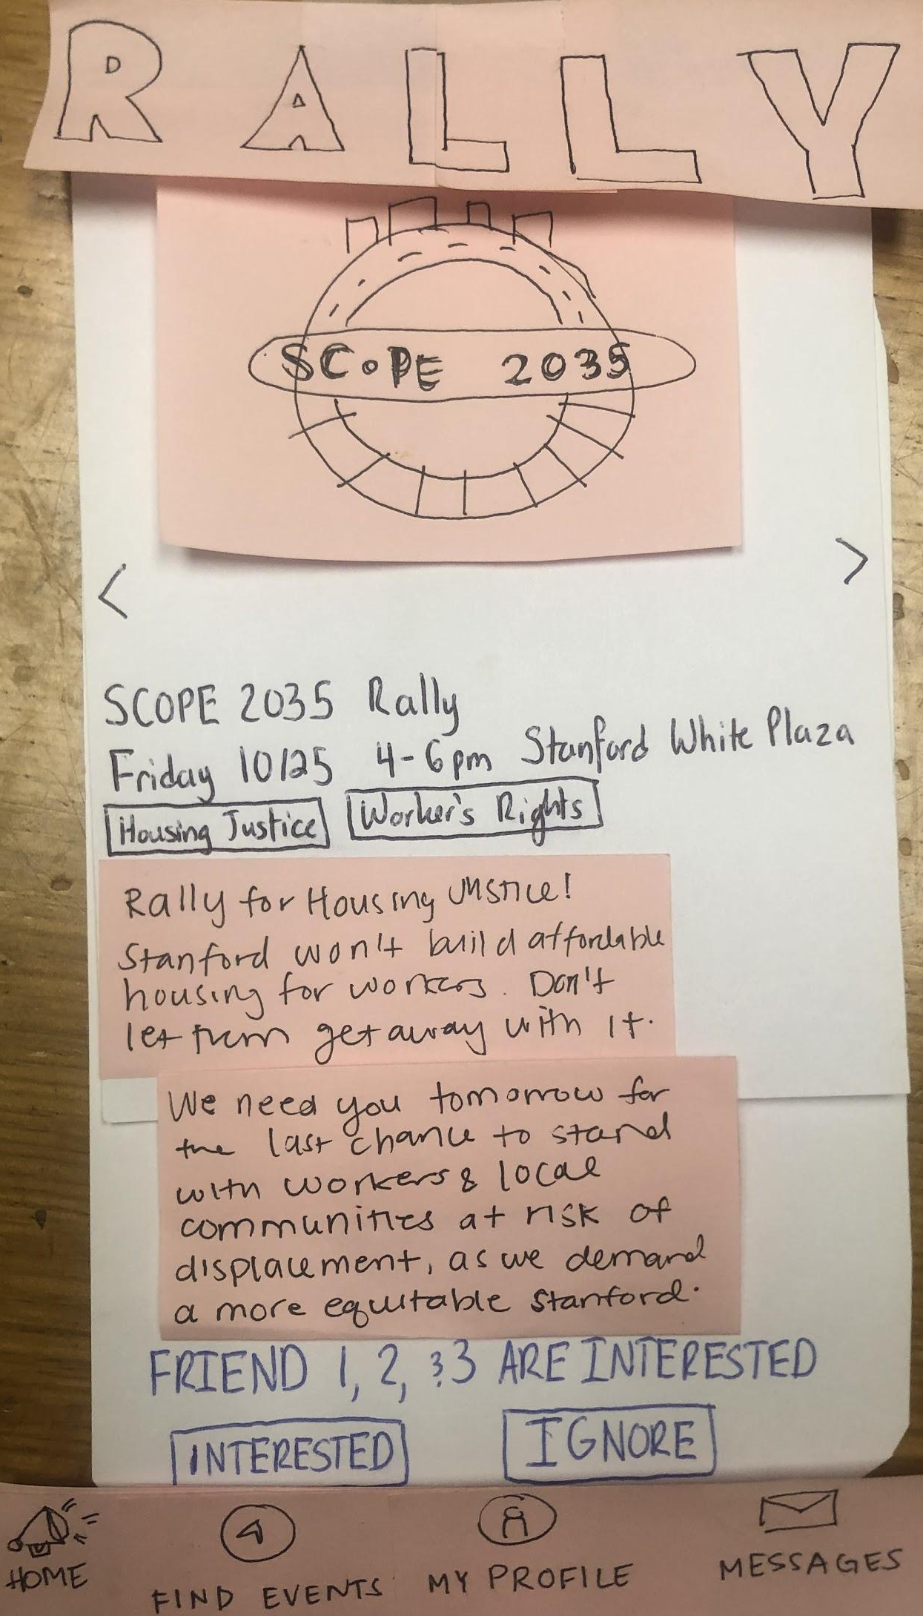
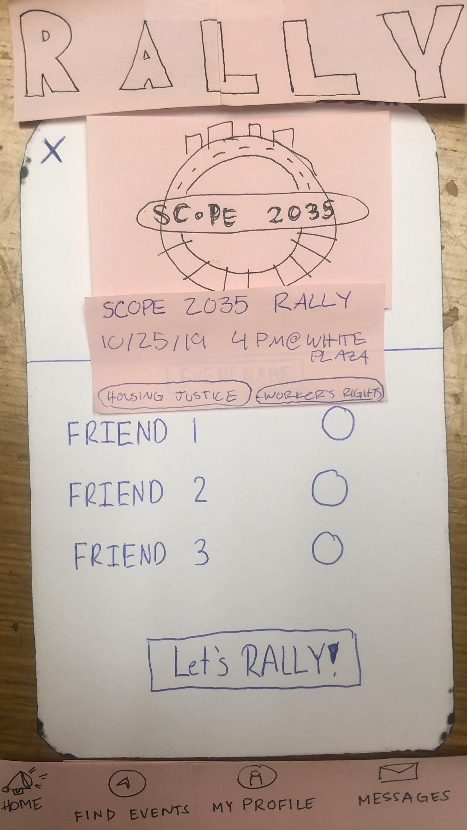
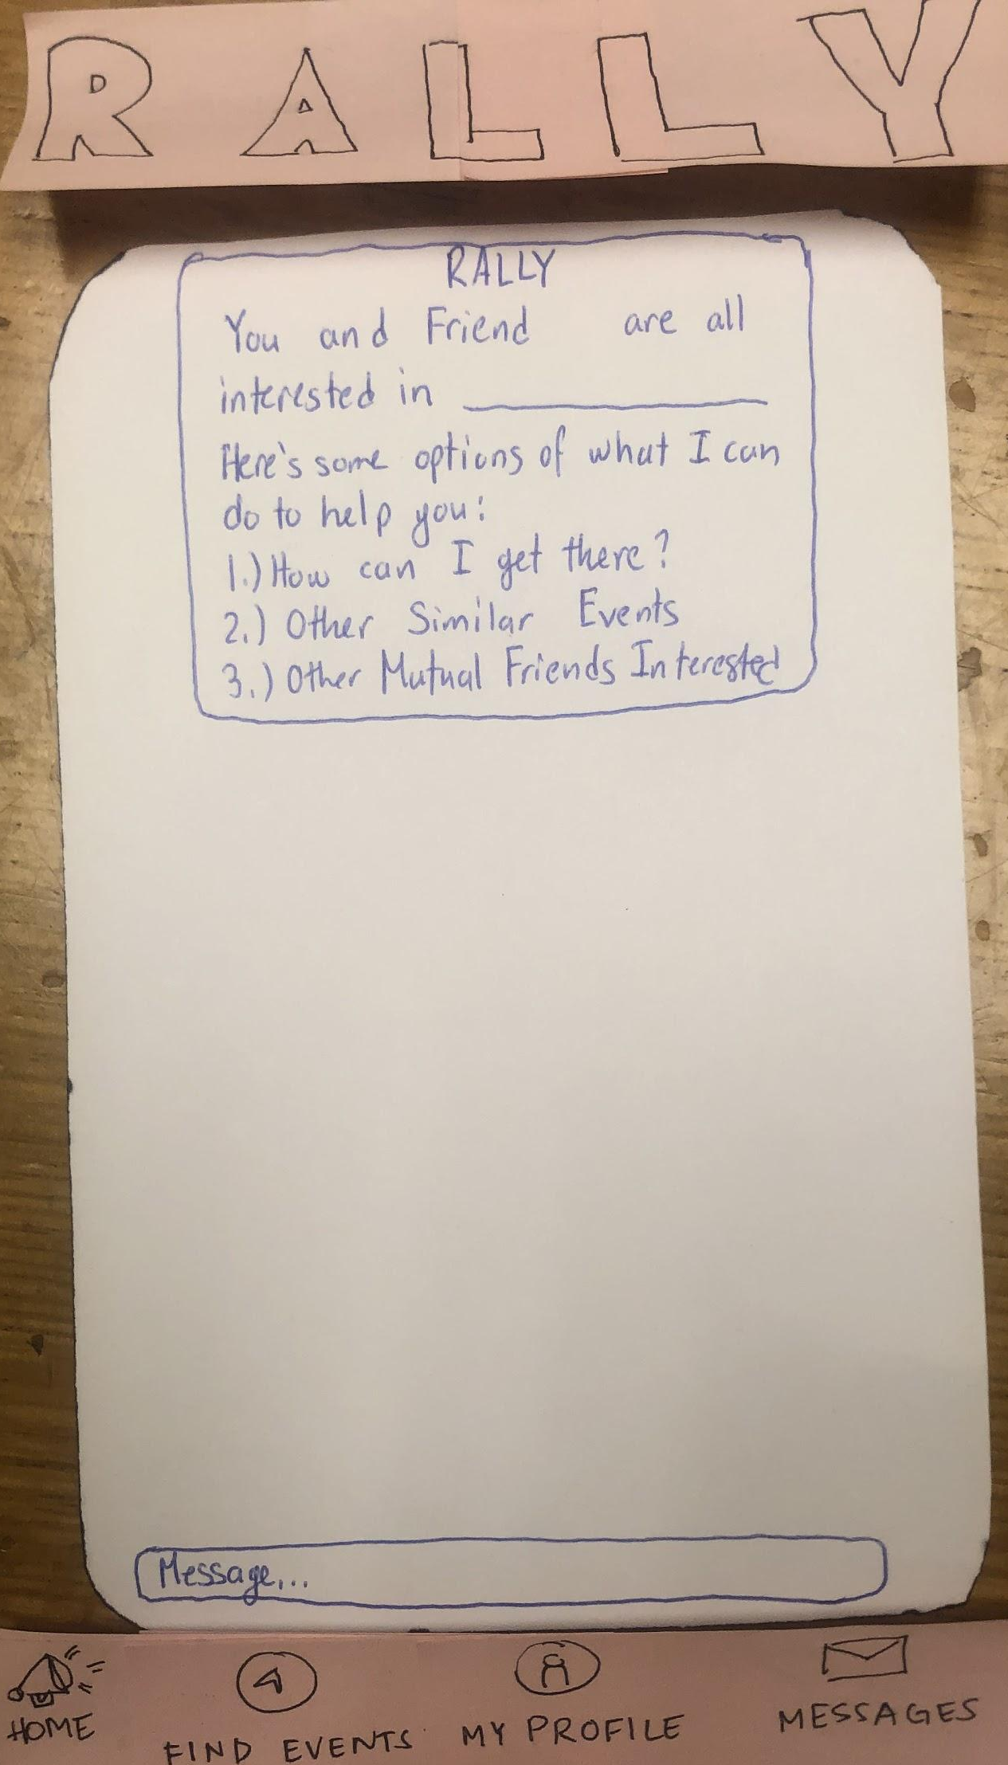
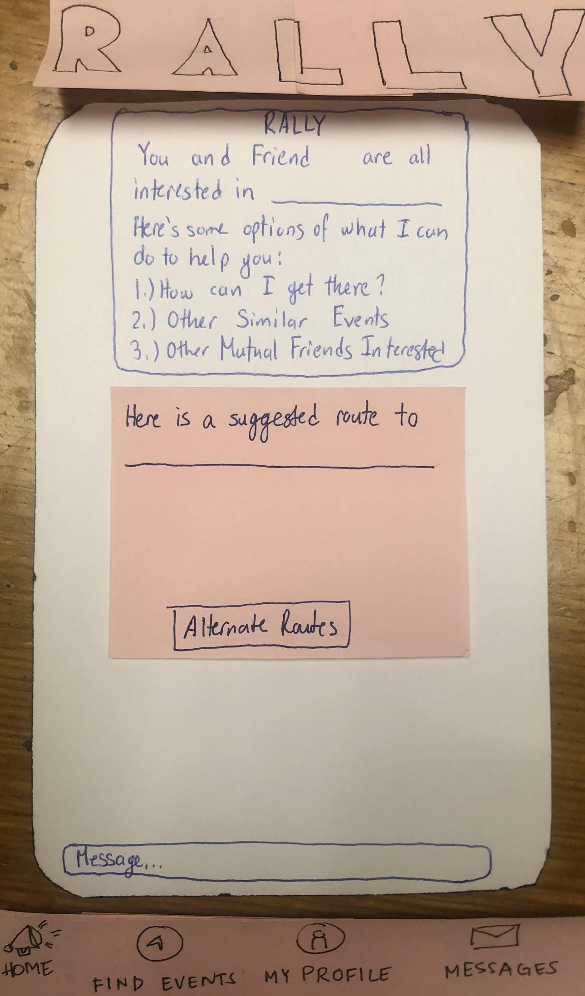
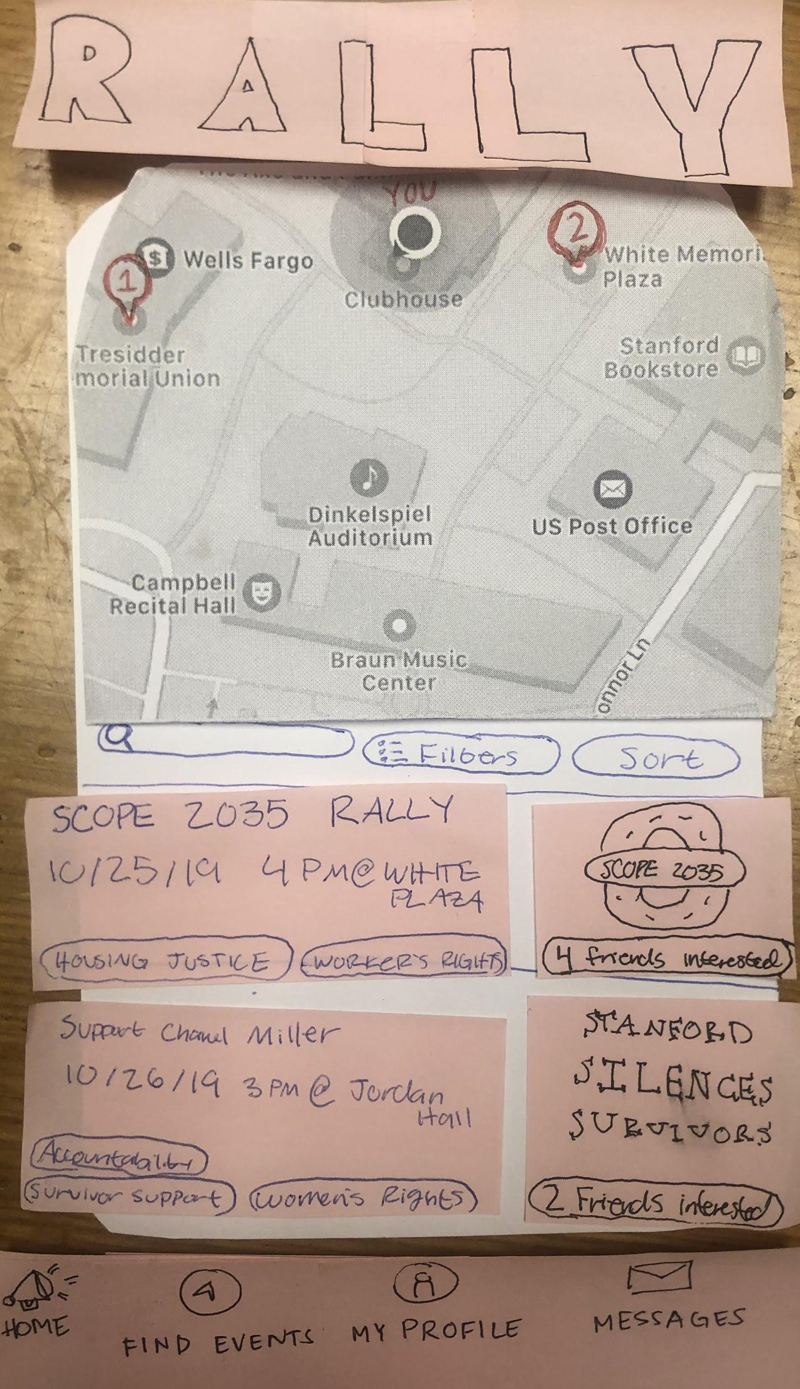
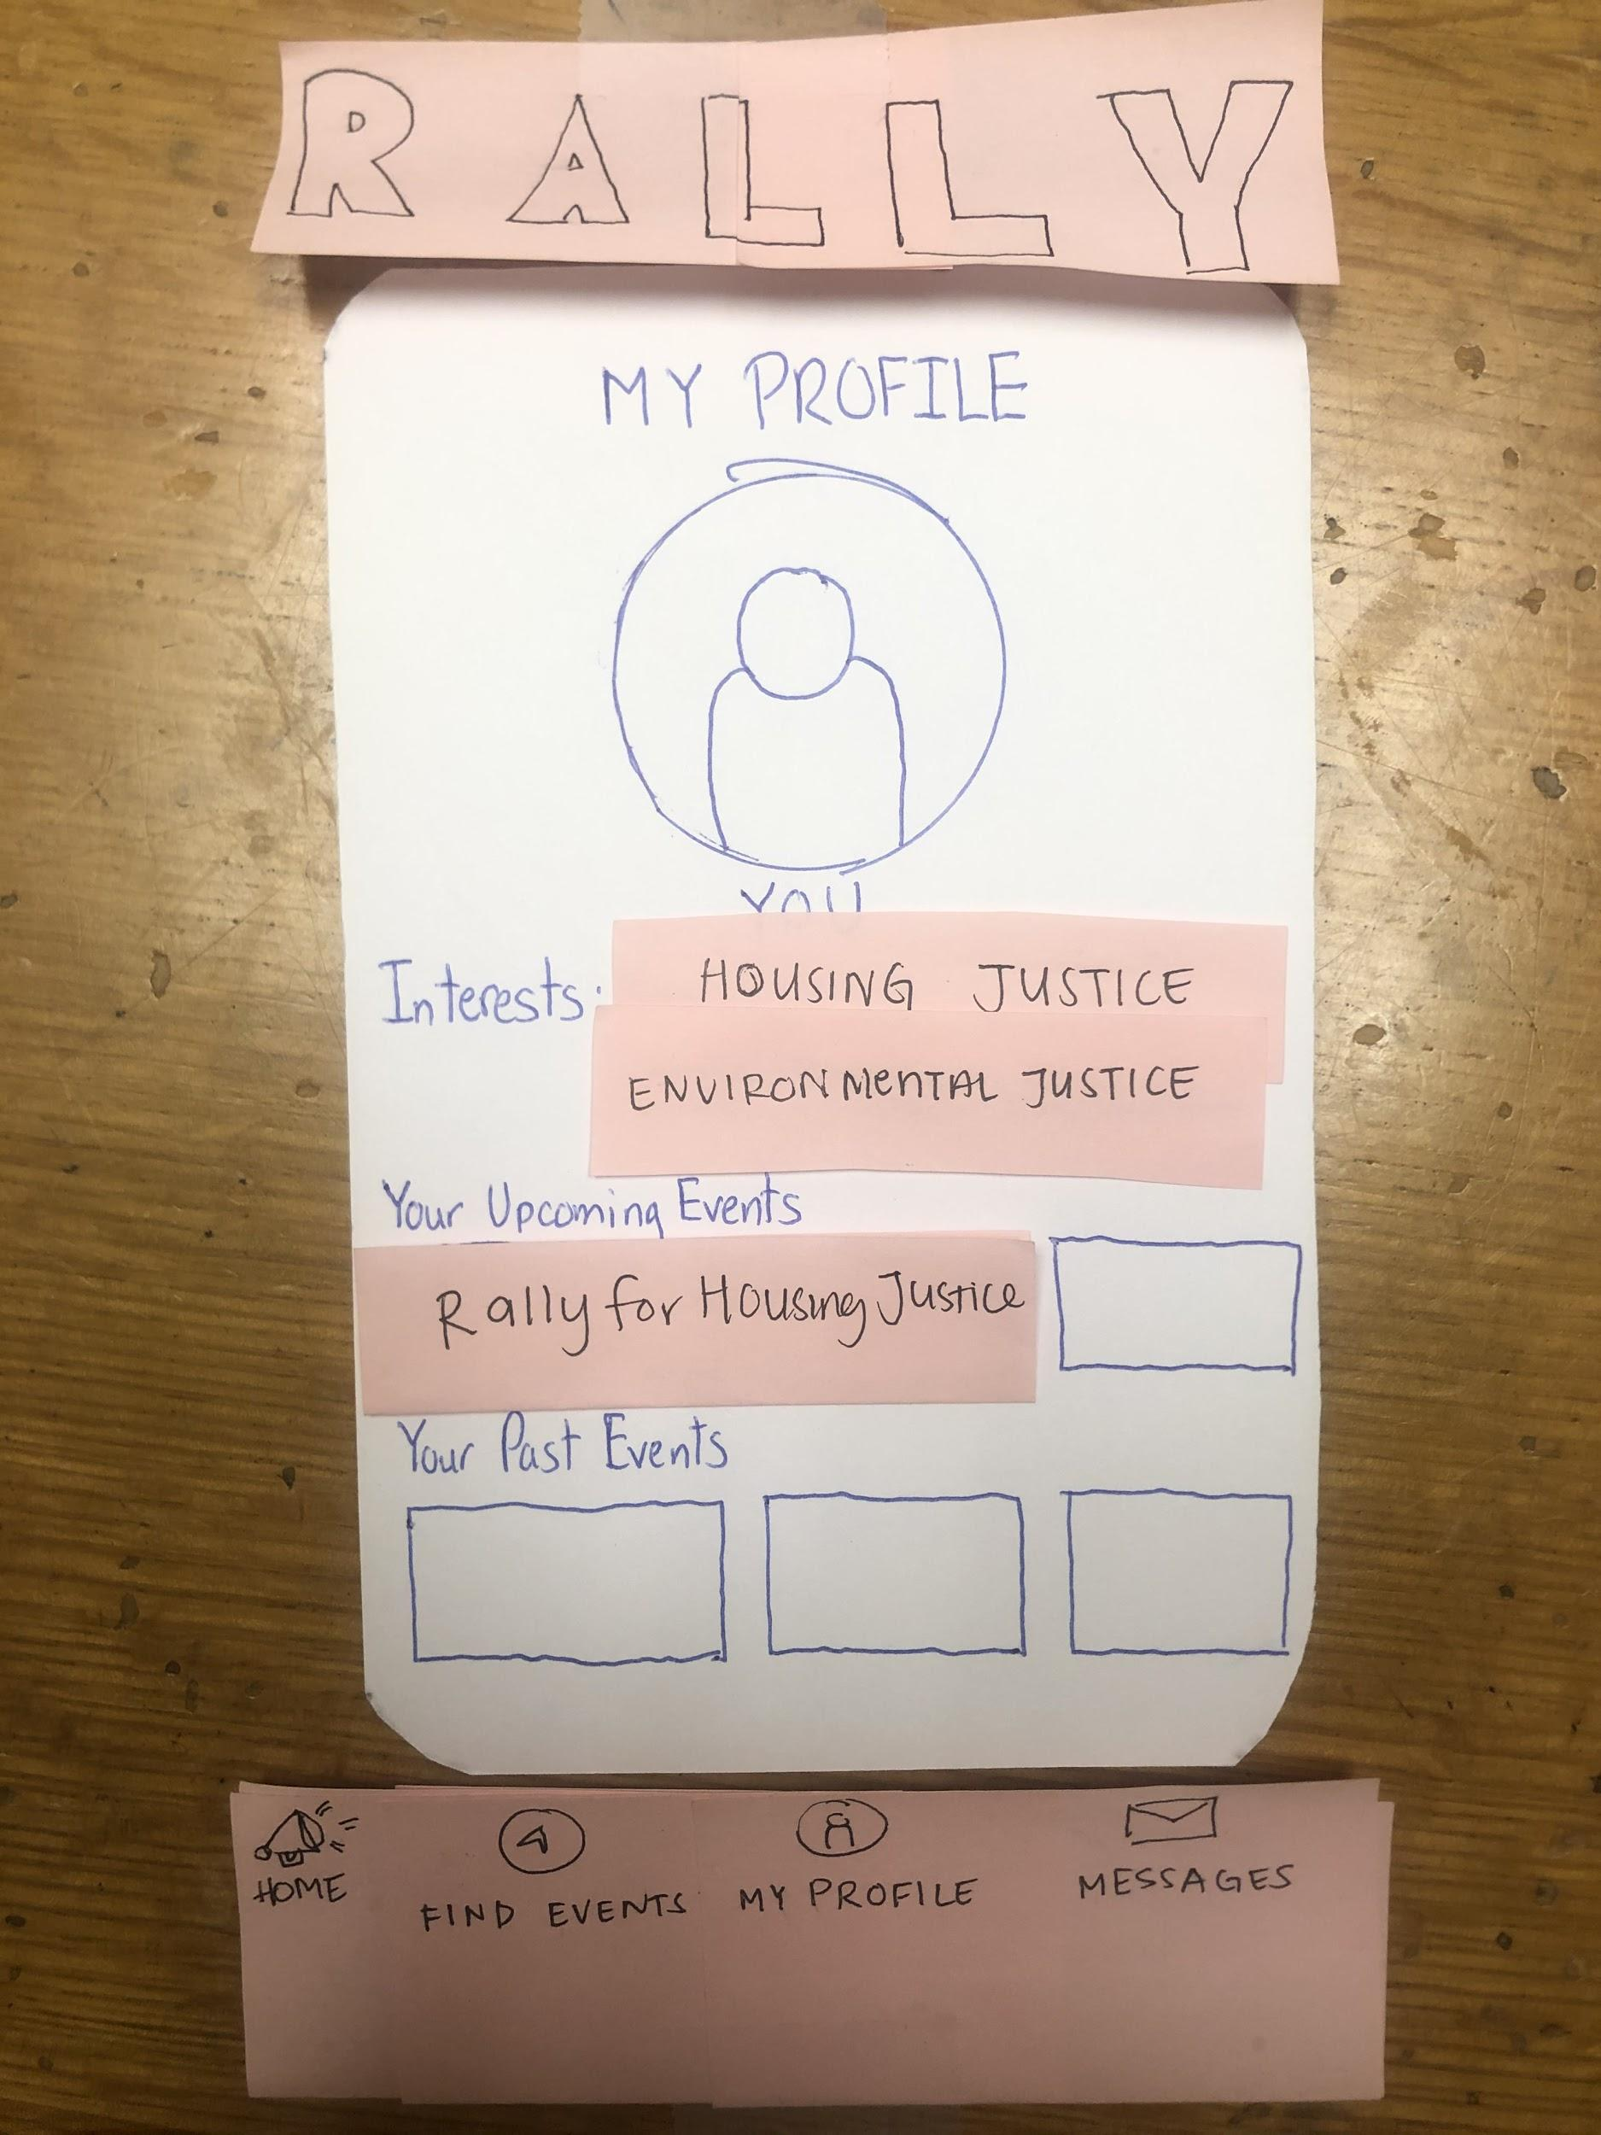
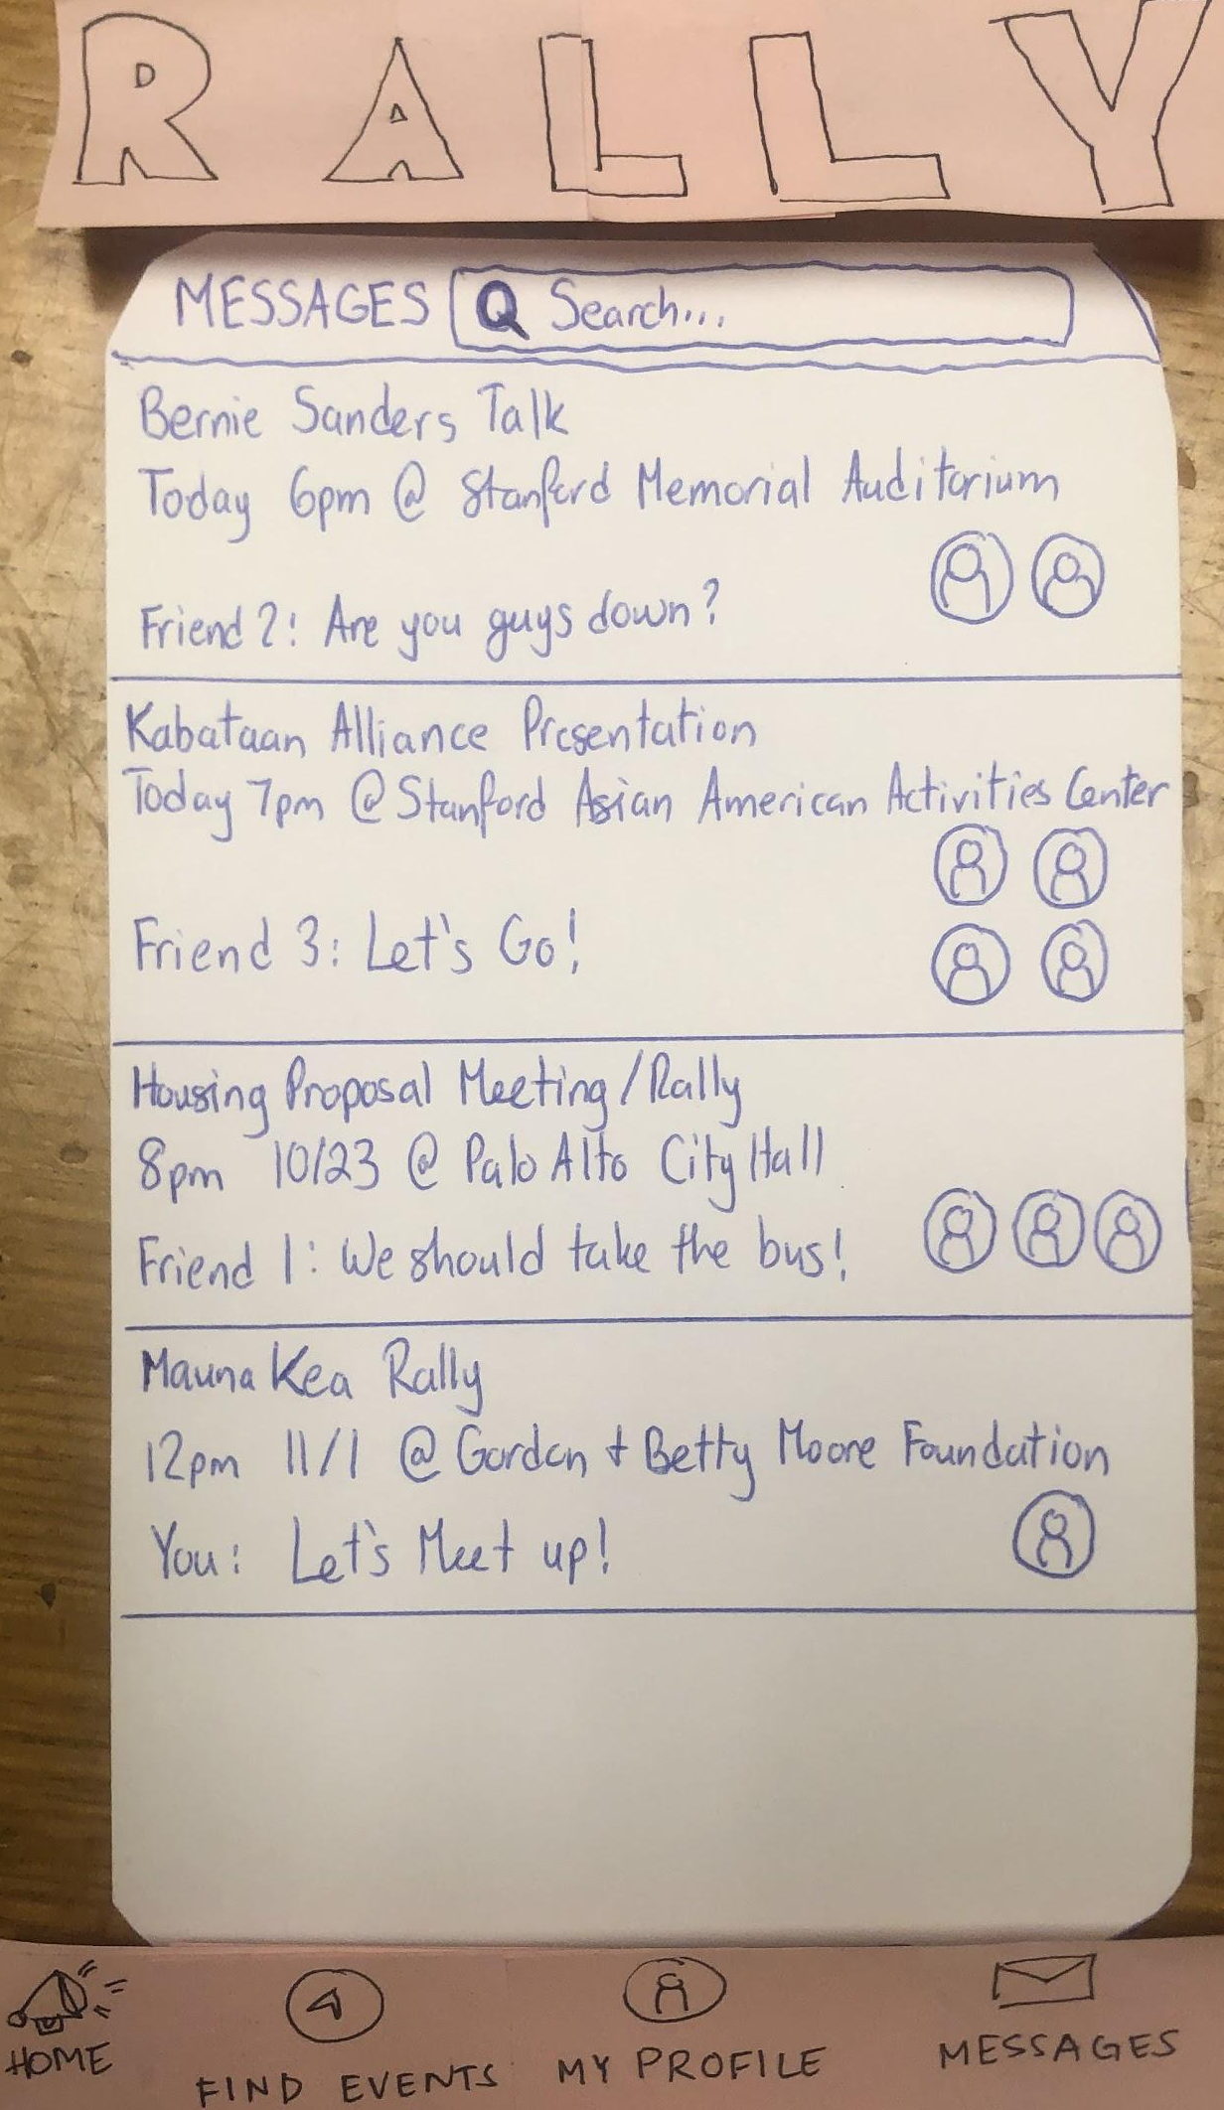
All Screens

Slide 11
Home Screen

Slide 12
Task 1: Find an event (flow 1)

Slide 13
Task 1: Find an event (flow 2)

Slide 14
Task 2: Find friends interested in same event

Slide 15
Task 3: Message friends & coordinate transportation (flow 1)

Slide 16
Task 3: Message friends & coordinate transportation (flow 2)

Slide 17
Experiment:
Methods & Results

Slide 18
Young woman working at Starbucks
Method
Female post-doc working at Joe & the Juice
21-year old student
Tested @ Stanford Shopping Center
3 Tasks
Noted successes & errors
Roles
Alyssa Ryan Gabby & Peter

Slide 19
Results
Successes
→ UI familiar/intuitive
→ Home screen to explore events
→ Users enjoyed friend-related features
Errors
→ Group creation & friend selection unclear
→ Confusing messaging system
→ No option to be interested in event without contacting friends

Slide 20
UI Changes

Slide 21
UI Changes
Implement features we left out
Clickable filters
Profile → Interests, Upcoming Events & Past Events
Clarify the messaging system
Make friend profiles viewable
Allow for event interest without contacting friends

Slide 22
Summary

Slide 23
Summary
→ Users found UI intuitive
→ Users wanted to continue searching for events
→ Users wanted to look into their friend’s events and profiles
→ We need to vastly improve the messaging system & Rally Bot

Slide 24
Questions & Comments?

