Slide 1
Week 9: Hi-Fi Midway Check-in
Peter C., Ryan C., Gabby R., Alyssa R.

Slide 2
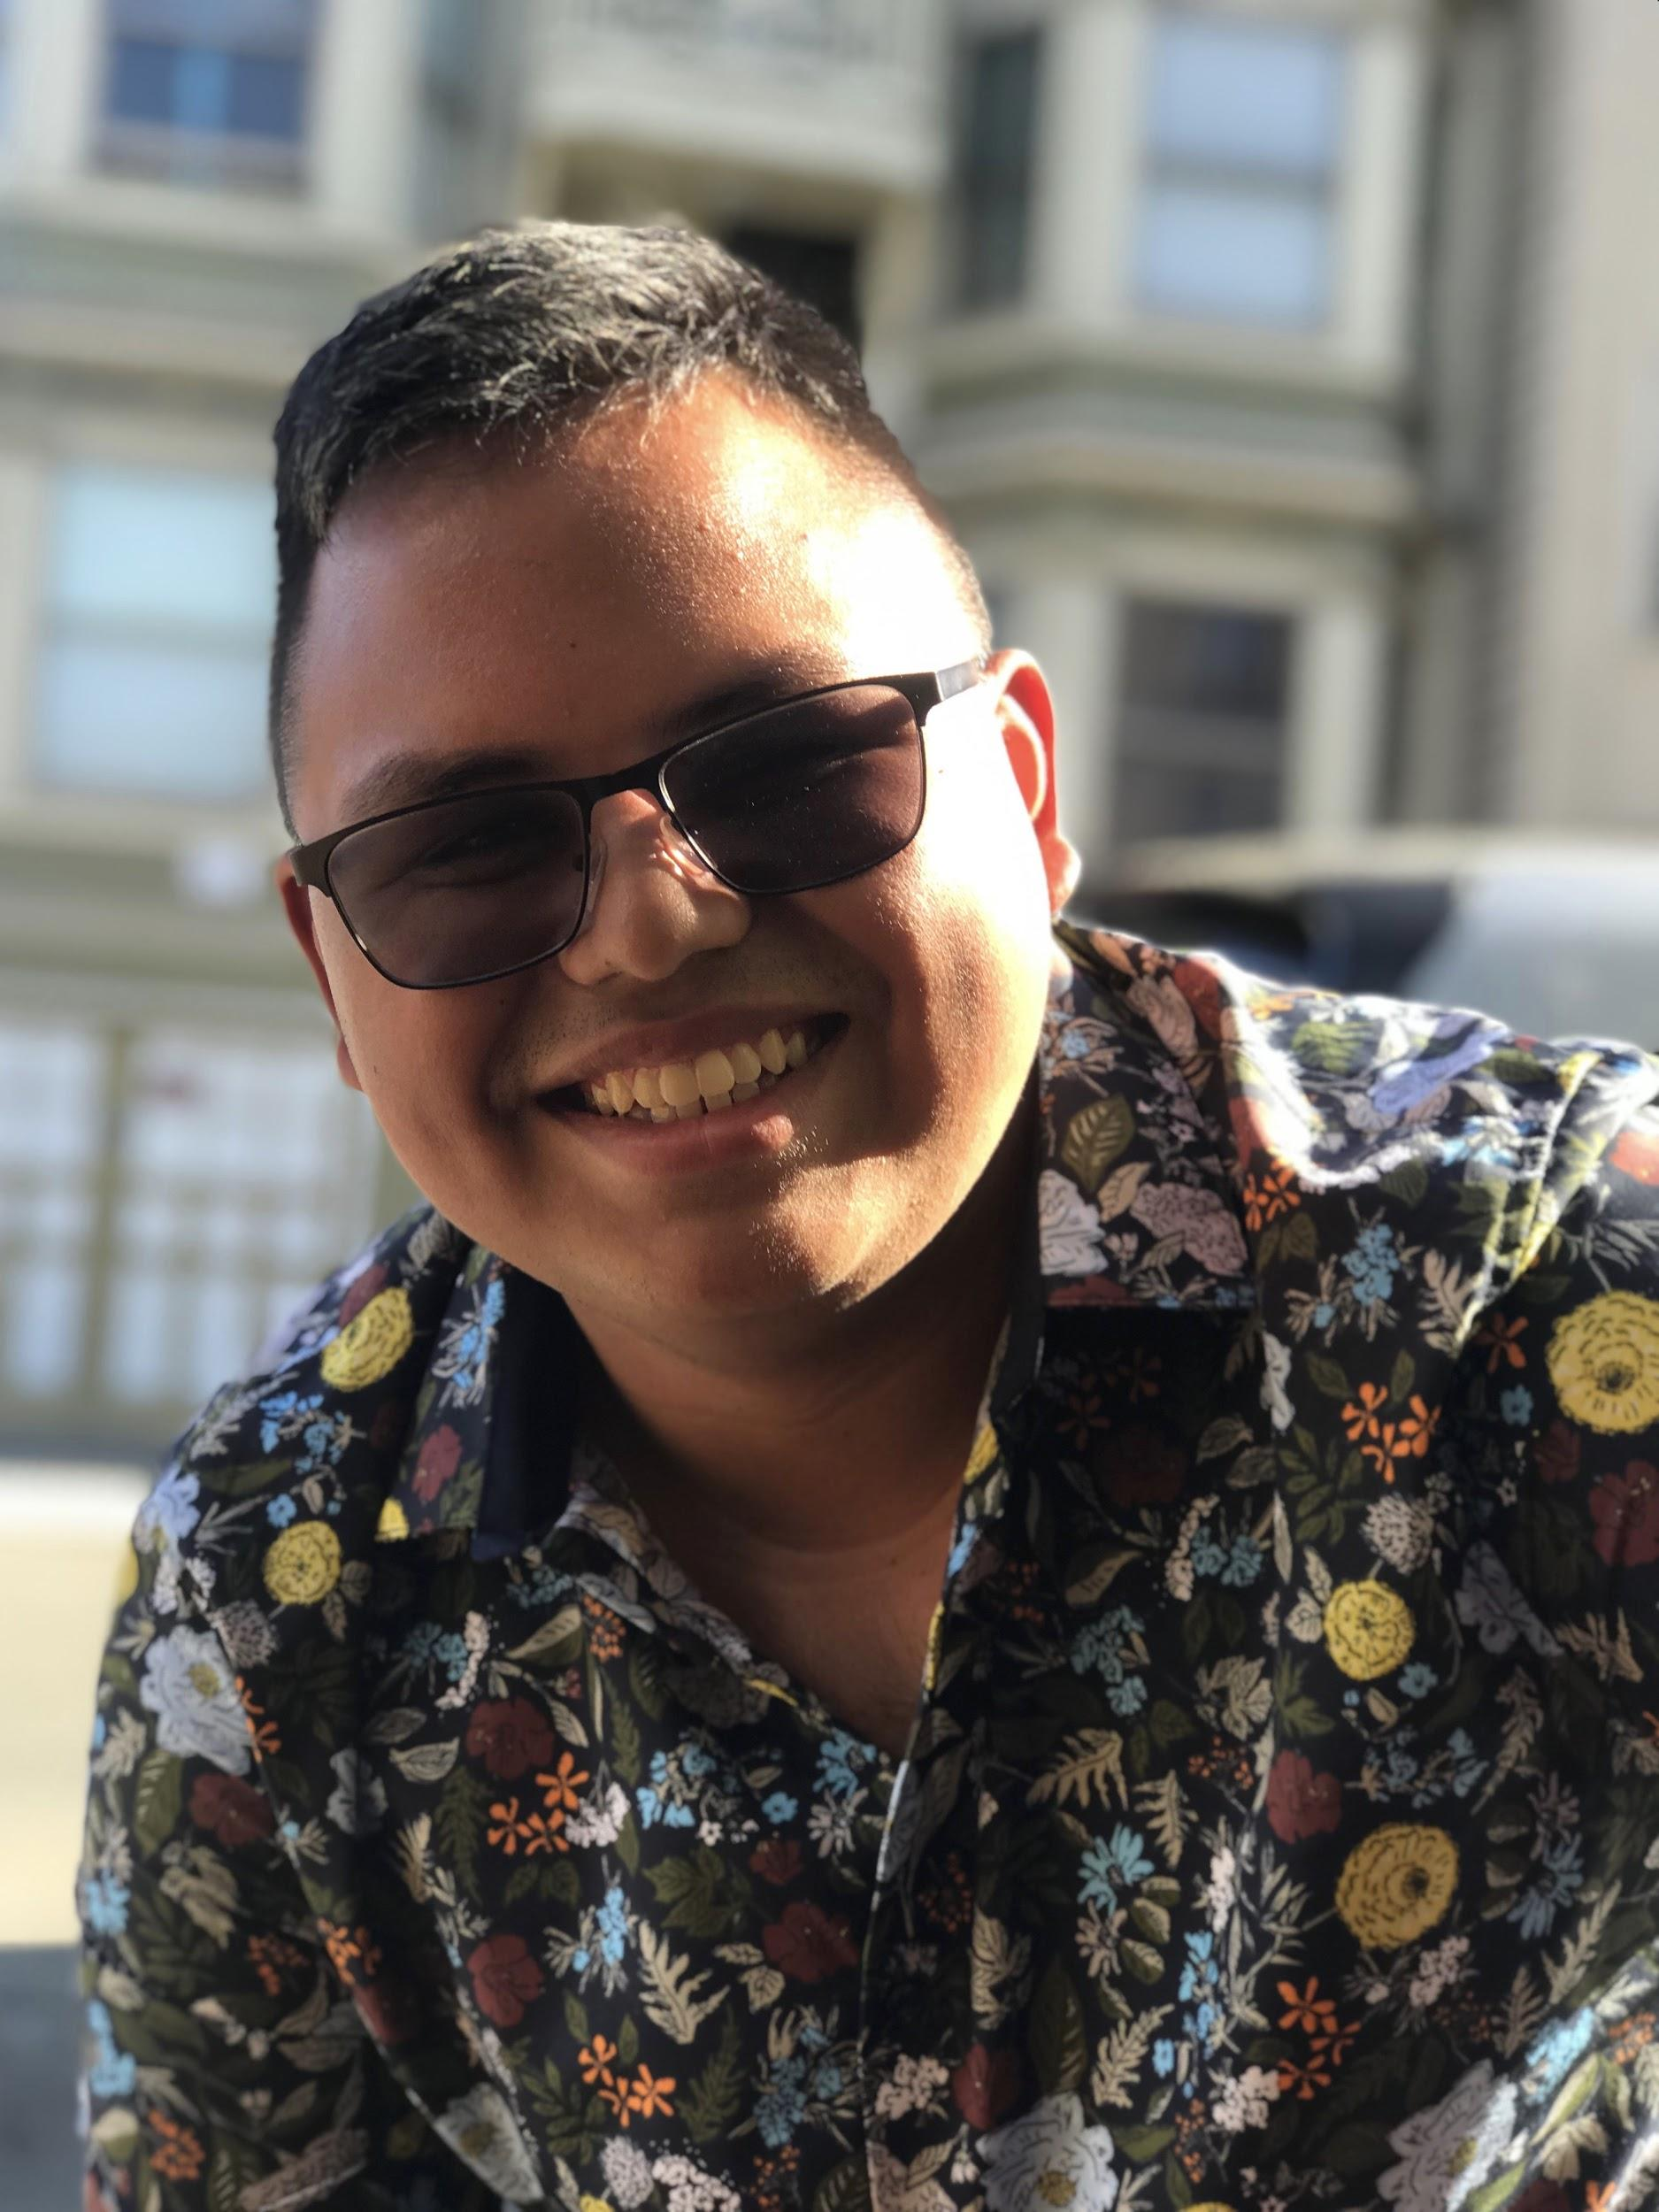
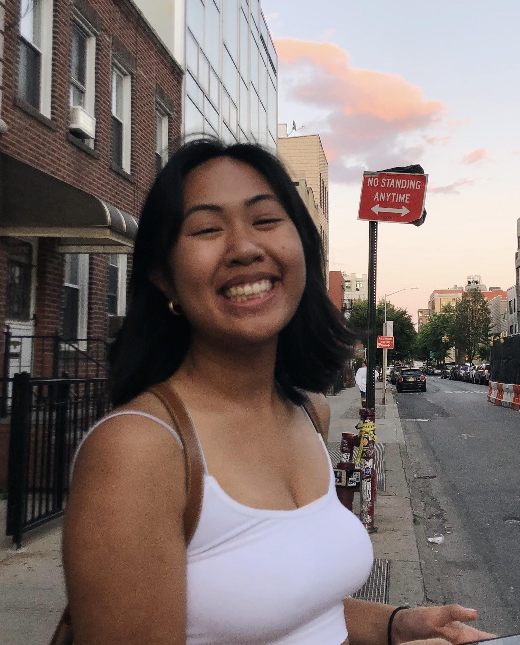
Team Members
Peter C.
Alyssa R.
Ryan C.
Gabby R.
Notes:
Today, im first going to discuss Rally’s goals. Then, I’ll talk about process by which we envisioned how Rally can achieve these goals through its user interface, and how we came to the final low-fi prototype. I will also discuss how user testing went and what changes we will implement to make Rally better!

Slide 3
Overview
Mission Statement + Value Proposition
Problem & Solution Overview
Heuristic Evaluation Results
Revised Design
Prototype Implementation Status
Demonstration of Prototype
Notes:
Today, im first going to discuss Rally’s goals. Then, I’ll talk about process by which we envisioned how Rally can achieve these goals through its user interface, and how we came to the final low-fi prototype. I will also discuss how user testing went and what changes we will implement to make Rally better!

Slide 4
Mission Statement
We want to make civic engagement accessible, easy, and community-based.
Notes:
Rally’s Mission Statement →

Slide 5
Value Proposition
Your one stop shop for civic engagement.
Notes:
Rally’s Value Proposition

Slide 6
Problem &
Solution Overview
Going to political events can be inconvenient and uncomfortable -- RALLY makes civic engagement an easy decision, giving users transportation recommendations and connecting them with friends who want to show out to events.
Notes:
Rally’s Value Proposition

Slide 7
Heuristic Evaluation Results

Slide 8
Results in Summary
Total Level 3+4 Severity violations - 12
Key Areas of Heuristic Violations -
Filtering by Events
Group Chats
Filtering by Friends

Slide 9
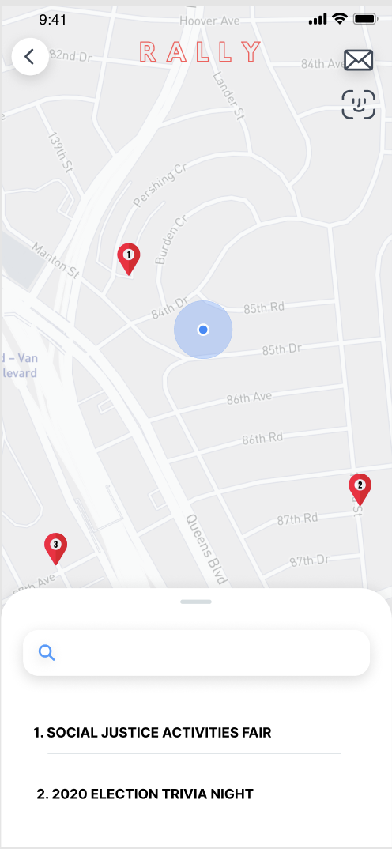
Filtering by
Events

Slide 10
Filtering by
Events
No indication that the screen is currently filtering by events

Slide 11
Filtering by
Events
No indication that the screen is currently filtering by events
No indication that events are ordered by distance

Slide 12
Filtering by
Events
No indication that the screen is currently filtering by events
No indication that events are ordered by distance
No indication of events that you are interested in

Slide 13
Filtering by
Events
No indication that the screen is currently filtering by events
No way to see events beyond initial map image
No indication that events are ordered by distance
No indication of events that you are interested in

Slide 14
Filtering by
Events
Issues -
H3 - User Freedom and Control
No clear indication the list is ordered by distance
H6 - Recognition Rather than Recall
No visual indication of events that you are interested in
H7 - Flexibility and Efficiency of Use
Explore events past the bounds of the initial map image
Fix -
Adding visibility to events filter page

Slide 15
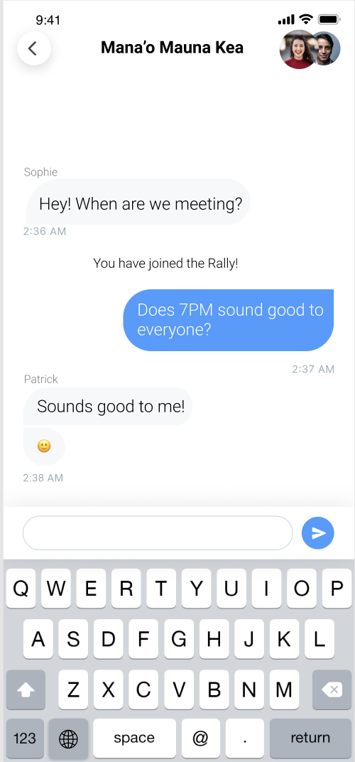
Group Chats

Slide 16
Group Chats
Recall over recognition for remembering event details

Slide 17
Group Chats
Recall over recognition for remembering event details
Unable to leave a rally

Slide 18
Group Chats
Recall over recognition for remembering event details
Unable to leave a rally
Disparate cognitive models about first-degree and second-degree connections

Slide 19
Group Chats
Issues -
H6 - Recognition over Recall
No information about rally in the group chat
H3 - User Freedom and Control
Unable to leave group chats once joined
H1 - Visibility of System Status
Disparate cognitive models about first-degree and second-degree connections
Fix -
Adding functionality to group chats

Slide 20
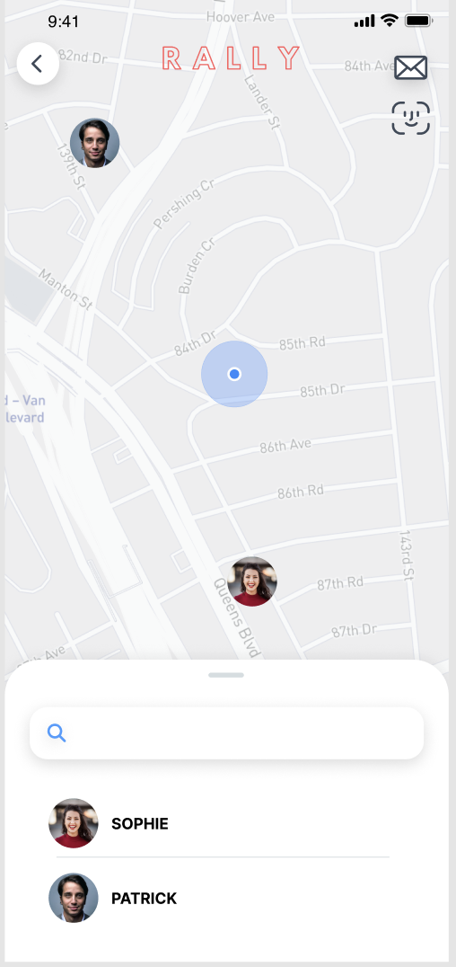
Filtering by
Friends

Slide 21
Filtering by
Friends
Find my friends functionality?

Slide 22
Filtering by
Friends
Find my friends functionality?
No current way to add new friends

Slide 23
Filtering by
Friends
Issues -
H4 - Consistency and Standards
Find my friends features
H7 - Flexibility and Efficiency of Use
Find friends option
Fix -
Add new features to the filtering by friends page

Slide 24
Revised Design

Slide 25
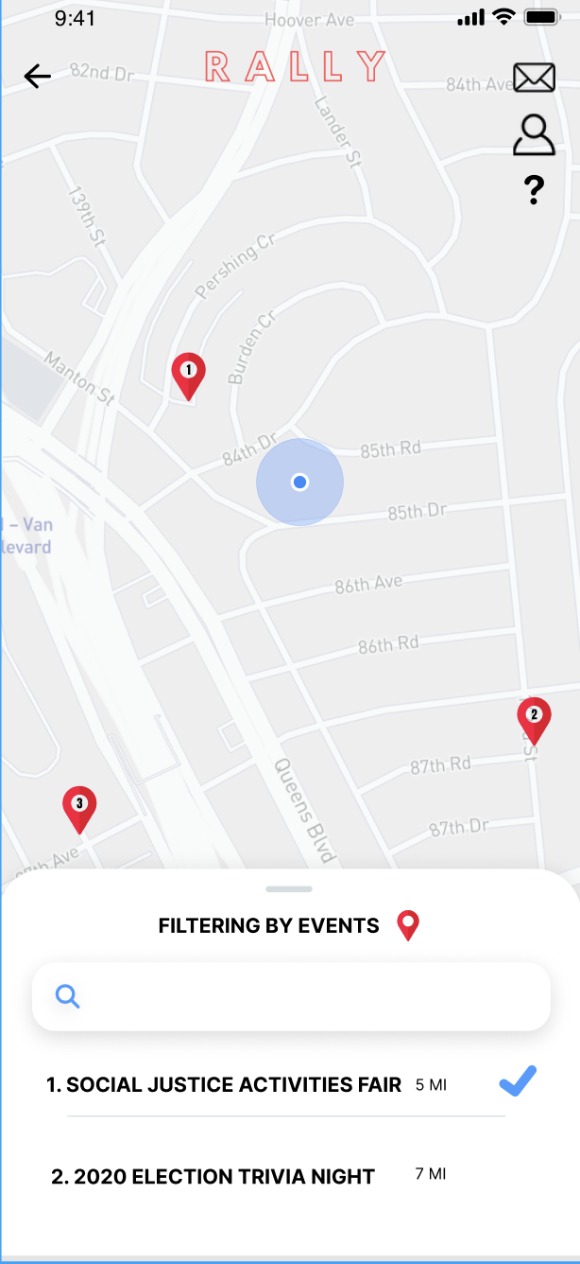
Filtering by
Events Fix

Slide 26
Filtering by
Events Fix
Informative help and documentation

Slide 27
Filtering by
Events Fix
Informative help and documentation
Visualization of current filter

Slide 28
Filtering by
Events Fix
Informative help and documentation
Visualization of interested in event
Visualization of current filter

Slide 29
Filtering by
Events Fix
Informative help and documentation
Visualization of interested in event
Visualization of current filter
Visualization of ordering by distance

Slide 30
Filtering by
Events Fix
Informative help and documentation
React Native Maps helps with exploration of other maps
Visualization of interested in event
Visualization of current filter
Visualization of ordering by distance

Slide 31
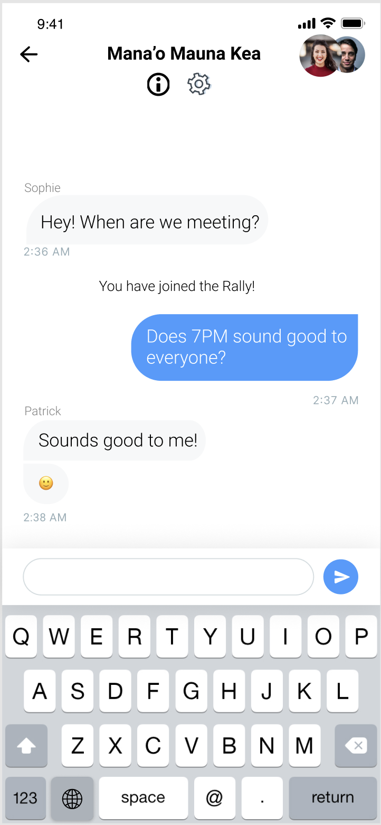
Group Chats

Slide 32
Group Chats
Added button that goes directly to the information card for the given event

Slide 33
Group Chats
Added button that goes directly to the information card for the given event
Added settings page to add functionality like leaving the rally chat

Slide 34
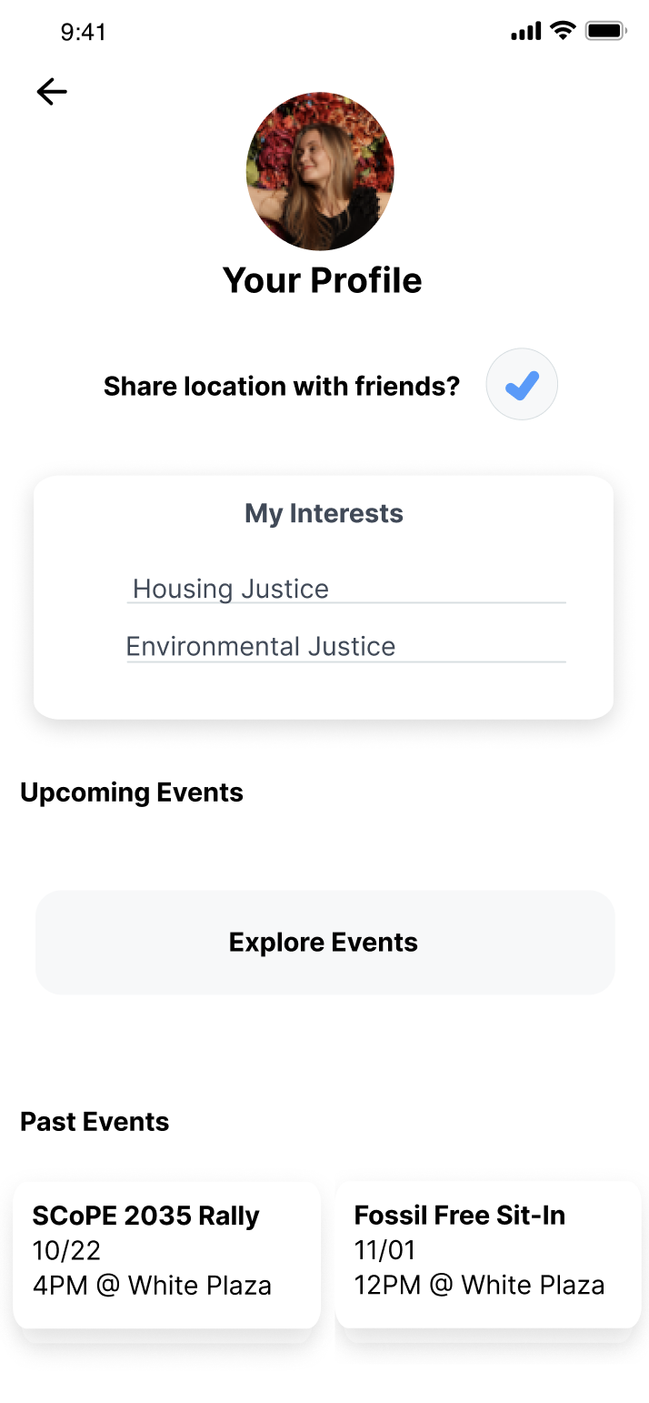
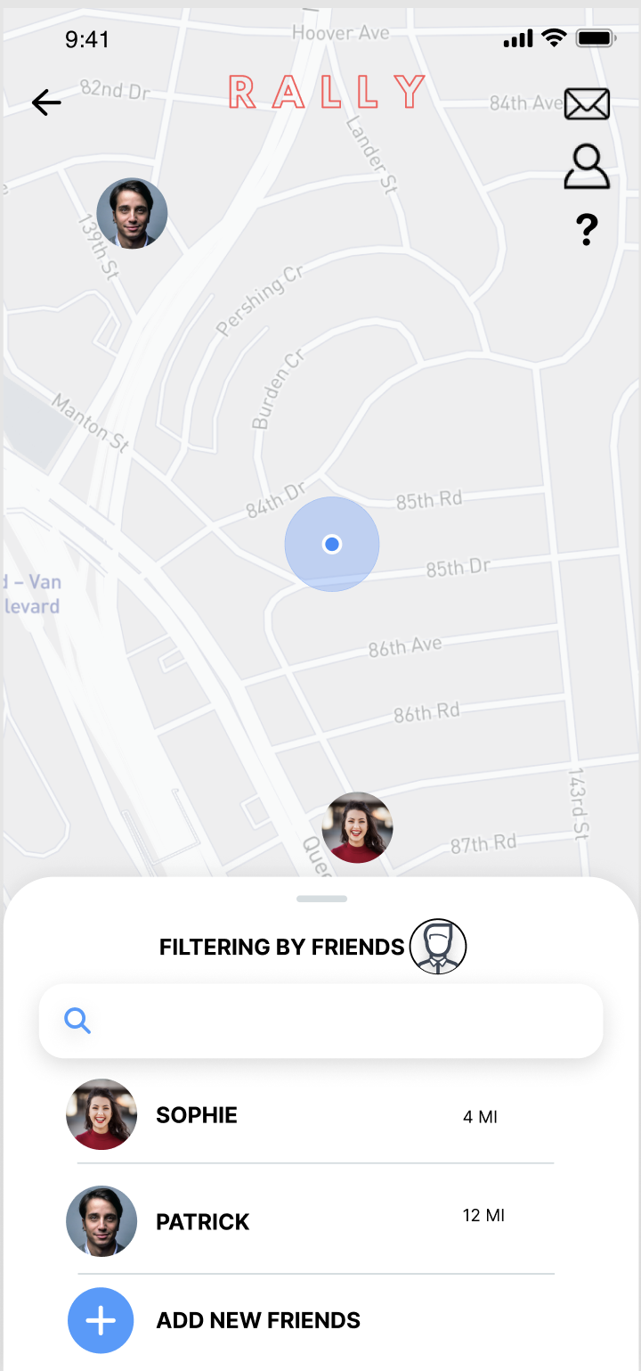
Filtering by
Friends

Slide 35
Filtering by
Friends
Explicit consent to sharing location with friends through this application

Slide 36
Filtering by
Friends
Explicit consent to sharing location with friends through this application
New functionality to add new friends

Slide 37
Prototype Implementation Status

Slide 38
Tools Being Used

Slide 39
Implemented Features
React-native-maps API
Markers on Map, clicking on markers
Events Filter, Rally Filter, and Friends Filter
Parallax Scrolling and Scroll View
Basic card view for events

Slide 40
Unimplemented Features
Log-in
Adding Friends
Profile screens
Rally cards & Icons
Friends cards & icons
Messaging System
Public Transit Routes
Location

Slide 41
Future Plans
Finish Basic Functionality (Events API, Public Transit & Friends)
Improve UI & decide on cohesive aesthetic
Add more features if time allows (Facebook log-in, database, etc.)

Slide 42
Wizard of Oz Techniques
Location-based
We are not using user’s real-time location
Hard-coded Data
Events
Numbered
Distance
Names
Issues/Questions
Events API?
Transit API?

Slide 43
Prototype Demonstration

Slide 45
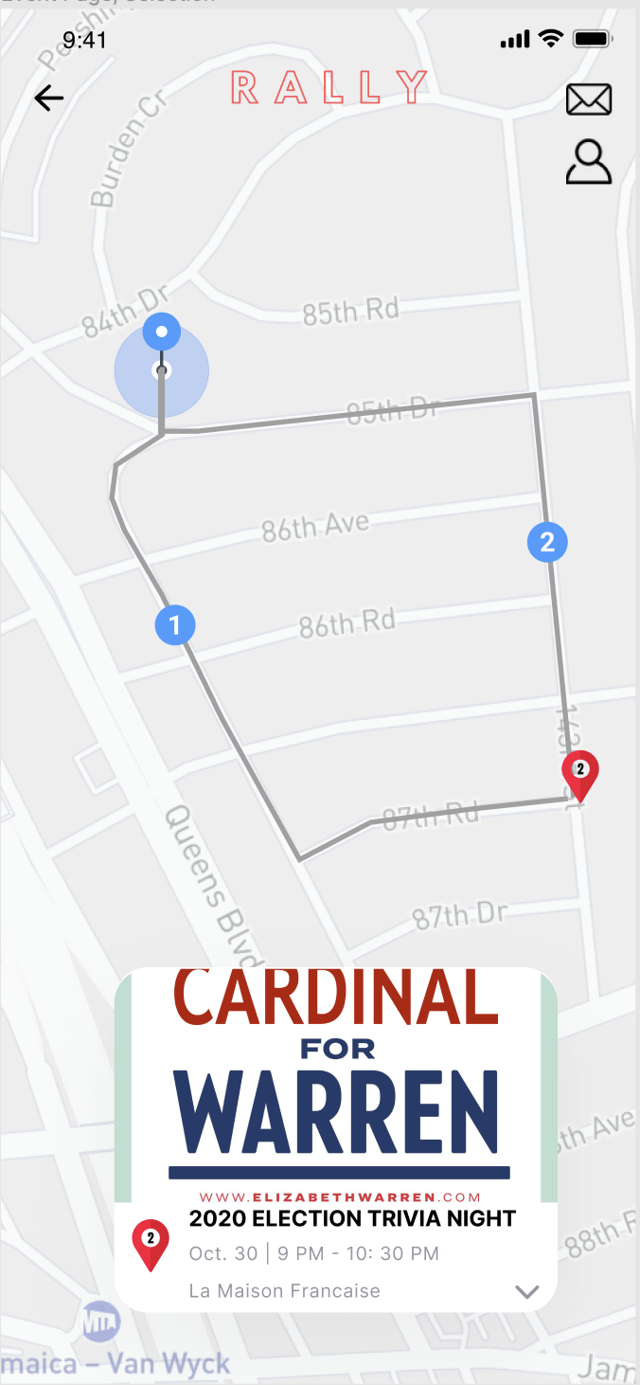
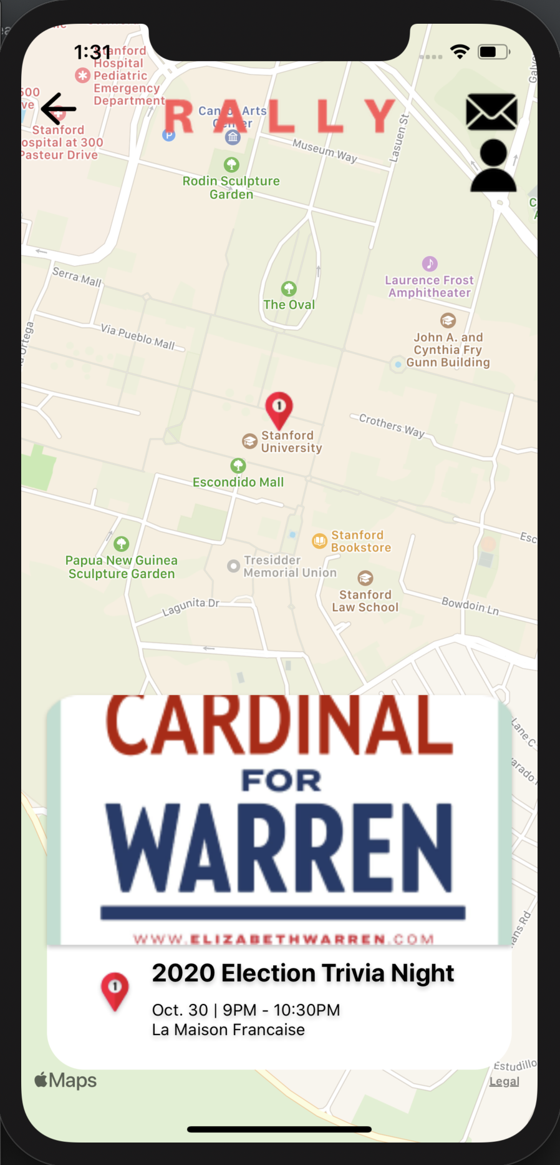

Slide 46
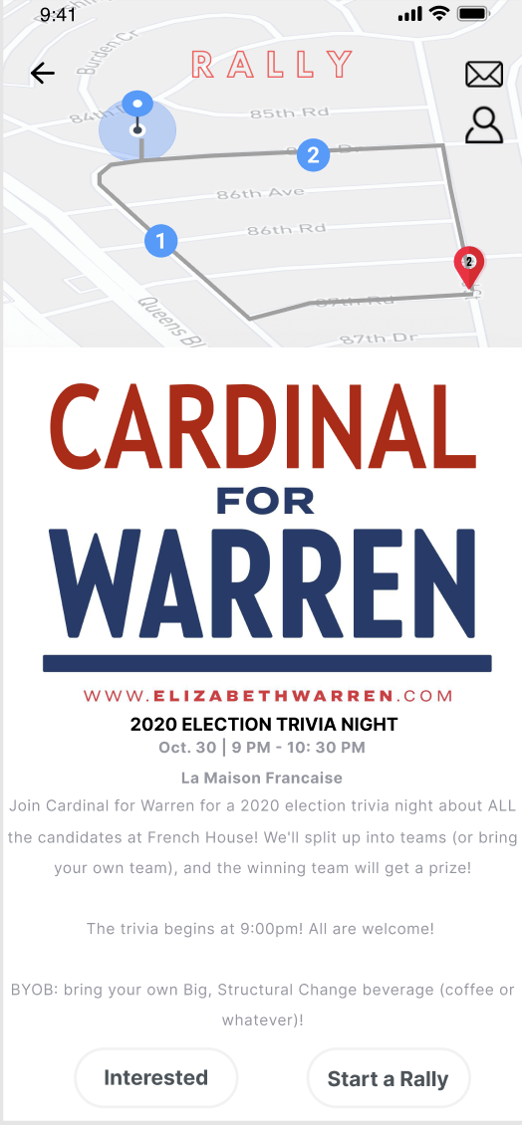
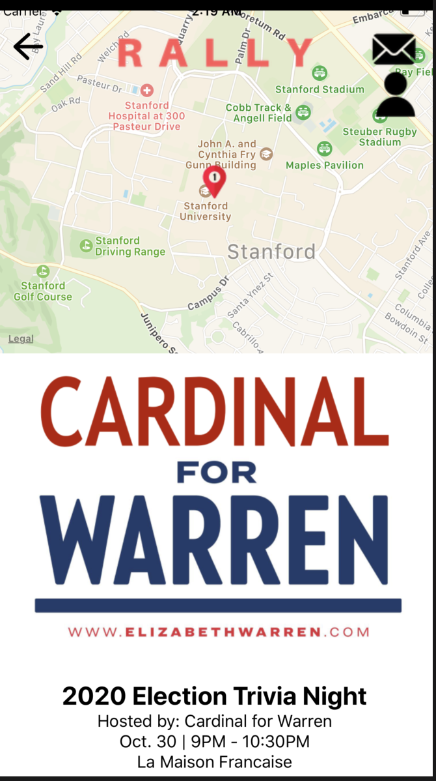
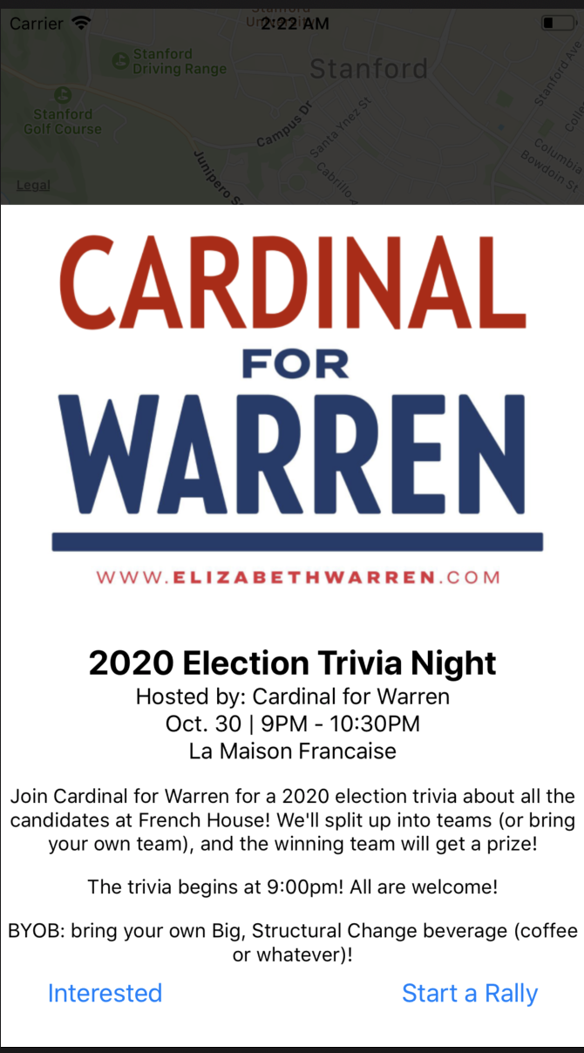

Slide 47
Summary
Gave users more freedom & flexibility by adding features like leaving a group chat, adding people as friends, and sharing location
Keeping actions visible by indicating changes in status and designing for recognition
Action Items
Events API
Location-based
Incorporate Public Transportation
Adding Friends functionality

Slide 48
Questions & Comments?

